Slide 1
Exercise 4
Simon Gehring
Philipp Gampe

Slide 2
Setup and data collection
Tools used: bash, curl, tr, cut, cat, awk, grep, gnuplot
Steps taken:
  Download linux-3.9.2.tar.xz (68.7 MB) (3x)
  Save curl progress with tr '\r' '\n' in file
  Post process data (filter, select)
  Plot data (gnuplot)
Connection: Stw Bonn (PPTP to DFN) via Informatik VPN
Idea from: http://copperlight.github.io/2014/07/02/measuring-transfer-speed-over-time-with-curl/

Slide 3
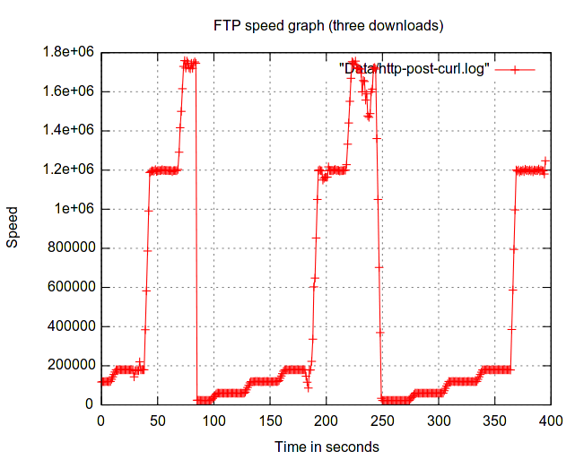
Results HTTP

Slide 4
Results HTTP
Changes ~ every 25-30 seconds
Flunctuates a bit over fixed point
Speeds:
  ~23 KB/s
  ~60 KB/s
  ~116 KB/s
  ~1 MB/s
  ~1,8 MB/s

Slide 5
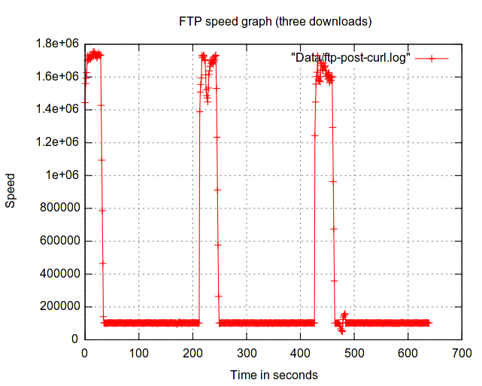
Result FTP

Slide 6
Results FTP
Starts with ~ 1,8 MB/s
After 30s reduces to 100 KB/s

