Slide 1

Individual Assignment W4W5 (Intermediate & Advanced)
Adytia Putra Pradana
RevoU FSDA Sec. Barcelona

Slide 2

Intermediate
Gampang-gampang susah
2

Slide 3
Question 1
Create a query to get the average amount of duration (in minutes) per month
3

Slide 4

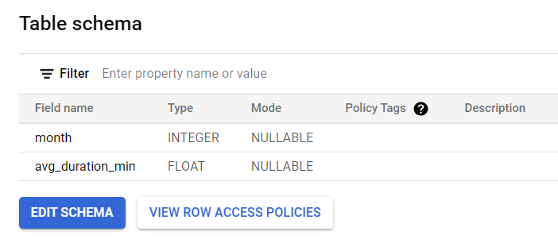
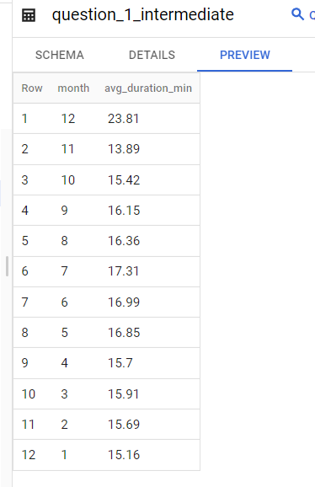
Question 1 Table Result Schema & Table Result
4

Slide 5
Question 1 SQL Syntax:
https://console.cloud.google.com/bigquery?sq=989149097558:1920a0e0d16746d68894308276a48be6
SELECT
EXTRACT (MONTH FROM start_date) AS month,
ROUND (AVG(duration_sec/60),2) AS avg_duration_min,
FROM
`bigquery-public-data.san_francisco_bikeshare.bikeshare_trips`
WHERE
start_date BETWEEN '2014-01-01' AND '2017-01-01'
GROUP BY
1
ORDER BY
1 DESC;
5

Slide 6
Question 2
Create a query to get total trips and total number of unique bikes grouped by region name
6

Slide 7
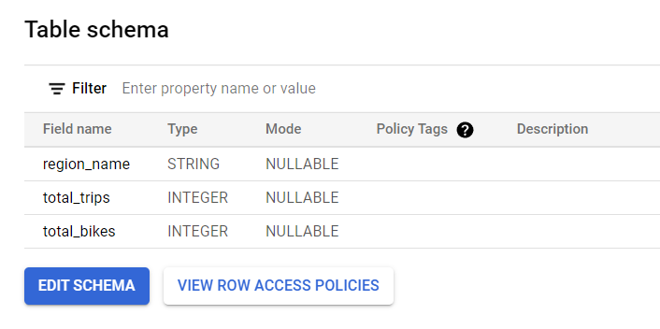
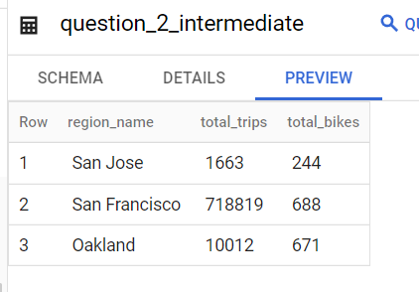
Question 2 Table Result Schema & Table Result
7

Slide 8
Question 2 SQL Syntax:
https://console.cloud.google.com/bigquery?sq=989149097558:1920a0e0d16746d68894308276a48be6
SELECT
bikeshare_regions.name AS region_name,
COUNT (bikeshare_trips.trip_id) AS total_trips,
COUNT (DISTINCT bikeshare_trips.bike_number) AS total_bikes
FROM `bigquery-public-data.san_francisco_bikeshare.bikeshare_trips` AS bikeshare_trips
INNER JOIN `bigquery-public-data.san_francisco_bikeshare.bikeshare_station_info` AS bikeshare_station_info
ON bikeshare_trips.start_station_id = bikeshare_station_info.station_id
INNER JOIN `bigquery-public-data.san_francisco_bikeshare.bikeshare_regions` AS bikeshare_regions
ON bikeshare_station_info.region_id = bikeshare_regions.region_id
WHERE
bikeshare_trips.start_date BETWEEN '2014-01-01' AND '2017-01-01'
GROUP BY 1
ORDER BY 1 DESC;
8

Slide 9
Question 3
Find the youngest and oldest age of the members, for each gender. Assume this year is 2022.
9

Slide 10
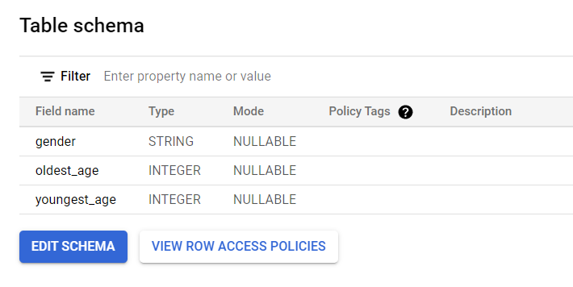
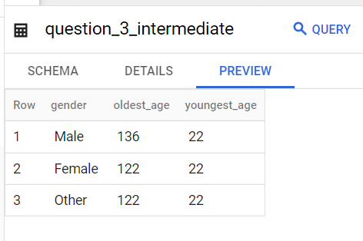
Question 3 Table Result Schema & Table Result
10

Slide 11
Question 3 SQL Syntax:
https://console.cloud.google.com/bigquery?sq=989149097558:1920a0e0d16746d68894308276a48be6
WITH member_status AS
(SELECT
member_gender AS gender,
MAX (DATE_DIFF(DATE(2022,01,01),DATE((member_birth_year),01,01),YEAR)) AS oldest_age,
MIN (DATE_DIFF(DATE(2022,01,01),DATE((member_birth_year),01,01),YEAR)) AS youngest_age
FROM `bigquery-public-data.san_francisco_bikeshare.bikeshare_trips`
WHERE member_gender IS NOT NULL
GROUP BY member_gender)
SELECT
*
FROM member_status;
11

Slide 12
Question 4
Get the latest departure trip in each region
12

Slide 13
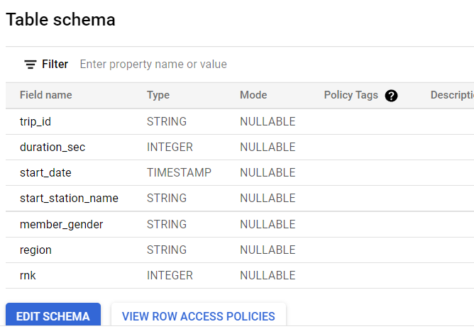
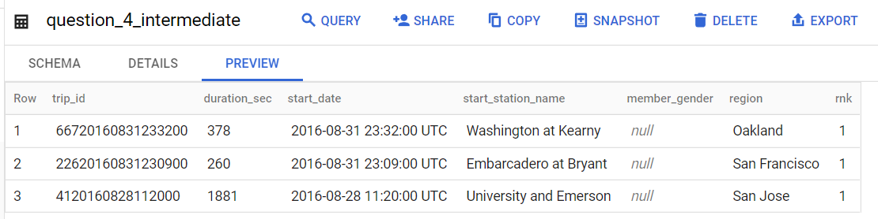
Question 4 Table Result Schema & Table Result
13

Slide 14
Question 4 SQL Syntax:
https://console.cloud.google.com/bigquery?sq=989149097558:1920a0e0d16746d68894308276a48be6
WITH combine_2 AS
(WITH combine AS
(SELECT
trip_id,
duration_sec,
start_date,
start_station_name,
member_gender,
bikeshare_regions.name AS region
FROM `bigquery-public-data.san_francisco_bikeshare.bikeshare_trips` AS bikeshare_trips
INNER JOIN `bigquery-public-data.san_francisco_bikeshare.bikeshare_station_info` AS bikeshare_station_info
ON bikeshare_trips.start_station_id = bikeshare_station_info.station_id
INNER JOIN `bigquery-public-data.san_francisco_bikeshare.bikeshare_regions` AS bikeshare_regions
ON bikeshare_station_info.region_id = bikeshare_regions.region_id
WHERE
bikeshare_trips.start_date BETWEEN '2014-01-01' AND '2017-01-01')
SELECT
*,
RANK () OVER(PARTITION BY region ORDER BY start_date DESC) AS rnk
FROM combine)
SELECT *
FROM combine_2
WHERE rnk < 2
ORDER BY region
14

Slide 15
Question 5
Create a query to get Month to Date of total trips in each region, breakdown by date
15

Slide 16
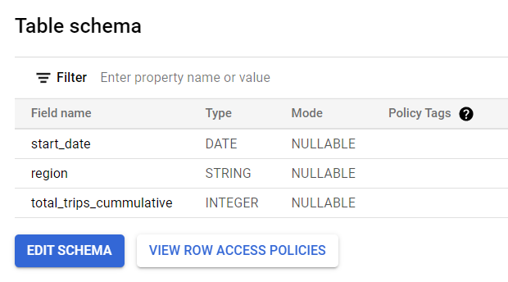
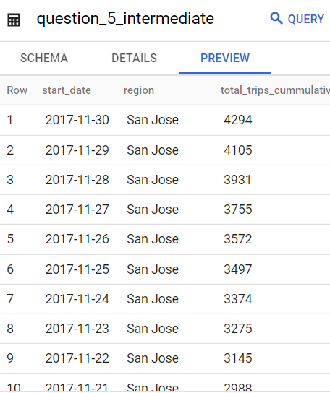
Question 5 Table Result Schema & Table Result
16

Slide 17
Question 5 SQL Syntax:
https://console.cloud.google.com/bigquery?sq=989149097558:1920a0e0d16746d68894308276a48be6
WITH combine AS
(SELECT
CAST (bikeshare_trips.start_date AS DATE) AS start_date, bikeshare_regions.name AS region, COUNT (bikeshare_trips.trip_id) AS cumulative
FROM `bigquery-public-data.san_francisco_bikeshare.bikeshare_trips` AS bikeshare_trips
INNER JOIN `bigquery-public-data.san_francisco_bikeshare.bikeshare_station_info` AS bikeshare_station_info
ON bikeshare_trips.start_station_id = bikeshare_station_info.station_id
INNER JOIN `bigquery-public-data.san_francisco_bikeshare.bikeshare_regions` AS bikeshare_regions
ON bikeshare_station_info.region_id = bikeshare_regions.region_id
WHERE
bikeshare_trips.start_date BETWEEN '2017-11-01' AND '2017-12-01' AND bikeshare_regions.name IS NOT NULL
GROUP BY 2,1
ORDER BY 1),
combine_2 AS
(SELECT start_date,region, SUM (cumulative) AS sum_cumulative
FROM combine
GROUP BY 2,1)
SELECT
start_date,
region,
SUM (sum_cumulative) OVER (PARTITION BY region ORDER BY start_date) AS total_trips_cummulative
FROM combine_2
ORDER BY 2 DESC, 1 DESC
17

Slide 18
Advanced
Ngelamun dulu baru terjawab
18

Slide 19
Question 6
Find monthly growth of trips in percentage, ordered by time descendingly. Only for trips from the region that has the highest total number of trips.
19

Slide 20
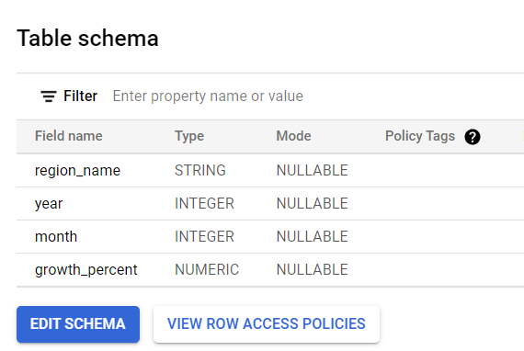
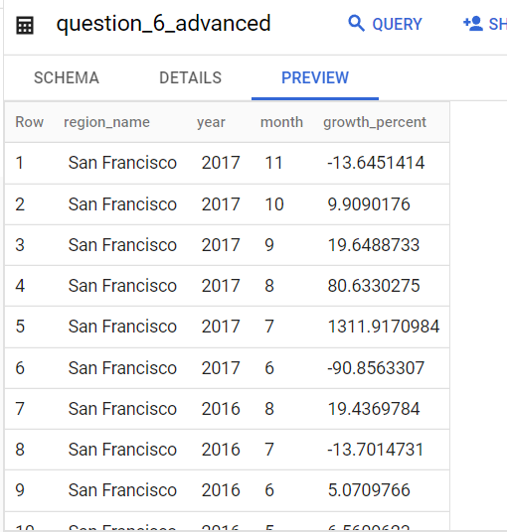
Question 6 Table Result Schema & Table Result
20

Slide 21
Question 6 SQL Syntax:
https://console.cloud.google.com/bigquery?sq=989149097558:1920a0e0d16746d68894308276a48be6
WITH combine AS
(SELECT
bikeshare_regions.name AS region_name,
EXTRACT (YEAR FROM bikeshare_trips.start_date) AS year,
EXTRACT (MONTH FROM bikeshare_trips.start_date) AS month,
COUNT (bikeshare_trips.trip_id) AS total_trips,
FROM `bigquery-public-data.san_francisco_bikeshare.bikeshare_trips` AS bikeshare_trips
INNER JOIN `bigquery-public-data.san_francisco_bikeshare.bikeshare_station_info` AS bikeshare_station_info
ON bikeshare_trips.start_station_id = bikeshare_station_info.station_id
INNER JOIN `bigquery-public-data.san_francisco_bikeshare.bikeshare_regions` AS bikeshare_regions
ON bikeshare_station_info.region_id = bikeshare_regions.region_id
WHERE bikeshare_trips.start_date BETWEEN '2014-01-01' AND '2017-12-01' AND bikeshare_regions.name IS NOT NULL
GROUP BY 1,2,3),
combine_2 AS
(SELECT
region_name, year, month,
LAG (total_trips) OVER (ORDER BY region_name,year,month) AS total_trips_prev,
total_trips,
FROM combine
GROUP BY 1,2,3,5)
SELECT region_name,
year,
month,
(CAST ((total_trips - total_trips_prev) AS DECIMAL)/total_trips_prev)*100 AS growth_percent
FROM combine_2
WHERE region_name = 'San Francisco'
ORDER BY region_name ASC, year DESC, month DESC;
21

Slide 22
Question 7
Given another dataset (Hacker News) please use table “stories” to create monthly retention cohorts (the groups, or cohorts, can be defined based upon the date that a user/author started a story) and then how many of them (%) coming back for the following monts in 2014. After analyzing the retention cohort, is there any interesting insight that we can get?
22

Slide 23
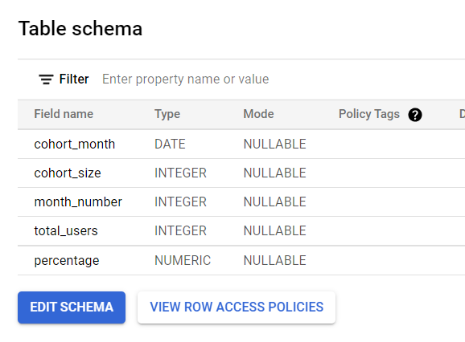
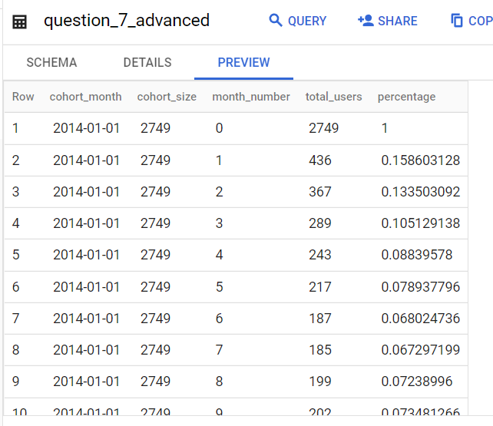
Question 7 Table Result Schema & Table Result
23

Slide 24
Question 7 SQL Syntax:
https://console.cloud.google.com/bigquery?sq=989149097558:1920a0e0d16746d68894308276a48be6
WITH cohort_items AS (
SELECT stories.by AS user_id,
MIN(DATE(DATE_TRUNC(time_ts, MONTH))) AS cohort_month
FROM bigquery-public-data.hacker_news.stories
GROUP BY 1),
user_activities AS (
SELECT stories.by AS user_id,
DATE_DIFF(DATE(DATE_TRUNC(time_ts, MONTH)),cohort_items.cohort_month,MONTH) AS month_number
FROM bigquery-public-data.hacker_news.stories AS stories
LEFT JOIN cohort_items ON stories.by = cohort_items.user_id
WHERE EXTRACT(YEAR FROM cohort_month) IN (2014)
GROUP BY 1,2),
cohort_size AS (
SELECT cohort_month,
COUNT (1) AS num_users
FROM cohort_items
GROUP BY 1
ORDER BY 1),
24

Slide 25
Question 7 SQL Syntax:
retention_table AS (
SELECT
C.cohort_month,
A.month_number,
count(1) AS num_users
FROM user_activities AS A
LEFT JOIN cohort_items AS C ON A.user_id = C.user_id
GROUP BY 1,2)
SELECT
B.cohort_month,
S.num_users AS cohort_size,
B.month_number,
B.num_users AS total_users,
CAST(B.num_users AS decimal)/S.num_users AS percentage
FROM retention_table AS B
LEFT JOIN cohort_size AS S ON B.cohort_month = S.cohort_month
WHERE B.cohort_month IS NOT NULL
ORDER BY 1,3;
25

Slide 26
Question 7 Visualization & Cohort Analysis
 | # of month
cohort month | 0 | 1 | 2 | 3 | 4 | 5 | 6 | 7 | 8 | 9 | 10 | 11 | 12
1/1/2014 | 100% | 15.86% | 13.35% | 10.51% | 8.84% | 7.89% | 6.80% | 6.73% | 7.24% | 7.35% | 6.26% | 5.82% | 6.95%
2/1/2014 | 100% | 17.02% | 11.35% | 8.32% | 7.86% | 7.22% | 6.73% | 6.17% | 6.24% | 5.25% | 5.81% | 5.64%
3/1/2014 | 100% | 13.95% | 10.20% | 8.33% | 8.14% | 6.13% | 6.17% | 6.49% | 5.72% | 6.30% | 5.33%
4/1/2014 | 100% | 13.74% | 9.20% | 7.72% | 7.58% | 7.44% | 7.09% | 5.78% | 4.95% | 6.23%
5/1/2014 | 100% | 13.21% | 10.67% | 8.09% | 7.97% | 7.89% | 6.87% | 6.46% | 6.50%
6/1/2014 | 100% | 15.68% | 9.50% | 8.29% | 7.94% | 6.68% | 6.10% | 5.82%
7/1/2014 | 100% | 14.65% | 10.61% | 8.41% | 7.34% | 6.56% | 6.49%
8/1/2014 | 100% | 14.36% | 10.12% | 8.02% | 7.57% | 7.27%
9/1/2014 | 100% | 15.08% | 9.57% | 9.07% | 8.30%
10/1/2014 | 100% | 13.72% | 9.66% | 9.59%
11/1/2014 | 100% | 12.76% | 10.13%
12/1/2014 | 100% | 15.68%
100%
12%
8%
*
0%
The number of story posts has decreased continuously from Feb 2014 until Dec 2014. It is shown by graph above, monthly. The forum needs to improve its user engagement and retention immediately since this decrease in activity has become a trend (downtrend)
26

Slide 27
Thank You
Terima Kasih
27

