Slide 1
Schedu-elp
Team Gamma
Poornima Ganesan
Shradha Cripe
Sheila Bernal
COEN 285 – Fall 2012

Slide 2
Agenda
Overview
Implemented User Stories
Demo
Architecture Diagram
Current System Status & Velocity
Challenges

Slide 3
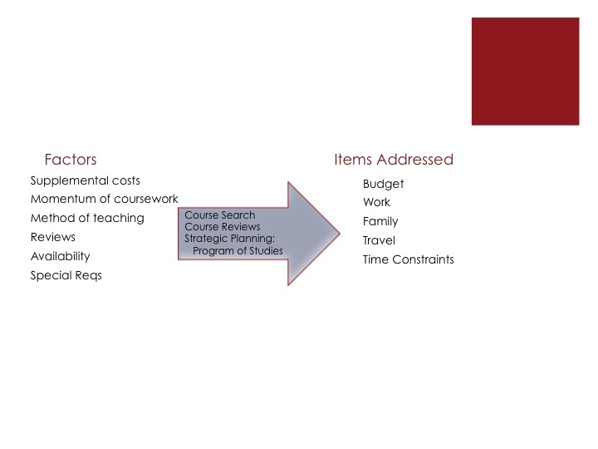
Schedu-elp Overview
Concept
Re-conceptualization of the ‘classic’ course planning system
One-stop course planning system for ambitious and strategically focused student
Aimed to help SCU students balance all their responsibilities through planning tools
Stakeholders
Team Gamma
SCU: Students and Departments (Programs and Financial)
Advertisers
Economic benefits
Reduced Educational Cost for Students
Increased revenue to SCU, from SCU business advertisements
Notes:
Shradha
Present the project idea, its scope, the stakeholders, the problems the system addresses, economic benefits, whether it is an existing system that is to be improved or a new idea. (1 slide). The content presented here is what you have submitted for assign1.

Slide 4
User Stories
User Story | Description
Access Homepage | View the Schedu-elp Home Page read an overview of the Schedu-elp system.
Sign-in | Sign in to the Schedu-elp system; create and access my profile.
Sign-out | Sign out of the Schedu-elp system
Search by Course Name | Search for available courses by inputting the course name; view the details of that course.
Search by Course Number | Search for available courses by inputting the course number; view the details of that course.
Search by Day of Week and/or Time of Day | Search for available courses by inputting preferred scheduling days and times; find a class that is scheduled during available times.
Access Contact Information | Access contact information; communicate methods for help
Add Course to POS | Add a course to POS; create a plan for graduate studies.
View POS | View POS online; verify added courses
Post Course Review | Post a review for a specific course; share course experience
View Course Reviews | View all reviews for a specific course
Access FAQs | View a list of frequently asked questions
Notes:
Sheila

Slide 5

Notes:
Team

Slide 6
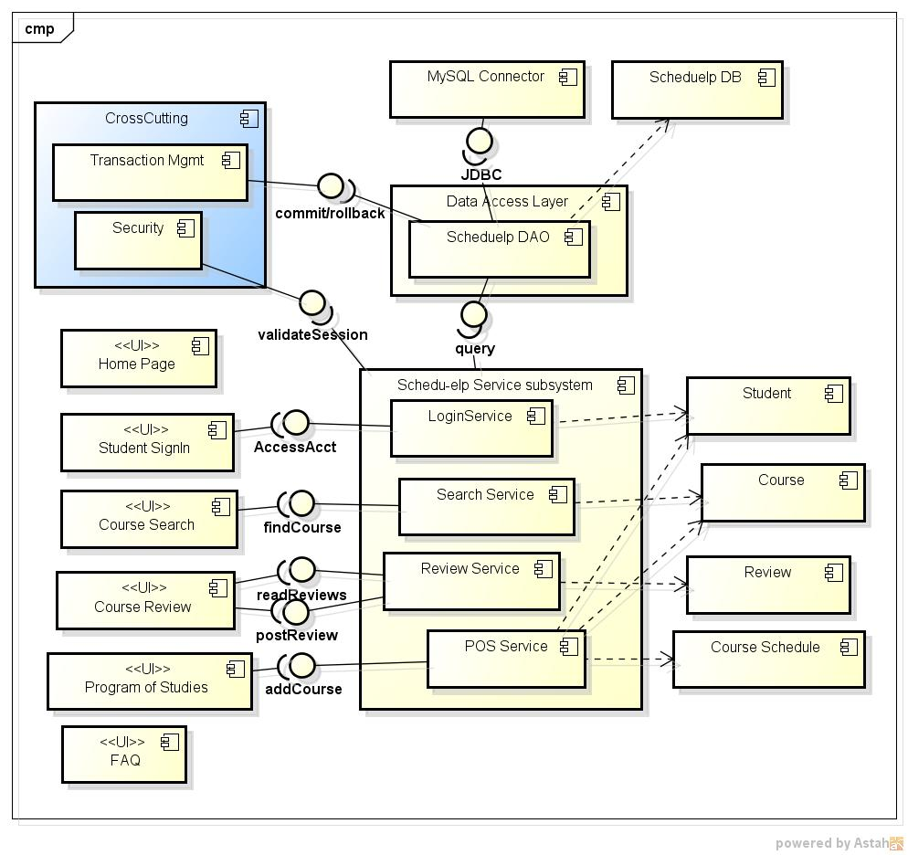
Schedu-elp Architecture
Notes:
Poornima

Slide 7
SCRUM ROLES
Scrum Master: Poornima
Product Owner: Shradha
Team: All
------------------------------------
Customer: Sheila
Schedu-elp Architecture
(cont.)
Functionality | Components | Developer(s)
Schedu-elp Home Page | Home Page UI | Shradha
FAQ | FAQ UI | Sheila
Course Search | UI, SearchService, Course | Poornima
Course Review | UI, ReviewService, Review | Poornima, Shradha
Program of Studies | UI, POSService, Course, CourseSchedule, Student | Poornima, Sheila
Student Sign in /Sign out | UI, LoginService, Student | Poornima
Cross Cutting Concerns | Security, Transaction Mgmt | Adapted from Spring framework (AspectJ)
Data Access | Scheduelp DB | All
 | Scheduelp DAO | All
Notes:
Poornima

Slide 8
Current System Status
Implemented core functionality first
Sign-in and Sign-out
Core search features
Preliminary review features
Add course to Program of Studies
Roadmap for future releases
Full use of Program of Studies
Advanced Search
Advertisements
Product Backlog
US001 - Access the Schedu-elp Home Page | US010 – Search Courses by Program Special Requirement
US002 – Sign-in to Schedu-elp | US011 – Add a Course to Program of Studies
US003 – Sign-out of Schedu-elp | US012 – Remove a Course from Program of Studies
US004 – Access Link to Advertisers’ Websites | US013 – View Program of Studies
US005 – Search Courses by Course Name | US014 – Print Program of Studies
US006 – Search Courses by Course Number | US015 – View all Reviews for a Course
US007 – Search Courses by Day of Week and/or Time of Day | US016 – Post a Course Review
US008 – Search Courses by Pre-requisite | US017 – Access Contact Information
US009 – Search Courses by Name of Professor | US018 – Access Online Help/FAQ
Notes:
Shradha

Slide 9
Project Velocity
Can do 6 user stories in one iteration (3-week sprint)
Sprint 2 estimation was more stable
Velocity = 28 story points
26 story points remaining in product backlog
Will most likely need one more sprint!
Notes:
Sheila

Slide 10
Challenges
Environmental
Host Database vs. Local instance
Windows vs. Mac
Technical
Hibernate for Object-Relational Mapping
High (re)learning curve
Troubleshooting
Balancing collaboration with independence
Process
Establish Configuration Management and Initial Training
Capturing and Communicating Issues
Modified Scrum – maintaining rhythm, balancing schedules
Notes:
Process – Shradha
Environmental – Sheila
Technical - Poornima

