Slide 1
Schedu-elp
Team Gamma
Poornima Ganesan
Shradha Cripe
Sheila Bernal
COEN 285 – Fall 2012

Slide 2
Agenda
Overview
Implemented User Stories
Demo
Architecture Diagram
Current System Status & Velocity
Challenges

Slide 3
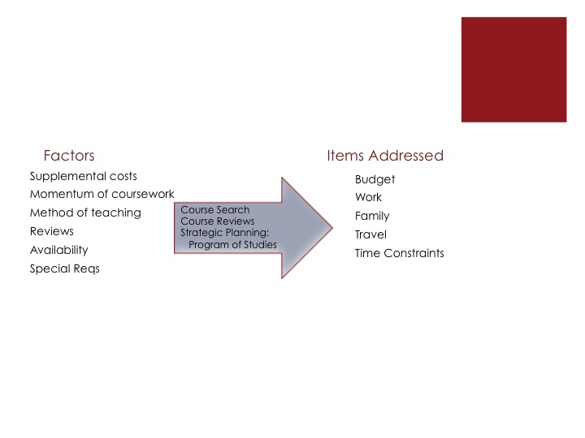
Schedu-elp Overview
Concept
Re-conceptualization of the ‘classic’ course planning system
One-stop course planning system for ambitious and strategically focused student
Aimed to help SCU students balance all their responsibilities through planning tools
Stakeholders
Team Gamma
SCU: Students and Departments (Programs and Financial)
Advertisers
Economic benefits
Reduced Educational Cost for Students
Increased revenue to SCU, from SCU business advertisements
Notes:
Shradha
Present the project idea, its scope, the stakeholders, the problems the system addresses, economic benefits, whether it is an existing system that is to be improved or a new idea. (1 slide). The content presented here is what you have submitted for assign1.

Slide 4
User Stories
User Story | Description
Access Homepage | View the Schedu-elp Home Page read an overview of the Schedu-elp system.
Sign-in | Sign in to the Schedu-elp system; create and access my profile.
Sign-out | Sign out of the Schedu-elp system
Search by Course Name | Search for available courses by inputting the course name; view the details of that course.
Search by Course Number | Search for available courses by inputting the course number; view the details of that course.
Search by Day of Week and/or Time of Day | Search for available courses by inputting preferred scheduling days and times; find a class that is scheduled during available times.
Access Contact Information | Access contact information; communicate methods for help
Add Course to POS | Add a course to POS; create a plan for graduate studies.
View POS | View POS online; verify added courses
Post Course Review | Post a review for a specific course; share course experience
View Course Reviews | View all reviews for a specific course
Access FAQs | View a list of frequently asked questions
Notes:
Sheila

Slide 5

Notes:
Team

Slide 6
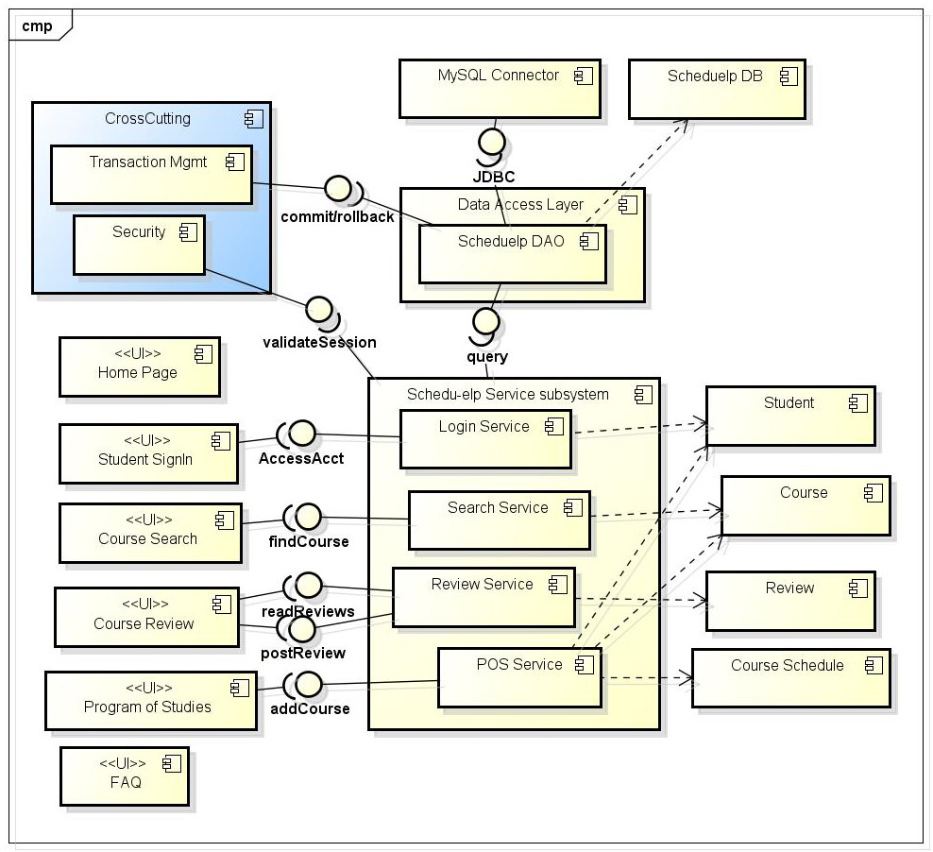
Schedu-elp Architecture
Notes:
Poornima

Slide 7
SCRUM ROLES
Scrum Master: Poornima
Product Owner: Shradha
Team: All
------------------------------------
Customer: Sheila
Schedu-elp Architecture
(cont.)
Functionality | Components | Developer(s)
Schedu-elp Home Page | Home Page UI | Shradha
FAQ | FAQ UI | Sheila
Course Search | UI, SearchService, Course | Poornima
Course Review | UI, ReviewService, Review | Poornima, Shradha
Program of Studies | UI, POSService, Course, CourseSchedule, Student | Poornima, Sheila
Student Sign in /Sign out | UI, LoginService, Student | Poornima
Cross Cutting Concerns | Security, Transaction Mgmt | Adapted from Spring framework (AspectJ)
Data Access | Scheduelp DB | All
 | Scheduelp DAO | All
Notes:
Poornima

Slide 8
Current System Status
Implemented core functionality first
Sign-in and Sign-out
Core search features
Preliminary review features
Add course to Program of Studies
Roadmap for future releases
Full use of Program of Studies
Advanced Search
Advertisements
Product Backlog
US001 - Access the Schedu-elp Home Page | US010 – Search Courses by Program Special Requirement
US002 – Sign-in to Schedu-elp | US011 – Add a Course to Program of Studies
US003 – Sign-out of Schedu-elp | US012 – Remove a Course from Program of Studies
US004 – Access Link to Advertisers’ Websites | US013 – View Program of Studies
US005 – Search Courses by Course Name | US014 – Print Program of Studies
US006 – Search Courses by Course Number | US015 – View all Reviews for a Course
US007 – Search Courses by Day of Week and/or Time of Day | US016 – Post a Course Review
US008 – Search Courses by Pre-requisite | US017 – Access Contact Information
US009 – Search Courses by Name of Professor | US018 – Access Online Help/FAQ
Notes:
Shradha

Slide 9
Project Velocity
Can do 6 user stories in one iteration (3-week sprint)
Sprint 2 estimation was more stable
Velocity = 28 story points
26 story points remaining in product backlog
Will most likely need one more sprint!
Notes:
Sheila

Slide 10
Challenges
Environmental
Host Database vs. Local instance
Windows vs. Mac
Technical
High (re)learning curve
Troubleshooting
Balancing collaboration with independence
Process
Establish Configuration Management and Initial Training
Capturing and Communicating Issues
Modified Scrum – maintaining rhythm, balancing schedules
Notes:
Process – Shradha
Environmental – Sheila
Technical - Poornima

