Slide 1

Semantic Analysis Surveillance Videos in Indoor Scenes
BTP Interim Progress Review,
Department of Computer Science & Engineering, IIT Jodhpur
Group members
Ganesh Patil, B14CS017
Varun Kumar, B14CS039
Mentor: Dr.Chiranjoy Chattopadhyay

Slide 2
Problem statement
Semantic Analysis of Video and triggered Actions in indoor scenes
Inputs - Real time Video / Recorded clips
Outputs - Time and Observations synchronized real time actions
Motivation
Video Surveillance : Computer-Aided :
-- Trillions of hours of Video -- Automatic
-- Human Labor for processing is expensive -- It can long 24 hrs * 7 days

Slide 3
Deliverable
Detection Most used Path on floor
---- Human Detection, Path Tracking and Prediction of most appropriate path
Action Synchronization with Observations
---- Abnormal Activity Detection :-
i) Entry in Prohibited Area
ii) Crowd Detection
---- Entry-exit criterion in indoor scenes
Action Synchronization with Time
---- Desirable entries in a cabin/area between given time intervals
Notes:
1)Time Synchronization
Network time server: If Surveillance Station is chosen to be the time server for the camera, both Surveillance Station and the camera are required to be located in the same LAN. If another Internet time server is selected, please make sure the camera is connected to the Internet.
Force synchronize every: You can enable this option and specify the time interval to synchronize the current time of Surveillance Station to your camera.
Note: This feature of periodic forced synchronization works only when the camera is enabled.
Sync now: Force synchronize the current time of Surveillance Station to your camera immediately.
⇒ Display to show Messages / Response

Slide 4
Progress & Timeline
Work done so far
-- Literature Survey
-- Human Tracking and path detection in recorded clips
( in progress )
Timeline (Modularization):
Literature Survey and Existing work
(Start ) :
Human Tracking & Path Detection
(Sept 20) :
Time Synchronized Actions
(Oct 20) :
Observation based actions
(Oct 5) :
Testing in Practical situation
(Nov 10) :
Notes:
Literature Survey
Human detection using pre-trained HOG-Linear SVM model available in openCV

Slide 5
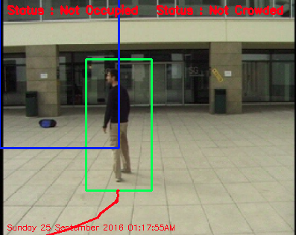
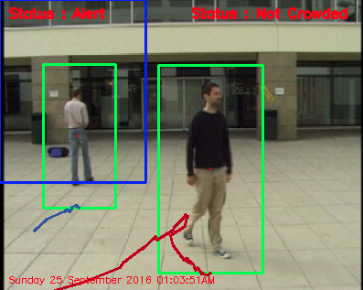
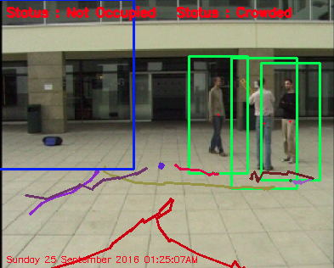
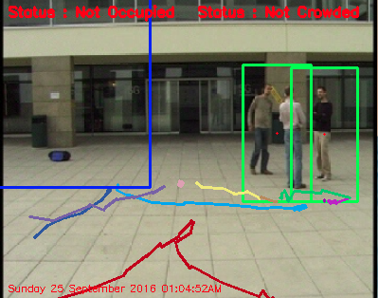
Demo….(Simple Prototype : work done till date )
Safe Region & Not Crowded
Alert & Not Crowded
Safe Region & Crowded
Safe Region & Not Crowded** +(Occlusion)
Notes:
This is demo of our own prototype implemented on video taken from web. We will implement our system in given IITJ scenario(e.g.Networks Lab).
What is next ?
1)Improving HOG descriptor classifier and training it for our defined scenarios for effective Human detection
2)Reducing occlusion effects : Improving Human Detection
3)Automatic creation of Alert/ Restricted Zones, using predicted most appropriate path
4)Crowd Detection : improved crowd detection
5)Entry -exit
6)Time interval

Slide 6
References
Qiang Zhu, Shai Avidan, Mei-Chen Yeh, Kweng-Ting Chang, “Fast Human Detection Using a Cascade of Histograms of Oriented Gradients”, Computer Vision and Pattern Recognition, 2006 IEEE Computer Society Conference
Dimitrios Makris,Tim Ellis, “Path Detection in Video Surveillance”,Image and Vision Computing,2002,Elsevier.
S Aggarwal, AM Namboodiri, CV Jawahar , “ Estimating Floor Regions in Cluttered Indoor Scenes from First Person Camera View” ,ICPR, 2014 , Information Society - IS 2012, Ljubljana, 8-12 October 2012.
Open CV Documention : http://docs.opencv.org/

Slide 7
Thank you
Queries & Suggestions

