Slide 1
Transfer Learning from Speaker Verification to Multispeaker Text-To-Speech Synthesis Conference : NIPS 2018
Theory project presentation by : Pooja Gangrade
CSCI- 575 Machine Learning
Fall 2019
Notes:
Motivation - Computer generated speech has existed for a while now. However, the quality of generated speech is still not human, and is not easy on ears. Although, they are catching up, but even the production quality systems like Google Now, Apple’s Siri or Amazon Alexa are far off from what a human generated speech would sound like
Intelligible
Naturalness
Transfer learning – sharing of knowledge between models.
The goal is to build a TTS system which can generate natural speech for a variety of speakers in a data efficient manner.

Slide 2
Introduction
Deep learning models have become predominant in many fields of applied machine learning
Text-to-speech or Speech synthesis is the artificial production of human speech
A system used for this purpose is called a speech computer or speech synthesizer
Clone a voice in 5 seconds to generate arbitrary speech in real-time
Three-stage deep learning framework

Slide 3
Related Work
Tacotron - a multispeaker variation of Tacotron which learned low-dimensional speaker embedding for each training speaker.
Deep Voice represents a fully convolutional encoder-decoder architecture which scaled up to support over 2,400 speakers from LibriSpeech
VoiceLoop represents a novel architecture based on a fixed size memory buffer which can generate speech from voices unseen during training.
Notes:
These systems learn a fixed set of speaker embeddings and therefore only support synthesis of voices seen during training.

Slide 4
Problem Statement
Computer generated speech does not have good quality
Lacks Intelligible and Naturalness in speech
Lacks speaker verification in multi speaker environment

Slide 5
Solution Approach
A neural network-based system for text-to-speech (TTS) synthesis that can generate speech audio in the voice of different speakers
Concatenative TTS: technique relies on high-quality audio clips recordings, which are then combined to form the speech.
The implementation consists of three models:
Encoder
Synthesizer
Vocoder
Notes:
Encoder which compute the vector from speech signals, synthesizer which predicts a mel spectrogram from a sequence of grapheme or phoneme inputs, conditioned on the speaker embedding vector and vocoder which converts the spectrogram into time domain waveforms sequence-to-sequence TTS synthesis network and neural vocoder based on Tacotron 2

Slide 6
Solution Approach
Decouple speaker modeling from synthesis, then discriminate and verify multiple speakers
The synthesizer is trained on pairs of text transcript and target audio
Vocoder coverts synthesized results emitted by the synthesis network into time-domain waveforms
Zero-shot speaker adaptation
Notes:
Zero Shot Learning - Supervised learning where the model can classify an item as none of the classes that it trained on.
a zero-shot learning setting, where few seconds of un transcribed reference audio from a target speaker is used to synthesize new speech in that speaker’s voice, without updating any model parameters.

Slide 7
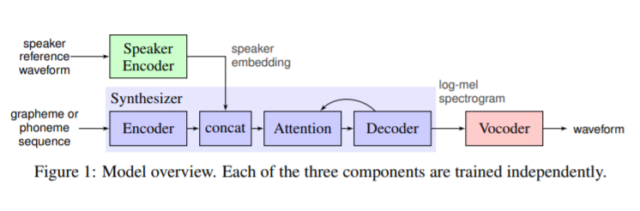
Model Overview
Notes:
The speaker encoder is fed a short reference utterance of the speaker to clone. It generates an embedding that is used to condition the synthesizer, and a text processed as a phoneme sequence is given as input to the synthesizer. The vocoder takes the output of the synthesizer to generate the speech waveform

Slide 8
Data
Machine Learning Technique - Supervised (Classification)
Deep learning model with 3-layer and 768 hidden nodes followed by a projection layer of 256 units.
Features – phoneme, spectrogram, frequency from audio speech samples
Targets - speaker identity, synthesizer training data, clean speech or transcripts data

Slide 9
Requirements
tensorflow-gpu>=1.10.0,<=1.14.0 | numpy>=1.14.0
visdom | webrtcvad
librosa>=0.5.1 | matplotlib>=2.0.2
Python3 | scipy>=1.0.0
tqdm | sounddevice
Unidecode | inflect
PyQt5 = 5.11.3 | numba

Slide 10
Experiment & Results
Package Installation
PyTorch Installation
Installing pretrained models
Preprocessing and training the models
Run the demo software
Run the actual software
Compare the results
Notes:
Use of two VCTK and LibriSpeech to train speed synthesis and vocoder network

Slide 11
Experiment & Results
Speaker Naturalness and Speaker Similarity compared based on Mean Opinion Score (MOS)
Speaker Verification was based on diversity of speakers
Speaker Embedding Space is evaluated based on PCA values
Speech from fictitious speakers compared to their nearest neighbors in the train sets

Slide 12
Preprocessing and Training
Preprocess and train encoder model
Preprocess and generate the synthesizer model then train it
The synthesizer output generated audios and spectrograms
Use the synthesizer to generate training data for the vocoder
Finally preprocess and train the vocoder

Slide 13
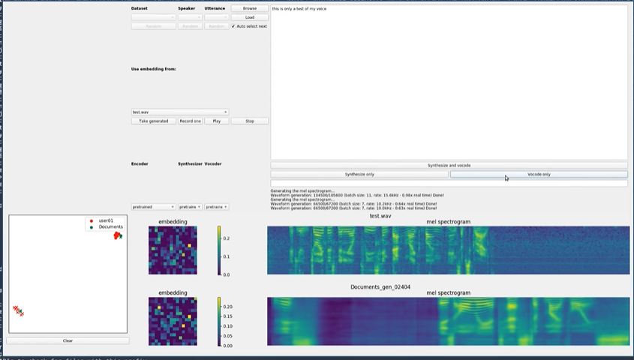

Slide 14
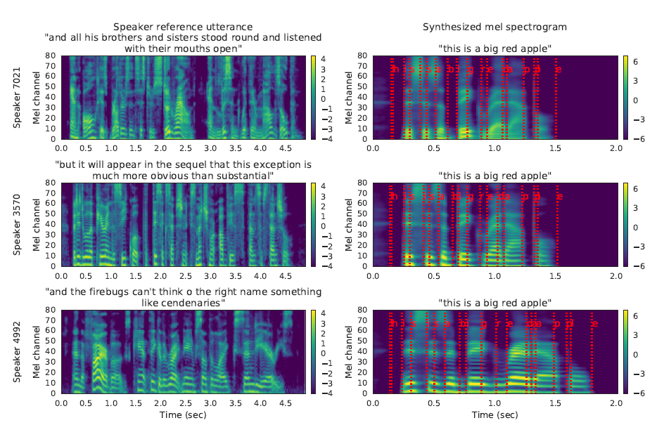

Slide 15
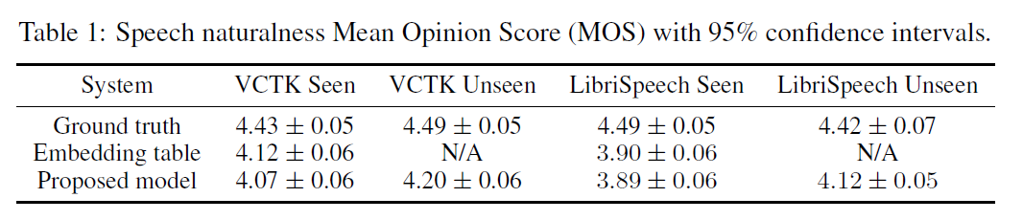
Results from Paper

Slide 16
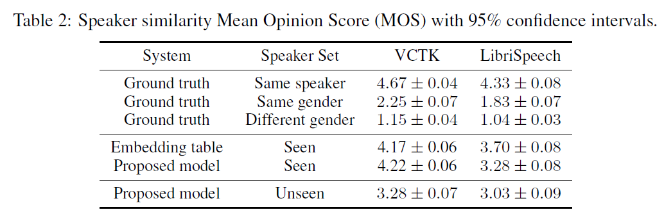
Results from Paper

Slide 17
Speech naturalness and similarity based on MOS
My Results ( Combined)
Metric | Speakers | VCTK | LibriSpeech | Naturalness and Similarity
Ground truth | Same | 4.67 | 4.33 | VCTK
Ground truth | Female voice | 2.25 | 1.83 | VCTK
Ground truth | Different | 1.16 | 1.04 | LibriSpeech
Embedding | Seen | 4.22 | 3.28 | Unseen

Slide 18
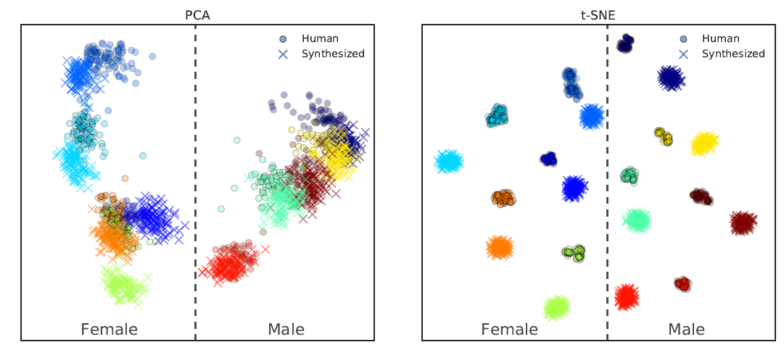
Different Gender Speaker Classification
Classification Results from Paper

Slide 19
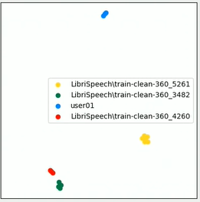
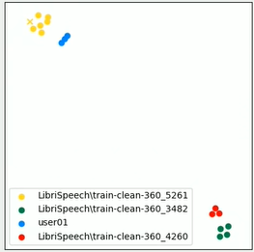
My Results

Slide 20
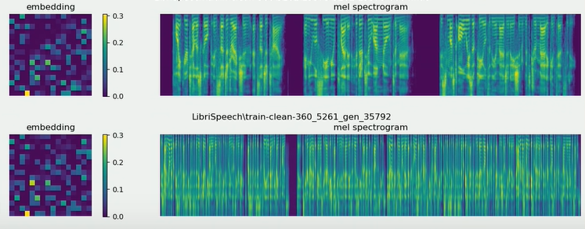
Speaker Embedding and spectrogram

Slide 21
Cross-dataset evaluation VCTK has larger score than LibriSpeech Speaker verification Equal Error Rate is based on GE2E therefore loss value is low
My Result Summary

Slide 22
Assumptions/Constraints/Implications
Speech data is not transcribed and contains noise
Training on large set of speaker utterances
Data set did not contain punctuations
At least 4 data points to generate the classification
Improved adaptation quality for the model

Slide 23
Conclusion
Speaker diversity to train synthesizer and increasing amount of speaker encoder training data has improved the results
Fascinated by seeing that model was able to generate realistic speech

Slide 24
Work Breakdown Structure
Task 1. Theory Project Proposal
Transfer Learning from Speaker Verification to Multispeaker Text-To-Speech Synthesis
Analysis of problem and what machine learning technique is used
Learning about Deep Neural Networks
Learning Convolutional Neural Networks
Understanding the concept of transfer learning

Slide 25
Work Breakdown Structure
Task 2. Proposal Presentation
Analysis of Models
Analysis of datasets
Working with pretrained
Task 3. Progress Presentation

Slide 26
Work Breakdown Structure
Task 4. Preprocessing and Training Models
Encoder and Synthesizer model
Task 5. Preprocessing and Training Models
Vocoder model
Task 6. Compare results of both datasets
Compare the results based on five parameters
Task 7. Final Presentation
.

Slide 27
Issues/Constraints
Unavailability of quality dataset
Training and preprocessing the model took a lot of time
To avoid overfitting, the speaker encoders needed to be trained on small datasets
Expected low cosine and high EER values to identify different speakers

Slide 28
Timeline ( Completed )
Critical Path
Task 1 – (10/22/19)
Task 2 – (10/29/19)
Task 3 – (11/12/19)
Task 4 – (11/18/19)
Task 5 – (11/28/19)
Task 6 – (11/30/19)
Task 7 – (12/04/19)

Slide 29
References
[1] Artificial Intelligence at Google – Our Principles. https://ai.google/principles/, 2018.
[2] Sercan O Arik, Jitong Chen, Kainan Peng, Wei Ping, and Yanqi Zhou. Neural voice cloning with a few samples. arXiv preprint arXiv:1802.06006, 2018.
[3] Dzmitry Bahdanau, Kyunghyun Cho, and Yoshua Bengio. Neural machine translation by jointly learning to align and translate. In Proceedings of ICLR, 2015.
[4] Steven Boll. Suppression of acoustic noise in speech using spectral subtraction. IEEE Transactions on Acoustics, Speech, and Signal Processing, 27(2):113–120, 1979.
[5] Yutian Chen, Yannis Assael, Brendan Shillingford, David Budden, Scott Reed, Heiga Zen, Quan

Slide 30
Questions

