Slide 1

SIDDAGANGA INSTITUTE OF TECHNOLOGY
TUMAKURU-572103
(An Autonomous Institute affiliated to VTU)
DEPARTMENT OF INFORMATION SCIENCE AND ENGINEERING
An automatic system to recognize kannada language NATURAL SIGN BOARD characters
MAJOR PROJECT PRESENTATION
Project Members:
B V Gowravi - 1SI14IS012
Pallavi Pratik - 1SI14IS028
Pawan Kumar Ganjhu - 1SI14IS029
Saurav Kumar - 1SI14IS063
Guided by:
Dr. Purohit Shrinivasacharya
Associate Professor
Dept. of ISE

Slide 2
Outline
Objective
Introduction
Literature Survey
∙ Existing System
∙ Proposed System
Requirements
Block Diagram
Architecture
Implementation
Future Work
Applications
Conclusions
References

Slide 3


Objective
To present work towards automatic Kannada text reading in natural scenes.
Recognition of Kannada Text.
Converting= text into English using OCR.
Kannada Image Text
Recognized Text

Slide 4
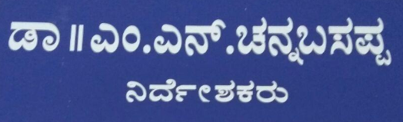
Introduction
Our country is a nation with diverse culture & language.
Difficult to understand non-native language.
Scene text may include street sign , name of shops , name plate etc.
Use of smart phones , recognition of text in image.
Eg. of Sign Board

Slide 5
Literature Survey
Existing System
The OCR system works on a grid infrastructure.
Google has translator converts English to other language.
This deals with the homogeneous character recognition or character recognition of simple language.
E.g. Google Translator

Slide 6
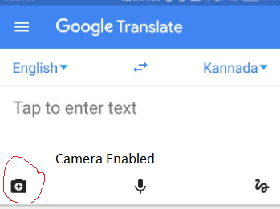
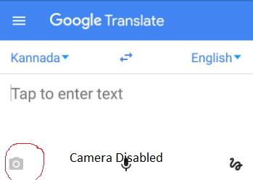

Drawbacks of Existing System
Capable to convert and recognize only the image containing English text.
The older system doesn’t recognize Kannada natural scene text.
Hand written text can not be recognized.
Traditional OCR system doesn’t recognize Kannada characters.
Handwritten Text
Recognizes English Text
Doesn’t Recognizes Kannada Text

Slide 7
Proposed System
System is to recognize Kannada Natural Sign Board Character
Focuses on recognizing characters that is not handled well by existing system.
The database of images contains Kannada characters.
Identifies character boundary and combine these characters to present a text.
OCR converts recognized texts and redirects into notepad.

Slide 8
Requirements
Software:
Matlab programming language.
Operating System.
Hardware :
Personal Computer which supports development of project.
Camera

Slide 9
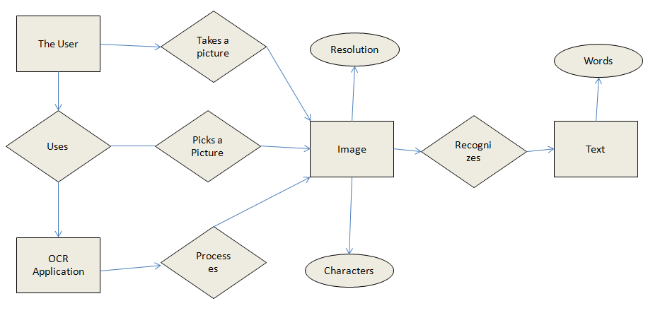
Architecture

Slide 10
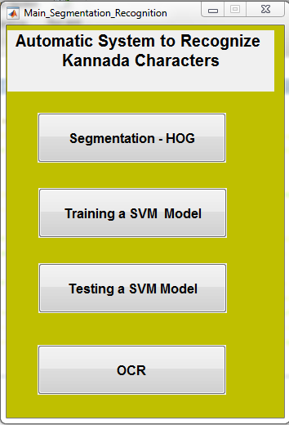
Implementation
Main Menu

Slide 11
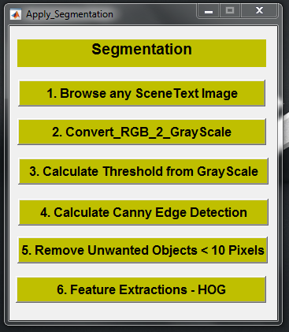
1. Segmentation-HOG

Slide 12
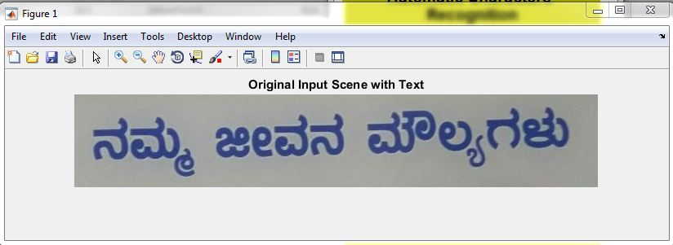
1.1 Browse Scene Text Image

Slide 13
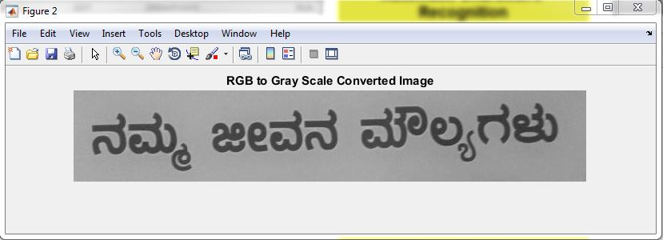
1.2 Convert RGB to Grey Scale

Slide 14
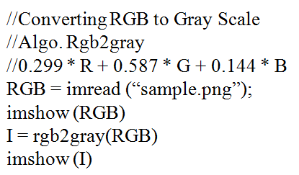
Function : rgb2gray

Slide 15
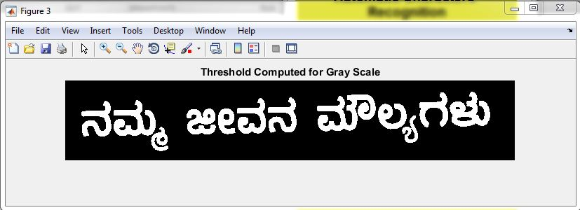
1.3 Calculate Threshold from Grey Scale

Slide 16
continued… Threshold Calculation
level = graythresh(I)
I – Image for which threshold need to be calculated
level – threshold value
graythresh – function

Slide 17
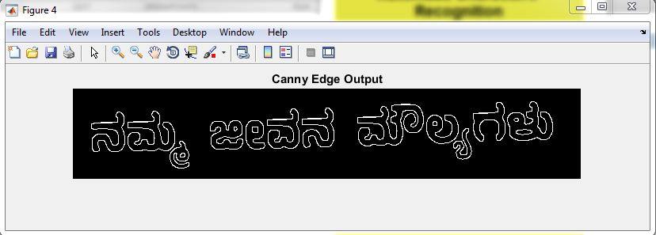
1.4 Canny Edge Detection

Slide 18
Canny Edge Detection
Smoothing: Blurring of the image to remove noise.
Finding gradients: The edges should be marked where the gradients of the image has large magnitudes.
Non-maximum suppression: Only local maxima should be marked as edges.
Double thresholding: Potential edges are determined by thresholding.
Edge tracking by hysteresis: Final edges are determined by suppressing all edges that are not connected to a very certain (strong) edge.

Slide 19
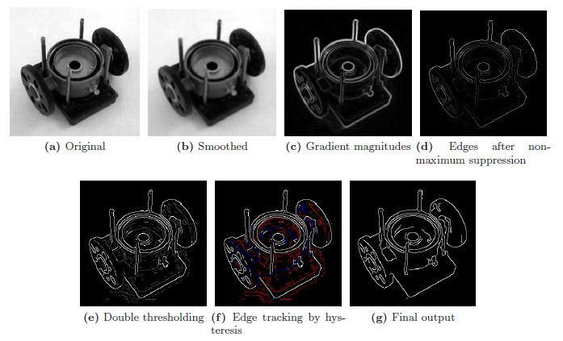
Canny Edge Detection Continued…

Slide 20
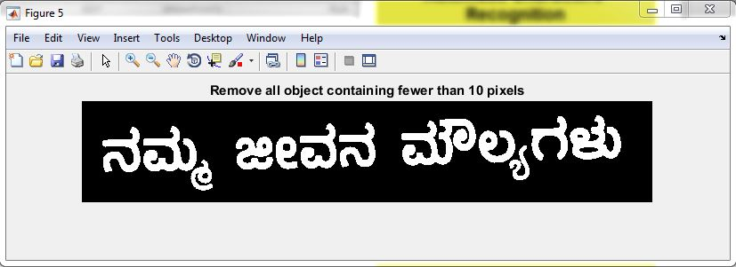
1.5 Remove Unwanted Objects

Slide 21
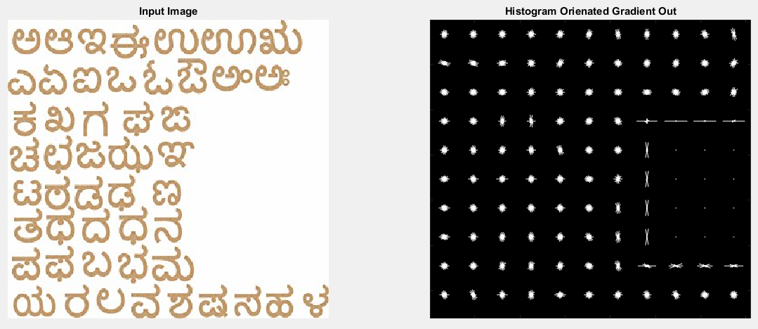
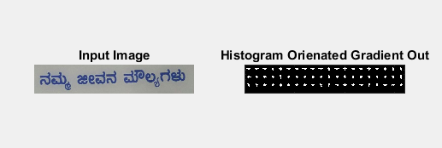
1.6 Feature Extraction
Sample 1
Sample 2

Slide 22
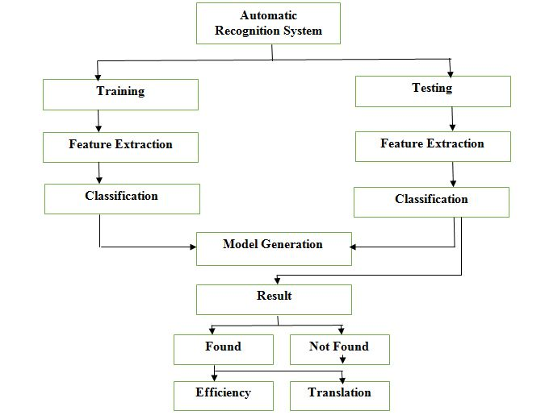
Block Diagram for Training and Testing

Slide 23
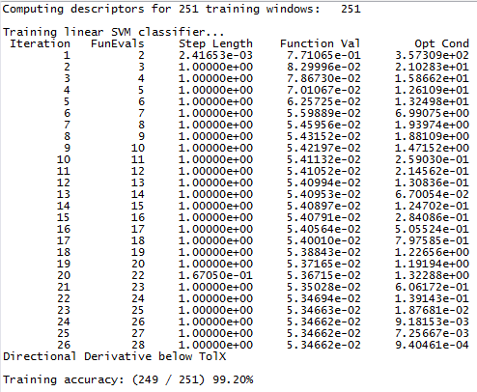
2. Training a SVM model

Slide 24
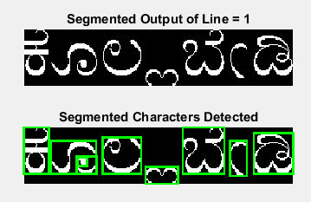
3. Testing SVM model

Slide 25
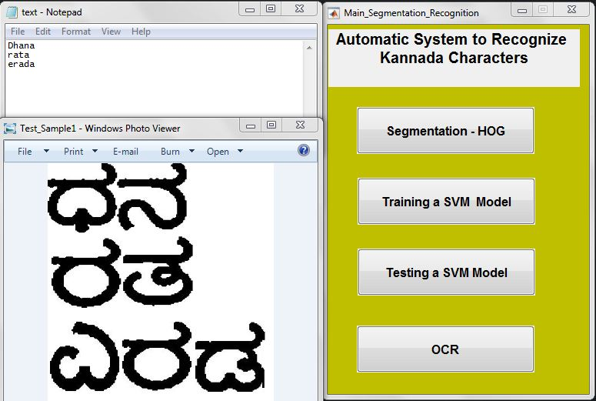
4. OCR

Slide 26
Conclusion
We have designed a system to tackle the problem of recognizing characters in images of natural scene. We will be using a database of street scenes taken in Tumkur.
Recognizes Kannada Characters.
Can be used by non-native speaker.
Saves time.

Slide 27
References
[1]. O. Akbani, A. Gokrani, M. Quresh, Furqan M. Khan, Sadaf I. Behlim, and Tahir Q. Syed, IEEE, “Character recognition in natural scene images”, Date Added to IEEE Xplore: 19 May 2016.
[2]. Keshava Prasanna, Ramakhanth Kumar P, Thungamani.M, and Manohar Koli, “Kannada text extraction from images and videos for vision impaired person”, International Journal of Advances in Engineering & Technology, Vol. 1, Issue 5, pp. 189-196.
[3]. Bolan Su, Shijian Lu, Shangxuan Tian, Joo Hwee Lim and Chew Lim Tan, IEEE, “Character Recognition in Natural Scenes using Convolutional Co-occurrence”, 2014 22nd International Conference on Pattern Recognition, 24-28 Aug. 2014.
[4]. Ya Jin, Stuart Geman, "Context and Hierarchy in a Probabilistic Image Model", Proceedings of the 2006 IEEE Computer Society Conference on Computer Vision and Pattern Recognition (CVPR’06).
[5]. Arshiya Nain, Sukhwinder Singh, "Character Recognition in Natural Images", International Journal of Enhanced Research in Science Technology & Engineering, ISSN: 2319-7463 Vol. 3 Issue 3, March-2014, pp: (123-126).

Slide 28
Thank You…

