Slide 1

SIDDAGANGA INSTITUTE OF TECHNOLOGY
TUMAKURU-572103
(An Autonomous Institute affiliated to VTU)
DEPARTMENT OF INFORMATION SCIENCE AND ENGINEERING
PERSONALIZED GUI
Project Members:
Pallavi Pratik :1SI14IS028
Pawan Kumar Ganjhu :1SI14IS029
Shubham Mishra :1SI14IS046
Guided by:
Professor Jagadamba. G.
Assistant Professor
Dept. of ISE

Slide 2
Objective
Introduction
Problem statement
Literature Survey
Existing System
Proposed System
Application
Use Case
Architecture
Snapshot
Future Work
Conclusion
References

Slide 3
Introduction
A person browsing internet finds difficulty managing the right amount of time to be spent browsing a webpage.
The idea is to come up with an application that will keep track of browsing time.
The clock efficiently manages the browsing time of the user by keeping track of how much time exactly the user has to spent on browsing the webpage or any other task.
If the user has to jot down an important point, perform brief calculations and conversions while browsing session then he/she can make use of clipboard, calculator and convertor tabs.

Slide 4
Problem Statement
Organized Home Browser
Personalized GUI for user.
User friendly.
Facilitates work scheduling in a smart way.

Slide 5
Literature Survey

Slide 6
Existing System
Alarm Clock
GU
I
Alarm clock : Free Alarm clock[3]
Clipboard : Microsoft Clipboard[4]
Calculator : Windows Calculator[5]
Currency Convertor : xe.com[6]
Clipboard
Calculator
Currency Convertor

Slide 7
Drawbacks of existing system
Alarm clock : Wakes up PC as soon as it goes to sleep mode.
Clipboard : The available clipboard allows saving of only one link at a time.
Calculator : It is not present in handy.
Currency Convertor : It is static, changes in real world does not reflect.

Slide 8
Proposed System
The GUI is divided into separate tabs.
There are 4 tabs: Alarm Clock, Clipboard, Calculator and Currency Convertor.
Alarm Clock acts as work scheduler.
Clipboard allows saving of multiple links, points and websites.
Calculator makes basic calculations handy.
Currency Convertor is dynamic and so it’s values tends to change as per market.

Slide 9
Applications of the project
It is a personalized GUI.
Time saver.
User friendly utilities.
Makes basic calculations handy.
Jot down important points and links from web.
It reduces the energy loss.
Helps in proper time scheduling.
Allows multiple links to be saved together in clipboard.
Currency Convertor is dynamic in nature.

Slide 10
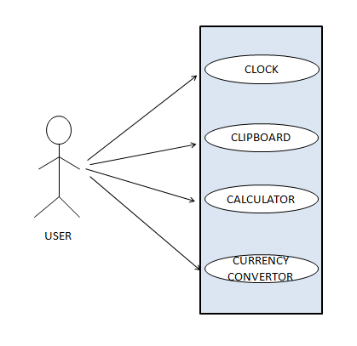
Use Case

Slide 11
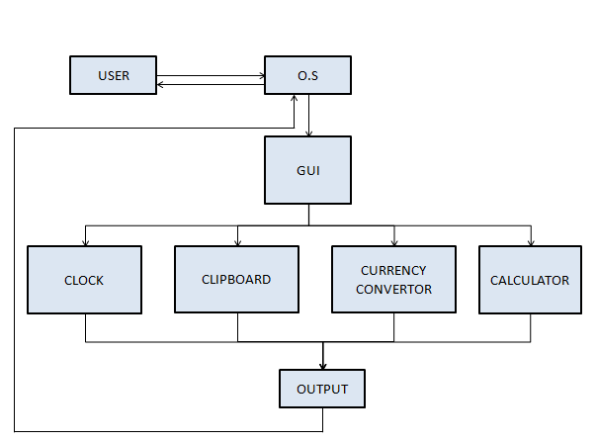
Architecture

Slide 12
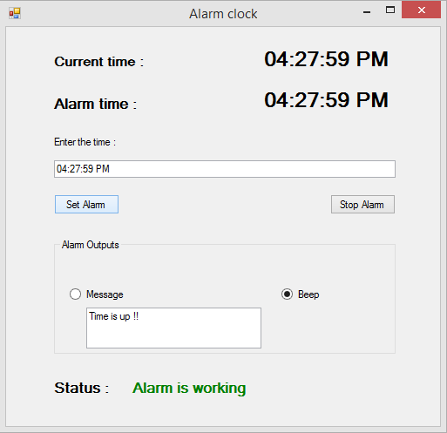
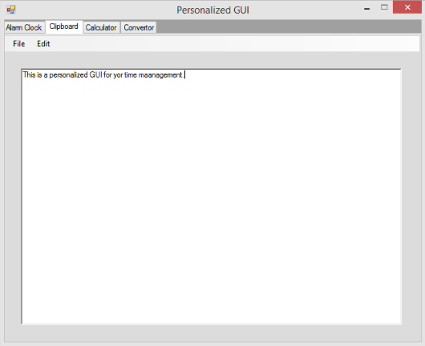
Snapshots

Slide 13
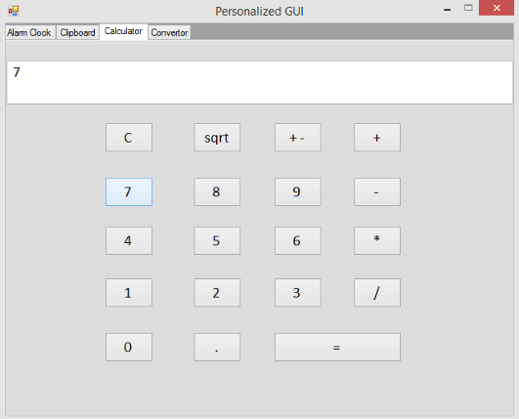
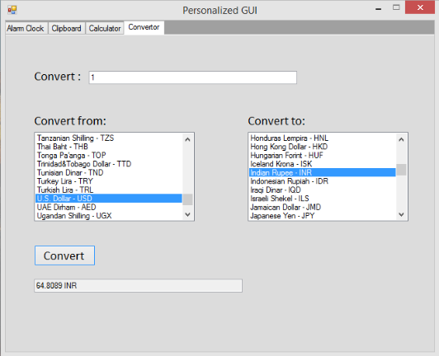

Slide 14
Future work
On overall there are UI improvements which needs to be done.
Alarm clock : Ringtones will replace the beep sound.
Calculator :Saving calculated result and including options for scientific calculations
Clipboard : Font options and making copying dynamic.
Convertor : Will include other unit conversions.

Slide 15
Conclusion
In today’s era we are completely dependent on technology. For every small task we refer to internet without any second thought. In order to reduce users valuable time, we are coming up with the user friendly application. The alarm clock will have facilities to set time, to set reminder and will also allow to prepare a schedule. And thus the time of the user will be saved. While working on internet a user may also need to do some mathematical calculation to analyse it. Furthermore, the result will be saved for future reference. A user may also need to convert units as per requirements. If a user finds something interesting and important, he can save those links in the Clipboard for later references.

Slide 16
References
Software Engineering, Roger S. Pressman, McGraw Hill, Edition 2010.
Pro C# with .NET 3.0, Troelsen and Andrew W,Apress
http://download.cnet.com/Free-Alarm-Clock/3000-2350_4-75328290.html
https://www.microsoft.com/en-us/store/p/clipboard/9wzdncrdmbkl
https://www.microsoft.com/en-us/store/p/windowscalculator/
http://www.xe.com/currencyconverter/convert/?Amount=
http://www.linfo.org/gui.html

Slide 17
Thank You

