Slide 1
Limited Transmit for TCP
Paul Amer
CISC 856 - TCP/IP & Upper Layer Protocols
May 17, 2011
references:
RFC 3042
Hari Balakrishnan's PhD Thesis

Slide 2

Motivation: World Wide Web
Empirical data shows that more than half of all objects downloaded from the Web are small (e.g., < 10KB)
Many objects are less than 5KB
These objects can be transferred in 3-4 TCP round trips
Limited Transmit serves to help transient connections deal with loss

Slide 3
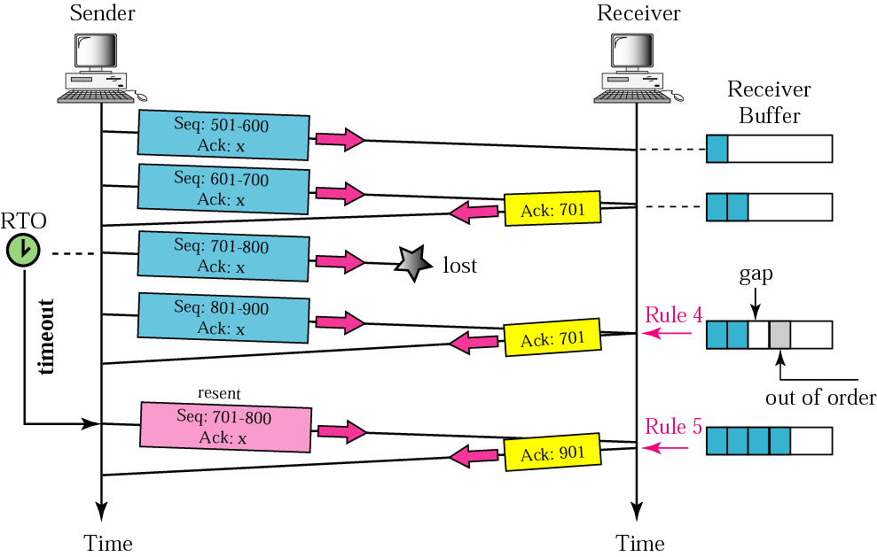
Dealing with Loss
Retransmission Time-Out (RTO)‏
Notes:
Picture above is NOT drawn to scale. Retransmission Time-Out is very long in comparison to normal sequence of sending data and receiving acknowledgements.

Slide 4
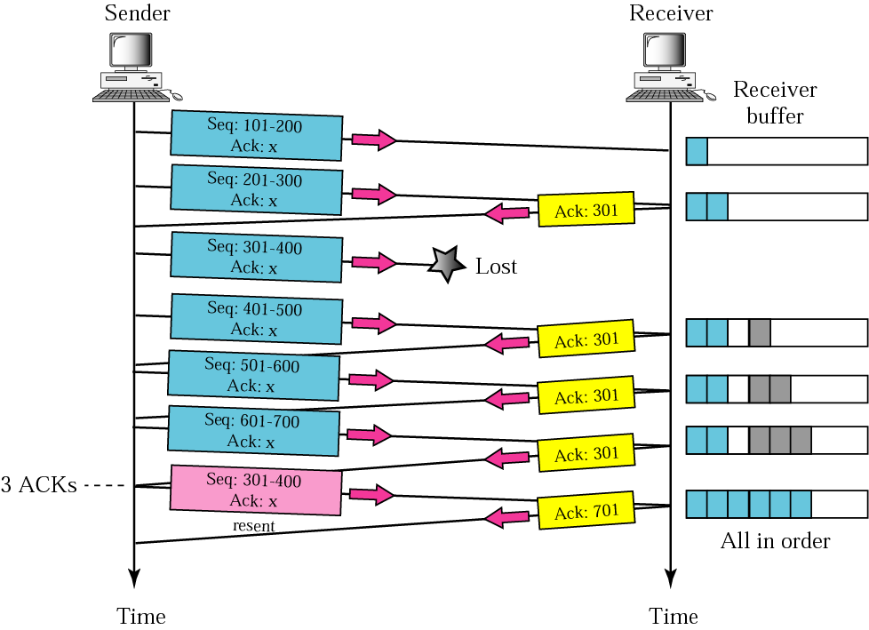
Fast Retransmission
Avoid waiting for timeouts
Three DUPACKs spur retransmission
Why are 3 DUPACKs used instead of just 1-2, or 4-5??

Slide 5
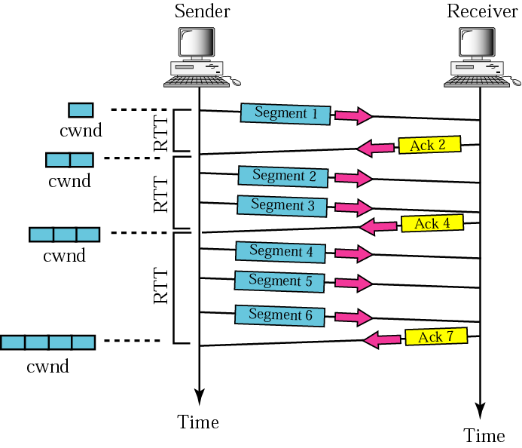
Reason Why Fast Retransmit
Might Not Happen
Small congestion window (cwnd) at sender

Slide 6
Limited Transmit
For each of first two DUPACKs received, sender transmits new data, if
1. receiver's advertised window allows, and
2. outstanding data would be within the congestion window plus two segments
    (In other words, the sender can send two segments beyond the congestion window (cwnd))
RESULT:
If these new data and ACKs are not lost, sender will infer initial data loss sooner by the 3-DUPACK rule, and Fast Retransmit rather than time-out

Slide 7
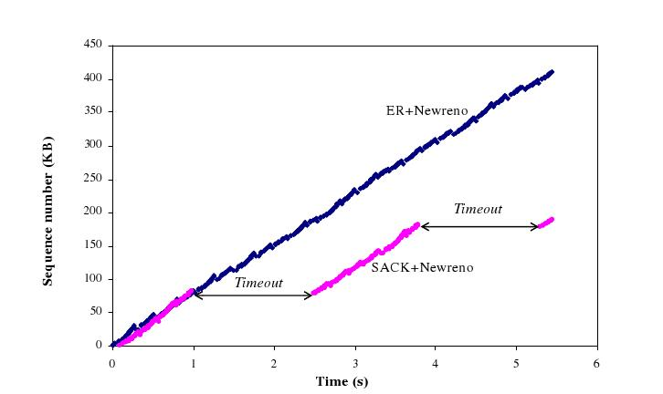
More Visual Results
Limited Transmit
Network tested: Cross-country Internet.

Slide 8
Conservation of Packets
The two DUPACKs hint that a packet has left the network
However, the original PDU has not been technically declared lost yet (< 3 DUPACKs).
  need more DUPACKs for Fast Retransmission
No reason to think congestion state is wrong. This means: SENDING NEW DATA IS OK

Slide 9
Proven by Real-World Experiment
A busy webserver's retransmissions were studied:
- Retransmissions due to timeouts
- TCP Fast Retransmissions
- TCP w/ SACK Fast Retransmissions
- TCP w/ Limited Transmit Fast Retransmissions

Slide 10
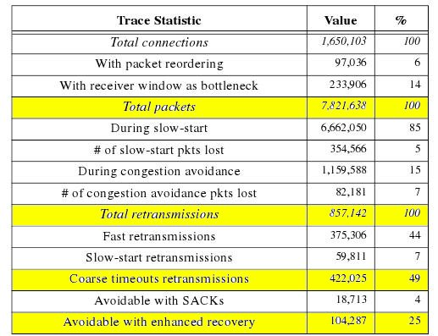
Data
From PhD Thesis of Hari Balakrishnan, his early work leading up to Limited Transmit idea. He is a co-author of RFC 3042. Here he calls the idea Enhanced Recovery. This test analyzed the 1.6 million TCP connections with the IBM Web Server for the 1996 Atlanta Olympics.
KEY VALUE:
104,287 RTO-induced retransmissions were avoidable.
This is at least 104,287 seconds of efficiency altogether wasted by the server, or
29 hours!

Slide 11
Limited Tx Summary
Limited Transmit improves throughput when a sender cannot receive three DUPACKs due to the congestion window being too small.

Slide 12
Questions?

Slide 13
Reasons Fast Retransmit
Might Not Happen
Small congestion window at sender (cwnd)
  Sender might not even have a queue of data
    To provoke DUPACKs, new data must be sent
    Consider a real-time application waiting for input
    Or, consider when connection is closing

Slide 14
Limited Tx Doesn't Solve...
Limited Transmit does NOT solve the problem of not receiving three DUPACKs due to not having outstanding data to send!
Solution:
Early Retransmit

Slide 15
Early Retransmit
Similar to Limited Tx, even more lenient
Not an official RFC yet, is in draft state
Draft specifies TCP implementors MAY use Early Rtx , while Limited Tx is listed as SHOULD BE used.
The RFC keyword pecking order as defined in RFC 2119:
{Imperative} MUST, MUST NOT, REQUIRED, SHALL, SHALL NOT
{Suggested} SHOULD, SHOULD NOT, RECOMMENDED
{Allowed} MAY, OPTIONAL

Slide 16
Two Versions of Early Rtx
TCP sender is REQUIRED to track the outstanding bytes. A TCP sender MAY track the number of outstanding PDUs.
Early Retransmit MAY be implemented in either case
Early Retransmit calculates a value called ER_thresh: a threshold to determine the number of DUPACKs needed to trigger
Fast Retransmission

Slide 18
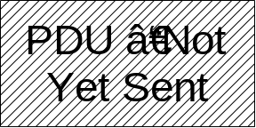
PDU-based Early Rtx
Concept of outstanding segments (oseg)‏
PDU – Sent
& ACK'd
PDU – Sent
& ACK'd
PDU – Sent
& Not ACK'd
PDU – Sent
& Not ACK'd
PDU – Sent
& Not ACK'd
oseg
ER_thresh = oseg - 1

Slide 20
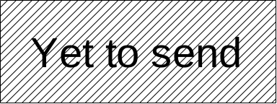
Byte-based Early Rtx
Concept of outstanding window (ownd)‏
Bytes sent & ACK'd
Bytes sent but not yet acknowledged
ownd
ER_thresh = CEILING( ownd / SMSS ) - 1
Sender Maximum Segment Size

Slide 21
Early Rtx Conditions
Used if and only if:
  ER_thresh ≤ 3
Why?
  No new data to send exists
Why?

Slide 23
Special SACK Case
If connection is using SACKs, the outstanding data must be SACKed before data is retransmitted. Why?

