Slide 1
Impact Of TCP on Web Performance
Paddy Ganti

Slide 2
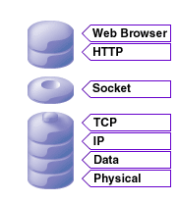
The Stack

Slide 3
Introduction
HTTP is a request response protocol
Parameter passing in http based on mail "headers".
Basic Unit of Communication in HTTP is a “Message”
Basic Unit of Communication in TCP is a “Segment”
RFC 1945 for HTTP/1.0 and RFC 2616 for HTTP/1.1 are standards
Neither RFC mandates a specific transport protocol like TCP
However all HTTP implementations use TCP and not UDP
UDP preserves message boundaries like CRLF whereas TCP cannot

Slide 4
TCP Parameter Space
Tahoe, Reno, NewReno, SACK, CUBIC,etc
Timer Granularity
Initial Retransmission Timeout (RTO)
Initial Congestion Window Size
Maximum Segment Size (MSS) and Path MTU
Timestamps
Delayed Acknowledgements
Nagle, Silly Window Syndrome, Buffer Sizes, Socket Options

Slide 5
HTTP Parameter Space
HTTP/1.1 is quite complex; 175 page spec. Not very modular. Mixes up issues at many levels of abstraction
Parallel Connections
- Multiple connections between client & server
- Overcome small initial wnd for slow start
Persistent Connections
- Some TCP overhead avoided as connection stays open
Pipelining
- Multiple Requests without waiting for individual responses

Slide 6
TCP & HTTP Interaction
Network Conditions
- Different Recovery Mechanisms of TCP Variants depending on loss
Persistent Connections
- Depends on Initial RTO, Timer Granularity
Parallel Connections
- Some TCP overhead avoided as connection stays open
There are five different ways to delimit a HTTP message and four of the involve interactions with the higher levels and the fifth uses TCP particularly badly [ See RFC 2068 section 4.4 for the details]
Notes:
4.4 Message Length When a message-body is included with a message, the length of that body is determined by one of the following (in order of precedence): 1. Any response message which MUST NOT include a message-body (such as the 1xx, 204, and 304 responses and any response to a HEAD request) is always terminated by the first empty line after the header fields, regardless of the entity-header fields present in the message. 2. If a Transfer-Encoding header field (section 14.40) is present and indicates that the "chunked" transfer coding has been applied, then Fielding, et. al. Standards Track [Page 32] RFC 2068 HTTP/1.1 January 1997 the length is defined by the chunked encoding (section 3.6). 3. If a Content-Length header field (section 14.14) is present, its value in bytes represents the length of the message-body. 4. If the message uses the media type "multipart/byteranges", which is self-delimiting, then that defines the length. This media type MUST NOT be used unless the sender knows that the recipient can parse it; the presence in a request of a Range header with multiple byte-range specifiers implies that the client can parse multipart/byteranges responses. 5. By the server closing the connection. (Closing the connection cannot be used to indicate the end of a request body, since that would leave no possibility for the server to send back a response.) For compatibility with HTTP/1.0 applications, HTTP/1.1 requests containing a message-body MUST include a valid Content-Length header field unless the server is known to be HTTP/1.1 compliant. If a request contains a message-body and a Content-Length is not given, the server SHOULD respond with 400 (bad request) if it cannot determine the length of the message, or with 411 (length required) if it wishes to insist on receiving a valid Content-Length.

Slide 7
Bandwidth Delay Product
Convert the network data rate in bits to bytes and multiply it by the delay in the network - Residential DSL: 2 Mb/s, 50 ms RTT BDP = 12.5 kB.
Mobile broadband (HSDPA): 6 Mb/s, 100 ms RTT BDP = 75 kB.
High-speed terrestrial network: 1 Gb/s, 1 ms RTT BDP = 125 kB.
The greater the distance (latency) and the greater the bandwidth of the network, the more data that can be in flight across that link at any point
The nodes exchanging data over the network do not have buffers or window sizes large enough to adequately utilize the available link capacity.
With multiple concurrent connections no issue, but a single connection has a difficult time taking advantage of (or simply cannot take advantage of) the large amount of network capacity available because of the lack of buffer space

Slide 8
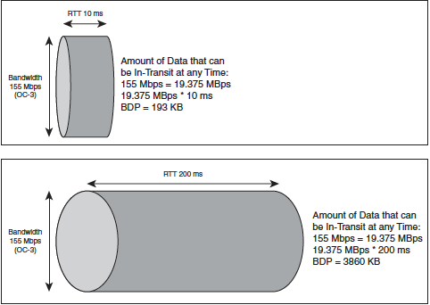
Bandwidth Delay Product

Slide 9
Router Queues
Large Queues => delay, rtt spikes
Small Queues => Loss
Queueing Discipline affects TCP (FIFO,RED,WRED,etc)
Queue Size + BDP is the "storage"
Implies only that many flows can have 1 packet outstanding.
Hence TCP sees timeouts which are exponentially backed off with a min of 1

Slide 10
Implications of BDP for TCP
TCP is inherently unfair to long RTT connections (compare throughput of 10 ms versus 200 ms RTT)
This is because of "additive increase”
cwnd + = 1/cwnd
cwnd opens per ACK received rather than per segment acknowledged
TCP works as designed if delay is low or bandwidth is low but does not for both being high
TCP Appropriate Byte Counting (RFC 3465) addresses some of these concerns

Slide 11
Packet Loss
TCP was originally designed assuming that the average packet loss rate was less than 1%
Multiple packet losses don't imply multiple congestion events
Only packet losses spaced by atleast one RTT can be considered independent
TCP does not often see a real loss, at first, because reordering obscures it. So need to wait for timeout
DECbit reduced flows to 7/8 (rather than 1/2) after a packet loss.
p must be roughly (c/RTT*B)² or greater where Bottleneck Bandwidth is “B”
2% is a magical number as this means less than 6 packets per connection

Slide 12
Why Does Congestion Happen?
Bandwidth Allocation Change: Change in a variable bandwidth circuit can result in the network being able to service more or less overall throughput based on the direction and nature of the change
Network oversubscription: When a shared network connection between upstream devices is used by multiple concurrent users, it can become congested to the point of loss or delay.
Congestion of device queues: Similar to network oversubscription, a shared device such as a router can have its queues exhausted to the point of not being able to accept new packets
Overload of destination: Destination socket buffers can become full because of an application’s inability to drain data from them in a timely fashion, potentially because of the server being overwhelmed.

Slide 13
TCP for Transactions (RFC 1644)
Cache per host information to bypass 3 way handshake and slow start
Reduce TIME_WAIT state from 240 sec to 12 sec
HTTP Response Times improved by 18-55% relative to stock TCP
cwnd opens per ACK received rather than per segment acknowledged
Has Security Implications (prediction of ISN,etc ) which prevented its adoption by the community at large
Same Gains achieved with persistent connections for a session (Persistent HTTP provides connection caching at user level but T/TCP does the same in the kernel)

Slide 14
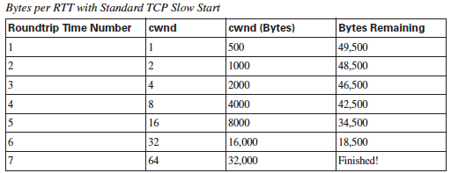
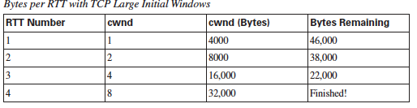
Impact of Large Initial Congestion Window

Slide 15
TCP Slow Start
cwnd + = 1 for each ack until you reach ssthresh (usually 64KB on Linux 32k is also not uncommon)
Each round trip send cwnd(i) -unACKed(i) packets
- cwnd(i) = cwnd(i-1)+ACKs(i-1)
- cwnd(1) = 2 (due to handshake)
Roughly RTT * log₂(BW/MSS) is the time spent in slow start
Once you reach ssthresh start CA phase where cwnd + = 1/cwnd
In slow start, send n packets, get n/2 acks back, next window= 1.5n

Slide 16
Slow Start Restart
If all data is acknowledged and no more data is sent for one RTO,
- set cwnd back to ICW and restart the slow start
Linux tends to decay this post 2.4 which is much nicer
This is one reason HTTP Keep-Alives do not work as well as you expect
We see benefits of 80ms – 120 ms when we turn it off

Slide 17
Delayed Acknowledgements
Initial Idea was to save bandwidth costs by piggybacking acks
Send ACKs only after the receipt of 2 full MSS (RFC 1122- Host Req)
| |
Delay upto 200 ms (clock granularity that time) before sending out pure ACK
For HTTP traffic the consumer of the data typically has nothing to send after the GET request and will only delay the ACK 200 ms thus reducing the increase in cwnd of the producer
In fact the sqrt(2) in the TCP throughput is due to this feature
Also bad for FTP or any other file upload system today

Slide 18
Corner Case Delays
Short Initial Segment: If we dont have 2 full segments of Data to send then we delay as per RFC 1122
Odd Final Segment: Assuming a odd number of full segments and one last short segment, we wont send because of silly window avoidance
Nagle: Proxy doing a write-write-read => 500 ms of delay
For solution read http://en.wikipedia.org/wiki/Nagle%27s_algorithm
Use TCP_CORK as an option when doing such writes

Slide 19
Reordering
Happens due to multiple paths, multicore queues within a router, etc
Data packets are more likely to be reordered than ACKs (due to ACK every other full segment)
TCP does not have waiting time to generate DUP if there is a sequence hole
Non existent below a certain load
Happens at small timescales and more as inter-packet space decreases (more at 1 gig and 10 gig and 100gig rather than 1 M)
It makes it hard to open the congestion window.
Loses self clocking and becomes very bursty.

Slide 20
Pacing
ACKs coming back to back will produce bursty traffic
Sudden Bursts will move the network equilibrium
We have a choice to send "n" packets over 1 RTT either in a burst or in a spaced manner
Pacing refers to sending such packets via a leaky bucket mechanism
Only consensus out there is that this will help high bandwidth delay products
Can be implemented in the sender or the receiver
Idea is to use rates rather than Acknowledgements

Slide 21
Fast Retransmit
Instead of waiting for RTO expiry, we can send 3 duplicate ACKs that will trigger the retransmission of *one* DUP segment
Then wait for additional dupACKs to arrive indicating atleast half the inflight data has left network: resend
SACK helps but the size imposes limit to 4 or even 3 (if timestamps option)
Minimum cwnd to trigger FR is 4 (below 3 its impossible)
On the receiver side, Fast Recovery means no slow start but halve the congestion window

Slide 22
RTO Expiry
Most common method to retransmit a lost packet on the net (>55%)
Very coarse grained
Imagine the RTO on Initial SYN loss (3,6,9 seconds of connect time)
Exponential smoothing implies we need more samples to converge on the correct value (before which a single http transaction is done)
Losing a retransmit packet?
Three reasons for timeout : non-trigger of fast retransmit (not enough data to send), multiple losses, lost retransmit.
Roughly time spent in RTO is ~ 1/(1+rtt/cwnd)

Slide 23
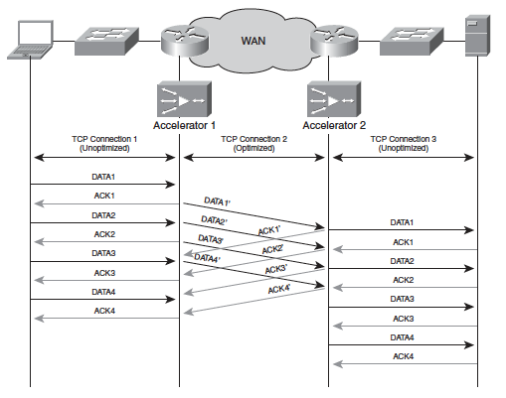
Putting it all Together
Previously single client- server loop is now broken into 3 loops by placing the Connection 1 and Connection 3 in the normal TCP comfort zone while applying all the above techniques in the “middle mile”.

Slide 24
If you want me to shut up start asking questions!!

