Slide 1
CITI BIKE
Overnight Rebalancing Optimization
NYU Stern — B60.2350 Decision Models & Analytics
Prof. Juran | Spring 2026
Paul Garofalo

Slide 2
AGENDA
01
The Problem
Why stations become imbalanced daily
02
Data & Methodology
12 months of real trip data, demand profiling, distribution fitting
03
Cost Model
Truck operations, opportunity cost of inaction
04
Optimization
TSP-based truck routing for minimum cost
05
Simulation
5,000-trial Monte Carlo with stochastic demand
06
Efficient Frontier
How many trucks is enough?
07
Recommendations
Our answer and next steps

Slide 3
THE REBALANCING PROBLEM
Morning Rush (7–9 AM)
Overnight Fix (12–5 AM)
Residential stations empty out as commuters ride to work
Midtown stations overflow as bikes arrive faster than they leave
Empty stations → lost revenue. Full stations → frustrated riders.
Lyft deploys trucks to redistribute bikes
Pick up from overstocked stations, drop off at understocked
Question: How many trucks, which stations, what cost?
Inspiration: Alibaba & Meituan solve this exact problem for shared bikes in China at massive scale.

Slide 4
WHY THIS MATTERS
$7,494
$225K
3,549
386
Daily opportunity cost
of no rebalancing
Monthly lost revenue
& dissatisfaction
Bikes that need
moving each night
Stations in study area
(Manhattan < 59th St)
Based on 44.6 million real Citi Bike trips (Apr 2025 – Mar 2026).

Slide 5
DATA & METHODOLOGY
Data Sources
Study Area
Citi Bike S3 trip data (Apr 2025 – Mar 2026)
GBFS live station feed (real-time)
44.6M trips across 386 stations
Manhattan below 59th Street
386 stations, full 12-month coverage
Captures core commuter corridor
Trip Data
Demand
Profiling
Imbalance
Analysis
Truck
Optimization
Monte Carlo
Simulation
Efficient
Frontier
Course Techniques: Solver (LP/IP) • Network Models • Crystal Ball • SolverTable • Efficient Frontier

Slide 6
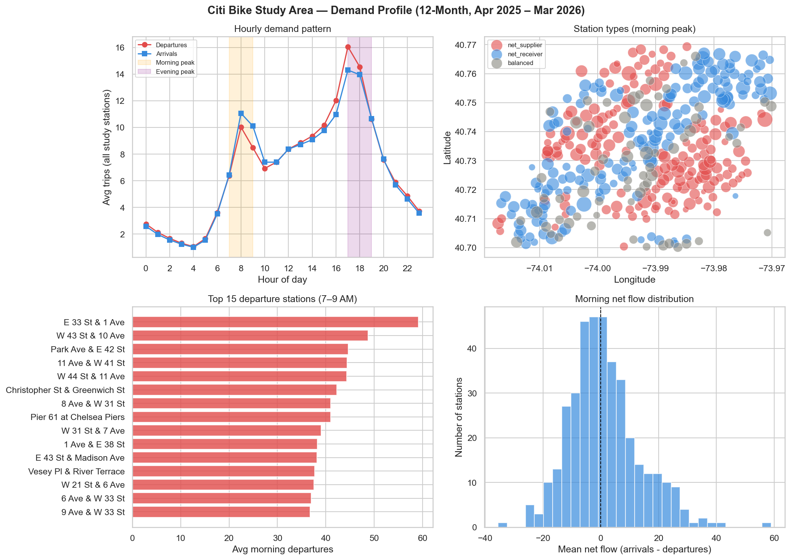
DEMAND PROFILING
Morning peak (7–9 AM): Fitted Poisson & Normal distributions to each station’s daily departures across 12 months

Slide 7
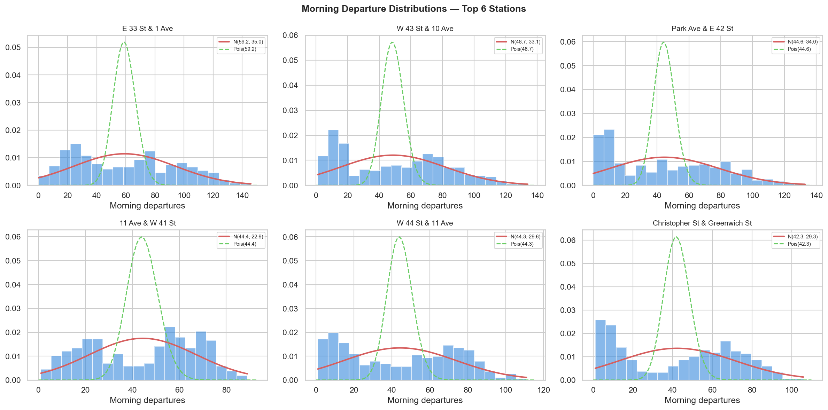
STATION DISTRIBUTIONS
Morning departure histograms for the 6 busiest stations — Poisson (green) and Normal (red) fits overlaid

Slide 8
COST MODEL
Rebalancing Costs
Opportunity Costs
Parameter | Value
Fixed cost / truck / night | $450
Variable cost / mile | $3.50
Driver wage | $35/hr
Overtime (>8 hrs) | 1.5×
Truck capacity | 20 bikes
Fuel | $3.80/gal @ 8 mpg
Load/unload time | 12 min/stop
Parameter | Value
Lost trip revenue | $4.50/trip
Dissatisfaction penalty | $2.00/trip
Brand damage multiplier | 1.25×
Total per unmet trip | $8.13
All parameters are editable in the Excel workbook — Juran can adjust and re-run scenarios.

Slide 9
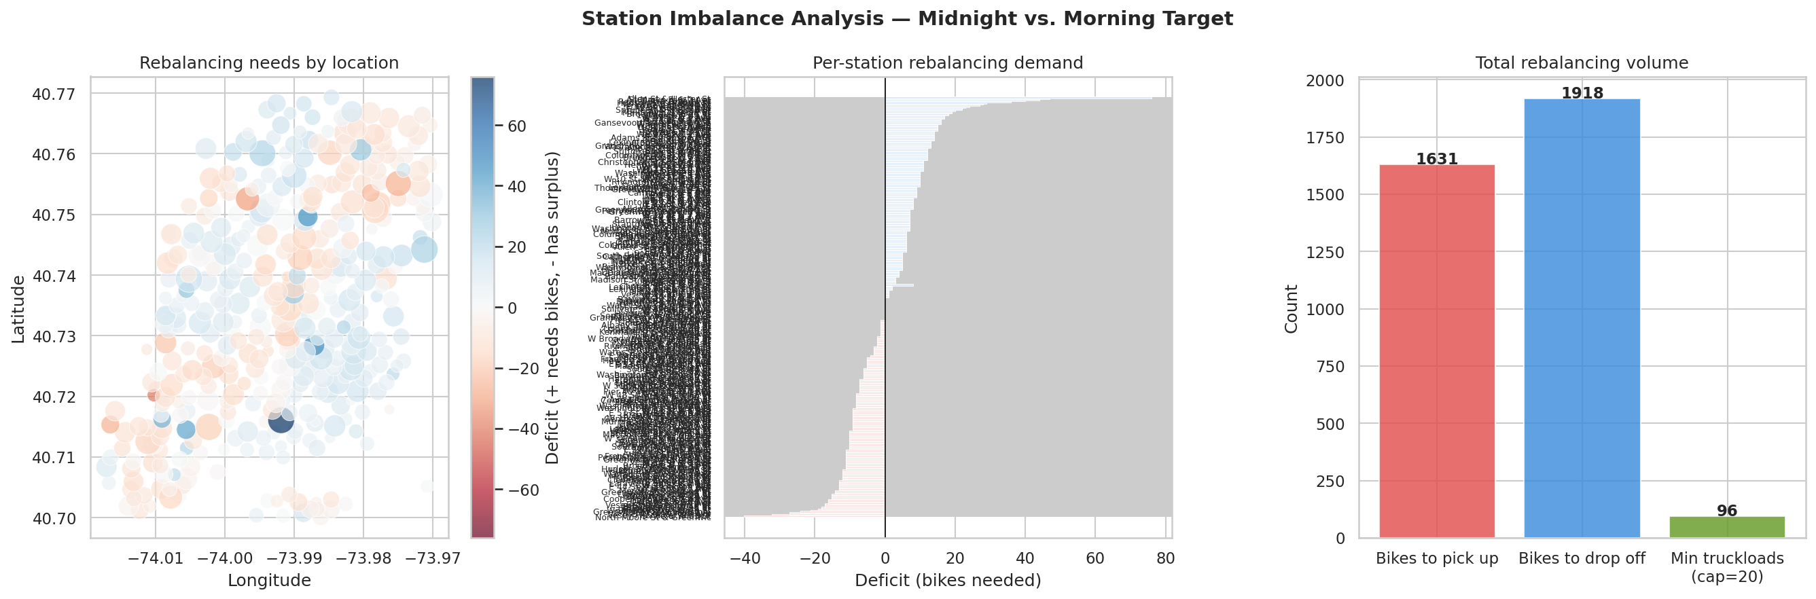
IMBALANCE ANALYSIS
Midnight inventory vs. morning target — who needs bikes and who has too many?
163
Net Suppliers
160
Net Receivers
3,549
Total Bikes
to Move

Slide 10
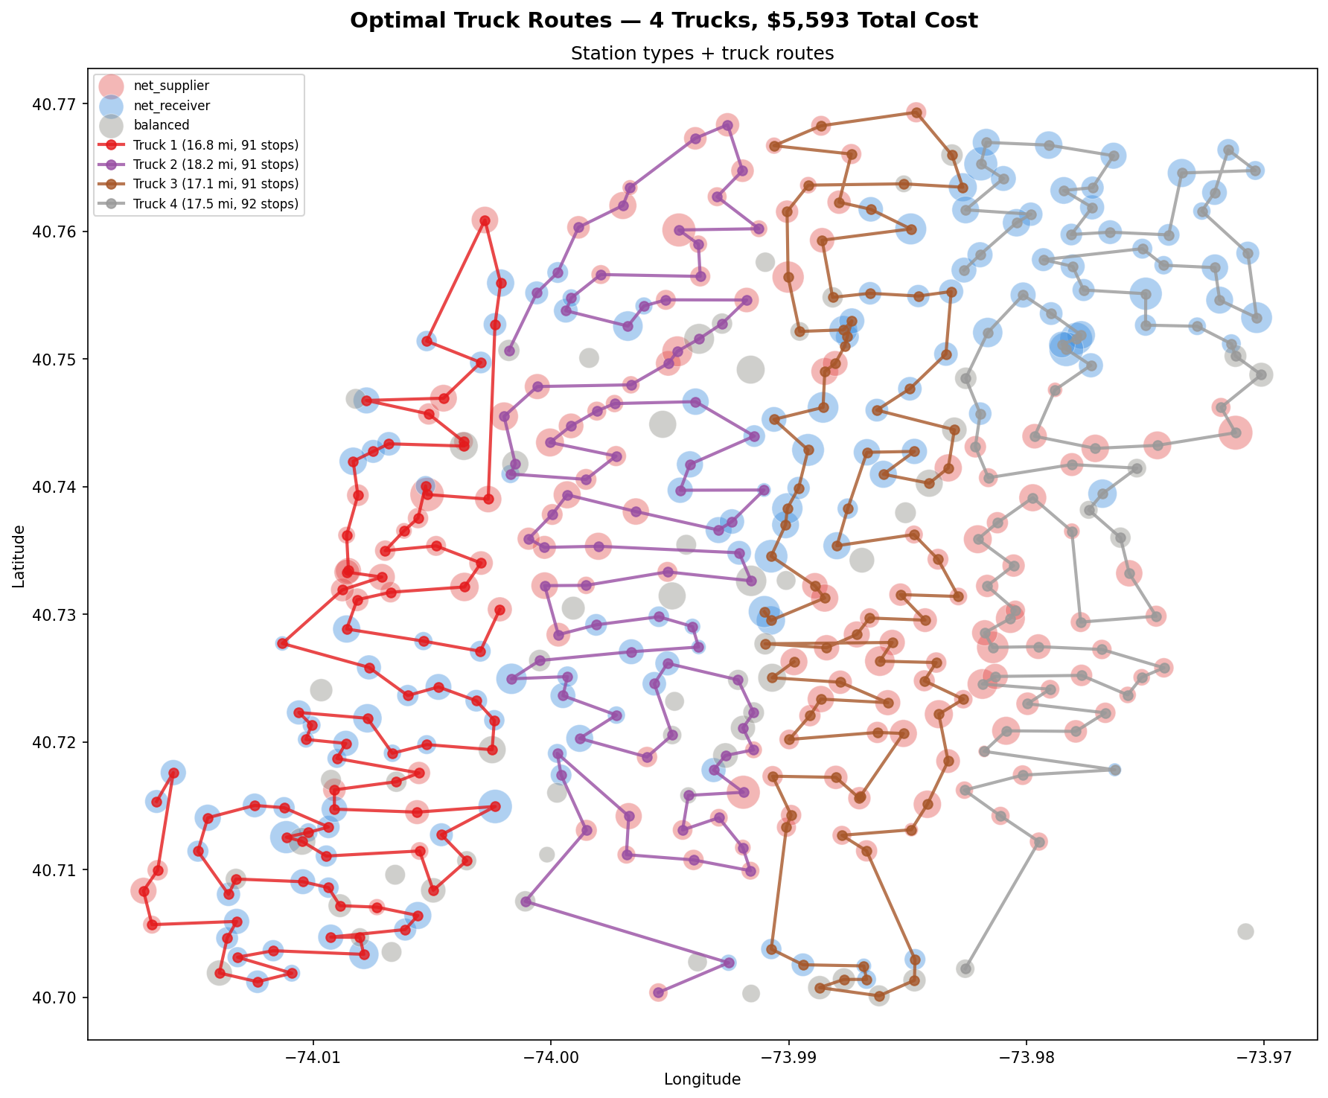
TRUCK ROUTING OPTIMIZATION
Nearest-neighbor TSP + 2-opt improvement heuristic with geographic clustering by longitude.

Slide 11
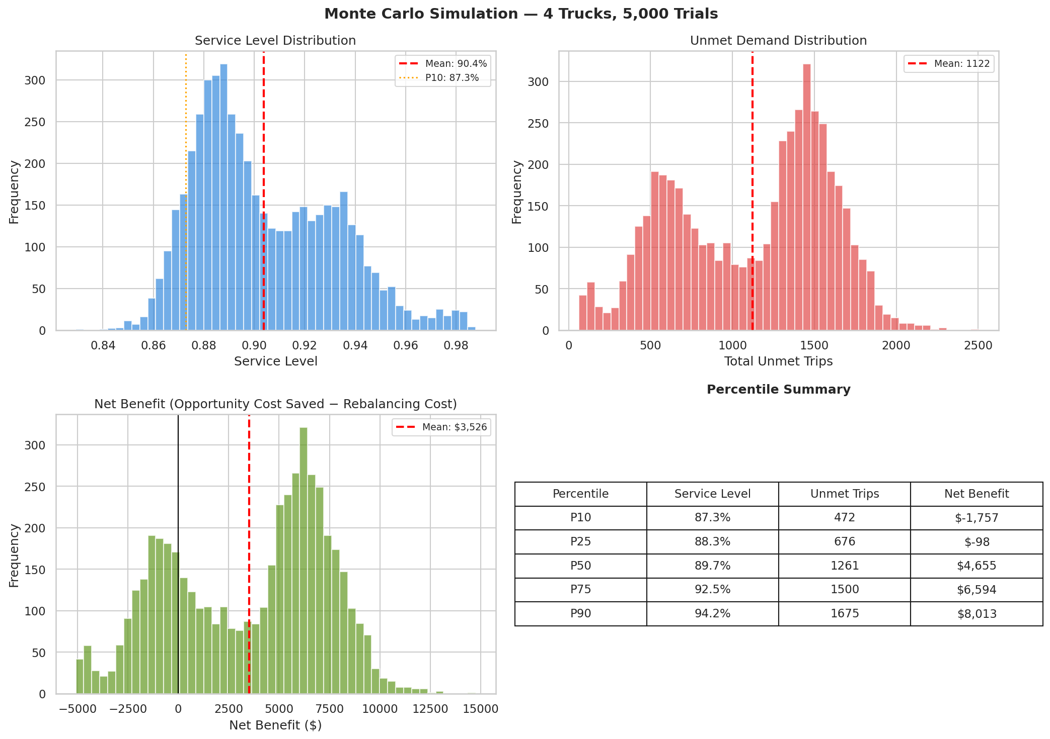
MONTE CARLO SIMULATION
5,000 trials with stochastic demand (Poisson), weather effects, and day-of-week variation

Slide 12
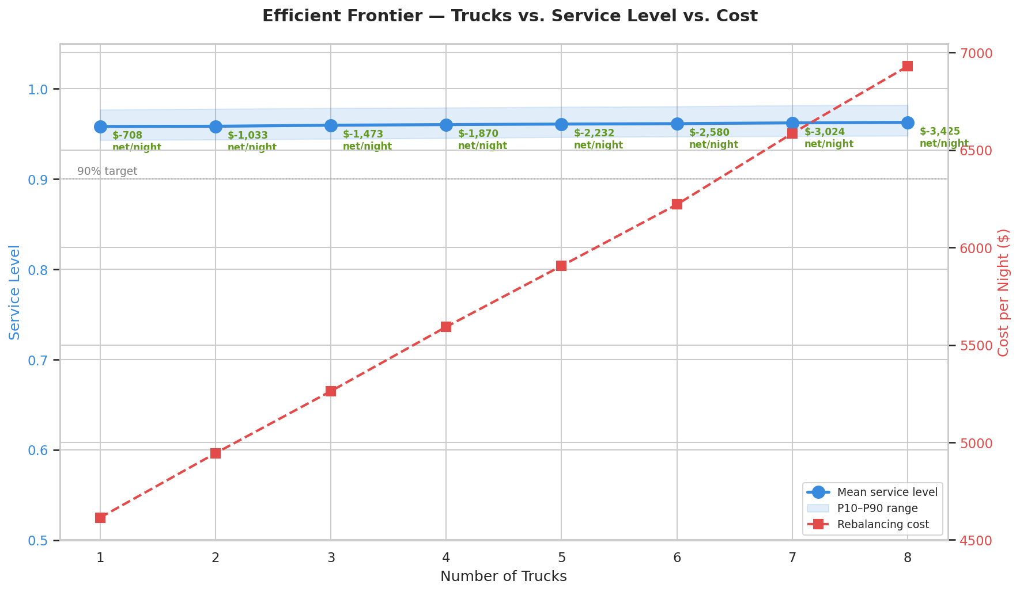
THE EFFICIENT FRONTIER
“Is the next truck worth it?” — SolverTable-style sweep of 1–8 trucks, each with 2,000 simulation trials.

Slide 13
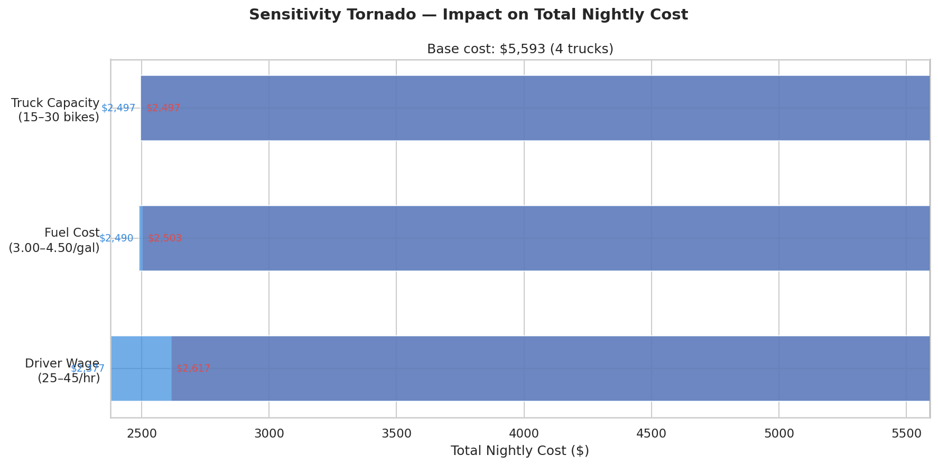
SENSITIVITY ANALYSIS
Tornado diagram: which parameters drive total cost the most? Truck capacity, driver wage, and fuel cost swept.

Slide 14
RECOMMENDATION
Deploy 1 truck nightly — highest ROI on the efficient frontier.
95.8% service level • $4,614/night cost • 63 miles • 52% probability of positive net benefit
Key insight: With 386 stations, the system’s natural flow diversity provides strong baseline service. Adding trucks yields diminishing marginal returns — each additional truck adds ~0.1% service at $300+/night.
1 truck
95.8% service, −$708 net/night
Best ROI — least negative net cost
3 trucks
96.0% service, −$1,473 net/night
Marginal service gain, higher cost
8 trucks
96.3% service, −$3,425 net/night
Diminishing returns, 1% chance of positive net

Slide 15
LIMITATIONS & FURTHER WORK
Limitations
Further Work
Study area limited to Manhattan < 59th St
Heuristic routing (NN + 2-opt), not exact MIP
No real-time traffic or road closure modeling
Assumes homogeneous truck fleet
Opportunity cost estimates are conservative
Expand to all of Manhattan / Brooklyn
Full MIP solver (Gurobi / CPLEX) for routing
Incorporate e-bike charging logistics
Weather API integration for adaptive planning
Multi-objective: service + equity + sustainability

Slide 16
QUESTIONS?
Paul Garofalo | pgaro1ks@stern.nyu.edu
github.com/pgaro1ks/nyu-dma-citibike
Excel workbook with editable Solver parameters available in submission.

