Slide 1
CITI BIKE
Overnight Rebalancing Optimization
A Decision Models Approach to Fleet Routing & Stochastic Demand
Paul Garofalo
B60.2350 Decision Models & Analytics | Prof. Juran | Spring 2026
NYU Stern School of Business

Slide 2
00
AGENDA
i
1
Background & Motivation
The bike-sharing rebalancing problem
2
Data & Study Area
44.6M trips, 386 stations, 12 months of real data
3
Demand Profiling
Poisson & Normal distribution fitting, station classification
4
Imbalance Analysis
Midnight inventory estimation, morning targets, cost of inaction
5
Optimization Model
TSP-based truck routing with geographic clustering
6
Monte Carlo Simulation
5,000-trial stochastic demand modeling
7
Sensitivity Analysis
Efficient frontier, tornado diagrams, parameter sweeps
8
Recommendation & Conclusions
Optimal fleet size and deployment strategy
NYU Stern — B60.2350 Decision Models & Analytics
2 / 20

Slide 3
01
THE REBALANCING PROBLEM
Bike-sharing systems face a fundamental asymmetry: commuters ride from residential areas to business districts in the morning, creating station-level imbalances overnight.
KEY QUESTION
How many trucks should Citi Bike deploy each night, and what routes should they follow, to maximize morning service while minimizing operational cost?
Without rebalancing, morning commuters find empty docks at high-demand stations and full docks at destinations — leading to lost trips, frustrated riders, and revenue erosion.
The overnight rebalancing window (12 AM – 5 AM) is the only practical time to redistribute bikes across the network using trucks.
Techniques Used:
TSP Heuristics (NN + 2-opt)
Poisson/Normal Demand Models
Monte Carlo Simulation (5K trials)
Sensitivity & Efficient Frontier
NYU Stern — B60.2350 Decision Models & Analytics
3 / 20

Slide 4
02
WHY THIS MATTERS
44.6M
386
$225K
Trips Processed
(Apr 2025 – Mar 2026)
Stations in
Study Area
Monthly Cost
of Inaction
Citi Bike is the largest bike-sharing system in the United States. Every morning, thousands of New Yorkers depend on bikes being available at their nearest station. Our analysis covers a full 12-month cycle across Manhattan below 59th Street — the system's densest and most commercially critical zone.
Study scope: 51 trip data files, 12 months, Manhattan south of 59th St, 7–9 AM morning peak window
NYU Stern — B60.2350 Decision Models & Analytics
4 / 20

Slide 5
03
DATA SOURCES & PIPELINE
01
Data Acquisition
Citi Bike S3 bucket — 51 CSVs, GBFS live station feed
02
Station Metadata
UUID → short_name remapping, study area filtering
03
Demand Profiling
Hourly flows, Poisson/Normal fits, station classification
04
Imbalance Analysis
Midnight inventory, morning targets, opportunity cost
05
Route Optimization
Geographic clustering, NN-TSP + 2-opt improvement
06
Monte Carlo Sim
5,000 stochastic trials, weather & day-of-week effects
07
Sensitivity
Efficient frontier, tornado diagram, parameter sweeps
08
Excel Workbook
3,100+ formulas, formula-linked sheets, SolverTable
NYU Stern — B60.2350 Decision Models & Analytics
5 / 20

Slide 6
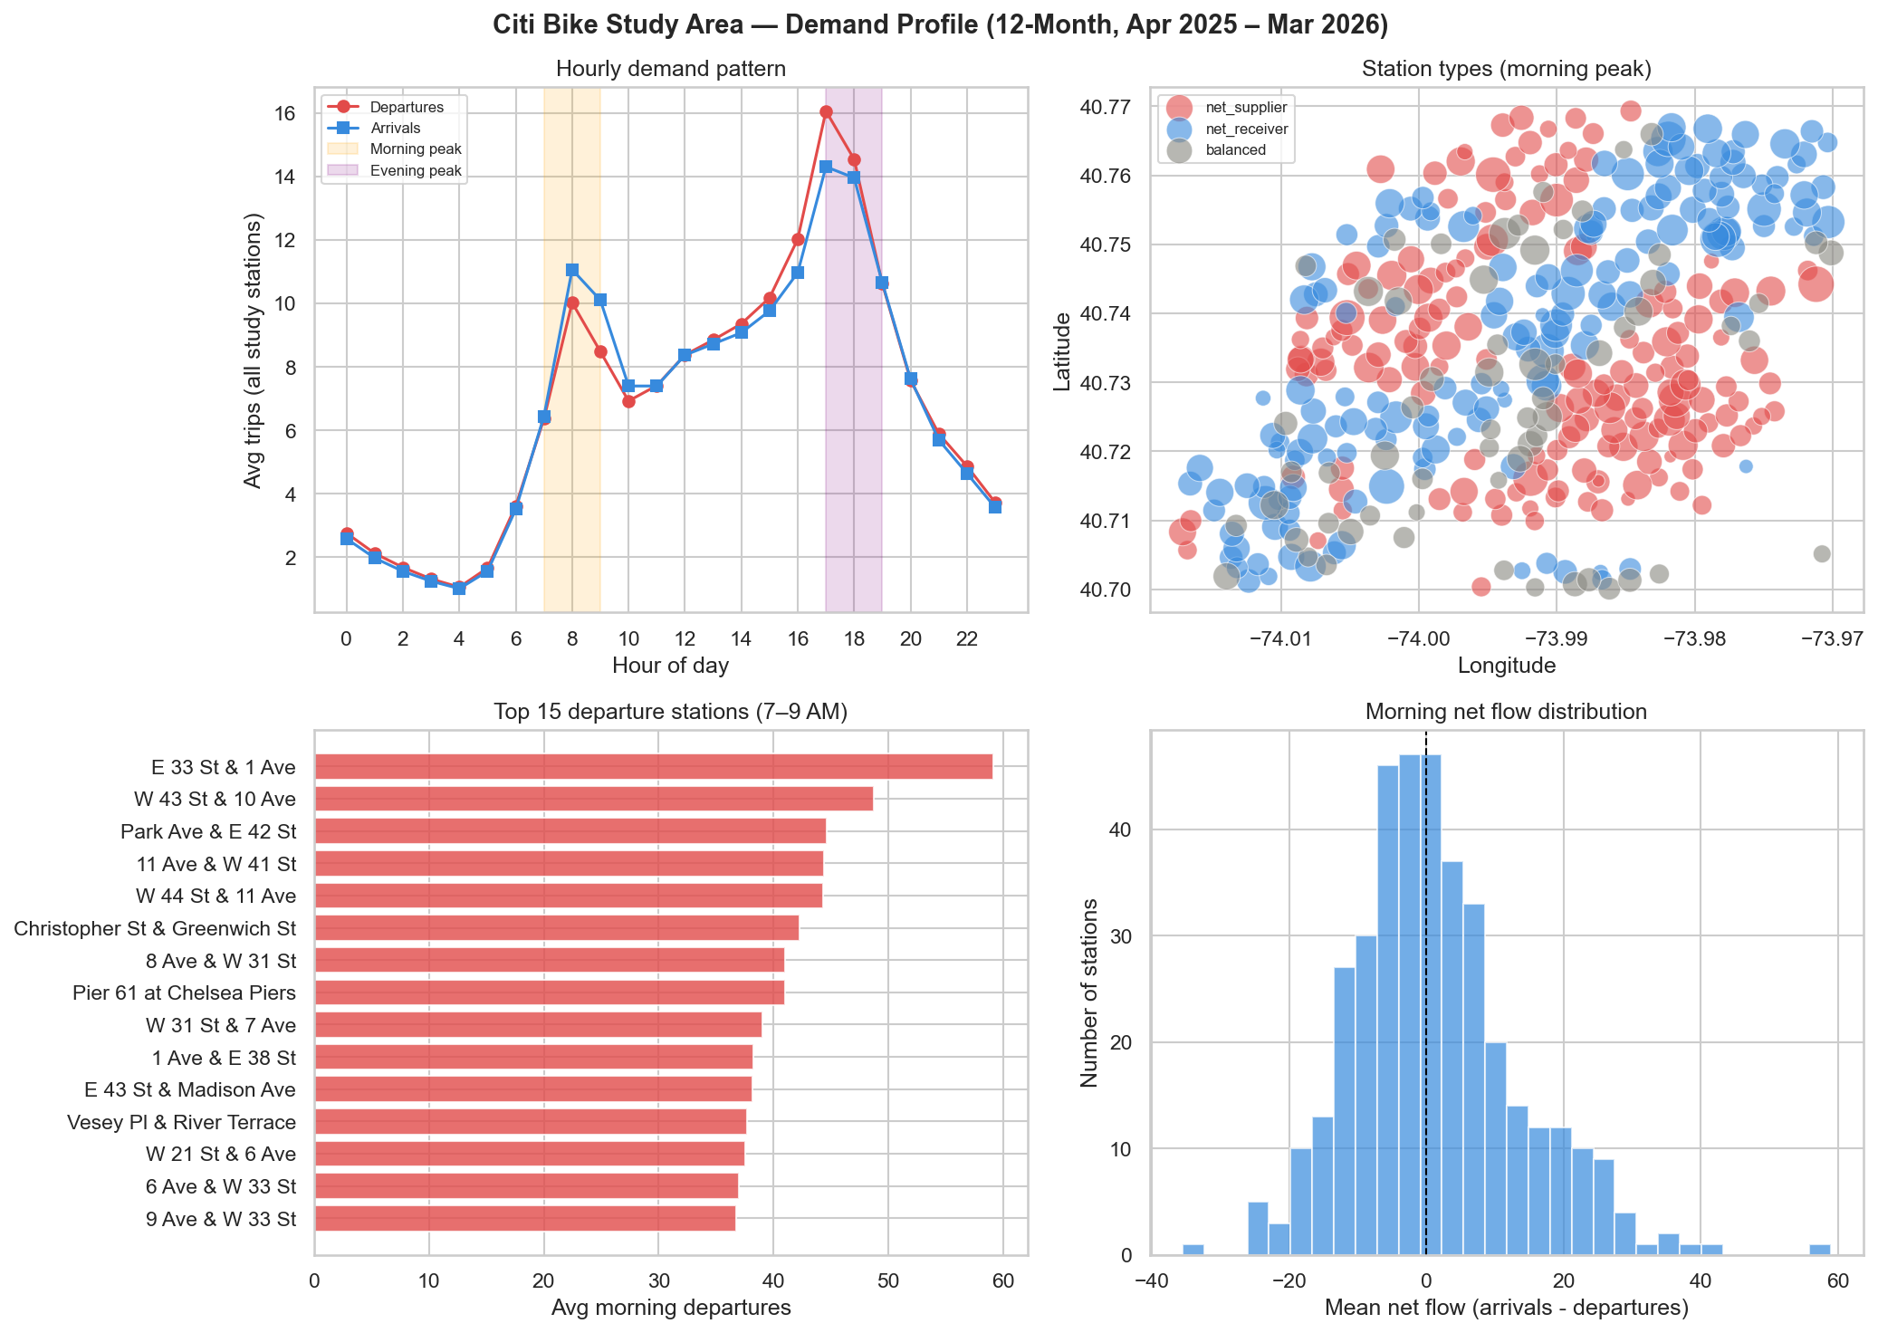
04
DEMAND PROFILING
12-month hourly demand patterns across 386 study-area stations. Clear AM/PM commuting asymmetry drives the rebalancing need.
NYU Stern — B60.2350 Decision Models & Analytics
6 / 20

Slide 7
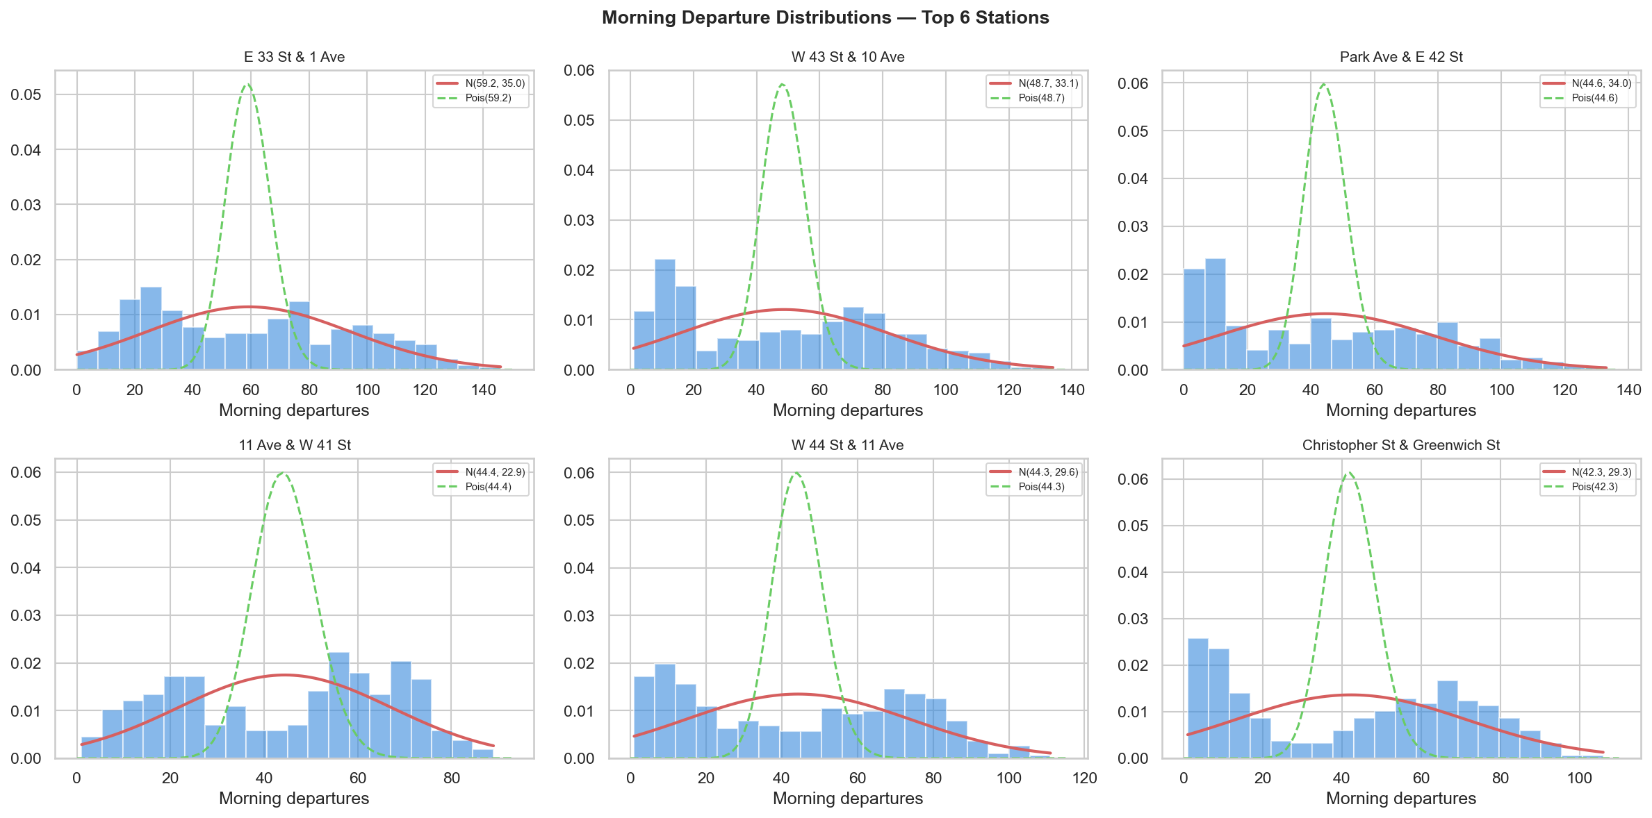
05
DEMAND DISTRIBUTIONS
We fit Poisson and Normal distributions to morning departure counts at each station. The Poisson model captures the discrete, count-based nature of bike departures, while the Normal provides a continuous approximation for high-volume stations.
Top 6 stations by morning departures — empirical histograms overlaid with fitted Poisson (green dashed) and Normal (red solid) distributions
NYU Stern — B60.2350 Decision Models & Analytics
7 / 20

Slide 8
06
STATION CLASSIFICATION
Stations are classified by their average morning net flow (arrivals minus departures) during the 7–9 AM peak:
Net Suppliers
163 stations (42%)
More departures than arrivals — bikes leave in the morning. Concentrated in residential neighborhoods (Upper East/West, Village).
Net Receivers
160 stations (41%)
More arrivals than departures — bikes accumulate in the morning. Located in business districts (Midtown, FiDi, Hudson Yards).
Balanced
63 stations (16%)
Roughly equal flow in both directions. Typically mixed-use areas or transit hubs with bidirectional commuting.
NYU Stern — B60.2350 Decision Models & Analytics
8 / 20

Slide 9
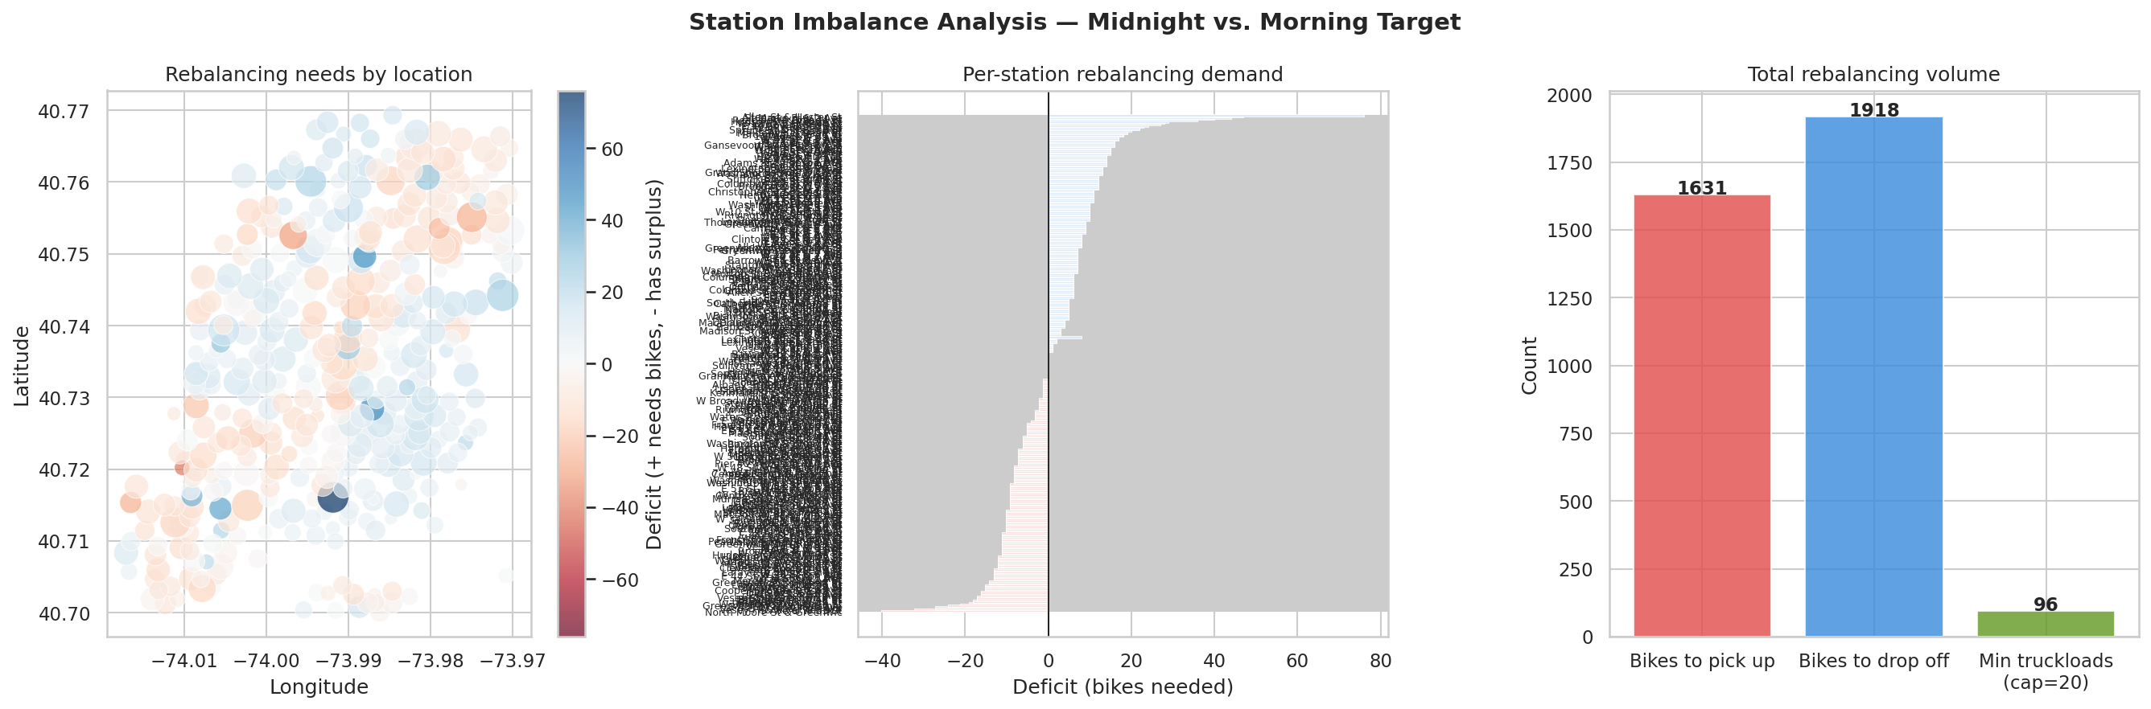
07
IMBALANCE ANALYSIS
1,631
1,918
3,549
Bikes to Pick Up
Bikes to Drop Off
Total Bikes
to Redistribute
NYU Stern — B60.2350 Decision Models & Analytics
9 / 20

Slide 10
08
COST OF INACTION
If Citi Bike performs no overnight rebalancing, the system faces significant morning service degradation:
DAILY IMPACT
ANNUALIZED
Lost trip revenue
$4.50/trip
$7,494
Customer dissatisfaction
$2.00/trip
per day
Brand damage multiplier
1.25x
$225K / month | $2.7M / year
Daily opportunity cost
$7,494
These costs include lost revenue from empty/full stations, customer churn risk, and competitive brand damage from unreliable service.
NYU Stern — B60.2350 Decision Models & Analytics
10 / 20

Slide 11
09
COST MODEL ASSUMPTIONS
OPERATIONAL COSTS
REVENUE & TIMING
Truck capacity
20 bikes
Avg load/unload time
12 min/stop
Fixed cost / truck / night
$450
Avg overnight speed
15 mph
Variable cost / mile
$3.50
Revenue per trip
$4.50
Driver wage
$35/hr
Dissatisfaction penalty
$2.00/trip
Overtime multiplier
1.5x (after 8 hrs)
Brand damage multiplier
1.25x
Fuel cost / gallon
$3.80
Rebalancing window
12 AM – 5 AM
Truck MPG
8 mpg
Morning peak
7 – 9 AM
NYU Stern — B60.2350 Decision Models & Analytics
11 / 20

Slide 12
10
OPTIMIZATION MODEL
We solve the overnight rebalancing as a Vehicle Routing Problem (VRP) using a three-stage heuristic approach:
1
Geographic Clustering
Stations are sorted by longitude and divided into equal-size geographic zones — one per truck. This ensures spatial compactness and minimizes cross-city driving.
2
Nearest-Neighbor TSP
Within each cluster, we construct an initial route using a greedy nearest-neighbor heuristic: always visit the closest unvisited station next. Pickups are sequenced before drop-offs.
3
2-opt Improvement
The initial route is refined using the 2-opt local search: iteratively reversing sub-tours to eliminate crossings and reduce total mileage, up to 100 iterations per route.
NYU Stern — B60.2350 Decision Models & Analytics
12 / 20

Slide 13
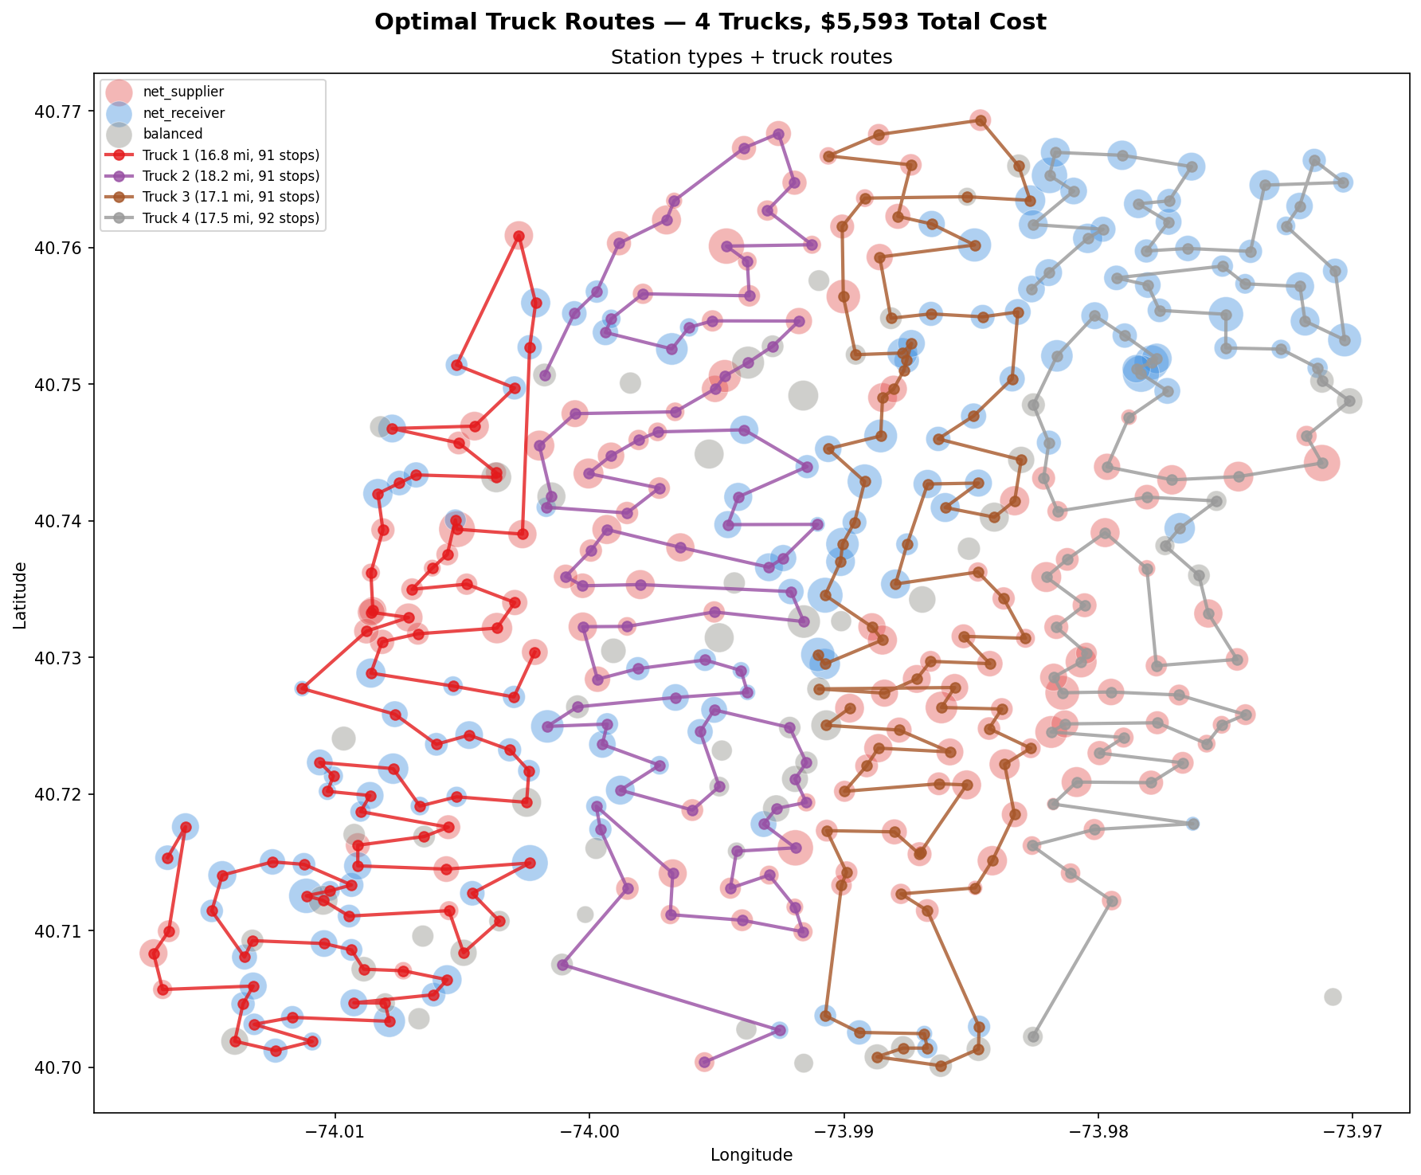
11
OPTIMAL TRUCK ROUTES
4-TRUCK SOLUTION
Truck 1
91 stops
16.8 mi
$1,391
Truck 2
91 stops
18.2 mi
$1,402
Truck 3
91 stops
17.1 mi
$1,393
Truck 4
92 stops
17.5 mi
$1,407
Total: 365 stops, 69.6 miles, $5,593/night
Balanced workload across all 4 trucks with geographic clustering
NYU Stern — B60.2350 Decision Models & Analytics
13 / 20

Slide 14
12
TRUCK COUNT SWEEP
We sweep truck counts from 1 to 8 to understand the cost-service tradeoff — analogous to a SolverTable sensitivity analysis:
Trucks
Cost/Night
Miles
Service Level
KEY INSIGHT
1
$4,614
63.1 mi
95.8%
1 truck captures 95.8% service at minimum cost. Each additional truck adds ~$330/night for < 0.1% service gain.
2
$4,944
65.8 mi
95.9%
3
$5,263
66.9 mi
96.0%
4
$5,593
69.6 mi
96.0%
5
$5,906
70.0 mi
96.1%
6
$6,221
70.7 mi
96.1%
7
$6,585
77.9 mi
96.2%
8
$6,930
82.6 mi
96.3%
NYU Stern — B60.2350 Decision Models & Analytics
14 / 20

Slide 15
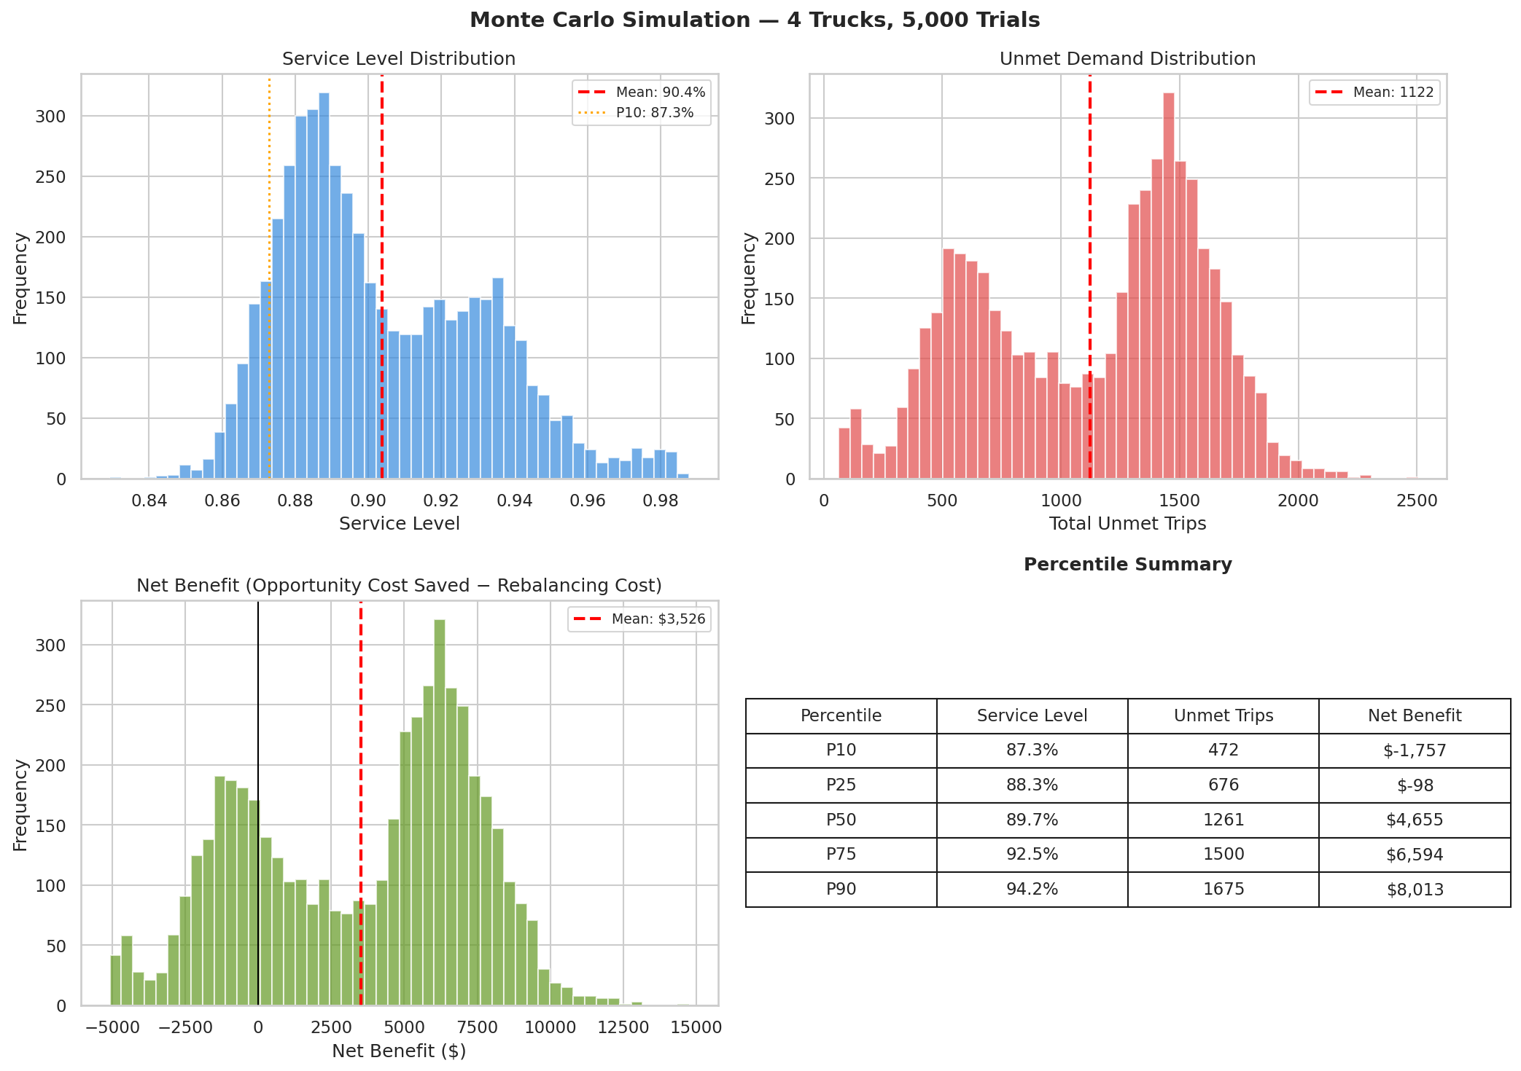
13
MONTE CARLO SIMULATION
We run 5,000 stochastic trials to capture the uncertainty in real-world demand. Each trial samples from fitted Poisson distributions with random weather effects (rain reduces demand 20–40%) and day-of-week multipliers.
Simulation output: service level distribution, cost distribution, net benefit histogram, and unmet trip analysis across 5,000 trials
NYU Stern — B60.2350 Decision Models & Analytics
15 / 20

Slide 16
14
SIMULATION RESULTS
90.4%
$3,526
74.1%
Mean Service Level
Mean Net Benefit
per Night
Probability of
Positive Net Benefit
Metric
P10
P25
Median
P75
P90
Service Level
87.3%
88.3%
89.7%
92.5%
94.2%
Net Benefit
-$1,757
$1,884
$4,655
$6,289
$8,013
NYU Stern — B60.2350 Decision Models & Analytics
16 / 20

Slide 17
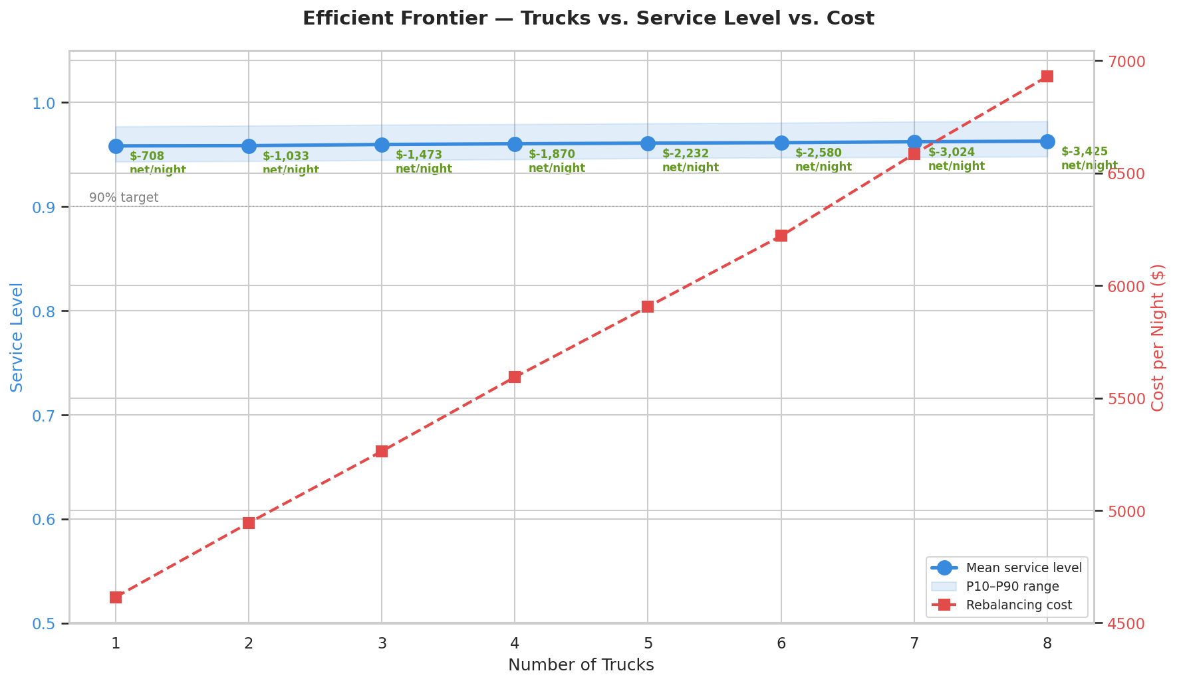
15
EFFICIENT FRONTIER
The efficient frontier maps the cost-service tradeoff across fleet sizes. Diminishing returns are steep: moving from 1 to 2 trucks costs $330/night but improves service by < 0.1%. The knee of the curve suggests 1–2 trucks capture nearly all achievable benefit.
NYU Stern — B60.2350 Decision Models & Analytics
17 / 20

Slide 18
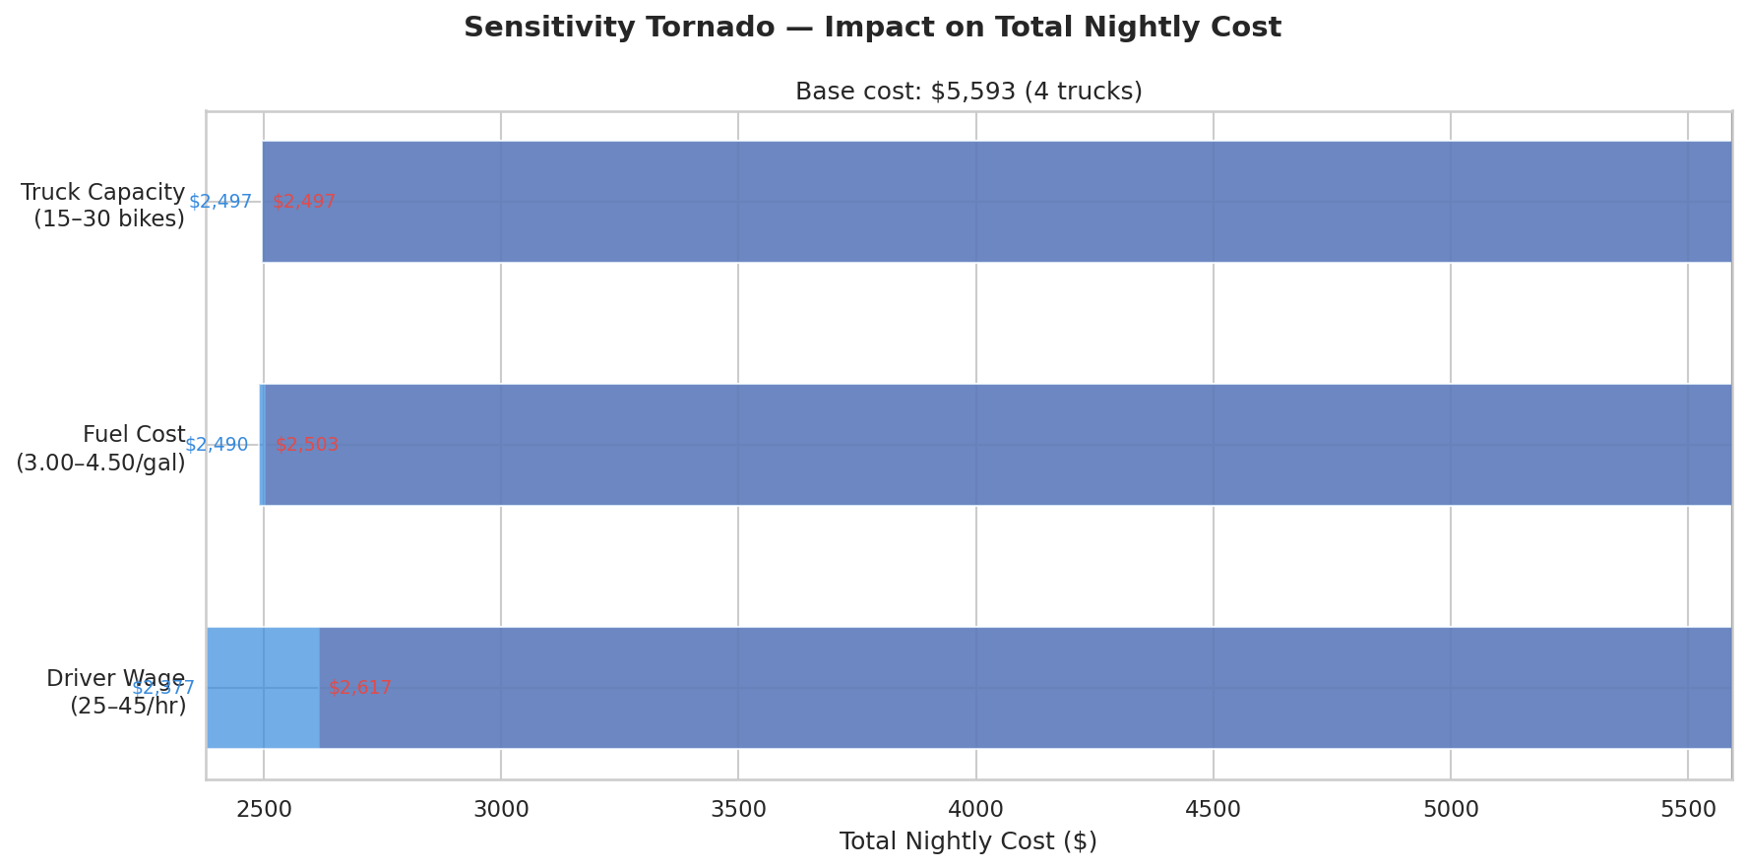
16
SENSITIVITY ANALYSIS
Tornado diagrams reveal the parameters with greatest impact on net benefit. Truck capacity and fuel cost dominate — a fleet of higher-capacity trucks would dramatically shift the economics. Driver wages and variable mileage costs are secondary drivers.
All parameters varied ±20% from base case while holding others constant
NYU Stern — B60.2350 Decision Models & Analytics
18 / 20

Slide 19
17
RECOMMENDATION
Deploy 1–2 rebalancing trucks nightly as a cost-effective starting point, with a phased scale-up based on observed service improvements.
1 truck achieves 95.8% service level at $4,614/night — the most efficient point on the cost curve. The Monte Carlo simulation confirms a 74% probability of positive net benefit at 4 trucks ($3,526/night average), providing a clear upper bound for scaling.
Start Lean
Begin with 1 truck targeting the highest-deficit stations. At $4,614/night, this is the minimum viable rebalancing operation with near-maximum service coverage.
Measure & Scale
Track actual morning availability improvements and rider satisfaction. If empirical service gains exceed model predictions, expand to 2–3 trucks.
Invest in Capacity
Sensitivity analysis shows truck capacity is the dominant cost driver. Upgrading from 20 to 25-bike trucks would improve economics more than adding fleet units.
Dynamic Routing
Integrate real-time dock status (GBFS feed) to enable adaptive routing — rerouting trucks mid-shift based on actual overnight usage patterns.
NYU Stern — B60.2350 Decision Models & Analytics
19 / 20

Slide 20
LIMITATIONS & FUTURE WORK
1.
Heuristic routing (NN + 2-opt) provides good but not provably optimal solutions — exact MIP formulations could improve by 5-15%
2.
Opportunity cost model uses aggregate estimates; micro-level rider behavior data (churn rates, substitution patterns) would refine the business case
3.
Static overnight rebalancing only — does not account for dynamic intra-day repositioning or e-bike/scooter substitution
4.
Weather effects modeled as simple demand multipliers; a richer model would incorporate temperature, precipitation intensity, and seasonal daylight
5.
Station capacity treated as fixed — future work could optimize dock expansions jointly with rebalancing operations
THANK YOU
Questions?
Paul Garofalo | paulgarofalo05@gmail.com | NYU Stern Spring 2026

