Slide 1

Sinhgad College of Engineering
Department of Computer Engineering
MINI PROJECT REPORT
ON
“ANALYSIS OF ENERGY CONSUMPTION IN INDIA”
Subject - Skill Development Laboratory
(T.E Computer Engineering)
Guided By -
Prof. Sakeeb Shaikh
Internal Guide
Department of
Computer Engineering
Presentation By-
Shrayank Mistry. Roll no:305236
Parag Nankar. Roll no: 305240
Gaurav Patil. Roll no: 305241
Prathamesh Tambe. Roll no: 305258

Slide 2
Contents
Title Page
Abstract
Problem Statement
Software and Hardware Requirement
Methodology
Results and Discussion
Conclusion
Refrences

Slide 3
Abstract
Energy is one of the most important resources available to man and it is necessary to keep a check on the growing need of energy day by day.
The Issue of availability of Energy is getting prominent these days. So to analyze the consumption of energy and production of Energy via available Energy Resources is important.
The project describes the consumption of energy resources of all states of India of last few years with respect to the population of India state wise and predicts the future energy requirements for every states.

Slide 4
Problem Statement
“Analysis of Energy Resources and Population of every state of India using Python and Prediction of Energy using Machine learning.”

Slide 5
INTRODUCTION
India is a growing economic superpower. At this point in time, we are sitting at the tip of our economic explosion. The vast reserves of resources in all factors of production have earned us the title of The Land of Potential. But this comes at a cost, with this growing potential comes the need to satisfy the potential through generation of energy.
To meet this challenge of growing energy is very important for India and it is even more important to predict the future requirements of energy in our country.
If we are able to predict the energy required in the future it will boost the potential of the country and increase the overall growth in every field

Slide 6
Background and Basics:
Programming language Python is very useful for analysis of data in every field.
Python has been used to show the analysis of data in diagrammatical format like Pie Chart, Bar Chart, Multiple Bar Chart.
It also shows map of India with respect to intensity of the Energy Consumption as well as Population of India state wise. By using Machine Learning.
We have predicted the requirement of amount of energy for every state using The Linear Regression Machine Learning Algorithm. It uses two parameters on the outcome and one on which the outcome depends
Population has been used as a parameter on which energy depends
Future Use
This program gives clear idea about the energy requirement in Future.

Slide 7
Software and Hardware Requirement
Details of software
Python
Anaconda (Spyder) IDE
Required Python Libraries:
Numpy
Pandas
Matplotlib
Tkinter
PIL
Mpl_toolkits.basemapDetails of hardware
Details of Hardware
Working PC

Slide 8
>Flow Charts
Machine learning algorithm
def evaluate_algorithm
(dataset,algorithm,train,test)
Machine Learning Algorithm
test_set = list()
for row in test
row_copy = list(row)
row_copy[-1] = None
test_set.append(row_copy)
Predicted = algorithm (train,test_set)
return predicted
End for
End

Slide 9
Concept of Simple Linear Regression
def simple_linear_
regression(train,test)
predicted = list()
b0,b1 = coefficient(train)
for row in test
End for
yhat = b0 + b1 * row[0]
predictions.append(yhat)+
return predictions
End

Slide 10
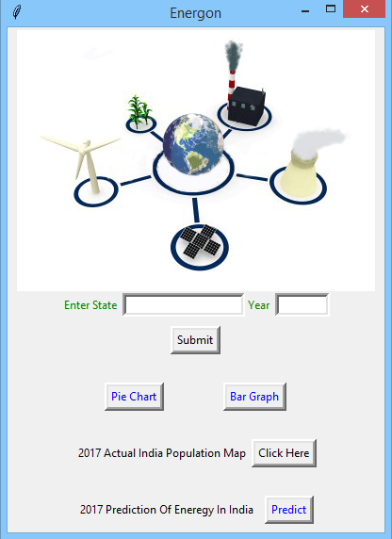
Methodology

Slide 11
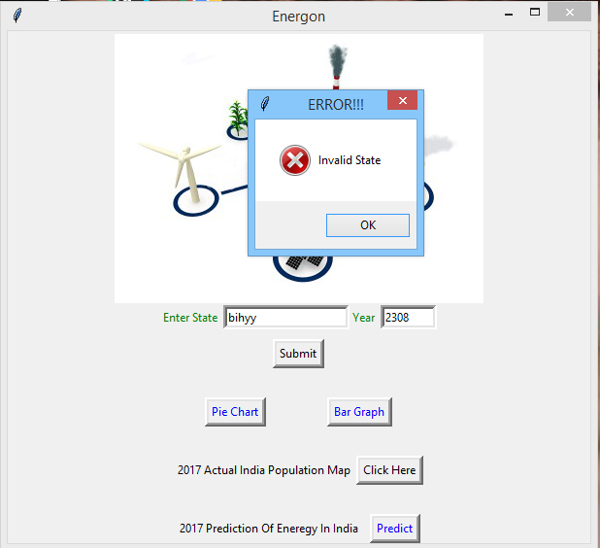
The SUBMIT button on the GUI checks the avaliability of state i.e.it checks the correct state.

Slide 12
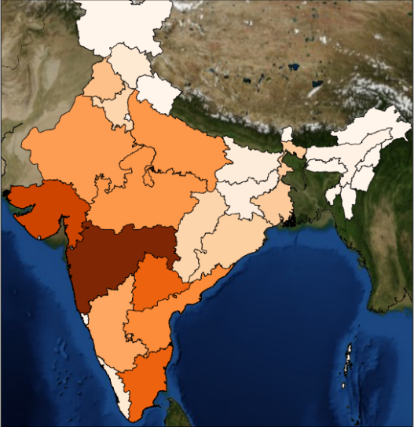
The PREDICT button plots the map of india and shows
the intensity wise energy distrbution.

Slide 13
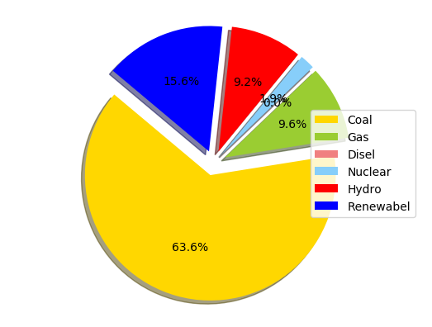
The PIE Chart on the GUI plots the energy resource required percentage wise.

Slide 14
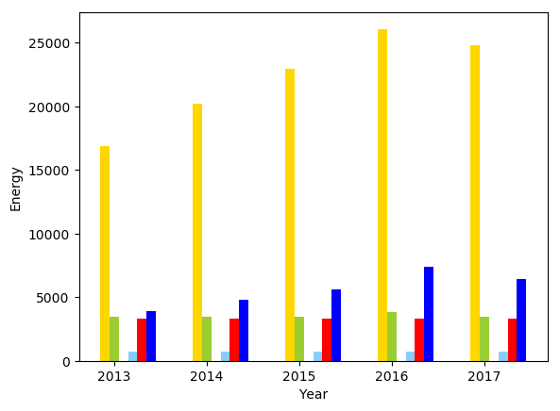
The BAR Chart on the GUI plots the energy resource required percentage wise.

Slide 15
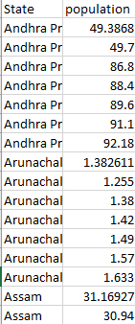
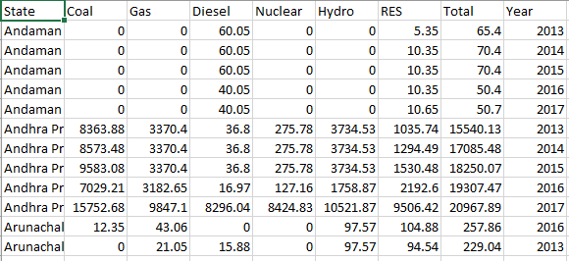
Flow of Project
Our projects takes dataset of population from the year 2013 to 2017 and energy requirements in India per state from the year 2013 to 2016.
Dataset For Energy Resources
Dataset For Population

Slide 16
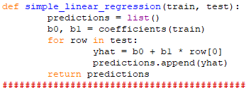
The data from every set from the year 2013-16 has been used in order to train the machine using linear Regression and data from 2017 for population has been used in order to test the model to predict the future requirement of energy.
This Function uses the Linear Regression the find 2 coefficients from the test Dataset that are used to predict the outcome using the train data

Slide 17
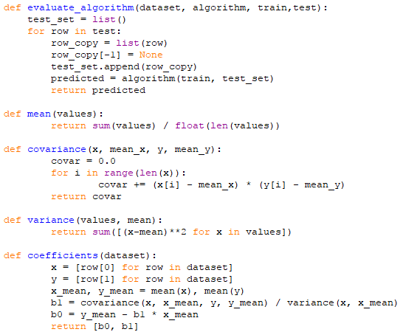
This function uses all datasets and
Passes them to the machine learning
Algorithm.
This function evaluates the
Mean.
This function evaluates the
Covariance.
This function evaluates the
Variance.
This function finds the coefficients
b0 and b1 that are useful to predict
Outcomes.

Slide 18
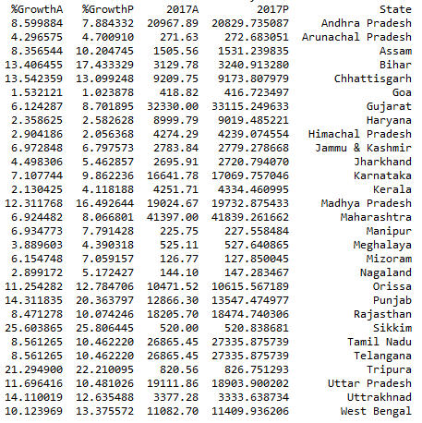
The energy requirements predicted as well as actual have been represented using the map of India i.e. greater the intensity on the map higher the energy requirement for that state, bar chart and Pie chart.

Slide 19
Results and Discussion
Pie Chart of Energy Resources of Maharashtra Year 2015
Resource wise Production of energy

Slide 20
Results and Discussion
Map of India according to energy consumption

Slide 21
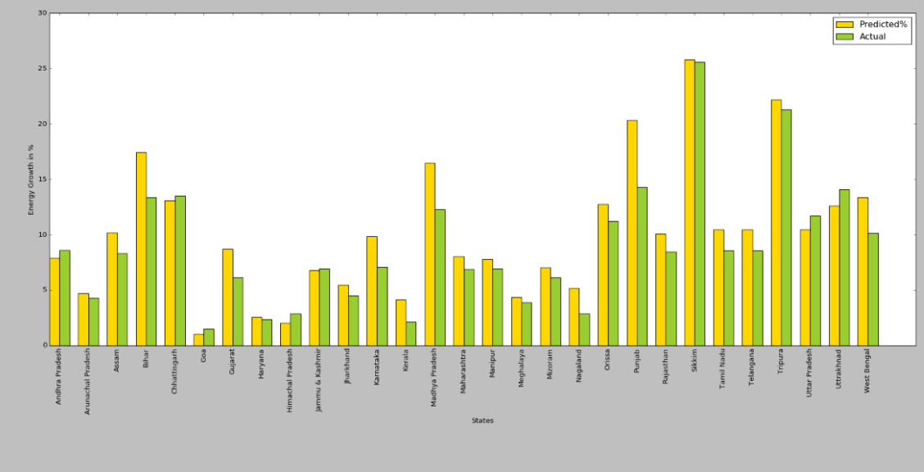
Conclusion
We have used python to show the analysis of data in diagrammatical format like Pie Chart, Bar Chart, Multiple Bar Chart.
It also shows map of India with respect to intensity of the Energy Consumption as well as Population of India state wise.
By using Machine Learning, we have predicted the requirement of amount of energy in the specified year for each state in India.
Technologies used in project are Python, Machine learning, Data Analysis.
This program gives clear idea about the energy requirement in Future.

Slide 22
References
Book
[1]Trevor Hastie, Robert Tibshirani. ESL II, 2nd Edition, Spinger Publication.
[2]Martin C.Brown. Python Complete Reference.
World Wide Web
[1]www.python.org
[2]www.stackoverflow.com
[3]www.datacamp.com
[4]www.data,gov.in

