Slide 1

QUnit
JS Unit Testing
http://qunitjs.com/
http://github.com/jquery/qunit

Slide 2
QUnit
Framework de tests unitaires très simple et léger
Développé à l'origine par John Resig (jQuery)
    Devenu public en 2008
Tests lancés dans le navigateur
Format xUnit
Extensible (plugins)

Slide 3

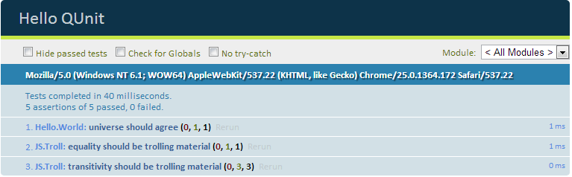
QUnit
Très simple d'utilisation :
qunit.html
tests.js
<html>
<head>
<title>Hello QUnit</title>
<link rel="stylesheet" href="/qunit.css">
</head>
<body>
<div id="qunit"></div>
<div id="qunit-fixture"></div>
<script src="/qunit.js"></script>
<script src="/tests.js"></script>
</body>
</html>
module("Hello.World");
test("universe should agree", function() {
ok(42==42, "probably true");
});
module("JS.Troll");
test("equality should be trolling material", function() {
equal('\n\r\t' , 0, "a whitespace string is equal to zero");
});
test("transitivity should be trolling material", function() {
equal(0, "", "zero is equal to empty string");
equal(0, "0", "zero is equal to the strong '0'");
notEqual("", "0", "the empty string is not equal to the '0' string");
});
Résultat

Slide 4
Assertions
Peu nombreuses :
    ok()
    equal()
    deepEqual()
    strictEqual()
    throws()
    notEqual / not[...]
    et c'est tout...
// ok()
ok(3 > 2); // pass
ok(1==2); // fail
// equals()
equal("same value", "same value"); // pass
equal("some value", "another value"); // fail
// deepEqual()
var a = { someValue : 2 };
var b = { someValue : 2 };
equal(a, b); // fail because a and b have not the same reference.
deepEqual(a, b); // pass because a and b have the same attributes.
// strictEqual()
equal(1, true); // pass because (1==true) is true
strictEqual(1, true); // fail because (1===true) is false"
// throws()
throws(function() {
throw "thrown";
}, "thrown"); // pass because expected exception is raised.

Slide 5
Tests asynchrones
Utilisation de asyncTest et de start
asyncTest("stuff and remote work loading", function() {
var stuff = new Stuff();
ok(!stuff.readyToWork);
$.get("/some/work/url", function(work) {
stuff.loadWork(work);
ok(stuff.readyToWork);
start(); // telling the test to start.
});
});

Slide 6
Ecosystème
// assertion definition
QUnit.extend( QUnit.assert, {
/**
* given number should be strictly greater than given minimum
*/
greaterThan : function(number, minimum, message) {
QUnit.push(number > minimum, number, ">" + minimum, message);
}
});
// [...] using the assertion in a test
test("testing my assertion", function(assert) {
var five = 5;
var three = 3;
assert.greaterThan(five, three, "5 should be greater than 3");
});
Plugins divers :
Assertions (canvas, html...)
Runners (junit)
Integration (drupal, rails)
Framework integration (sinon, jsTestDriver)
Themes
Définition d'une assertion

