Slide 1

Automotive CAN Node for Smart Defogging and Adaptive Headlight Control
Guided by: | Submitted by:
 | Name: K. Dhanashree PRN: 250240130009
 | Name: U. Poonam PRN: 250240130024
 | Name: R. Vaishnavi PRN: 250240130029
 | Name: D. Sakshi PRN: 250240130030
 | Name: A. Shivangi PRN: 250240130034

Slide 2
Problem Statement
Problem 1: Fog-Induced Visibility Obstruction Fog forms on the windshield due to temperature & humidity difference. Manual defogging distracts the driver and delays response time.
Need: Automatic detection of high humidity & activation of defogger.
Problem 2: Improper Headlight Usage Drivers forget to switch headlights in low-light conditions (tunnels, dusk, fog). Unnecessary high-beam use causes glare to oncoming traffic.
Need: Intelligent detection of ambient light & vehicle distance for adaptive headlight control.

Slide 3
Objectives
Sensor Integration
Real-time Data Processing
CAN Communication Implementation
Adaptive Headlight Control
Smart Defogging System

Slide 4
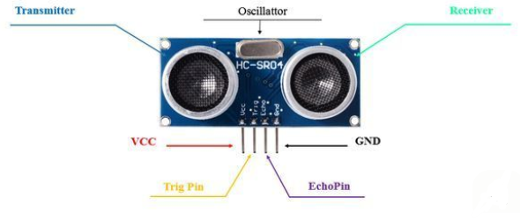
HC-SR04 Ultrasonic Sensor
Purpose:
Proximity detection of oncoming vehicles
Principle:
Time-of-flight of 40 kHz ultrasound
Specs:
Range: 2–450 cm
Trigger: 10 µs TTL pulse
Echo: pulse width 4 m distance
Integration:
TRIG/ECHO to STM32 GPIO, input capture

Slide 5
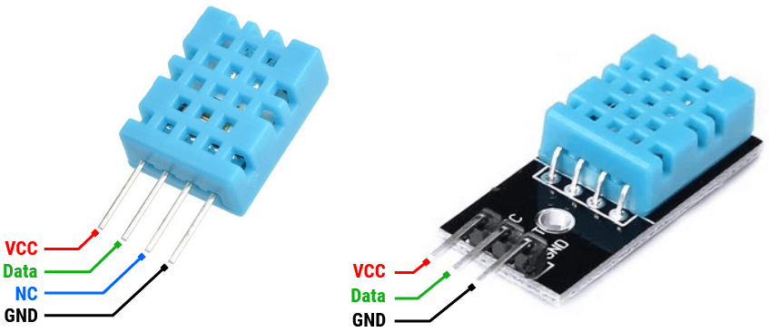
DHT11 Temperature & Humidity Sensor
Purpose:
Detect cabin humidity & temperature for fog-risk assessment
Principle:
Resistive humidity + NTC thermistor
Specs:
Humidity: 20–90% RH ±5%
Temp: 0–50°C ±2°C
Integration:
Single-wire + pull-up resistor

Slide 6
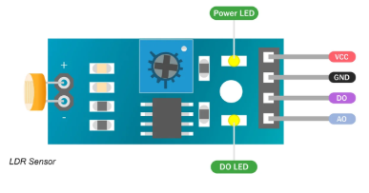
Light Dependent Resistor (LDR)
Purpose:
Detects ambient light for headlight control.
Principle:
Resistance decreases as light intensity increases.
Specs:
High resistance in dark, low in light
Integration:
Uses a voltage divider circuit to give ADC an input.

Slide 7
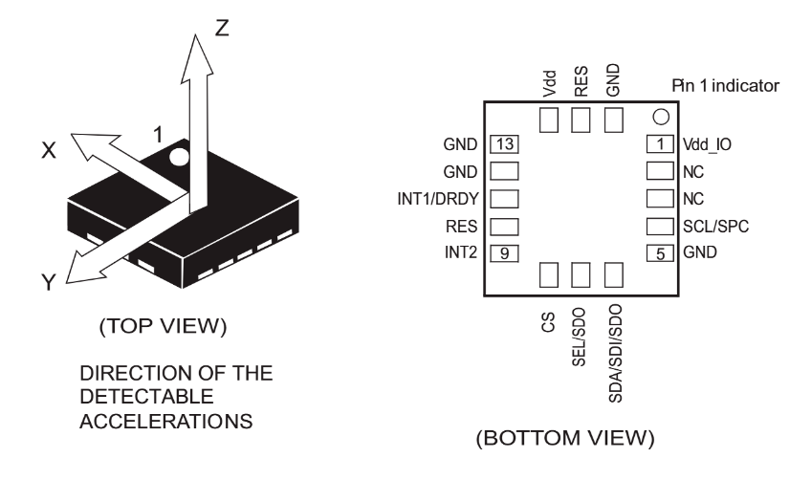
3-Axis Accelerometer (LIS3DSH)
Purpose:
Detect vehicle motion/tilt
Principle:
Measures acceleration using MEMS capacitive sensing.
Specs:
- has a 16-bit ADC for high resolution
- a Digital Motion Processor (DMP) for data fusion.
Integration:
Connects to STM32 via SPI protocol and is interrupt-based.

Slide 8
CAN
A CAN network is a system network made up of CAN node ( electronic control units with a CAN interface) which exchange data with another over their individual CAN interfaces and a transmission medium (CAN bus) that interconnects all the CAN interfaces.
Why CAN?
Robustness and Reliability
Real-Time Communication
Multi-Master Architecture
Efficiency
Widely Supported
CAN Protocol in Automotive Industry
Used due to Reduced Wiring, Robust in noisy environments, Real- Time performance, Scalability and Interoperability
Application using CAN: Engine Control, Transmission Control, Anti-Braking System, Body Control, Airbag Control Module
CAN Bus Type: High Speed CAN(up to 1Mbps), Low Speed CAN(~125 kbps), CAN FD(up to 8Mbps)
Future Aspects : Automotive Ethernet

Slide 9
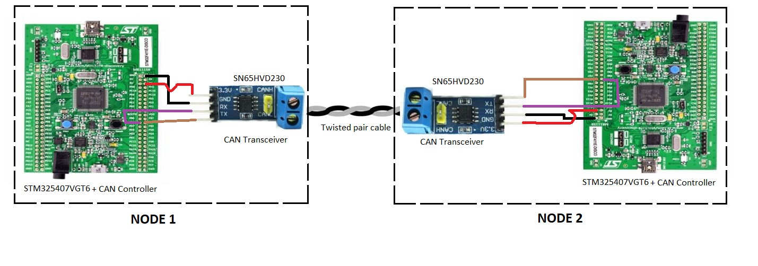
CAN Controller Network Communication in Project

Slide 10
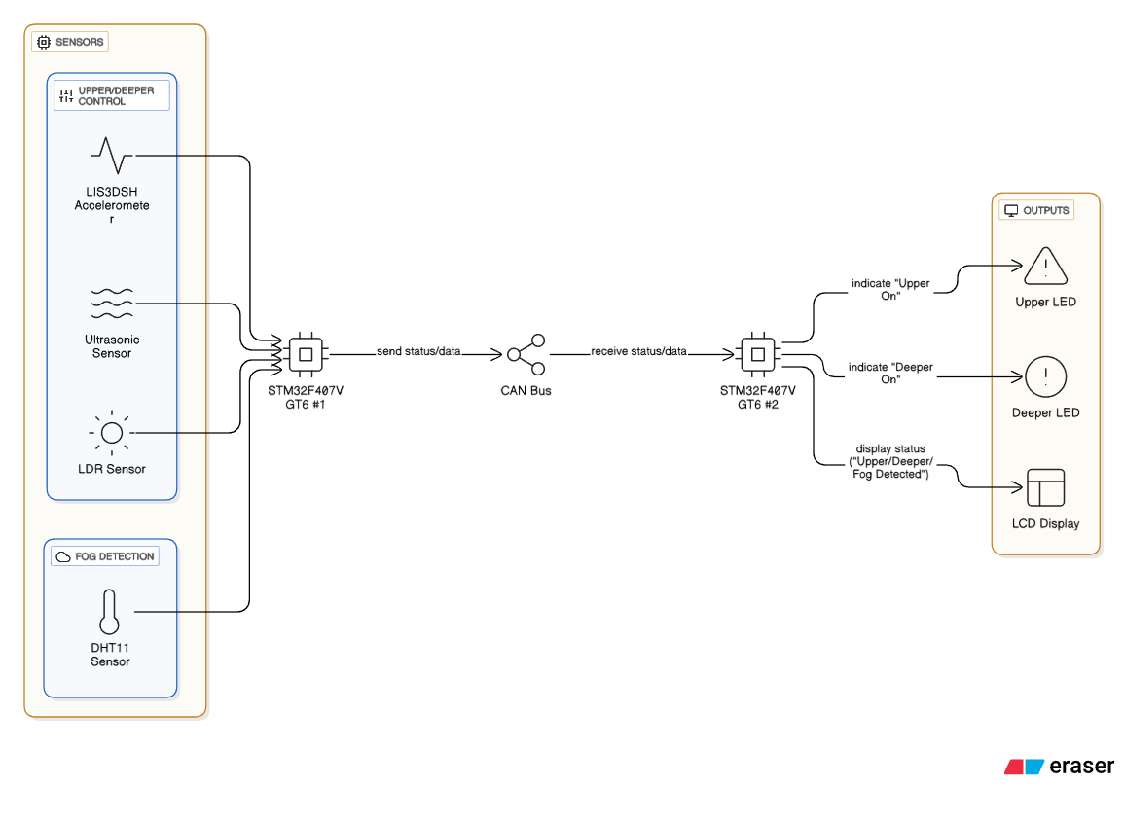
System Block Diagram

Slide 11
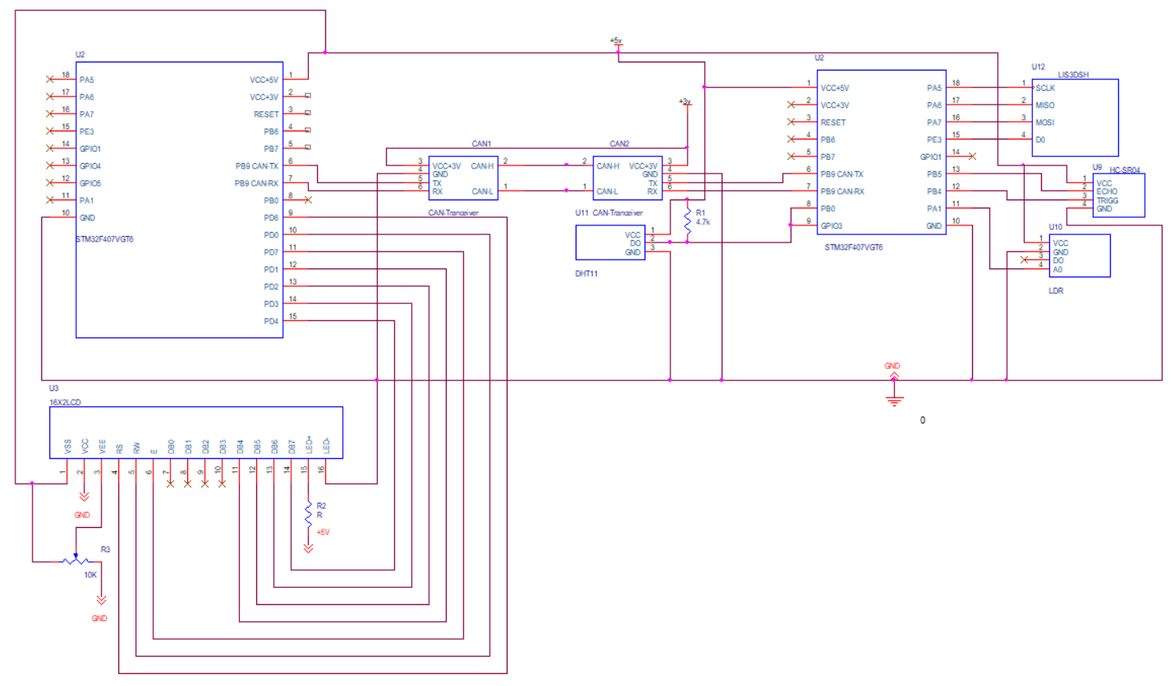
Circuit Diagram

Slide 12
Conclusion
Robust sensor integration via CAN for safety.
Functional Adaptive Headlight Control
Effective Smart Defogging System
Future Enhancements
• Replace DHT11 with DHT22
• ECU integration & in-vehicle testing
• Add rain/lightning sensors for full adaptability

Slide 13
Thankyou

