Slide 1

AMCAT Data Set EDA

Slide 2
About me
NAME: POTUKA GEETHA
Intern Id :IN1240707
DEGREE : BACHELOR OF SCIENCE (Statistics )
After my graduation I found interest om IT Domine . I start knowing about current trades and industries happenings ,so finally I applied for Data science course in Innomatics Research labs.
LinkedIn : https://www.linkedin.com/in/p-geetha-reddy-32734a24a/
GitHub : https://github.com/pgeethareddy

Slide 3
Objective :
To find the insights and decide the patterns on how the salary pay scale is impacted based on various parameters like Age , Years of Work Experiences, academic achievements etc..
Summary of the Dataset:
1.There are total of 38 columns that are used to find their individual impacts on salary.
2.With 3998 data points that make our analysis to the optimal insights with all the required information

Slide 4
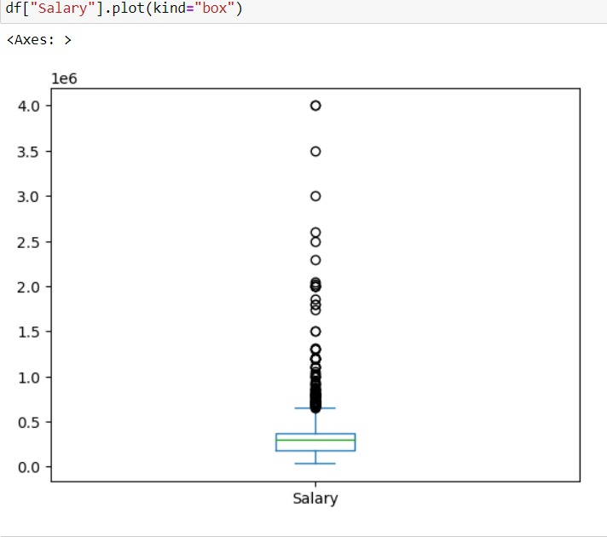
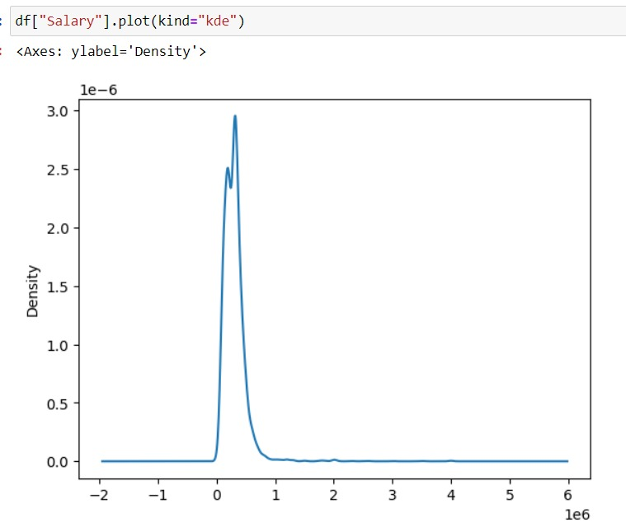
UNIVARITE ANALYSIS
Salary Column
Mean:307699.84
Median:300000
Min:35000
Max:4000000
Skew:6.4510811
Std:212737
“The salary range spans from 35k to 40 lakhs, with a median of 307,699, and follows a right-skewed distribution.”

Slide 5
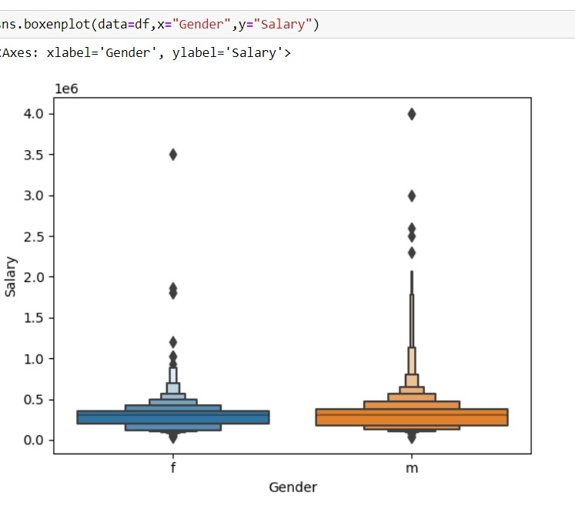
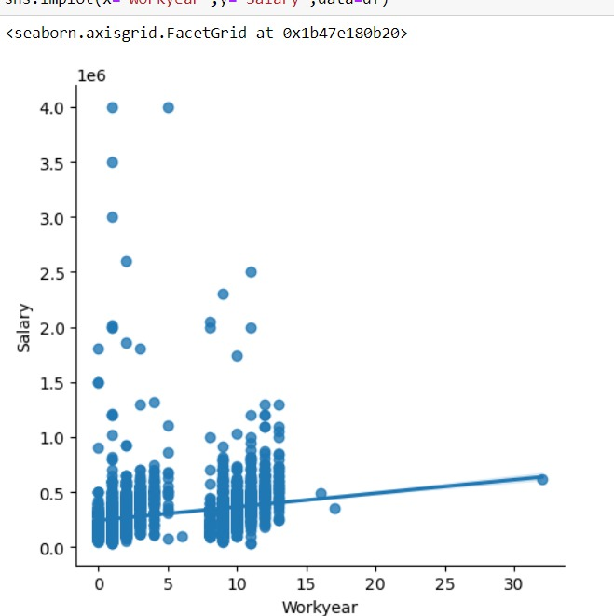
Bivariate Analysis
Salary V/s Gender
Salary V/s Work Year
Male has Higher Median Salary when compared to Female
F-Female
M-Male
A slight increase for work experience and salary.And there is a good pay scale for the freshers

Slide 6
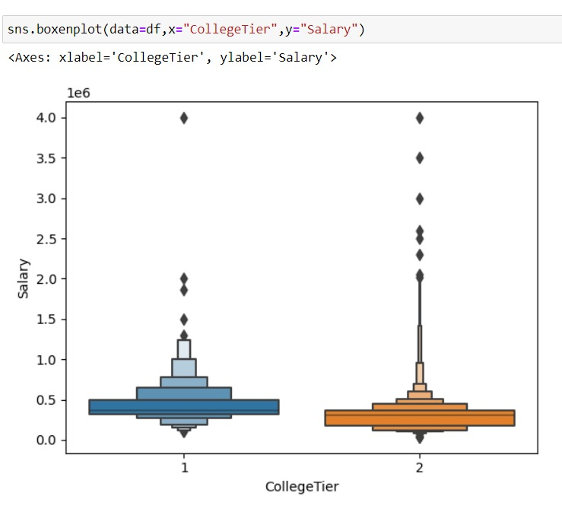
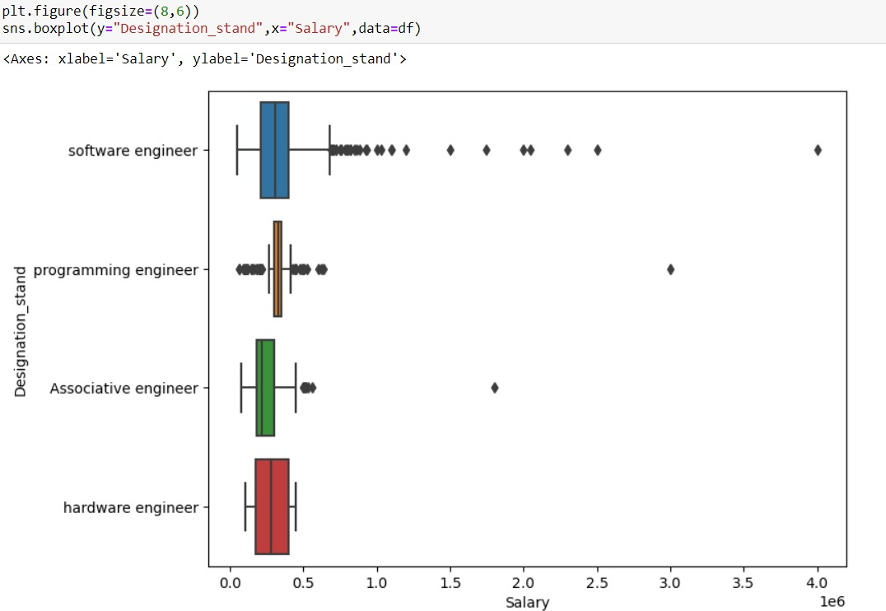
Salary V/s College Tier
Designation V/s Salary
This plot suggests attending a tier 1 college may leads to higher salary.
“It seems that software engineers are earning more than those in other engineering streams.”

Slide 7
Conclusion:
1.Males are earning more salary than females.
2.There is a good pay for freshers also And for work experience people also earning more money
3.Tier 1 college graduates have chance of getting more salary pay.
4.Software engineers are earning More salary.

Slide 8

THANK YOU

