Slide 1


Business Approach
Manual Reporting
Individual Report X₁
Manual Data Entry
Copy Paste
“Master”
Template
Individual Report X₂
Monthly
Email
Final
Data
Individual Report X_{n}

Slide 2



Data Science Approach
Current Solution Allows for:
Reduced Manual Data Entry Tasks
Efficient Operational Dashboards
Semi-Automated Reporting
Individual Report X₁
Manual Data Entry
“Master”
Template
Individual Report X₂
Run Python Script
Update Database
Power BI
Dashboard
Individual Report X_{n}

Slide 3
Business Approach
Manual Reporting
Individual Report X₁
Manual Data Entry
Copy Paste
“Master”
Template
Individual Report X₂
Monthly
Email
Final
Data
Individual Report X_{n}
Data Science Approach
Current Solution Allows for:
Reduced Manual Data Entry Tasks
Efficient Operational Dashboards
Semi-Automated Reporting
Individual Report X₁
Manual Data Entry
“Master”
Template
Individual Report X₂
Run Python Script
Update Database
Power BI
Dashboard
Individual Report X_{n}

Slide 4

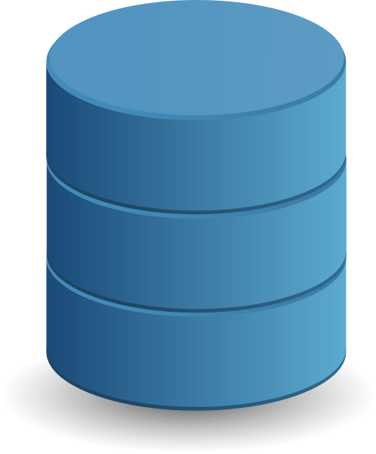

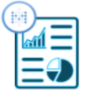

Business Approach
Manual Reporting
Individual Report X₁
Manual Data Entry
Copy Paste
“Master”
Template
Individual Report X₂
Monthly
Email
Final
Data
Individual Report X_{n}
Semi-Automated Reporting
Data Science Approach
Individual Report X₁
Manual Data Entry
Individual Report X₂
“Master”
Template
Run Python Script
Update Database
Power BI
Dashboard
Individual Report X_{n}
Recommended Next Steps Solution
Integrated Solution
Controlled Data Entry
Directly to Database
Every N min
API/APP
Data Lake
Airflow
ETL
Data
Warehouse
Ready-to-use
Dashboards

