Slide 1
Company X - Tobacco Industry
WORK IN PROGRESS - PRESENTATION SKELETON ONLY
Analysing Retailers and Salesman Performance
Pedro Geirinhas
https://github.com/pgeirinhas

Slide 2
Analysing Retailers and Salesman Performance: Agenda
Introduction & Business Problem
Data Analysis
Data Limitations
New KPIs
Findings & Results
New Dashboard
Conclusions
Next Steps / Recommendations
WORK IN PROGRESS - PRESENTATION SKELETON ONLY

Slide 3
Introduction & Business Problem

Slide 4
Data Analysis - Limitations
Current Dataset creation
Insert diagram
Manual entry
Time consuming
Prone to error
Better alternatives can be considered (API/APP)

Slide 5
Data Analysis - Limitations
WORK IN PROGRESS
Dynamic industry - too many external dependencies (e.g.: marketing campaigns, new legislation) to be able to determine increased sales without control group.
A/B testing is required to make more confident and exploratory statistical inferences and conclusions about experiment (provide control-group recommended sample size, sample type and running-time of experiment).
Note: could also use survey or NPS tool (if already available) to get more data for additional statistics
Currently, from data available, insights show possible positive impact. Attention: correlation does not imply causation:
Population
Control Group
Retailers | # Retailers | Average Δ
Zone X | 20 | -0.1
Zone Y | 25 | 0
Zone Z | 22 | 0.1
# Retailers | Average Δ | Δ Sale
100 | 0.5 | 0.5
200 | 1.3 | 1.3
150 | 0.3 | 0.1

Slide 6
Data Analysis - New KPIs
WORK IN PROGRESS
Given KPIs
# Incentives per Retailer: incentives objective set by company
Cost €: how much company paid retailer in € for reaching their incentives
Incentives Achieved (#): how many incentives the retailer achieved
Newly Created KPIs
Coverage %: Incentive Achieved (#) / # incentives per retailer
Incentive Δ %: increased incentives over period
Average Sales Δ (#): average sales increase # over period
Average Sales Δ (%): average sales increase % over period
Incentive Δ Cost (€): Cost / (Average Incentive Δ * #Incentive per Retailer)
Assumption: Incentive Δ = Retailer Δ

Slide 7
Data Analysis - New KPIs
WORK IN PROGRESS
In practice: *(transpose table below, think about showing critical KPIs only)

Slide 8
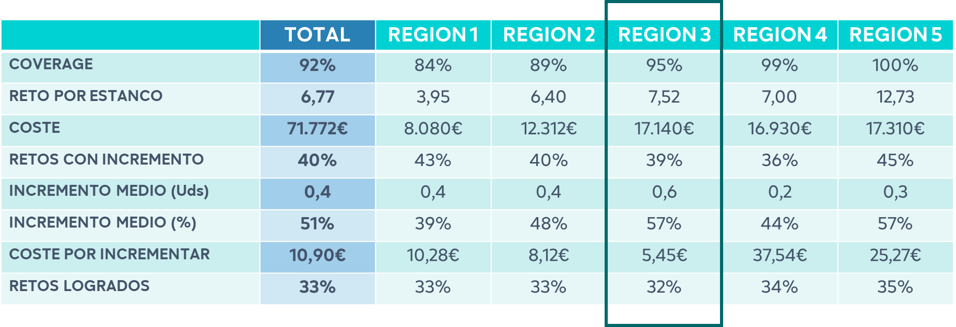
Data Analysis – Findings and Results A
WORK IN PROGRESS
Currently: Cost to Increase = 10.9€
Region 3 has best performance

Slide 9
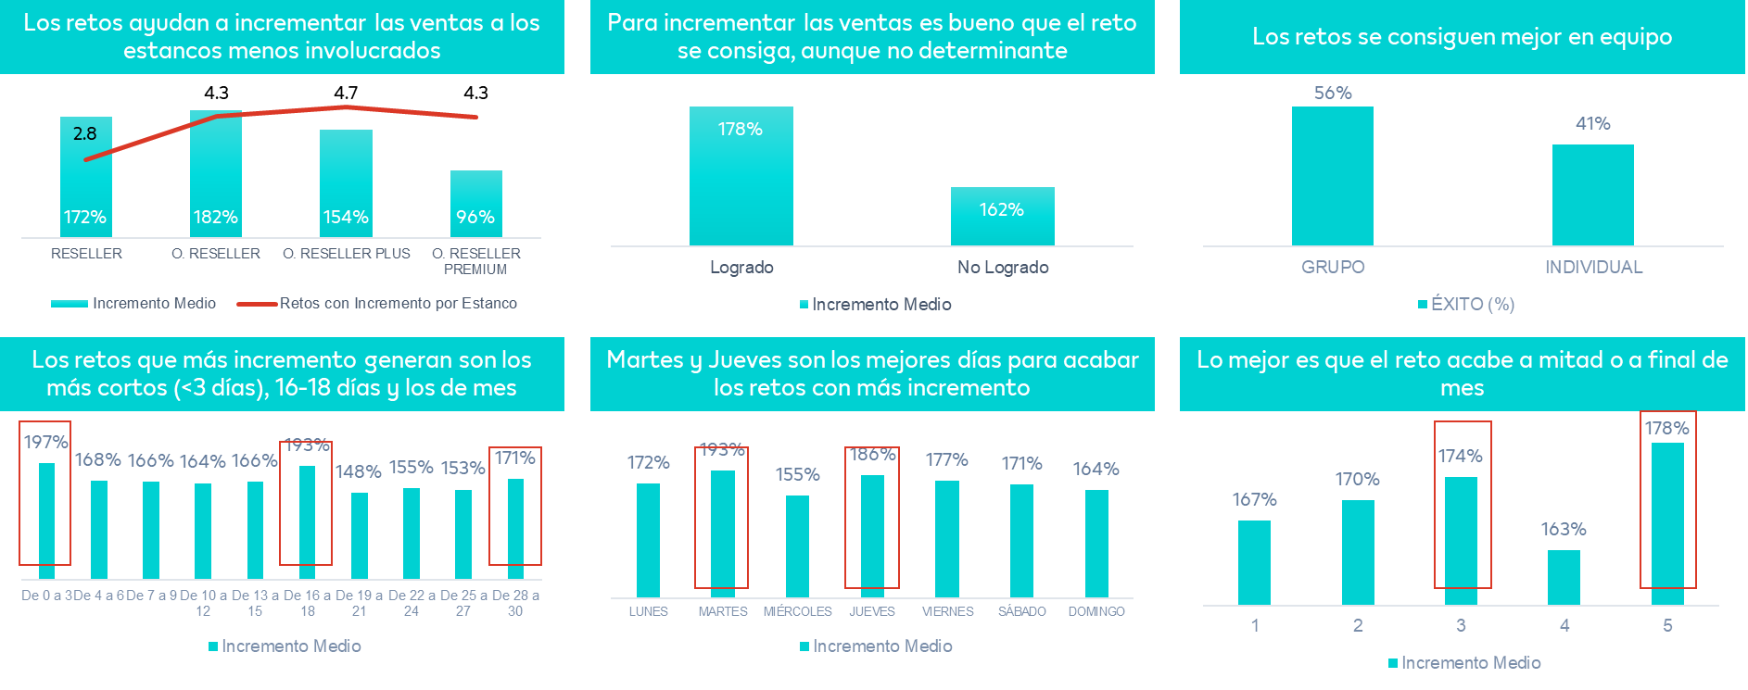
Data Analysis – Findings and Results B
WORK IN PROGRESS

Slide 10
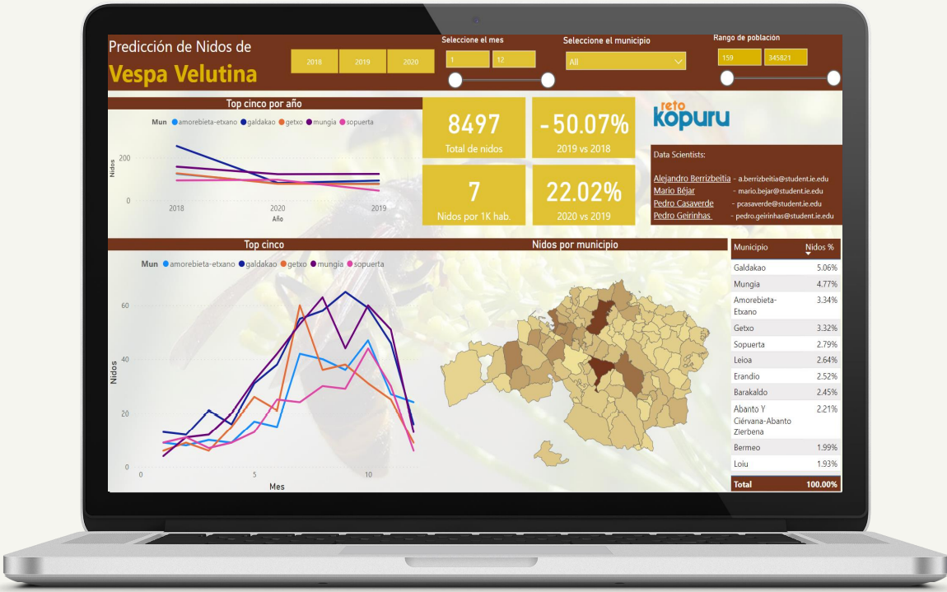
Power BI Dashboard
WORK IN PROGRESS

Slide 11
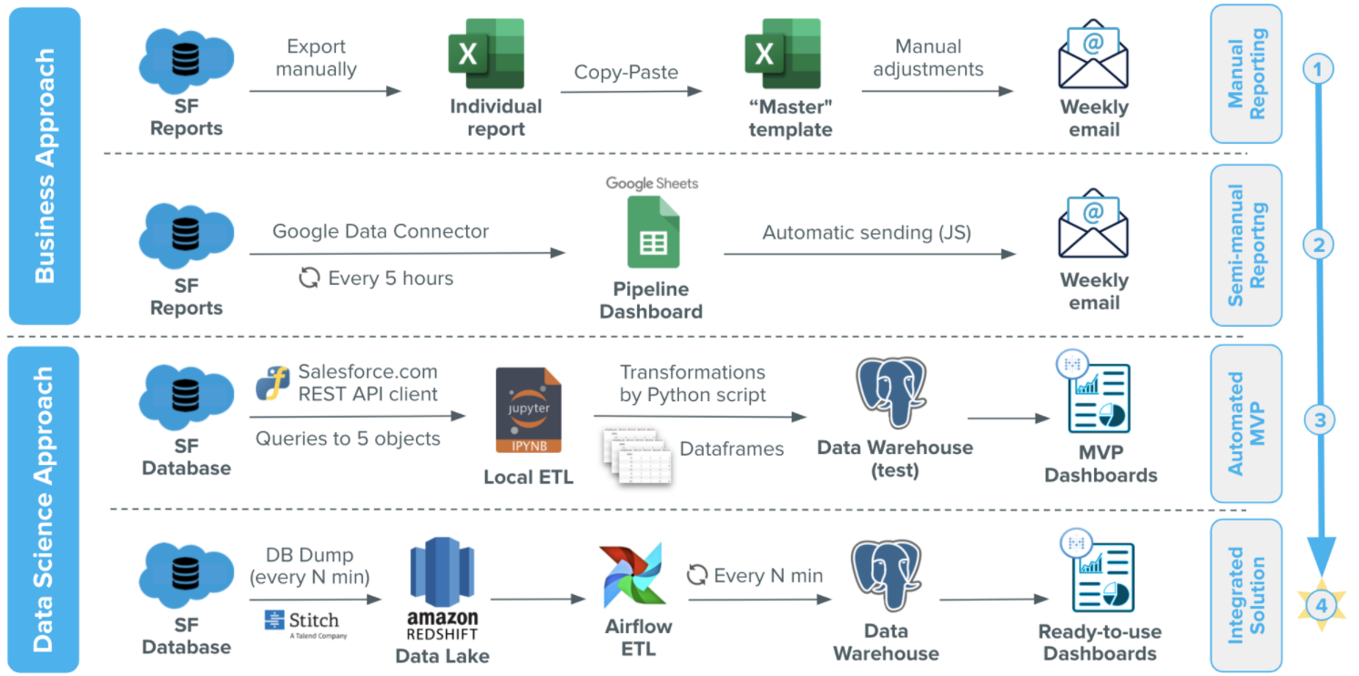
Next Steps / Recommendations
WORK IN PROGRESS
Creation of an API/APP to avoid manual data entry (maximize business análisis and reduce error + manual tasks)
Creation of a Control Group for A/B Testing -> detailed incentives campaign efficiency measurement
Investing in Airflow ETL for automated Dashboard
(maximize business análisis and reduce manual tasks)
Consider using merchandising or other resources as incentives in order to reduce investment
Consider exponential variables money incentives for (Monthly, Quarterly, Semi-annually) inestead of fixed incentive per successful lead/sale

