Slide 1

DotNet Memory Memoir
Introductions

Slide 2

Agenda-Mind Blow
Silicon and Synapsis
Mind Map
Mind the Mime Pulling Strings
Train of Thought
Mind Games
Brain Farts
Haemorrhaging

Slide 3
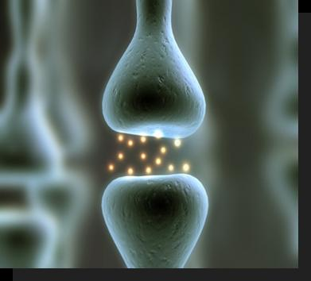
Silicon and Synapsis
Why? - Storage
What? - D-Latches
Where? – Task Manager
How? - PIDs

Slide 4

Mind Map
Machine instructions
Stack - Value types (Struct)
Stack overflow
Heap - Reference types/Pointers (Class)
LOH
SOH
Managed
Unmanaged
Memory leaks

Slide 5


Mind the Mime Pulling Strings
Threads
Mimes stuck in a box?
Pulling Strings

Slide 6

SOHs Train of Thought
Generations
Managed memory
CLR, IL, Compiler, GC
Unmanaged
Pinned
Marshalled/Interop

Slide 7

Mind (the) Games
When GC?
GC.Collect()
Low memory – threshold
Fragmentation
What happens GC?
Roots
Survivors and Promotions
Frozen
Strong vs Weak Reference

Slide 8

Brain Farts in the SOH
Unmanaged Resources
Machine code
Memory leaks

Slide 9

Haemorrhaging
Destructor
Finalise on managed.
High performance
“Using” Dispose
Must implement on unmanaged
Managed memory?

