Slide 1

DotNet Memory Memoir
Introductions

Slide 2

Agenda-Mind Blow
Silicon and Synapsis
Mind Map
Mind the Mime Pulling Strings
Train of Thought
Mind Games
Brain Farts
Haemorrhaging

Slide 3
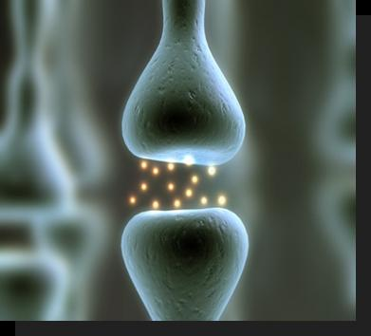
Silicon and Synapsis
Why? - Storage
Where? – RAM and Disk
Why PIDs?
Self Preservation
Security
OS
Disk
RAM
Process 1
(PID 1)
Process 2
(PID 2)
Notes:
How to we as humans remember our past and tasks, and plan for the future.
For PC it is much the same way – which is stored as bits in either volatile mem ie RAM or non-volatile ie Disk.
For short term task its RAM and long term task store on disk.
When running an app the OS allocates memory

Slide 4
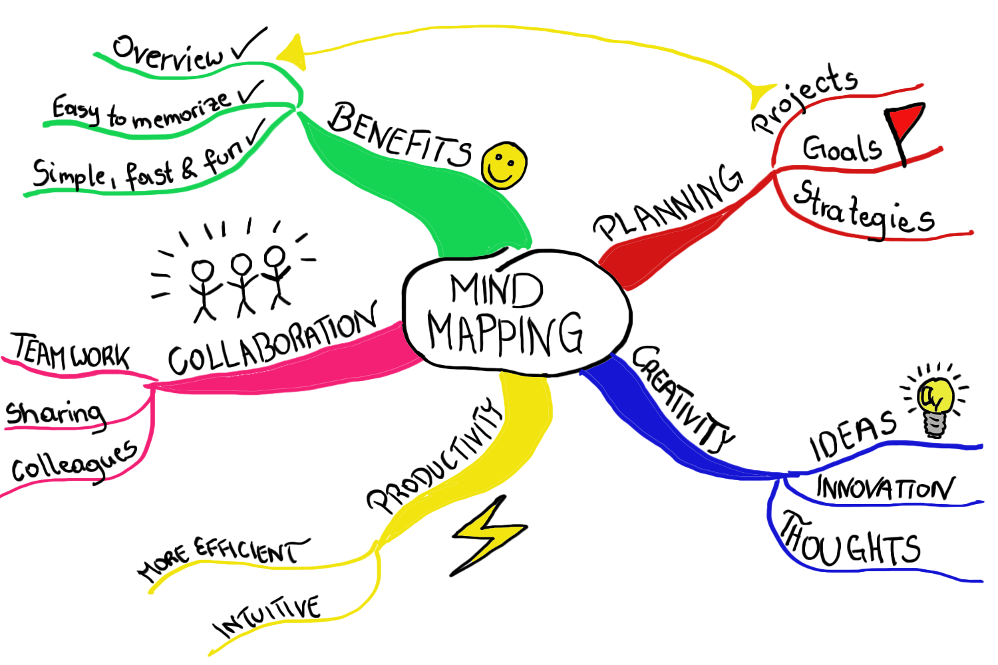
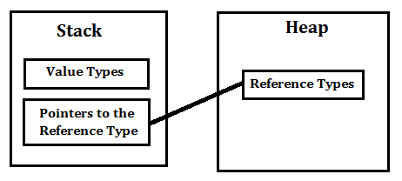
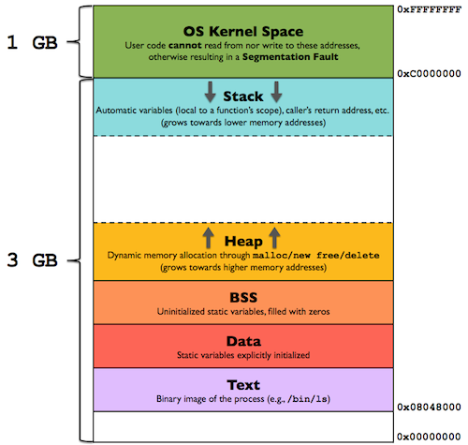
Mind Map
Heap
Small Object Heap (SOH)
Large Object Heap (LOH)
>85KB
Gen 0
Gen 1
Gen 2
Managed
Unmanaged
Notes:
Def val and ref
Why generations – to make sure that we don’t redundantly scan objects.
Machine instructions
Stack - Value types (Struct)
Stack overflow
Heap - Reference types/Pointers (Class)
LOH
SOH
Managed
Unmanaged
Memory leaks

Slide 5
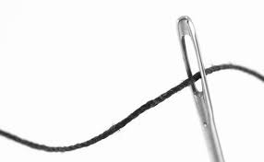

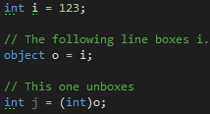

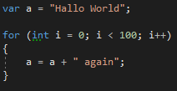
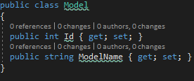
Mind the Mime Pulling Strings
Notes:
hreads
Mimes stuck in a box?
Pulling Strings
The problem that it solves – value type and ref def.
String changes how it looks.
Example of value type changed to a ref type.

Slide 6
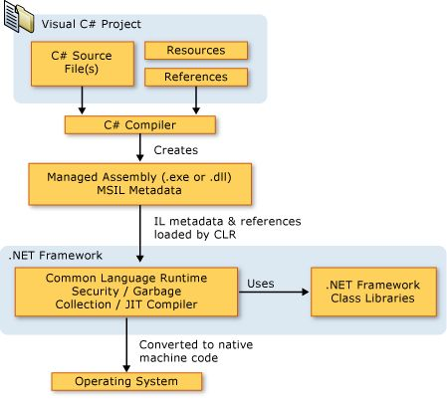

SOHs Train of Thought
What is Managed Memory?
Notes:
Generations
Managed memory
CLR, IL, Compiler, GC

Slide 7
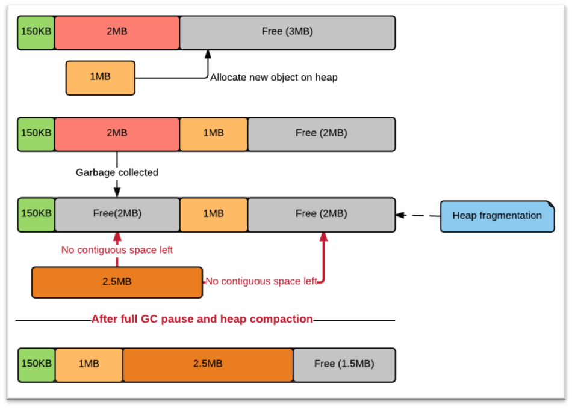
Mind (the) Games
When GC?
GC.Collect()
Low memory – threshold
Fragmentation
What happens GC?
Roots
Survivors, Promotions and Compression
Frozen
Strong vs Weak Reference

Slide 8

Brain Farts in the Heap
Unmanaged Resources
Machine code
Pinned
Marshalled/Interop
No GC!
Memory leaks
Notes:
Unmanaged
Pinned
Marshalled/Interop

Slide 9
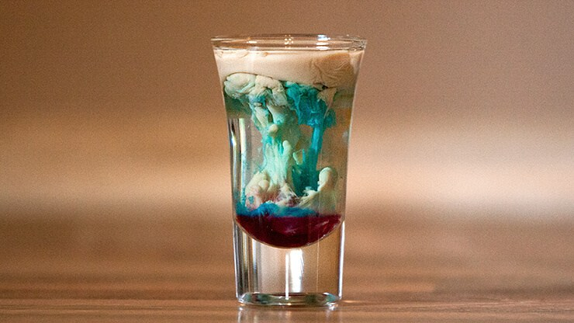
Haemorrhaging How to get rid of objects ASAP
Why a Destructor?
What is a Finalizer?
GC
GC does not run immediately after ~object()
Finalizer queue
When GC runs, non-deterministic finalization
Finalizer could be invoked
Notes:
3 rules for implementing the IDipose pattern

Slide 10
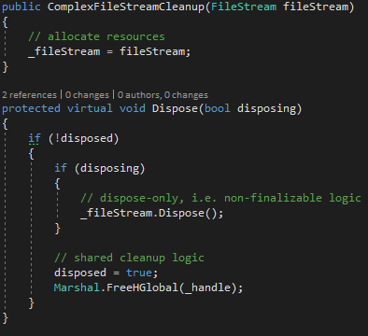
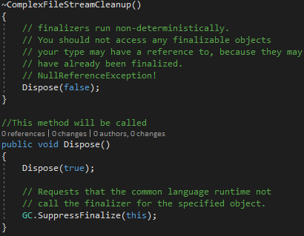
Haemorrhaging – Brain Surgery… Deterministic Finalization through IDisposable

Slide 11

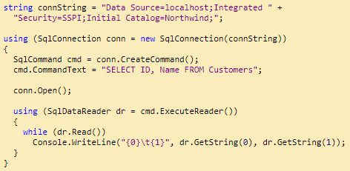
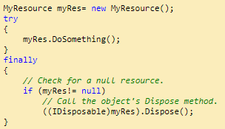
Haemorrhaging – Brain Surgery…
The “using” statement

Slide 12
Thanks! Questions?

