Slide 1


Using cloud services A simple Chat Service
Cloud computing
Philipp Gerhard 766710| Arina Markova 751215

Slide 2
Requirements
Security:
using TLS channels between client and server
Login:
password field
user credentials into Cloud NoSQL database
users provide a profile picture
users provide a preferred language (use the IBM Watson “Language Translator”)
Vulnerability Advisor
Fix at least three identified issue

Slide 3
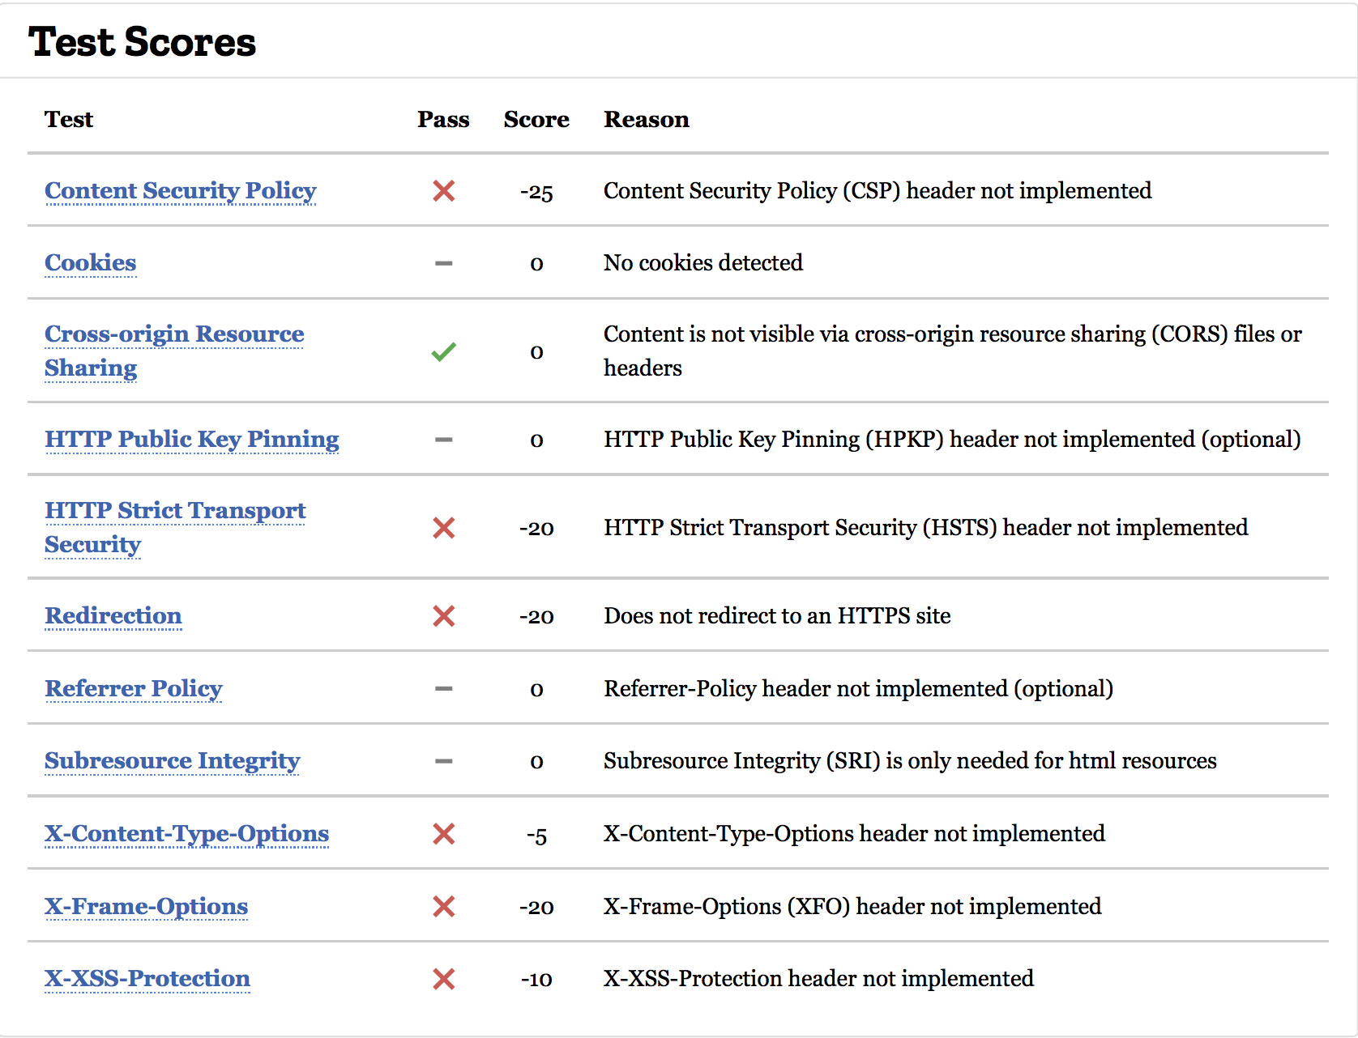
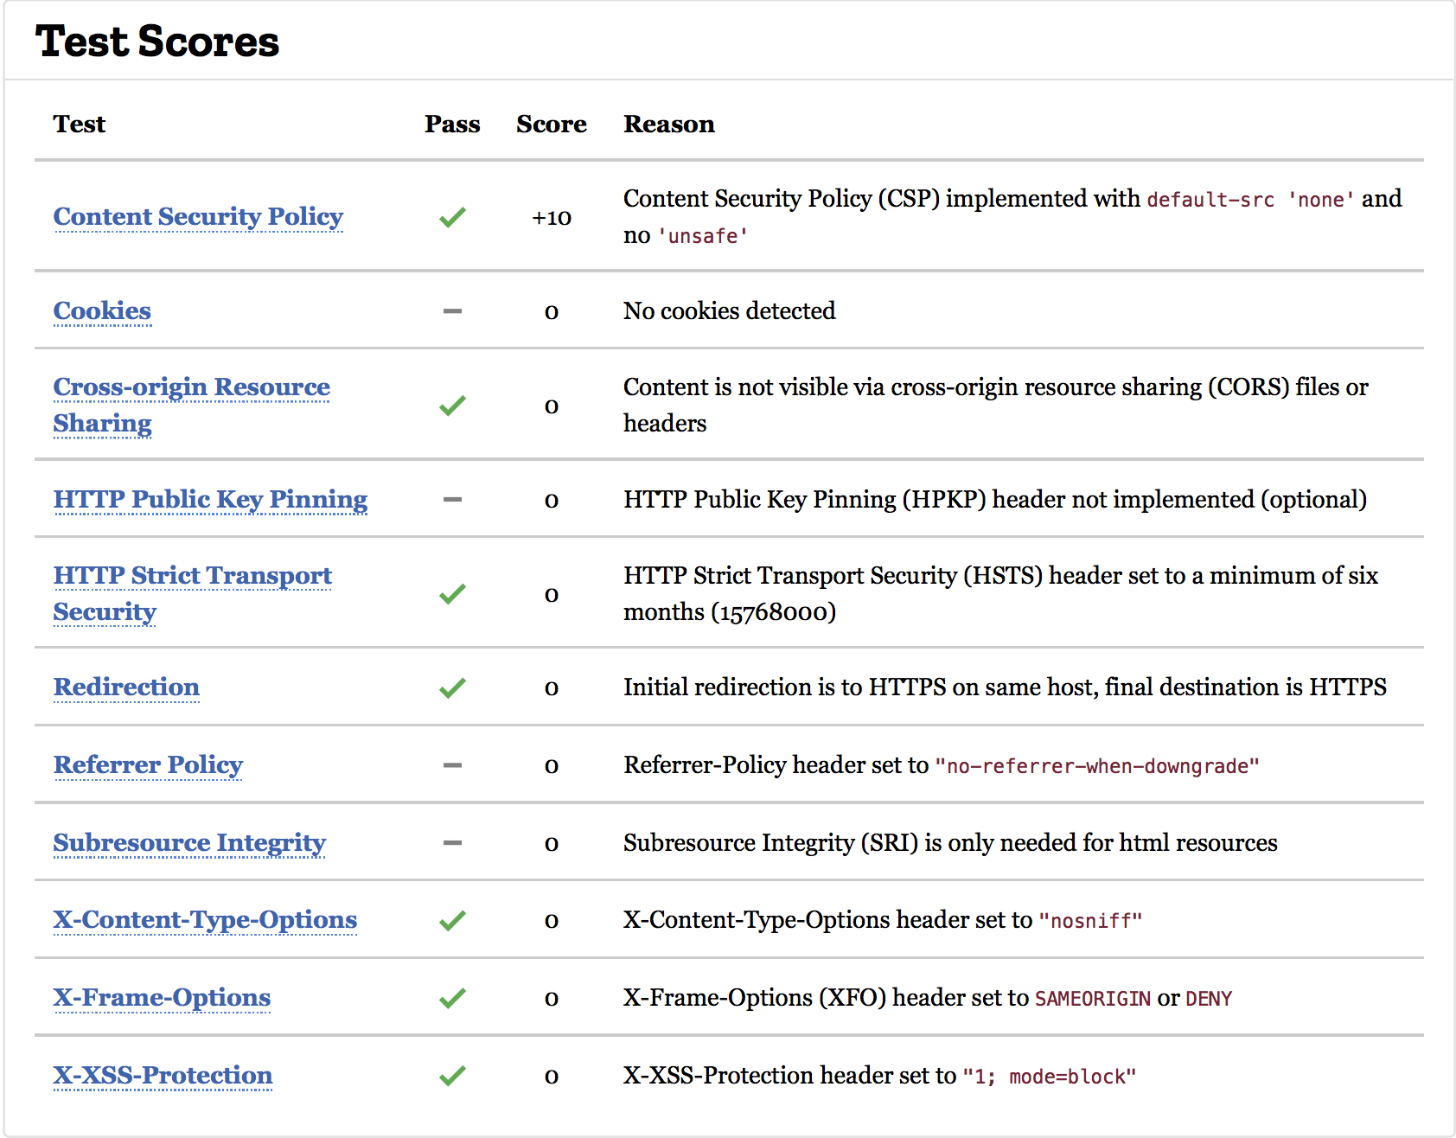
Mozilla Observatory – Frontend

Slide 4
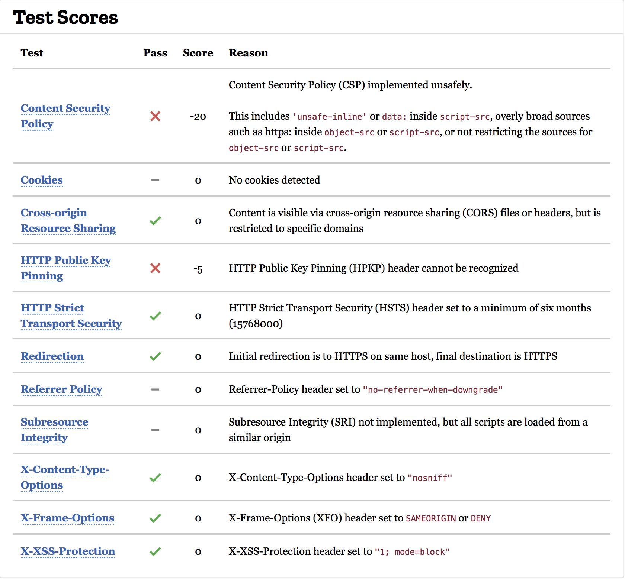
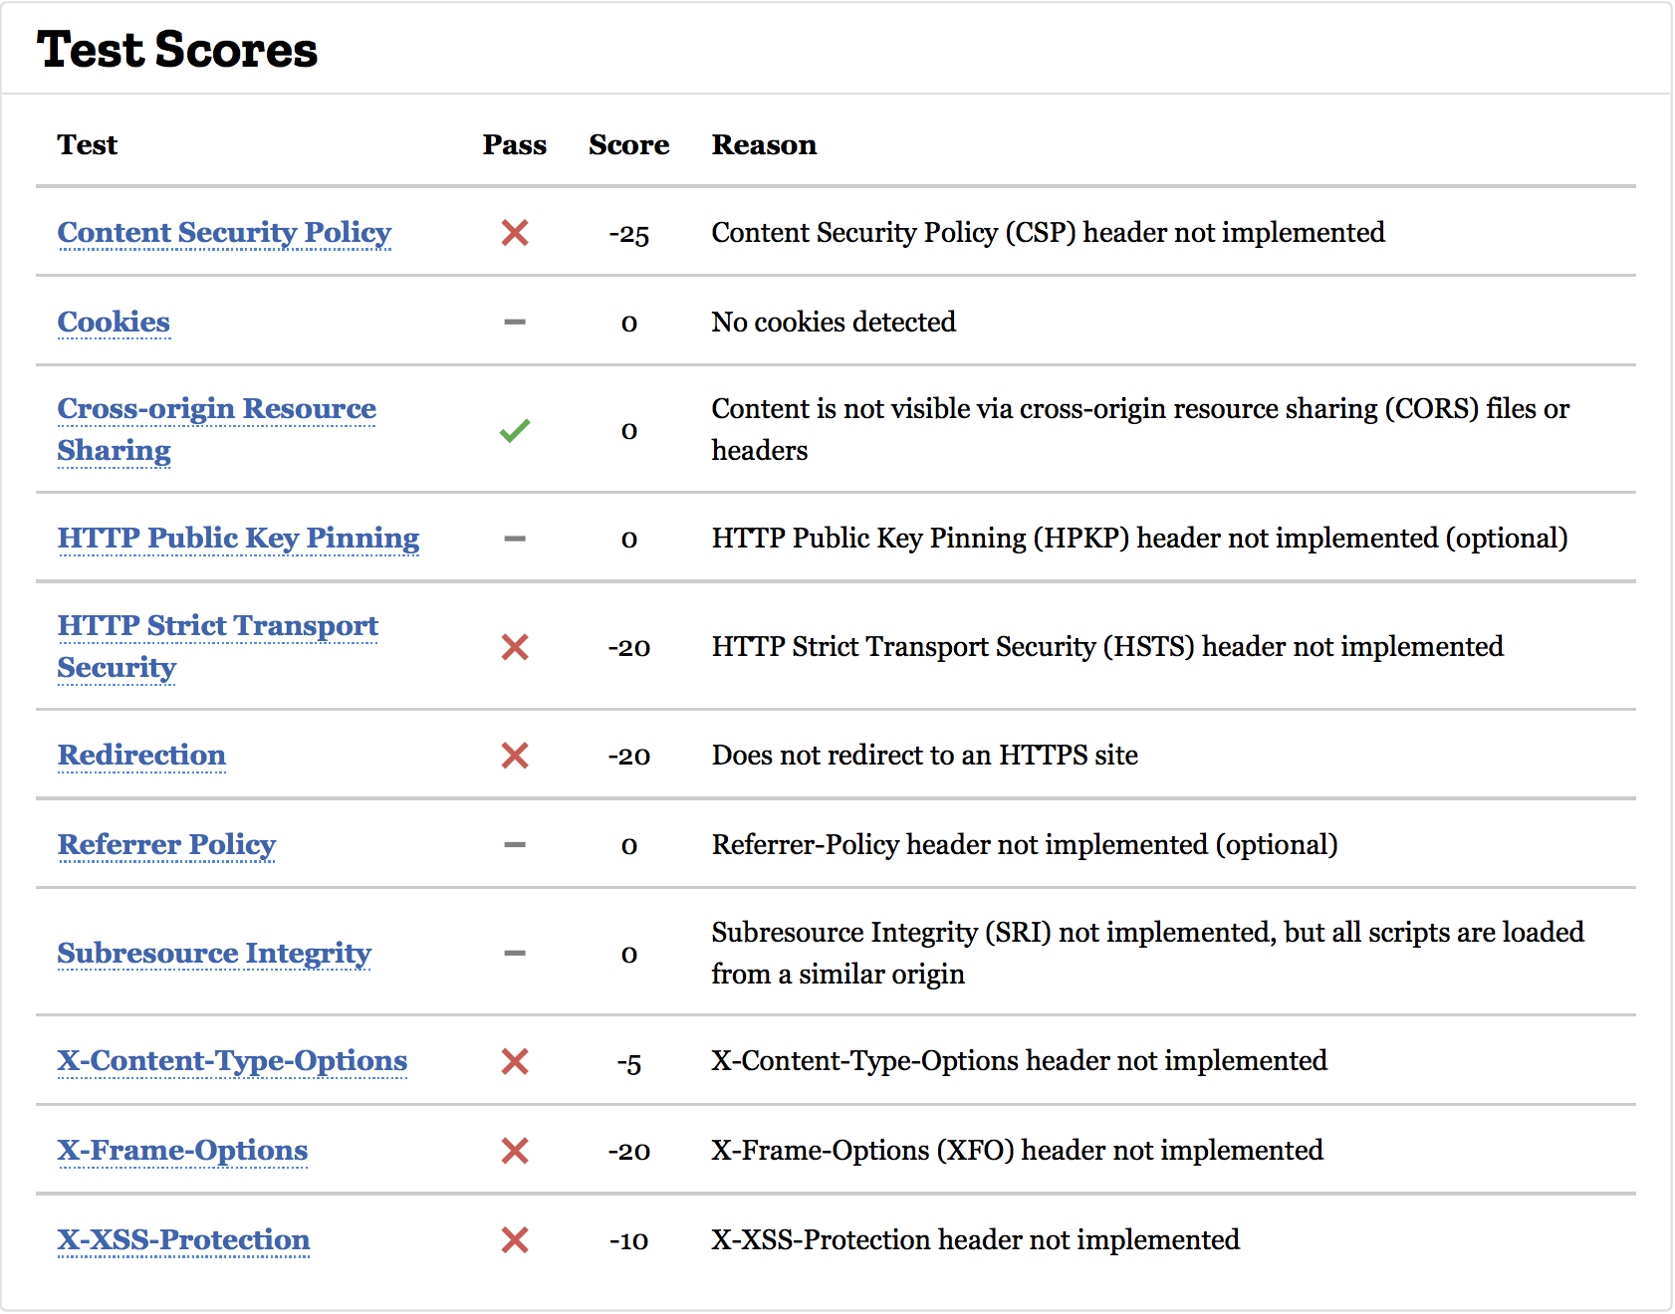
Mozilla Observatory – Frontend

Slide 5



Technologies
technologies
Notes:
NoSQL Database Cloudant: Store user information and information on objects saved in Cloud Object Storage
Language Translator: Automatically translate messages
Cloud Object Storage: Storage objects such as profile pictures and uploads

Slide 6

Chat Demonstration

Slide 7
What is did we learn?
Problem with Contents Security Policy & Angular
A good policy makes cross-site script injection impossible
'unsafe-inline' compromises the policy
Events focus/blur
The focus event is called on focusing, and blur – when the element loses the focus.
Notes:
1) CSP & Angular:
Since Angular is bootstrapped in the browser via an inline script tag while loading the index.html. It is necessary to allow this in the Content Security Policy. This is could be a possible security issue and as a result this is usually forbidden by most Content Security Policies. Since we need to explicitly enable this we receive a worse score on Mozilla Observatory.
2) Events focus/blur
The focus event is called on focusing, and blur – when the element loses the focus. Let’s use them for validation of an input field. An element receives a focus when the user clicks on it. Focusing generally means: “prepare to accept the data here”. The moment of losing the focus (“blur”) can be even more important. That’s when a user clicks somewhere else to go to the next form field. Losing the focus generally means: “the data has been entered”, so we can run the code to check it or even to save it to the server and so on.
For example, how we use it in our chat login page:The Method onFocus() – When the user clicks on the name or password field, show the message box (accept or not accept input). The Method onBlur()- When the user clicks outside of the name or password field, show the same message box and Loginbutton is either clickable or not.

Slide 8

Thank you!

