Slide 1


A simple Chat Service
Cloud computing
Philipp Gerhard 766710| Arina Markova 751215

Slide 2
Requirements
Login:
A user can login through a valid username
Chatroom:
A list of all online users in the chat room is displayed
Private chatroom (Peer to Peer)
General chatroom(Broadcast)
Chat chatroom (Multicast)
Messages:
Chronological order with a timestamp
A marked message each time a new user connects or leaves chatroom
Multi-media files

Slide 3


Technologies
technologies

Slide 4
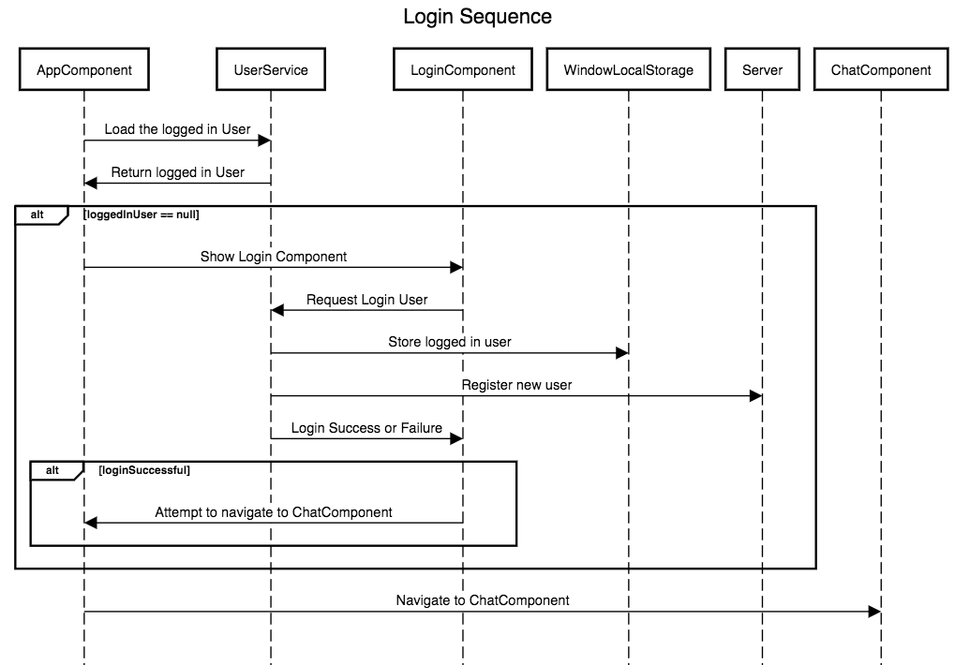
Sequenzdiagramm - Login

Slide 5
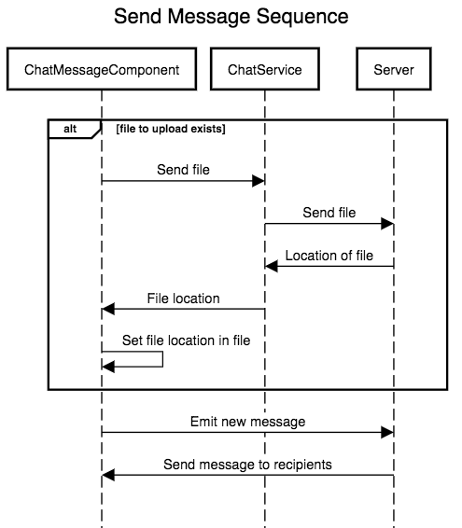
Sequenzdiagramm - Send Message

Slide 6
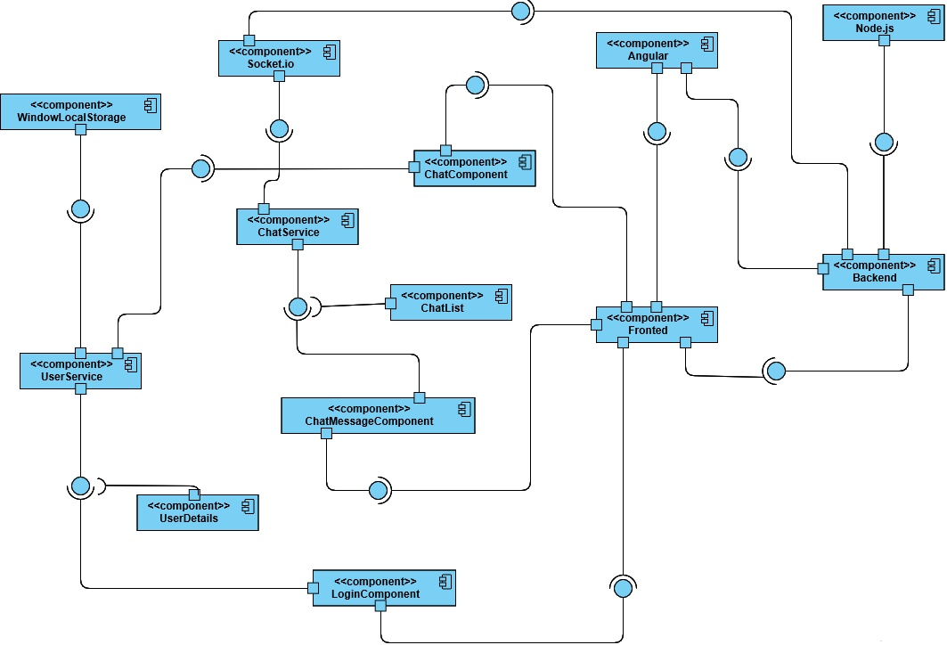
Componentdiagramm
Notes:
WindowLocalStorage: Using WindowLocalStorage we save the logged in user, so that it is not necessary to login again on browser refresh or when opening the chat server again after closing the window/tab
UserService: Handles the user login and provides the list of available users
ChatService: Handles the sending of chat messages
Other components are angular components representing different UI parts of the app

Slide 7

Chat Demonstration

Slide 8
What is did we learn?
Frontend
Ease of creating new Angular components
Separation of concerns
Backend
Features of Socket.io
Asynchronous programming
Notes:
Using Angular it is very easy to create new components
Angular provides a clear separation of presentation, logic and styling. This makes it easy to extend or maintain existing code
Features that Socket.io provides as an alternative to REST. How using websockets differs from using a REST based API. E.g. we do not wait for the answer to a request, but react to another event containing the response
How easy it is to use an event driven approach with NodeJs and how this compares to traditional development with synchronous languages (e.g. Java). We can not be sure in which orders our statements are executed

Slide 9

Thank you!

