Slide 1


Using cloud services A simple Chat Service
Cloud computing
Philipp Gerhard 766710| Arina Markova 751215

Slide 2
Requirements
Security:
using TLS channels between client and server
Login:
password field
user credentials into Cloud NoSQL database
users provide a profile picture
users provide a preferred language (use the IBM Watson “Language Translator”)
Vulnerability Advisor
Fix at least three identified issue

Slide 3
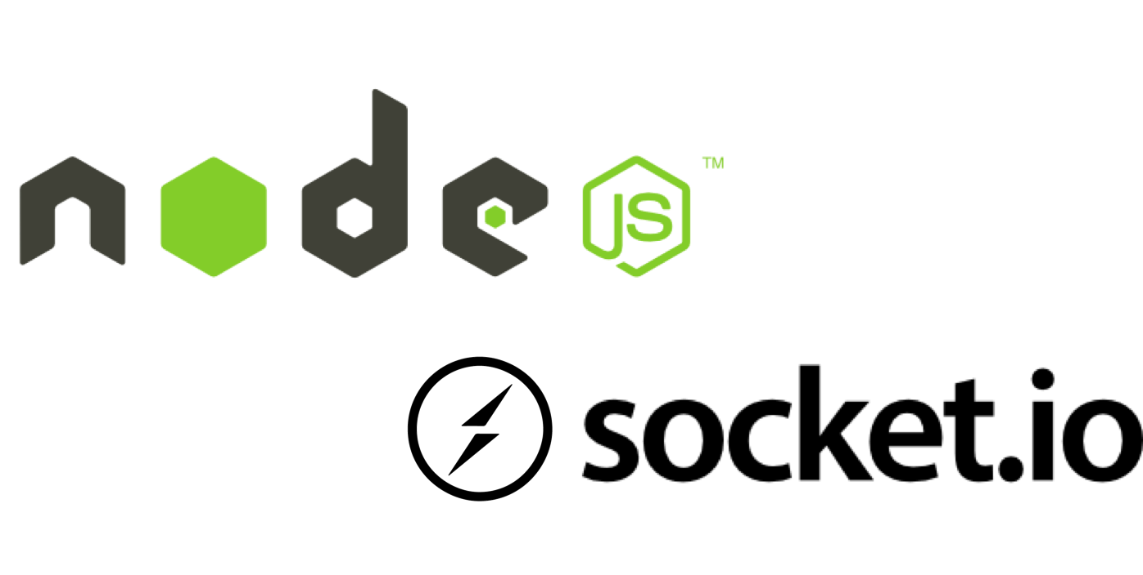


Technologies
technologies
Notes:
NoSQL Database Cloudant: Store user information and information on objects saved in Cloud Object Storage
Language Translator: Automatically translate messages
Cloud Object Storage: Storage objects such as profile pictures and uploads

Slide 4

Chat Demonstration

Slide 5
What is did we learn?
Problem with Contents Security Policy & Angular
A good policy makes cross-site script injection impossible
'unsafe-inline' compromises the policy

Slide 6

Thank you!

