Slide 1


The Accidental DBA
a guide for
the perplexed
Don't Panic
Josh Berkus
PostgreSQL Experts, Inc.
FOSS4G 2014

Slide 2
covered in this talk
installation
extensions
installing PostGIS
updates and upgrades
configuration
connections & security
backups
VACUUM
query management

Slide 3
not covered
older versions (< 9.1)
  older PostGIS (< 2.0)
schema design
query rewriting
indexes
testing
application stuff

Slide 4
replication
included in the slides
included in the exercises
not covered in this workshop
covered in the afternoon session

Slide 5
Exercises & Slides
https://github.com/pgexperts/
accidentalDBA
accidentalDBA/tutorial/exercises.txt
exercises are Vagrant VM
  you needed to install this before you got here

Slide 6
“You know Linux, right?
You're in charge of the database now.”

Slide 7
“Efficiency”
“DevOps”
“Cloud”
“Growth Opportunity”

Slide 8
“We're not going to hire a DBA”

Slide 9
Y U no DBA?
limited budgets
shortage of operational staff
cheaper OSS databases
… you are the DBA now.

Slide 10
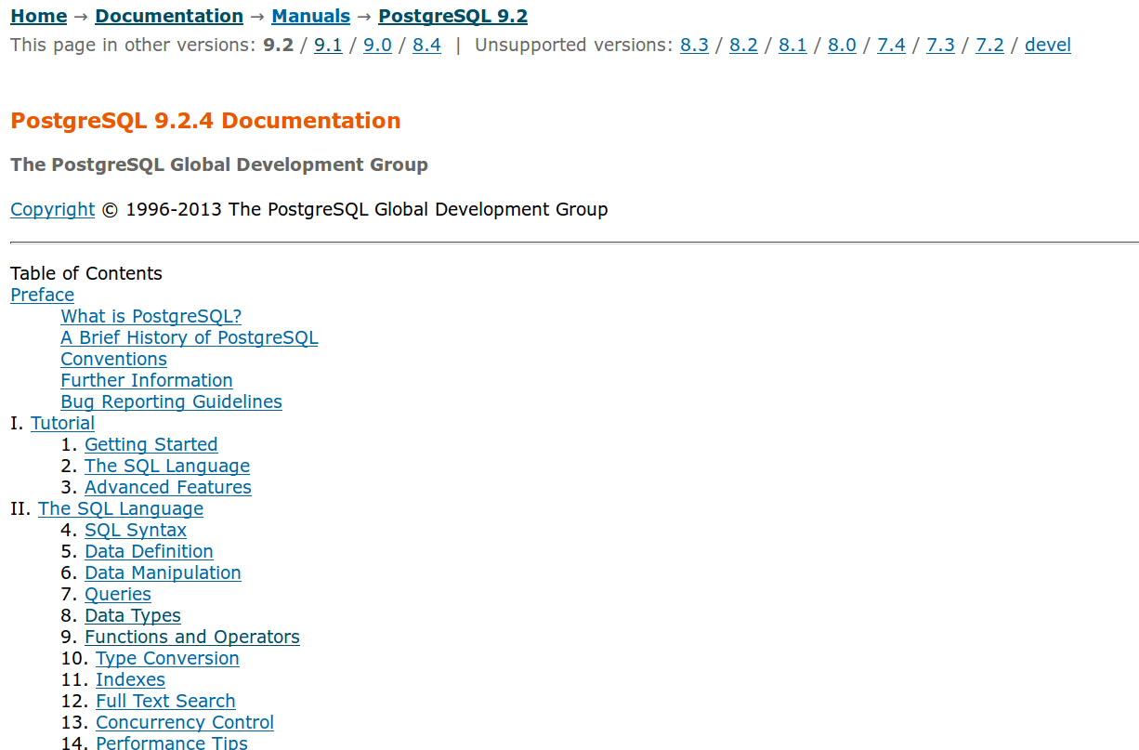

Slide 11

Oh My God,
We’re All Going To Die.

Slide 12
Don't Panic

Slide 13
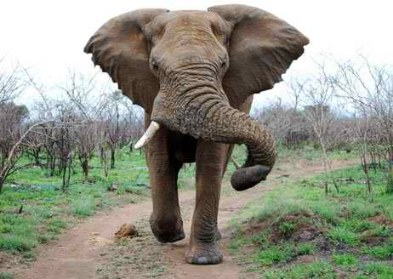

Slide 14


Slide 15
vagrant up now
cd /dir/to/accidentalDBA/vagrant/
vagrant up

Slide 16
Installation
Don't Panic

Slide 17
Linux: use packages!
version not important?
use the ones that come with your distro
  Red Hat, Centos, SciLinux
  Debian, Ubuntu
  SuSE

Slide 18
Linux: use packages!
need the latest version?
alternate packages
  Red Hat: yum.postgresql.org
  Ubuntu: apt.postgresql.org
  SuSE: build service
  Debian: apt.postgresql.org

Slide 19
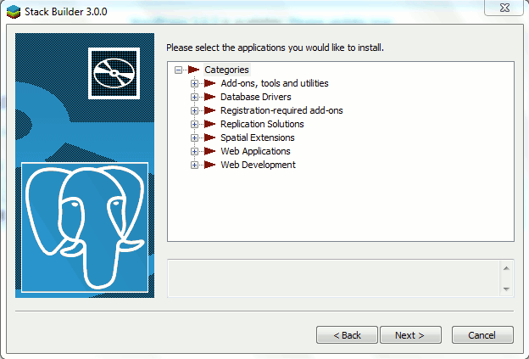
Windows/OSX

Slide 20
Windows/OSX
use the graphical installer
  from EnterpriseDB
  “wizard” GUI
also installs optional components
  pgAdmin
  Some extensions

Slide 21
other platforms
Packages available:
  Solaris 10/11
  OpenSolaris/
  Illumos
  FreeBSD
  OpenBSD
  NetBSD
No Packages:
  HP-UX
  AIX
  Solaris 9
  Tablets
  “Home” Windows

Slide 22
get logged in
vagrant ssh
sudo su -
tmux

Slide 23
packages exercise
less /etc/apt/sources.list.d/pgdg.list
apt-cache search postgresql
apt-cache search postgis

Slide 24
create data directory
$PGDATA is where the database files live
most packages create it
if not, use “initdb” to create it
  pick a suitable location!
initdb -D /db/9.3/main

Slide 25
initdb exercise
su – postgres
mkdir test
initdb -D test
cd test
ls -l
exit

Slide 26
starting & stopping
Don't Panic

Slide 27
3 commands
service / initdb scripts
normal use, recommended
pg_ctl
for custom configurations
must be run as “postgres”
postgres
only for control script-writers

Slide 28
kill

Slide 29
4 states
start
stop
restart
reload

Slide 30
start & stop
what it says on the tin
except …
  “smart” stop: wait for all connections
  “fast” stop: force disconnect
  “immediate” stop: just like “kill”

Slide 31
restart
shuts down and restarts postgres
breaks all connections
required for:
  changes to memory, connections
  changes to archive_mode
  changes to logging_collector

Slide 32
reload
signals the postmaster to reload files
does not break connections
works for
  changes to security (pg_hba.conf)
  most changes to logging
  changes to defaults

Slide 33
start/stop exercise
service postgresql start
service postgresql restart
service postgresql reload
service postgresql stop

Slide 34
start/stop exercise
su - postgres
pg_ctl -D /etc/postgresql/9.3/main start
pg_ctl -D /etc/postgresql/9.3/main
-m fast stop
exit

Slide 35
start/stop exercise
cd /etc/postgresql/9.3/main/
EDITOR postgresql.conf
service postgresql start
less /var/log/postgresql/postgresql-{DOW}.log

Slide 36
start/stop exercise
EDITOR postgresql.conf
service postgresql start
less /var/log/postgresql/postgresql-{DOW}.log

Slide 37
the psql command line

Slide 38
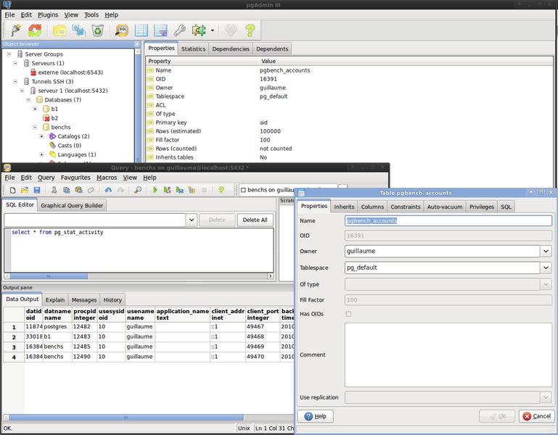
pgAdmin

Slide 39
psql exercise
su – postgres
psql libdata
\?
\h create table
\dt
\d+ copies

Slide 40
extensions
Don't Panic

Slide 41
extensions?
extensions add extra functionality
  like Python/Perl modules, Ruby Gems, etc.
need to be installed separately
  some come with PostgreSQL packages
  some need to be installed from PGXN or source
handled very differently before 9.1

Slide 42
libdata extensions
Extension | Purpose | Source
plpgsql | Procedural language for triggers and functions. Automatically included 9.0 and later. | core
citext | Case-insensitive text data type | contrib
isn | Product scan code data type. Used in libdata for ISBNs | contrib

Slide 43
installing extensions
install the binary files
  using packages, PGXN, or source
  installs to postgres “share” directory
  a few extensions don't have binaries
install the extension in each database where it's used

Slide 44


Slide 45
Installing PostGIS
Install PostGIS packages / binaries
Install the PostGIS extension into each database
Load databases
Load geographic data

Slide 46
Packages for PostGIS
Most updated Postgres:
  apt.postgresql.org / yum.postgresql.org
Best lib/tool support:
  OSGeo / ubuntugis / etc.
Too old:
  OS packages
Too hard:
  source code compile

Slide 47
Mac/Windows
EnterpriseDB installer

Slide 48
extensions exercise
\dx
create extension hstore;
select * from pg_extension;
select 'fname => josh,
lname => berkus'::hstore;

Slide 49
extensions exercise
\c earth
\dx
alter extension postgis update;

Slide 50
updates
& upgrades
Don't Panic

Slide 51
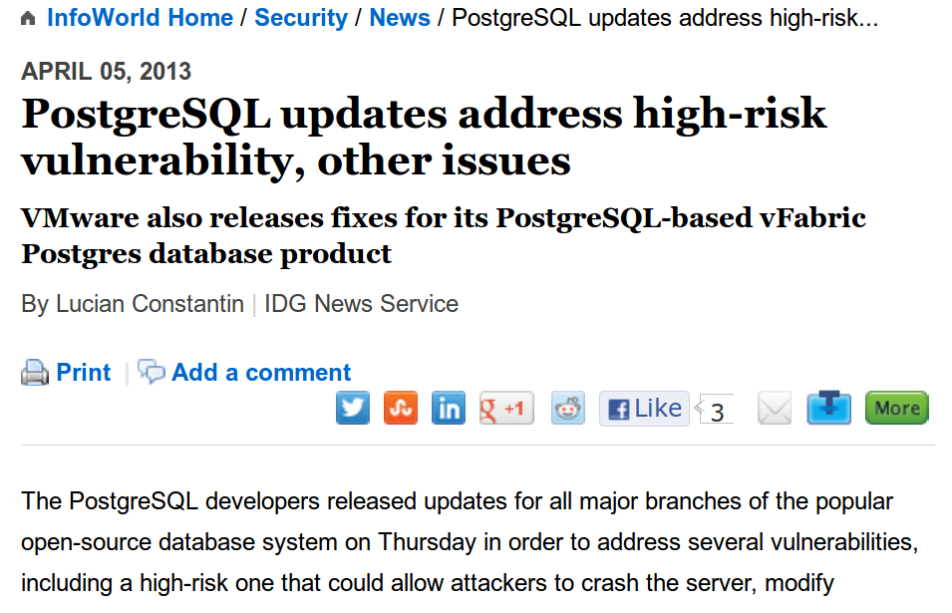

Slide 52
major vs. minor
9.3 == a major version
  requires an upgrade from 9.2.8
  contains features not in 9.2
  requires testing and planned downtime
9.3.5 == a minor version
  is a minor update from 9.3.4.
  can (and should) be applied immediately

Slide 53
minor updates
come out ~~ every 2 months
contain only bugfixes
  security hole patches
  data loss prevention
  fix server crashes
no new or changed features
  occasional documented breakage

Slide 54
update promptly update often

Slide 55
update procedure
schedule 5 minute downtime
download packages
shut down postgresql
install packages
restart postgresql
restart application

Slide 56
major upgrades
come out once per year
have many new features
  and sometimes break stuff which used to work
require extensive testing with your application
require significant downtime to upgrade

Slide 57
upgrade procedures
dump & reload
  use pg_dump & pg_restore on database
  most reliable way
  “cleans up” database in process
  best with small databases
  can take a long, long time

Slide 58
upgrade procedures
pg_upgrade
  upgrade “in place”
  much faster
  does not “clean up” database
  sometimes doesn't work
    issues with extensions

Slide 59
EOL after
5 years

Slide 60
upgrading extensions
not possible before 9.1
upgrade Postgres (or not)
install new extension binaries
run upgrade script in each DB
ALTER EXTENSION postgis UPDATE;

Slide 61
configuration
Don't Panic

Slide 62
configuration
Hardware
OS/FS
PostgreSQL

Slide 63
use good hardware
databases use all the hardware
  RAM, CPU, IO
  disk can be very important
    DB larger than RAM
    write-heavy database
  PostGIS requires lots of RAM + CPU
the database cannot outperform bad hardware

Slide 64
put the database on its own server
(or virtual server)

Slide 65
cloud servers
cloud server performance sucks
  especially IO
AWS tip: make sure you have enough RAM to cache the whole database

Slide 66
Linux configuration
turn the OOM killer off
turn reclaim_zone_files off
use XFS or Ext4 for database files
  use “noatime,nodiratime”
increase shmmax, shmall
  so that you can raise shared_buffers
  only required before 9.3

Slide 67
tmux new window
<ctrl>b,c
<ctrl>b,n
<ctrl>b,n

Slide 68
kernel params
less /etc/sysctl.d/30-postgresql-shm.conf
Q: what would it take for 1GB?
not required for 9.3 and later

Slide 69
BSD/Solaris Config.
Use ZFS
  decrease block size to 8K
increase shmmax/shmmall on BSD
may need to mess with ulimits
  on very busy systems
  Postgres will give you errors

Slide 70
Windows/OSX
optimization not possible

Slide 71
the xlog
xlog == WAL
  where transactions are recorded
best on its own drive/volume
  write-only
  writes synchronously
  response time paramount
create volume, then link pg_xlog dir

Slide 72
xlog dir
<ctrl>b,n
cd 9.3/main/pg_xlog
ls -lh

Slide 73
postgresql.conf
parameters you care about:
parameters you don't care about:
10 to 25
206 to 207

Slide 74
postgresql.conf
cd /etc/postgresql/9.3/main
$EDITOR postgresql.conf
editors availble:
  joe, jmacs, vi, nano

Slide 75
postgresql.conf
psql
show max_connections;
show all;
\x
select * from pg_settings;

Slide 76
connections
& security
Don't Panic

Slide 77
network
local connections: unix sockets
  faster than TCP/IP
other servers: port 5432
  make sure it's open on the firewall!
on the cloud? use SSL
  secure your connections
  PITA to set up, though

Slide 78
max_connections
“ERROR: connection limit
exceeded for non-superusers”
postgresql.conf
increase number of connections
good up to about 20 + 10 x cores
keep needing to increase it?
something is wrong

Slide 79
security
“FATAL: password authentication
failed for user "wwwuser"”
Postgres users & passwords
  CREATE/ALTER USER
  “group” ROLEs
Or: use LDAP, GSSAPI or PAM

Slide 80
create user
psql
create user 'bench' password 'benchmark';
\du
\q

Slide 81
host-based access
“FATAL: no pg_hba.conf entry for host "192.168.0.1", user "chaos", database "chaosLRdb", SSL off”
pg_hba.conf
access control list:
  database/user/host address
  like iptables for Postgres
change config and reload

Slide 82
pg_hba.conf
<ctrl>b,n
$EDITOR /etc/postgresql
/9.3/main/pg_hba.conf
service postgresql reload

Slide 83
pg_hba.conf
<ctrl>b,n
psql
\q
psql -U bench
\q

Slide 84
.pgpass
cd ~
cp /setup/postgres/.pgpass .
chmod 700 .pgpass
less .pgpass
psql -U bench

Slide 85
three tips for security
don't expose the postgres server/port to the internet
don't allow users to connect as the superuser (postgres)
use the strongest authentication which is practical

Slide 86
connection pooling
pgbouncer
  event-based pooler
  separate package
  on DB server, or
  app server, or
  3rd “bouncer” server

Slide 87
pgbench
simple “benchmark” utility
  based on “Wiconsin” benchmark
  ships in postgresql-contrib
  useful for testing for really bad
  OS/hardware issues
  also for demos

Slide 88
setting up pgbench
createdb bench
pgbench -U bench -i -s 10

Slide 89
pgbouncer
<ctrl>b,n
less /etc/pgbouncer/pgbouncer.ini
less /etc/pgbouncer/userlist.txt
service pgbouncer start
<ctrl>b,n
psql -U bench -p 6432
\q

Slide 90
pgbouncer
cd /setup/pgbench
less runbench_pool.sh
./runbench_pool.sh
<ctrl>b,n
su – postgres
psql

Slide 91
pgbouncer
select count(*) from pg_stat_activity;
\q
<ctrl>b,n
<ctrl>c

Slide 92
backups
Don't Panic

Slide 93
2012-01-27 18:00:44 MSK FATAL:
invalid page header in block
311757 of relation
base/26976/27977
2012-01-27 18:00:44 MSK CONTEXT:
xlog redo insert:
rel 1663/26976/27977;
tid 311757/44
2012-01-27 18:00:44 MSK LOG:
startup process (PID 392)
exited with exit code 1
2012-01-27 18:00:44 MSK LOG:
aborting startup due
to startup process failure

Slide 94


Slide 95
three methods
pg_dump
PITR
filesystem snapshot

Slide 96
pg_dump
“logical” backup
  portable
  compressed
  works for upgrades
good for small databases
use -Fc
  custom binary format

Slide 97
pg_restore
used to reload pg_dumps
  parallel mode for fast loading
  extract specific tables, schema
  extract to an alternate database

Slide 98
pgdump
cd ~
pg_dump -Fc -v
-f backup/libdata.dump
libdata
ls -lh backup/libdata.dump

Slide 99
pg_restore
pg_restore -l backup/libdata.dump
createdb libdata2
pg_restore -v -d libdata2
backup/libdata.dump
psql libdata2
\dt
\q

Slide 100
PITR
“Point-In-Time Recovery”
“binary” and “continuous” backup
  take snapshot of DB files
  accumulate logfile copies
good for large databases
can combine with replication

Slide 101

DROP TABLE circulation;

Slide 102
PITR - PITA
can be difficult to set up & monitor
use tools:
  Barman
  OmniPITR
  WAL-E (for AWS)

Slide 103
PITR
<ctrl>b,n
exit
$EDITOR /etc/postgresql/9.3/main
/postgresql.conf
$EDITOR /etc/postgresql/9.3/main
/pg_hba.conf
service postgresql restart
less /setup/postgres/archive_logs.sh

Slide 104
PITR
<ctrl>b,n
cd ~
pg_basebackup -x -P -D 9.3/replica
cd wal_archive
ls -lh

Slide 105
filesystem snapshot
works with snapshotting filesystems
  ZFS, BTRFS
  LVM
  Some SANs
must be real snapshot
  coherent
  point-in-time

Slide 106
have a DR plan
ways you can lose data
  recovery time
  acceptable data loss
how to recover from lost data
  detailed steps
  verification

Slide 107
replication
Don't Panic
Not Appearing in this Version

Slide 108
use replication for ...
availability: have an “always on” failover server
load-balancing: offload traffic
  especially reporting workloads
security: provide users read-only access

Slide 109

binary replication
run statements
Master
Replica
Replica

Slide 110
DRBD for PostgreSQL
(only much much faster)

Slide 111
also called ...
streaming replication
  refers to the ability to stream new data pages over a network connection
hot standby
  refers to the ability of standbys to run read-only queries while in standby mode

Slide 112
advantages
low administration
low overhead on master
  not much incremental cost
non-invasive
  no extra tables/triggers
  no primary key requirements
  no limitations on statements

Slide 113
disadvantages
need to replicate the whole server
  not individual databases or tables
no writes of any kind on replicas
some things not replicated
query cancel (described later)

Slide 114
how it works

Slide 115
how it works
walreciever

Slide 116
how it works
walsender
walreciever

Slide 117
how it works
walsender
walreciever
walreciever

Slide 118
“recovery”
historical term
  because replication grew out of PITR
used to refer to the replica being “in recovery mode”, i.e no write queries
all over parameter and file names
  recovery.conf
  recovery_target
  pg_is_in_recovery()

Slide 119
replication
<ctrl>b,n
cd ~/9.3/replica
cp -p -r /setup/postgres/archive/* .
less recovery.conf
pg_ctl -D . start

Slide 120
replication
psql -p 5433
select pg_is_in_recovery();
\q
psql -p 5432
select * from
pg_stat_replication;
\q

Slide 121
failover
pg_ctl -D . promote
psql -p 5433
select * from pg_is_in_recovery();
\q
pg_ctl -D . stop

Slide 122
other cloning methods
rsync
filesystem snapshot
  (on shared storage)
VM cloning
  (if rapid)

Slide 123
creating a snapshot
make sure you are replicating transaction logs to the replica
pg_start_backup('replication')
rsync / snapshot / clone
pg_stop_backup()

Slide 124
failover vs. load-balancing
load causes replicas to fall behind
your replica can work for:
rapid failover
offloading work
but not both!

Slide 125
other replication
synchronous replication
Slony-I
Londiste
Bucardo

Slide 126
monitoring
Don't Panic

Slide 127
use your favorite tool
ganglia, collectd, Hyperic, OpenNMS, OpenView, whatever ....
nagios check_postgres.pl
  broad list of checks
  mine it for queries and techniques

Slide 128
many useful checks
disk space
caching RAM
response time
connections
idle transacts
table growth
waiting queries
long queries
database size
table bloat
system load
replication lag
XID wraparound
execution time

Slide 129
OS checks
disk space (per volume!)
system load
memory usage
IO activity
network activity

Slide 130
database checks
connections: active, idle, idle xtns
blocked queries (number, time)
query times (pg_stat_statements)
table size & growth
table & index bloat
XID wraparound
replication lag

Slide 131
activity log
connections & disconnections
slow queries
DB swap usage
schema changes
lock waits & deadlocks

Slide 132
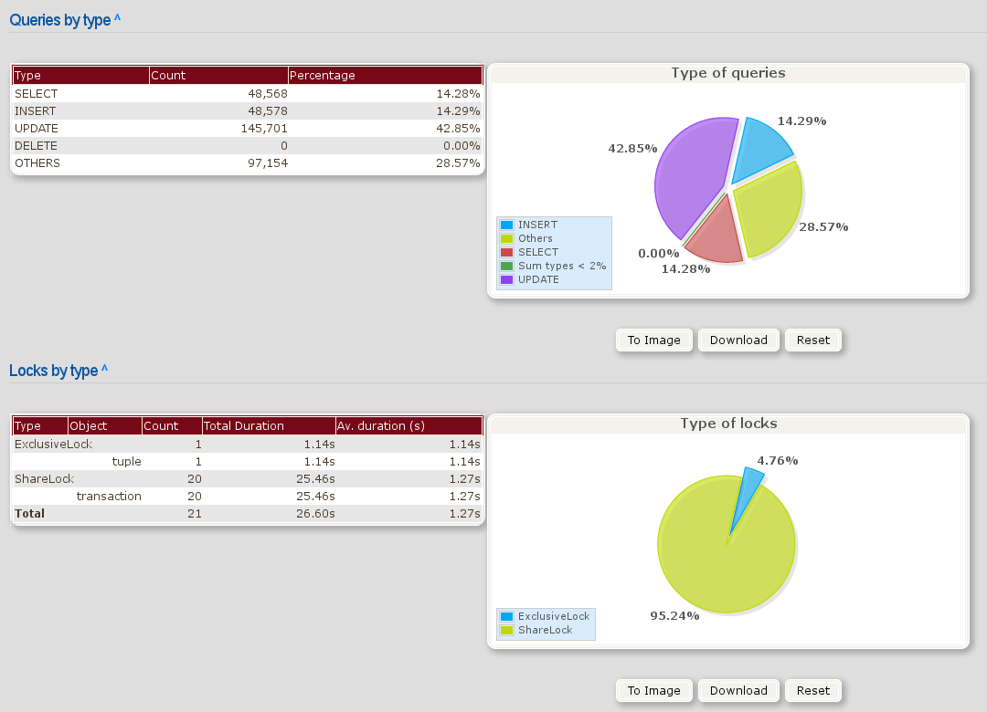
pgbadger

Slide 133
DB activity
<ctrl>b,n
$EDITOR /etc/postgresql/9.3/main
/postgresql.conf
service postgresql reload
<ctrl>b,n
cd /setup/pgbench
runbench_log.sh

Slide 134
DB activity
<ctrl>b,n
su – postgres
psql
select * from pg_stat_activity;
\x
select * from pg_stat_activty;

Slide 135
DB activity
\c bench
select * from pg_stat_user_tables;
select pg_size_pretty(
pg_total_relation_size(
'pgbench_history'));
select * from pg_stat{TAB}

Slide 136
DB logs
exit
cd /var/log/postgresql
less activitylog-Mon.csv
pgbadger --format csv --out
/setup/postgres/badger.html
activitylog-Mon.csv

Slide 137
VACUUM
& ANALYZE
Don't Panic

Slide 138
non-overwriting
Base Relation
UPDATE
Old Row Version
New Row Version

Slide 139

garbage collection
Tuplestore
Row C: Version 1
Row C: Version 2
Row C: Version 3
Row C: Version 4
Row C: Version 5

Slide 140
garbage collection
Tuplestore
Row C: Version 5

Slide 141
garbage collection
Tuplestore
Row C: Version 5

Slide 142
garbage collection
Tuplestore
Row C: Version 5

Slide 143
garbage collection
Tuplestore
Row C: Version 5

Slide 144

Autovacuum

Slide 145

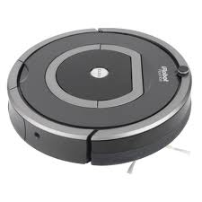
falling behind

Slide 146
bloat check
pg_stat_user_tables: dead_rows/live_rows
nagios bloat query
  https://gist.github.com/jberkus/9923948
trend table/database size
scans very slow to return the first row

Slide 147
fixing bloat
manual VACUUMs
  even VACUUM FULL
pg_repack
tune autovacuum
  increase frequency for busy tables
  increase workload size (vacuum_cost_limit)
  more autovacuum workers

Slide 148
vacuum
<ctrl>b,n
psql bench
\x
select * from pg_stat_user_tables;
select pg_total_relation_size(
'pgbench_tellers');

Slide 149
vacuum
vacuum analyze pgbench_tellers;
select pg_total_relation_size(
'pgbench_tellers');
vacuum full pgbench_tellers;
select pg_total_relation_size(
'pgbench_tellers');

Slide 150


XID wraparound

Slide 151
preempt wraparound
track age(datfrozenxid) for each table
  nagios has probe for this
VACUUM FREEZE tables preemptively
  link_to_flexible_freeze_here
lower vacuum_freeze_min_age
  maybe to 250,000

Slide 152
xid freezing
select relname,
age(relfrozenxid) as xid_age
from pg_class JOIN pg_stat_user_tables USING (relname) order by xid_age desc;
VACUUM FREEZE;
select relname ...

Slide 153
ANALYZE
keeps DB statistics up to date
non-intrusive
  uses sampling
  low IO
should be run frequently (hourly?)
  autovacuum takes care of this
when not run, query plans get really bad

Slide 154
ANALYZE
manual ANALYZE when:
  you create & populate a brand new table
  you do a massive DELETE or TRUNCATE
  you're seeing bad query plans due to bad stats
ANALYZE individual tables

Slide 155
stats
\a
select * from pg_stats where schemaname = 'public';

Slide 156
managing queries
Don't Panic

Slide 157
pg_stat_activity
-[ RECORD 2 ]----+--------------------------------
datid | 16422
datname | libdata
procpid | 46295
usesysid | 10
usename | dataentry
application_name | psql
client_addr | 192.168.101.114
client_port | 5432
backend_start | 2012-08-26 15:09:05.233-07
xact_start | 2012-08-26 15:09:06.113-07
query_start | 2012-08-26 15:11:53.521-07
waiting | f
current_query | <IDLE> in transaction

Slide 158
locks
write queries can block on other write queries
  as can table schema changes
  queries can wait forever on locks
look for old “idle in transaction”
  that's a zombie database connection

Slide 159
kill it kill it kill it

Slide 160
killing zombies
pg_cancel_backend(pid)
  kills running queries with sigINT
  like CTRL-C
pg_terminate_backend(pid)
  kills bad connections, idle transactions
  can cause DB to reload in some cases

Slide 161
zombie killing
cd /setup/pgbench
runbench_locks.sh
<ctrl>b,n
su – postgres
psql bench
select * from pg_stat_activity;

Slide 162
zombie killing
select pg_cancel_backend(pid)
from pg_stat_activity
where state = 'idle in transaction'
and state_change <
( now() - interval '10 seconds');
select * from pg_stat_activity;

Slide 163
EXPLAIN
Nested Loop (cost=792.00..828.08 rows=1422317 width=99)
-> HashAggregate (cost=792.00..792.00 rows=1 width=4)
-> Index Scan using index_player_summaries_on_player_id on player_summaries ps (cost=0.00..791.80 rows=403 width=4)
Index Cond: (player_id = 21432312)
-> Index Scan using index_player_summaries_on_match_id on player_summaries (cost=0.00..33.98 rows=600 width=99)
Index Cond: (match_id = ps.match_id)

Slide 164
EXPLAIN ANALYZE
Nested Loop (cost=792.00..828.08 rows=1422317 width=99) (actual time=9928.869..20753.723 rows=13470 loops=1)
-> HashAggregate (cost=792.00..792.00 rows=1 width=4) (actual time=9895.105..9897.096 rows=1347 loops=1)
-> Index Scan using index_player_summaries_on_player_id on player_summaries ps (cost=0.00..791.80 rows=403 width=4) (actual time=27.413..9890.887 rows=1347 loops=1)
Index Cond: (player_id = 21432312)
-> Index Scan using index_player_summaries_on_match_id on player_summaries (cost=0.00..33.98 rows=600 width=99) (actual time=7.375..8.037 rows=10 loops=1347)
Index Cond: (match_id = ps.match_id)
Total runtime: 20764.371 ms"

Slide 165
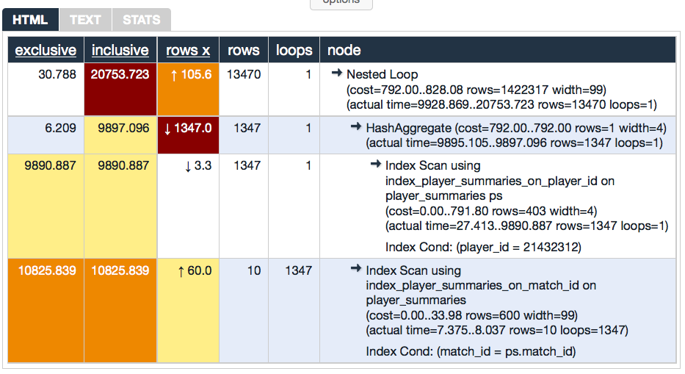
explain.depesz.com

Slide 166
explain.depesz.com

Slide 167
what to look for
“seq scan” on large table
  maybe index needed
cartesian joins
really bad row estimates
  ANALYZE needed?

Slide 168
explain analyze
explain select count(*) from loans where checkout_date between '2011-01-01' and '2011-03-31';
explain analyze …
explain ( analyze on, buffers on )...
explain ( analyze on, format yaml ) ...

Slide 169
explain analyze
\i /setup/postgres/
explain_quarterly_report.sql

Slide 170
Learn More
Main Docs
  http://www.postgresql.org/docs
Blogs
  http://planet.postgresql.org
User Groups
  http://www.postgresql.org/community/user-groups/

Slide 171
Learn More
User Groups:
PDXPUG
SFPUG
NYCPUG
many others!
Conferences:
PDXpgDay
Sept. 6, Portland
PostgresOpen
Sept. 16, Chicago
pgConf.EU:
Oct. 23, Madrid

Slide 172
questions?
www.pgexperts.com/tutorials.html
Josh Berkus: josh@pgexperts.com
  PGX: www.pgexperts.com
  Blog: www.databasesoup.com
Copyright 2013- 2014 PostgreSQL Experts Inc. Released under the Creative Commons Attribution License. All images are the property of their respective owners. The Don't Panic slogan and logo is property of the BBC, and the Dilbert image belongs to Scott Adams and is used here as parody.

