Slide 1

Sprocket Central Pty Ltd
Data analytics approach

Slide 2
Agenda
Data Exploration
Model Development
Interpretation
The approach will be implemented in three stages :-

Slide 3
Agenda
Approach for New Customer Data Analysis :-
Age distribution
Bike related purchases
Job industry
Number of cars owned

Slide 4
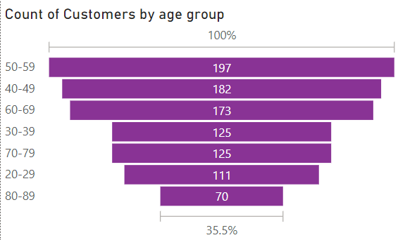
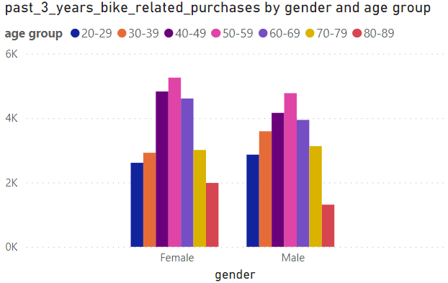
Data Exploration : Age Distribution & Bike Purchases
New customers are more from the age group of 50-59 , followed by 40-49 & 60-69.
Fewer customer are from 20-29 & 80-89 for obvious reasons.
Data shows age group 50-59 has high count in terms of bike purchased in last 3 years with a slightly greater female ratio.
The target audience for our marketing and advertising should be inclined to provide focus on females than males.

Slide 5
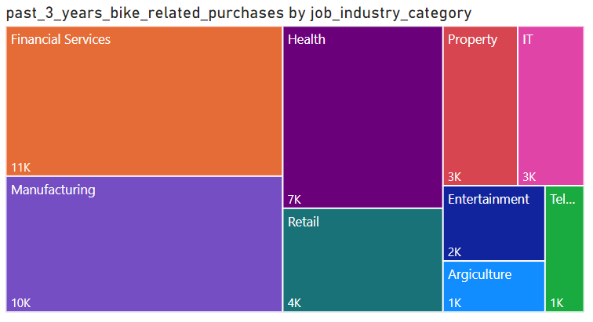
Data Exploration : Job Industry
Financial Services, Manufacturing, and Health are the top three profit-generating industries, followed by retail and property.

Slide 6
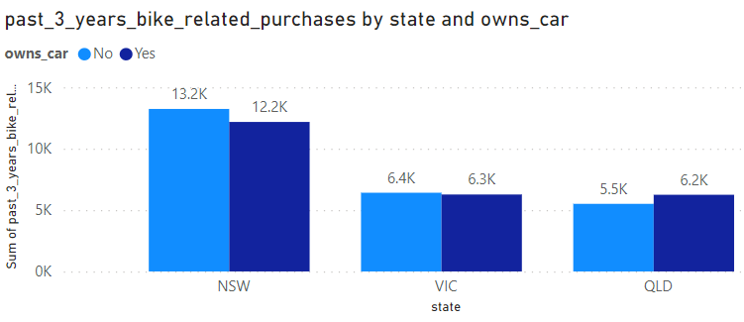
Data Exploration : Number of cars owned
Out of three states, New South Wales, could be potential market opportunities for the company.
New South Wales has the biggest potential since the number of people who own vehicles is less than to the number of individuals who do not own cars, indicating that there is room for value customers there.
VIC and QLD has more customers that own car that who don’t but we can try to have something so that those owns car will buy bikes.

Slide 7
Model Development
CUSTOMER CLASSIFICATION – Targeting High Value Customers
The following are the high-value clients to target from the new list :
Aged between 50 – 59.
Most of the high value customers are female compared to male
Working in Financial Service, Manufacturing and Health.
Who are currently living in New South Wales and Victoria.

Slide 8
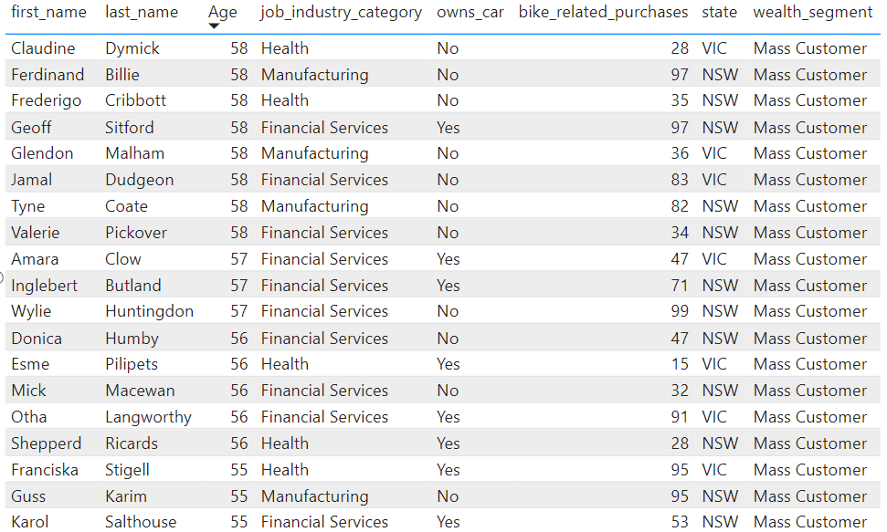
Interpretation
HIGH-VALUE CUSTOMER SUMMARY TABLE

Slide 9
Thank You

