Slide 1

Loan Approval Prediction
Prakash Ghatani
Regis University
MSDS692_S40_Data Science Practicum
May 14, 2026
pghatani@regis.edu

Slide 2
Notebook Structure & Analysis Sections
Basic Overview : Check the data size, data types, missing values, loan approval counts, and data distributions like gender, education, and property area.
Approval Rate by Category : Compare loan approval rates by gender, married status, education, self-employment, property area, credit history, and dependents.
Credit History Deep Dive : Study how credit history affects loan approval. Credit history is an important factor in this project.
Income, Loan & Term Patterns : Analyze applicant income, co applicant income, total income, loan amount, and loan term.
Feature Correlations : Check which features have the strongest relationship with loan approval.
Notes:
1. First, I will check the basic overview of the data. This includes the data size, data types, missing values, loan approval counts, and common categories like gender, education, and property area.
2. Next, I will compare loan approval rates by different categories, such as gender, married status, education, self-employment, property area, credit history, and dependents.
3. After that I will look at income patterns, loan amounts and loan terms. This includes the applicants income, the co-applicants income, the total income, how much the loan is for and how long the loan is, for.
4. Finally, I will see which features are closely related to loan approval by checking their correlations.

Slide 3

Research Questions Core Question: Can we predict loan approval using applicant demographics and financial data?
Which Applicant Factors are the best indicators of loan approval?
📊 Feature importance bar chart, correlation heatmap
2. Is credit history the most important factor in loan approval prediction?
📊 Credit history approval rate bar chart
3. Do income or loan amounts affect the chances of loan approval?
📊 Scatter plot, histogram of ApplicantIncome vs. LoanAmount
4. Do gender and education affect loan approval decisions?
📊 Side-by-side approval rate charts per demographic group
Notes:
First, I will identify which applicant factors are the best indicators of loan approval. I will use feature importance charts and a correlation heatmap to understand which variables have the strongest impact.
Second, I will examine whether credit history is the most important factor in loan approval prediction. The credit history approval rate chart will help show how approval changes based on credit records.
Third I will look at how the income and the loan amount impact the chances of getting a loan approved. I will use scatter plots and histograms to see how the income and the loan amount are connected to the approval decisions.
Finally I will see if the gender and the education of the applicant have an effect, on the loan approval decisions. Side-by-side approval rate charts will compare approval patterns across different demographic groups.

Slide 4
The Loan Approval Problem The Challenge
Predictive Model
Train ML algorithms on 598 historical loan records to predict approval probability
Feature Discovery
Identify which applicant attributes drive approval vs. rejection decisions
Fairness Audit
Detect and mitigate demographic bias using SHAP-based explainability
Business Value
Reduce processing time, improve consistency, lower default risk
Banks manually review thousands of applications monthly — slow, costly, and inconsistent
Human bias can disadvantage qualified applicants based on demographic factors
Rejecting creditworthy borrowers = lost revenue; approving risky ones = default losses
Regulatory pressure demands fair, explainable, and auditable decisions
Financial institutions need a faster, data-driven, and consistent scoring system
Notes:
Banks receive thousands of loan applications every month. Manual review takes a lot of time, costs money, and may produce inconsistent decisions.
Human decisions can also include bias, which may affect qualified applicants based on demographic factors such as gender or location.
At the same time, rejecting good borrowers can reduce business revenue, while approving risky applicants can increase loan default losses.
Financial institutions also face regulatory pressure to make fair, explainable, and auditable decisions.
To solve these problems, this project uses a predictive machine learning model trained on historical loan data to predict loan approval probability.
The project also focuses on feature discovery to identify which applicant factors most influence approval or rejection decisions.
Another important goal is fairness auditing using explainable AI techniques like SHAP to detect possible demographic bias.

Slide 5
Methodology & Approach
Data Processing
Handle missing values · encode categories · normalise · detect outliers
EDA
Histograms · box plots · heatmaps · count plots · correlation matrices
Data Collection
598-record CSV — demographics, financials, credit history, loan status
Feature Engineering
Total Income · income-to-loan ratio · affordability & risk metrics
Model Building
Logistic Regression · Decision Tree · Random Forest · GB · XGBoost
Evaluation
Accuracy · Precision · Recall · F1 · ROC-AUC · Cross-Validation · Tuning
Notes:
1. The dataset has 598 loan records with information about people and their money and credit history.
2. First we fix the data by dealing with missing information putting categories into numbers and finding values that do not make sense.
3. Next we look at the data to see what it tells us using pictures and heatmaps to understand what is going on in the data.
4. We make new information like income and how much money people make compared to how much they want to borrow to make our predictions better.
5. We try ways to make predictions, like Logistic Regression, Decision Tree, Random Forest and XGBoost.
6. Finally we see how good our predictions are by looking at how we are right how precise we are, how well we find all the right answers how good our predictions are overall and how well we can tell the difference between yes and no using things, like accuracy, precision, recall, F1-score and ROC-AUC to evaluate the loan records predictions.

Slide 6
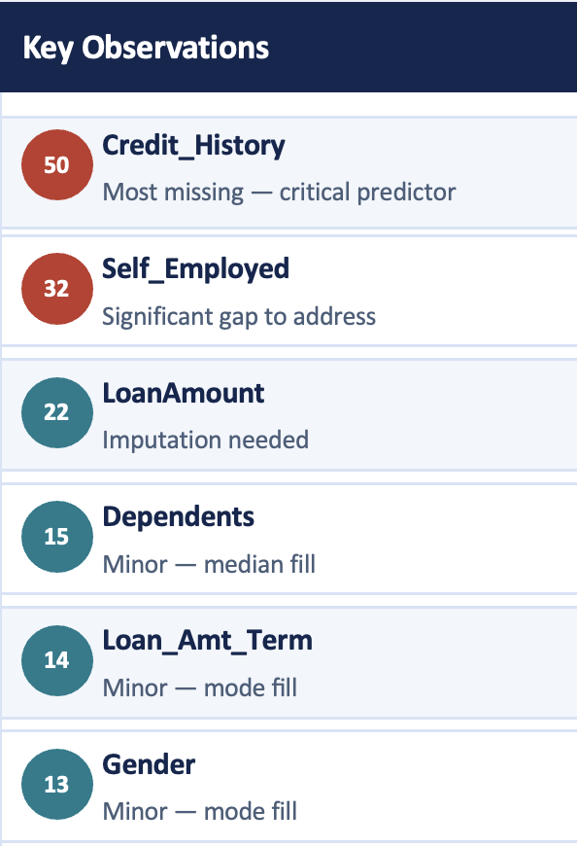
Basic Overview — Missing Values
Notes:
This slide is about the missing values in the dataset.
1. The chart says that Credit History has the missing values, with 50 records missing. This really matters because Credit History is a part of predicting loan approval.
2. Credit History is very important. It has a lot of missing values. Self_Employed also has a lot of missing values with 32 records missing.
3. LoanAmount is missing 22 values and Dependents and Loan Amount Term and Gender are missing a values.
4. Some parts of the dataset like Education and ApplicantIncome and CoapplicantIncome and Property Area and Loan Status do not have any values.
5. To get the data ready for modeling we fill in the missing values using methods like mode or median or special imputation techniques, for the Credit History and other parts of the dataset.

Slide 7
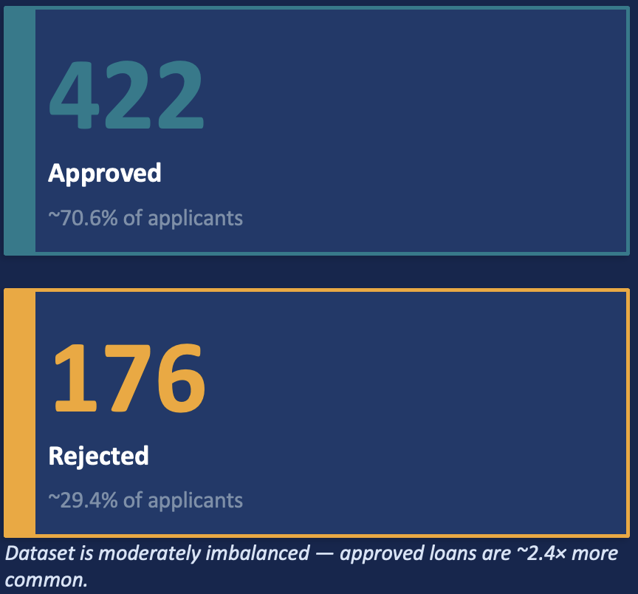
Basic Overview — Loan Status Distribution
Notes:
This slide is about the loan approval distribution.
It tells us how many loans were approved and how many were rejected.
There are 422 loans that were approved this is 71 percent of all the loans we have.
On the hand there are 176 loans that were rejected this is 29 percent of all the loans we have.
Loan approvals are more common than loan rejections.
When we know this information about loan approvals and loan rejections it helps us understand the loan data before we build the prediction model, for loan approvals and loan rejections.

Slide 8
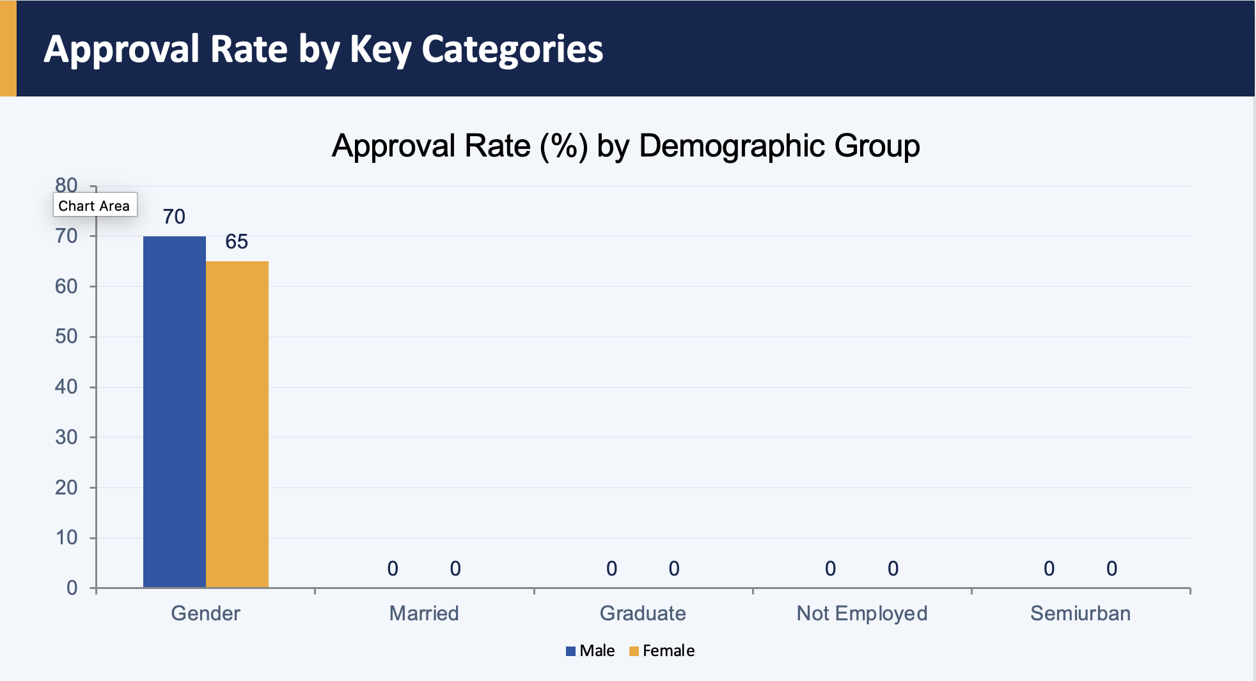
Approval Rate by Key Categories
Notes:
This slide shows us how many loans get approved for kinds of people.
The chart looks at how loans are approved for different groups like men and women married or single people, how much education someone has what kind of job they have and where they live.
Men who apply for loans get approved a little often than women who apply.
Looking at this information helps us figure out which groups of people are more or less likely to get a loan approved.
This information is really useful for understanding what our customers are like and for making our predictions, about loans better.

Slide 9
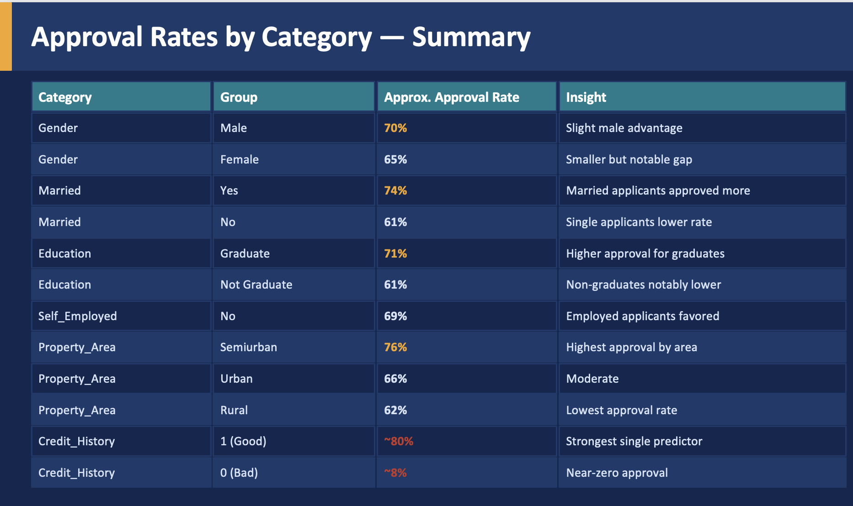
Approval Rates by Category — Summary
Notes:
This slide is about loan approval rates for groups of people.
Loan approval rates are a little higher for applicants than for female applicants.
When we look at loan approval rates for people and single people we see that married people get approved more often.
People who finished college have a chance of getting a loan than people who did not finish college.
If we look at where people live we see that people who live in areas get approved the most.
The thing that matters the most for loan approval is credit history.
If you have a credit history it is much easier to get a loan because a good credit history really helps with loan approval, for loan applicants.

Slide 10
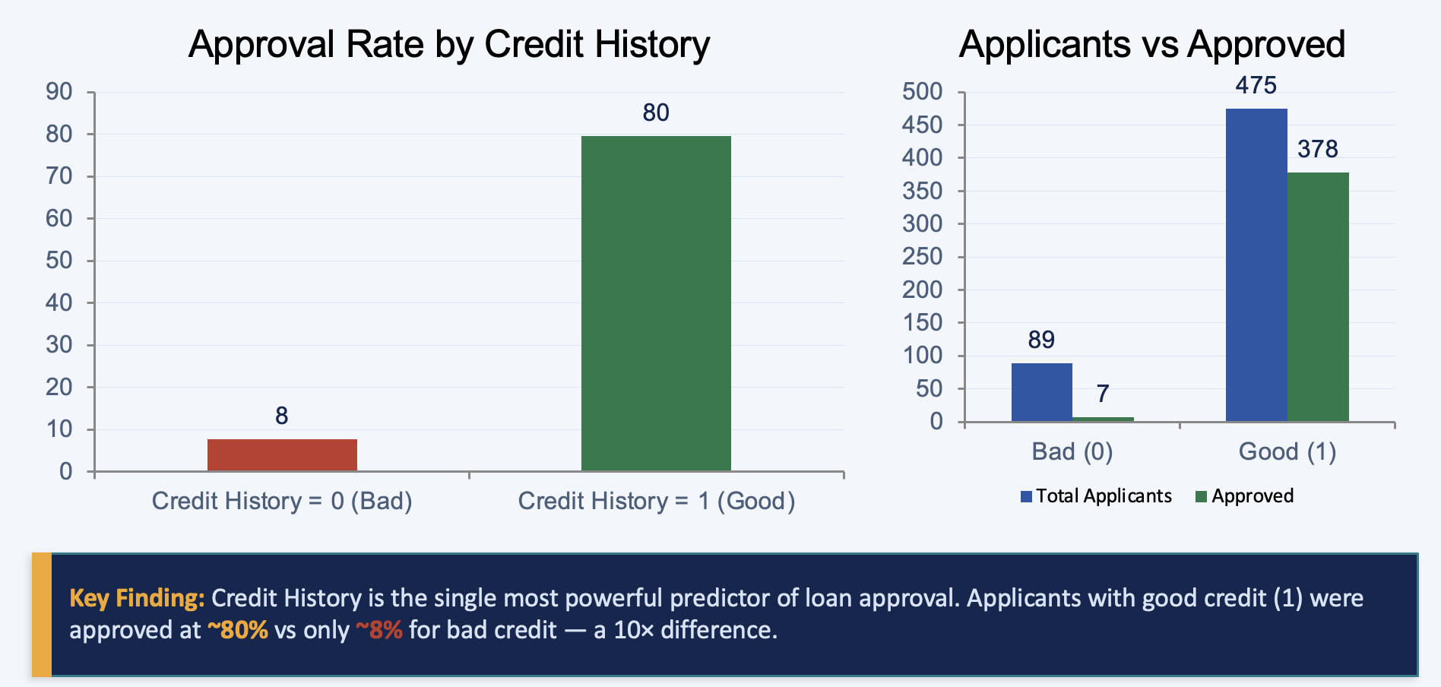
Credit History — Dominant Predictor
Notes:
This slide shows that credit history is the strongest factor in loan approval.
1. Applicants with good credit history have about an 80% approval rate.
2. Applicants with bad credit history have only about an 8% approval rate.
3. The second chart also shows that most approved loans come from applicants with good credit history.
4. This means credit history is the most important predictor in the loan approval model.

Slide 11
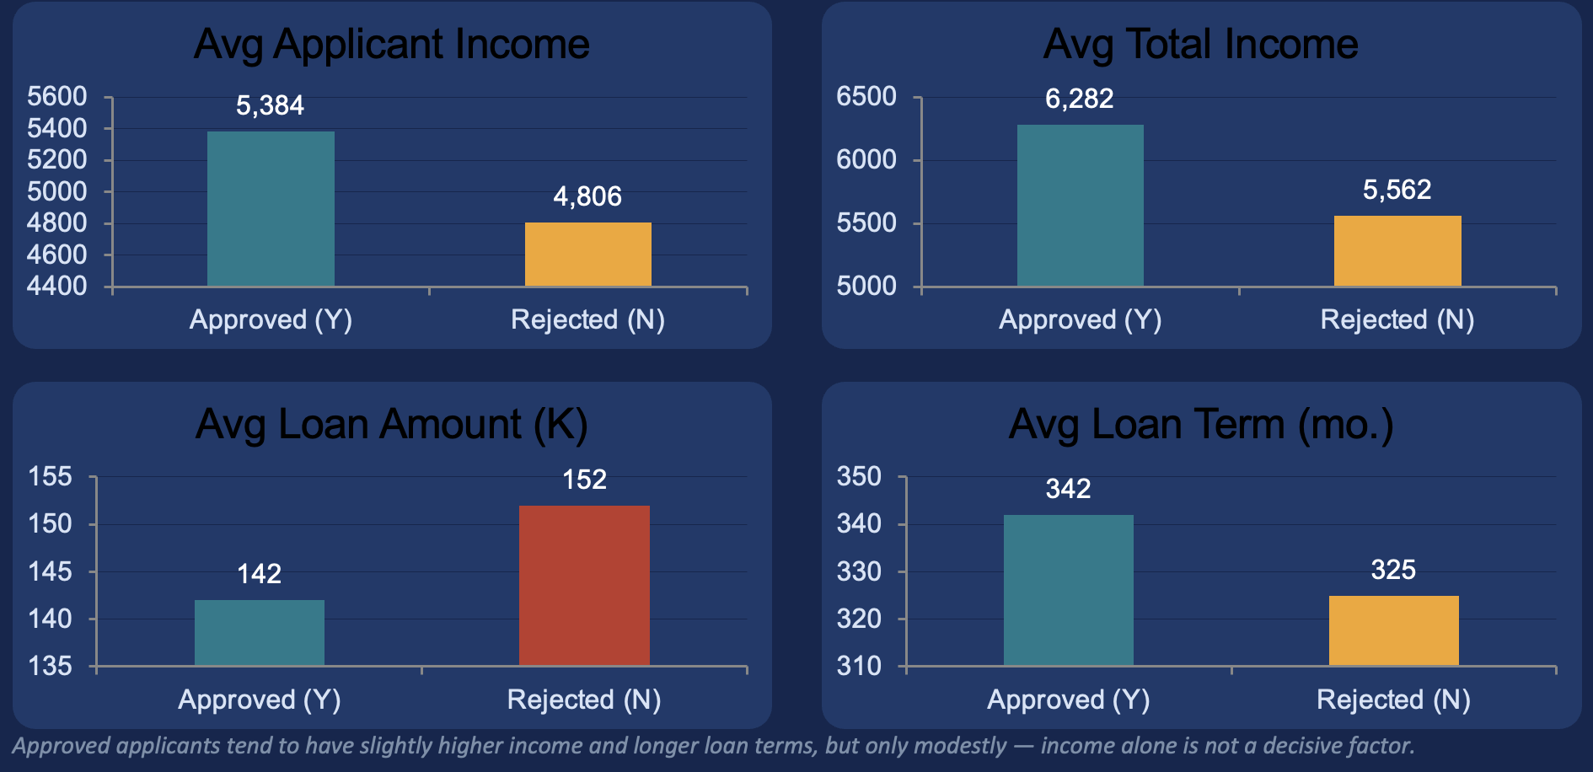
Income, Loan Amount & Loan Term Patterns
Notes:
This slide shows income, loan amount, and loan term patterns.
1. Approved applicants have slightly higher applicant income and total income than rejected applicants.
2. Rejected applicants have a slightly higher average loan amount.
3. Approved applicants also have slightly longer loan terms.
Overall, income and loan amount affect loan approval, but they are not the strongest factors in the model.

Slide 12
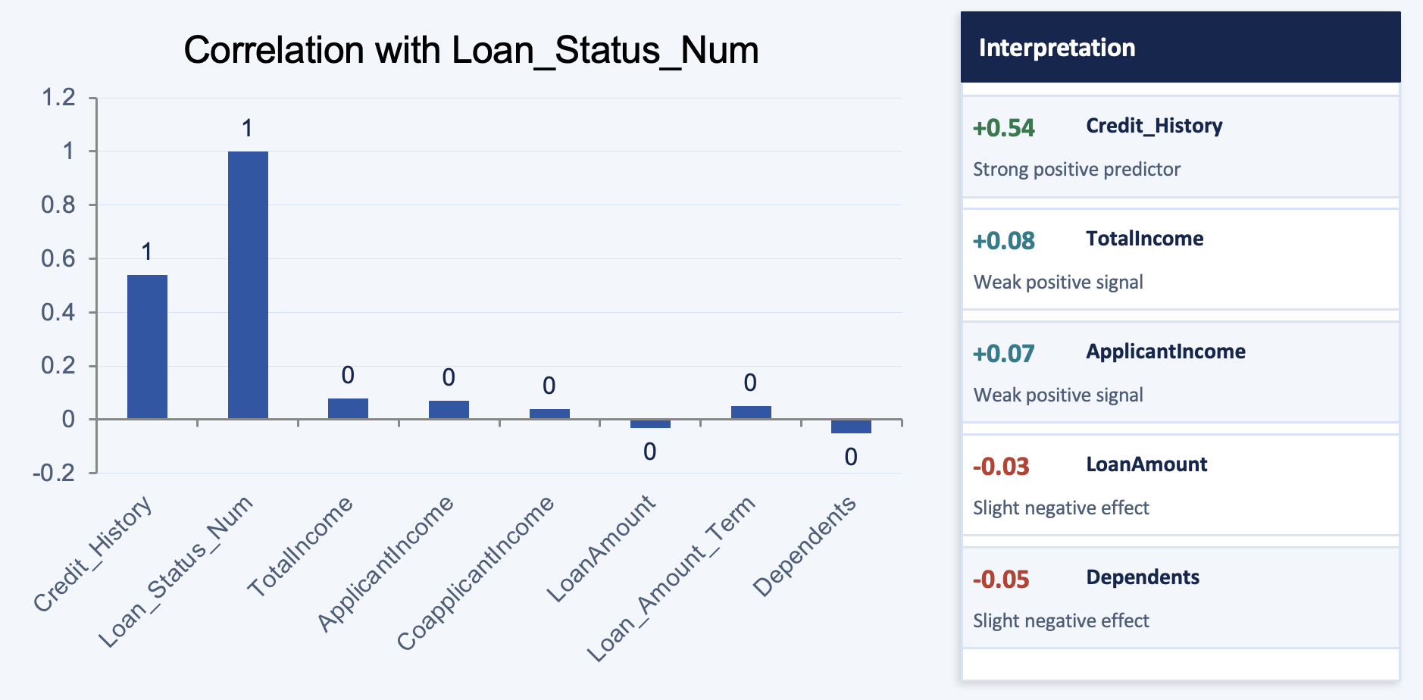
Feature Correlations with Loan Approval
Notes:
This slide shows the correlation between features and loan approval.
1. Credit history has the strongest positive relationship with loan approval.
2. Total income and applicant income have a small positive effect.
3. Loan amount and dependents have a slight negative effect on approval.
Overall, credit history is the most important feature in predicting loan approval.

Slide 13
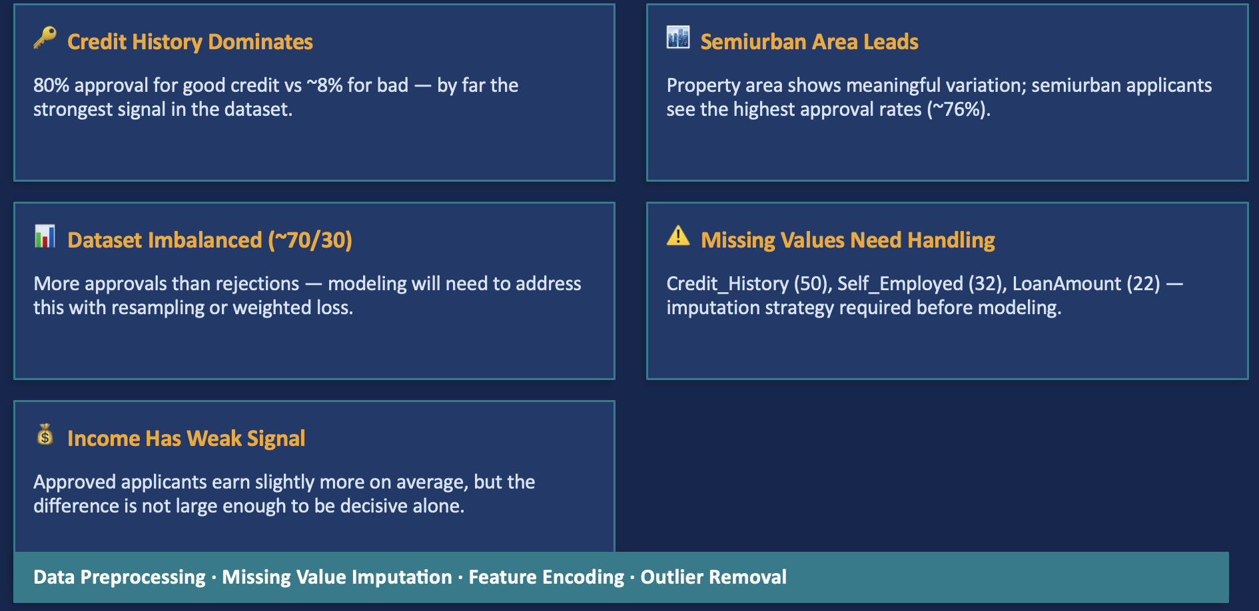
Key Findings & Conclusion
Notes:
This slide shows the main findings of the project.
1. Credit history is the most important factor in loan approval.
2. Semiurban applicants have the highest approval rates.
3. The dataset has more approved loans than rejected loans.
4. Some columns have missing values and need data cleaning.
5. Income has only a small effect on loan approval.

Slide 14
References
Dumitrescu, E., Hué, S., Hurlin, C., & Tokpavi, S. (2022). Machine learning for credit scoring: Improving logistic regression with non-linear decision-tree effects. European Journal of Operational Research, 297(3), 1178–1192. | https://doi.org/10.1016/j.ejor.2021.06.053
Zhu, X., Chu, Q., Song, X., Hu, P., & Peng, L. (2023). Explainable prediction of loan default based on machine learning models. Data Science and Management, 6(3), 123–133. | https://doi.org/10.1016/j.dsm.2023.04.003
FinRegLab. (2023). Machine learning explainability and fairness: Insights from consumer lending. FinRegLab Whitepaper. | https://finreglab.org
Federal Trade Commission. (2025). Understanding your credit. FTC Consumer Information. | https://consumer.ftc.gov/articles/understanding-your-credit
Lundberg, S. M., & Lee, S. I. (2017). A unified approach to interpreting model predictions. Advances in Neural Information Processing Systems, 30 (NIPS 2017). | https://proceedings.neurips.cc/paper/2017/hash/8a20a8621978632d76c43dfd28b67767-Abstract.html
Notes:
The references include research papers

Slide 15
Thank You

