Slide 1

Predicting insurance claim costs
PREDICTIVE ANALYTICS · INSURANCE
Data Science Practicum 2 — Final Presentation, MSDS696_S70_Data Science Practicum II
Prakash Ghatani | Regis University, Denver, CO | pghatani@regis.edu
BLUF
Insurance executives should use the tuned Gradient Boosting model to rank claims and send the top 5% of scored claims to experienced adjusters for early review before setting reserves.
Data Science Project | August 2026

Slide 2
Project Topic and Business Goal
Finding high-cost claims early helps managers review them sooner and set better reserves.
Project topic: predict insurance claim costs using machine learning.
Business goal: identify potentially expensive claims earlier and support better reserve planning.
Target variable: loss — the dollar amount of an insurance claim.
Decision-support focus: help claims managers prioritize reviews and allocate resources.

Slide 3
Kaggle Dataset Loaded into Python
Source
Kaggle — Allstate Claims Severity
Dataset
188,318 rows 132 columns
Features
116 categorical 14 numerical
Loaded and analyzed with pandas and scikit-learn.
No duplicate rows and no missing values were found in the initial inspection.

Slide 4
Data-Fit Evaluation: Fit, Provenance, Limits, Feasibility
Fit
Loss is a dollar amount, so regression is used
Provenance
Allstate Claims Severity competition data from Kaggle.
Limits
Anonymized predictors, skewed target, limited claim context
Feasibility
188K+ rows support training, testing, tuning, and visuals.

Slide 5
Three Dataset Limitations
Anonymized features such as cat1 and cont1 limit business interpretation.
Claim loss is strongly right-skewed: most claims are small while a few are very expensive.
The dataset does not include claim dates, policy details, or external factors.
Therefore, the model should support—not replace—claims professionals.

Slide 6
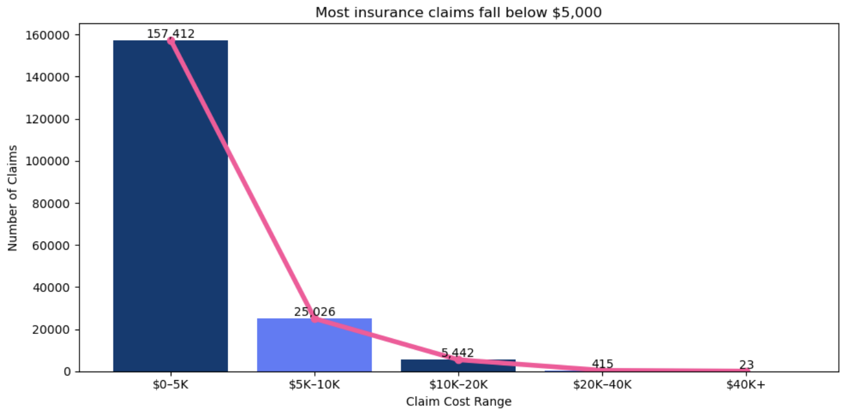
EDA: Most Claims Are Below $5,000
Most claims (83.59%) cost less than $5,000. • Only 23 out of 188,318 claims cost more than $40,000.
• A few expensive claims can cause a big financial loss
6

Slide 7
Business Insight: Prioritize Rare High-Cost Claims Earlier
Business Insight
Claims managers should pilot early review of the top 5% of model-ranked claims.
Use model scores to rank claims early
Send the top 5% of claims for early review.
In the held-out test set, the top 5% captured all 6 claims above $40,000. Continue validating this result before full use.
7

Slide 8
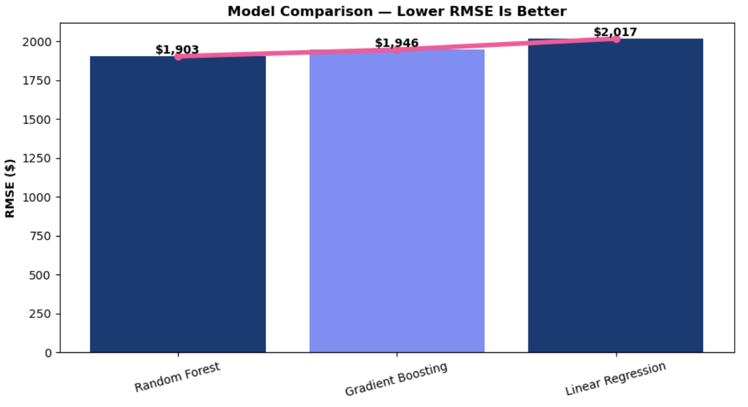
Random Forest Led Initially; Tuned Gradient Boosting Finished Best
• Linear Regression: RMSE $2,016.61; R² 0.5016.
• Random Forest: RMSE $1,903.31; R² 0.5560.
• Gradient Boosting: RMSE $1,945.67; R² 0.5361.
• Random Forest performed best at first, then Gradient Boosting was tuned.
8

Slide 9
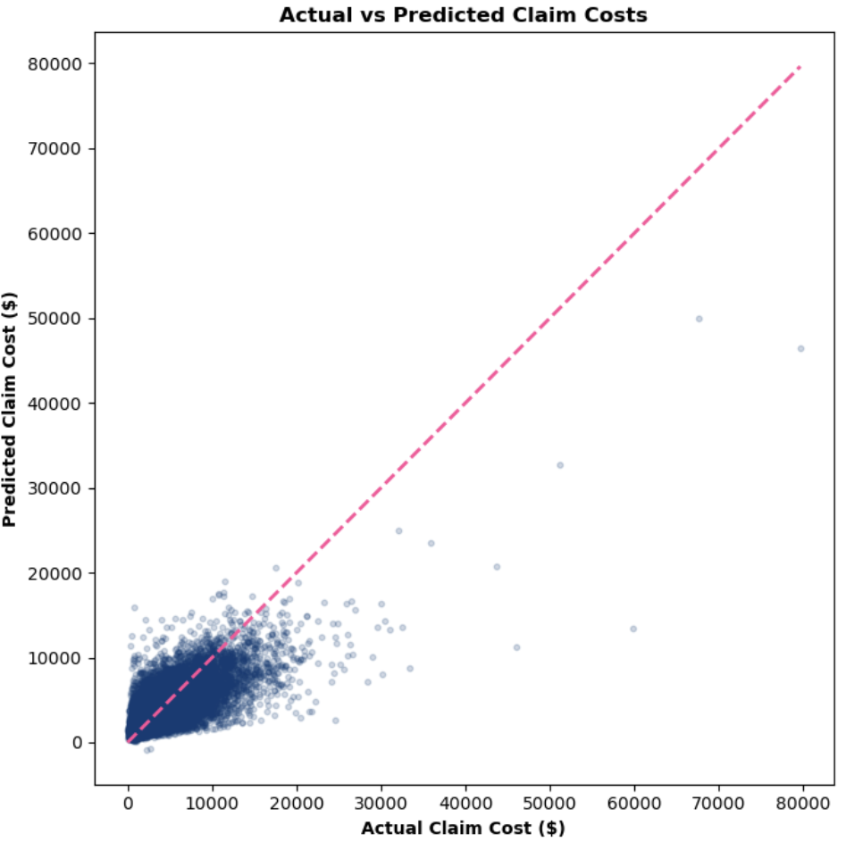
Tuned Gradient Boosting Improved Overall Error, but Extreme Claims Remain Harder
RMSE
$1,884.82
MAE
$1,218.61
R²
0.5646
• Tuned Gradient Boosting achieved the lowest final RMSE among the evaluated models.
• High-cost tail errors remain visible, so exact pricing of extreme claims is still difficult.
• The top 5% captured all 6 claims above $40,000 in the held-out test set. Because there were only 6, further validation is needed
9

Slide 10
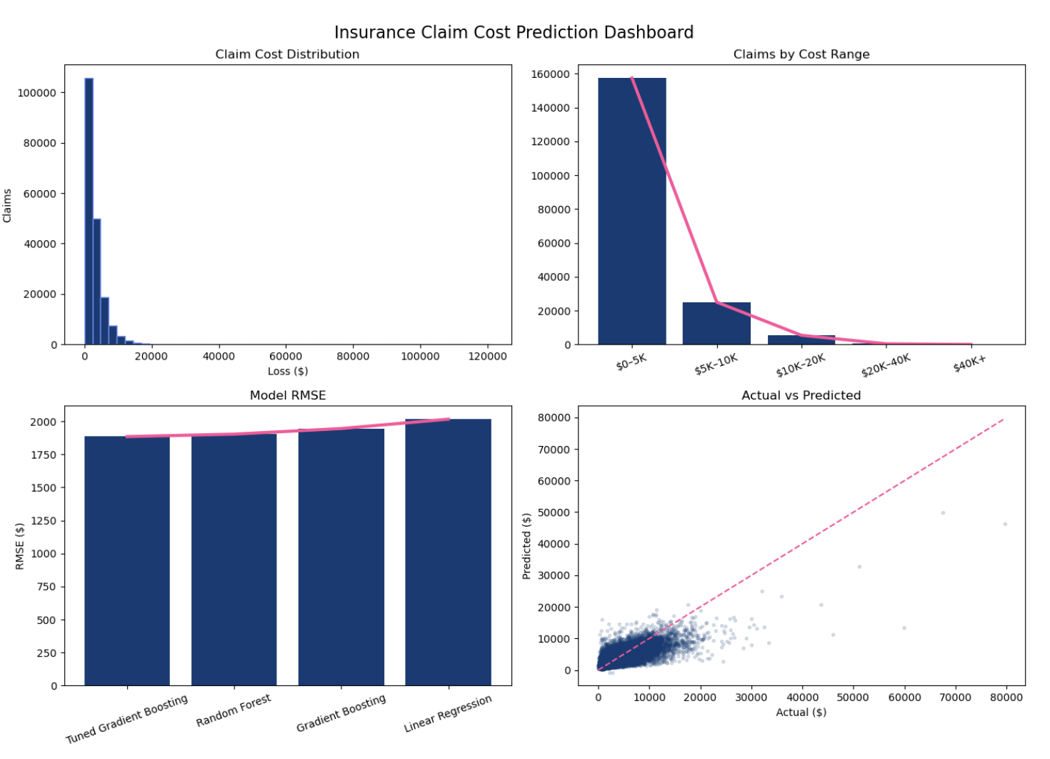
Visualization Dashboard
• Claim-cost distribution
• Claims by cost range
• Final model RMSE comparison
• Actual vs. predicted claim costs
• Dashboard connects technical results to business decisions.
10

Slide 11
Final Recommendation and Conclusion
Recommendation
Insurance executives should test the tuned Gradient Boosting model and send the top 5% of scored claims to experienced adjusters for early review before setting reserves.
• In the held-out test set, the top 5% captured all 6 claims above $40,000. Continue validating the threshold on additional data before full deployment.
• Final test performance: RMSE $1,884.82, MAE $1,218.61, and R² 0.5646.
• Limit: High-cost claims are harder to predict, so use the model to prioritize claims, not automatically set reserves.
11

Slide 12
References / Project Deliverables
• Kaggle — Allstate Claims Severity training dataset.
• Python: pandas, NumPy, Matplotlib, and scikit-learn.
• Completed deliverables: data-fit evaluation, data cleaning, EDA, business insight, analysis plan, regression models, model tuning, final evaluation, dashboard, final report, and presentation.
• Technical notebook: Allstate Claims Complete Project.
• Detailed cleaning, preprocessing, tuning, and model-selection steps are documented in the technical notebook/repository.
12

Slide 13
Most important numbers to remember for Q&A: 188,318 claims → 83.59% below $5,000 → only 23 above $40,000 → final RMSE $1,884.82 → MAE $1,218.61 → R² 0.5646 → The top 5% is a pilot threshold supported by the held-out test result, but it requires further validation.
Thank you !

