Slide 1
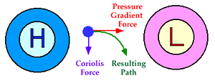
Surface winds
An air parcel initially at rest will move from high pressure to low pressure (pressure gradient force)
Geostrophic wind blows parallel to the isobars because the Coriolis force and pressure gradient force are in balance.

Slide 2
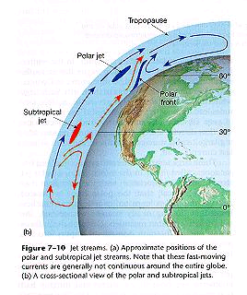
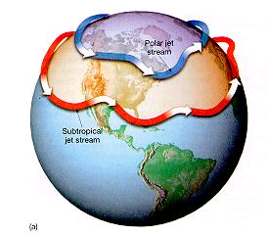
Rossby waves and the westerly wind belt
The jet stream is closely linked to the position of Rossby waves.

Slide 3
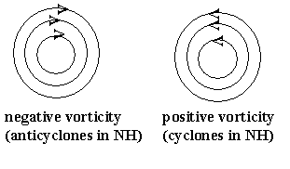
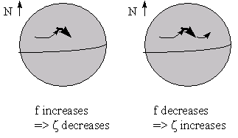
Rossby waves
Vorticity - the tendency to spin about an axis
On the spinnng Earth there is vorticity from the Earth’s spin (planetary vorticity) and local vorticity due to cyclonic/anticyclonic behaviour (relative vorticity)
The absolute vorticity is conserved: zeta + f = constant (f = 2 \omega sin \phi)
Oscillations: Rossby waves
Topographic Rossby waves: standing wave fixed to a permanent forcing location

Slide 4
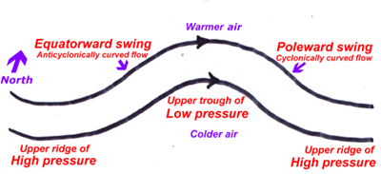
Rossby waves and the westerly wind belt
large-scale meanders of the mid-latitude jet stream. Here Southern Hemisphere
Extend: 30° of latitude
Zeta + f = const.

Slide 5
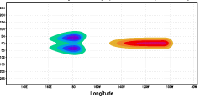
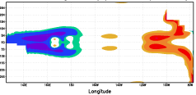
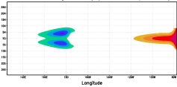
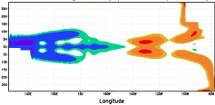
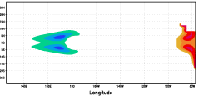
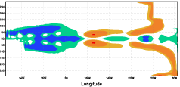
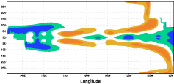
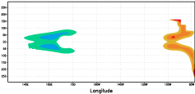
Kelvin wave (3 m/s, 70 days) Rossby wave (1m/s, 210 days)
25 days
125 days
50 days
175 days
75 days
225 days
275 days
100 days
sea surface height anomalies

Slide 6
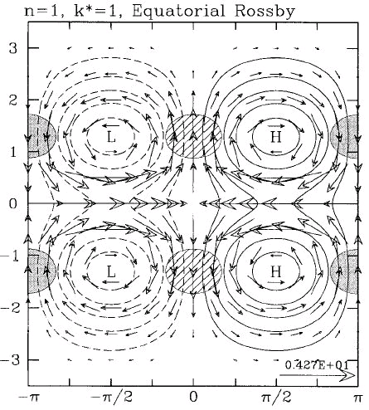
N=1, k=1 Rossby wave

Slide 7
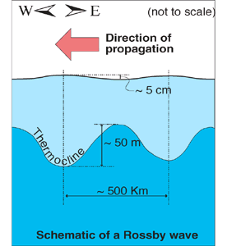
Rossby waves: Ocean
Schematic view "first-mode baroclinic" Rossby wave
Existence in the oceans (Carl-Gustav Rossby, 1930s) has been only indirectly confirmed before the advent of satellite oceanography.
Why is it so difficult to observe them?
It is the big difference in the horizontal and vertical scale of these waves which makes them so difficult to observe.
speed varies with latitude and increases equatorward, order of just a few cm/s

Slide 8
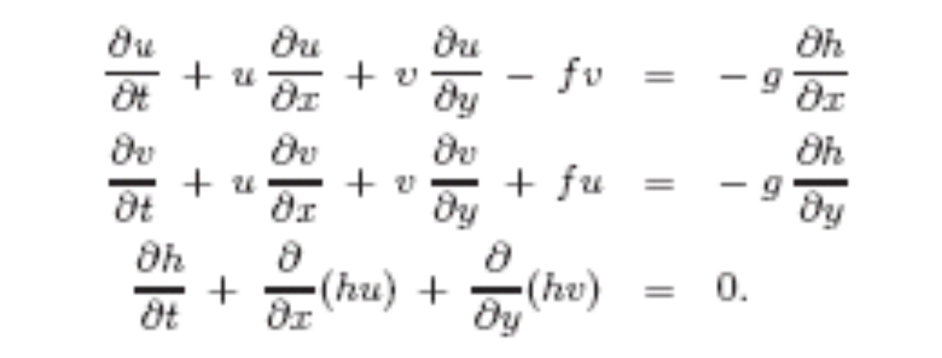
Shallow Water Model
Case b=0
This is a formulation that we will encounter in layered models !

Slide 9
Shallow Water Model
Case b=0

Slide 10
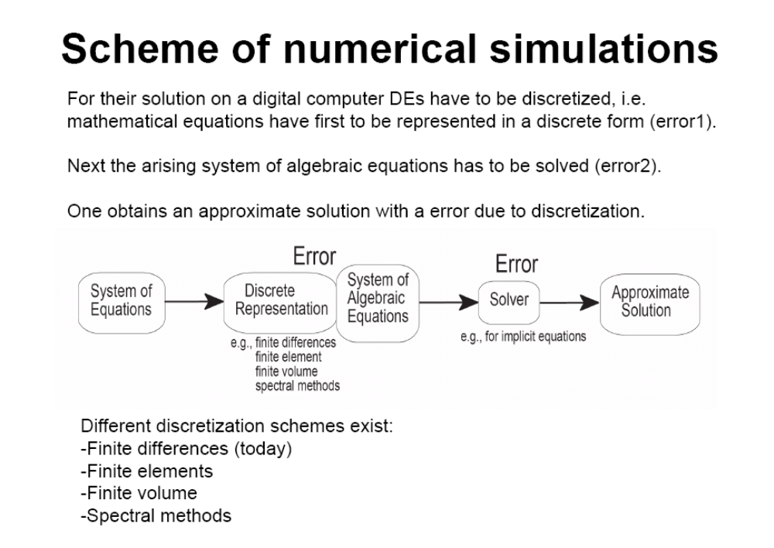

Slide 11
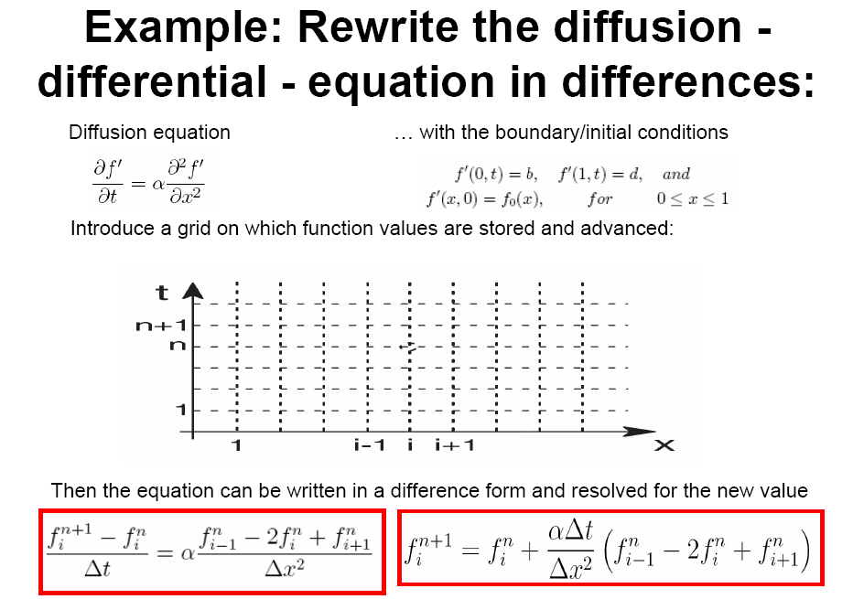

Slide 12
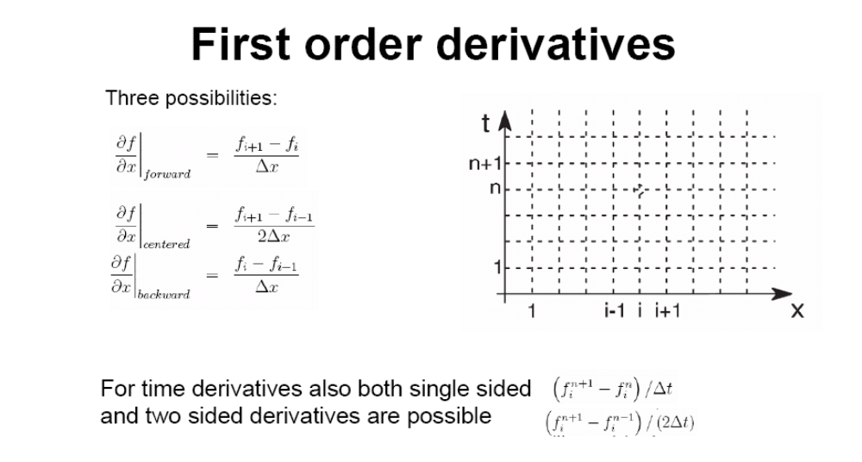

Slide 13
