Slide 1

MOTOR INSURANCE DATABASE
Done by- P.GIRI KISHORE
Usn- 1NH16CS104
Class-5th
Section-’B’
Course- DBMS

Slide 2
Objectives
Should be able to create ER diagram for the given assumptions
Should be able to map the ER diagram into relational schema.
Should be able to query the tables and get required output.
Should be aware of normalisation and should be able to normalise the table until Boyce Codd Normal Form(BCNF).
Should be able to create an appropriate front end for the database.

Slide 3
PROBLEM STATEMENT
This project allows users to create a new motor insurance policy by entering in their personal details and the vehicles details.
The admin updates the policy information in the policy table maintained by the insurance company.
The customer can claim insurance by filling in the claim form
The Admin can either approve the claim or reject the claim.
The approved claim is updated in the settlement table.

Slide 4
ER Diagram
ClaimID
ClaimDate
ClaimStatus
ClaimAmt
Insurance
Has
Settlement
DamageType
Date
Description
Gender
Name
Dateofclaim
Amt
FIRnum
Claims
Has
DOB
Email
Cust_ID
Phone
Customer
PolicyNum
Effdate
ChassisNum
Year
EngNum
VehicleID
IssueDate
Has
Lincense
Policy
Address
ExpiryDate
Make
Vehicle
Has
TotalAmt
CoverageType
DateOfPurchase
Has
Color
Model
RegNum
CityOfPurchase
ExpiryDate
CardNumber
Payment
Has
Bill
BankNname
IsCard?
Lname
Mname
Fname
Date
AmountPaid

Slide 5
SCHEMA
CUSTOMER
Cust_ID
Fname
Mname
Lname
Gender
DOB
Phone
License Issue Date
LincenseIssueState
LicenseNum
Hno
Street
City
State
Pin
Active
VEHICLE
VehicleID
Years
Make
Model
Color
RegNum
Fuel Type
Engine Number
Chassis Number
DateOf Purchase
CityOfPurchase
CustID
INSURANCE
Claim_ID
ClaimAmt
Damage Type
FIRNum
DateOfClaim
Claim Status
DateOf Incident
Description
CustID
SETTLEMENT
ID
Date
Amt
CustID
ClaimID
POLICY
Policy Num
IssueDate
EffectiveDate
Expiry Date
Coverage Type
TotalAmt
Active
VID
BILL
Billnum
Date
Amt
PymtID
Pnum
PAYEMNT
Pymt_ID
Fname
Mname
Lname
Bank Name
Acct Num
IsCard
Card Number
Expiry Date

Slide 6
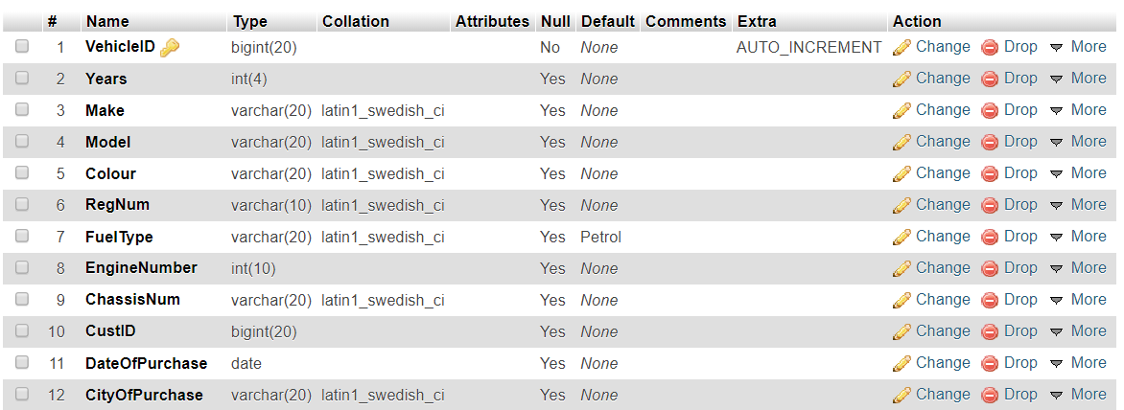
QUERY
CREATE TABLE `insurance`(`Claim_ID`bigint(20) NOT NULL AUTO_INCREMENT,`ClaimAmt` decimal(10,2) DEFAULT NULL,`DamageType`varchar(20) DEFAULT NULL,`FIR_Number` varchar(20) DEFAULT NULL,`DateofClaim` date DEFAULT NULL,`ClaimStatus` varchar(20) DEFAULT NULL, `CustID` bigint(20) DEFAULT NULL,PRIMARY KEY (`Claim_ID`),KEY `CustID` (`CustID`),CONSTRAINT `insurance_ibfk_1` FOREIGN KEY (`CustID`) REFERENCES `customer` (`cust_id`) ON DELETE SET NULL ON UPDATE CASCADE)

Slide 7
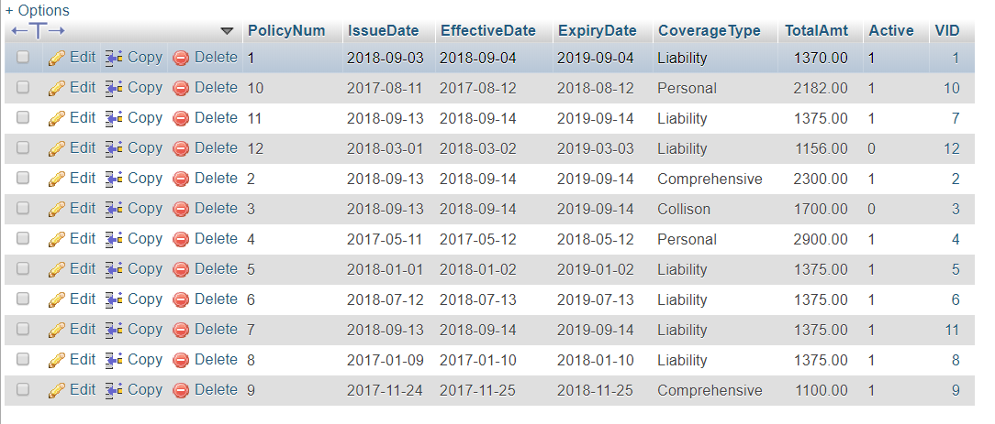
SELECT * FROM POLICY ;

Slide 8
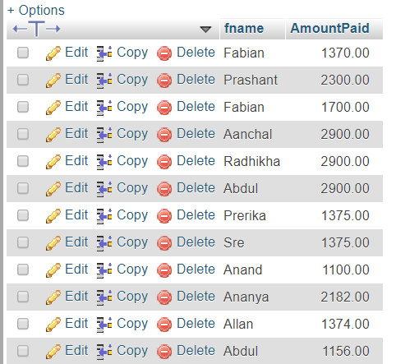
CREATE VIEW billdet AS SELECT Fname,AmountPaid FROM customer,vehicle,policy,bill WHERE CustID=Cust_ID AND VID=VehicleID AND Pnum=PolicyNum;

Slide 9
THANK YOU

