Slide 1
Battle of Neighborhood's
AREAS OF opportunity to Improve the coverage of the health system of the cdmx.
By Pedro G Jimenez
Presentation for IBM’s Coursera Capstone Project .

Slide 2
DATA
Data requirements to solve the problem: List of CDMX boroughs with population density and coordinates. List of public sector hospitals. Search for health interest venues in each borough.
Hospitals and Health Centers in Mexico City. https://datos.cdmx.gob.mx/explore/dataset/hospitales-y-centros-de-salud/
Wikipedia.
https://es.wikipedia.org/wiki/Ciudad_de_M%C3%A9xico
https://es.wikipedia.org/wiki/Anexo:Delegaciones_de_la_Ciudad_de_M%C3%A9xico_por_IDH
Google Geocoding API.
Foursquare API.

Slide 3
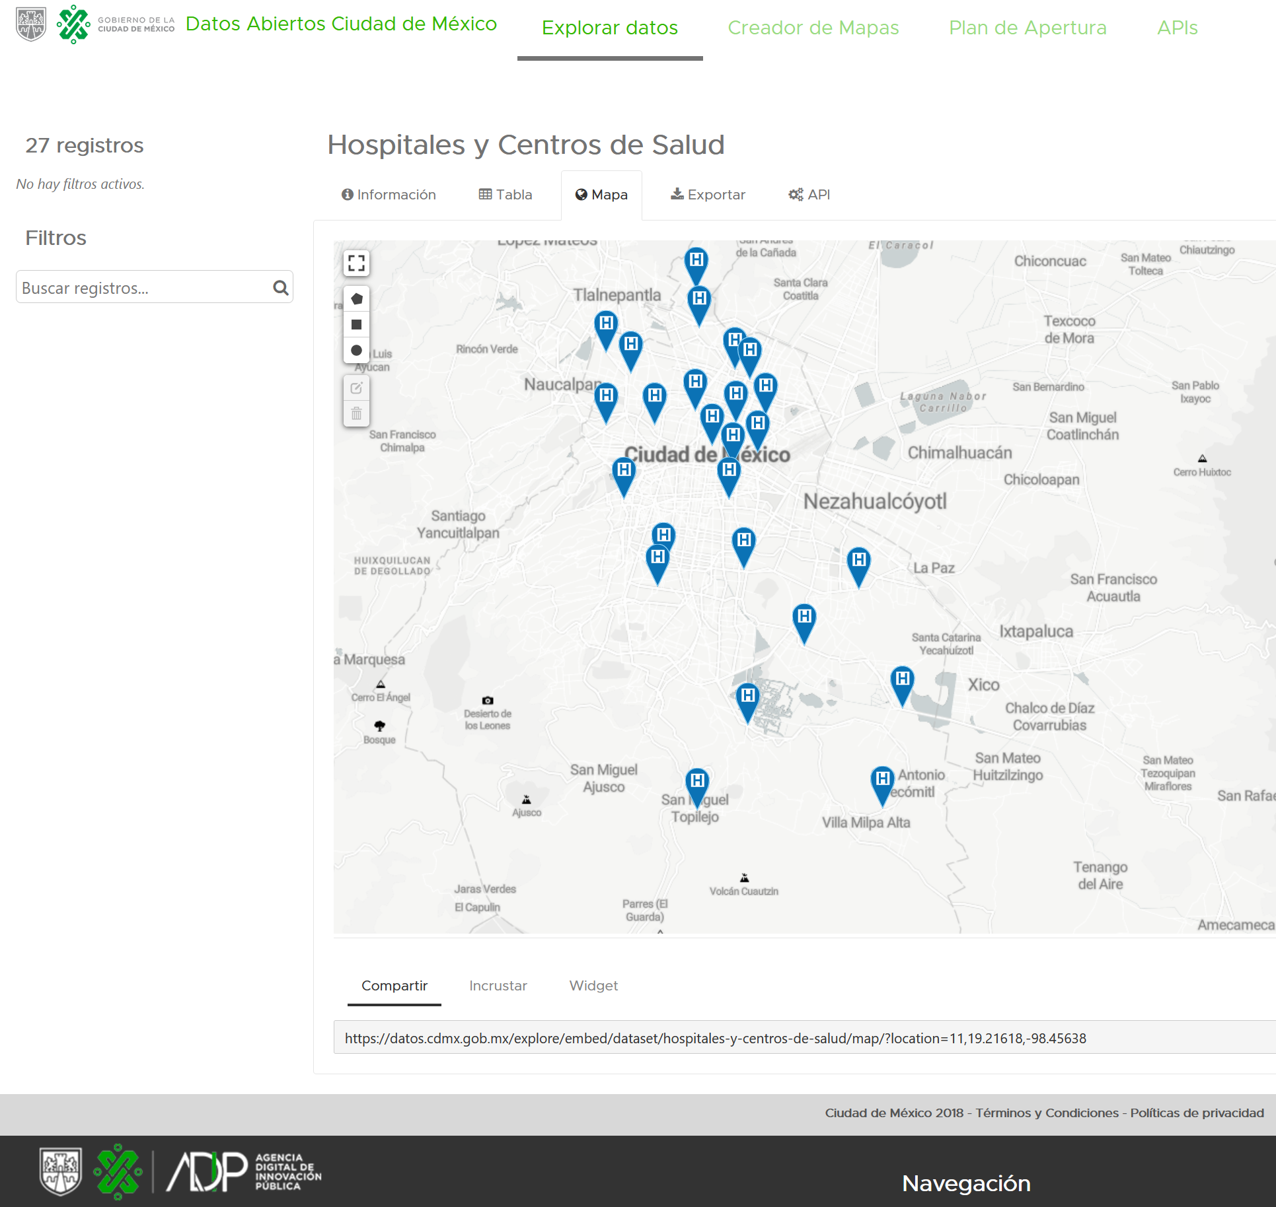
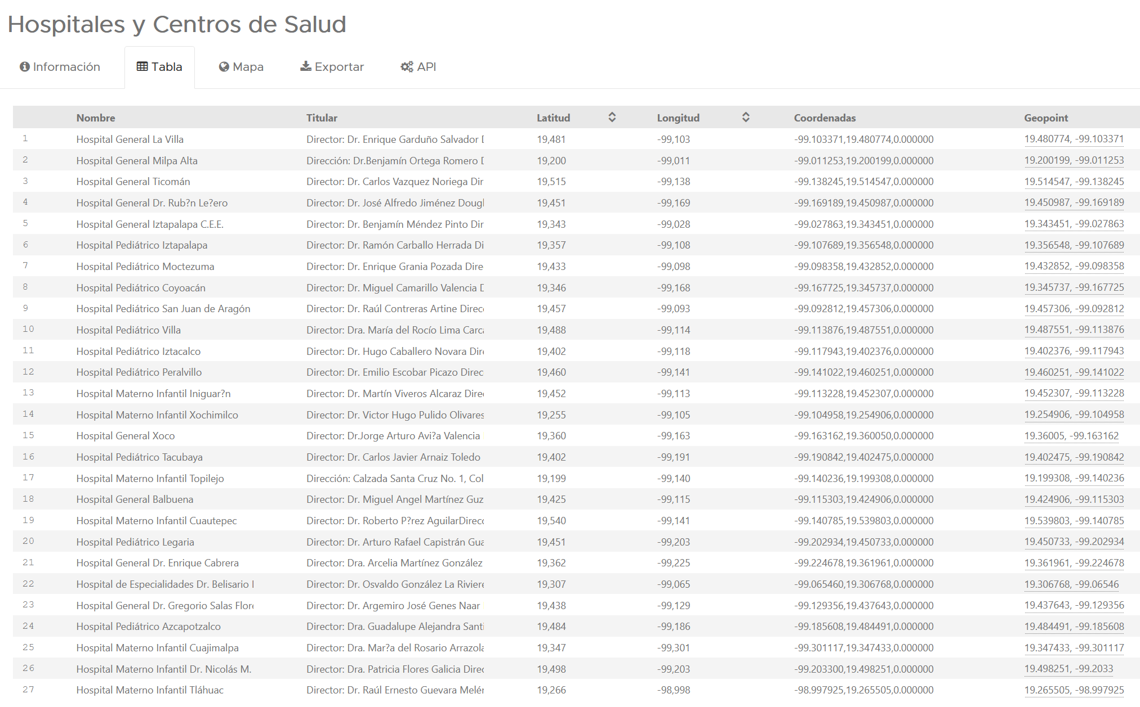
example

Slide 4
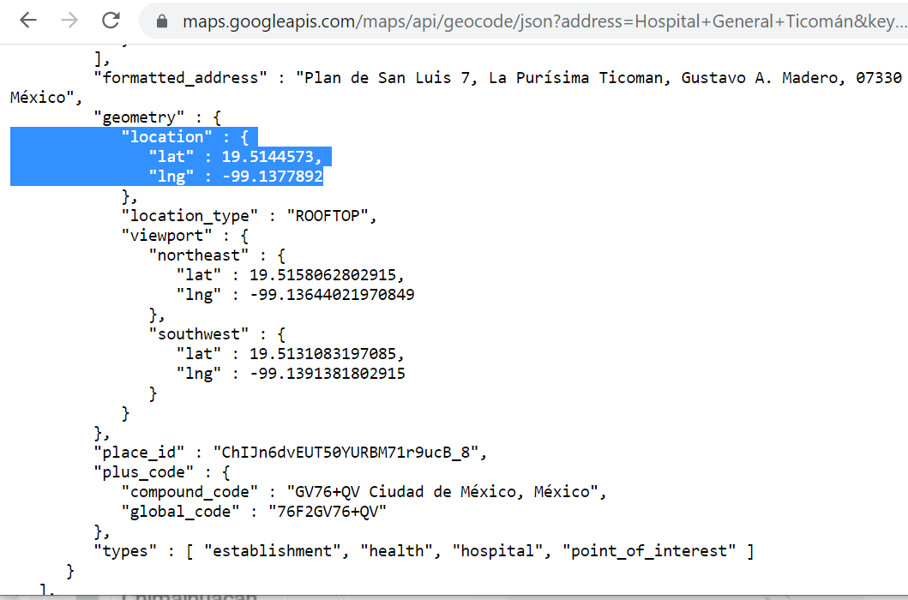
example

