Slide 1
Battle of Neighborhood's
AREAS OF opportunity to Improve the coverage of the health system of the cdmx.
By Pedro G Jimenez
Presentation for IBM’s Coursera Capstone Project .

Slide 2
Introduction
Mexico City abbreviated as CDMX, is the capital city of Mexico and the most populous city in North America.
The city has 16 subdivisions, formerly known as boroughs.
Only 1 in 10 Mexicans has insurance for private medical expenses.
Insurance companies in the health sector have the opportunity to increase the percentage of the insured population for the private sector.
The public health sector is applying the strategy of improving existing capacity, or temporarily reconverting internal areas to deal with the covit-19 pandemic global.

Slide 3
Business problem
The purpose of this project is to identify boroughs in CDMX, with a low number of public hospitals. Health is a priority issue, and it is essential to have effective universal medical coverage. The challenge is to expand the health system. Where should there be another hospital?
Target Audience: This project specifically will be targeted for stakeholders interested in knowing, using or improving the hospital health system in CDMX.

Slide 4
DATA
Data requirements to solve the problem: List of CDMX boroughs with population density and coordinates. List of public sector hospitals. Search for health interest venues in each borough.
Hospitals and Health Centers in Mexico City. https://datos.cdmx.gob.mx/explore/dataset/hospitales-y-centros-de-salud/
Wikipedia.
https://es.wikipedia.org/wiki/Ciudad_de_M%C3%A9xico
Foursquare API.

Slide 5
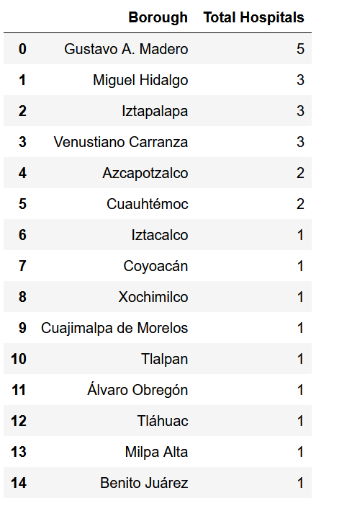
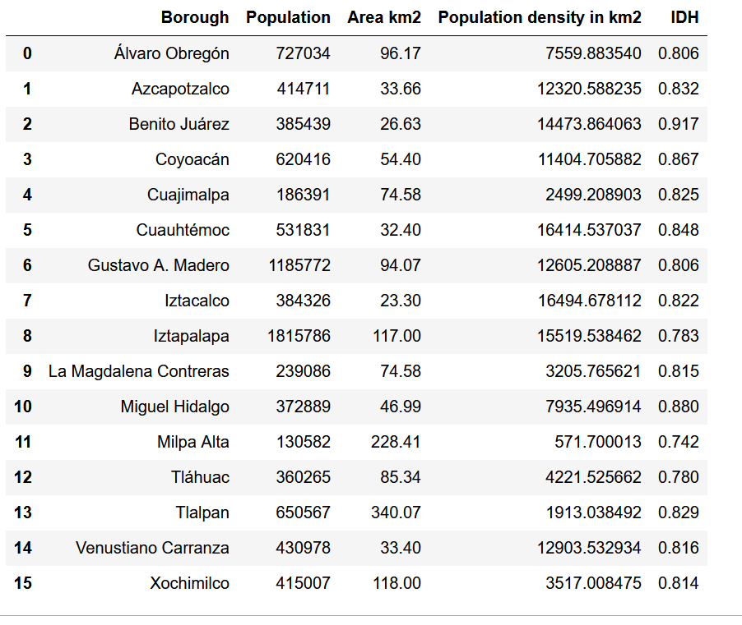
DATA - EXAMPLES

Slide 6
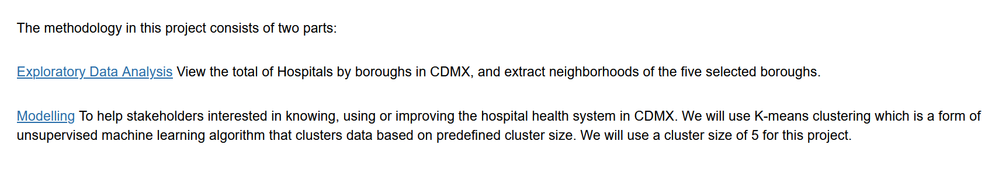
METHODOLOGY

Slide 7
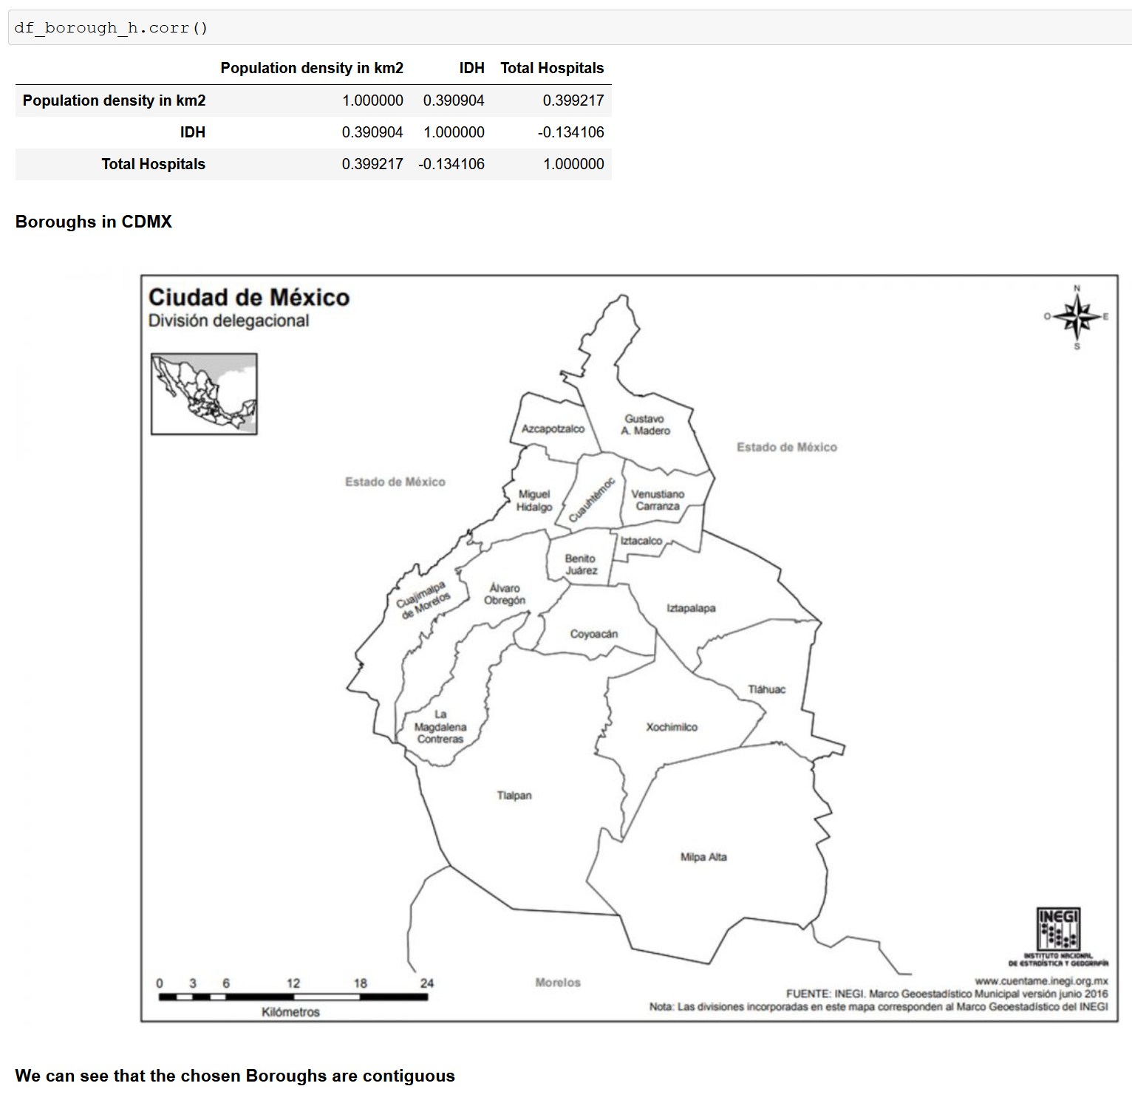
Analys data

Slide 8
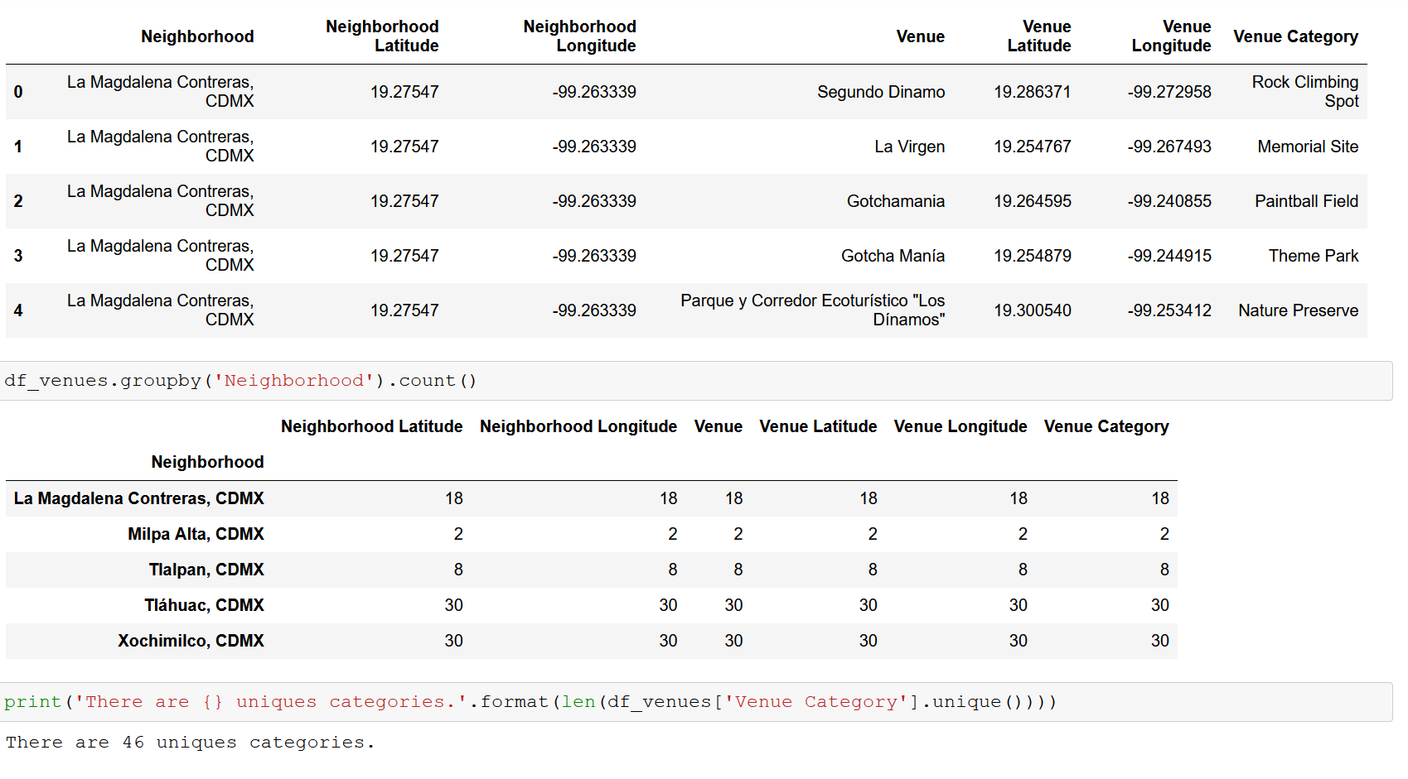
Modelling
Finding all the venues within a 3000 meter radius of each neighborhood. Perform one hot ecoding on the venues data. Grouping the venues by the neighborhood and calculating their mean. Performing a K-means clustering (Defining K = 5)

Slide 9
Modelling
Finding all the venues within a 3000 meter radius of each neighborhood. Perform one hot ecoding on the venues data. Grouping the venues by the neighborhood and calculating their mean. Performing a K-means clustering (Defining K = 5)

Slide 10
