Slide 1
HydroSafe

Slide 2
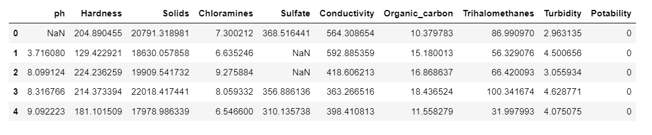
ABOUT DATASET
Potability of water decides if it is suitable for human consumption (i.e., water that can be used for drinking or cooking). The term implies that the water is drinkable as well as safe.
pH: The pH level of the water.
Hardness: A measure of mineral content
Solids: Total dissolved solids in the water
Chloramines: Chloramines in the water.

Slide 3
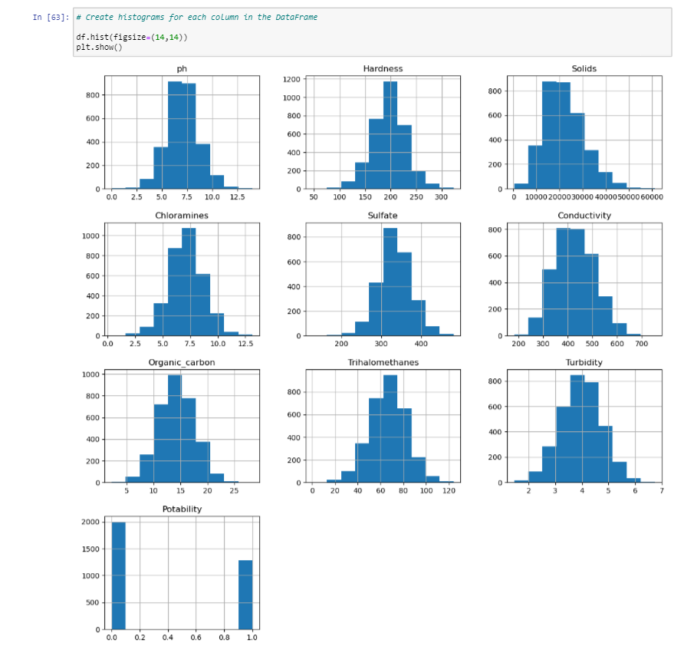
HISTOGRAM
A histogram is a visual representation of the distribution of numeric data. It's a type of chart that shows the frequency distribution of data points across a continuous range of numerical values.
CODE
OUTPUT

Slide 4
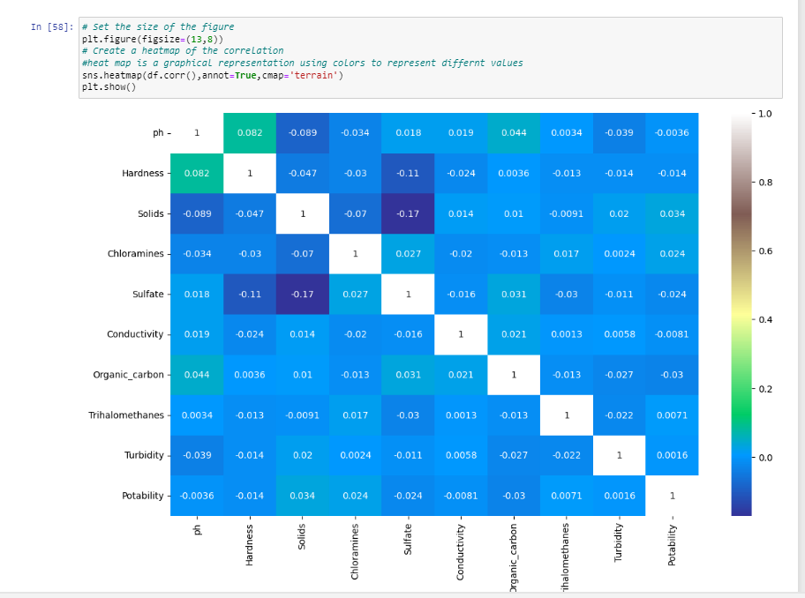
HEATMAP
A heatmap is a graphical representation of data that uses a system of color coding to represent different values.

Slide 5
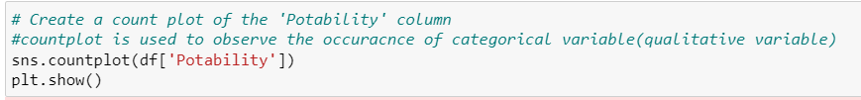
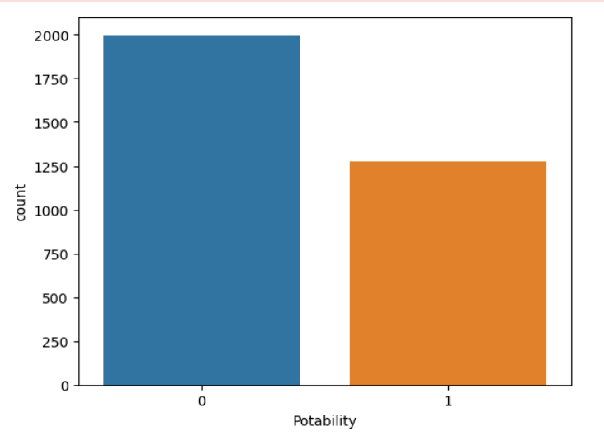
COUNTER PLOT FOR THE DATASET
The countplot is used to represent the occurrence(counts) of the observation present in the categorical variable. It uses the concept of a bar chart for the visual depiction.
CODE :
OUTPUT :

Slide 6
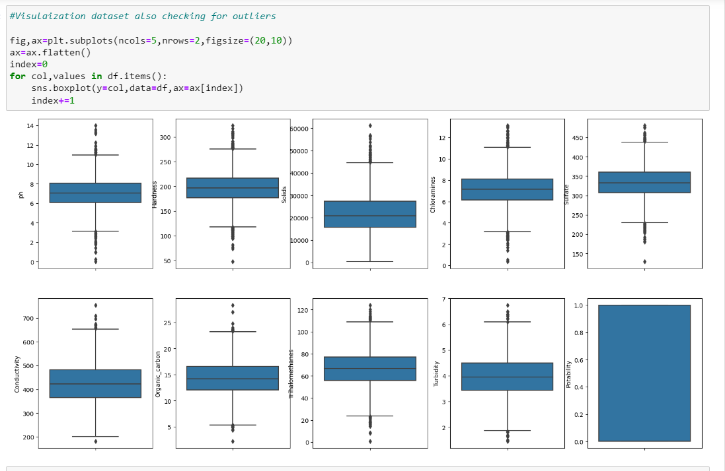
VISUALIZATION OF DATASET FOR OUTLIERS
Box plots, are a great chart to use when showing the distribution of data points across a selected measure.
CODE :
OUTPUT:

Slide 7
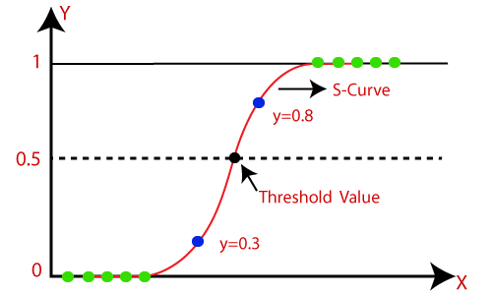
WHAT IS LOGISTIC REGRESSION?
Logistic regression predicts the output of a categorical dependent variable.
Therefore the outcome must be a categorical or discrete value.
It gives the probabilistic values which lie between 0 and 1.
Logistic regression is used for solving the classification problems.

Slide 8
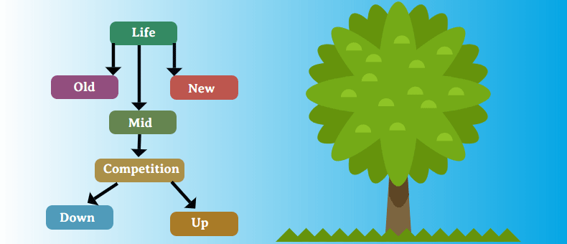
WHAT IS DECISION TREE CLASSIFIER?
Decision Tree is a Supervised learning technique used for solving Classification problems.
It is a tree-structured classifier, where internal nodes represent the features of a dataset, branches represent the decision rules and each leaf node represents the outcome.
The decisions or the test are performed on the basis of features of the given dataset.

Slide 9
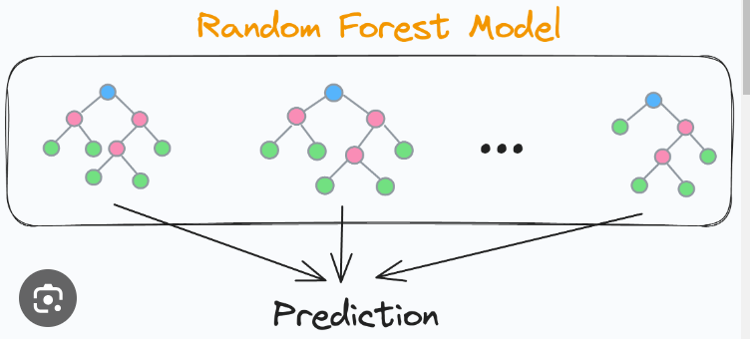
WHAT IS A RANDOM FOREST CLASSIFIER?
Random Forest is a classifier that contains a number of decision trees on various subsets of the given dataset and takes the average to improve the predictive accuracy of that dataset.
It is based on the concept of ensemble learning, which is a process of combining multiple classifiers to solve a complex problem.

Slide 10
CONCLUSION:
Advancements in technology have facilitated the development of various solutions for improving water portability.
These include portable water purification systems, lightweight storage containers, and innovative transportation methods such as pipelines and tanker trucks.
This would be possible by constructing the model using Python.

Slide 11
THANK YOU!

