Slide 1


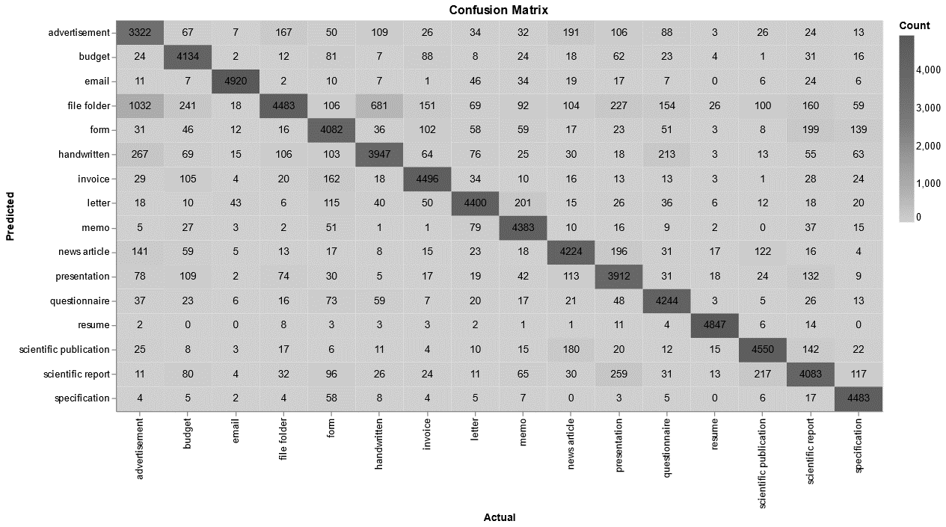
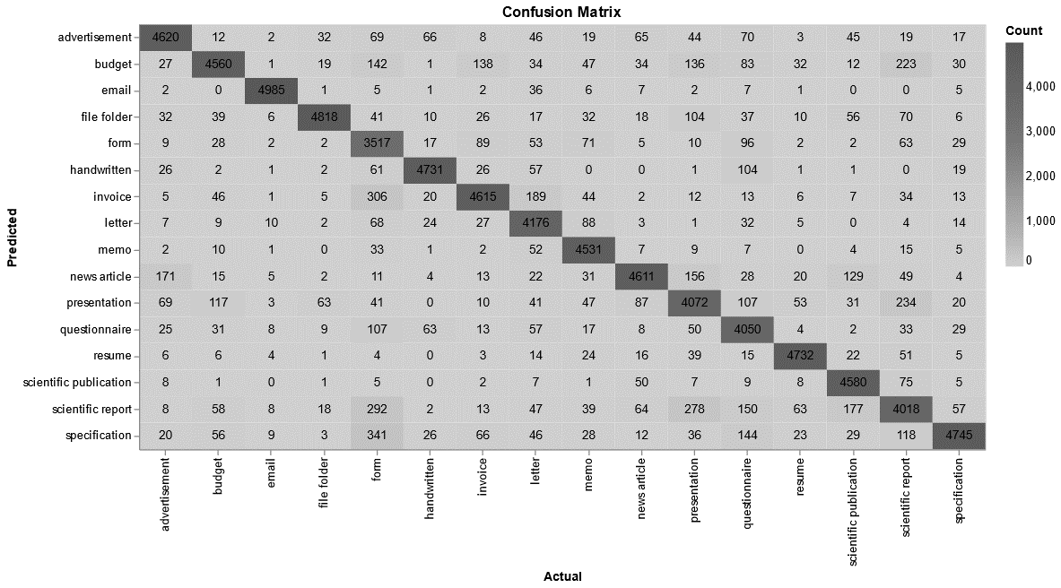
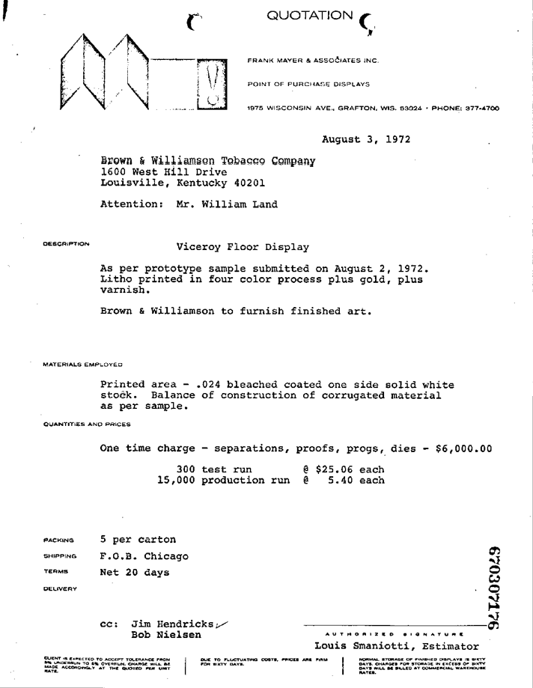
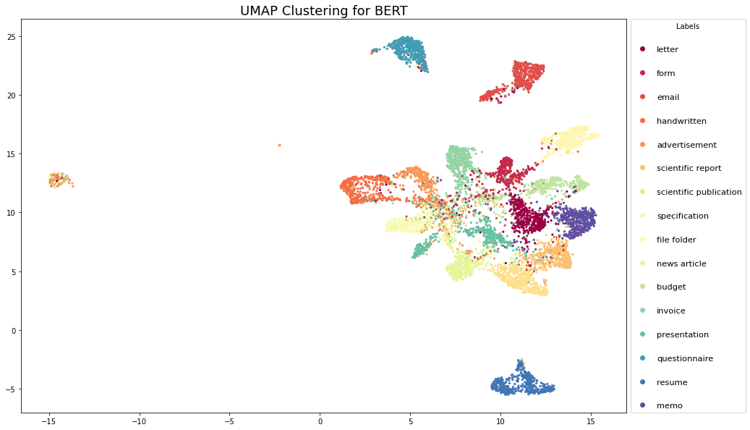
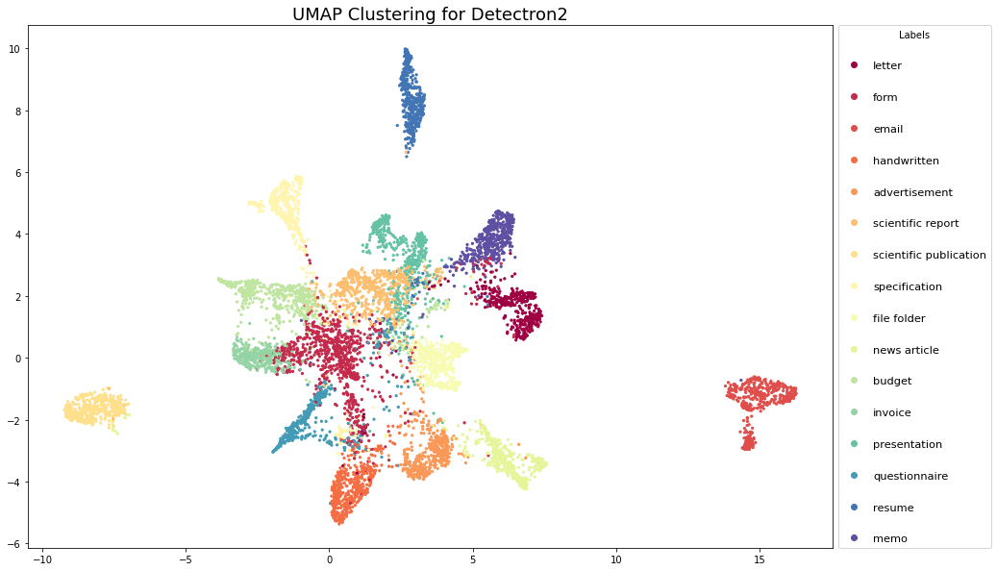
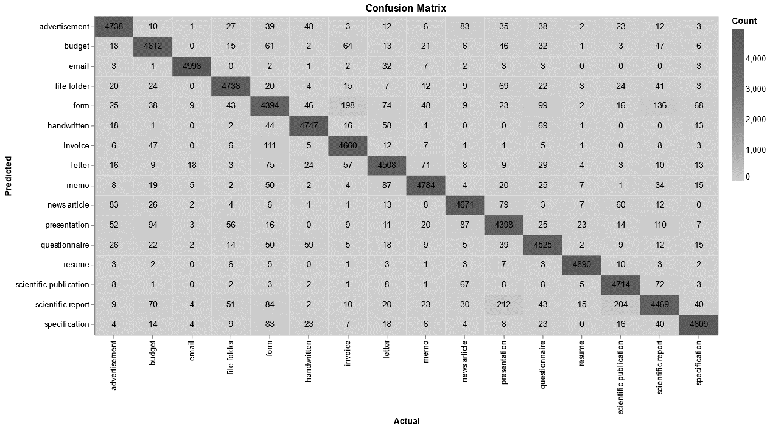
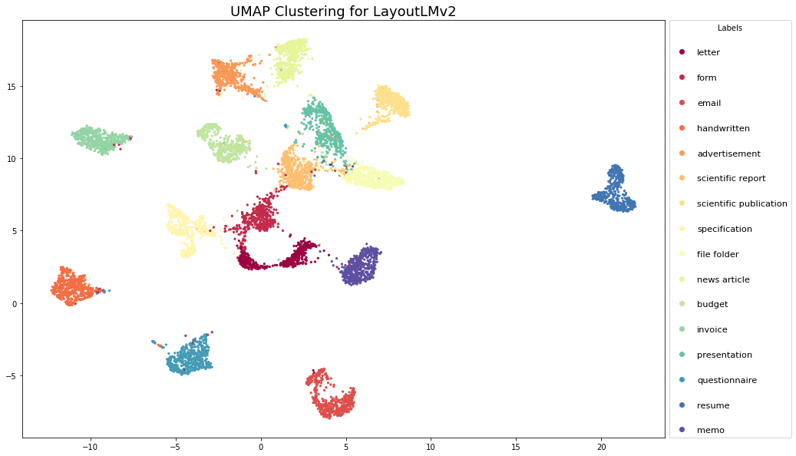
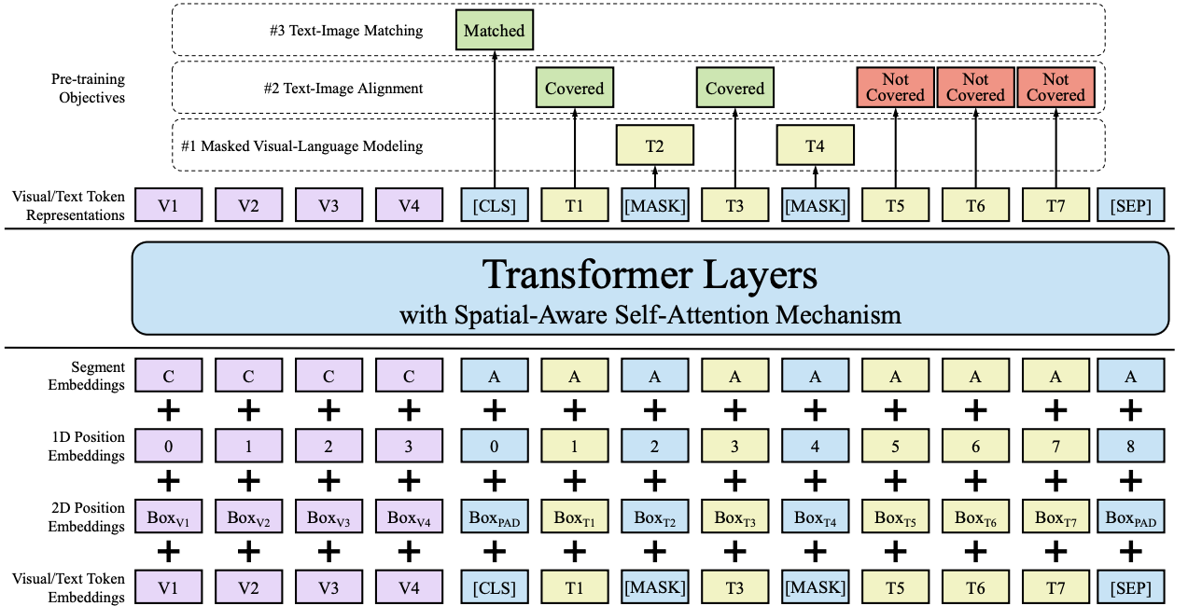
MULTIMODAL REPRESENTATIONS FOR DOCUMENT UNDERSTANDING
Project team: Pavel Gladkevich, David Trakhtenberg, Ted Xie, Duey Xu Project mentors: Supriya Anand (Senior Applied Scientist, Zillow), Shourabh Rawat (Director, Applied Science & Machine Learning, Zillow)
BERT
Text
Project Introduction
Datasets used
ResNeXt-FPN
Visual
Model implementation:
BERT was selected to establish a text-only baseline for comparison against LayoutLMv2 (as was done by the authors of the LayoutLMv2 paper). Multiple BERT versions were tested (base, large, cased, uncased) but did not produce notably variable results; the figures presented on the right are from the “bert-base-uncased’ version.
A batch size of 32 and initial learning rate of 2e-5 were used with early-stopping; models ran in approximately 10 hours using a single GPU.
Due to the verbosity of some document examples, text segmentation was necessary in order to work around the maximum sequence length limit (512 tokens).
Error analysis:
UMAP clustering was conducted on 10k document examples using the final hidden layer embeddings in our best BERT model. Clustering reveals that the model struggles to achieve good separation on most classes.
The classes on which the model performs well include classes “resume” and “questionnaire”. Notably, there are no classes for which BERT was uniquely capable of distinguishing.
Compared to ResNeXt-FPN and LayoutLMv2, the BERT classes are both more mixed up and spread out.
MODEL RESULTS (Macro averaging)
Dataset | Accuracy | F1 | Precision | Recall
RVL-CDIP | 0.8559 | 0.8614 | 0.8562 | 0.8667
Zillow |  | 0.95
The state of the art in Visually-rich Document Understanding (VrDU) is LayoutLMv2 (Xu et al., 2021) which itself builds upon LayoutLM (Xu et al, 2020). They implement a multi-modal approach for generic document understanding tasks which we utilize and explore via several experiments. The modes include text, layout, and visual which we separate into different model baselines to compare against the LayoutLMv2’s multi-modal approach. In doing so, we learn various strengths and weaknesses of these various modes to better inform future users of these models on where they can trade off between time, data, and compute.
This project was proposed to the NYU Center for Data Science by Zillow’s Applied Science & Machine Learning Group. Utilizing the current state of the art, we were able to achieve an improvement in classification accuracy over Zillow’s preexisting MLP (Multi-layer Perceptron) solution with custom featurization that incorporates both text and spatial modes (testing was done on proprietary document scans stored at Zillow).
RVL-CDIP: We trained and tested all models on the publicly available academic dataset, RVL-CDIP. The dataset consists of 400k grayscale scanned documents collected during Tobacco lawsuits in the mid-1900s. There are 16 document classes in total; class volumes are perfectly balanced across each.
Zillow: The best models produced during our work were tested on a scanned document dataset owned by Zillow Group. The dataset consists of Public Records documents and the task was to identify documents relevant to real estate transactions.
Model implementation:
Initially, we employed Detectron2 which utilizes a ResNeXt-FPN (Xie et al., 2016; Lin et al., 2017) architecture for the encoder backbone.
An image is input into the encoder which outputs a feature map. The output feature map is average-pooled to a fixed size, flattened and then passed through to a linear layer for the image embeddings.
Error analysis:
Our ResNeXt-FPN implementation struggled to classify forms. The model often confused documents from this class with the “Invoice”, “Scientific Report”, and “Specification” classes. This is possibly due to these document classes having similar visual layouts.
In contrast, the model performed well on Email and Resume, as they both have structure that ResNeXt-FPN can learn from. UMAP clustered the visual model’s representations poorly, with only a few well defined and separated clusters.
MODEL RESULTS (Macro averaging)
Dataset | Accuracy | F1 | Precision | Recall
RVL-CDIP | 0.8913 | 0.8662 | 0.8666 | 0.8659
Zillow |  | 0.88
IMAGE:
CONFUSION
MATRIX
Three modalities for scanned document representation
IMAGE:
CONFUSION
MATRIX
Text
Example from RVL-CDIP document class 11: Invoice
Layout
The Text modality aims to capture the information contained in the words and language written on a document.
Text information can be extracted from a scanned document using an OCR (Optical Character Recognition) converter. We used Google Tesseract. Text data is stored as strings; machine learning models typically require that text is tokenized before it can be interpreted and understood. WordPiece tokenization is used for both BERT and LayoutLMv2.
In order to establish figures for a text-only baseline, we selected BERT, as was originally used by the authors of the LayoutLMv2 paper.
The Layout modality aims to add 2D contextual information to the words written on a document.
The current state of the art (LayoutLMv2) in document understanding utilizes layout-oriented intelligence to enrich document representation. In such models, each tokenized text item is paired with a layout embedding; a layout embedding is computed from bounding box for every text token defined by two sets of x, y coordinates that convey the location and size of the box containing that text.
For example, in the sample document on the left taken from RVL-CDIP (document class 11: Invoice), the token for the text “Quotation” found at the top of the document is associated with the bounding box [468, 14, 618, 27]. This bounding box is written in the form [x0, y0, x1, y1] where (x0, y0) corresponds to the coordinates of the top left corner of the bounding box and (x1, y1) corresponds to the bottom right corner.
Layout embeddings can be highly informative to document understanding models. From the bounding box for “Quotation”, a model can infer that the word appears close to the center-top of the page. It is likely to be the title of the document, and highly suggestive of the document’s classification.
Visual
The Visual modality aims to capture the purely optical elements of a scanned document.
A scanned document image such as the one on the right can be represented as a three-layer RGB tensor (dimensions for this project were 3x224x224 after resizing) with each tensor element taking on a value between 0 (black) and 255 (white) representing each pixel.
Convolutional Neural Networks are common models used to extract features from image data; for our project we selected a ResNeXt-FPN model to produce visual-only baseline results.
Concluding comments:
Overall, our best BERT model produced relatively similar results to our best ResNeXt-FPN model. The performance of NLP models in scenarios such as this depend strongly on how the language distribution is characterized across the document corpus.
Notably, BERT took the least amount of compute time to achieve model convergence on the full RVL-CDIP dataset; presenting an important advantage that is worth considering when implementing models in a business context. On the other hand, extracting text data from scanned documents using OCR can be highly expensive from a time and compute perspective; for this project we had to pre-process all text and cache these representations in order to run models in a reasonable timeframe.
Finally, we hypothesized that BERT’s performance in this task could be enhanced with some domain-specific pretraining on RVL-CDIP data.
Per-class accuracy by classification model
Model | Letter | Form | Email | Handwritten | Ad | Sci. report | Sci. pub | Specification | File folder | News article | Budget | Invoice | Presentation | Questionnaire | Resume | Memo
LayoutLMv2 | 92.1% | 87.1% | 99.0% | 95.6% | 94.0% | 89.3% | 92.5% | 96.1% | 95.2% | 93.6% | 92.4% | 92.2% | 88.7% | 91.4% | 98.5% | 95.2%
BERT | 89.9% | 80.9% | 97.5% | 79.5% | 66.0% | 81.6% | 89.3% | 89.6% | 90.1% | 84.7% | 82.8% | 89.0% | 78.9% | 85.7% | 97.7% | 87.2%
ResNeXt-FPN | 85.3% | 69.7% | 98.8% | 95.3% | 91.7% | 80.3% | 89.9% | 94.8% | 96.8% | 92.4% | 91.4% | 91.3% | 82.1% | 81.8% | 95.3% | 90.2%
Concluding comments:
Across the board, LayoutLMv2 is the better model for VrDU (specifically document classification). However, if time to train is a limitation or the train set is exceedingly large, a purely visual approach can be advantageous as it requires less time and data to train on while still producing strong results. Other experiments not shown here conveyed the ability of ResNeXt-FPN to train on a limited train set (25% of RVL-CDIP) and learn strong representations (85.5% accuracy).
When training ResNeXt-FPN on Zillow’s imbalanced dataset, the model was able to achieve a strong F1 score; however, BERT and LayoutLMv2 both did better by a considerable amount. The reason for this is that Zillow’s data is text heavy and there is not much visual structure to exploit. Another tradeoff benefit of using this visual baseline over the other models is that since text is not necessary for ResNeXt-FPN, we do not have to derive an OCR cache from the scanned documents, which can be a computationally intensive task.
LAYOUTLMV2
Text
Visual
Layout
FUTURE EXPERIMENTS / IN-FLIGHT
Model architecture:
Multi-modal Transformer model to integrate the document text, layout and image information in the pre-training stage, which learns the cross-modal interaction end-to-end in a single framework.
LayoutLMv2 differs from the first version in that it incorporates visual embeddings during pretraining.
Both versions pretrained on IIT-CDIP with masked visual-language modeling, text-image alignment, and text-image matching tasks.
MODEL RESULTS (Macro averaging)
Dataset | Accuracy | F1 | Precision | Recall
RVL-CDIP | 0.9321 | 0.9145 | 0.9147 | 0.9144
Zillow |  | 0.96
IMAGE:
CONFUSION
MATRIX
Concluding comments: LayoutLMv2 achieves significant improvements across each class over the visual and text baselines; however, there are significant overhead costs in fine-tuning (not mentioning the pre-training).
Comparison to Zillow: We were also able to achieve a 2% F1 score improvement over Zillow Group’s existing MLP-based solution. Relative to BERT and ResNeXt-FPN, LayoutLMv2 took:
- 3 x BERT’s time to achieve model convergence - 2.5 x ResNeXt-FPN’s time to complete training
A notable magnitude of difference in computational time and cost.
Diminishing Returns: 25%, 50%, and 75% training subsamples resulted in quickly diminishing returns. E.g. 50% subsample achieved 92% accuracy while only 93.3% was achieved on the full dataset.
Frozen Encoder Layer: When training the model with frozen initial weights and updating the classification layer only, the model was still able to learn, but performance capped significantly below that of the model fine-tuned end-to-end (~70%).
One-shot/few-shot learning: How do multi-modal representations help learn classifiers that can recognize unknown/new classes with limited labeled examples?
Document splitting: Given a document with multiple sub-documents or an input stream of pages, learn classifiers to identify and extract each sub-document.
Active learning: Can an active learner reduce the time it takes humans to manually label documents by dynamically querying the most informative instances?
Acknowledgements: We would like to extend our gratitude to Supriya Anand, Shourabh Rawat for their guidance and support during this project. Also thank you to Sara Price for assistance in preparing our final poster.
References:
Adam W Harley, Alex Ufkes, and Konstantinos G Derpanis. Evaluation of deep convolutional nets for document image classification and retrieval. In International Conference on Document Analysis and Recognition (ICDAR), 2015.
Xu, Y., Xu, Y., Lv, T., Cui, L., Wei, F., Wang, G., Lu, Y., Florencio, D., Zhang, C., Che, W., Zhang, M., &amp; Zhou, L. (n.d.). Layoutlmv2: Multi-modal pre-training for visually-rich document understanding. –&nbsp;arXiv Vanity. Retrieved December 8, 2021, from https://www.arxiv-vanity.com/papers/2012.14740/.
Wu, Y., Kirillov, A., Massa, F., Lo, W.-Y., &amp; Girshick, R. (2019). Detectron2. GitHub. Retrieved December 2021, from https://github.com/facebookresearch/detectron2.
Devlin, J., Chang, M.-W., Lee, K., &amp; Toutanova, K. (2019, May 24). Bert: Pre-training of deep bidirectional Transformers for language understanding. arXiv.org. Retrieved December 2021, from https://arxiv.org/abs/1810.04805.
Error analysis:
Of the three different models, LayoutLMv2 achieved not only the best separation between document classes, but also the tightest clustering within each class. Interestingly LayoutLMv2 struggles the most with forms, which it confuses for advertisements, invoices, and scientific publications

