Slide 2



Slide 4


Slide 6


Slide 7

piston
z(t)
gas

Slide 10




1
1
diving board
2
3
7.44
10.2
60 kg
2142 Ns
-1554 Ns

Slide 11
(A)
in
Q = 600 J/s
out
Q = 600 J/s
Tin = 200 K
Tout = 300 K
(B)
in
Q = 600 J/s
out
Q = 600 J/s
Tin = 300 K
Tout = 200 K

Slide 12
piston
z

Slide 13





t1
v
t0

Slide 14
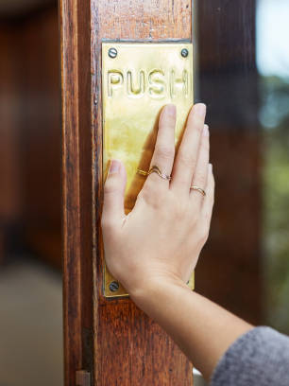
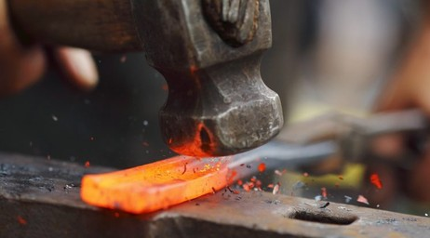
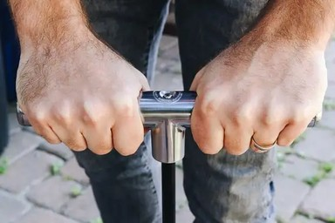

Slide 15
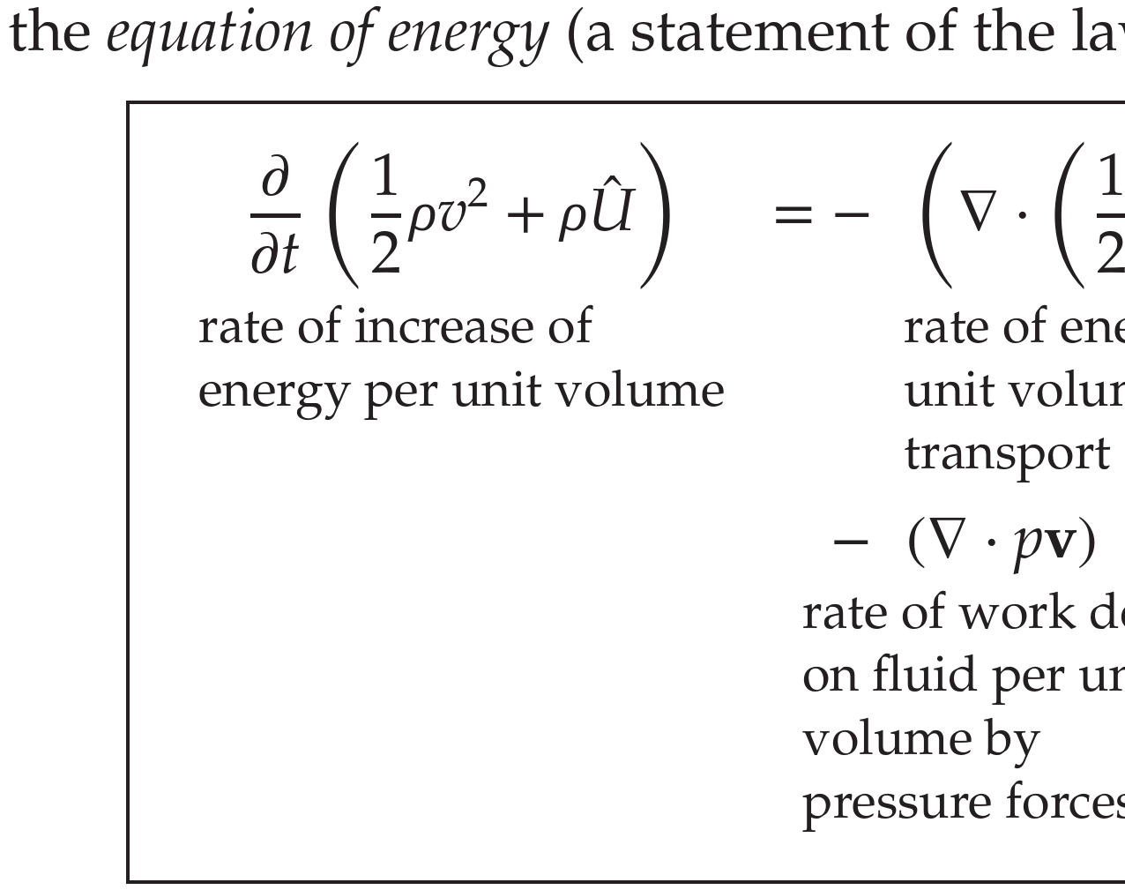
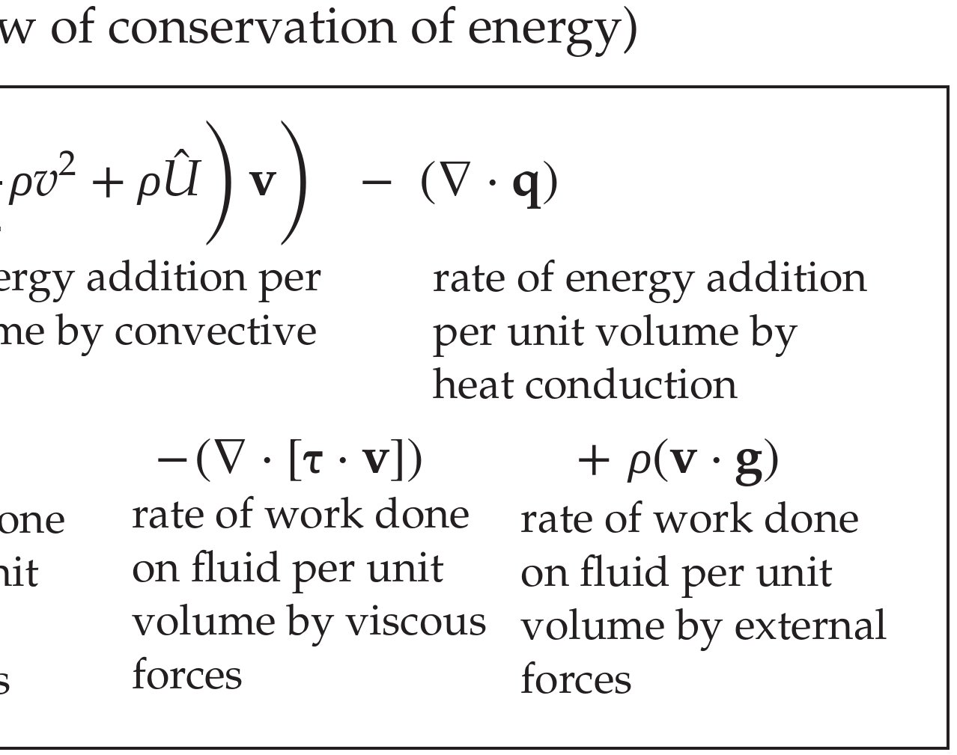

Slide 16
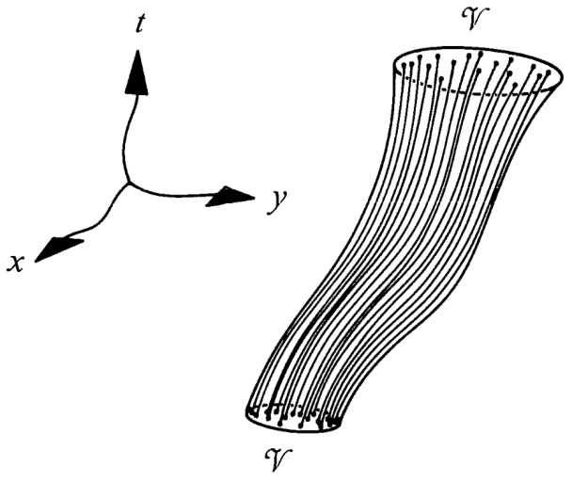
control surface between t1 and t2
t2
control volume at t2
control surface evolving in time
t1
control volume at t1

Slide 18
t1
t1
t2

Slide 19
initial
situation
final
situation
t1
t2
z
x

Slide 20
initial
situation
z
final
situation
t1
t2
x

Slide 21
initial
situation
z
final
situation
t1
t2
x

Slide 22
initial
situation
z
final
situation
t1
t2
x
integrated flux = [0, 0, 0] N s
integrated supply = [0, 0, –4.72] N s

Slide 23
initial
situation
z
final
situation
t1
t2
x
integrated flux = [0, 0, –3.15] N s
integrated supply = [0, 0, –1.57] N s

Slide 24
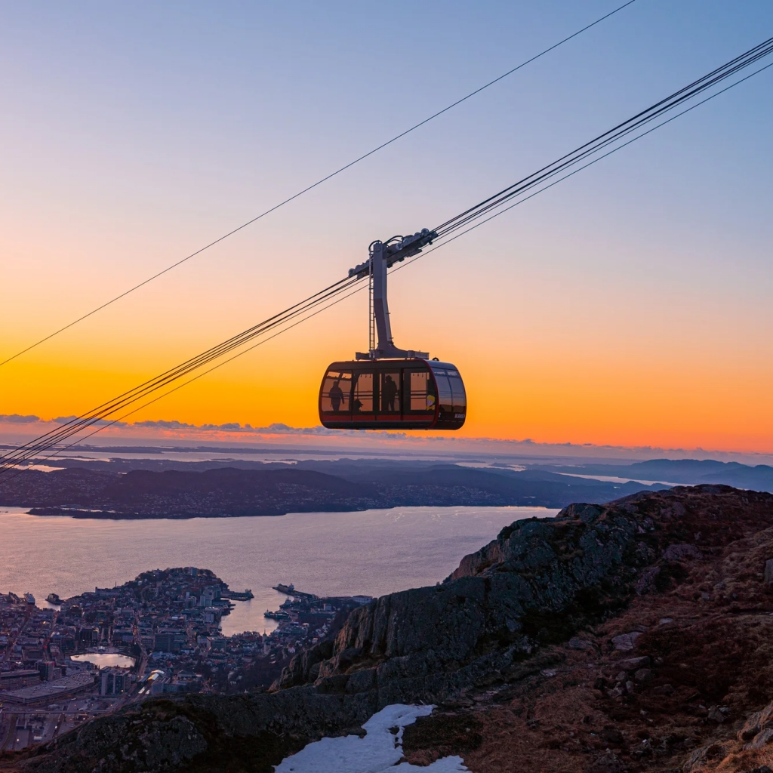

Slide 25


Slide 27


Slide 29
matter
energy-mass
momentum
angular momentum
entropy
how much is in this volume?
t = 13:30:15
matter
energy-mass
momentum
angular momentum
entropy
how much is flowing through this surface per unit time?

Slide 30
matter
energy-mass
momentum
angular momentum
entropy
how much is in this volume?
t = 13:30:15
matter
energy-mass
momentum
angular momentum
entropy
how much is flowing through this surface per unit time?

Slide 31
volume V
vx
Jx
N
area A
z
y
x

Slide 32
volume V
Px
V
Jx
A
z
area A
y
x

Slide 33
Px
V
Jx
A
z
y
x

Slide 34
volume V
Jx
Jx
N
area A
z
y
Px = ρ Jx
x

Slide 35
z
y
x

Slide 36
z
y
x

Slide 37
z
y
x

Slide 38
z
y
x

Slide 39
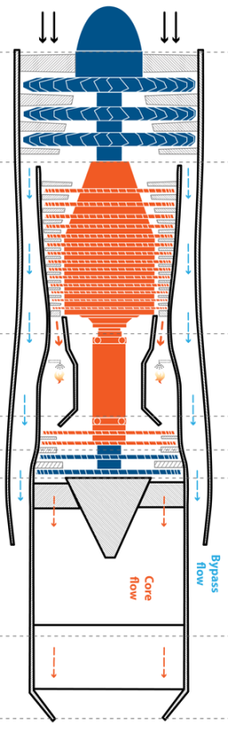
A1

Slide 40
J1
N
-J2

Slide 41
v

Slide 42
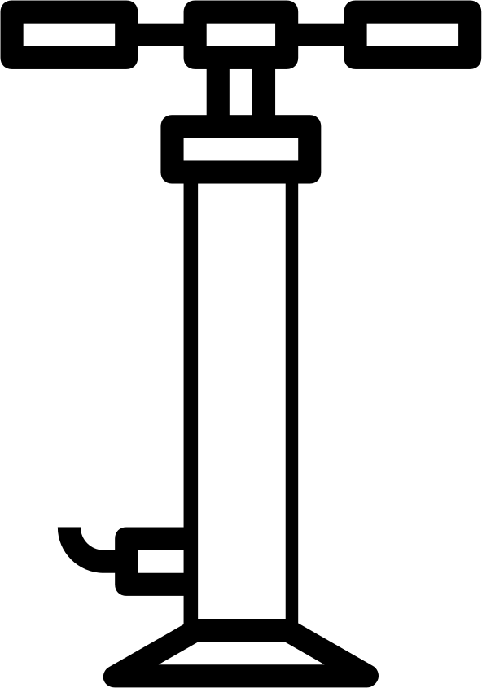

Slide 44
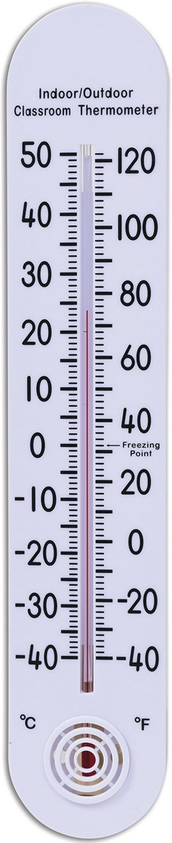
Ta
Tb
–Q
Q
xa
xb
x
Ta
Tb
–Q
Q
x

Slide 45


Slide 46
+
=

Slide 47




Slide 49
– 6 C

Slide 51
+
+

Slide 52
–
–

Slide 53
–
–

Slide 55
– 6 C

Slide 56
–5 J/s
+5 J/s
8 N
through
whole surface
through
whole surface

Slide 57
(0, 2, 0) N
through
whole surface
(0, 4, 0) N
(2, –1, 0) N
(–2, –1, 0) N

Slide 58
through
whole
surface

Slide 59
– 6 C

Slide 60
y
x
y
x

Slide 61
+5
+5
–5
–5

Slide 62
+5
(–21, +25, 0)
–5
(+21, –25, 0)

Slide 63
(–6, –3, 0)
(–9, 6, 0)
P
P
(6, 3, 0)
(9, –6, 0)

Slide 64
–1 J/s
+5 J/s
+1 J/s
–5 J/s
–1 J/s
+3 J/s
+1 J/s
–3 J/s
+5 J/s
+3 J/s
-3 J/s
-5 J/s

Slide 65
1 m/s

Slide 66
+

Slide 69


Slide 70


Slide 72


Slide 73


Slide 75


Slide 78
A
B
A
B
A
B

Slide 79
A
B
B
A
A
B
B
A
B
A
B
A

Slide 80
10 N
10 N
y
x
3 N
y
3 N
x
z
y
x

Slide 81
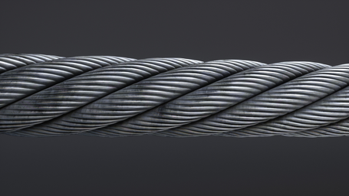
0.12 rad ≈ 6.9°

Slide 82
0.12 rad ≈ 6.9°

Slide 83
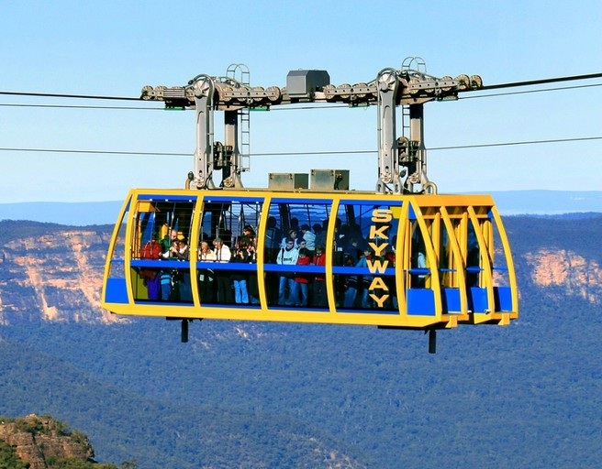


z
x

Slide 85
F
F
ln
F
F

Slide 86
Fe
ln
Fe

Slide 87
Fe
Fe
ln

Slide 88
Fe
ln
Fe

Slide 89
Fe
Fe
ln

Slide 90
b
b
b
Fbs
Fb
– Fbs
– Fas
Fa
a
Fas
a
a
a
b

Slide 91
time
space

Slide 92
matter content:
20 mol
integrated
matter flux:
– 3 mol
integrated
matter flux:
3 mol
matter content:
23 mol
entropy content:
20 J/K
entropy content:
> 20 J/K
integrated
entropy flux:
3 J/K
integrated
entropy flux:
– 3 J/K
entropy content:
> 23 J/K

Slide 93
400 K
mech. power
50 J/s
heat flux
40 J/s
heat flux
200 J/s
150 K
mech. power
30 J/s
100 K
100 K
heat flux
10 J/s

Slide 94
heat flux
mech. power

Slide 95
heat flux
mech. power

Slide 96


Slide 97
?  +
$


 
✓✔✗✘
🚀

