Slide 1
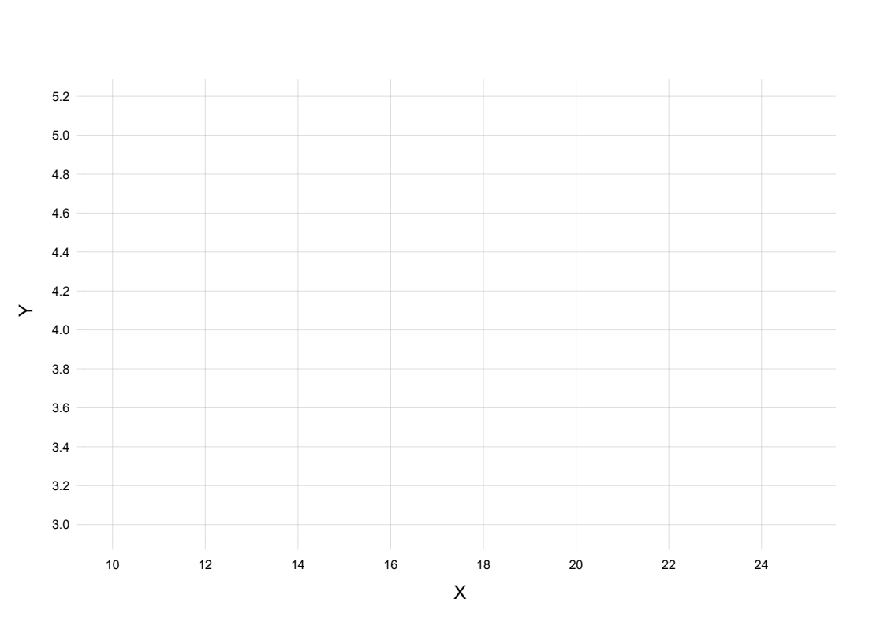
Plot X and Y for all subjects: past, present, future

Slide 2
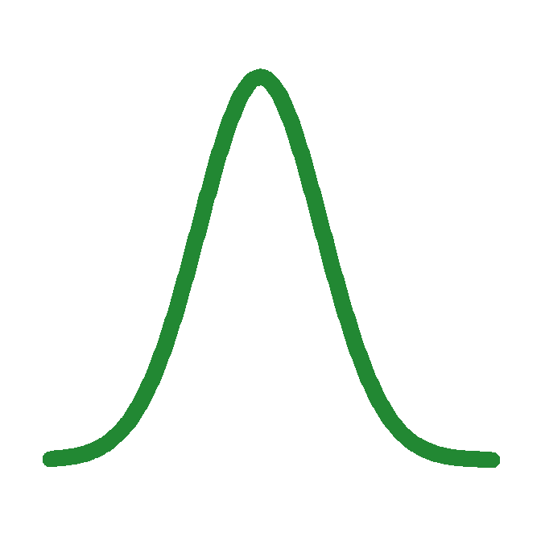
New patient: X = 16
⇒ Y ≈ 4.5–4.7
F(X, Y): population distribution of X, Y

Slide 3
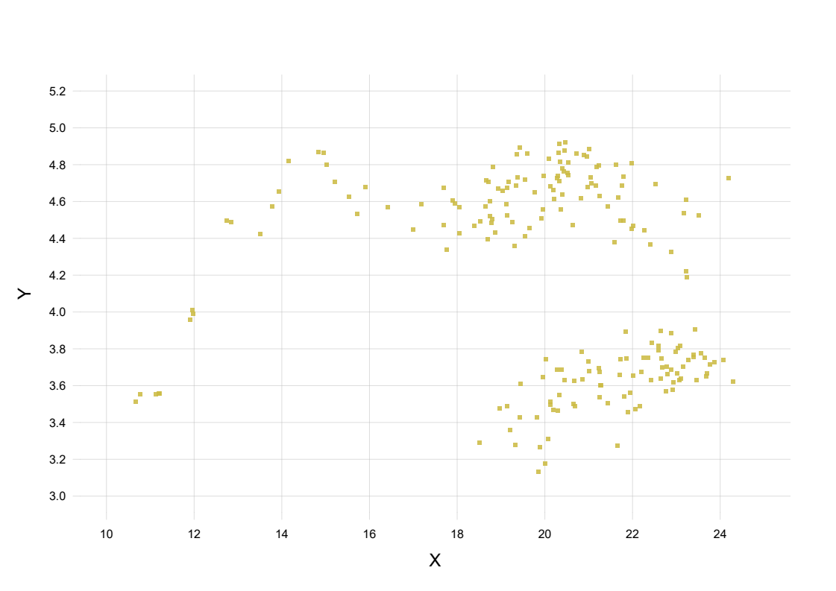

Slide 4
P(y | x) = ∫ F(y | x) p(F | data) dF
probability = average over all possible population distributions
p(F | data) ∝ F(y1, x1) × F(y2, x2) × F(y3, x3) × ... × p(F | prior info)
how well the candidate distribution fits the data
extra-data knowledge

Slide 5
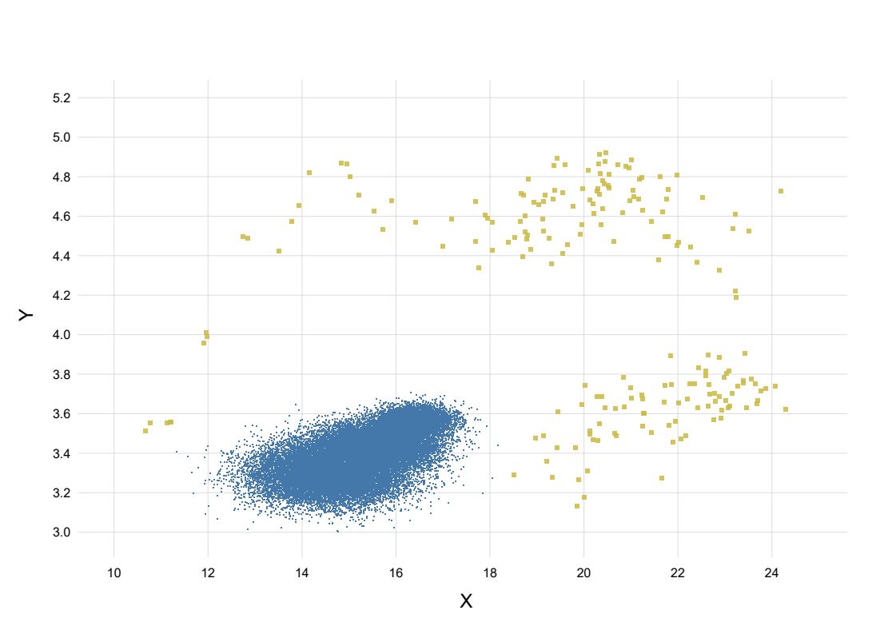
poor candidate: doesn’t fit the data
candidate F

Slide 6
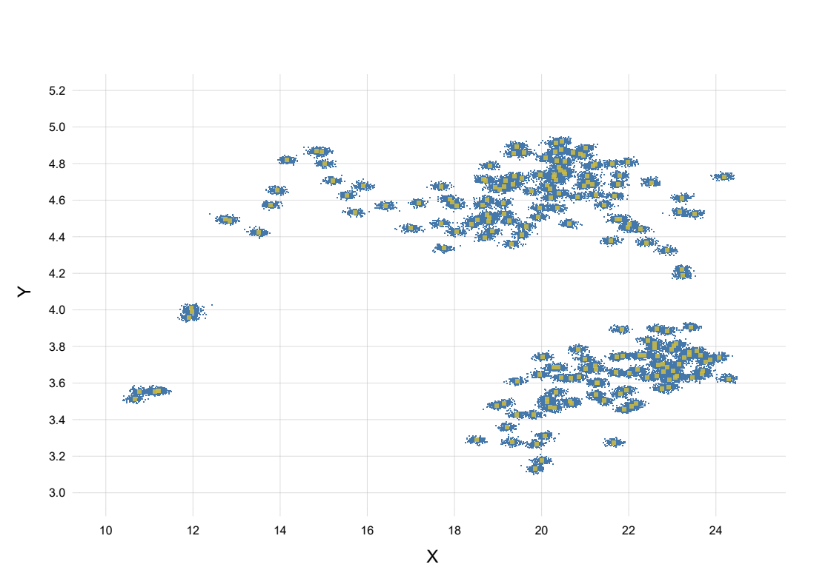
poor candidate: fits the data but is biologically implausible
candidate F

Slide 7
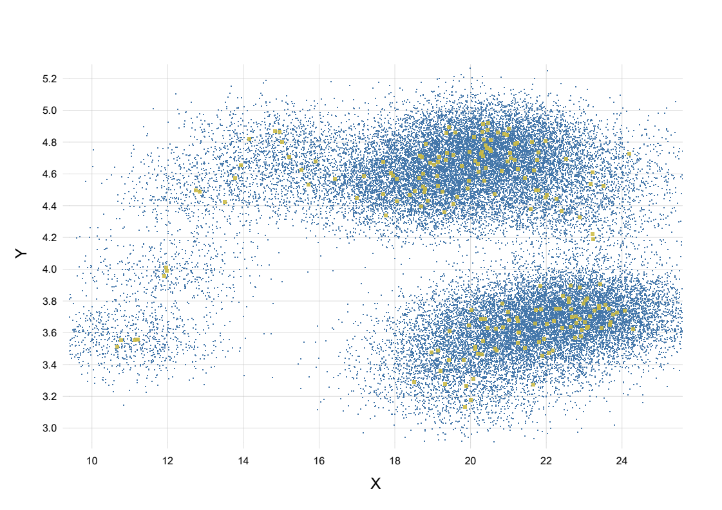
reasonable candidate: fits the data and is biologically plausible
candidate F

Slide 8
intuition → mathematics

Slide 9
first principles → mathematics → intuition
(‘Bayesian’)

Slide 10
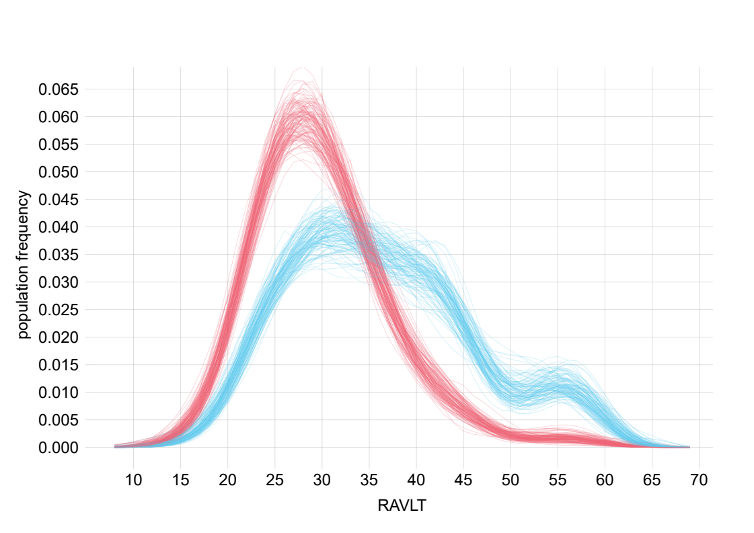

Slide 11
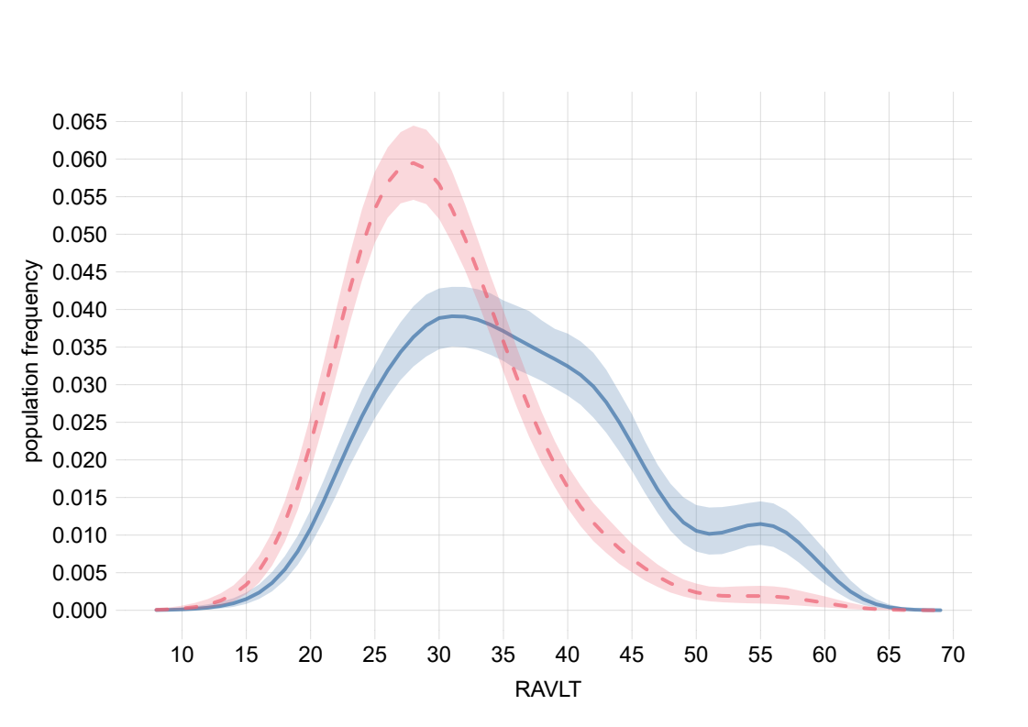

Slide 12
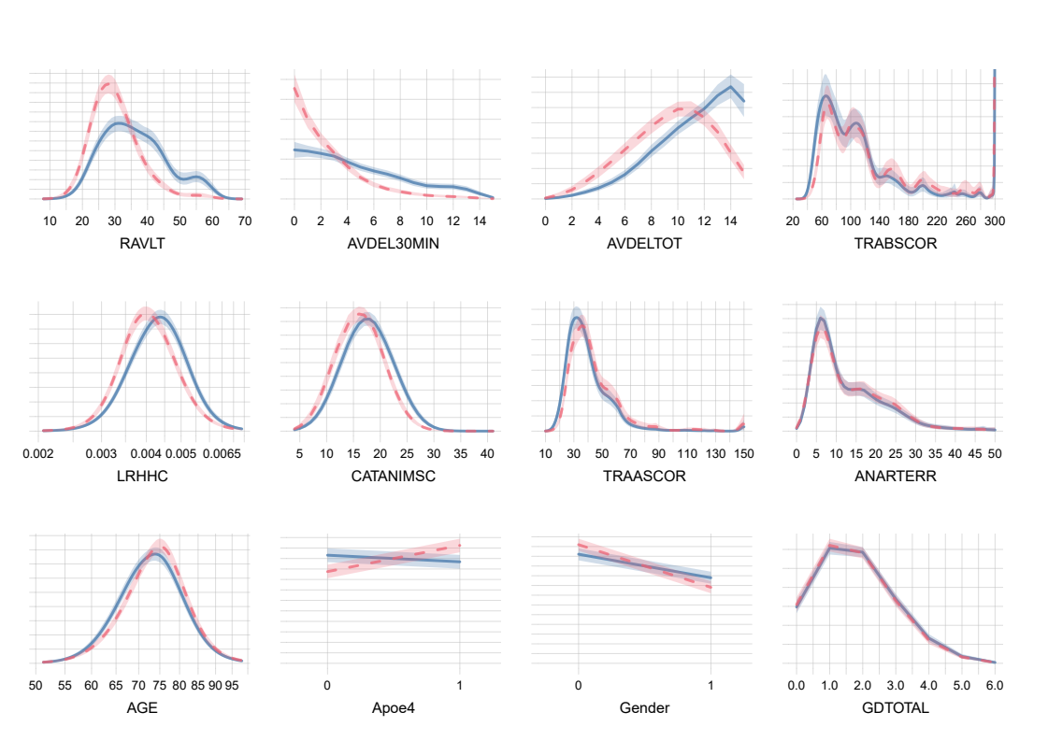

Slide 13
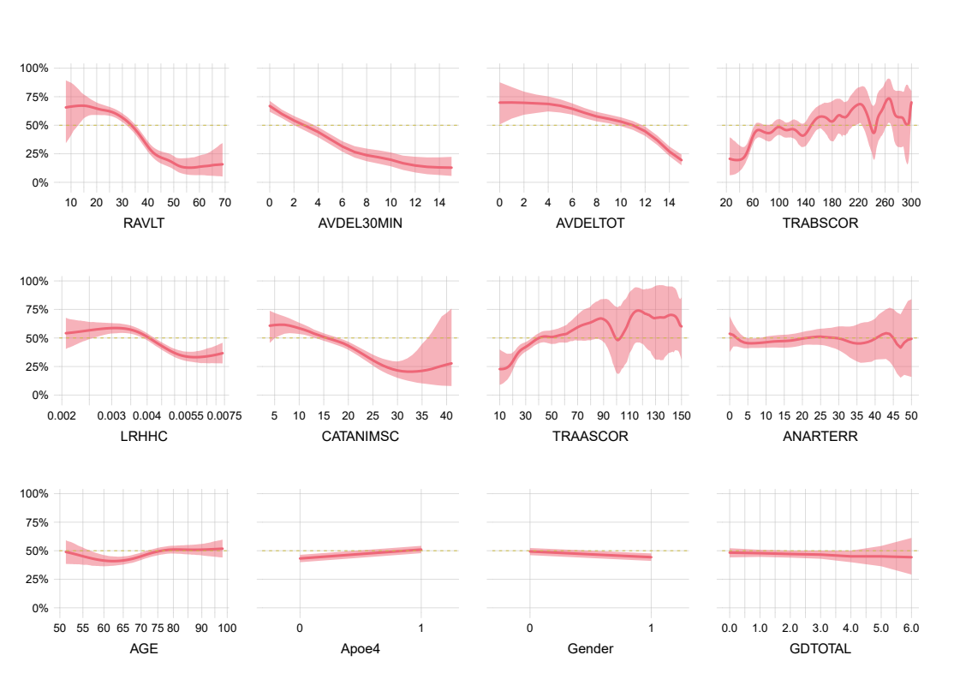
Probability of AD onset

