Slide 1
Bayesian nonparametric density regression
&
information analysis
example
from a hypothetical Alzheimer study
Luca
🚀 CDA 2022 🚀

Slide 6
Plot (X, Y) for all past, present, future subjects
+

Slide 7
patient: X = 16
⇒ Y ≈ 4.5–4.7
F(X, Y): population distribution of X, Y

Slide 8
P(y | x) = ∫ F(y | x) p(F | data) dF

Slide 9
F(X, Y): population distribution of X, Y

Slide 11
P(y | x) = ∫ F(y | x) p(F | data) dF
P(y | x) = ∫ F(y | x) p(F | data) dF
probability = average over all possible population distributions
p(F | data) ∝ F(y1, x1) × F(y2, x2) × F(y3, x3) × ... × p(F | prior info)
p(F | data) ∝ F(y1, x1) × F(y2, x2) × F(y3, x3) × ... × p(F | prior info)
p(F | data) ∝ F(y1, x1) × F(y2, x2) × F(y3, x3) × ... × p(F | prior info)
how well the ‘candidate’ distribution fits the data
extra-data knowledge

Slide 12
poor candidate: doesn’t fit the data
F(y1, x1) × F(y2, x2) × F(y3, x3) × ... × p(F | prior info)
low
high
candidate F

Slide 13
poor candidate: biologically implausible
F(y1, x1) × F(y2, x2) × F(y3, x3) × ... × p(F | prior info)
high
low
candidate F

Slide 14
reasonable candidate
F(y1, x1) × F(y2, x2) × F(y3, x3) × ... × p(F | prior info)
high
high
candidate F

Slide 15
intuition → mathematics

Slide 16
first principles → mathematics → intuition
(‘Bayesian’)

Slide 17
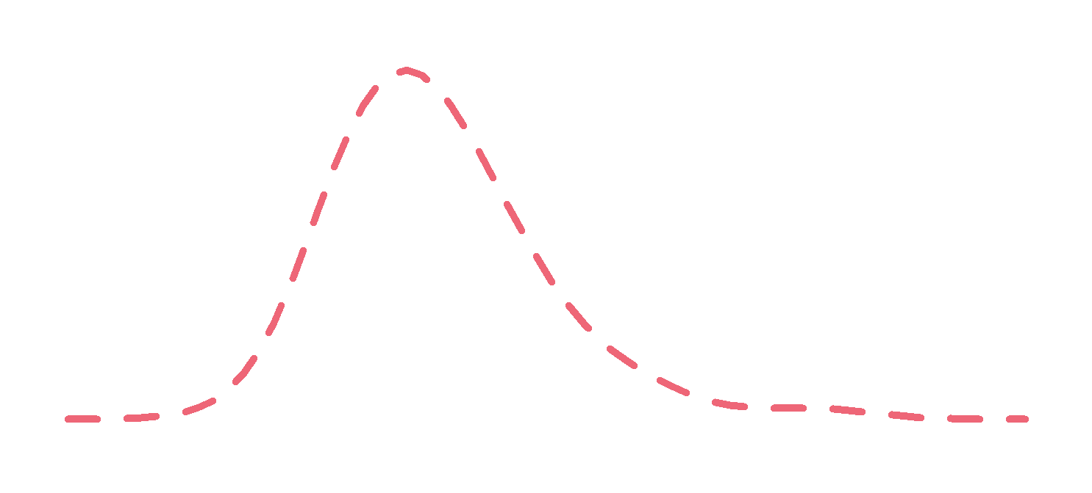
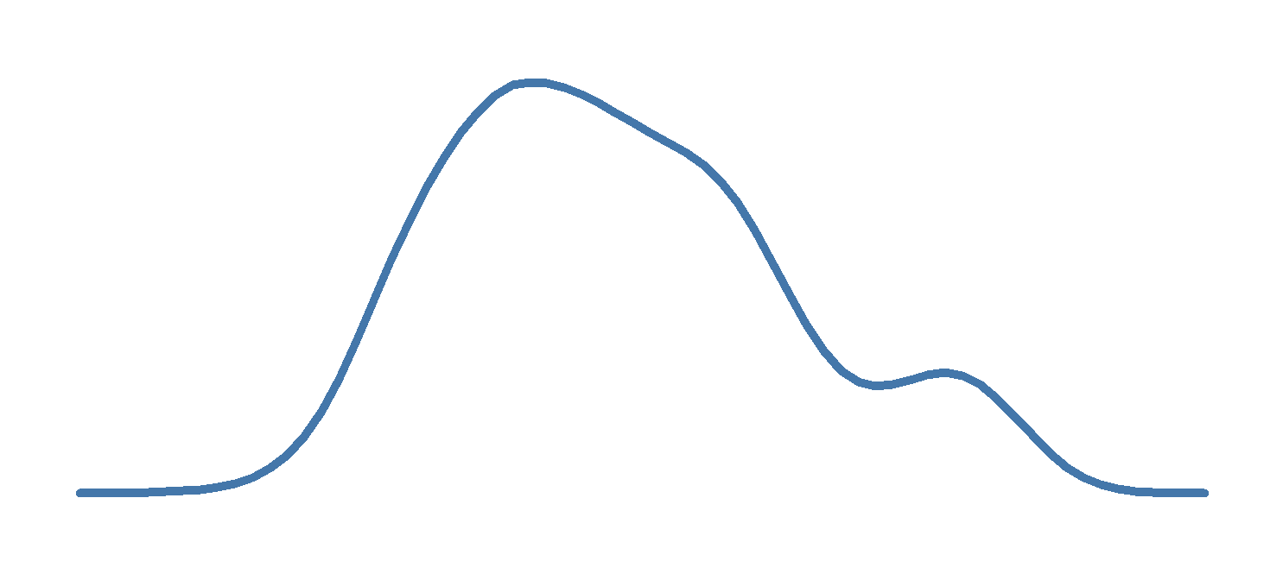

Slide 19
How ‘good’ are these features at prognosing the later onset of Alzheimer?
⚤ Gender
⚤ AGE
🧬 Apoe4
🧠 LRHHC
⏰ ANARTERR
⏰ GDTOTAL
⏰ TRABSCOR
⏰ AVDEL30MIN
⏰ CATANIMSC
⏰ TRAASCOR
⏰ AVDELTOT
⏰ RAVLT
Healthy
time
Alzheimer Disease
Healthy

Slide 20
12+1 variates, 678 datapoints
Computation time: ~65 h (3 parallel sessions to assess numeric convergence)
HPC

Slide 22
H
AD

Slide 23
H
AD
87.5% credible interval

Slide 24
H
AD
87.5% credible interval
🧠
🧬

Slide 25
87.5% credible interval
Probability of AD onset
🧠
🧬

Slide 26
Interesting characteristics of F(Y, X):
• Several high-density regions in the 12D space
• Some features seem more robust if used in a ‘discriminative’ way: P(Y | X),
others in a ‘generative’ way: P(X | Y)

Slide 28
How to quantify the ‘importance’ or ‘prognostic power’ of a set of features?
“Language is a product of, and reflects, thinking. Sloppy usage reflects sloppy thinking, a kind of thinking incompatible with good scientific habits of mind”
(D. J. Helfand)

Slide 29
Prediction problem:
guess the six digits of the winning lottery ticket ??????
Clue A: ✔✔✔✔??
Clue B: ✔✔✔?✔?
Clue C: ???✔✔✔
What is the ‘importance’ or ‘predictive power’ of each clue?

Slide 30
Scenario 1: we can use only one clue
Clue A: ✔✔✔✔??
Clue B: ✔✔✔?✔?
Clue C: ???✔✔✔
Best: A or B (each gives 1/81 winning chance)
Worst: C (gives 1/729 winning chance)
increasing
importance

Slide 31
Scenario 2: we can use all clues
Clue A: ✔✔✔✔??
Clue B: ✔✔✔?✔?
Clue C: ???✔✔✔
→ We fully know the winning number! 💰

Slide 32
Scenario 2: what happens if we discard clues?
Clue A: ✔✔✔✔??
Clue B: ✔✔✔?✔?
Clue C: ???✔✔✔
• Discard A: still 100% win ⇒ A has ‘importance = 0’
• Discard B: still 100% win ⇒ B has ‘importance = 0’
• Discard A and B: 1/9 winning chance
⇒ A and B together have ‘importance > 0’
‘ 0 + 0 ≠ 0 ’

Slide 33
‘Importance’ or ‘predictive power’ is not an additive property

Slide 34
Scenario 3: we have to discard one clue. Which?
Clue A: ✔✔✔✔??
Clue B: ✔✔✔?✔?
Clue C: ???✔✔✔
discard A: still 100% win
discard B: still 100% win
discard C: 1/9 winning chance
increasing
importance
→ If we have to discard one clue, it’s most important that we keep C

Slide 35
increasing importance
Scenario 1:
choose one clue
Scenario 3:
discard one clue
A
B
C
A
B
C
increasing importance

Slide 36
‘Importance’ or ‘predictive power’ of X is context-dependent
(which other features are we considering?)

Slide 37
x = 11.5 ⇒ y ≈ 3.60–3.65

Slide 38
x = 22 ⇒ y ≈ 3.50–3.85 or 4.25–4.90

Slide 39
What is the ‘overall predictive power’ of X?

Slide 40

What is the ‘overall predictive power’ of X?
P(X)

Slide 41
What is the ‘overall predictive power’ of X?
P(X)

Slide 42
The ‘importance’ or ‘predictive power’ of X depends on P(X)
⚠ Careful with ‘data balancing’! ⚠

Slide 44
Information Theory

Slide 45
‘predictive power’ of X for Y ≔ Mutual information between Y and X
(mean transinformation content)
I(Y; X1, X2) ≥ I(Y; X1)
but I(Y; X1, X2) ≠ I(Y; X1) + I(Y; X2)
I(Y; X1, X2) ≥ I(Y; X2)

Slide 48
If Y is binary:
0 Sh ≤ I(Y; X) ≤ 1 Sh
X and Y are independent
Using X is no better than flipping a coin
Y is a deterministic function of X
X always yields perfect predictions
I(Y; X) = 0.22 Sh
In N = 100 new prognoses:
• we are completely certain about 22
• we are completely uncertain about 100 – 22 = 78
→ approx 22 + 78/2 = 61 correct prognoses (TP+TN)
Any prognostic algorithm
which does less than this
is performing poorly
Upper bound ≈
correct prognoses
Maximum accuracy attainable
by any algorithm which uses only feature set X

Slide 50
Scenario 1: use only one feature
🧠
🧬

Slide 51
Scenario 2: use all features
🧠
🧬

Slide 52
Scenario 3: discard one feature
🧠
🧬

Slide 53
🧠
🧠
🧬
🧬

Slide 54
🧠
🧠
🧬
🧬

Slide 55
To reach these prognostic levels
we need additional or different features
just changing algorithm won’t work

Slide 57
P(Y|X) P(X) ≡ P(X|Y) P(Y)

Slide 58
!
P(Y|X) P(X) ≡ P(X|Y) P*(Y)

Slide 59
? ? ?
P*(Y|X) P*(X) ≡ P*(X|Y) P*(Y)

Slide 61
H
AD
Prob. of AD onset Sample-data counts

Slide 62
H
AD
87.5% credible interval
Prob. of AD onset Sample-data counts

Slide 63
H
AD
👪
Prob. AD onset Sample data
🧠
🧠

Slide 64
H
AD
87.5% credible interval
👪
Prob. AD onset Sample data
🧠
🧠

Slide 65
Thank you!

