Slide 1
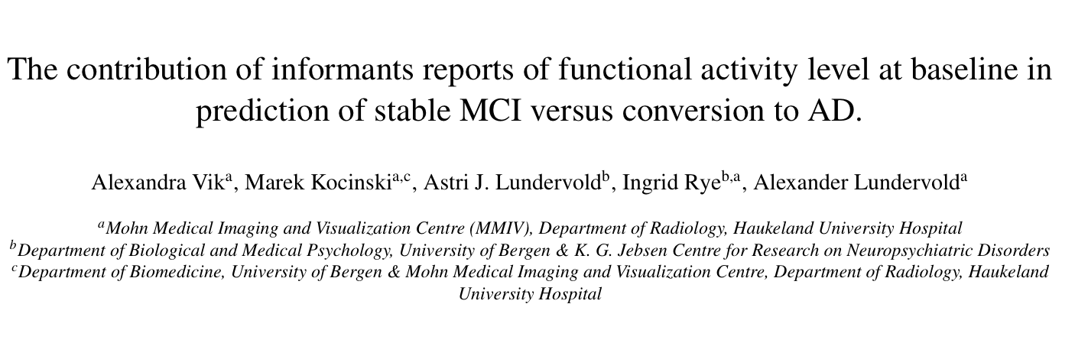


Notes:
12/14/10
1
12/14/10
1

Slide 2
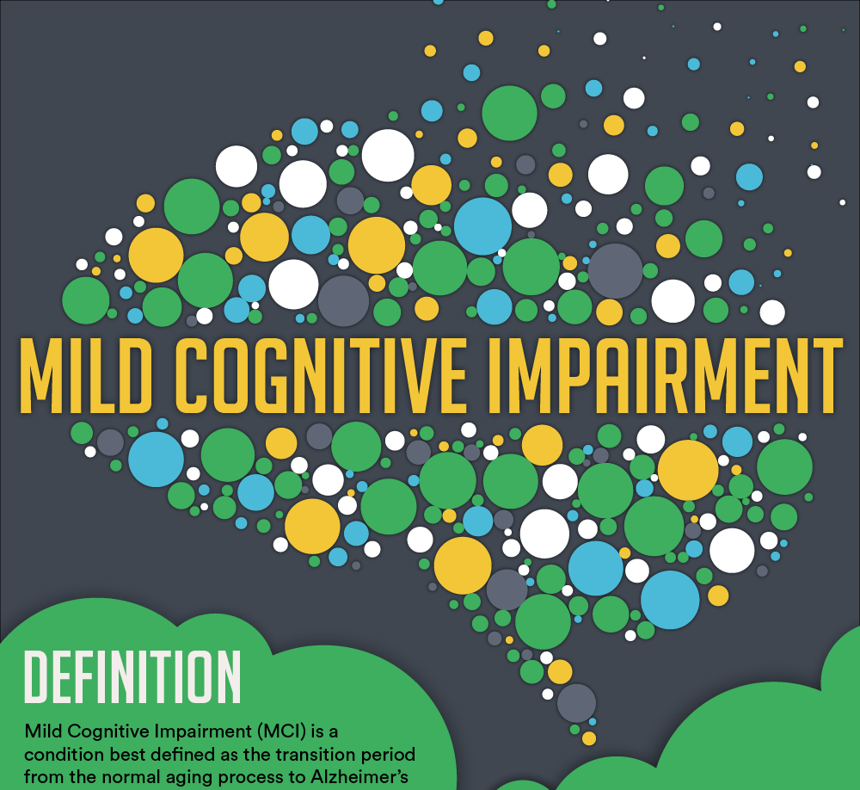

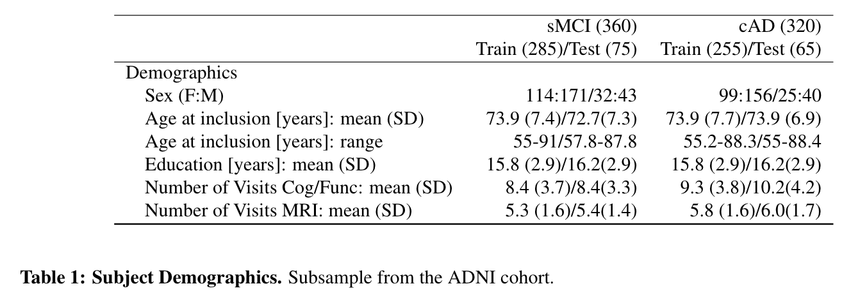
Introduction: Stable MCI versus converting AD
Cognitive aging is a process characterized by individual differences in both pace and characteristics. Whereas some adults show preserved cognitive function into old age, unfortunately, old age is also one of the highest risk factors for developing Alzheimer’s disease (AD) and other neurodegenerative diseases. The intermediate stage between normal cognitive aging and dementia is referred to as mild cognitive impairment (MCI). It has been shown that about 10 -15 % of the MCI patients will progress to dementia each year. Thus, identifying and predicting already at baseline those characterized as stable MCI versus those more likely converting to AD at an earlier stage is highly warranted.
Method: The data set
In the current study we define two subgroups:
Stable MCI (sMCI): MCI diagnosed maintained across all visits.
Converted Alzheimer’s Disease (cAD): adults progressing from MCI to AD at one time point during the examination period

Slide 3
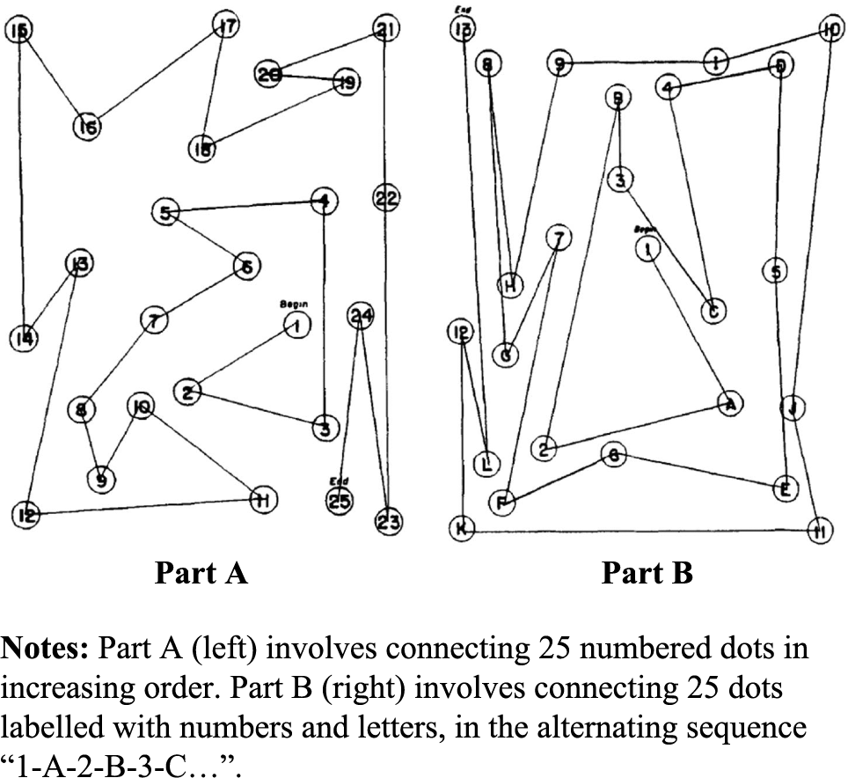
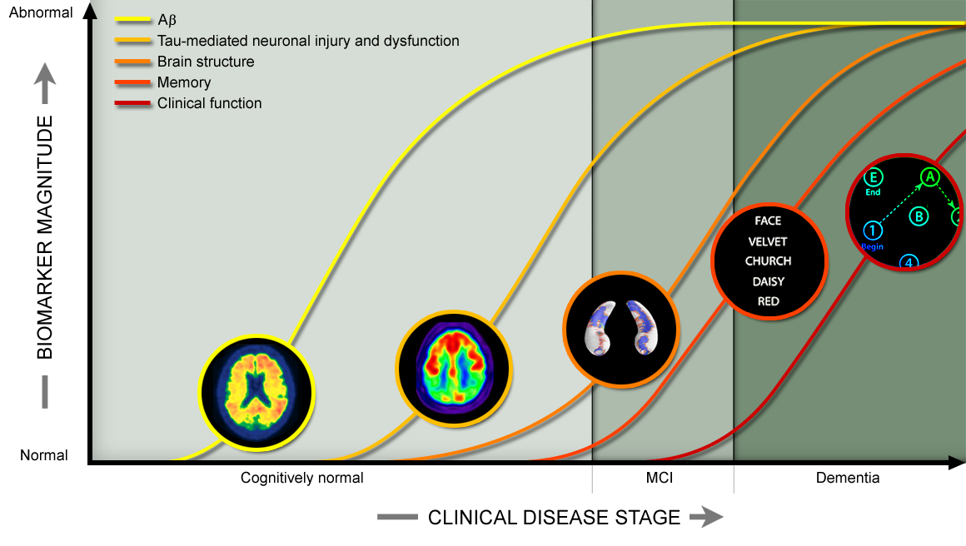
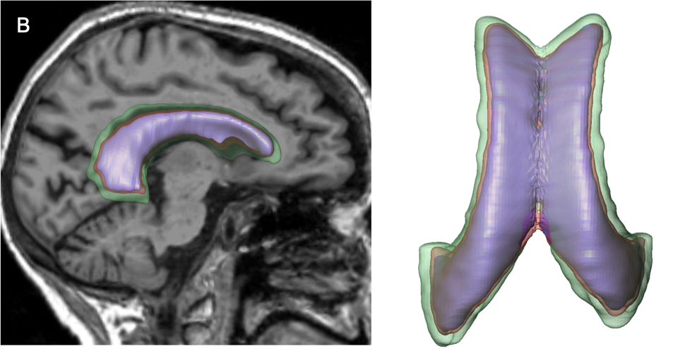
Predicting diagnose progression from multimodal neurocognitive baseline data:
Neuropsychological Tests:
Rey auditory verbal test (RAVLT)
Trail making test (TMT)
Category fluency test (CFT)
Functinal activity level: FAQ
sMRI: global and local measures derived
From FreeSurfer (long stream ver. 7.1)
Machine Learning classification
Binary classifier:
Random Forest
Stable MCI
(sMCI, N=360)
MCI to MCI
Converted AD
(cAD, N= 320)
MCI to AD
When these eleven neurocognitive measures were used as input in a Random Forest (RF) binary classifier (sMCI vs. cAD) we obtained an accuracy, recall, precision and F1 scores of 73%/ 69%/72% and 70% on the hold-out test set.
Reprinted from Mofrad et al., (2021). Illustrates expansion of lateral ventricle volume (LVV) for one subject at one scan diagnosed as healthy control (HC), MCI and Alzheimer’s disease (AD).
Notes:
On the hold-out test set the RF classifier obtained an accuracy,recall, precision and F1 scores of 73%/ 69%/72% and 70%.
mean F1-score of 73%, using a k-fold cross validation procedure with 10-folds (update to 20).

