Slide 1


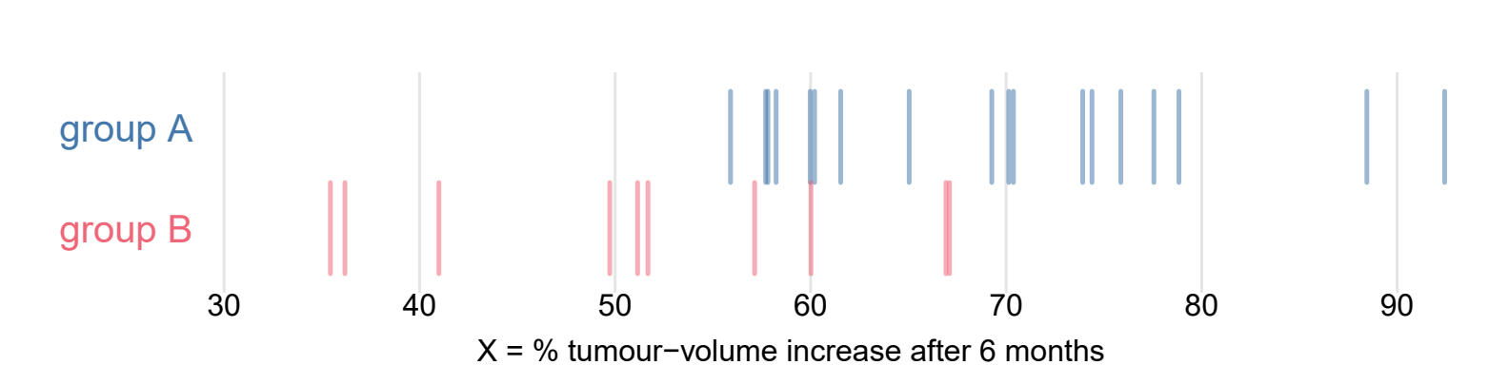
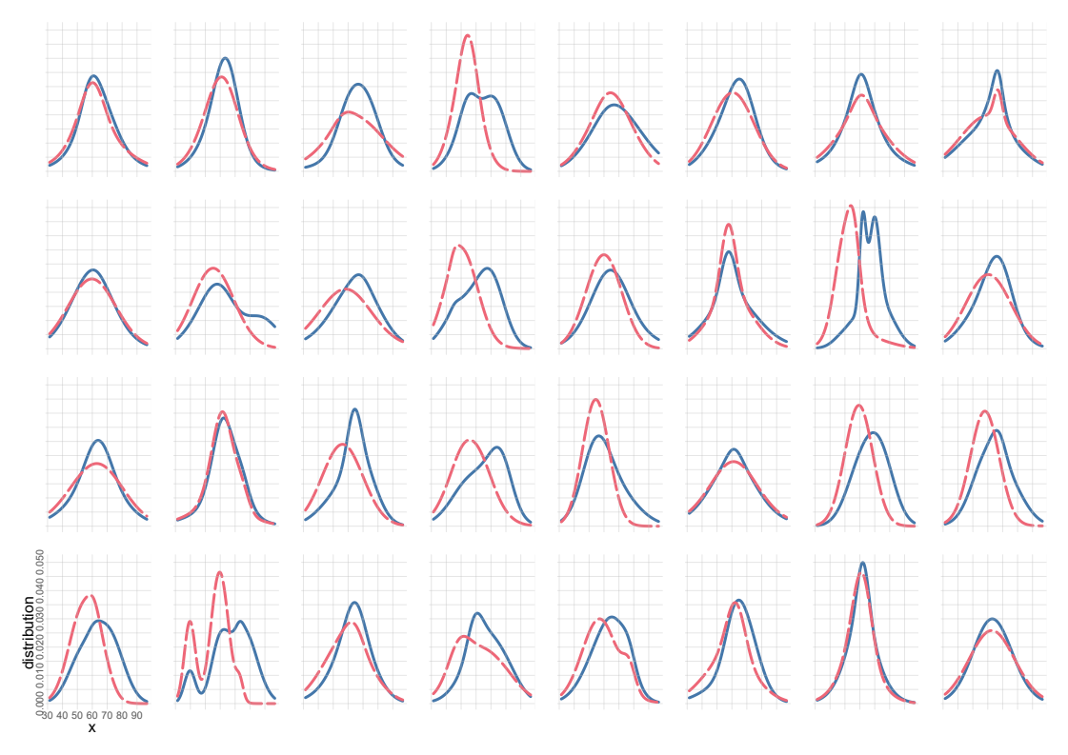
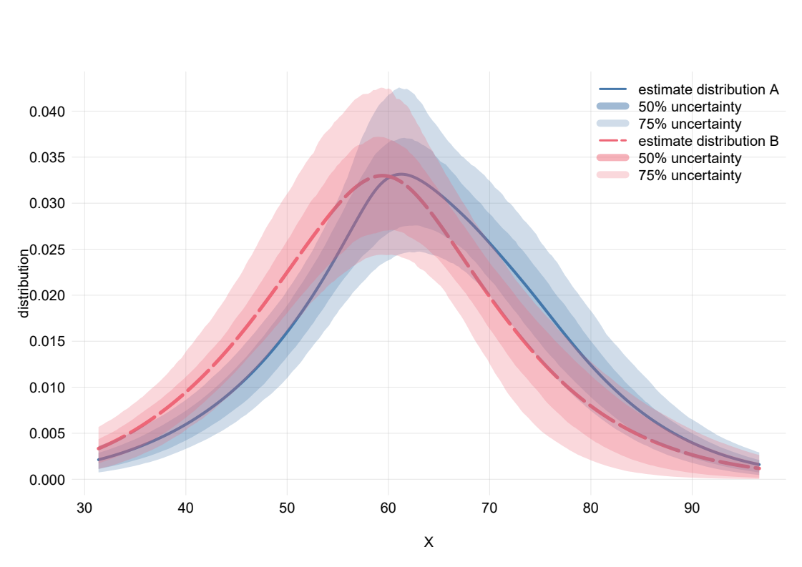
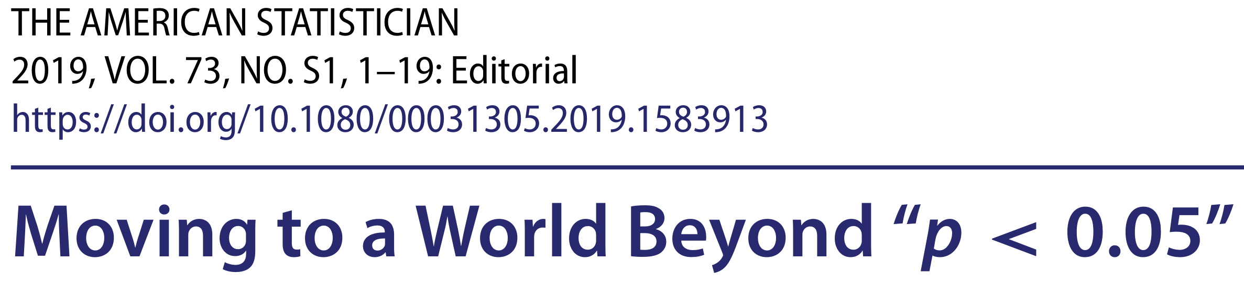
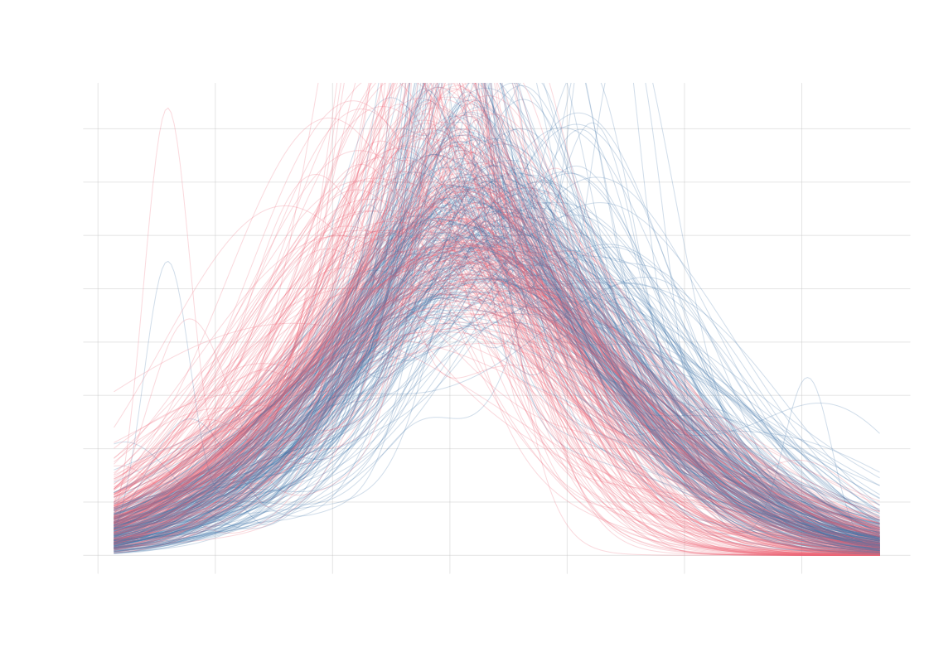
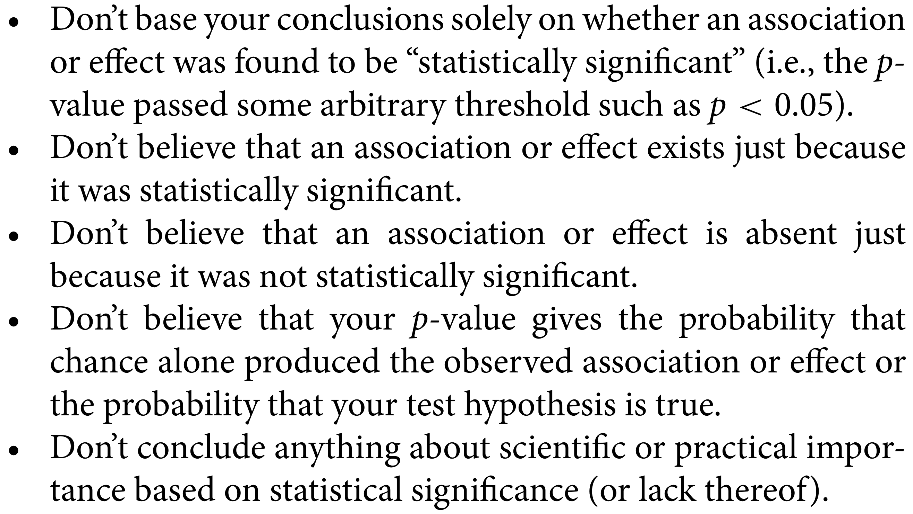
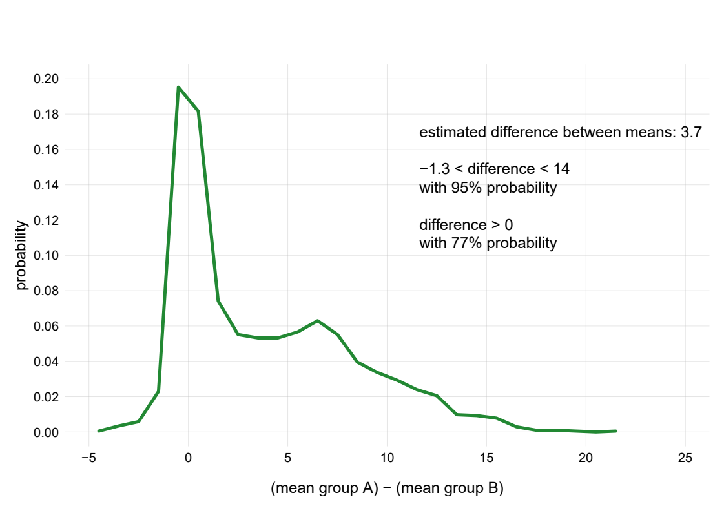
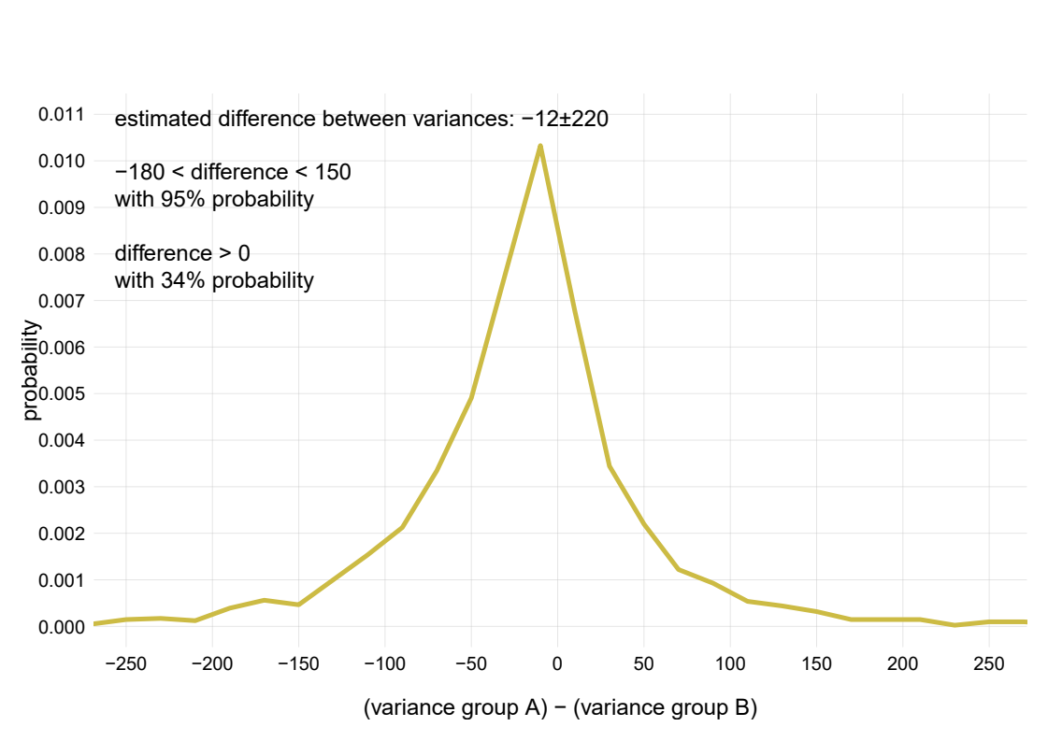
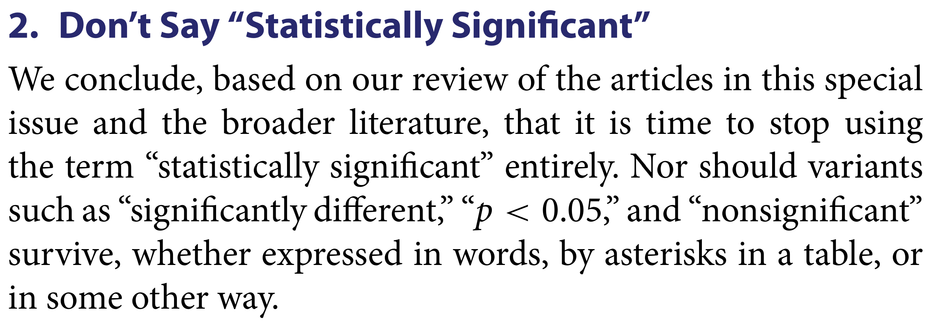
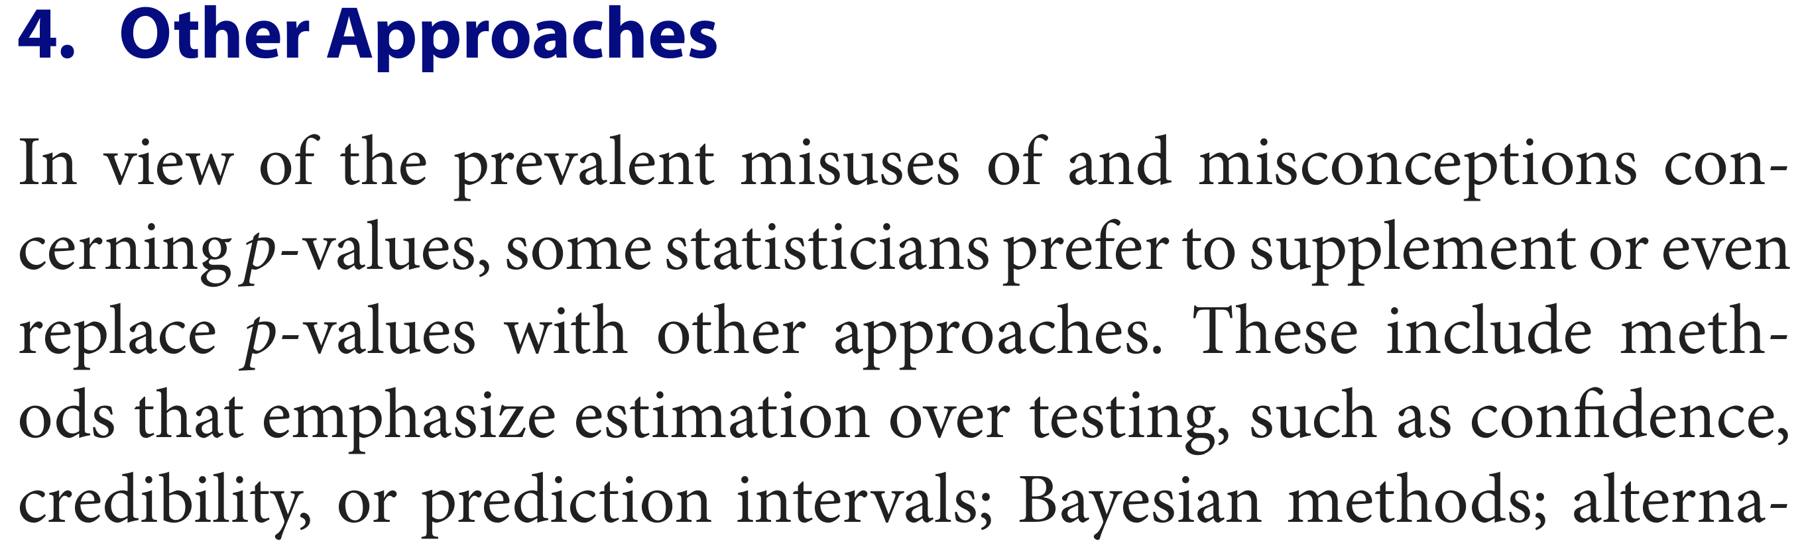

This is only a draft!
User-friendly software for Bayesian analysis of medical data
PierGianLuca Porta Mana, Kjetil Dyrland, Alexander Selvikvåg Lundervold [add addresses]
Simple example question:
do treatment A and treatment B
have different effects on tumour increase X?
This is A4 size
Bayesian theory
old sampling theory
Very few data!
Bayesian probability theory considers
all likely full-population distributions
given the data
Estimates of full distributions
and uncertainty of estimates.
New data cannot modify our predictions
beyond these regions
It’s actually more probable
that the variances are different:
non-gaussianity leads to an unreliable F-test
American Statistical Association’s official statement
“ Assuming that the two full populations:
are gaussian and independent
have identical variances (F-test, p = 0.44)
The hypothesis that their means are equal
has a p-value 0.00043 (two-tail t-test: +4.0).
The sample mean difference of X is 17.6
The 95% confidence interval is [8.6, 26.7] ”
No assumptions
of gaussianity
all possible distributions
are combined
These curves are predictions
of the effect
on the next future patient
...and
infinitely
many more
Predictions of what
the actual values and differences will be
Does the value “0.00043” have a meaning easy to grasp?
These detailed probabilities
can be used in a cost/benefit analysis
(“given that:
treatment A costs $ and gives Y% benefit,,
treatment B costs $$ and gives Z% benefit,
which treatment should we choose?”)
This does not mean that 8.6 < X < 26.7 with 95% probability!
It means that this technique to construct the interval
contains the true value in 95% of all imaginary datasets.
But we care about the dataset actually observed!
“ Assuming that the two full-population distributions are smooth, we predict:
The distributions of future treatment outcomes will be as in the plots, within the uncertainties shown
Future patients under treatment A will have on average X = 63, and 59 < X < 69 with 95% probability
Future patients under treatment B will have on average X = 59, and 52 < X < 66 with 95% probability
The difference between the mean X of the treatments will be within –1.3 and 14 with 95% probability
Average X under treatment A will be larger than under treatment B with 77% probability
Variance of X under treatment A will be smaller than under treatment B with 66% probability ”
Compare the two analyses
The predictions of Bayesian analysis are:
• detailed
• quantitative
• easy to understand
(eg, “fraction x% of population will have effect y”)
The statements of sampling theory are:
• vague
• obscure or misleading
• heavily dependent on tacit assumptions
This was just a simple example. Bayesian theory deals in the same way
with multiple covariates and correlation questions
“Looks great, but
there’s very little friendly software
for doing this!”
True! That’s why we are preparing
a user-friendly software to do Bayesian analysis
on (non-imaging) medical data
We’re already using a prototype version
for drug-discovery research
Please get in touch if you want to test it
and help us making a great sofware!
The maths will be taken care of under the hood
Works with continuous and categorical variables
- allows predictions about their correlations and relevance
No assumptions of gaussianity or other assumptions typical of sampling theory
No need for corrections of any kind
The software will suggest meaningful questions to be asked (in line with ASA’s statement)

