Slide 1


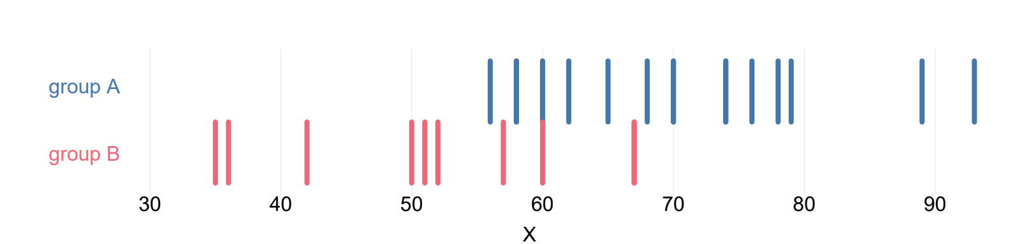
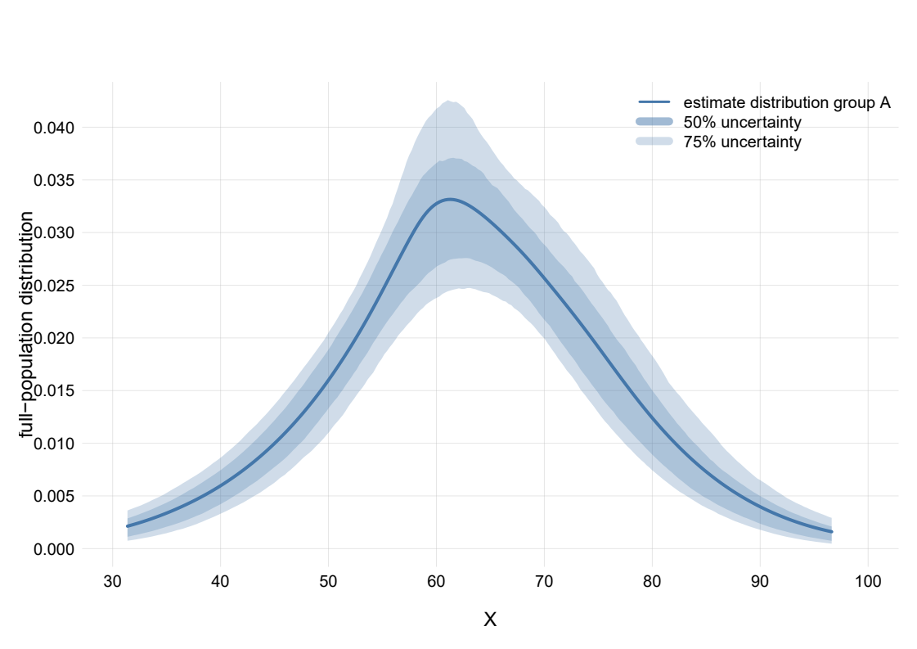
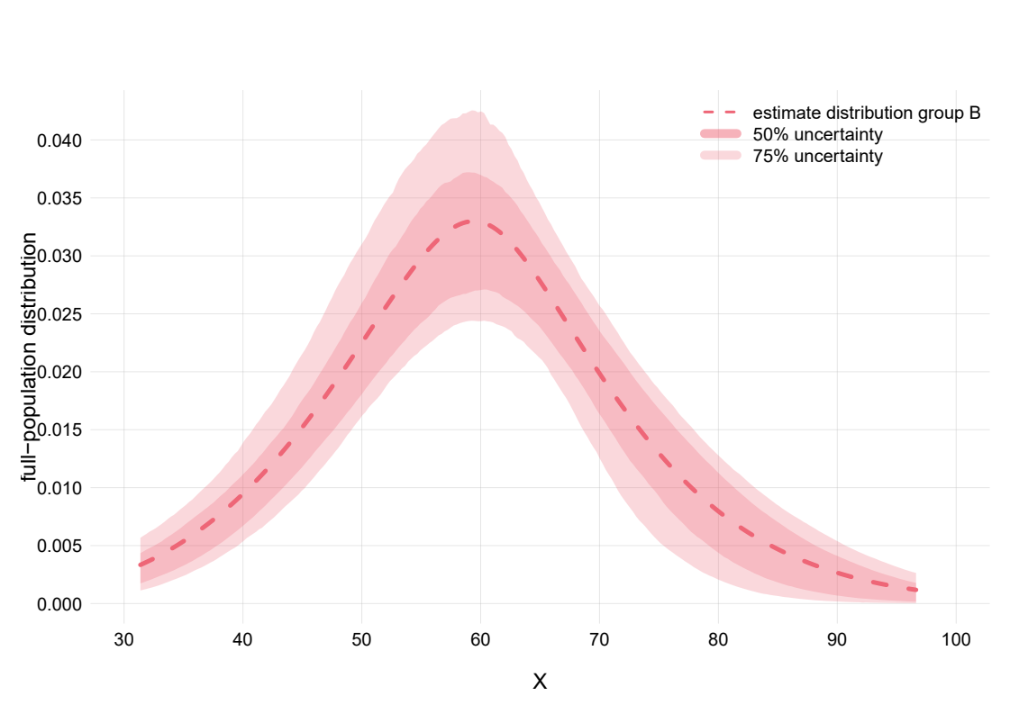
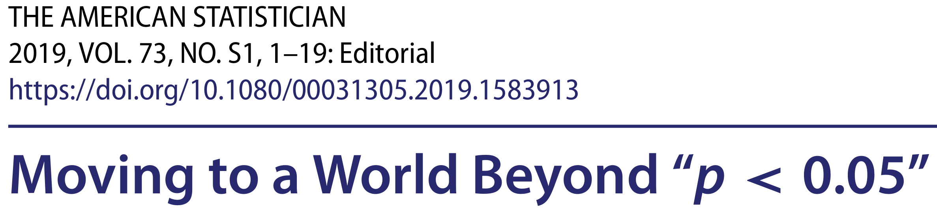
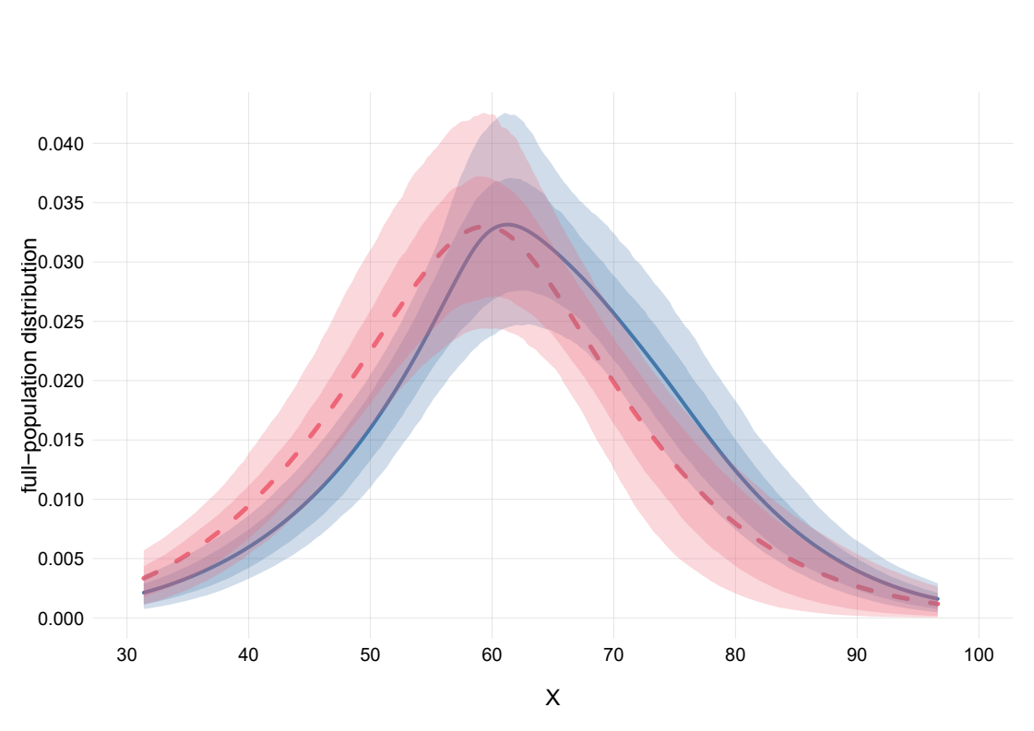
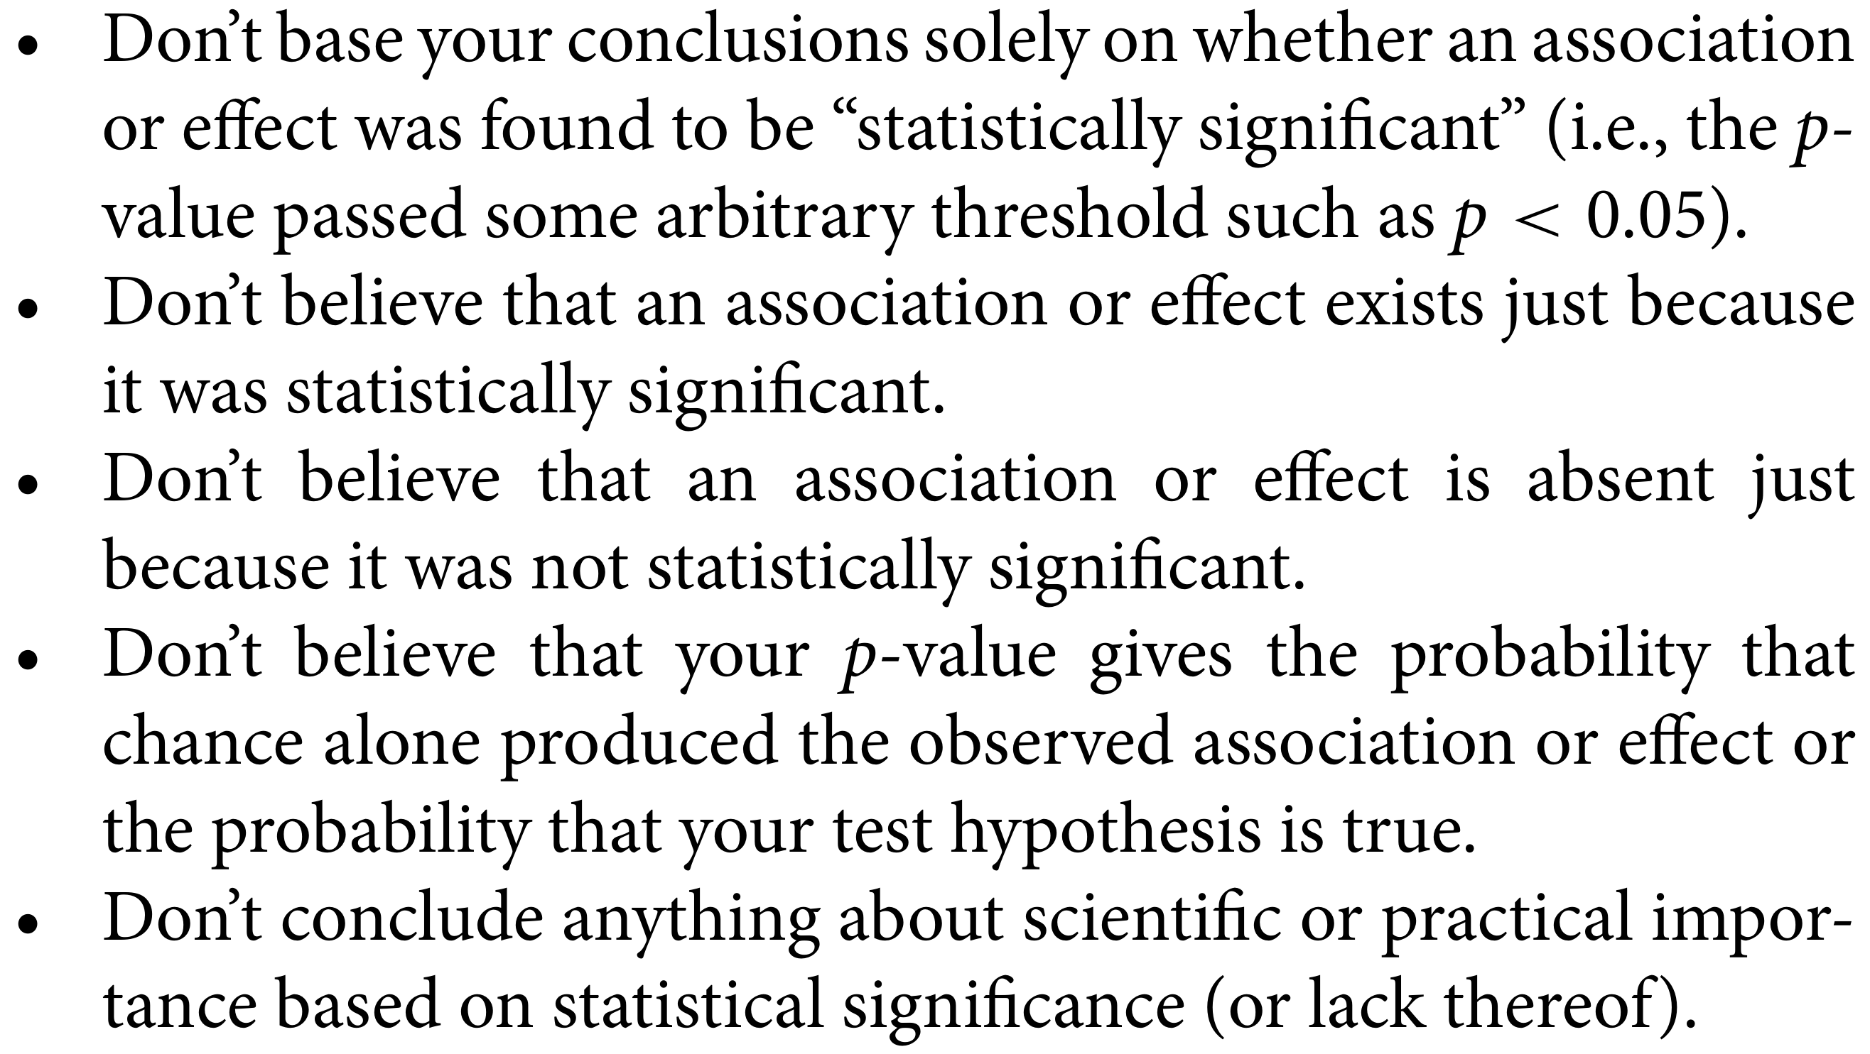
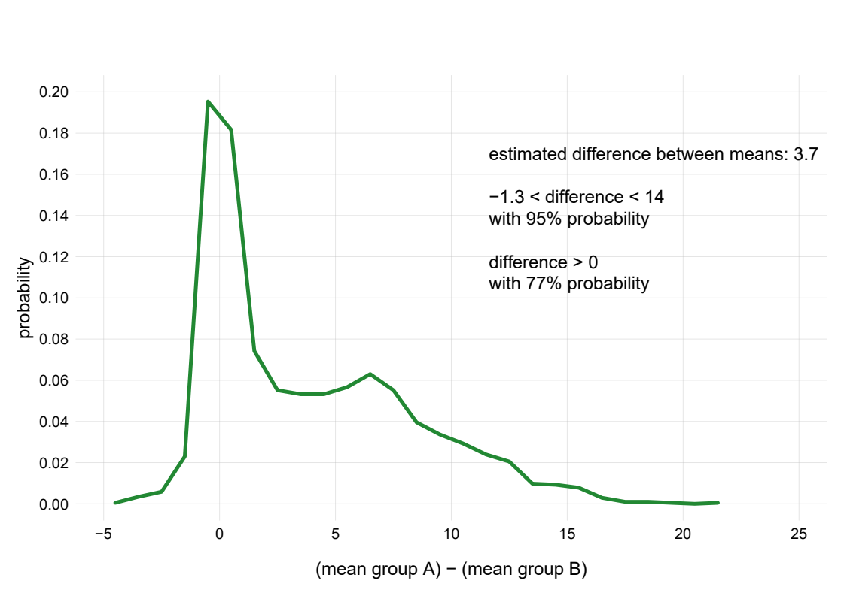
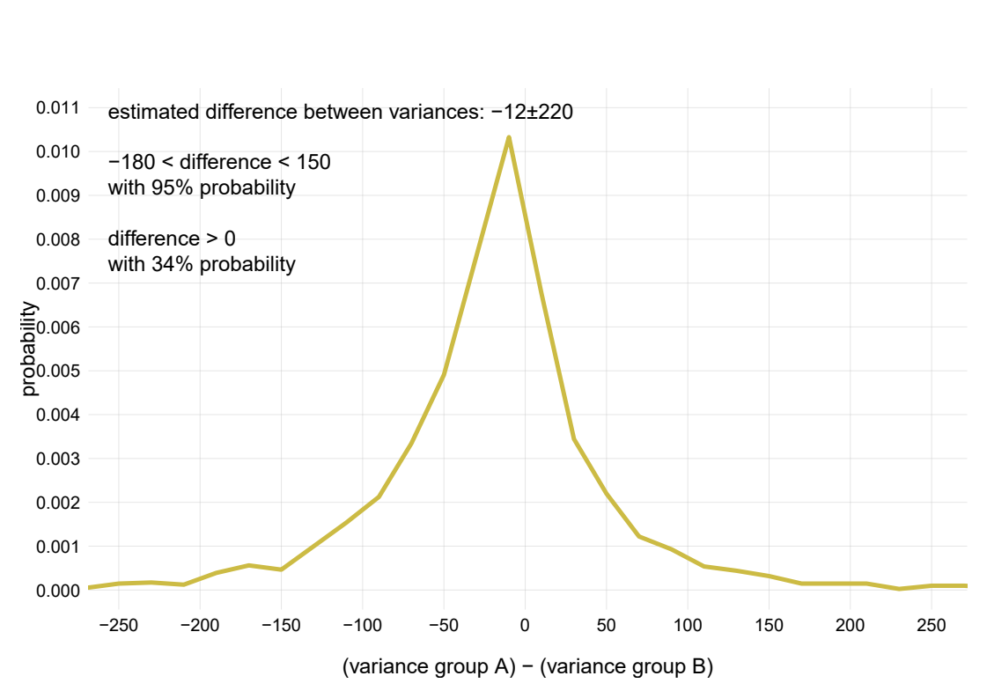
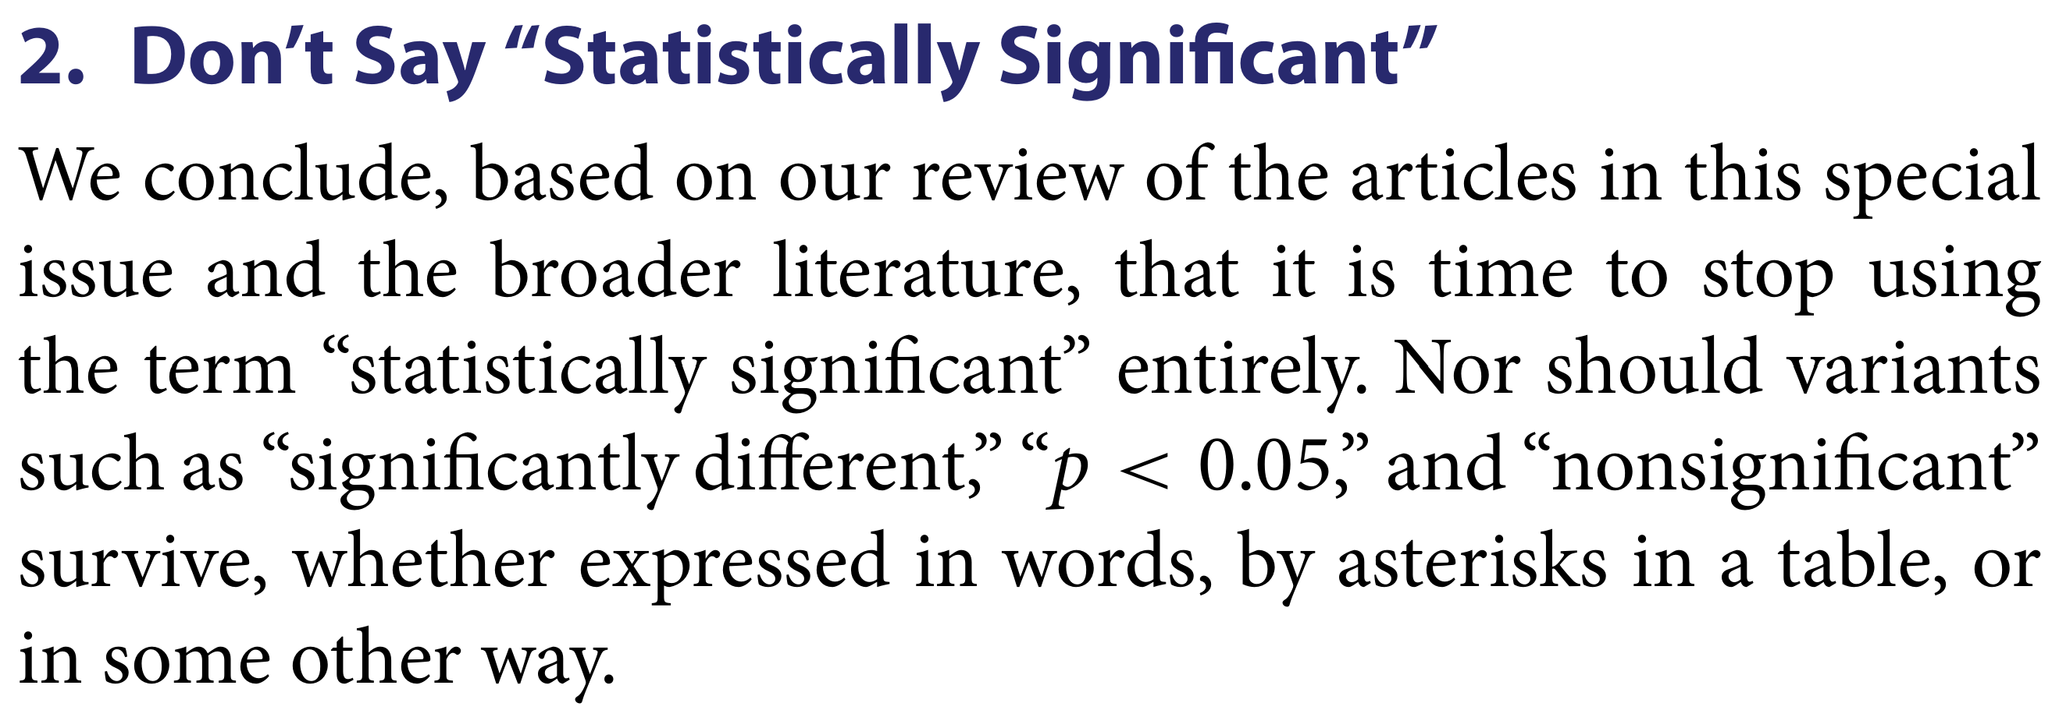
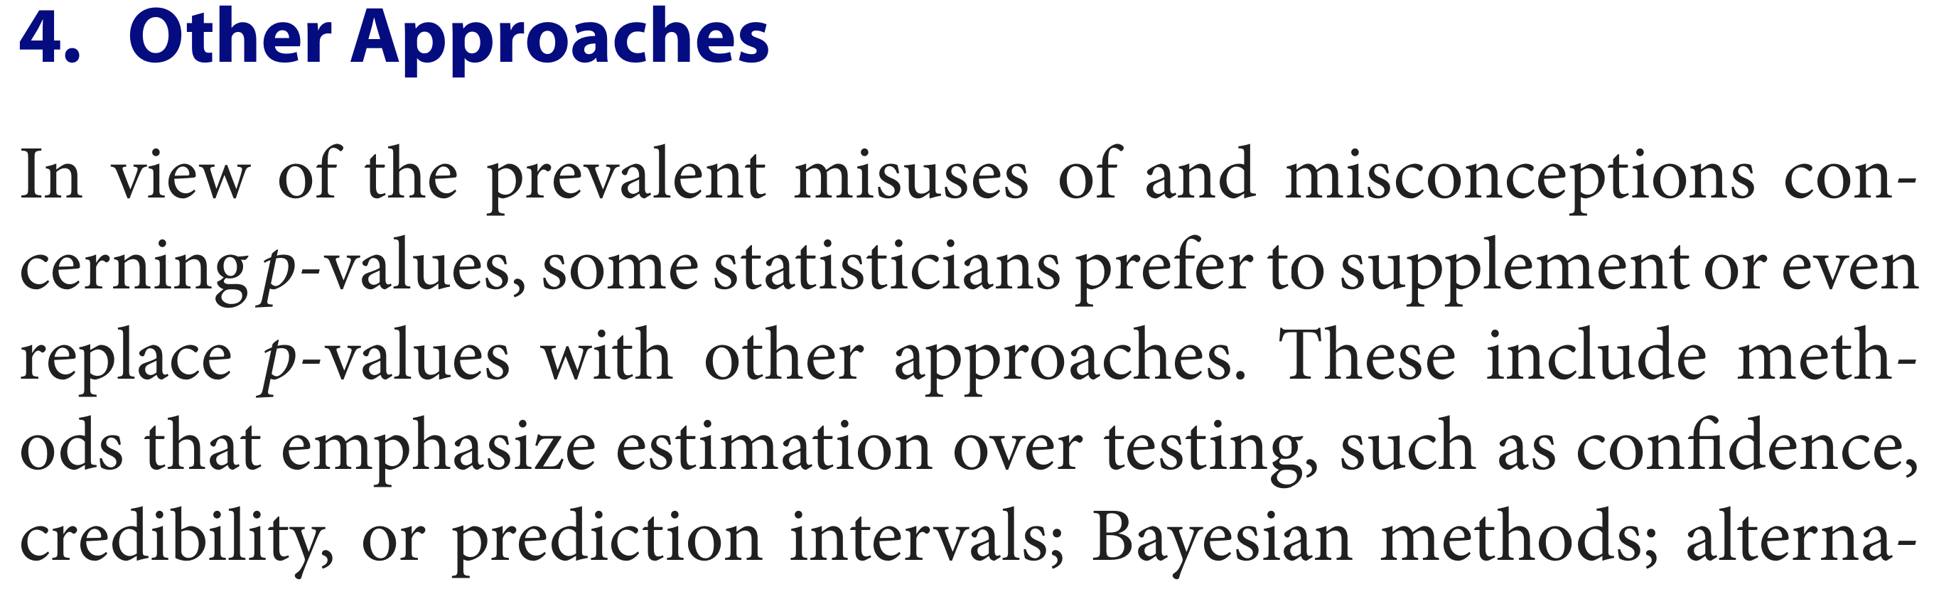

This is only a draft!
User-friendly software for Bayesian analysis of medical data
Authors, addresses
Question: do drug A and drug B
have different effects on X?
Bayesian analysis
old sampling theory
Very few data!
No assumptions of gaussianity
Estimates of full distributions,
with uncertainty of estimates:
they tell us that new data cannot modify our conclusions beyond these regions
“ Assuming that the two full populations:
have identical variances (F-test, p = 0.44)
are gaussian and independent
The hypothesis that their means are equal
has a p-value 0.00043 (t-test: +4.0).
The sample mean difference is 17.6
The 95% confidence interval is [8.6, 26.7] ”
Predictions of what
the actual values and differences
will be
It’s actually more probable
that the variances are different:
non-gaussianity leads to an unreliable F-test
“ Assuming that the full populations don’t have discontinuities, we estimate:
the distributions of future measurements to be as in the plots, within the uncertainties shown
the expected mean of population A to be 63, within 59 and 69, with 95% probability
the expected mean of population B to be 59, within 52 and 66, with 95% probability
the difference between the means to be within –1.3 and 14, with 95% probability
the difference between the means to be larger than zero with 77% probability
the difference between the variances to be smaller than zero with 66% probability ”
“OK, but there’s very little friendly software to do this!”
True! That’s why we are working on a user-friendly application to do Bayesian analysis on (non-imaging) medical data
All the maths will be under the hood
No assumptions of gaussianity or other assumptions typical of sampling theory
No need for corrections of any kind
The software will suggest meaningful questions to be asked (in line with ASA’s statement)

