Slide 1


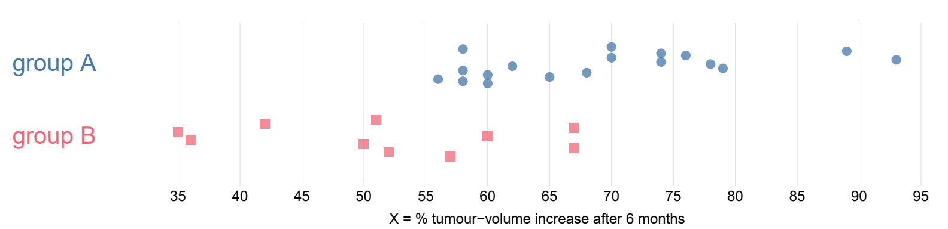
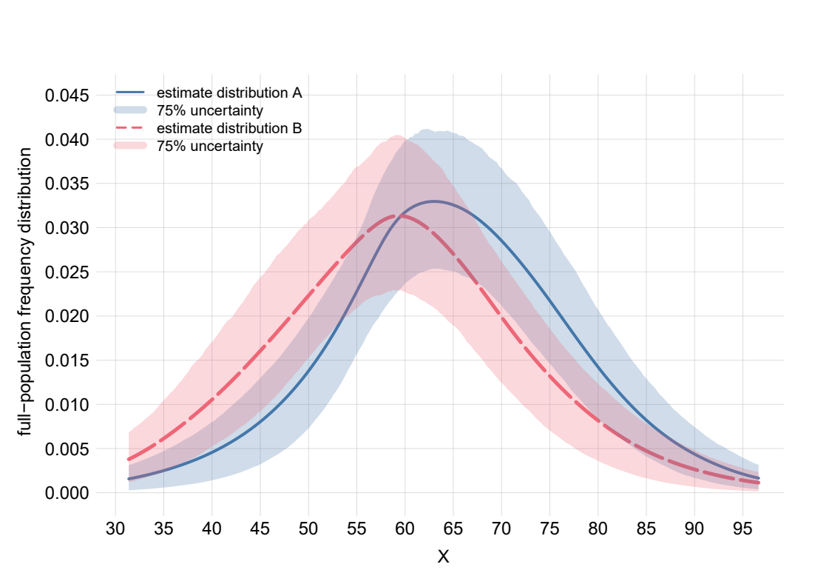
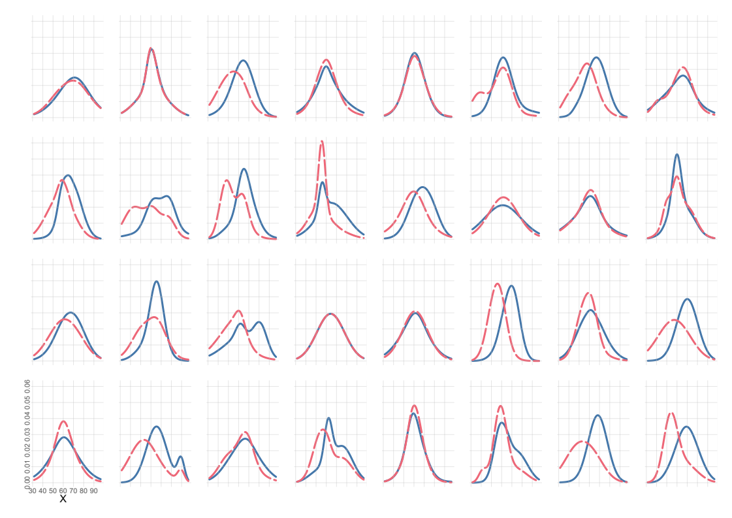
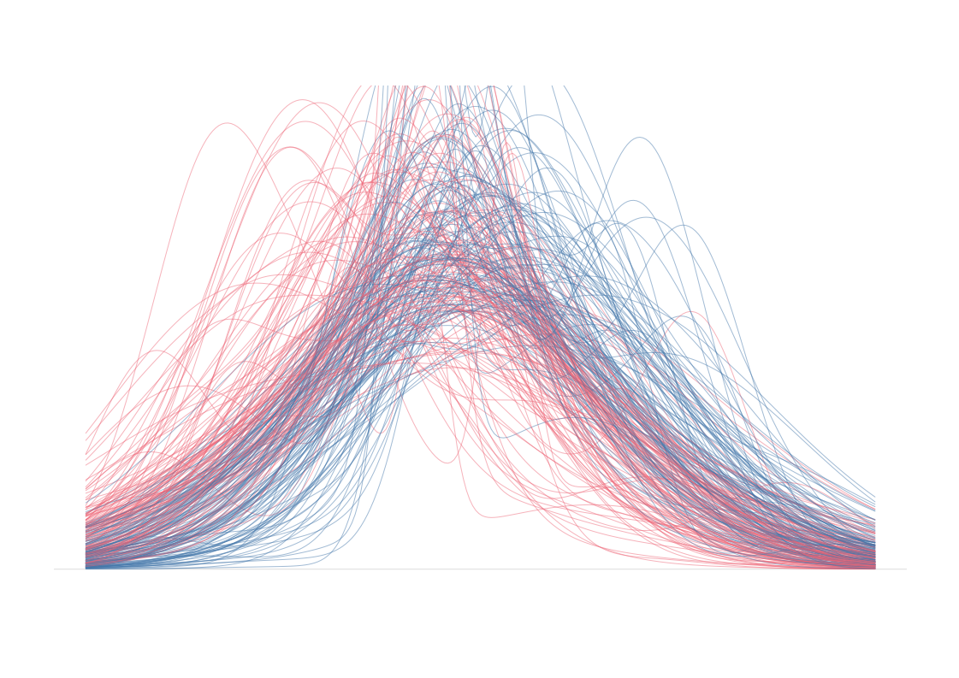
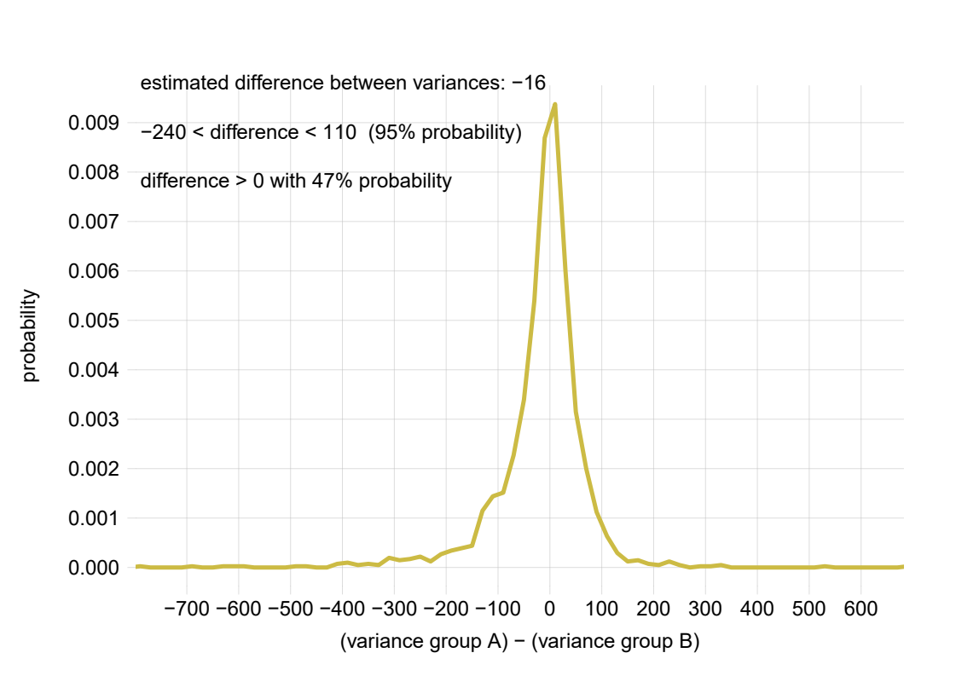
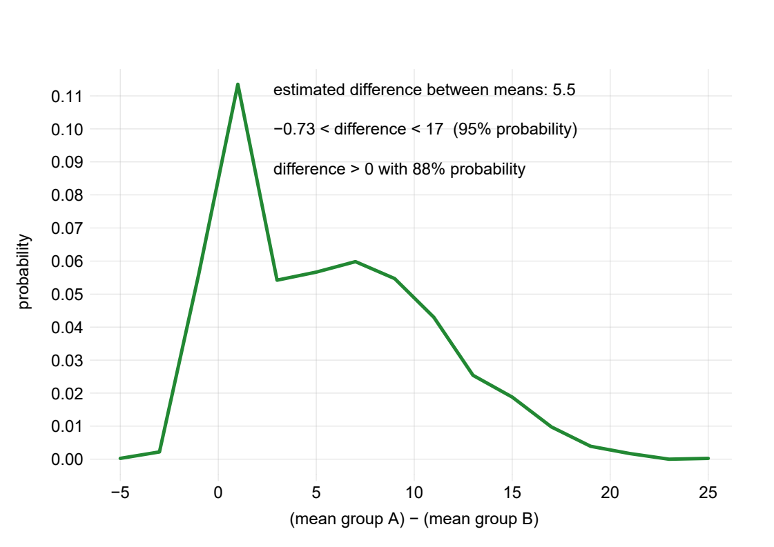
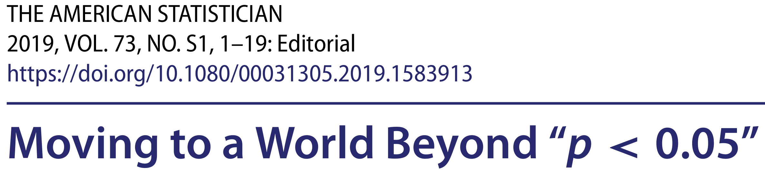
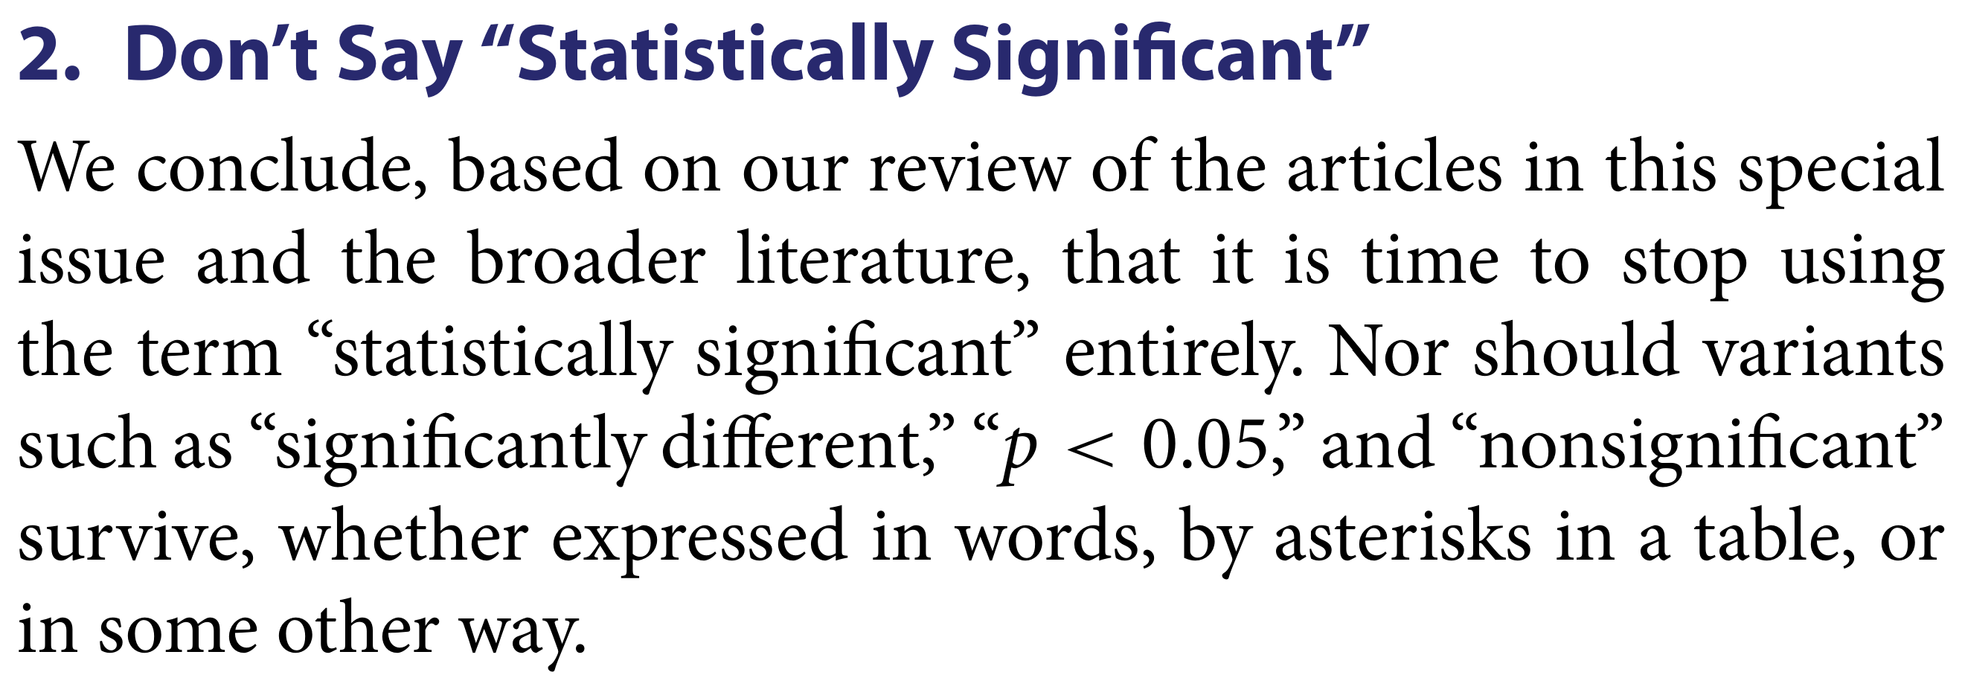
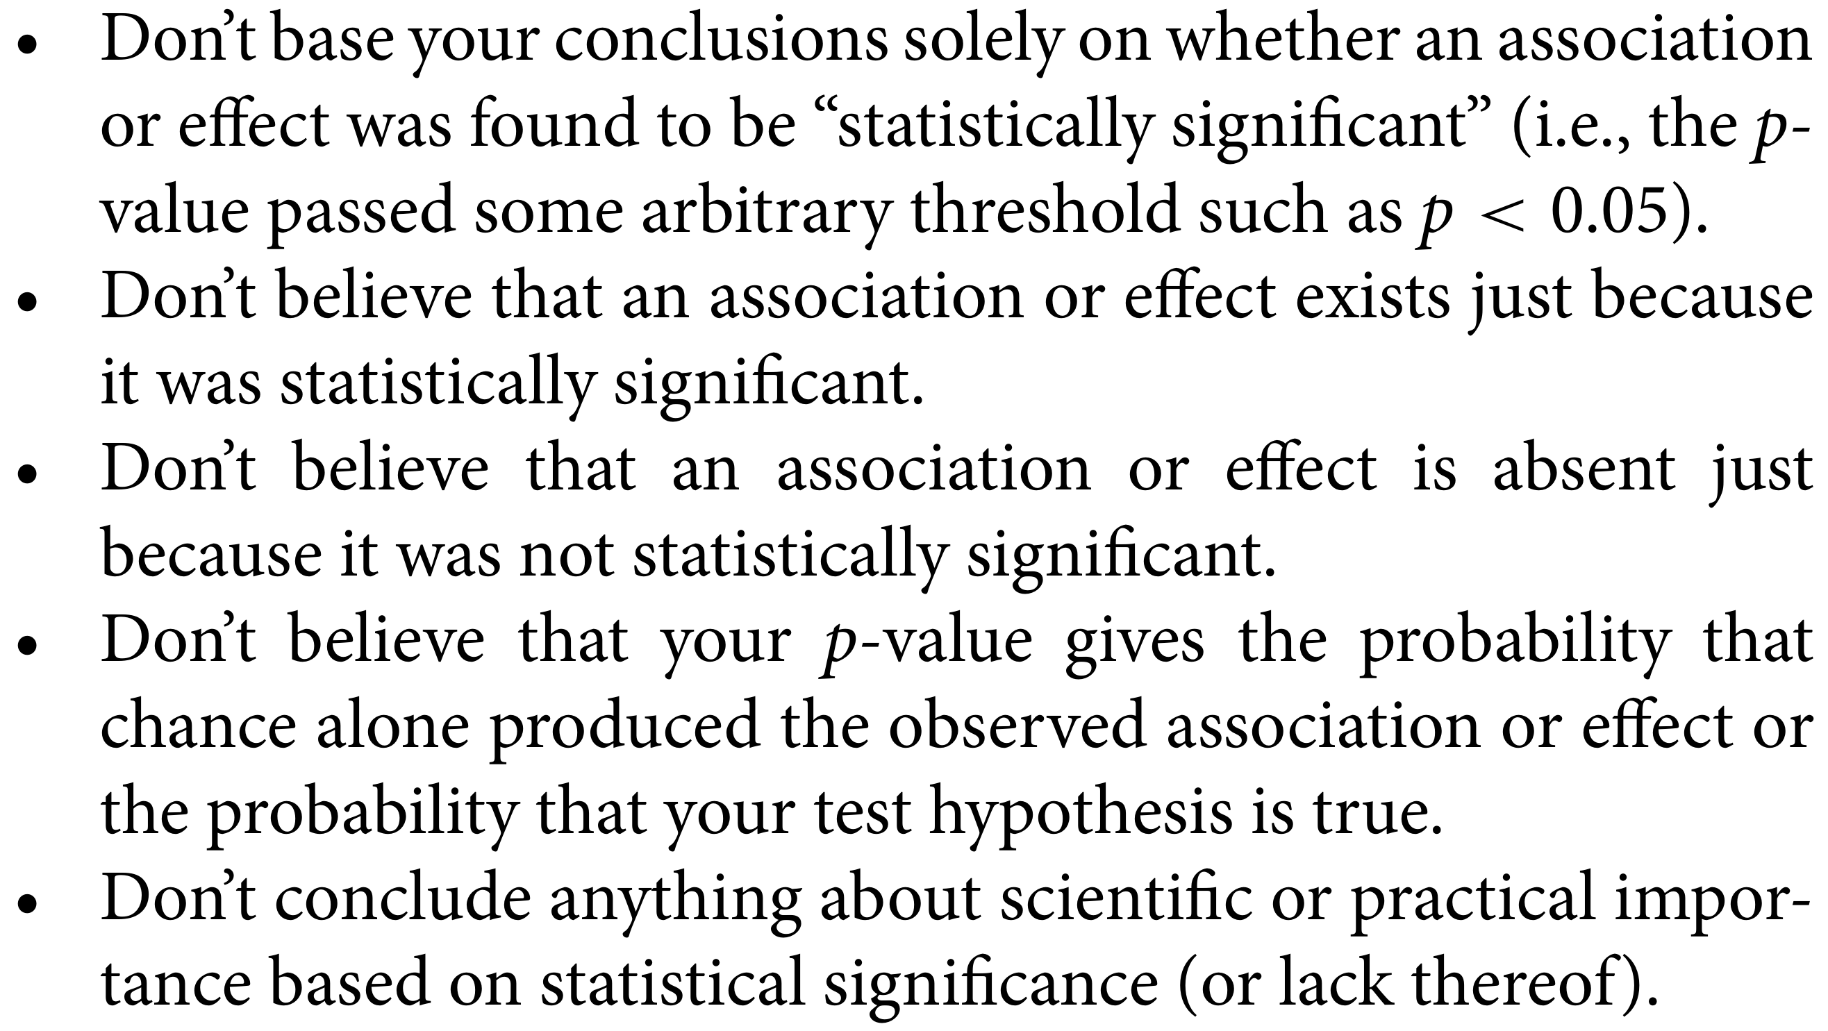
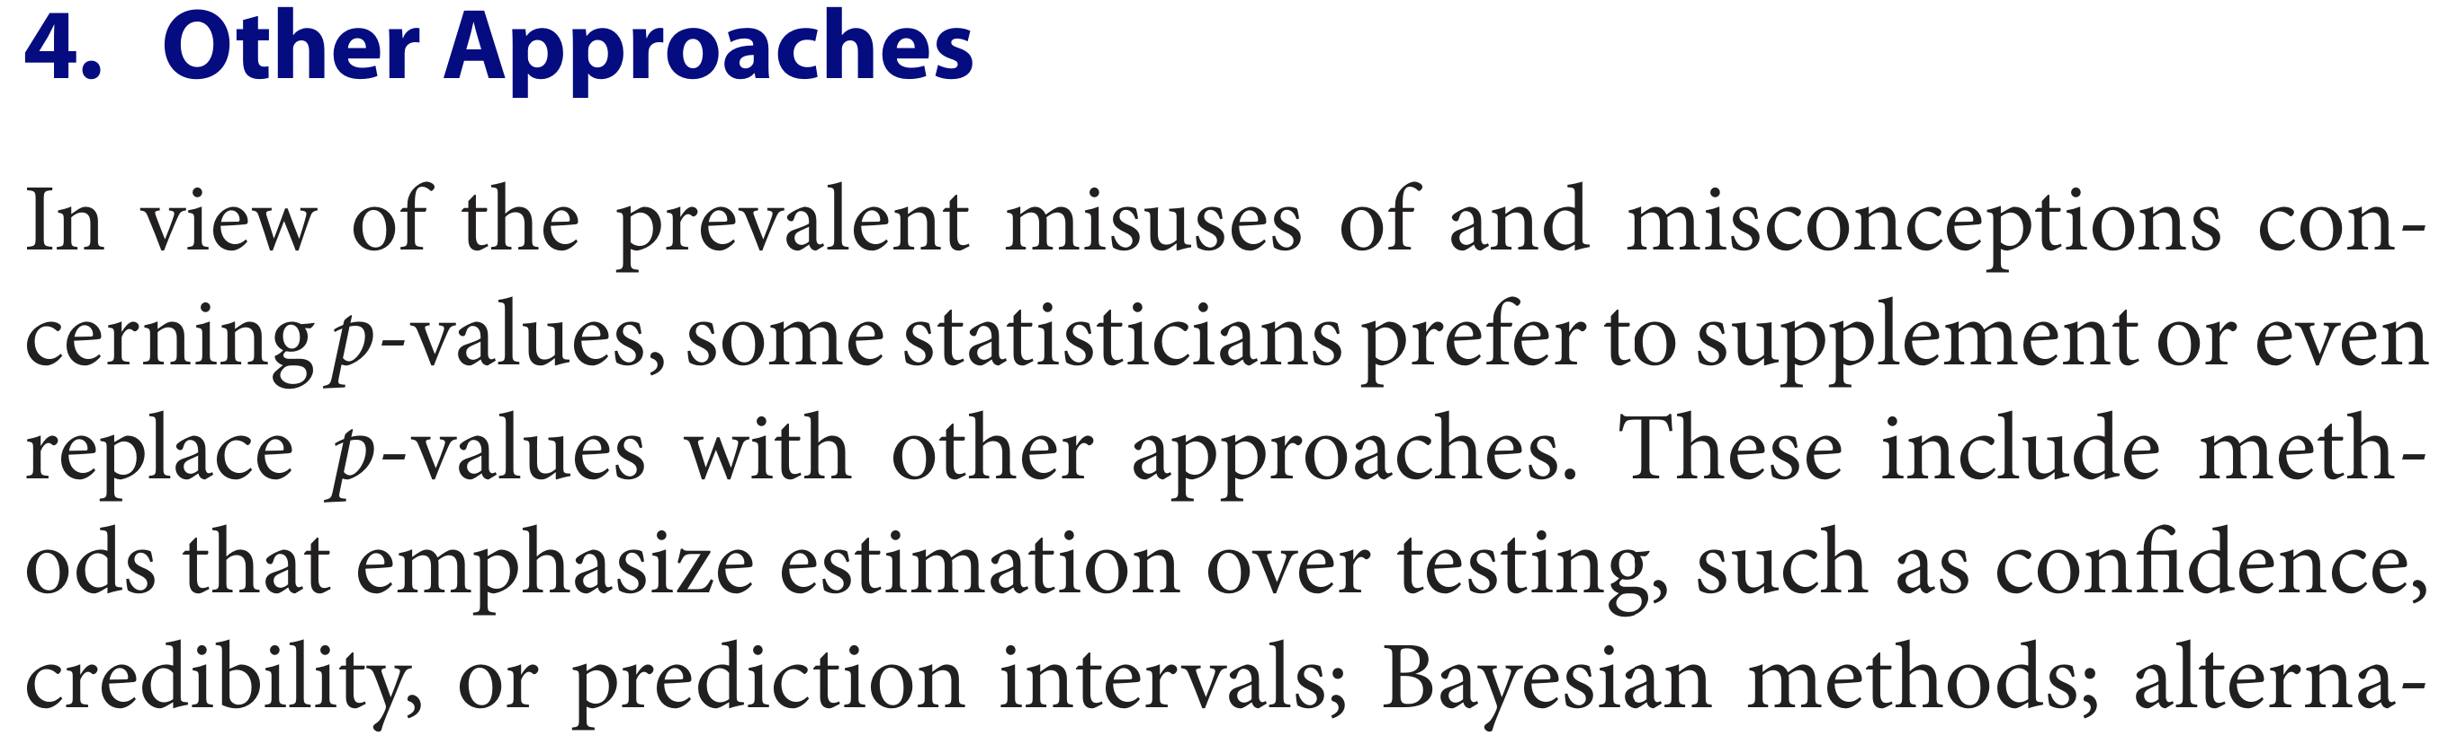
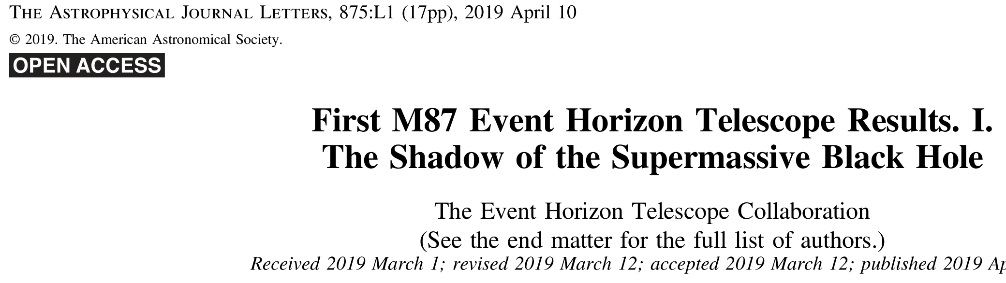
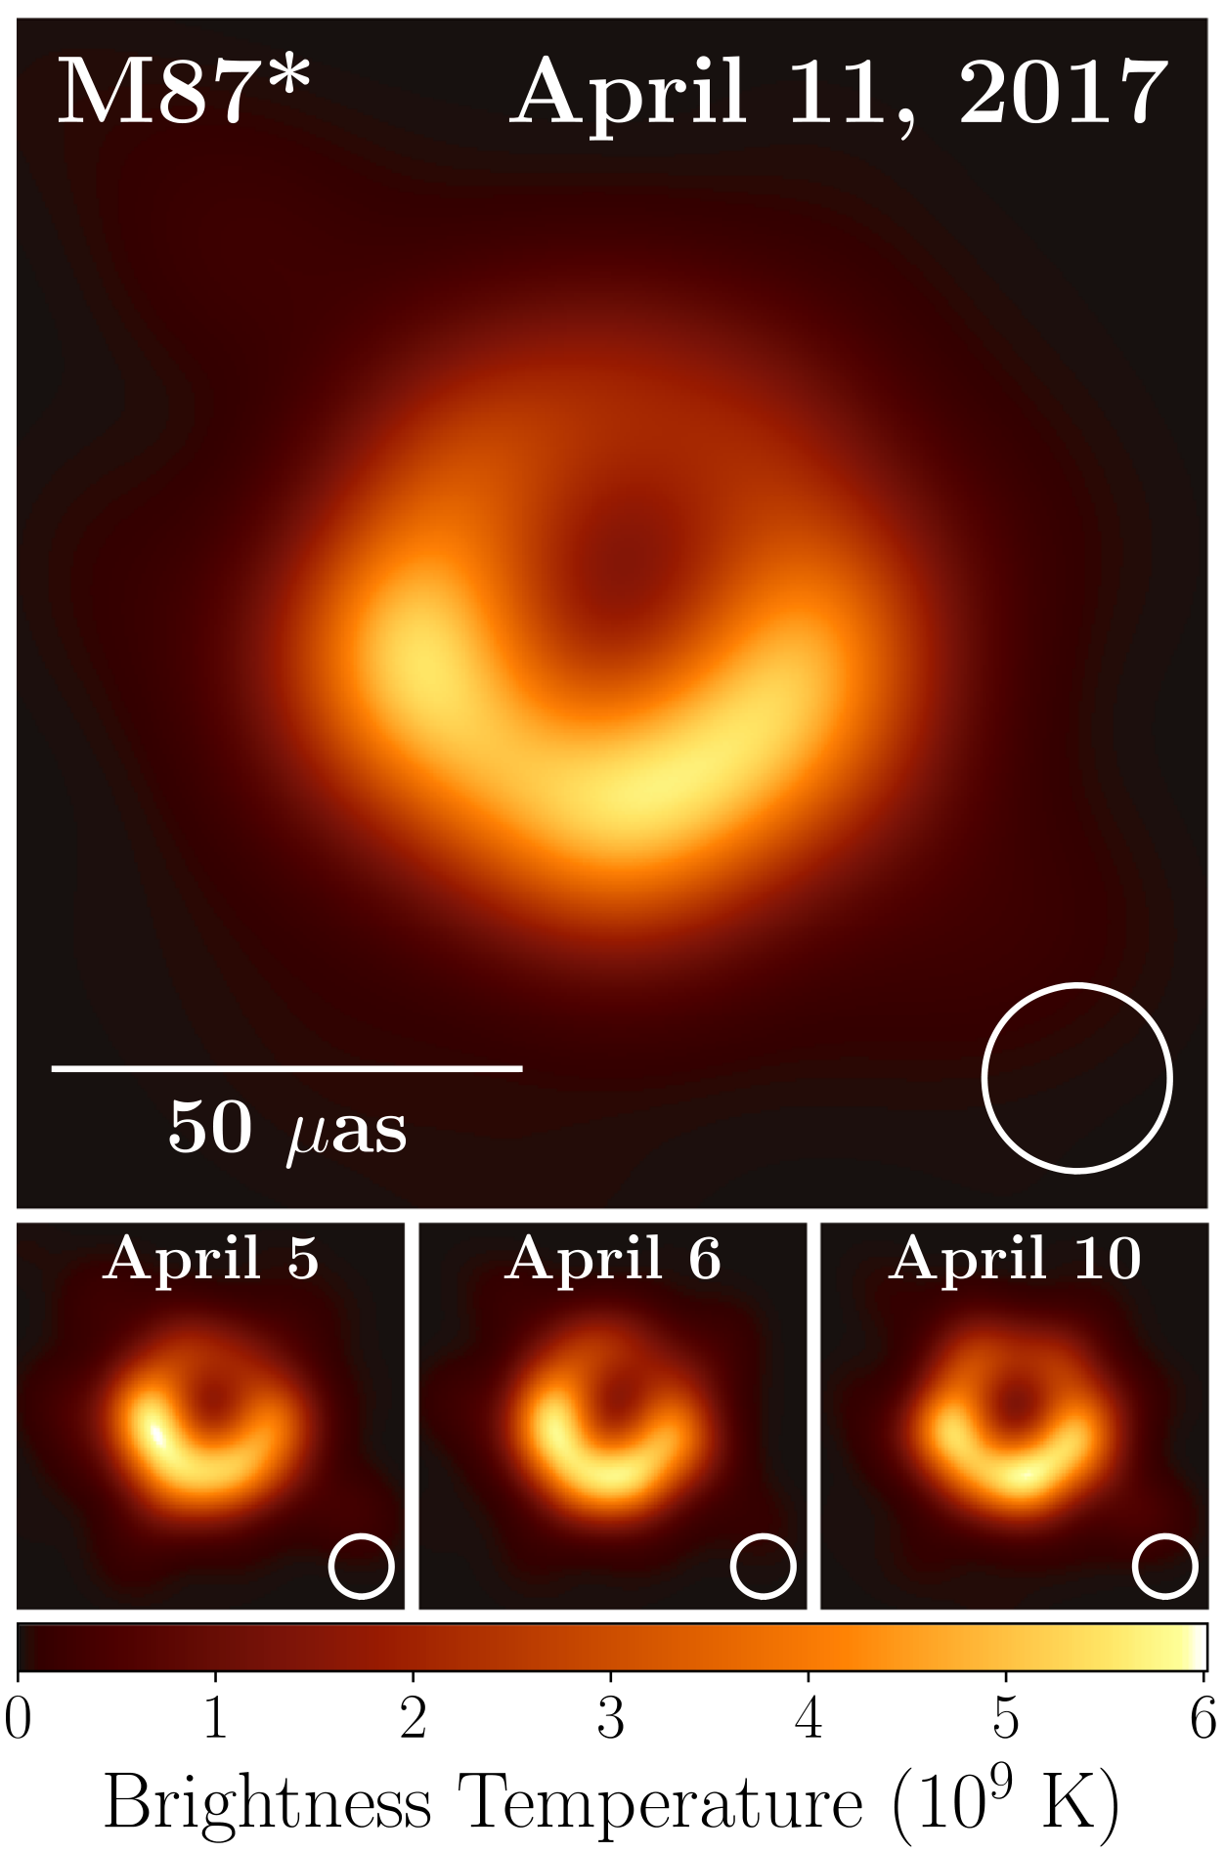
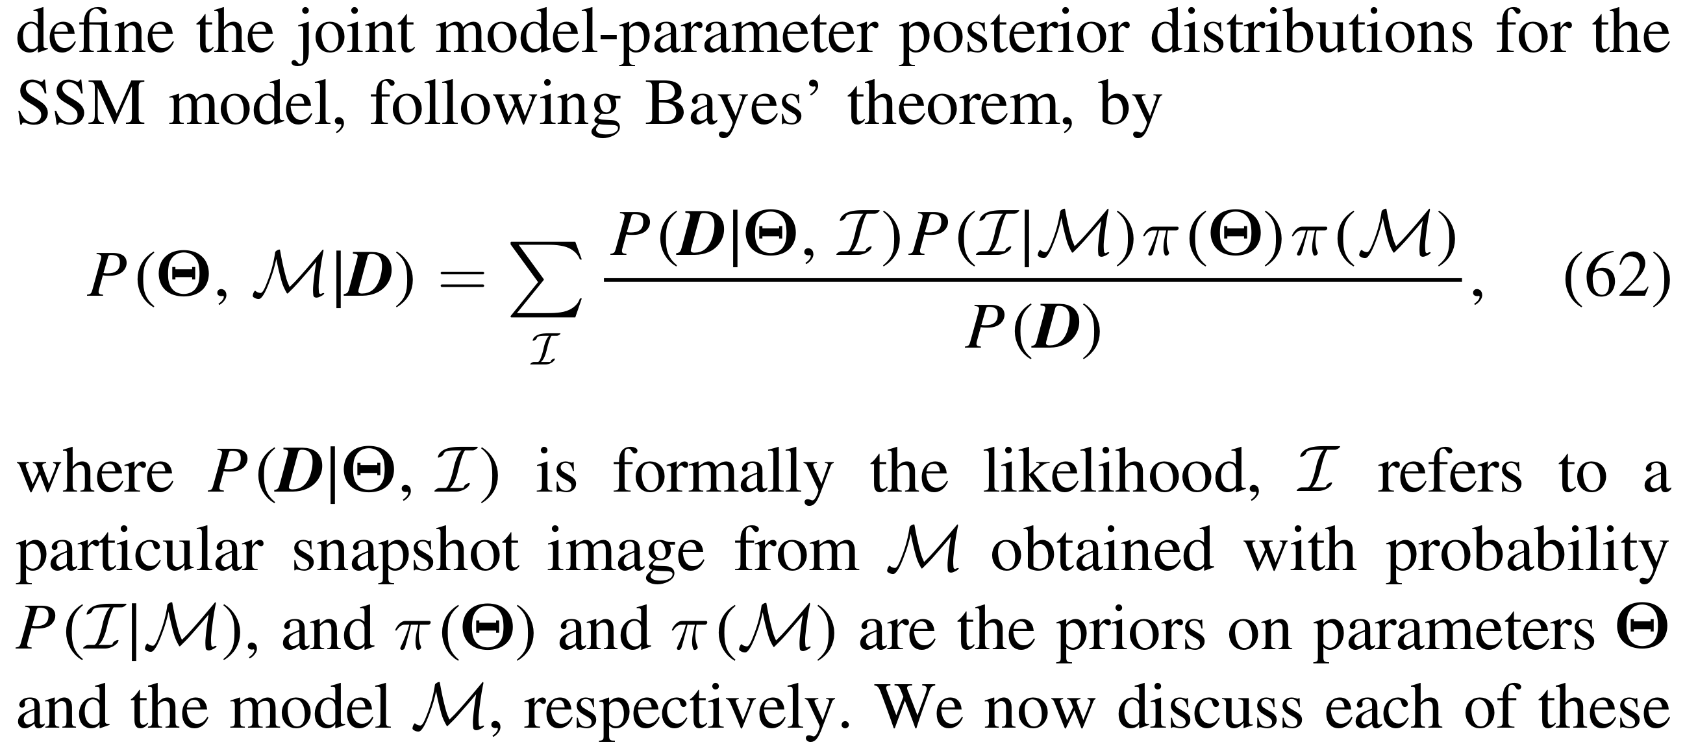


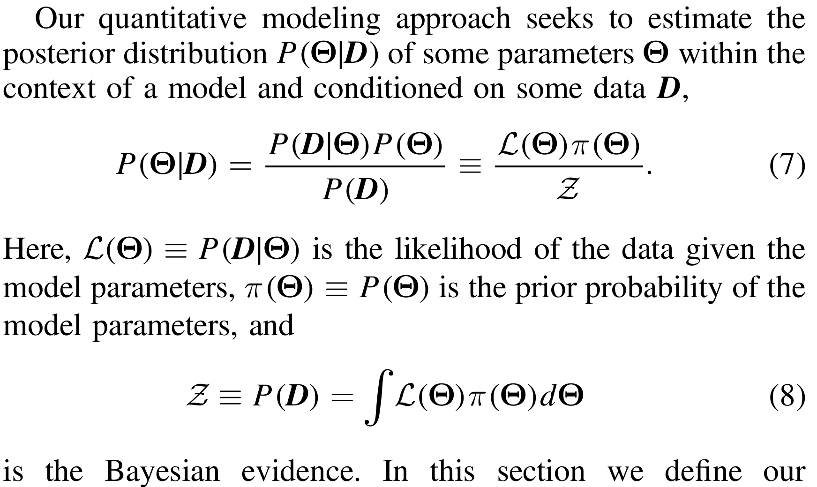
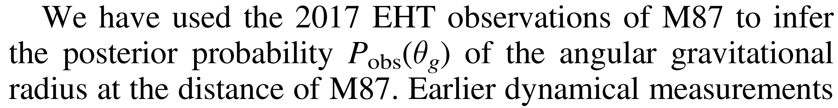
Bayesian theory
User-friendly software
for Bayesian analysis of medical data
PierGianLuca Porta Mana, Kjetil Dyrland, Alexander Selvikvåg Lundervold
Dept of Computer Science, Electrical Engineering, and Mathematical Sciences, HVL; MMIV, HUS
This is A4 size
Sampling theory
Simple example question:
do treatment A and treatment B have different effects on tumour increase X?
Bayesian theory
group A
group B
Very few data!
You are probably familiar with
the typical conclusions from sampling theory:
The Bayesian calculation is always the same
– no matter how many data we have
– no matter how the sample sizes were chosen
and it does not need any corrections
“ Assuming that the two full populations:
are gaussian and independent
have identical variances (F-test, p = 0.44)
and that the sample sizes where decided
before running the experiment, then:
The hypothesis that the population means are equal
has a p-value 0.00043 (two-tail t-test: +4.0)
The sample mean difference of X is17.6
The 95% confidence interval is [8.6, 26.7] ”
Main result: estimates of full distributions
and uncertainty of estimates.
New data is unlikely to modify our predictions
beyond these regions
Bayesian probability theory considers
all likely distributions for future patients
in the two groups, given the data
It’s actually slightly more probable
that the variances are different
all possible distributions
are combined
...and
infinitely
many more
These curves are
predictions of the effect
on the next future patient
What does the number “0.00043” really mean?
This p-value is wrong
If the sample sizes 18 & 10
were decided not in advance
but by some other rule!
No assumptions
of gaussianity
We can estimate any quantity we want
For example the mean and variance
of each population
and their differences
This does not mean that 8.6 < X < 26.7 with 95% probability!
It means that this technique to construct the interval
contains the true value in 95% of all imaginary datasets.
But what’s the best interval that contains X for our dataset?
These detailed probabilities
can be used in a cost/benefit analysis
(decision theory)
“Treatment A costs $, gives a% benefit.
Treatment B costs $$, gives b% benefit.
Which treatment should we choose?”
American Statistical Association’s official statement
American Statistical Association’s official statement
The numbers have
understandable meanings
“ Assuming that the two full-population distributions are probably smooth, we predict:
The distributions of future treatment outcomes will be as in the plots, within uncertainties shown
Future patients under treatment A will have on average X = 65, and 60 < X < 71 with 95% probability
Future patients under treatment B will have on average X = 59, and 51 < X < 65 with 95% probability
The difference between the treatment means will be within [–0.73, 17] with 95% probability
Average X under treatment A will be larger than under treatment B with 88% probability
Variance of X under treatment A will be smaller than under treatment B with 53% probability ”
The statements of sampling theory are:
• vague
• obscure or misleading (“significant”?)
• heavily dependent on tacit assumptions
gaussianity, stopping rules, ...
• subject to doubts and corrections
“should I use this test or that test?” “Bonferroni correction?”
Compare the two analyses
Bayesian theory is used, for example,
for all inferences about the black hole
observed in the galaxy M87
The predictions of Bayesian theory are:
• detailed
• quantitative
• easy to interpret and understand
eg: “fraction x% of population will have effect y”
• calculated always in the same way
no matter the sample size, no matter how many hypotheses
This was just a simple example. Bayesian theory deals in the same way
with multiple hypotheses, variates, and correlation questions
Sounds great, but
there’s very little
friendly software
for doing this!
True! That’s why we are preparing
a user-friendly software to do Bayesian analysis
on (non-imaging) medical data
Machine
Learning
The maths will be taken care of under the hood
The software will suggest meaningful questions to be asked (in line with ASA’s statement)
Works with continuous and categorical variables
– can make predictions about their correlations and relevance
No assumptions of gaussianity, linearity or other (ie: nonparametric)
No need to wonder which test or formula to use, no corrections of any kind
cleanpng.com
We’re already using a prototype version
for drug-discovery and Alzheimer research
Please get in touch if you want to test it
and help us making a great sofware!

