Slide 1


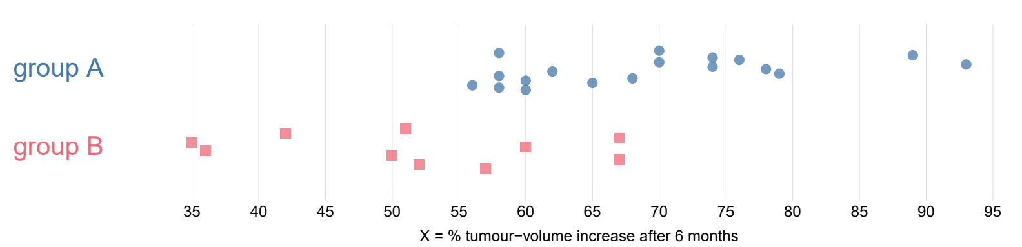
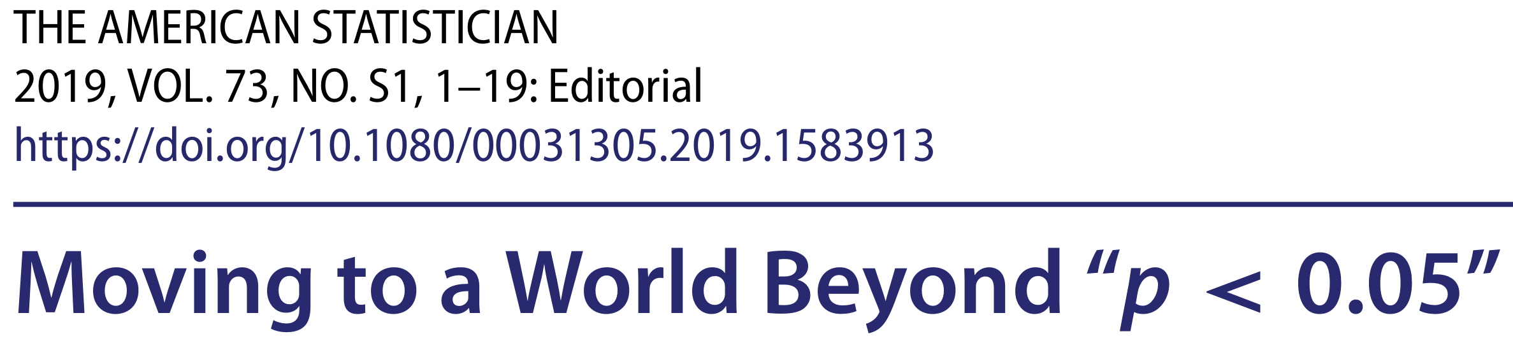
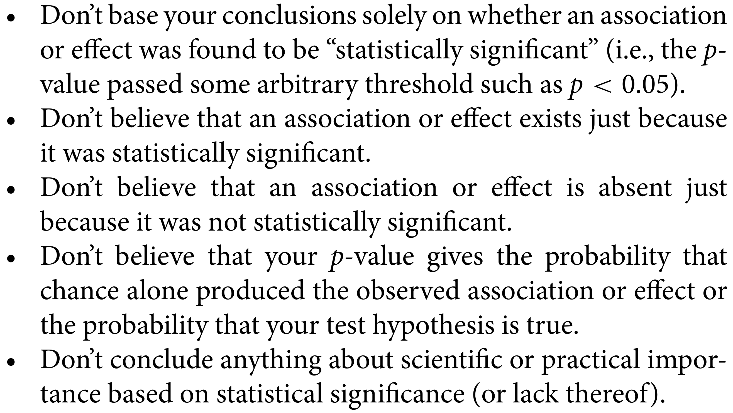
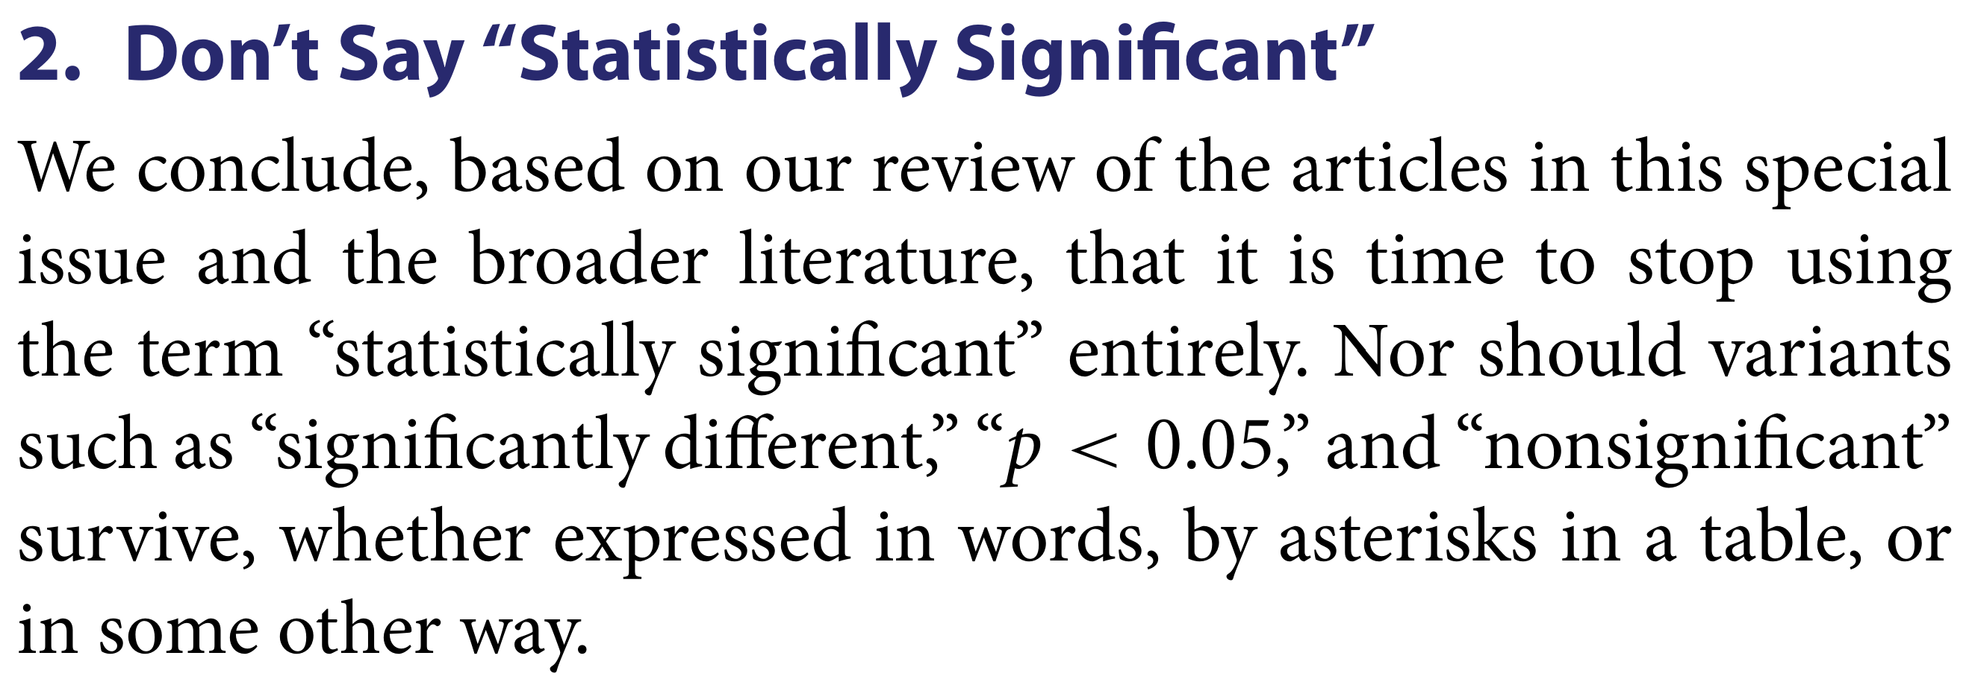
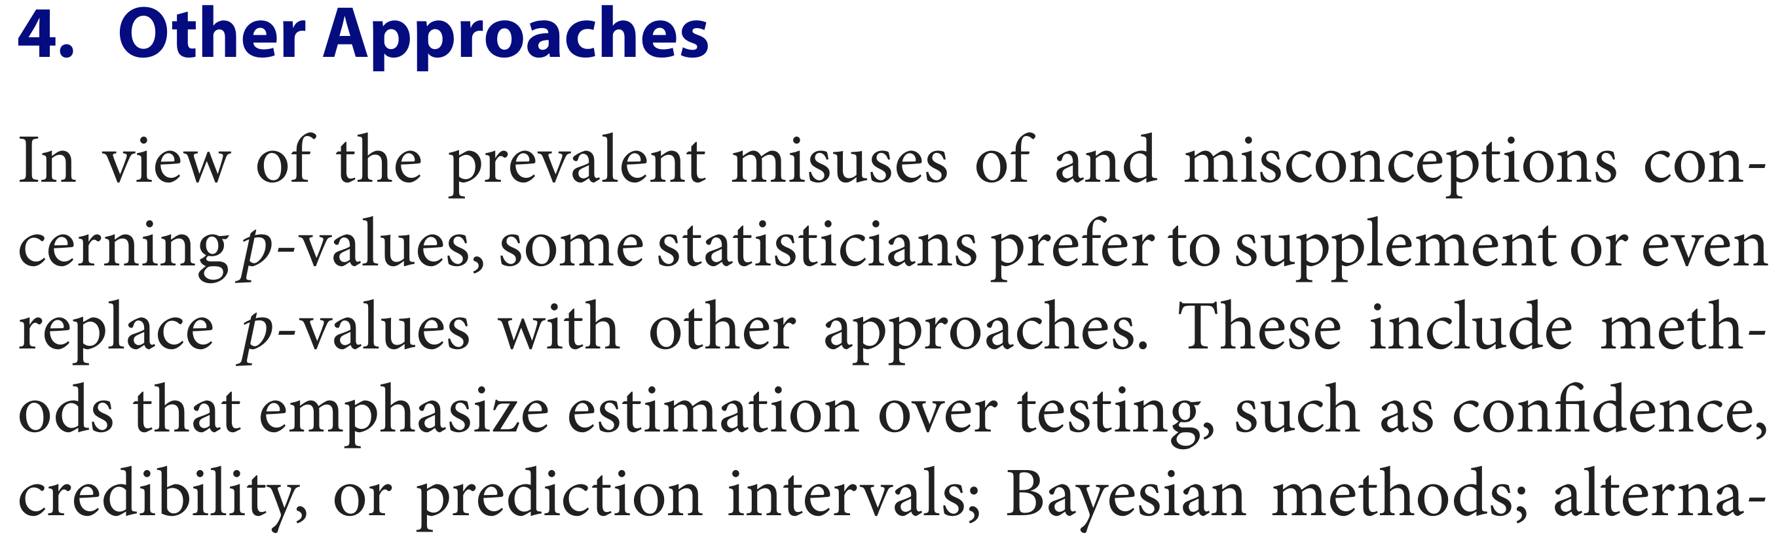
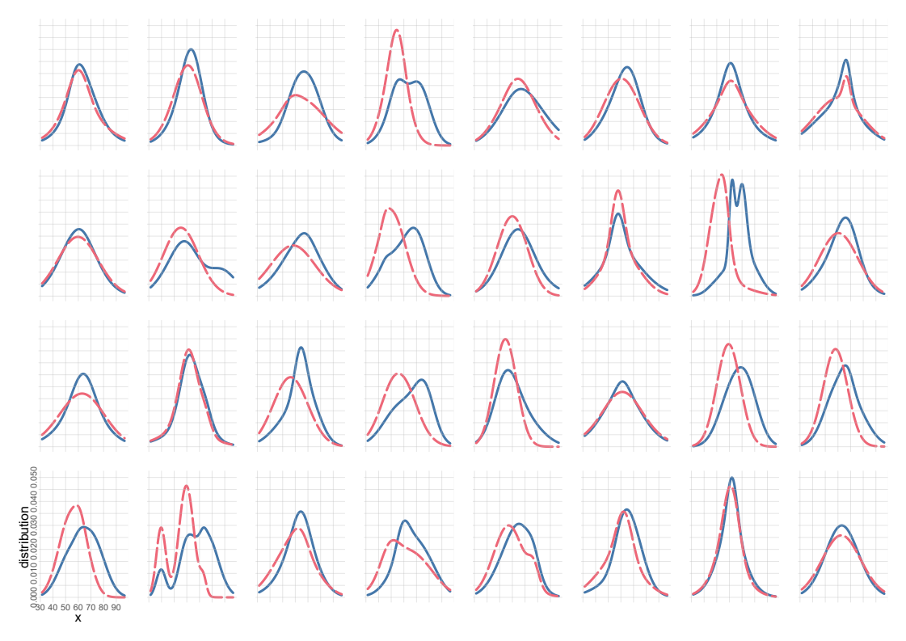
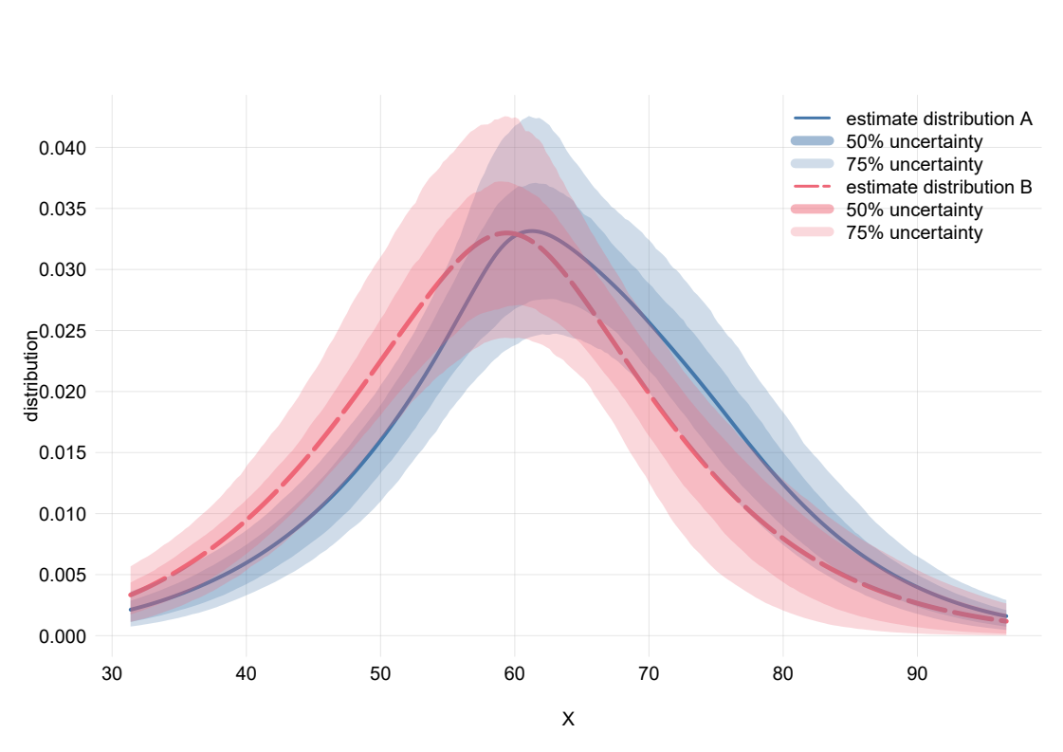
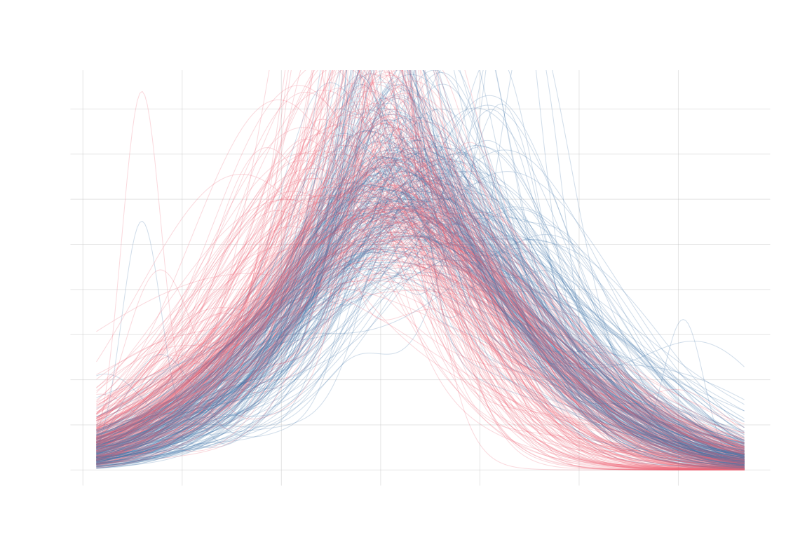
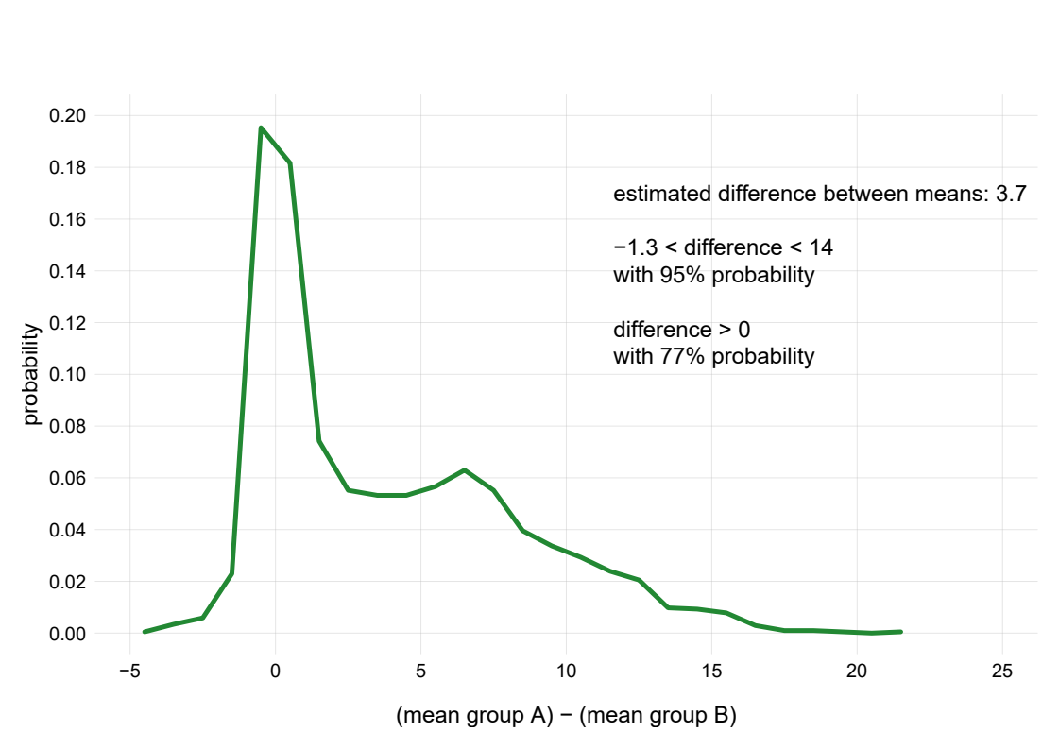
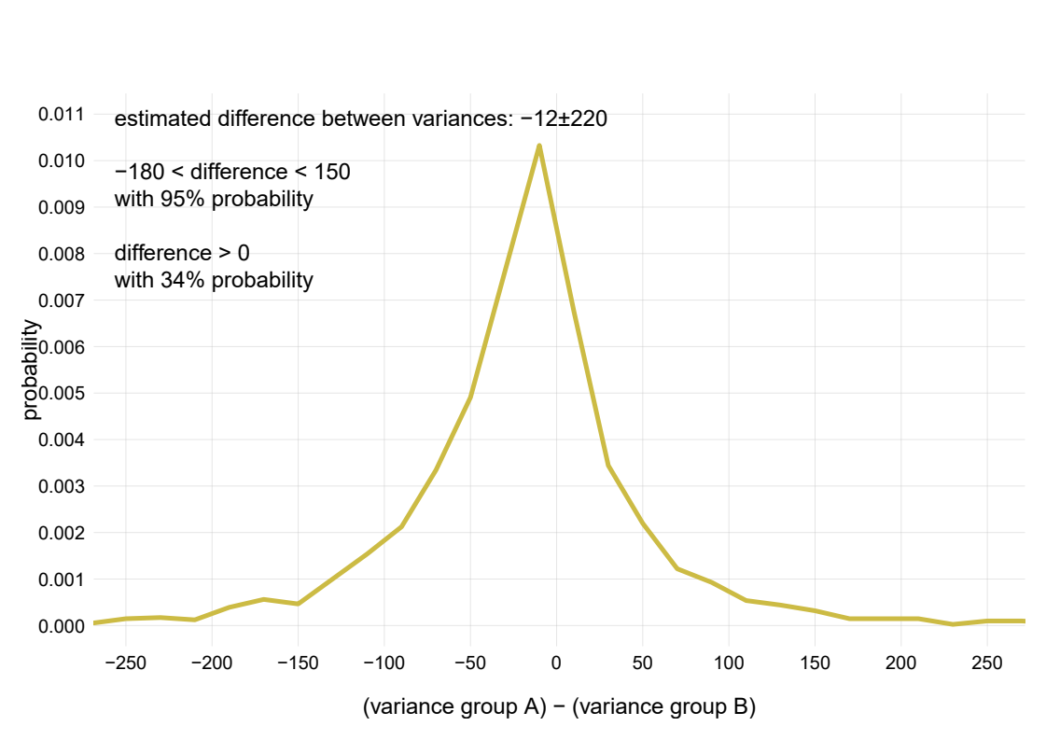

User-friendly software
for Bayesian analysis of medical data
PierGianLuca Porta Mana, Kjetil Dyrland, Alexander Selvikvåg Lundervold
Dept of Computer Science, Electrical Engineering, and Mathematical Sciences, HVL; MMIV, HUS
This is A4 size
Simple example question:
do treatment A and treatment B have different effects on tumour increase X?
Bayesian theory
Very few data!
old sampling theory
It’s actually more probable
that the variances are different:
non-gaussianity leads to unreliable F-test
American Statistical Association’s official statement
“ Assuming that the two full populations:
are gaussian and independent
have identical variances (F-test, p = 0.44)
and that the sample sizes where decided
before running the experiment, then:
The hypothesis that the population means are equal
has a p-value 0.00043 (two-tail t-test: +4.0).
The sample mean difference of X is17.6
The 95% confidence interval is [8.6, 26.7] ”
This p-value is wrong
If the sample sizes 18 & 10
were decided not in advance
but by some other rule
What does the number “0.00043” really mean?
This does not mean that 8.6 < X < 26.7 with 95% probability!
It means that this technique to construct the interval
contains the true value in 95% of all imaginary datasets.
But what’s the best interval that contains X for our dataset?
The Bayesian calculation is always the same
– no matter how many data we have
– no matter how the sample sizes were chosen
and it does not need any corrections
Bayesian probability theory considers
all likely distributions for future patients
in the two groups, given the data
Estimates of full distributions
and uncertainty of estimates.
New data cannot modify our predictions
beyond these regions
all possible distributions
are combined
These curves are predictions of the effect
on the next future patient
...and
infinitely
many more
We can estimate the mean and variance of each population
and their differences
No assumptions
of gaussianity
These detailed probabilities
can be used in a cost/benefit analysis
(“if treatment A costs $ and gives Y% benefit,
treatment B costs $$ and gives Z% benefit,
which treatment should we choose?”)
The numbers have
understandable meanings
“ Assuming that the two full-population distributions are smooth, we predict:
The distributions of future treatment outcomes will be as in the plots, within the uncertainties shown
Future patients under treatment A will have on average X = 63, and 59 < X < 69 with 95% probability
Future patients under treatment B will have on average X = 59, and 52 < X < 66 with 95% probability
The difference between the mean X of the treatments will be within –1.3 and 14 with 95% probability
Average X under treatment A will be larger than under treatment B with 77% probability
Variance of X under treatment A will be smaller than under treatment B with 66% probability ”
Compare the two analyses
The predictions of Bayesian theory are:
• detailed
• quantitative
• easy to understand
(eg, “fraction x% of population will have effect y”)
The statements of sampling theory are:
• vague
• obscure or misleading
• heavily dependent on tacit assumptions
“Looks great, but
there’s very little
friendly software
for doing this!”
True! That’s why we are preparing
a user-friendly software to do Bayesian analysis
on (non-imaging) medical data
This was just a simple example. Bayesian theory deals in the same way
with multiple hypotheses, variates, and correlation questions
The maths will be taken care of under the hood
The software will suggest meaningful questions to be asked (in line with ASA’s statement)
Works with continuous and categorical variables
- allows predictions about their correlations and relevance
No assumptions of gaussianity, linearity or other assumptions typical of sampling theory
No need for corrections of any kind
We’re already using a prototype version
for drug-discovery research
Please get in touch if you want to test it
and help us making a great sofware!

Slide 2
User-friendly software for Bayesian analysis of medical data
PierGianLuca Porta Mana, Kjetil Dyrland, Alexander Selvikvåg Lundervold
Dept of Computer Science, Electrical Engineering, and Mathematical Sciences, HVL; MMIV, HUS

