Slide 1

C Programming A Historical Perspective
Dr. Charles R. Severance
www.cc4e.com
code.cc4e.com (sample code)
online.dr-chuck.com

Slide 2
Learning Path: online.dr-chuck.com
Internet History, Technology, and Security – ihts.dr-chuck.com
Python for Everybody – www.py4e.com
Django (Python, HTML, CSS, SQL, JavaScript) – www.dj4e.com
Web Applications (PHP, HTML, CSS, SQL, JavaScript) – www.wa4e.com
PostgreSQL (SQL) – www.pg4e.com
C Programming – www.cc4e.com ← We are here ☺
Computer Architecture
Java Enterprise Application Development

Slide 3
History of C
1969 – B Language – Word oriented (i.e. not byte oriented)
1972 – C Multiple types including (byte / character)
1972 – 1978 – C and UNIX co-evolved with a goal of increasingly less assembly language in UNIX
1978 – K&R C
1989 – C89 / ANSI – void type, C++ declarations, character sets, locales
1990 - C90 / ISO C
1999 – C99 – complex type, // comments, Unicode
2011 – C11 – Library improvements
2018 – C17 - Cleanup of C11

Slide 4
Modern C / Future of C / post-C
Challenges to use C as general purpose languages
No dynamic memory support in the core types / libraries
No “safe” string type
C++ is best thought of as a more powerful and flexible C for professional programmers and systems applications
Java / JavaScript / C# / Python – Types are usually objects – not ”close to the metal” – Not as well suited for an operating system Kernel
The likely follow on to C in systems applications is Rust
Stays close to the metal while providing simple and safe core data types
Becoming the second official language in “Linux”

Slide 5
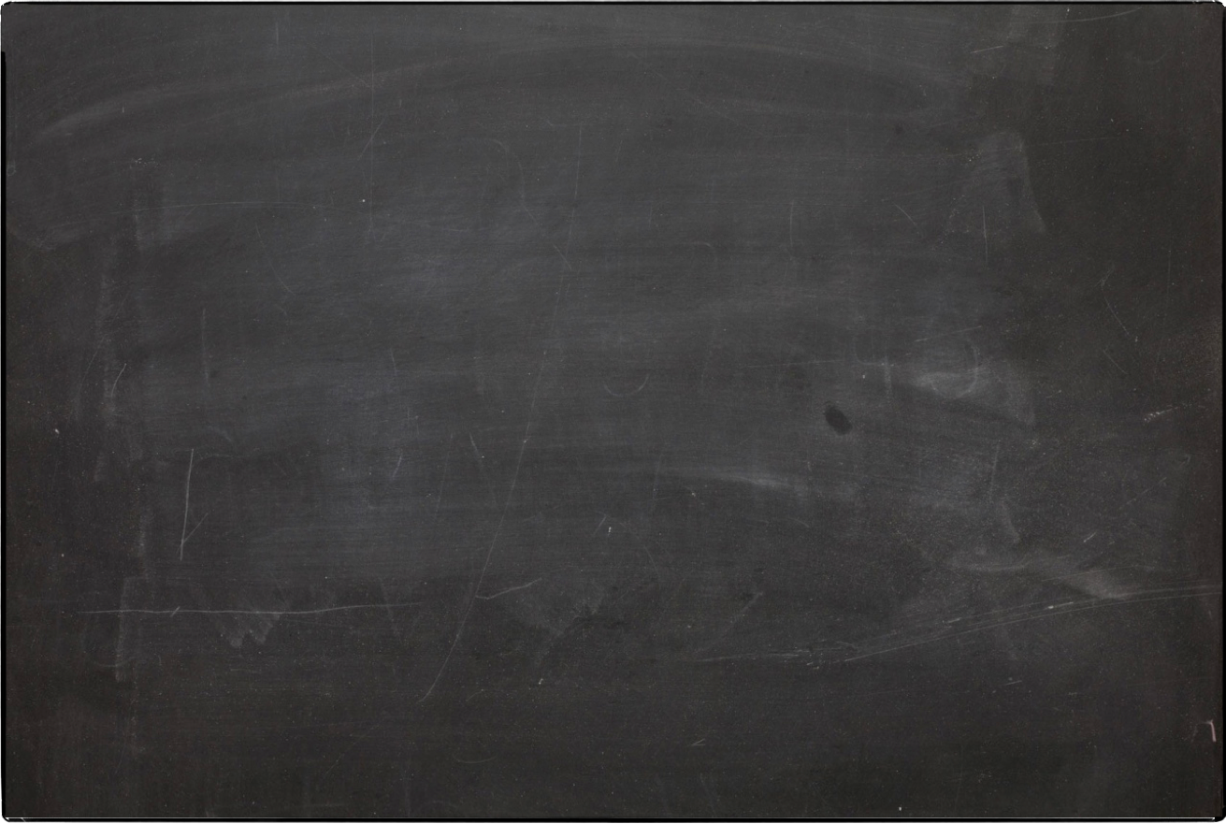
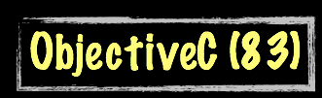
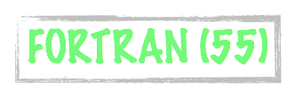


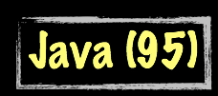




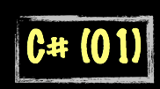
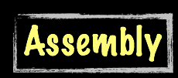
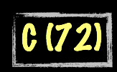
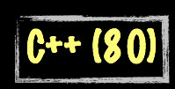

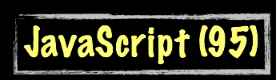



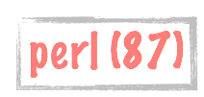
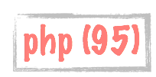

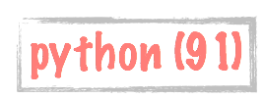
Evolution of Computer Languages
Science Calculations
System
System
bash (79)
C uses curly braces { } for code blocks.
Scripting/
Interpreted
http://en.wikipedia.org/wiki/History_of_programming_languages

Slide 6
A Brief History of Computers
1940's – Top Secret / Military / WWII (ihts.dr-chuck.com)
Early 1950's – Custom built
Late 1950's – Companies like IBM, DEC, etc. begin selling computers
1960's – More companies, less expensive, wider range of options
Late 1960's – Many kinds of computers old/new/fast/slow
1970's – Searching for "the one" solution for software
1980's – Microprocessors and Personal Computers – performance++
1990's – The network is the computer – performance++
2000's – Amazon AWS founded in 2002 – computing as commodity

Slide 7
History of UNIX
1960s – Multics
1970 – UNIX on a DEC PDP 11/20
1973 – UNIX Rewritten in C – Ran only on the PDP 11
1978 – UNIX ran on the Interdata 8/32 - C Evolved as well to support portability so UNIX could be ported
1978 – Unix version 7 ran on DEC VAX systems
1978 – 1BSD Unix Released from Berkeley Software Distribution
1982 - Sun Microsystems Founded – UNIX Workstation
Late 1980’s Intellectual Property became complex

Slide 8
The post-UNIX world
Late 1980’s UNIX was very popular – AT&T saw an opportunity to commercialize their work. Many variations of UNIX had bits and pieces taken from AT&T UNIX – it got complex quickly
1987 – Minux was developed as a fresh ground-up implementation by Andrew S. Tannenbaum to teach operating system concepts – it was free but modification and redistribution were restricted.
1991 – Linus Torvalds wanted to build a fresh ground up implementation of the “UNIX” kernel that was 100% free – some of the utility code came from the GPL-Licensed GNU project
1992 – Linux adopted the GPL license

Slide 9
A Brief History of Dr. Chuck
1970's – CDC 6500 / SCOPE/Hustler / FORTRAN / Pascal / Assembly
1980's
HP21MX – Assembly
Burroughs B4900 / COBOL
Fortune 32:13 / UNIX / C
IBM PC / DOS / DBase / Turbo Pascal
IBM 360 / Assembly
DEC VAX / VMS / Fortran
AT&T 3B2 / UNIX / C / FORTRAN
1990's – UNIX / Sun / Ardent / Stellar / IBM RS-6000 / Convex C2400 / NeXT – C - Also TCP/IP, HTTP – Windows / MacOS
2000's – Linux / MacOS – Java / PHP / JavaScript
2010's – Linux / MacOS – Python / Java / PHP / JavaScript

Slide 10
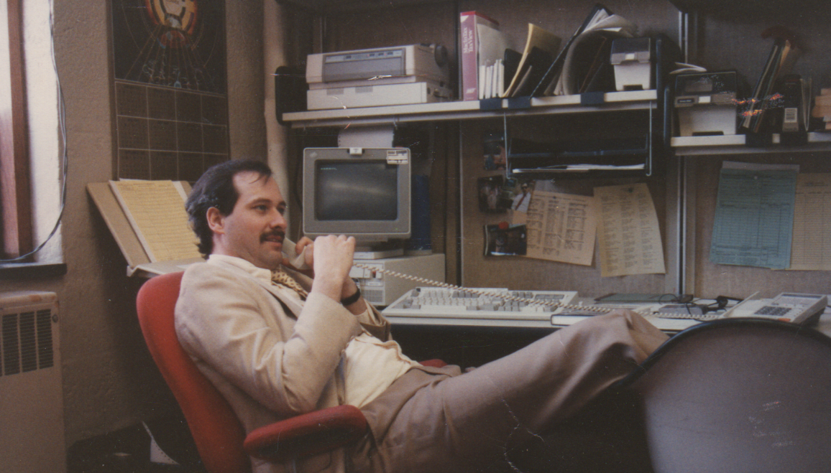
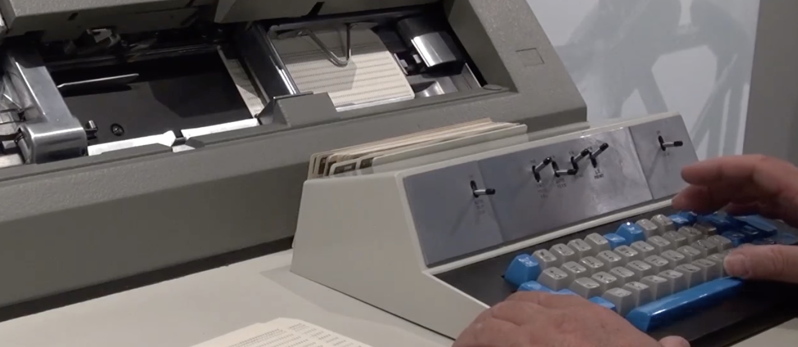
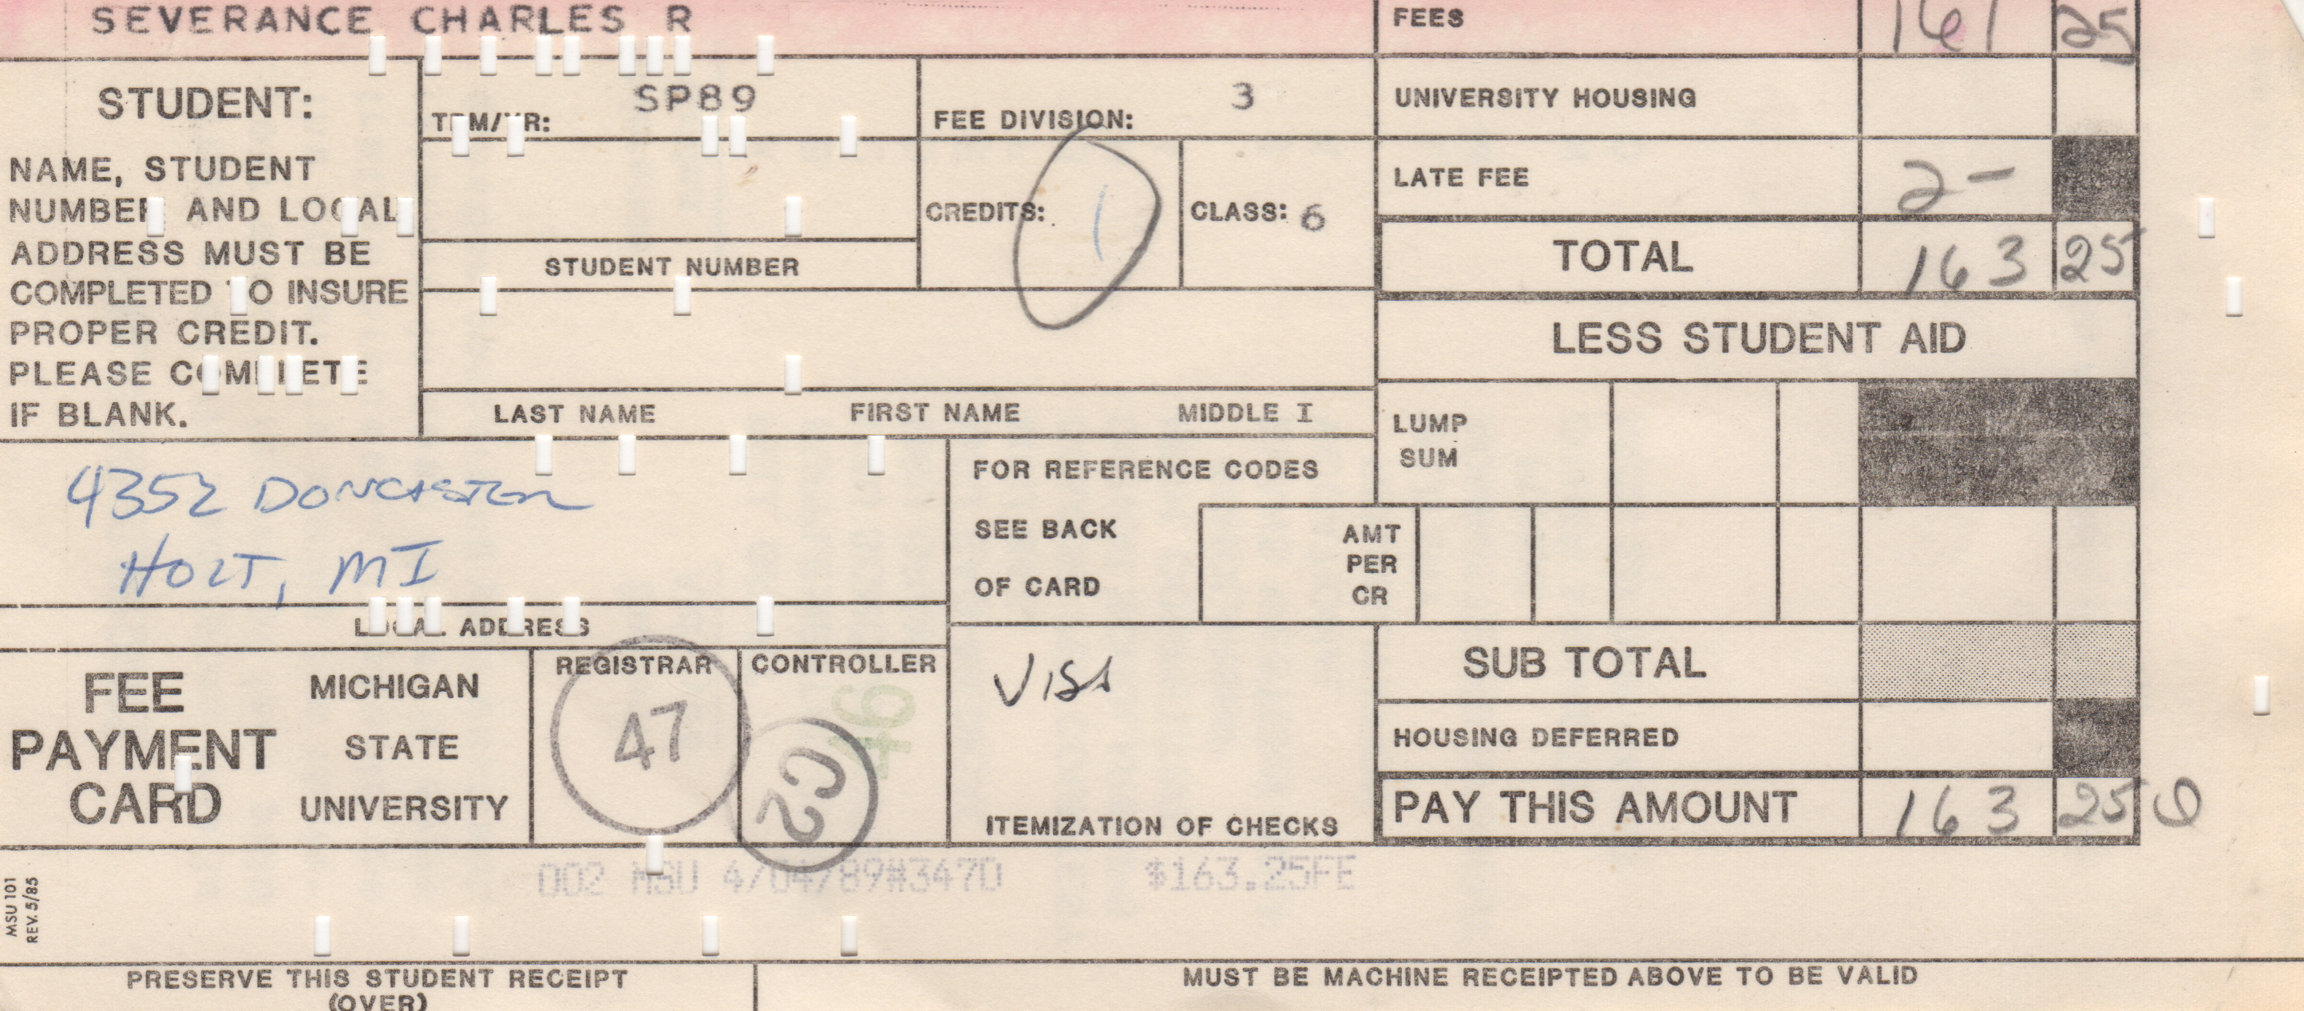
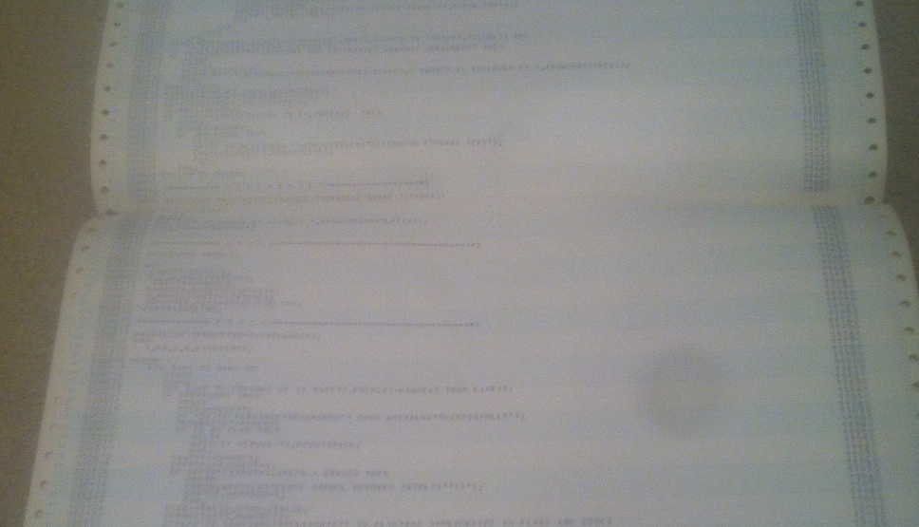

Slide 11
Programming for Everybody: online.dr-chuck.com
Internet History, Technology, and Security – ihts.dr-chuck.com
Python for Everybody – www.py4e.com
Django for Everybody – www.dj4e.com
Web Applications for Everybody – www.wa4e.com
PostgreSQL for Everybody (SQL) – www.pg4e.com
C Programming for Everybody – www.cc4e.com ← We are here ☺
Computer Architecture for Everybody
Java Enterprise Application Development for Everybody

Slide 12
C Programming for Everybody
C is the most important programming language you will ever learn
C should not be the first programming language we teach to students
You might never write a “professional” line of C during your career
Learning C at the right time in your path, is necessary for you to become a master programmer
Be patient – do not rush – do not search for solutions to programming
Each exercise is teaching you something and preparing you to learn something much more challenging later in the course

Slide 13
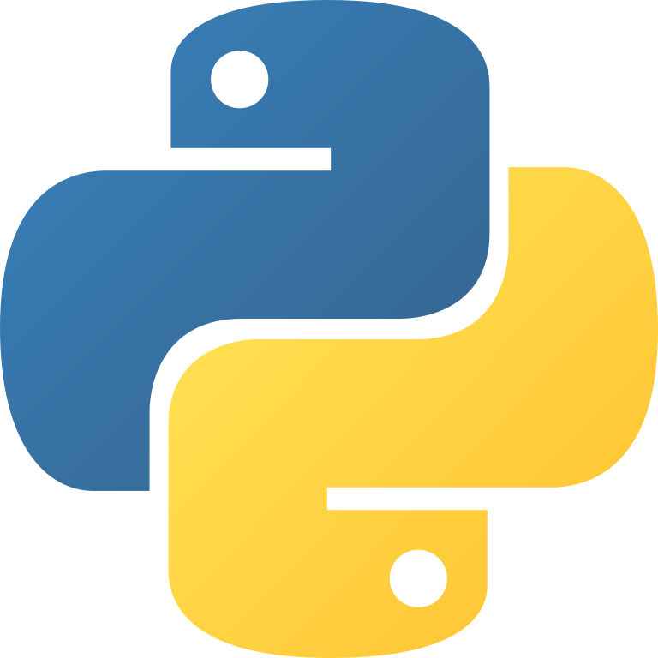

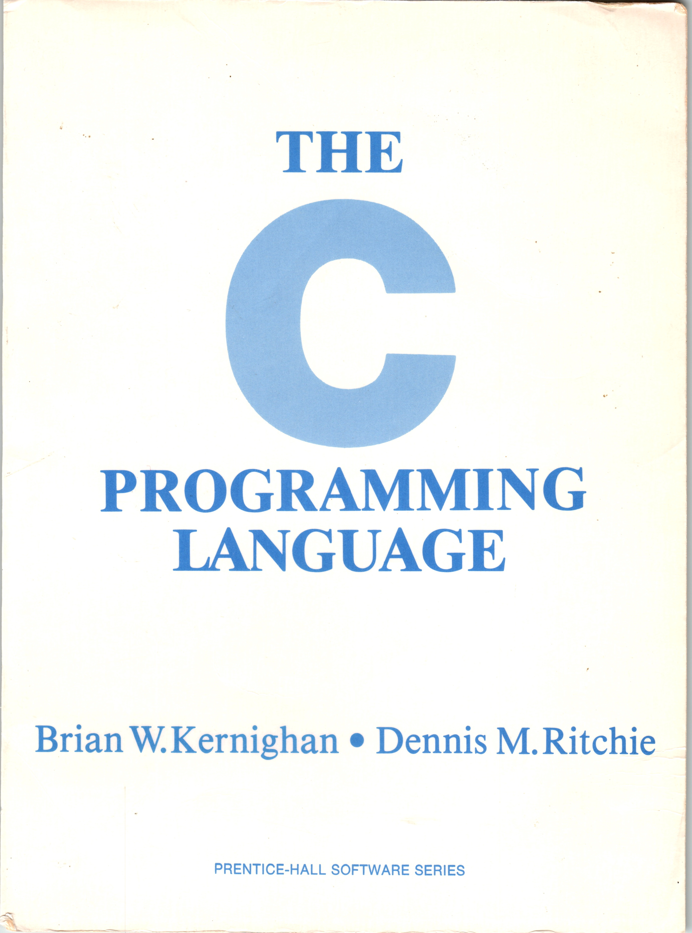
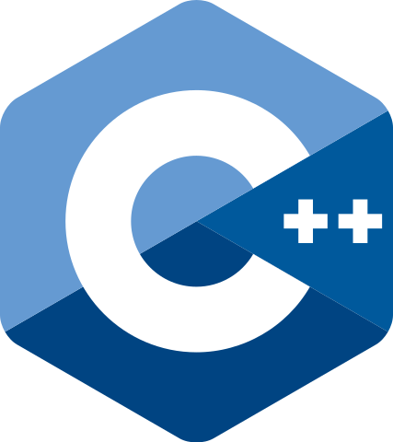
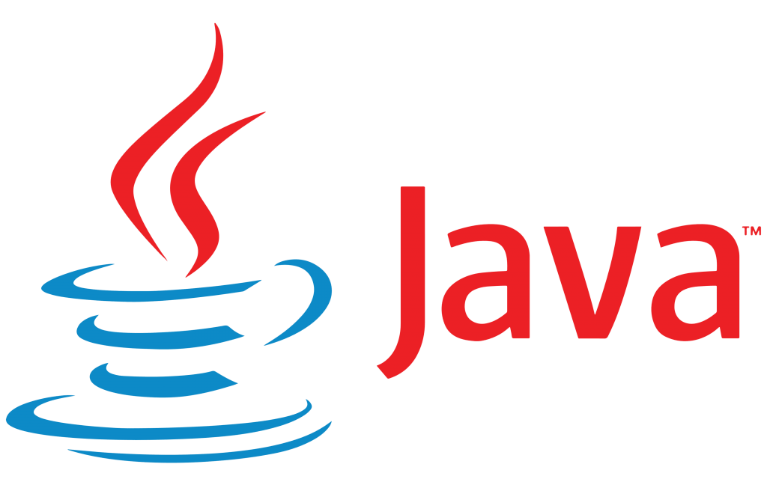

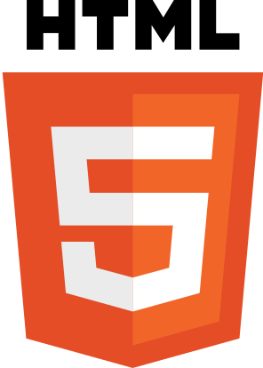
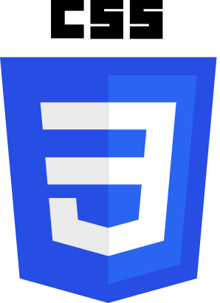


Unlocking Advanced Topics
Data Structures
Computer Architecture
Object Oriented Design
Hardware
Service Oriented Architecture

Slide 14
Summary
History of the C Language
History of Computer Hardware
History of the UNIX operating system
History of “Dr. Chuck” and Computing
Gender balance in computing

Slide 15
Acknowledgements / Contributions
These slides are Copyright 2022- Charles R. Severance (online.dr-chuck.com) as part of www.cc4e.com and made available under a Creative Commons Attribution 4.0 License. Please maintain this last slide in all copies of the document to comply with the attribution requirements of the license. If you make a change, feel free to add your name and organization to the list of contributors on this page as you republish the materials.
Initial Development: Charles Severance, University of Michigan School of Information
Insert new Contributors and Translators here including names and dates
Continue new Contributors and Translators here

