Slide 1


Welcome to Internet History, Technology, and Security
Dr. Charles Severance <csev@umich.edu>
http://www.dr-chuck.com/
Twitter: @drchuck
https://www.coursera.org/course/insidetheinternet

Slide 2
Who Should Take This Course?
Everyone (including your friends and family) !
There is no math. There is no computer programming. Really.
We talk about cool technical things but it is not a technical course.
The purpose of this course is to explain things and make you think and reflect

Slide 3
What is the Course About?
Oral history from Internet and Web innovators
  Not just names and dates - real history is a bit messy
  You will need to interpret and think critically
How the Internet and Web function

Slide 4
Dr. Chuck...

Slide 5
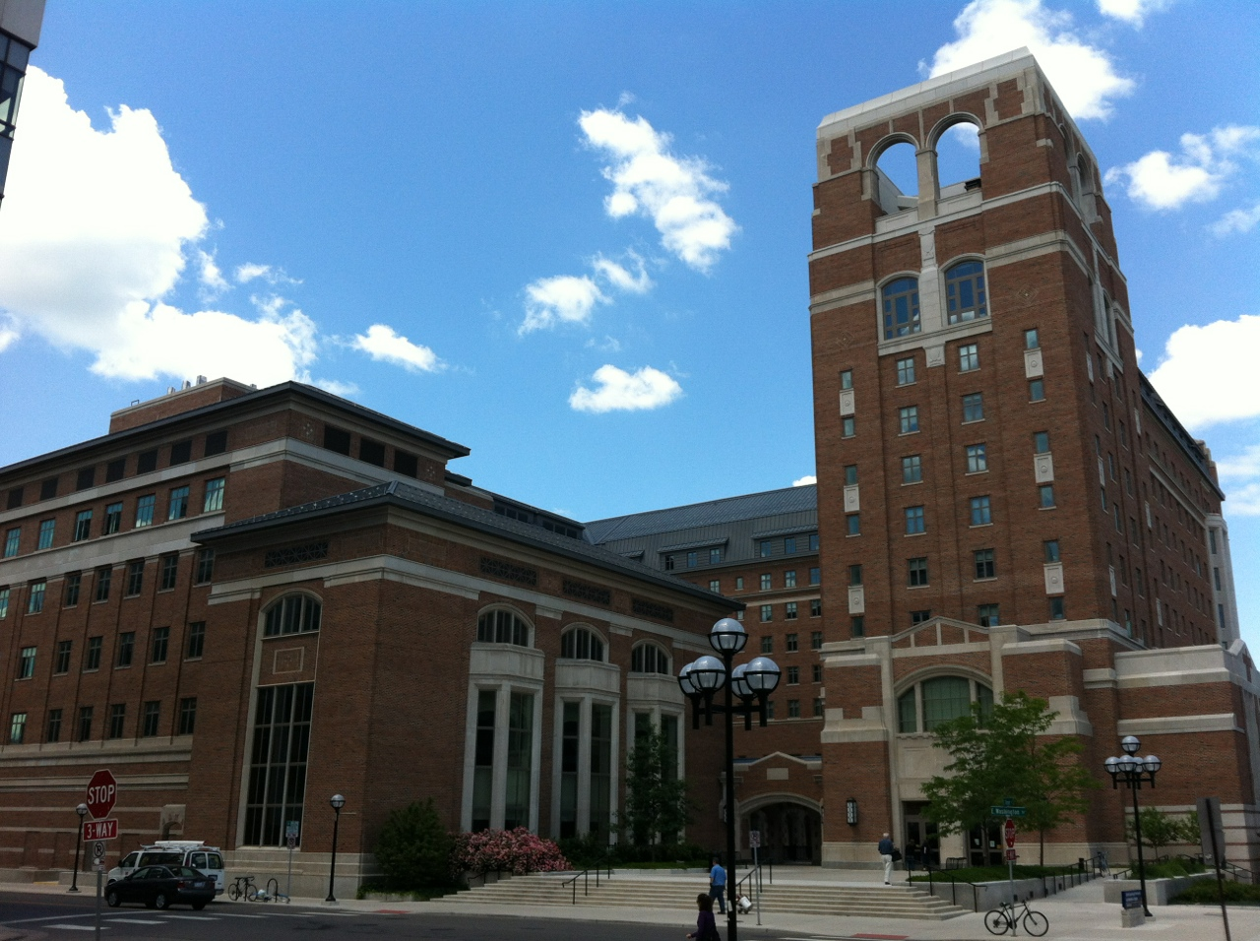
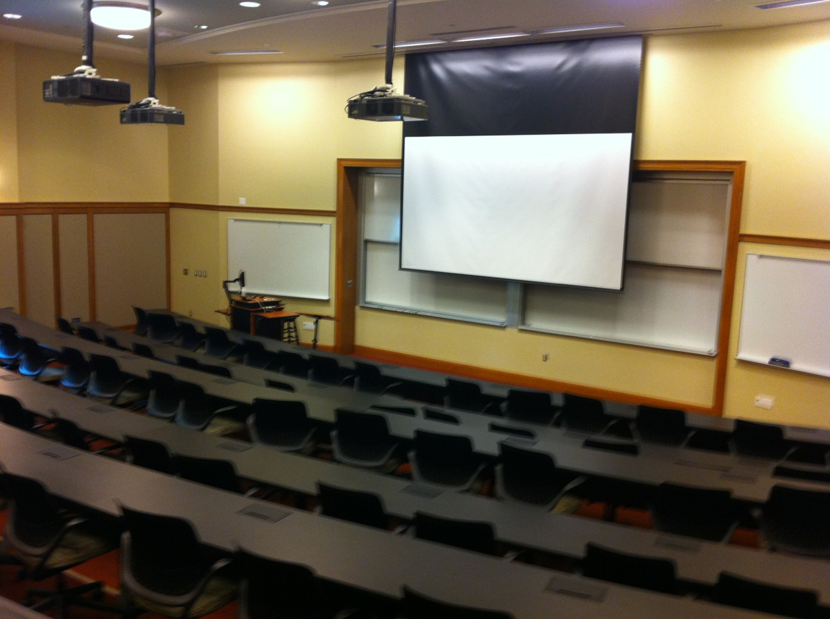
2455 North Quad
North Quad
University of Michigan
Ann Arbor, MI, USA

Slide 6



Dr. Charles SeveranceClinical Associate Professor
University of Michigan
School of Information
Twitter: @drchuck
www.dr-chuck.com
www.si.umich.edu

Slide 7
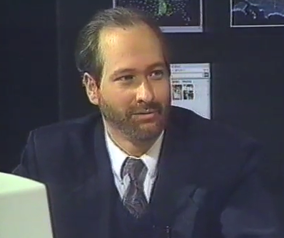
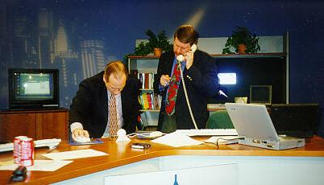
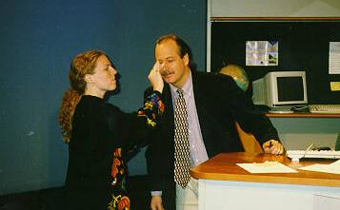
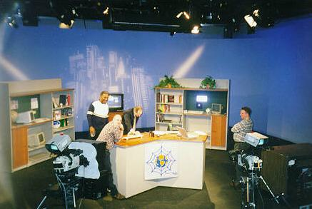
Internet: TCI
Nuthin' But Net

Slide 8
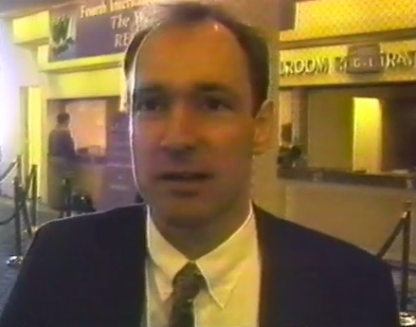
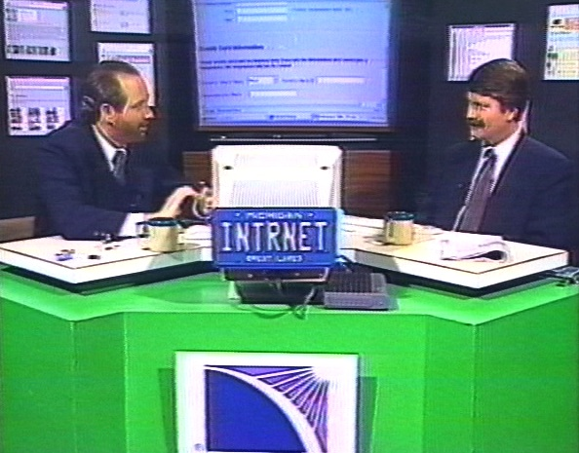
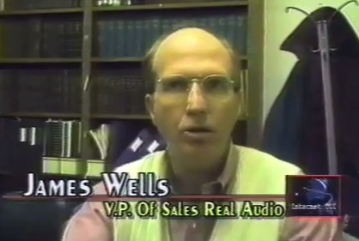
1995 - Internet: TCI
Charles Severance / Richard Wiggins
https://vimeo.com/4275919
00:52

Slide 9
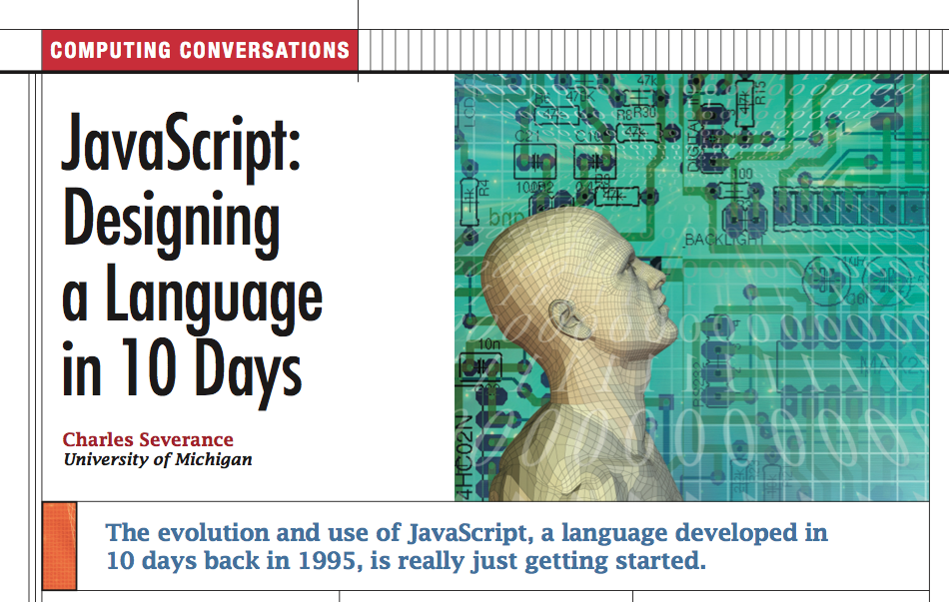
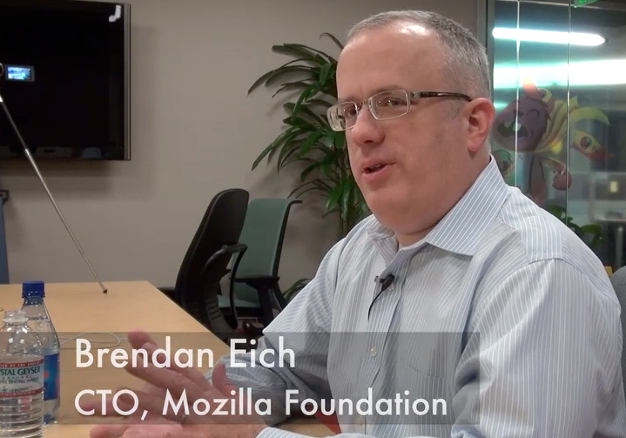
IEEE Computer Magazine
I write a monthly column for IEEE Computer magazine called "Computing Conversations"
There is a video interview for each article
IEEE Computer Society has given permission to use the articles for free in this course
www.computer.org (Thanks!)
http://www.computer.org/portal/web/computingnow/computing-conversations

Slide 10
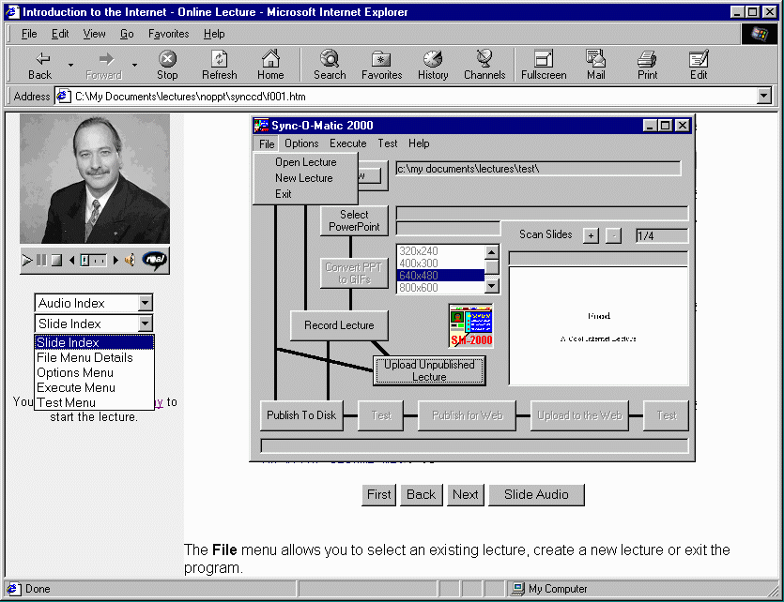
1996
http://www.syncomat.com/

Slide 11
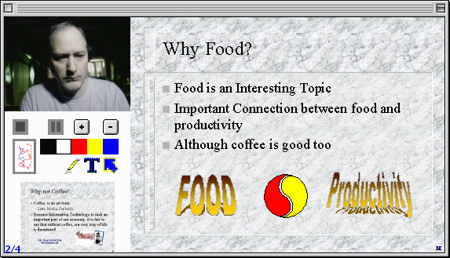
1999
http://www-personal.umich.edu/~csev/csev/projects/cb2k/index.htm

Slide 12


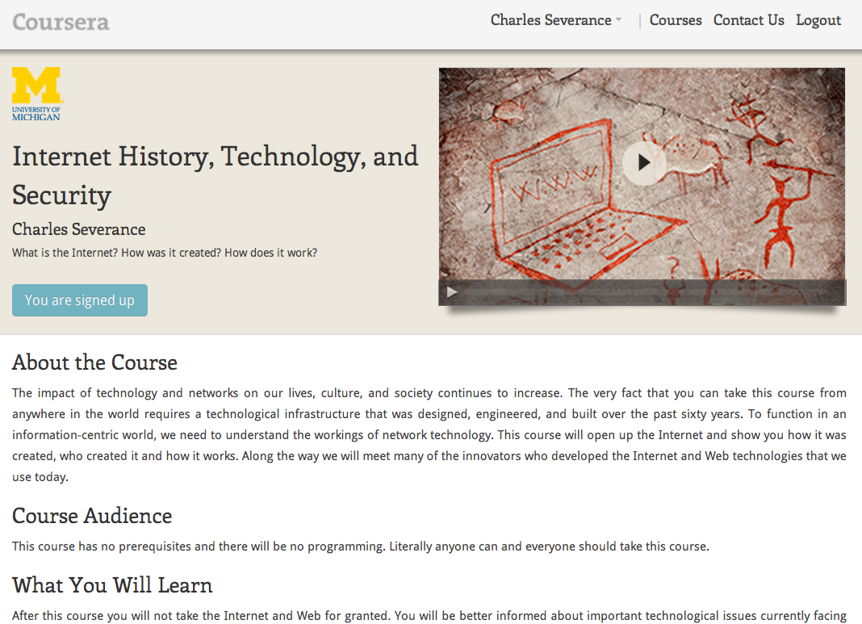
Fifteen years later...
1996

Slide 13
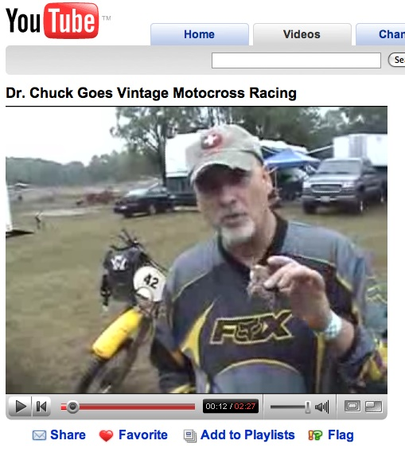
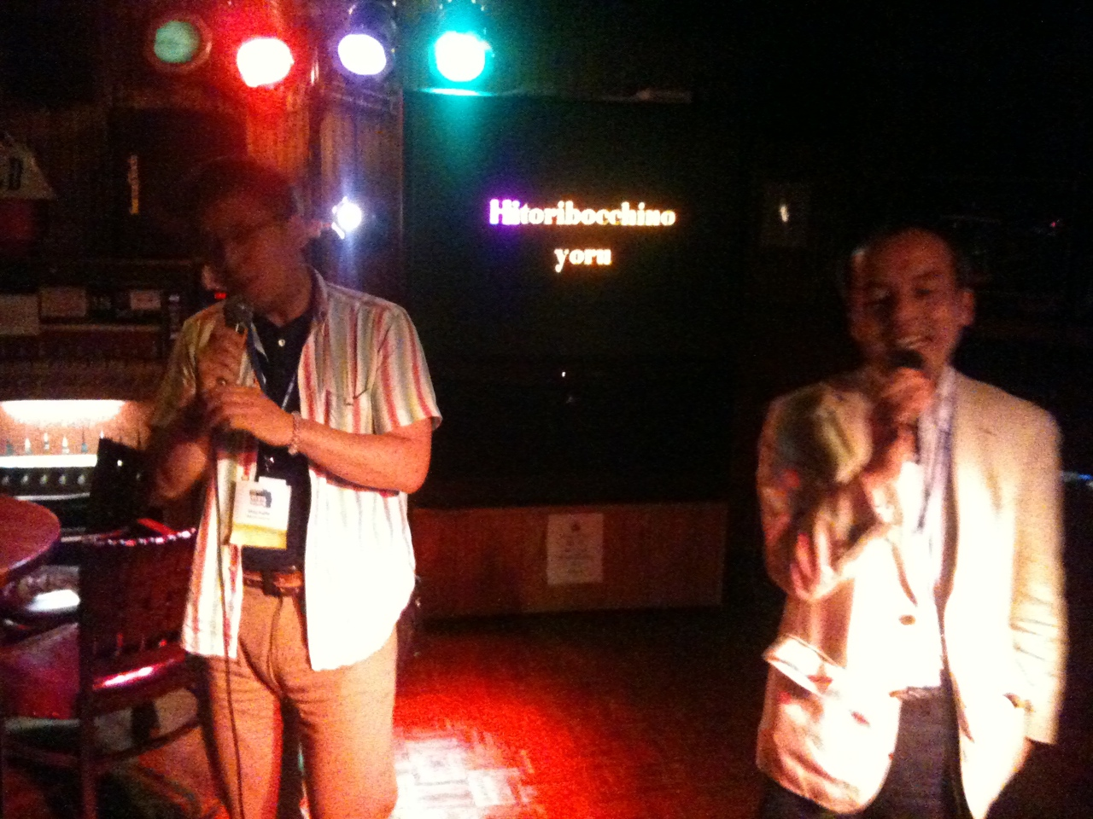
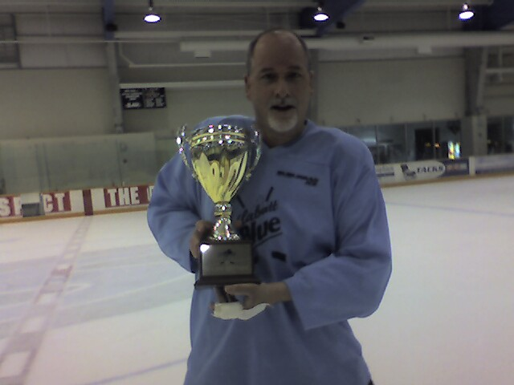
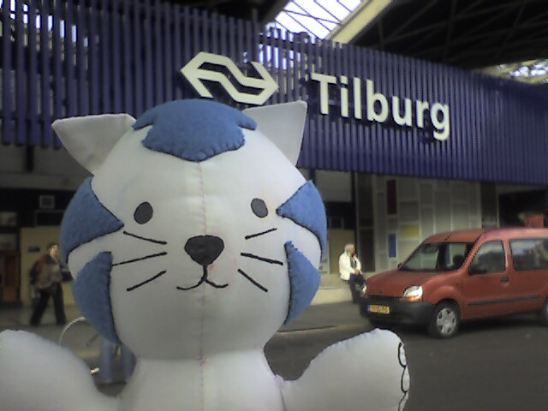
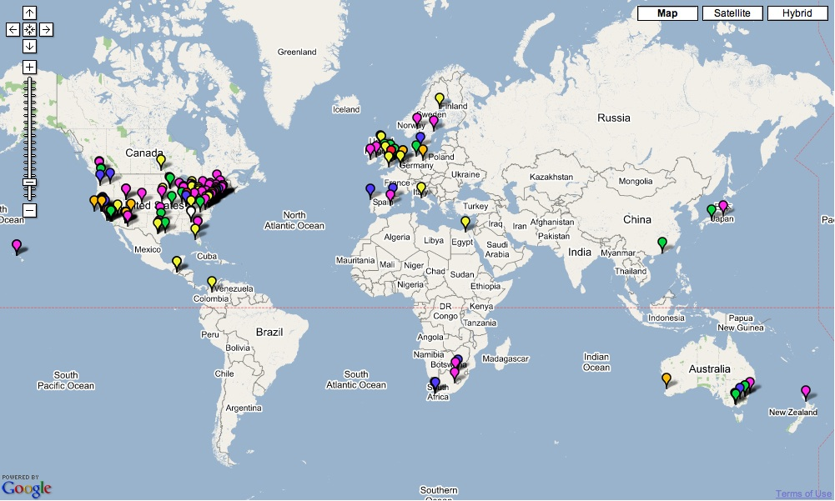

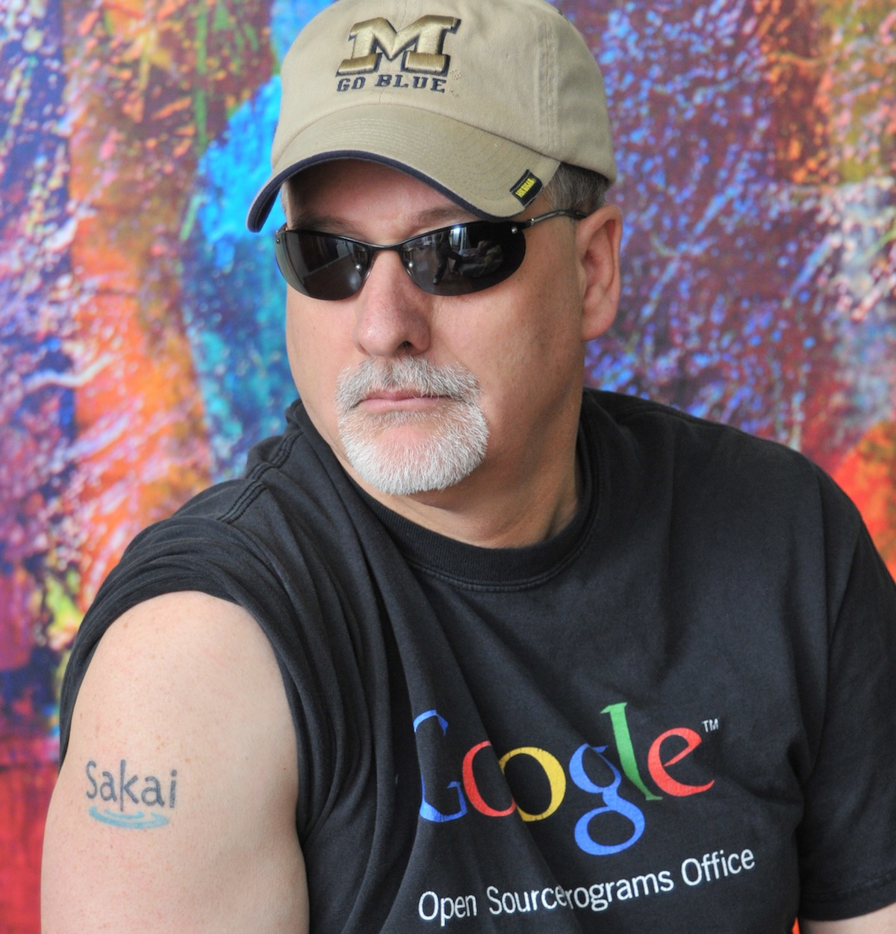
Dr. Chuck
Twitter: @drchuck
www.dr-chuck.com

Slide 14
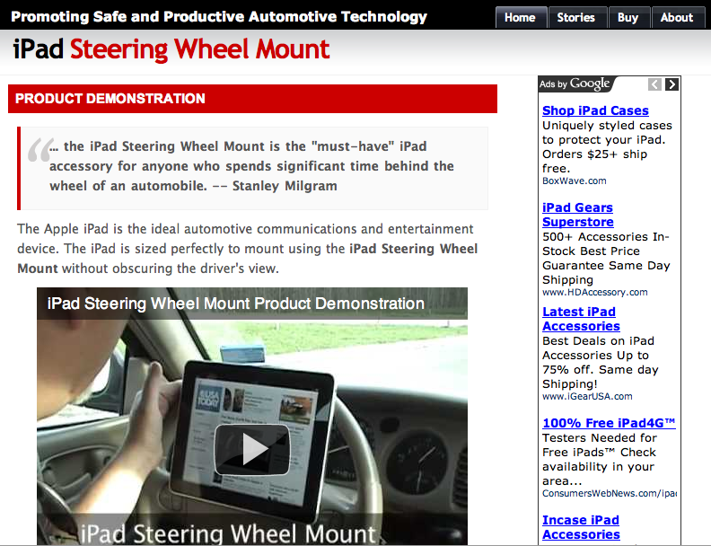

Slide 15
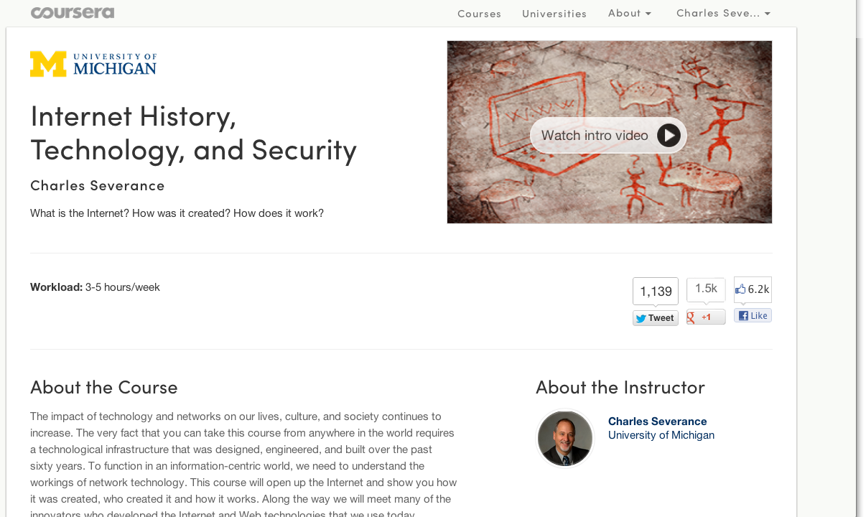


Slide 16
Course Overview

Slide 17
About this Material
This is part of a course at the University of Michigan School of Information
SI502: Networked Computing: Storage, Communication, and Processing
  www.pythonlearn.com - Lectures slides, audio, open book
  Internet History, Technology, and Security is taught between chapters 11 and 12

Slide 18
Goal: Be an Introductory Course
We need low-stakes "pre-requisite" courses in Coursera
  How to behave
  How to use the software
  How to write
  Learn to use MOOC software
  How to learn from others and help others learn....

Slide 19

Be an Open Learning Community
Open Source works well when there is a "Benevolent Dictator"
  There needs to be real and enforced rules - but as few as possible
  Those in power must not hide behind their power and must share their power with those who show the right behavior
  Must make valued behaviors "infectious" / "amplified"

Slide 20
Lectures
Lecture Notes - PDF / Print / PowerPoint
My slides are CC-BY so you can use them in your own teaching
Most of the videos are up on YouTube
Some videos have IEEE Articles with them - these remain Copyright IEEE

Slide 21
Schedule Notes
See the Syllabus for the course duration and topic outline
I am expecting you to invest a minimum of 3-4 focused hours per week to watch lectures, think and reflect, and take assessments
I want to make it so that folks can still join during the first two weeks and earn a certificate but
At some point I will shut down new enrollment (archives are open)

Slide 22
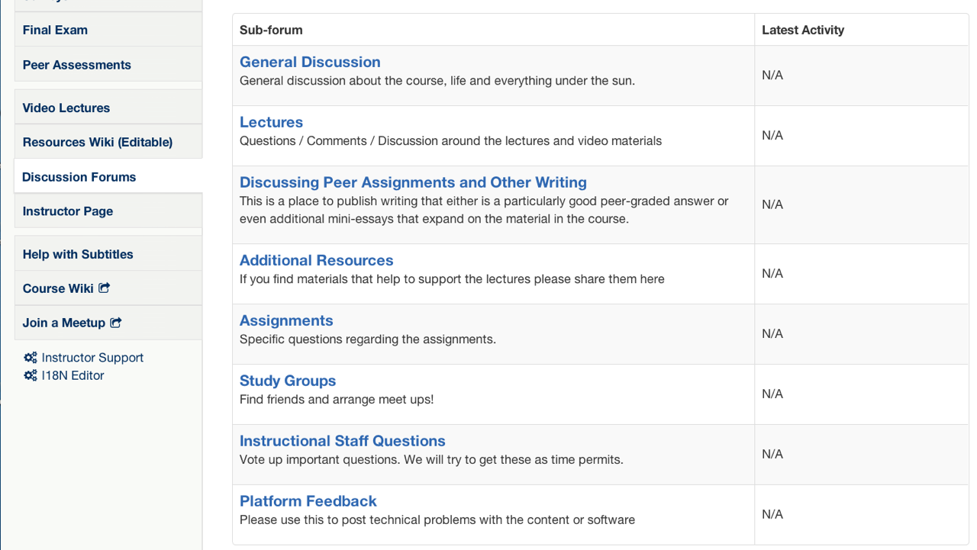

Slide 23
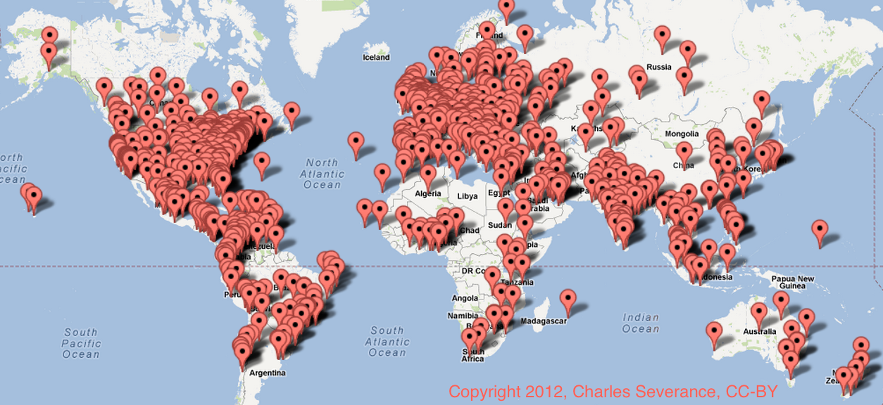
n=4701
Location
http://www.dr-chuck.com/coursera/insidetheinternet/2012-001/maps/where.html

Slide 24
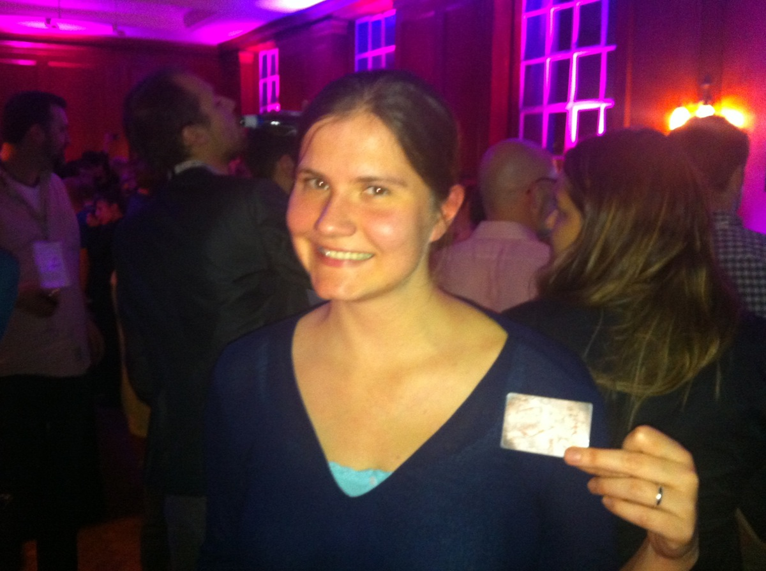
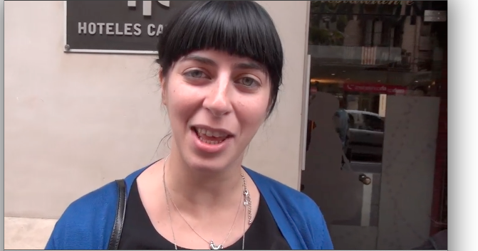
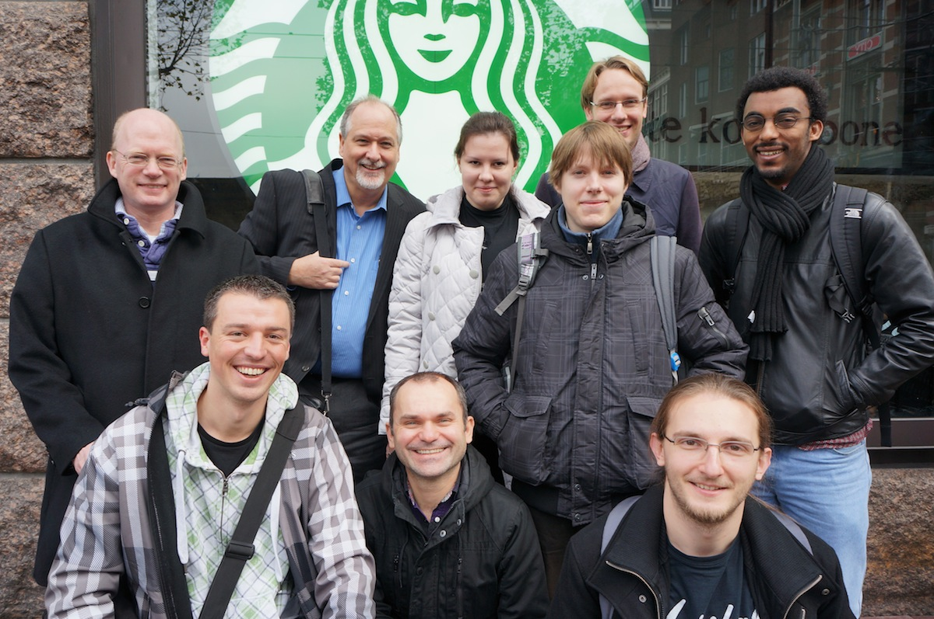
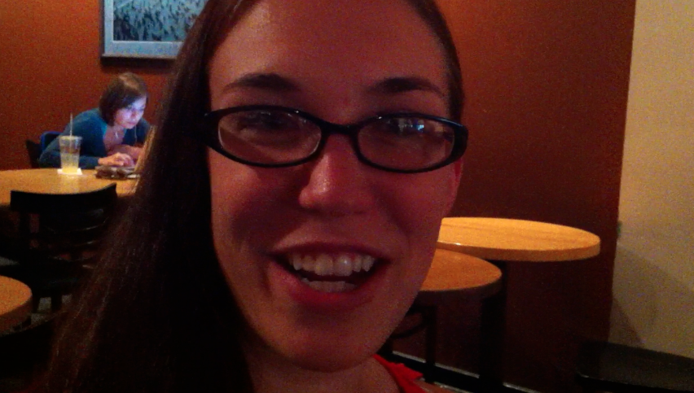
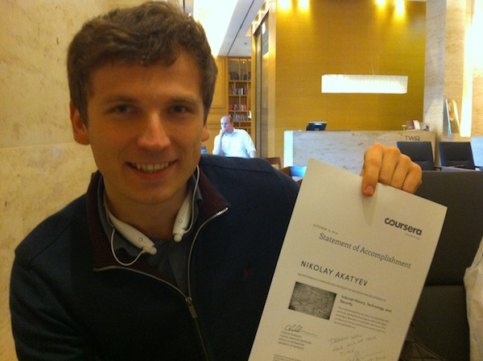
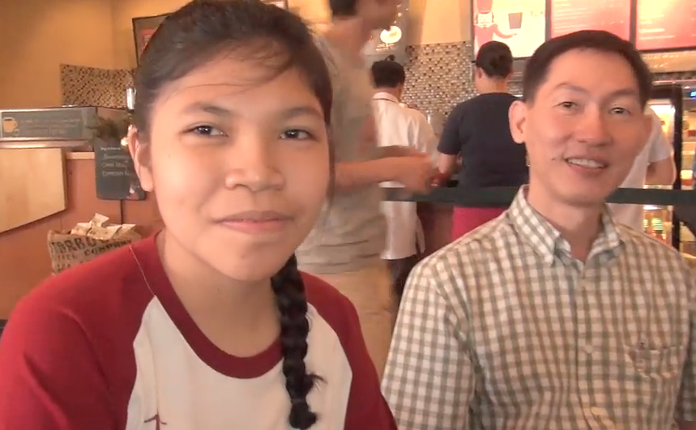
New York NY, Los Angeles, Ann Arbor MI, Wilmington, NC, Chicago, Washington, DC, Memphis, TN, Seattle WA, Seoul, Barcelona, London, Amsterdam
Manila
http://www.youtube.com/watch?v=R6zlQZcM72o

Slide 25
Assessments
The in-video questions do not count
One quiz per week - mostly multiple-choice style questions that randomize and you can retake andkeep the highest score (10 points)
Final exam
Peer graded writing assignments (10 points each) - Extra Credit

Slide 26
Peer Grading
All peer-graded material is extra credit for the course - you do not have to participate in the peer graded assignments to earn a certificate
Your peers *will* determine your grade on the assignments - no appeals
Write your submissions with this in mind....

Slide 27
Course Scoring
A course percentage above 75% will earn a certificate
If you really want a certificate don't do the minimum to get to 75%
There will be no individual arrangements / regrades / point appeals
total_assn + exam + total_extra
-----------------------------------------
total_assn + exam
(7 * 10) + 30 + (3 * 10)
-----------------------------
(7 * 10) + 30

Slide 28
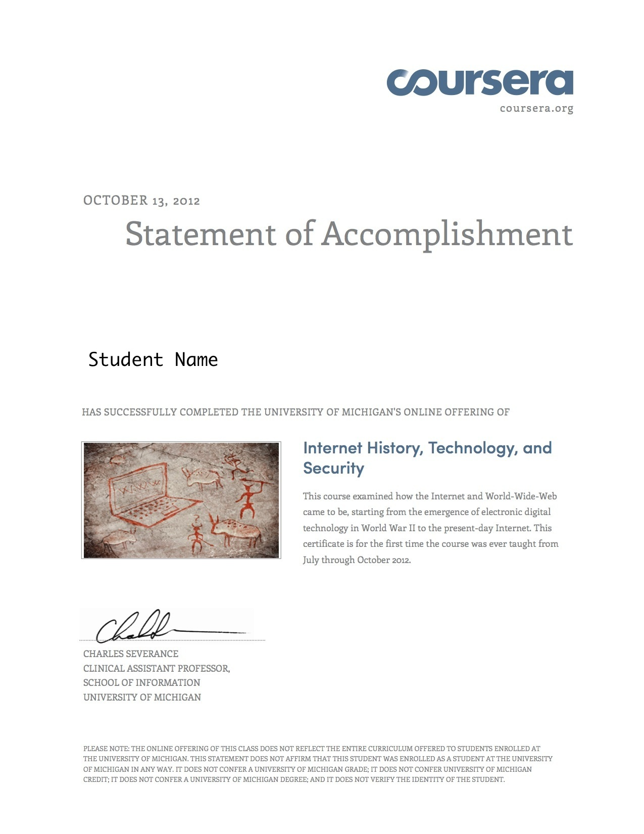
Certificates
See the syllabus for the details
I don't like two levels of certificate because performance ifs too often correlated with skill level prior to course entry.
http://www.dr-chuck.com/csev-blog/2012/09/coursera-scores-and-certificates-with-distinction/

Slide 29
Getting and Giving Help
The answer to most questions like this will be "use the forums"
With thousands of students in a class - other students will be the best source of answers (21 minute average response time in one course)
Feel free to ask each other questions about the quizzes and the questions on the quizzes - the purpose of quizes is to *learn* not to judge you

Slide 30
Plagarism
Plagarism is about using material copied and pasted from sources without attribution and representing it as your own
In this course it typically comes up on the peer-graded assignments
Peer graders will take points off as follows (10 point assignment)
  A portion of the answer was text from another source without attribution (-5)
  The entire essay was taken from another source (-10)

Slide 31
Honor Code
The final exam is to be taken according to the Honor Code:
  "You are agreeing to take this examination on your own, without asking anyone for help. You will not discuss the questions or your answers on this examination with anyone other than the course instructor or grader."
I will try to be clear when I am applying the honor code in each assessment
For quizzes, you should take the quiz without help, but you can discuss the questions in the forum.

Slide 32
Contacting Dr. Chuck
It is not practical for me to interact individually with a class with thousands of students
I and others will be monitoring the forums - if there is a problem and lots of students hit the same problem it will bubble up in the forums and get attention
You can follow me on twitter @drchuck
I may do Google Hangouts or mini-lectures if something pops up

Slide 33

Bring Your Friends!
Watch the first week's lecture and if you like it - get your friends to join - the more the merrier and forming a study group will be easier!
The first video from Bletchley Park is longer than most (25 minutes) - the rest wil be shorter
They should be able to earn a certificate (if that is what they are going for) adding during the first two weeks

Slide 34
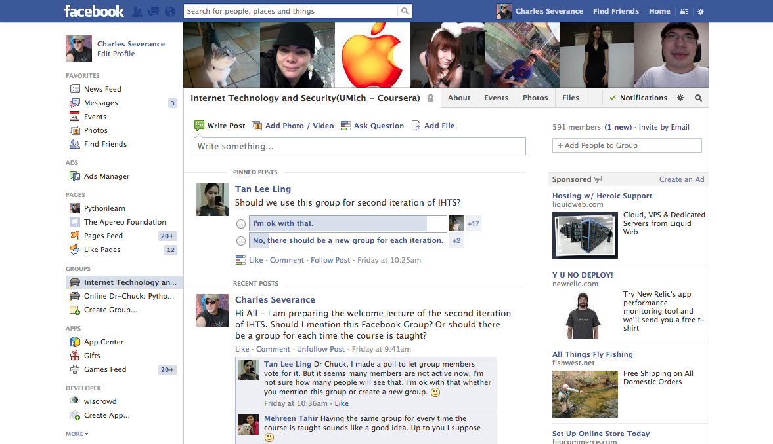

Slide 35
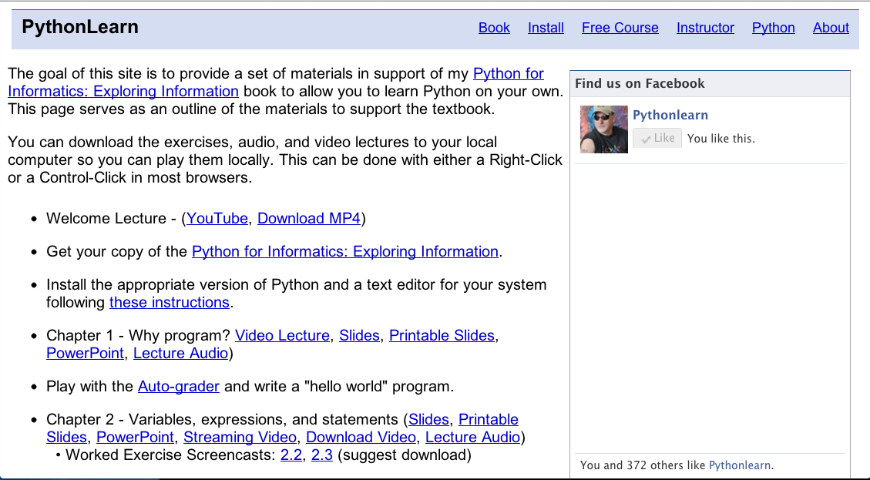
www.pythonlearn.com

Slide 36
Please Help!
Doing this is very cool but still evolving
This is social - you are an important part of the learning
It is as much about learning how to work together to learn at scale as it is about "History, Technology, and Security"
Help each other learn the material and make suggestions for improvement

Slide 37
Copyright Thanks
Thanks to IEEE Computer for permisison to use IEEE Computer magazine articles associated with the videos
Thanks to Richard Wiggins for the use of his video material
Thanks to Dave Malicke and Open Michigan (open.umich.edu) for help with copyright review of these materials

Slide 38
Open Content
My slides and my lecture videos (feel free to dowload and retain) are Creative Commons Atribution
I encourage and am honored if you would reuse / remix in any way you like

