Slide 1
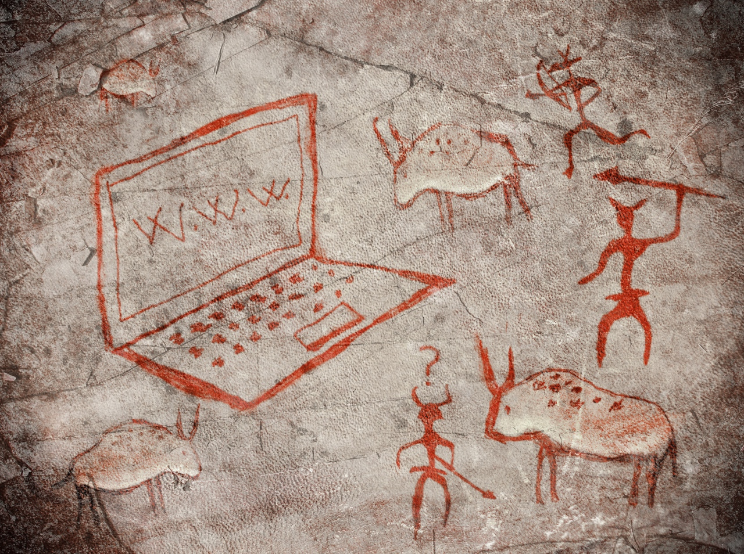

Internet History
Dr. Charles Severance <csev@umich.edu>
http://www.dr-chuck.com/
Twitter: @drchuck
https://www.coursera.org/course/insidetheinternet

Slide 2
Copyright Thanks
Thanks to IEEE Computer for permission to use IEEE Computer magazine articles associated with the videos
Thanks to Richard Wiggins for the use of his video material
Thanks to Dave Malicke and Open Michigan (open.umich.edu) for help with copyright review of these materials

Slide 3
High Level Phases
Dawn of Electronic Computing
Pre-Internet Communication
Research Networks - 1960s - 1970’s
The First “Internet” - Mid 1980’s
The Web Makes it Easy - Early 1990’s
Ubiquity of the Internet - 1996 and beyond
Notes:
Theme - where the money comes from, who are the good guys, the bad guys and what motivates people organizations and countries.

Slide 4
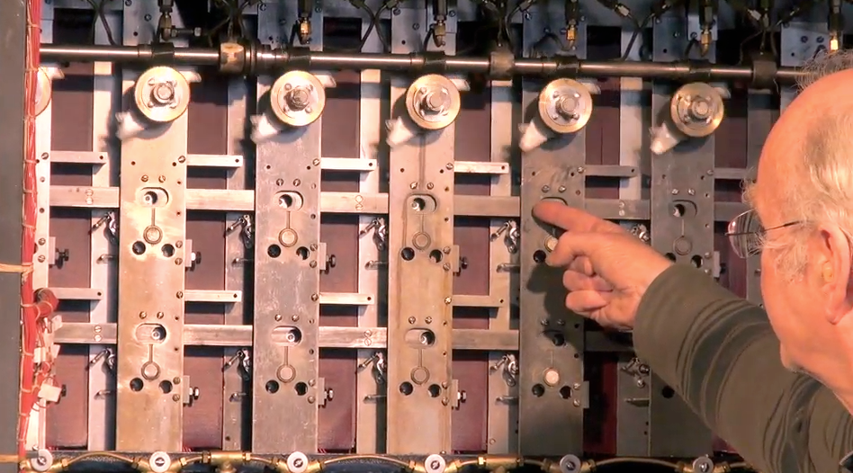
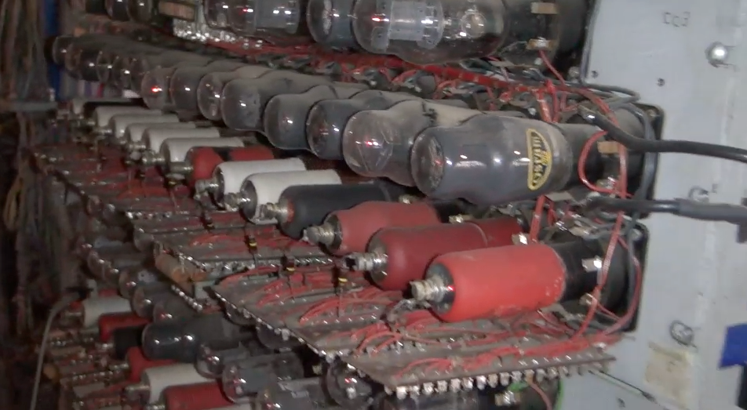
Alan Turing and Bletchley Park
Top secret code breaking effort
10,000 people at the peak (team effort)
BOMBE: Mechanical Computer
Colossus: Electronic Computer
http://www.youtube.com/watch?v=5nK_ft0Lf1s

Slide 5
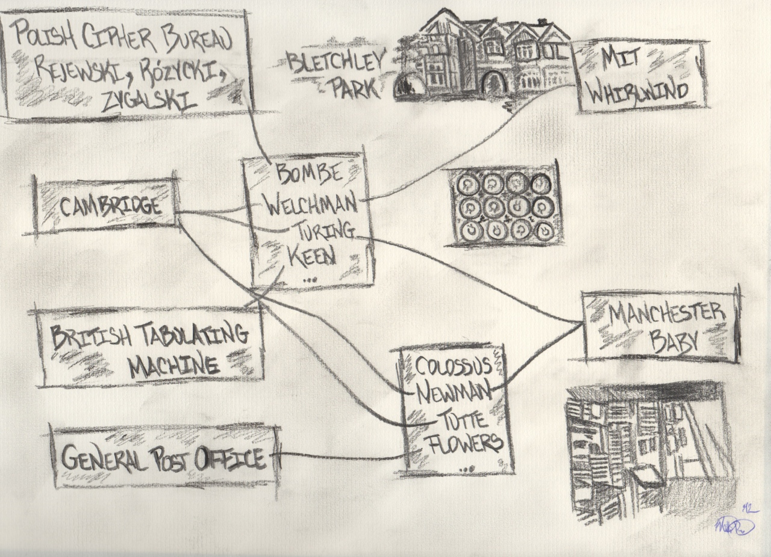
24:50
Graphic: Matt Pinter

Slide 6
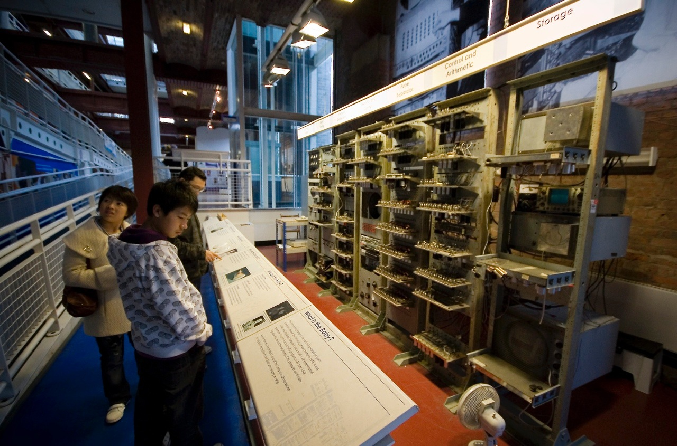
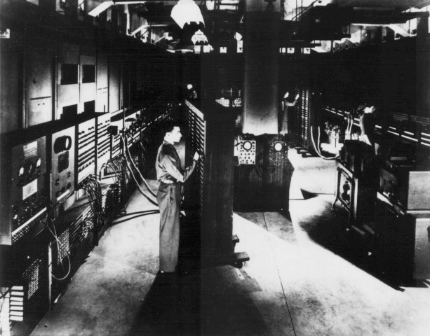
Post-War (1940s)
Alumni of the US and UK code breaking efforts and other started building general purpose computers
Manchester Baby
Ferranti Mark I
Harvard Mark I
US Army ENIAC
http://upload.wikimedia.org/wikipedia/commons/b/bb/SSEM_Manchester_museum.jpg
http://en.wikipedia.org/wiki/File:Classic_shot_of_the_ENIAC.jpg

Slide 7
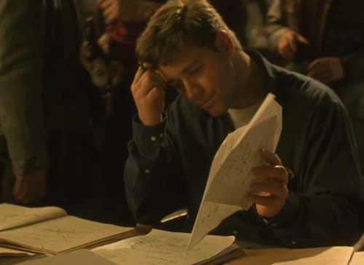
Post-War (1950s)
Math / Science “Won the war”
Broad-based investment in maintaining the US/West intellectual lead
Mathematicians were valued, recruited, brilliant, arrogant, and quirky
"A Beautiful Mind" gives a sense of the culture of the time
http://www.youtube.com/watch?v=CemLiSI5ox8
Notes:
"Governing dynamics..." Adam Smith the father of modern Ecomonics.

Slide 8
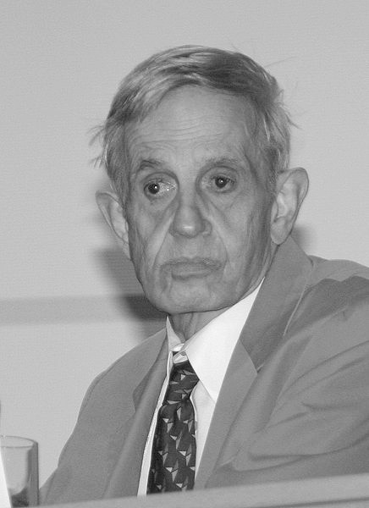
John Forbes Nash
Received his Phd. Mathematics at Princeton in 1950 at 22 years old
Mathematics faculty at MIT - 1951 - 1958
Schizophrenia 1959 - 1995
Nobel Prize in Economic Sciences - 1994
http://en.wikipedia.org/wiki/John_Forbes_Nash

Slide 9
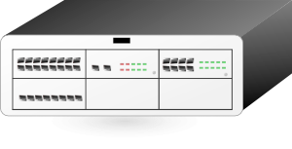
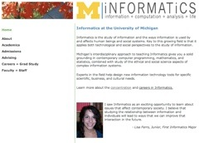
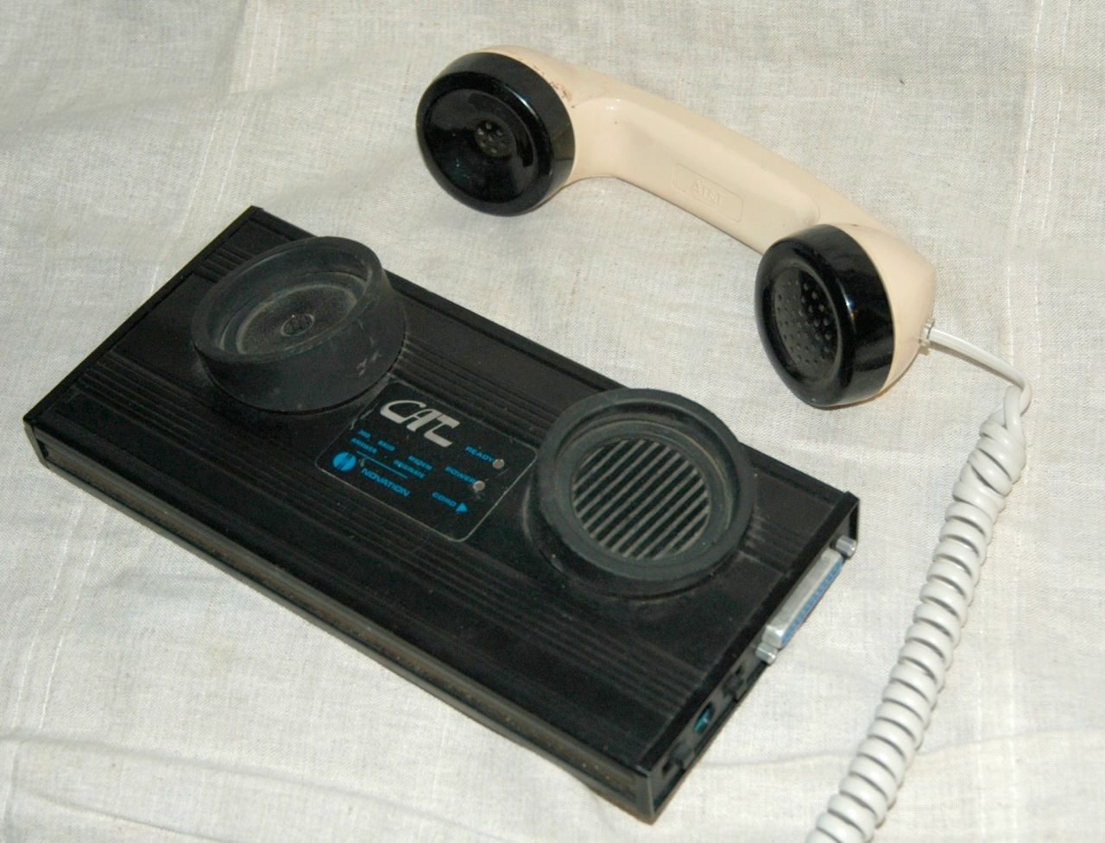
Phone Line Networking
Leased
Dialup
Clipart: http://www.clker.com/search/networksym/1
Modem: http://en.wikipedia.org/wiki/Modem

Slide 10
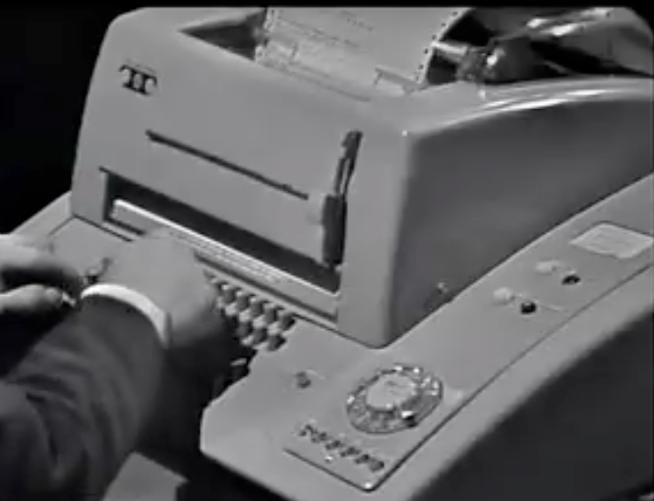
Dial-Up Access
You were happy to connect to one computer without having to walk across campus
You could 'call' other computers long distance
The characters were encoded as sound
Pretty Common in the 1970’s
6:00
http://deepblue.lib.umich.edu/handle/2027.42/79576 (1969)

Slide 11
Data Transfer with Leased Lines
You could get a dedicated connection between two points from the phone company
No dialing was needed leased lines are always connected
Reserved dedicated phone wires and permanent connections
Expensive because of limited copper - cost was based on distance
Think bank branch offices and other places where cost is significant
http://en.wikipedia.org/wiki/Leased_line

Slide 12
Store and Forward Networking
Leased
Dialup
http://en.wikipedia.org/wiki/BITNET
Clipart: http://www.clker.com/search/networksym/1

Slide 13
Store and Forward Networking
Leased
Dialup
http://en.wikipedia.org/wiki/BITNET
Clipart: http://www.clker.com/search/networksym/1

Slide 14
Store and Forward Networking
Leased
Dialup
http://en.wikipedia.org/wiki/BITNET
Clipart: http://www.clker.com/search/networksym/1

Slide 15
Store and Forward Networking
Leased
Dialup
http://en.wikipedia.org/wiki/BITNET
Clipart: http://www.clker.com/search/networksym/1

Slide 16
Store and Forward Networking
Leased
Dialup
http://en.wikipedia.org/wiki/BITNET
Clipart: http://www.clker.com/search/networksym/1

Slide 17
Store and Forward Networking
Leased
Dialup
http://en.wikipedia.org/wiki/BITNET
Clipart: http://www.clker.com/search/networksym/1

Slide 18
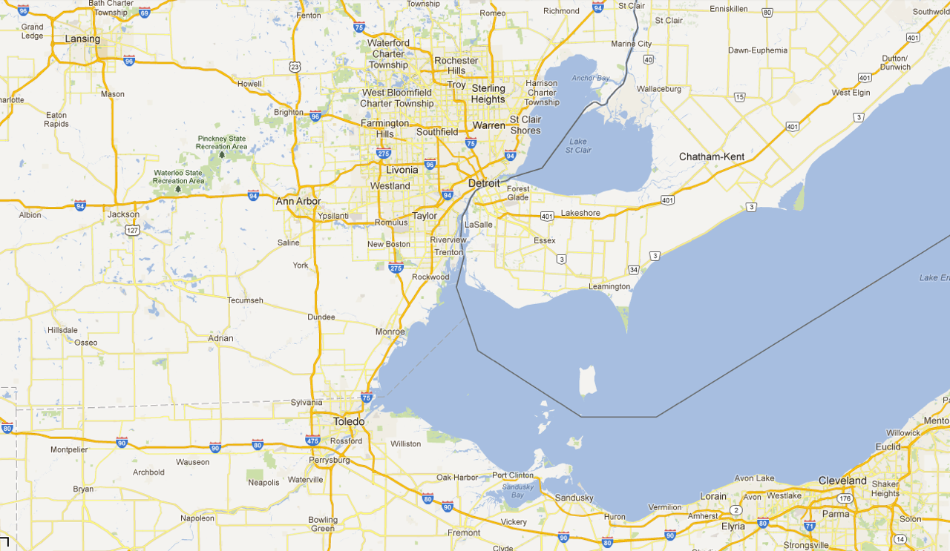




Saving Money with More "Hops"

Slide 19
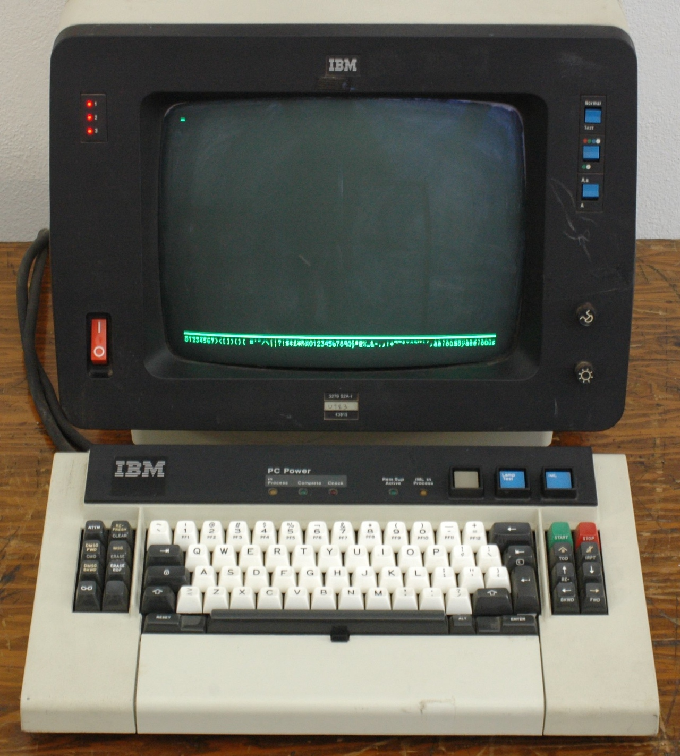
Store and Forward Networking
Typically specialized in Mail
E-Mail could make it across the country in six hours to about 2 days
You generally focused your life on one computer
Early 1980’s
http://en.wikipedia.org/wiki/IBM_3270
Notes:
This needs to be a 3270 terminal

Slide 20
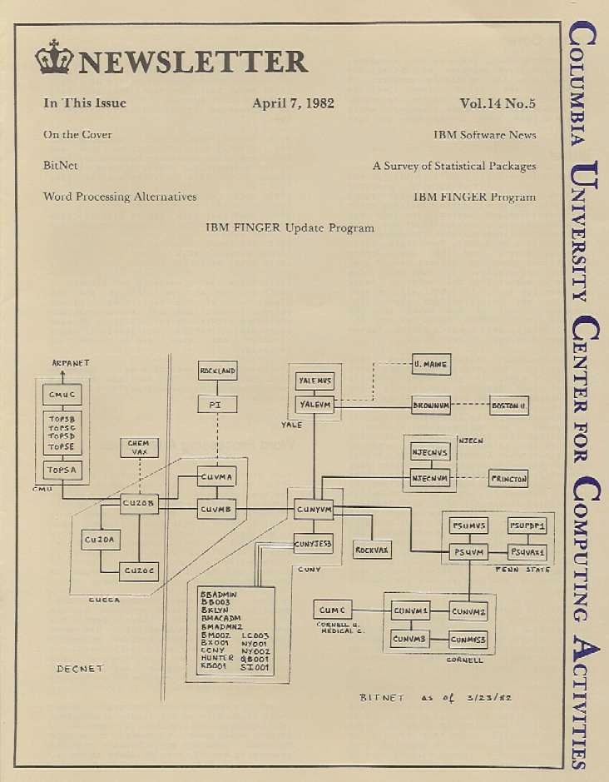
BITNET
Typically specialized in Mail
E-Mail could make it across the country in 6-hours to about 2 days
You generally focused your life on one computer
Academic network in the 1980’s
http://www.columbia.edu/acis/history/bitnet.jpg

Slide 21
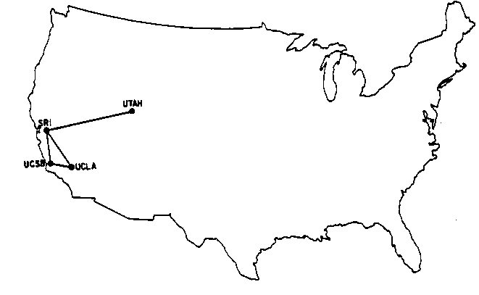
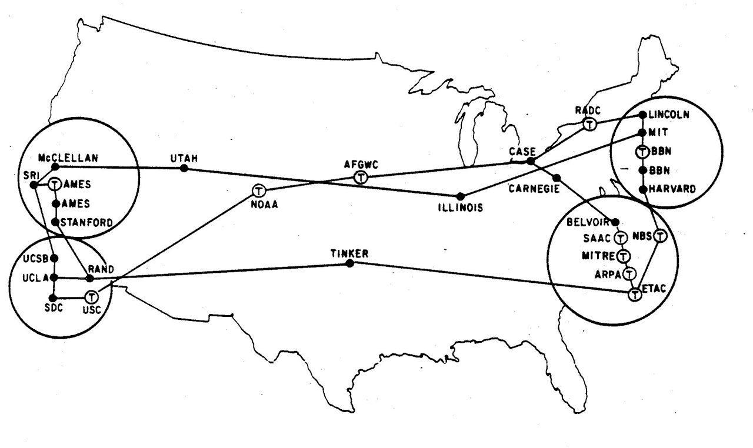
Research Networks
1960-1980’s
December 1969
How can we avoid having a direct connection between all pairs of computers or long snake-like connections?
How can we dynamically handle outages switching between multiple paths?
How to transport many messages simultaneously and efficiently?
August 1972
http://som.csudh.edu/fac/lpress/history/arpamaps/

Slide 22
Efficient Message Transmission: Packet Switching
Challenge: in a simple approach, like store-and-forward, large messages block small ones
Break each message into packets
Can allow the packets from a single message to travel over different paths, dynamically adjusting for use
Use special-purpose computers, called routers, for the traffic control
Notes:
Early approach = store and forward: at each hop, wait until the whole message arrives, then pass on. Problem: if a big message gets in line first, a small message has to wait forever. Alternative: packets. Small chunks of message that can be interleaved on the “wire”, and then re-assembled at the destination. (Example: M1 message that take 5 minutes from A to B; M2 message that takes 1 second. In store and forward, if M1 is there first, M2 takes 5 minutes and 1 second. If packet-switching, if M1 gets there first, then once M2 arrives, it has a 50% chance of transmitting next, so on average it will take 1.5 seconds (sometimes 1, sometimes 2), and M2 will take 5 min. and 1 sec.)
And even better, can break up a message and send it over different paths, depending on traffic conditions, re-assembling at the other end.
With store-and-forward, the intermediate machines were regular old general purpose computers. With the introduction of packet-switching, developed special processors, called routers, that we tuned to the problem of “routing”: forwarding on messages.
Seems obvious now—but working out the details was challenging; took 20 years of work.

Slide 23
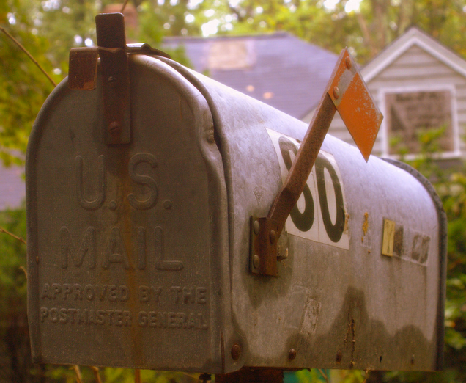
Packet Switching - Postcards
Hello there, have a nice day.
Hello ther (1, csev, daphne)
e, have a (2, csev, daphne)
nice day. (3, csev, daphne)
http://www.flickr.com/photos/stephoto/1519649375/
Notes:
Note: Don't go into too much internal detail here - will hit again.

Slide 24
Packet Switching - Postcards
e, have a (2, csev, daphne)
Hello ther (1, csev, daphne)
nice day. (3, csev, daphne)
Hello there, have a nice day.
http://www.flickr.com/photos/stephoto/1519649375/

Slide 25

Shared Network
Router
Wide Area Network
Local Area Network
Cable or
DSL
Clipart: http://www.clker.com/search/networksym/1
Notes:
Here’s what today’s internet looks like.
Have LANs: LAN = network in an area where you can legally drag a cable without getting into trouble; WAN = if you tried to do that, you’d be breaking the law
LANs connected together into a WAN
WAN use routers the transmit data
Can connect to a WAN via a cable modem or DSL (digital subscriber line); connect within a LAN via ethernet or wifi

Slide 26
An Example Problem to Solve
With each router having only a local / subset knowledge of the shape of the network, how do we avoid confusion if the information is a little "messed up"?
To: 67.149.*.*
Clipart: http://www.clker.com/search/networksym/1
Notes:
Usually we treat the internet as an abstraction or “black box”, but if we want to, we can peer into the internet to see how the packets move from one location to another—what is the path of hops?
While every router has on average some wrong information, there are some mistakes that cause huge problem: one is the existence of loops.
Note that the loops could be much longer than 3—could be 25 or 30 hops long.

Slide 27
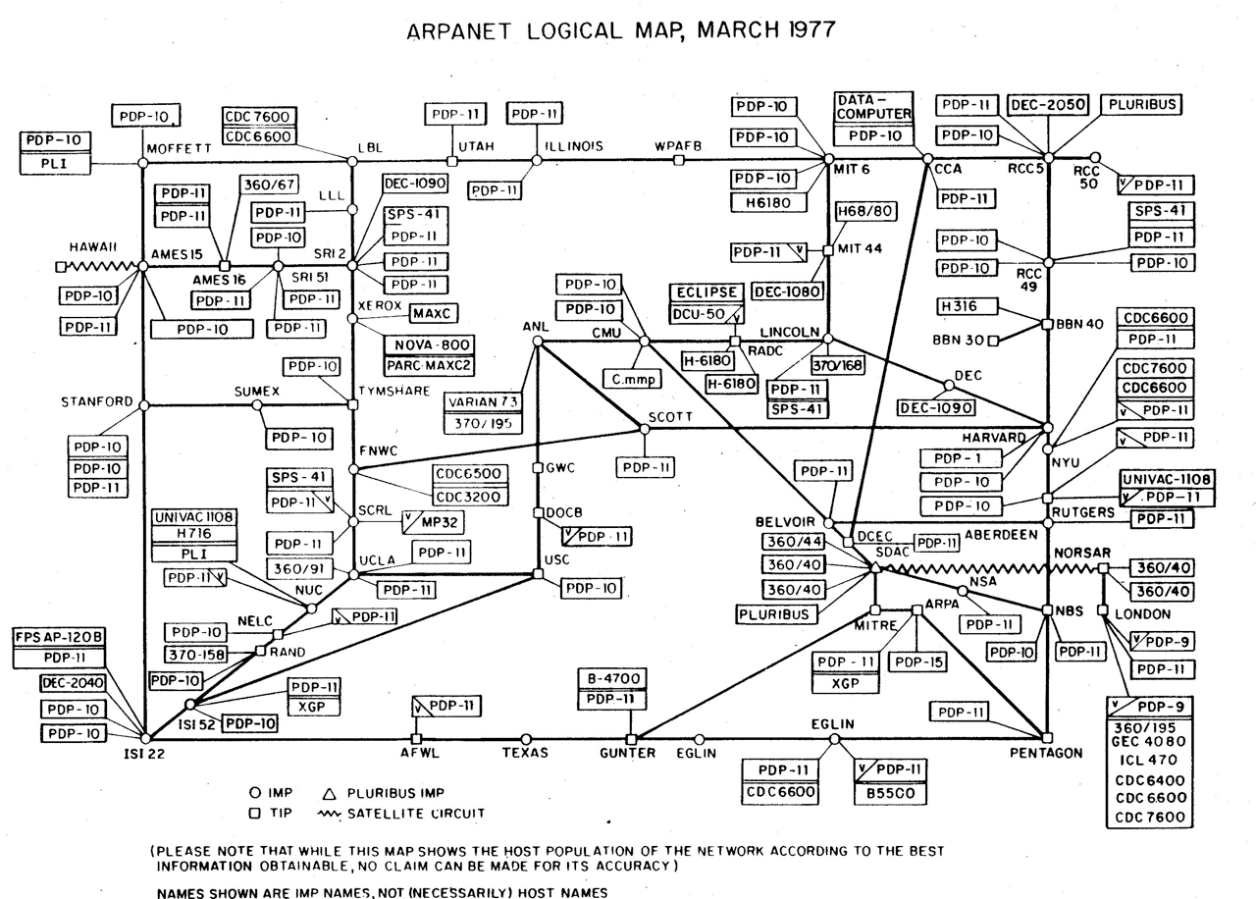
Heart, F., McKenzie, A., McQuillian, J., and Walden, D., ARPANET Completion Report, Bolt, Beranek and Newman, Burlington, MA, January 4, 1978.
http://som.csudh.edu/fac/lpress/history/arpamaps/arpanetmar77.jpg

Slide 28
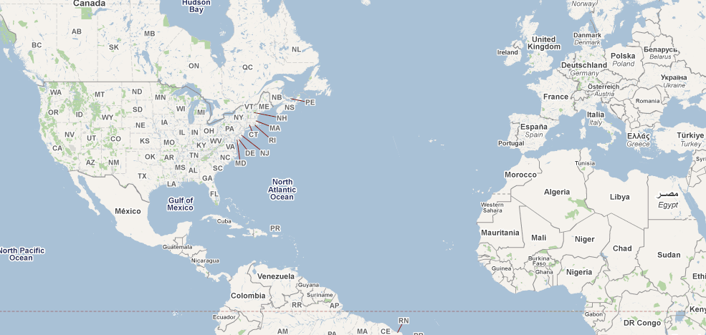
University of Illinois at Urbana-Champaign

Slide 29
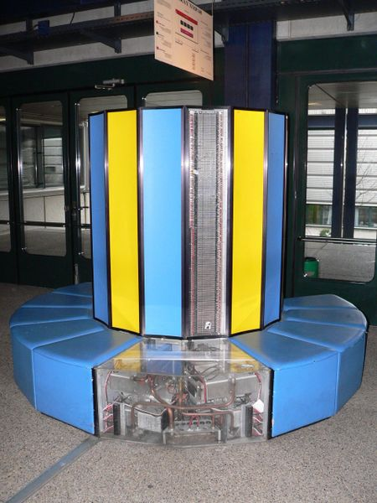
Supercomputers...
As science needed faster and faster computers, more universities asked for their own Multimillion dollar supercomputer
The National Science Foundation asked, “Why not buy a few supercomputers, and build up a national shared network?”
CC: BY-SA: Rama (Wikipedia)
http://creativecommons.org/licenses/by-sa/2.0/fr/deed.en_GB

Slide 30
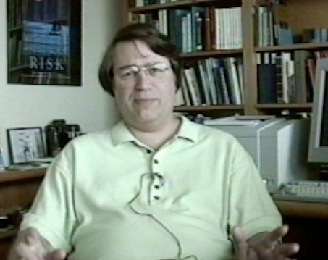
NCSA - Innovation
We now “assume” the Internet and the Web - it was not so easy...
A number of breakthrough innovations came from the National Center for Supercomputing Applications at Urbana-Champaign, Illinois
High Performance Computing and the Internet were deeply linked
Larry Smarr, NCSA
http://www.vimeo.com/6982439
(11:53)

Slide 31
University of Michigan
University of Illinois at Urbana-Champaign

Slide 32
NSF Net
NSFNet was funded by the National Science Foundation
Standardized on TCP/IP
The first national TCP/IP network that was “inclusive”
Initially the goal was all research universities
ARPANET August 1972
http://som.csudh.edu/fac/lpress/history/arpamaps/

Slide 33
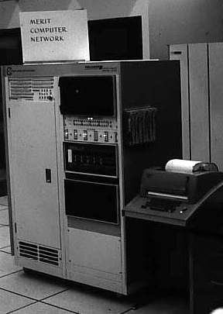
Michigan's State-Wide Network
In 1969, Merit was one of the earliest network projects that was intended for use by an entire campus population of students, faculty, and alumni. [1]
Text
Merit PDP-11 based Primary Communications Processor (PCP) at the University of Michigan, c. 1975
[1] http://www.zakon.org/robert/internet/timeline/

Slide 34
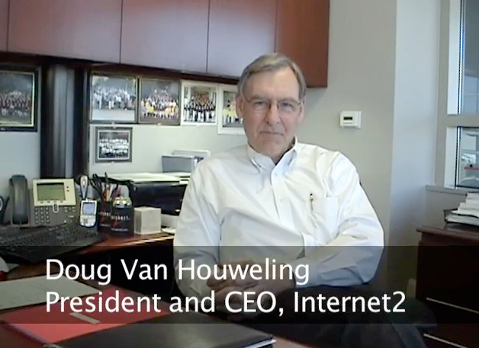
NSFNet @ University of Michigan
University of Michigan did not get a Supercomputer Center
Proposed a $55M high-speed network for $15M
Partners: University of Michigan, Merit Network, IBM Corporation, MCI, and State of Michigan
Operated from 1988-1995
http://www.vimeo.com/11044819
13:14

Slide 35
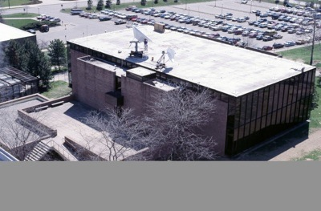
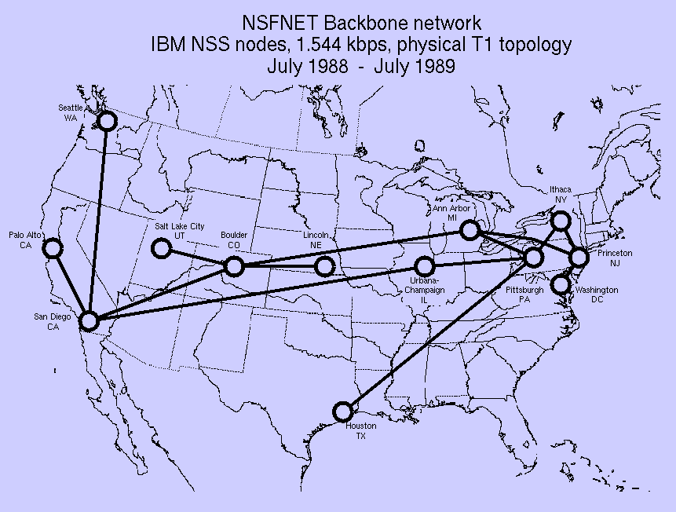
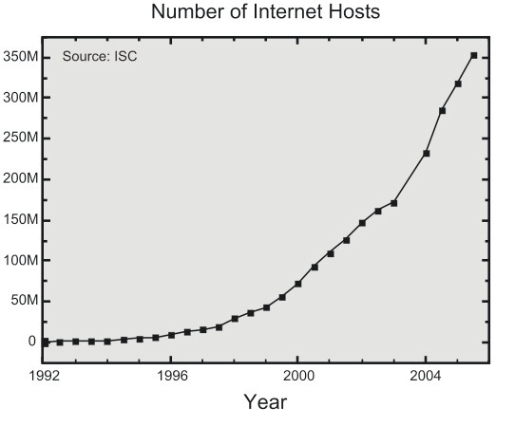
Source: http://hpwren.ucsd.edu/~hwb/NSFNET/NSFNET-200711Summary/
Notes:
Copyright folks: Do not replace the picture in the upper left of this slide.

Slide 36
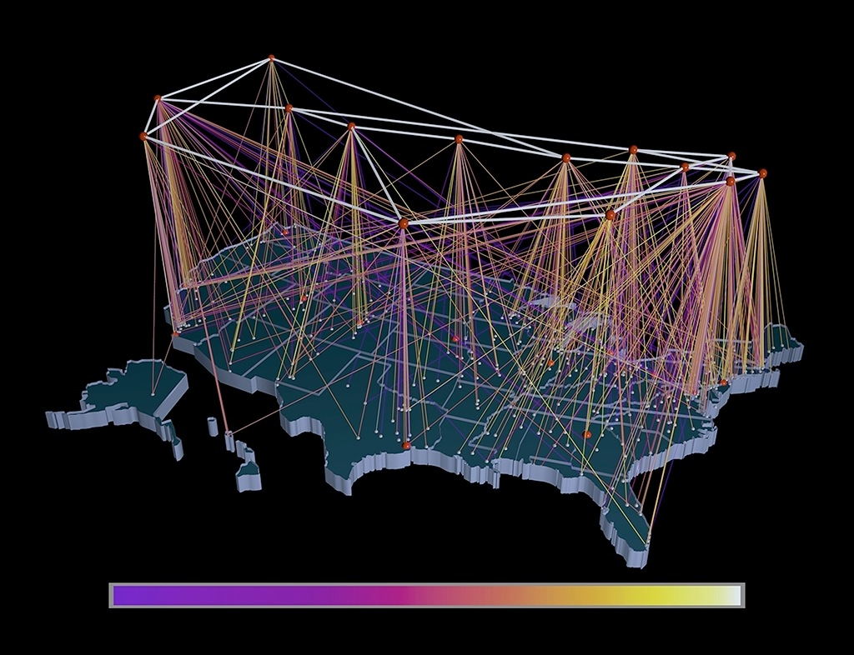
NSFNET T1 Backbone and Regional Networks, 1991
http://virdir.ncsa.uiuc.edu/virdir/raw-material/networking/nsfnet/NSFNET_1.htm

Slide 37
NSF Net Advocacy
Initially aimed at research universities
Cleveland FreeNet and similar efforts provided indirect Internet access to the average citizen
In about 1989-1990, the "academic-only" started being relaxed - led to Internet Service Providers making "dial-up Internet" available to the general public

Slide 38
University of Michigan
CERN
University of Illinois at Urbana-Champaign

Slide 39
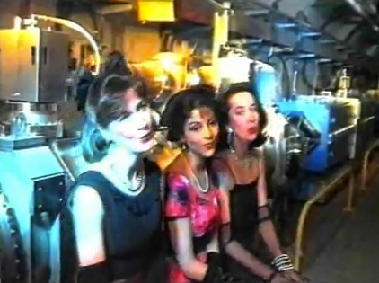
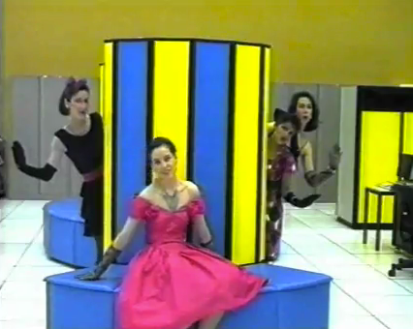
CERN - High-Energy (physics)
Brilliant physicists from all over the world
Work on long, highly detailed projects - 15-20 years
Have a lot of time to think..
(And have fun)
http://musiclub.web.cern.ch/MusiClub/bands/cernettes/
http://www.youtube.com/watch?v=A1L2xODZSI4
"... You Prefer your Collider"

Slide 41
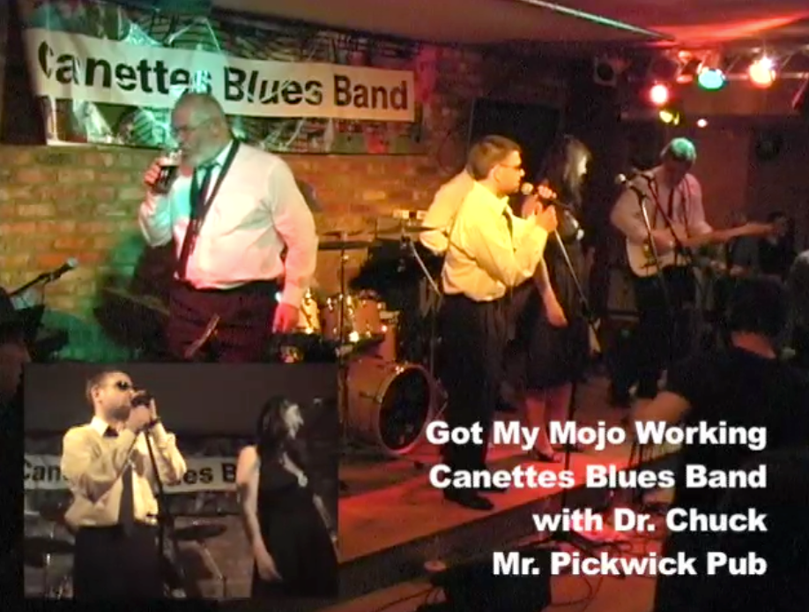
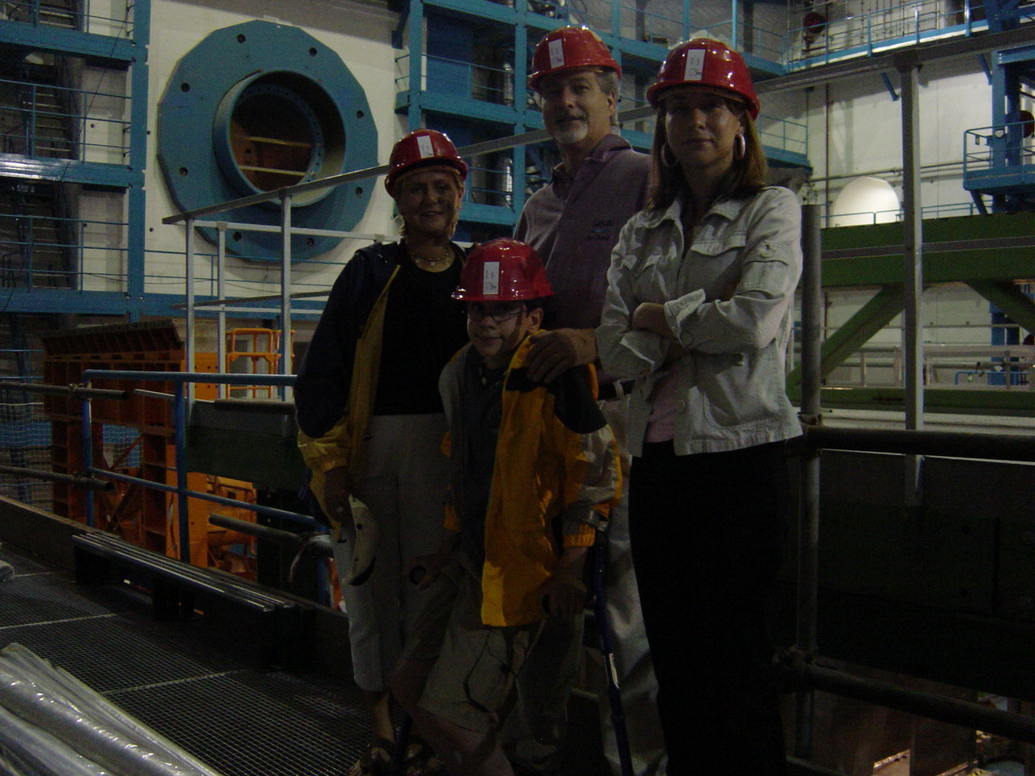
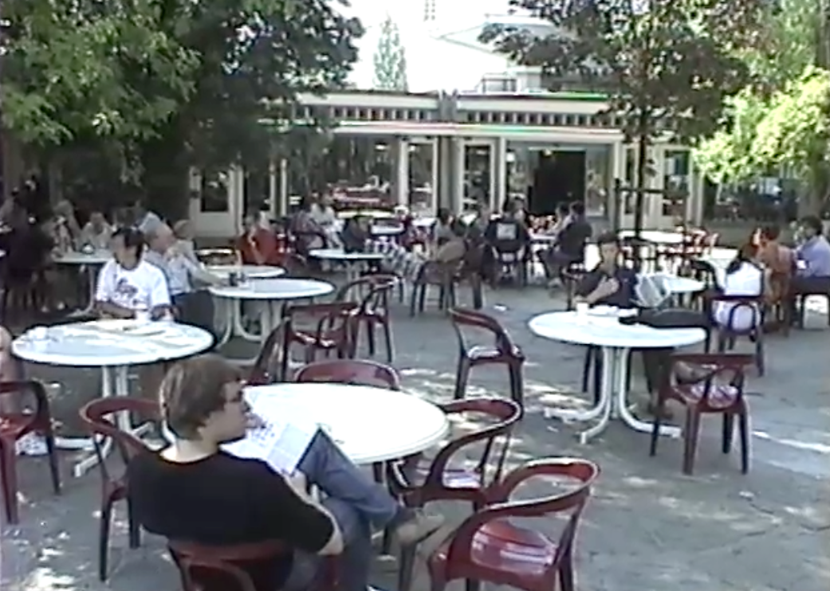
Visits to CERN!
http://club-softball.web.cern.ch/club-softball/Canettes/
http://www.youtube.com/watch?v=f90ysF9BenI

Slide 42
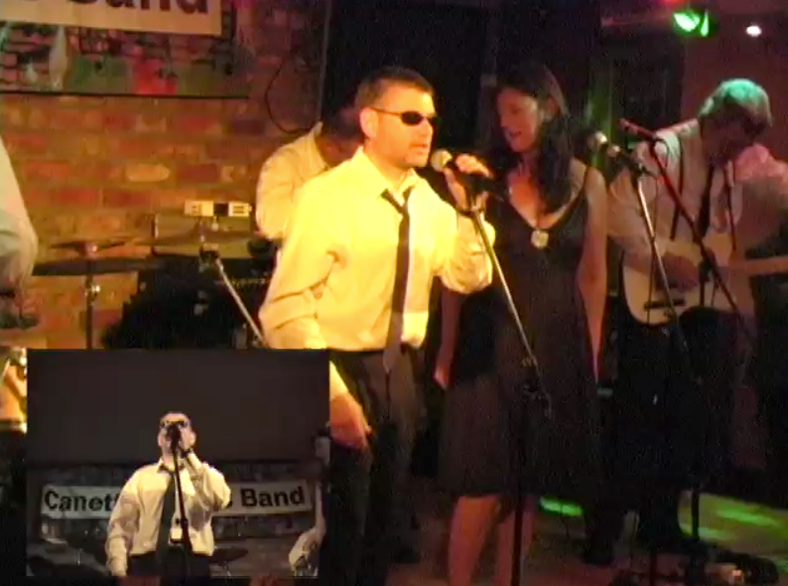
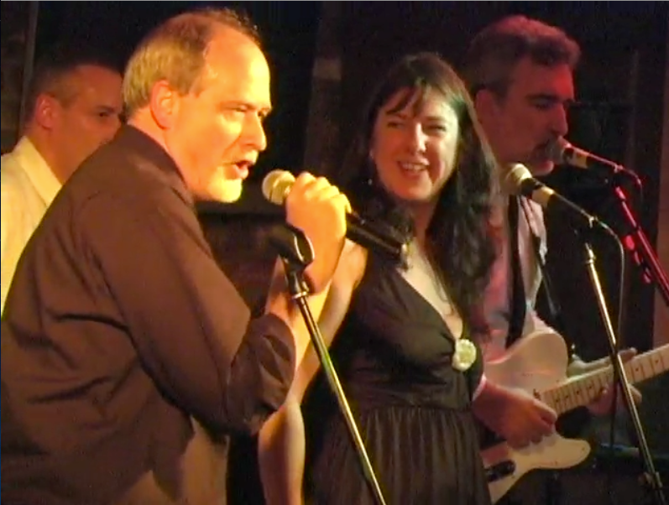

Slide 43
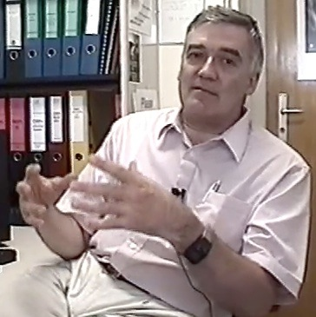
The Beginning of the Web: CERN
The Internet was infrastructure - the web gave the Internet a “user interface and URLs
The Web was invented at CERN by Tim Berners-Lee and Robert Cailliau
CERN developed browsers and servers - with a goal of worldwide hyperlinked documents
Robert Cailliau
CERN
(9:42)
http://www.youtube.com/watch?v=x2GylLq59rI

Slide 44
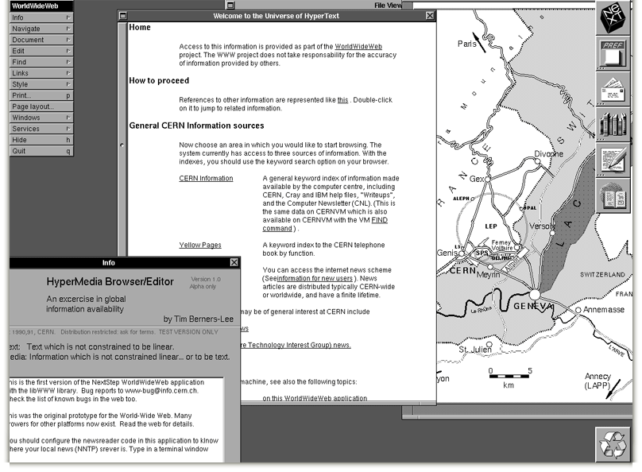
http://info.cern.ch/images/NextEditorBW.gif

Slide 45
University of Michigan
CERN
Stanford
University of Illinois at Urbana-Champaign

Slide 46
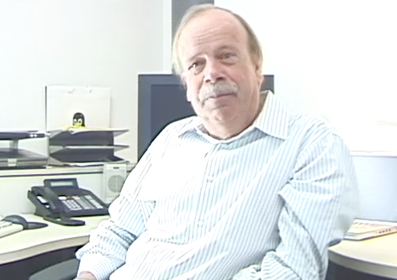
The First Web Server in America
The first web server in America was at the Stanford Linear Accellerator (SLAC)
It was a database of 300,000 research papers
Dr. Paul Kunz
December 12, 1991
Paul Kunz
SLAC
http://www.youtube.com/watch?v=lOgqP2yoKwc
(5:30)

Slide 47
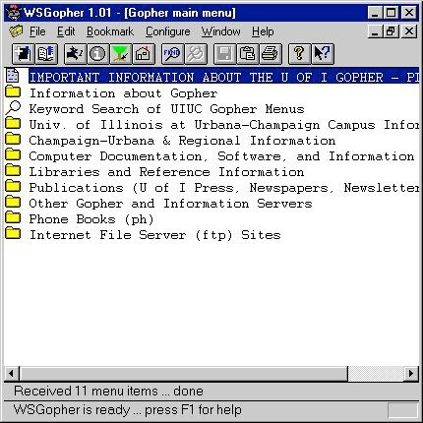
1993: Gopher is Dominant
Internet Engineering Task Force (IETF) Meeting
March 29-April 2, 1993 - Columbus, Ohio, USA (638 attendees)
Gopher BOF - 200 attendees
World-Wide Web BOF - 15 attendees including Tim Berners-Lee
P.S. DVD is invented this year
http://www.ietf.org/proceedings/26.pdf

Slide 48
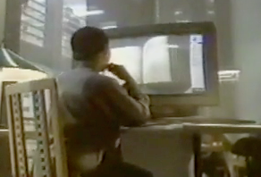
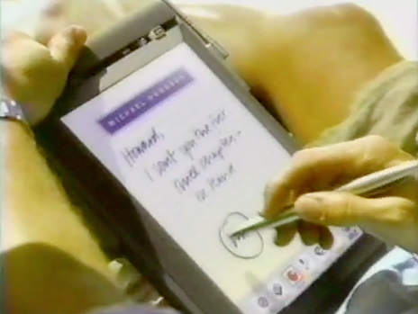
What industry was thinking in 1993...
http://www.youtube.com/watch?v=sYNUcFMCIzw
0:30

Slide 49
0:30

Slide 50
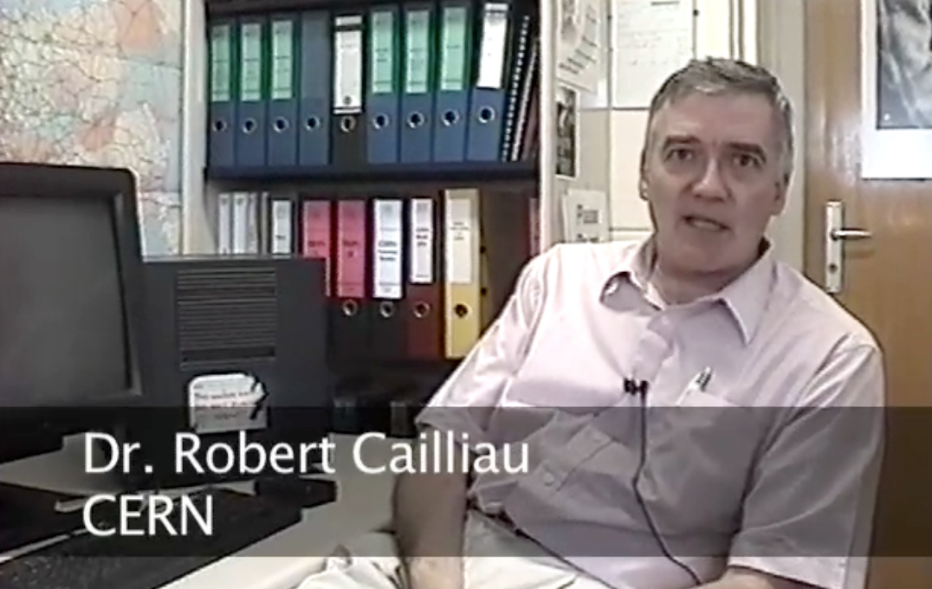
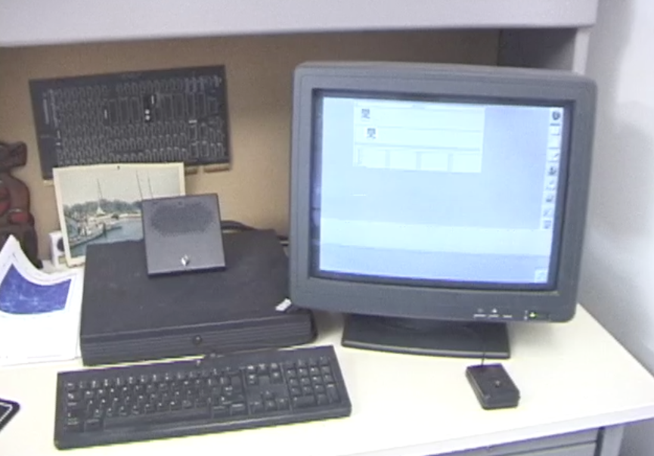
Steve Jobs and the World-Wide-Web?
For several years the primary web browser and web server were built as NeXT applications
Apple computers provided far superior graphics that allowed the development of Mosaic
http://www.youtube.com/watch?v=W9rPUFW6czc

Slide 51
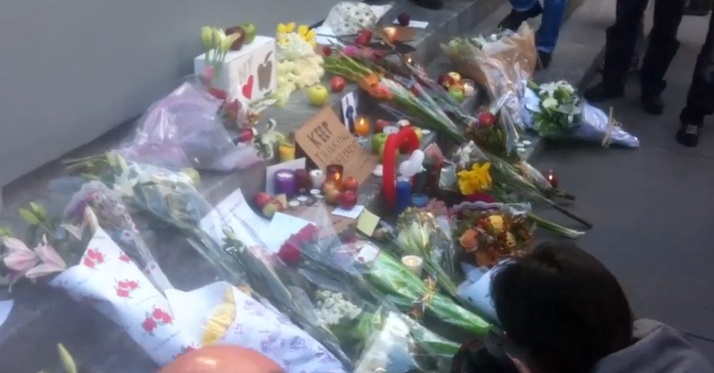
12:23

Slide 52
University of Michigan
CERN
Stanford
University of Illinois at Urbana-Champaign
Notes:
Why does innovation lightening strike twice? Culture.

Slide 53
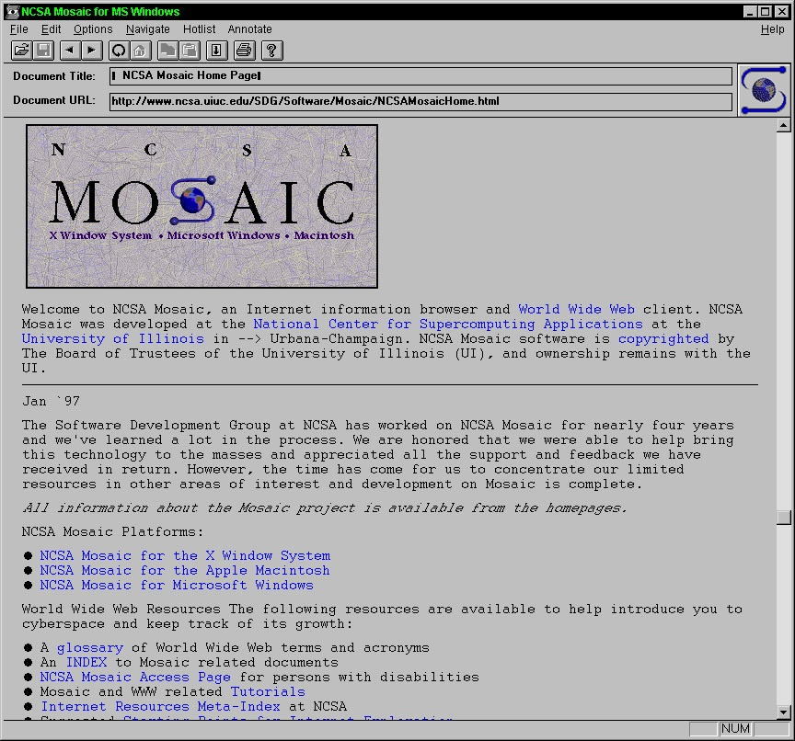
The Explosive Growth of the Web
The web was invented in the early 1990’s
Growing in Academia 1993
Growing everywhere 1994 - 1995
Cable Modems to the home started in the mid 1990’s
http://gladiator.ncsa.uiuc.edu/Images/press-images/mosaic.1.0.tif

Slide 54
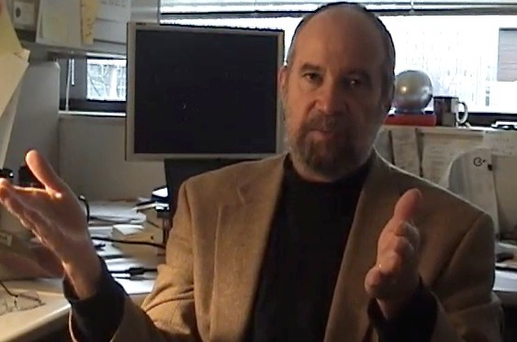
Mosaic - Netscape - Mozilla - Firefox
Mosaic was the first “consumer” web browser developed at NCSA
NCSA created the httpd web server which is the basic for the Apache web server
While most of the NCSA programmers formed Netscape and made their fortunes, NCSA released their browser for free and focused on building standards to keep the web open
Joseph Hardin, UM
http://www.vimeo.com/7053726
9:01

Slide 55
1994: Year of the Web
Netscape Founded - April 4, 1994
WWW Conf: May 25-26-27 1994, CERN, Geneva (Switzerland)
WWW Conf: October 17-19, 1994, Chicago, IL
October 1994, Tim Berners-Lee founded the (W3C) at MIT
November 8, 1994 - Windows 95 beta 2 - With a vengance!

Slide 56

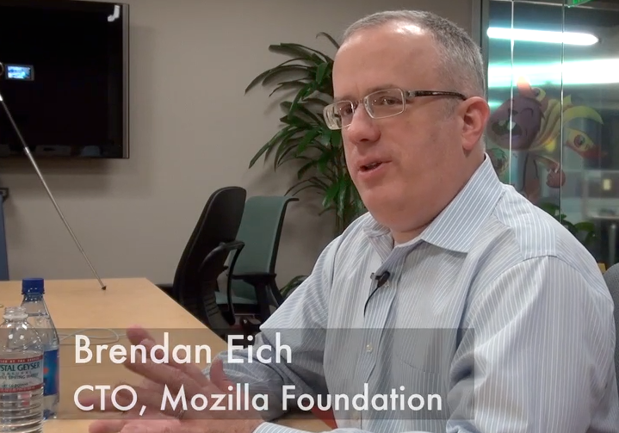
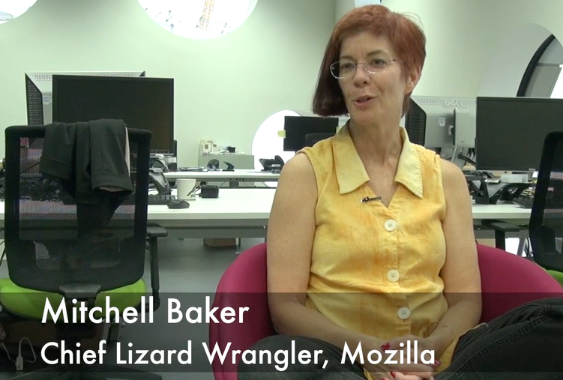
Netscape, JavaScript and FireFox
11:59
As Microsoft worked to suffocate Netscape::
JavaScript was invented to compete with Visual Basic (1995)
Netscape slowly leaked out into Open Source as Mozilla - which later became FireFox (late 1990's)
FireFox's search box gave the small Mozilla Foundation millions of dollars of revenue
http://www.youtube.com/watch?v=IPxQ9kEaF8c

Slide 57
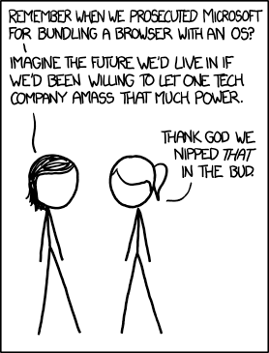
Did Microsoft Save the World-Wide Web?
Netscape wanted to make the web browser, web server, and web protocols propritary and owned by them
The web browser would be $50-$100 and sold separately
This threatened to make the desktop operating system irrelevant
http://xkcd.com/1118/

Slide 58
World-Wide-Web Consortium
The W3C was formed in October 1994 (www.w3c.org)
Led by Tim Berners-Lee who moved from CERN to MIT
Goal was to develop standards for the web and avoid proprietary balkanization of the Web
Many large companies (Microsoft, IBM, etc) joined quickly
http://en.wikipedia.org/wiki/World_Wide_Web_Consortium

Slide 59
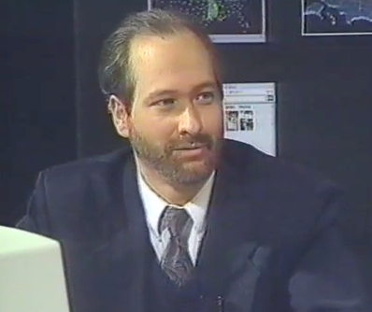

When You Can Assume the Web
Internet: TCI Show 08
http://www.vimeo.com/4275919
December 11-14, 1995
http://www.w3.org/Conferences/WWW4/
1:22

Slide 60


Some Great Books
How the Web was Born: The Story of the World Wide Web, James Gillies , Robert Cailliau
Weaving the Web: The Original Design and Ultimate Destiny of the World Wide Web, Tim Berners-Lee

Slide 61

Larry Smarr wanted to make supercomputers available to physicists
University of Michigan sneaked in 1.54Mb/sec instead of 56kb/sec backbone for their NSFNet proposal
Tim Berners-Lee and Robert Cailliau were building a system for network hosted documentation
Paul Kunz was trying to make his article database easier to use
Joseph Hardin wanted to make supercomputers more user friendly
Mitchell Baker - Just wanted us to have a free and open source browser
Notes:
No one is wealthy, all content to wander in a problem space with a curious and open mind, listening to ideas and riffing on them.

Slide 62

The Web Land Rush...
In the late 1990’s there were many fortunes to be made - simply by being first in a market
Everything was “novel” when it was re-invented on the web
New brands were quickly established and became dominant
http://www.vimeo.com/7048422
5:39

Slide 63
The Modern Internet
In the late 1990’s in the boom there was a great deal of Fiber optic that was installed in the US
High speed and long distance were cheap and common
Many national backbone networks emerged - commercial, government, academic, etc
These networks swap data at “peering points” so we see one seamless Internet - after about 1999 - this was all pretty boring - it just worked
http://en.wikipedia.org/wiki/Internet_Exchange_Point

Slide 64

http://www.zakon.org/robert/internet/timeline/

Slide 65

The “Web Effect”

Slide 66



A History of Open Source ....
http://www.vimeo.com/7307422
http://www.vimeo.com/3800796
http://www.vimeo.com/6215179

Slide 67
Other Resources
Hobbes Internet Timeline
http://www.zakon.org/robert/internet/timeline/
A Brief History of the Internet. Barry M. Leiner, et al. 2009. SIGCOMM Comput. Commun. Rev. 39, 5 (October 2009), 22-31. DOI=10.1145/1629607.1629613
http://doi.acm.org.proxy.lib.umich.edu/10.1145/1629607.1629613
Notes:
It is OK to disagree with my points in the chat room. You can even bring in all kinds of other resources tomake your points.

Slide 68
Additional Source Information
TuringBombeBletchleyPark: Sarah Hartwell, Wikimedia Commons, http://upload.wikimedia.org/wikipedia/commons/2/23/TuringBombeBletchleyPark.jpg. CC: BY-SA, http://creativecommons.org/licenses/by-sa/3.0/deed.en
SSEM Manchester museum: Parrot of Doom, Wikimedia Commons, http://commons.wikimedia.org/wiki/File:SSEM_Manchester_museum.jpg, CC: BY-SA, http://creativecommons.org/licenses/by-sa/3.0/deed.en
John f nash 200611023: Elke Wetzig, Wikimedia Commons, http://en.wikipedia.org/wiki/File:John_f_nash_20061102_3.jpg, CC: BY-SA, http://creativecommons.org/licenses/by-sa/3.0/deed.en
US Mail: Steve Johnson, Flickr, http://www.flickr.com/photos/stephoto/1519649375/, CC:BY-SA, http://creativecommons.org/licenses/by-sa/2.0/deed.en
EPFL CRAY-I 1: Rama, Wikimedia Commons, http://commons.wikimedia.org/wiki/File:EPFL_CRAY-I_1.jpg, CC:BY-SA, http://creativecommons.org/licenses/by-sa/2.0/fr/deed.en
Mitchell Baker: James Duncan Davidson/O’Reilly Media, Wikimedia Commons, http://upload.wikimedia.org/wikipedia/commons/8/8a/Mitchell_Baker.jpg, CC: BY, http://creativecommons.org/licenses/by/2.0/deed.en

Slide 69
Reuse of these materials
I intend for these materials to be reusable as open educational resources for those who would do so in a responsible manner
Please contact me if you are interested in reusing or remixing these materials in your own teaching or educational context

