Slide 1
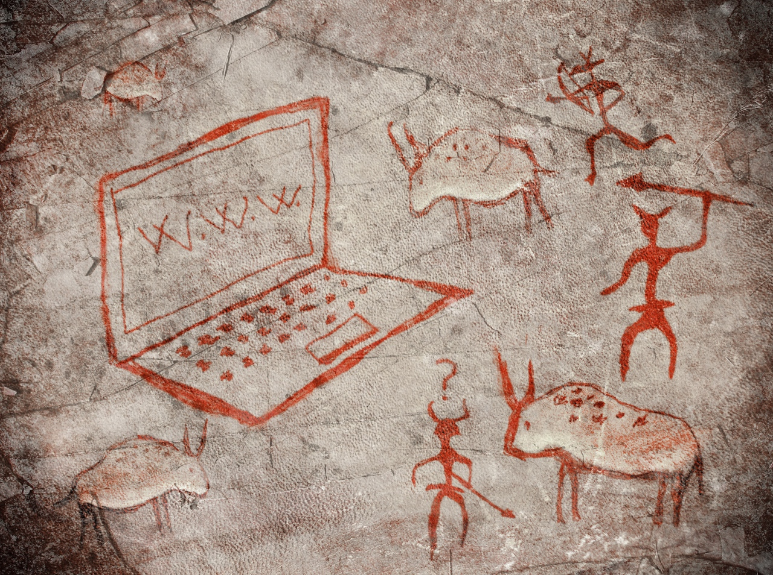

Internet Technology
Dr. Charles Severance <csev@umich.edu>
http://www.dr-chuck.com/
Twitter: @drchuck
https://www.coursera.org/course/insidetheinternet

Slide 2
Copyright Thanks
Thanks to IEEE Computer for permission to use IEEE Computer magazine articles associated with the videos
Thanks to Dave Malicke and Open Michigan (open.umich.edu) for help with copyright review of these materials

Slide 3
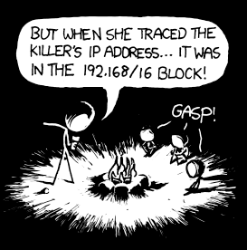
http://xkcd.com/742/

Slide 4
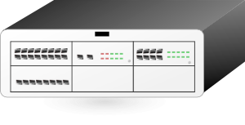

Store and Forward Networking
Leased
Dialup
http://en.wikipedia.org/wiki/BITNET
Clipart: http://www.clker.com/search/networksym/1
Notes:
Animate Store and Forward.

Slide 5
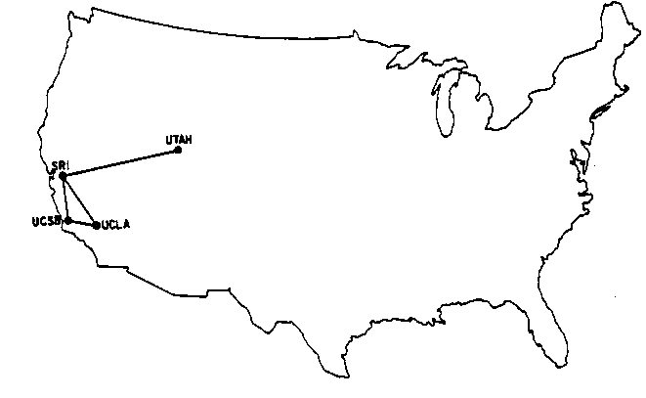
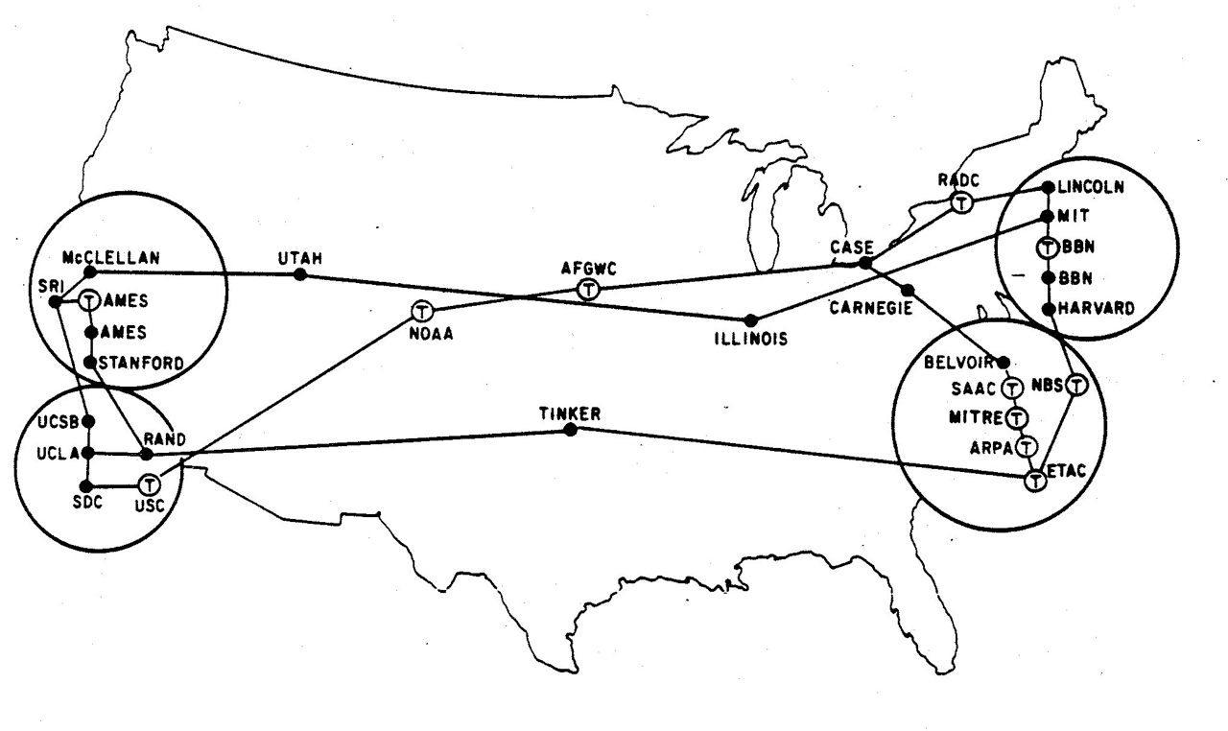
Research Networks
1960-1980’s
December 1969
How can we avoid having a direct connection between all pairs of computers?
How to transport messages efficiently?
How can we dynamically handle outages?
August 1972
http://som.csudh.edu/fac/lpress/history/arpamaps/

Slide 6
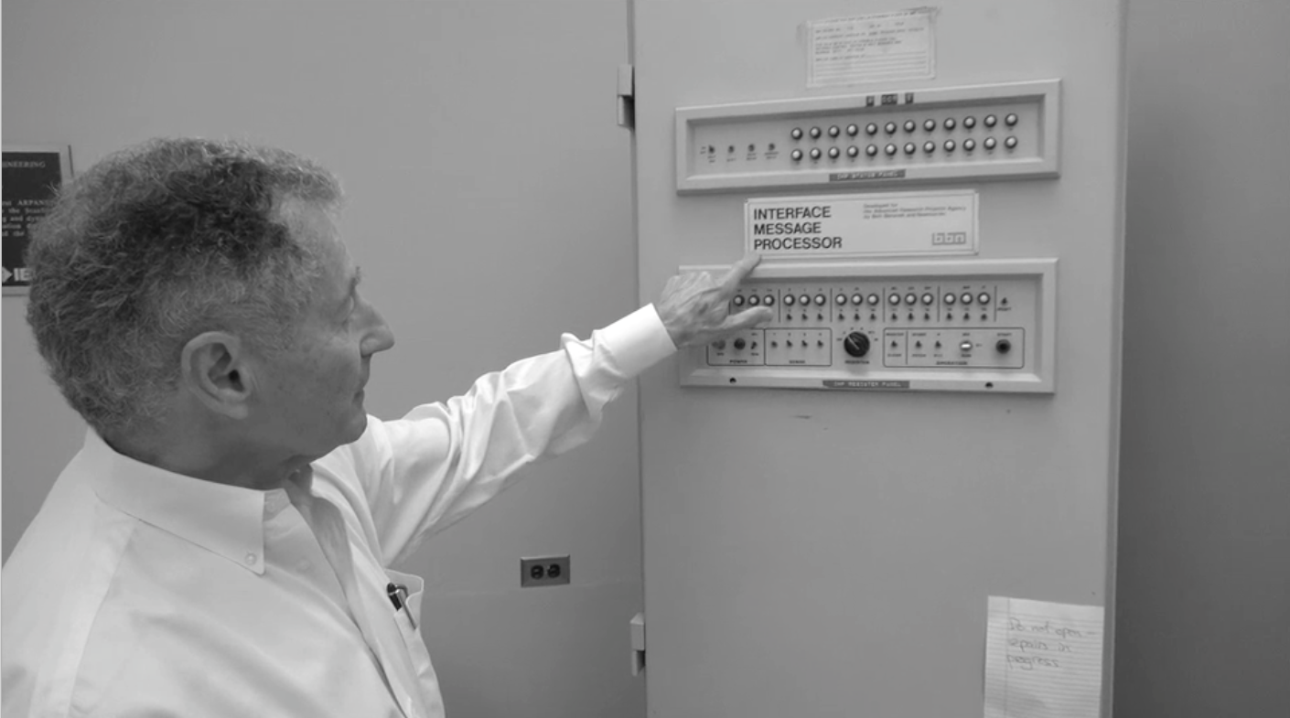
Len Kleinrock - The First Two Packets on The Internet

Slide 7
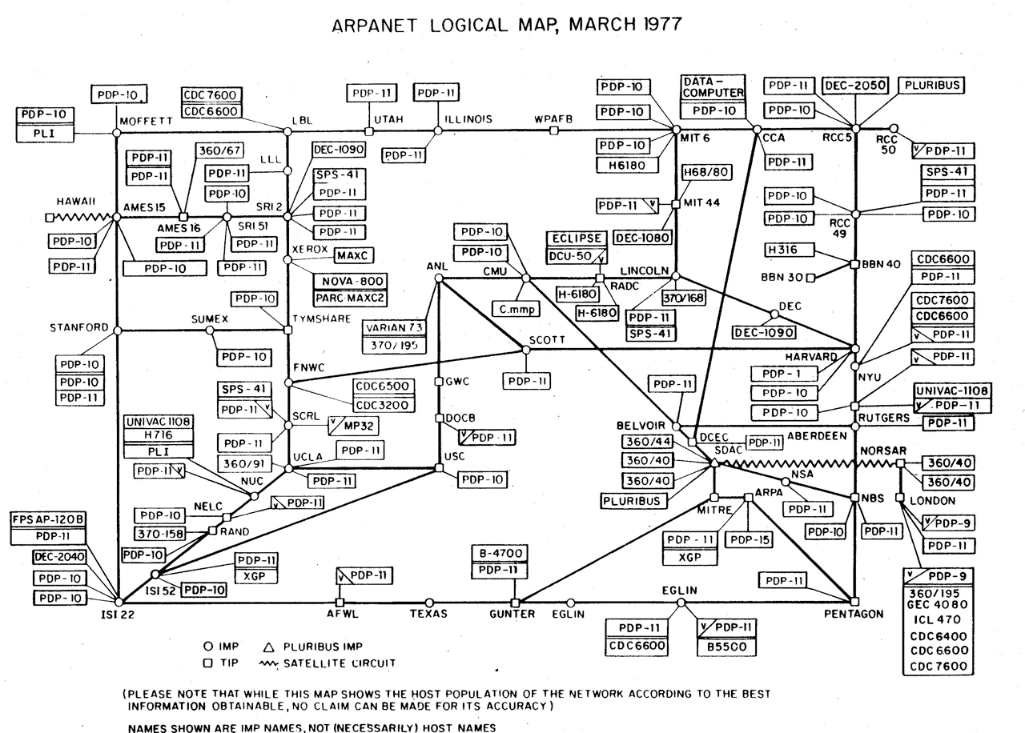
Heart, F., McKenzie, A., McQuillian, J., and Walden, D., ARPANET Completion Report, Bolt, Beranek and Newman, Burlington, MA, January 4, 1978.
http://som.csudh.edu/fac/lpress/history/arpamaps/arpanetmar77.jpg

Slide 8
Efficient Message Transmission: Packet Switching
Challenge: in a simple approach, like store-and-forward, large messages block small ones
Break each message into packets
Can allow the packets from a single message to travel over different paths, dynamically adjusting for use
Use special-purpose computers, called routers, for the traffic control
Notes:
Early approach = store and forward: at each hop, wait until the whole message arrives, then pass on. Problem: if a big message gets in line first, a small message has to wait forever. Alternative: packets. Small chunks of message that can be interleaved on the “wire”, and then re-assembled at the destination. (Example: M1 message that take 5 minutes from A to B; M2 message that takes 1 second. In store and forward, if M1 is there first, M2 takes 5 minutes and 1 second. If packet-switching, if M1 gets there first, then once M2 arrives, it has a 50% chance of transmitting next, so on average it will take 1.5 seconds (sometimes 1, sometimes 2), and M2 will take 5 min. and 1 sec.)
And even better, can break up a message and send it over different paths, depending on traffic conditions, re-assembling at the other end.
With store-and-forward, the intermediate machines were regular old general purpose computers. With the introduction of packet-switching, developed special processors, called routers, that we tuned to the problem of “routing”: forwarding on messages.
Seems obvious now—but working out the details was challenging; took 20 years of work.

Slide 9
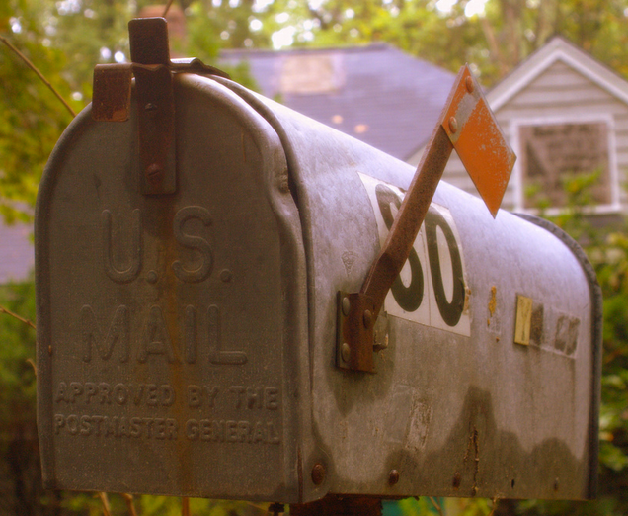
Packet Switching - Postcards
Hello there, have a nice day.
Hello ther (1, csev, daphne)
e, have a (2, csev, daphne)
nice day. (3, csev, daphne)

Slide 10
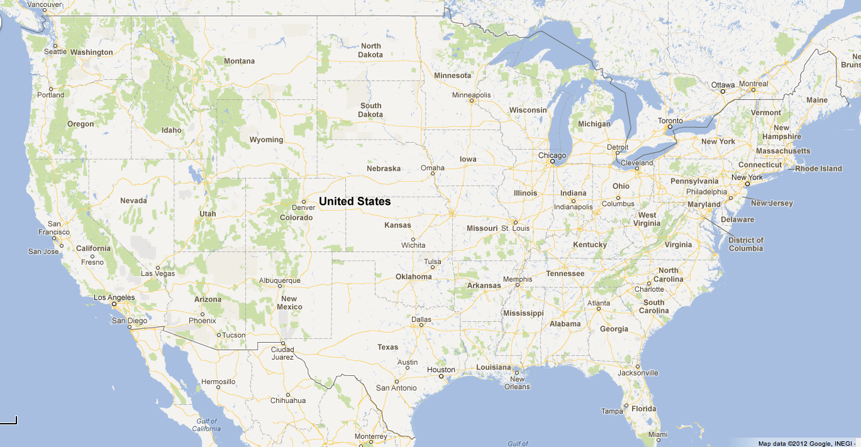
1
2
3

Slide 11
Packet Switching - Postcards
Hello ther (1, csev, daphne)
e, have a (2, csev, daphne)
nice day. (3, csev, daphne)
Hello there, have a nice day.

Slide 12

Shared Network
Router
Wide Area Network
Local Area Network
Cable or
DSL
Clipart: http://www.clker.com/search/networksym/1
Notes:
Here’s what today’s internet looks like.
Have LANs: LAN = network in an area where you can legally drag a cable without getting into trouble; WAN = if you tried to do that, you’d be breaking the law
LANs connected together into a WAN
WAN use routers the transmit data
Can connect to a WAN via a cable modem or DSL (digital subscriber line); connect within a LAN via ethernet or wifi

Slide 13
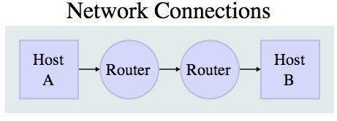
Shared Networks
In order to keep cost low and the connections short geographically - data would be forwarded through several routers.
Getting across the country usually takes about 10 “hops”
Network designers continually add and remove links to “tune” their networks
Source: http://en.wikipedia.org/wiki/Internet_Protocol_Suite
Notes:
Instead of establishing a dedicated connection between every pair of computers—much too expensive—create shared “wires” along which multiple messages can pass.

Slide 14
Layered Network Model
Application Layer
Web, E-Mail, File Transfer
A layered approach allows the problem of designing a network to be broken into more manageable sub problems
Best-known model: TCP/IP—the “Internet Protocol Suite”
There was also a 7 layer OSI: Open System Interconnection Model
Transport Layer (TCP)
Reliable Connections
Internetwork Layer (IP)
Simple, Unreliable
Link Layer (Ethernet, WiFi)
Physical Connections
Notes:
TCP = transmission control protocol
IP = internet protocol
The 7-layer model got bogged down in committee discussions and votes and eventually died. The 4-layer model was crude but effective—less elegant, but it worked! Each level is clearly different from the other.

Slide 15
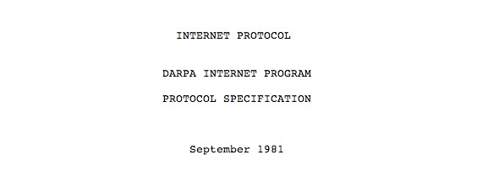
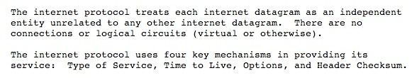
Internet Standards
The standards for all of the Internet protocols (inner workings) are developed by an organization
Internet Engineering Task Force (IETF)
www.ietf.org
Standards are called “RFCs” - “Request for Comments”
Source: http://tools.ietf.org/html/rfc791
Notes:
The standards (the “guts”) of the Internet protocols are developed by IETF
IETF was run by a bunch of engineers who didn’t like bureaucracy, didn’t like committees, didn’t like votes or lots of process. So they put out lots and lots of documents called RFCs—requests for comments. Encoded their values and mission in them. Wasn’t a push to get broad agreement. People put out RFCs, and a small group of companies might start using them. Then when other people saw problems, they would suggest corrections; it was a very fluid system, and one in which standards were never really “finished”. Now about 3000 of them. Many of the standards never got wide use, others are now obsolete, but a small number form the heart of the interent, e.g RFC 791 = IP.
Approach was to come up with ideas, try them out, see what worked, move forward. There were good reasons for this, beyond engineer’s dislike of bureaucracy. There were big companies, such as the telephone companies (ATT), large computer vendors (IBM), etc. that would have preferred that the internet never exist. So upstarts like Sun and Cisco had to just barrel forward. If you took votes, the big companies would vote things down, and so they structured this for innovation to thrive.

Slide 16
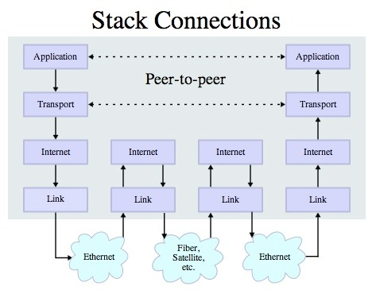

Layered Architecture
The Physical and Internet Layers are like trucks and trains - they haul stuff and get it to the right loading dock - it takes multiple steps
The Transport layer checks to see if the trucks made it and send the stuff again if necessary
Source: http://en.wikipedia.org/wiki/Internet_Protocol_Suite

Slide 17
Link Layer (aka Physical Layer)
As your data crosses the country may use a different physical medium for each “hop”
Wire, Wireless, Fiber Optic, etc.
The link is “one hop” - Is it up or down? Connected or not?
Very narrow focus - no view at all of the “whole Internet”
Source: http://en.wikipedia.org/wiki/Internet_Protocol_Suite

Slide 18
Problems solved by the Link Layer
How does data get pushed onto a link?
How is the link shared?
Common Link Technologies
Ethernet
WiFi
Cable modem
DSL
Satellite
Optical

Slide 19
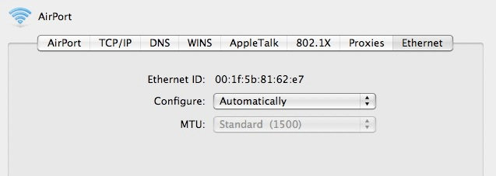
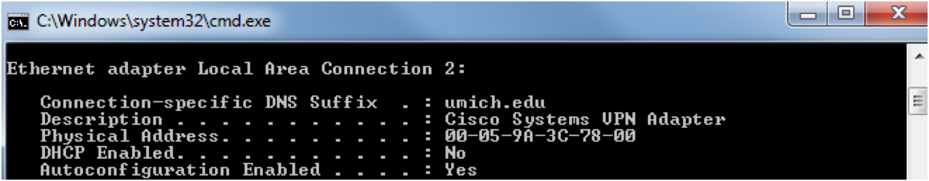
Link Layer Addresses
Many physical layer devices have addresses built in to them by the manufacturer
Ethernet
Wireless Ethernet (Wifi)
Notes:
So how do we avoid everything getting into one another’s way?
Everything has a serial number assigned to it. Your computer does, so does the wireless access point, or the internet router, etc. When a connection gets formed, the two linked device now recognize each other by their physical address.
Note that while your computer only talks to 1 WAP, the WAP talks to many devices. It needs to keep track of all of them. Put too many on and it will crash. The gadget in the ceiling can only handle about 100 or so devides. If 2000 people walked into this room now with laptops, the WAP would likely immediately crash. In meeting rooms, etc., use multiple WAPs. At a conference, you may notice sporadic access on wifi. When it reaches its limit, you get rejected. When you finally get access, it’s likely because someone else has left.

Slide 20
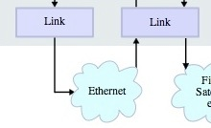
Link Layer
Physical addresses are to allow systems to identify themselves on the ends of a single link
Physical addresses go no farther than one link
Sometimes links like Wifi and Wired Ethernet are shared with multiple computers
0f:21:63:12:b3:1a
98:2f:4e:78:01:b4
Source: http://en.wikipedia.org/wiki/Internet_Protocol_Suite
Notes:
So, here’s the picture so far.
But there’s one other key problem for the Link Layer: how do you avoid chaos, with many “voices” (i.e., many devices) clashing with one another on the same link

Slide 21
Sharing Nicely - Avoiding Chaos
CSMA/CD Carrier Sense Multiple Access with Collision Detection
To avoid garbled messages, systems must observe “rules” (Protocols)
Ethernet rules are simple
Wait for silence
Begin Transmitting data
Listen for your own data
If you cannot hear your own data clearly, assume a collision, stop and wait before trying again
Each system waits a different amount of time to avoid “too much politeness”
Notes:
“Carrier” = tell the difference between silence and something being sent. Carrier means something is being sent.
Last step important: if we keep waiting and then restarting again at the same time, we’ll never get there—like the dance people sometimes do when they’re passing in the hallway
Solution: generate a random number and use that to decide when to go next
Odds are that that spreads out the retransmission.
Could in principle build an evil wireless card, that always immediately went again. If it happened to conflict with another device, that device would think it was an accident, would wait, generate another random number, and likely go later. Luckily, very hard to do this, since the link layer is embedded in the hardware of devices.
Alternative: token passing (talking stick)

Slide 22
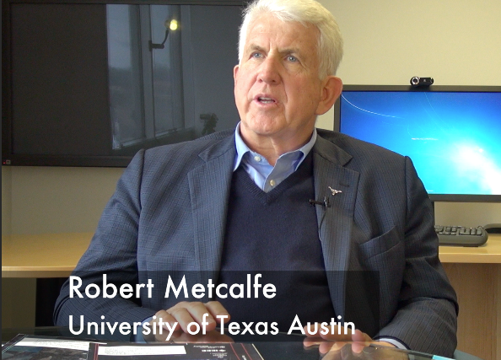
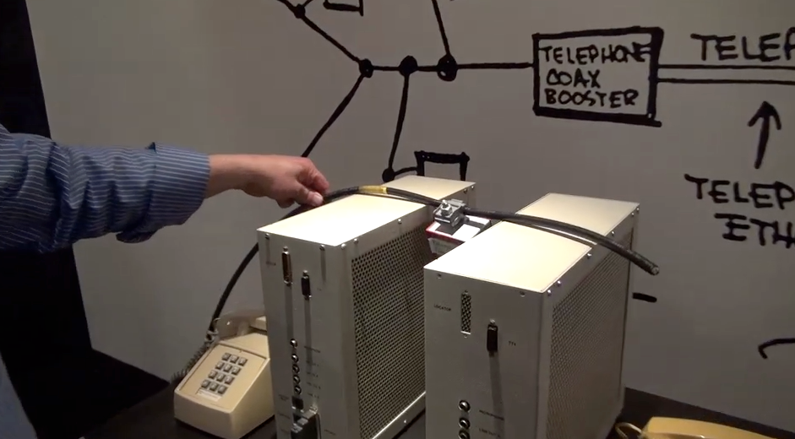
Ethernet
Invented at PARC (Xerox)
The first Local-Area-Network
Connected PC's to laser printers
Inspired by an earlier wireless network called Aloha from the University of Hawaii

Slide 23
Internetwork Layer
(IP)
Application Layer
Web, E-Mail, File Transfer
Transport Layer (TCP)
Reliable Connections
http://en.wikipedia.org/wiki/Internet_Protocol
http://en.wikipedia.org/wiki/Traceroute
http://en.wikipedia.org/wiki/Ping
Internetwork Layer (IP)
Simple, Unreliable
Link Layer (Ethernet, WiFi)
Physical Connections
Notes:
TCP = transmission control protocol
IP = internet protocol
The 7-layer model got bogged down in committee discussions and votes and eventually died. The 4-layer model was crude but effective—less elegant, but it worked! Each level is clearly different from the other.

Slide 24
Internet Protocol Layer
Goal: Gets your data from this computer to the other computer half way across the world
Each router knows about nearby routers
IP Is best effort - it is OK to drop data if things go bad...
Source: http://en.wikipedia.org/wiki/Internet_Protocol_Suite

Slide 25
IP Addresses
The IP address is the worldwide number which is associated with one particular workstation or server
Every system which will send packets directly out across the Internet must have a unique IP address
IP addresses are based on where station is connected
IP addresses are not controlled by a single organization - address ranges are assigned
They are like phone numbers – they get reorganized once in a great while

Slide 26
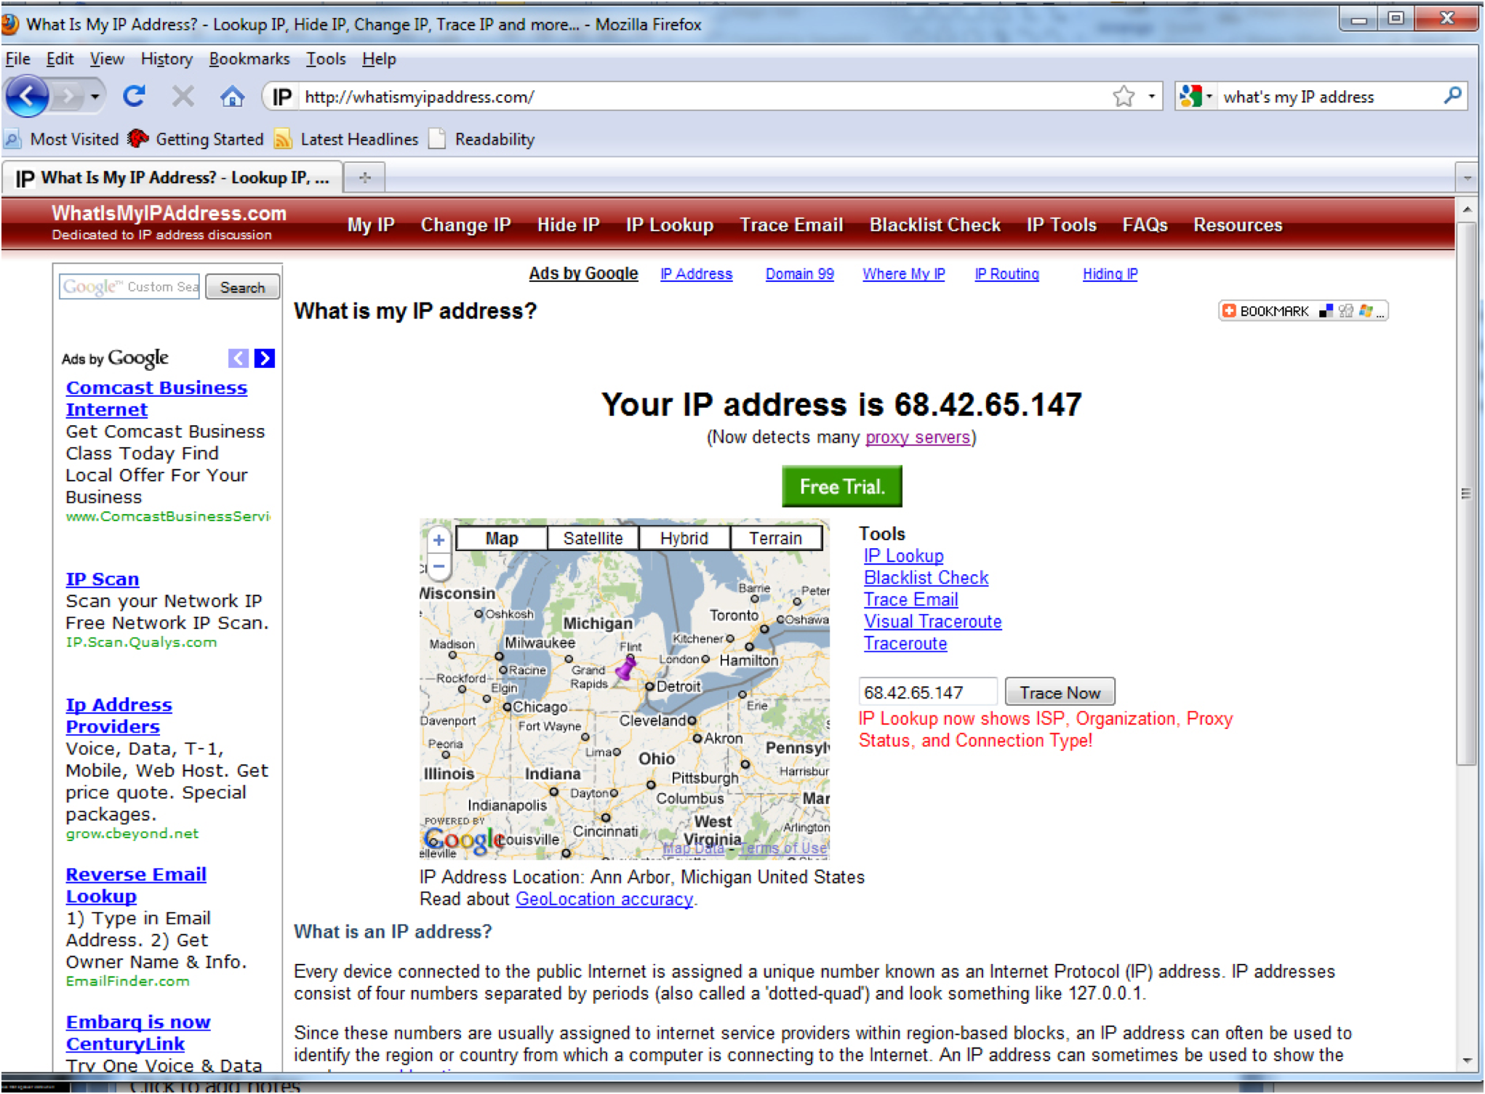

Slide 27
IP Address Format
Four numbers with dots - each number 1-255 (32 bits)
Kind of like phone numbers with an “area code”
The prefix of the address is “which network”
While the data is traversing the Internet - all that matters is the network number
(734) 764 1855
141.211.144.188
141.211.*.*
Network
Number
Area code

Slide 28

While in the network, all that matters is the Network number.
67.149.102.75
141.211.144.188
To: 67.149.*.*
67.149.*.*
To: 67.149.94.33
To: 67.149.94.33
67.149.94.33
Clipart: http://www.clker.com/search/networksym/1

Slide 29
No single router knows the whole network - just which way to send data to get it “closer”
67.149.102.75
141.211.144.188
To: 67.149.*.*
?
?
67.149.*.*
67.149.94.33
Clipart: http://www.clker.com/search/networksym/1

Slide 30
Router Tables
To: 67.149.*.*
?
Lists of where to send packets, based on
destination network address;
bandwidth on adjacent links;
traffic on adjacent links;
state of neighbor nodes (up or not);
. . .
Updated dynamically
Routers “ask each other” for information
?
Clipart: http://www.clker.com/search/networksym/1

Slide 31
IP Is Simple
Thousands of
network connections.
Billions of bytes of data per seconds.
Local
Network
67.149.*.*
Thousands of
user systems
One “area code” to keep track of inside the Internet.
100’s of servers
Clipart: http://www.clker.com/search/networksym/1

Slide 32
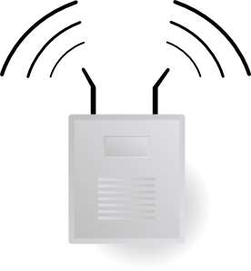
DHCP = Dynamic Host Configuration Protocol
Hello?
Here I am
What IP Address can I use?
141.26.14.1-100
141.26.14.1
Use 141.26.14.7
Notes:
Number is assigned using yet another internet protocol: DHCP (dynamic host configuration protocol)
Also used by your ISP (internet service provider), as well as in many LANS—”stretches” the number of IP addresses available

Slide 33
Non-Routable Addresses
A typical home router does Network Address Translation (NAT)
Your ISP gives your home router a real global routable address
Your router gives out local addresses in a special range (192.168.*.*)
The router maps remote addresses for each connection you make from within your home network
http://en.wikipedia.org/wiki/Network_address_translation

Slide 34



141.206.14.3
192.168.0.20
192.168.0.1
192.168.0.104
192.168.0.1
35.8.2.10
192.168.0.20
192.168.0.1
173.44.26.18
NAT = Network Address Translation
Clipart: http://www.clker.com/search/networksym/1
Notes:
Number is assigned using yet another internet protocol: DHCP (dynamic host configuration protocol)
Also used by your ISP (internet service provider), as well as in many LANS—”stretches” the number of IP addresses available

Slide 35
http://xkcd.com/742/

Slide 36
Peering into the Internet
Most systems have a command that will reveal the route taken across the internet (traceroute on Mac and tracert on Windows)
Each IP packet has a field called “Time to Live” - TTL
The TTL is used to deal with loops in the network - normally if routers got confused and ended up with a loop - the network would clog up rapidly.
To: 67.149.*.*
Clipart: http://www.clker.com/search/networksym/1
Notes:
Usually we treat the internet as an abstraction or “black box”, but if we want to, we can peer into the internet to see how the packets move from one location to another—what is the path of hops?
While every router has on average some wrong information, there are some mistakes that cause huge problem: one is the existence of loops.
Note that the loops could be much longer than 3—could be 25 or 30 hops long.

Slide 37
How Traceroute Works
Normal packets are sent with a Time to Live (TTL) of 255 hops
Trace route sends a packet with TTL=1, TTL=2, ...
So each packet gets part-way there and then gets dropped and traceroute gets a notification of where the drop happens
This builds a map of the nodes that a packet visits when crossing the Internet.
Notes:
Because of the risks associated with Traceroute, some networks will configure to block traceroute requests..
Tracert can potentially be used by hackers to obtain sensitive information about network architecture. Anyone can use it to figure out how packets are getting routed.

Slide 38
Traceroute
$ traceroute www.stanford.edu
traceroute to www5.stanford.edu (171.67.20.37), 64 hops max, 40 byte packets
1 141.211.203.252 (141.211.203.252) 1.390 ms 0.534 ms 0.490 ms
2 v-bin-seb.r-bin-seb.umnet.umich.edu (192.122.183.61) 0.591 ms 0.558 ms 0.570 ms
3 v-bin-seb-i2-aa.merit-aa2.umnet.umich.edu (192.12.80.33) 6.610 ms 6.545 ms 6.654 ms
4 192.122.183.30 (192.122.183.30) 7.919 ms 7.209 ms 7.122 ms
5 so-4-3-0.0.rtr.kans.net.internet2.edu (64.57.28.36) 17.672 ms 17.836 ms 17.673 ms
6 so-0-1-0.0.rtr.hous.net.internet2.edu (64.57.28.57) 31.800 ms 41.967 ms 31.787 ms
7 so-3-0-0.0.rtr.losa.net.internet2.edu (64.57.28.44) 63.478 ms 63.704 ms 63.710 ms
8 hpr-lax-hpr--i2-newnet.cenic.net (137.164.26.132) 63.093 ms 63.026 ms 63.384 ms
9 svl-hpr--lax-hpr-10ge.cenic.net (137.164.25.13) 71.242 ms 71.542 ms 76.282 ms
10 oak-hpr--svl-hpr-10ge.cenic.net (137.164.25.9) 72.744 ms 72.243 ms 72.556 ms
11 hpr-stan-ge--oak-hpr.cenic.net (137.164.27.158) 73.763 ms 73.396 ms 73.665 ms
12 bbra-rtr.Stanford.EDU (171.64.1.134) 73.577 ms 73.682 ms 73.492 ms
13 * * *
14 www5.Stanford.EDU (171.67.20.37) 77.317 ms 77.128 ms 77.648 ms
Notes:
Note that the postcard back tells both the location and the amount of time it took to get there and back.
Each line reports an attempt to send packets that many hops away.
Shows the times for 3 attempts (so you can get a better picture, smoothing over problems). If the numbers are very different from one another, it means there’s a lot of traffice.
1.4 ms for first hop (about 1 one thousandth). For all 14 hops, 78 ms (almost a tenth of a second)
* * * is from a router that is configured not to return a postcard.

Slide 39
Traceroute
$ traceroute www.msu.edu
traceroute to www.msu.edu (35.8.10.30), 64 hops max, 40 byte packets
1 141.211.203.252 (141.211.203.252) 2.644 ms 0.973 ms 14.162 ms
2 v-bin-seb.r-bin-seb.umnet.umich.edu (192.122.183.61) 1.847 ms 0.561 ms 0.496 ms
3 v-bin-seb-i2-aa.merit-aa2.umnet.umich.edu (192.12.80.33) 6.490 ms 6.499 ms 6.529 ms
4 lt-0-3-0x1.eq-chi2.mich.net (198.108.23.121) 8.096 ms 8.113 ms 8.103 ms
5 xe-0-0-0x23.msu6.mich.net (198.108.23.213) 7.831 ms 7.962 ms 7.965 ms
6 192.122.183.227 (192.122.183.227) 12.953 ms 12.339 ms 10.322 ms
7 cc-t1-ge1-23.net.msu.edu (35.9.101.209) 9.522 ms 9.406 ms 9.817 ms
8 * * *
Notes:
Here we’re going to Michigan state. Takes about 10 ms—a hundredth of a second.
Routers are very fast!

Slide 40
Traceroute
$ traceroute www.pku.edu.cn
traceroute: Warning: www.pku.edu.cn has multiple addresses; using 162.105.129.104
traceroute to www.pku.edu.cn (162.105.129.104), 64 hops max, 40 byte packets
1 141.211.203.252 (141.211.203.252) 1.228 ms 0.584 ms 0.592 ms
2 v-bin-seb.r-bin-seb.umnet.umich.edu (192.122.183.61) 0.604 ms 0.565 ms 0.466 ms
3 v-bin-seb-i2-aa.merit-aa2.umnet.umich.edu (192.12.80.33) 7.511 ms 6.641 ms 6.588 ms
4 192.122.183.30 (192.122.183.30) 12.078 ms 6.989 ms 7.619 ms
5 192.31.99.133 (192.31.99.133) 7.666 ms 8.953 ms 17.861 ms
6 192.31.99.170 (192.31.99.170) 59.275 ms 59.273 ms 59.108 ms
7 134.75.108.209 (134.75.108.209) 173.614 ms 173.552 ms 173.333 ms
8 134.75.107.10 (134.75.107.10) 256.760 ms 134.75.107.18 (134.75.107.18) 256.574 ms 256.530
9 202.112.53.17 (202.112.53.17) 256.761 ms 256.801 ms 256.688 ms
10 202.112.61.157 (202.112.61.157) 257.416 ms 257.960 ms 257.747 ms
11 202.112.53.194 (202.112.53.194) 256.827 ms 257.068 ms 256.962 ms
12 202.112.41.202 (202.112.41.202) 256.800 ms 257.053 ms 256.933 ms
Michigan
Tennessee
Seoul
Beijing
Notes:
Now takes a fifth of a second overall

Slide 41
The perfect is the enemy of the good
Le mieux est l'ennemi du bien. --Voltaire
IP Does: Best effort to get data across bunch of hops from one network to another network
IP Does Not: Guarantee delivery - if things go bad - the data can vanish
Best effort to keep track of the good and bad paths for traffic - tries to pick better paths when possible
This makes it fast and scalable to very large networks - and ultimately “reliable” because it does not try to do too much
Notes:
If a router doesn’t know what to do with a piece of data, it throws it away, and assumes that someone else will deal with it.
Part of the argument for this has become know as the "end-to-end" argument. If a feature like reliability or encryption is going to have to be provided anyway from end to end, it's better not to try to provide it on each link in the network. It's not a universal truth. It happens work well for the Internet because the transmission failure rate on each link is very low. If the failure rate on each hop were higher, it would be worth putting more resources into error detection and correction.

Slide 42
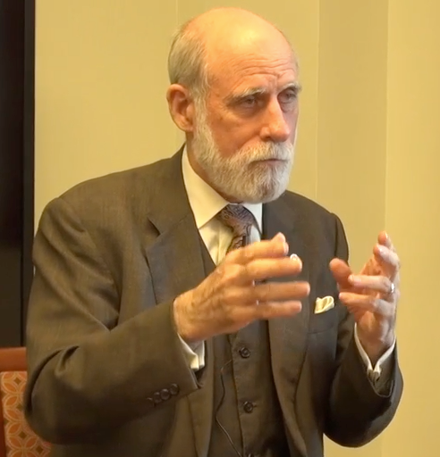
Vint Cerf: A Brief History of Packets
Instrumental in the design and development of the ARPANET
Vint was a graduate student as the notions of packet-switching were emerging across academia

Slide 43
Domain Name System
The Domain Name System convert user-friendly names, like
www.umich.edu
to network-friendly IP addresses, like
141.211.32.166
Source: http://en.wikipedia.org/wiki/Internet_Protocol_Suite

Slide 44
Domain Name System
Numeric addresses like 141.211.63.45 are great for Internet routers but lousy for people
Each campus ends up with a lot of networks (141.211.*.*, 65.43.21.*)
Sometimes (rarely) the IP address numbers get reorganized
When servers physically move they need new IP addresses

Slide 45
DNS: Internet Address Book
The Domain Name System is a big fast distributed database of Internet names to Internet “phone numbers”
IP Addresses reflect technical “geography”
141.211.63.44 - read left to right like a phone number
Domain names reflect organizational structure
www.si.umich.edu - read right to left like postal address
2455 North Quad, Ann Arbor, MI, USA, Earth

Slide 46
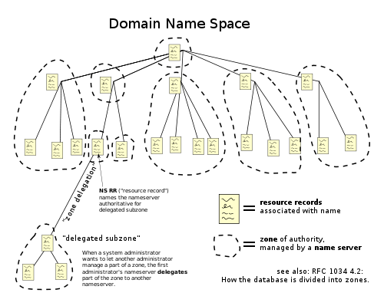
.edu
.com
.org
.nl
umich.edu
si.umich.edu
http://en.wikipedia.org/wiki/File:Domain_name_space.svg

Slide 47
Internetwork Layer
(IP)
Application Layer
Web, E-Mail, File Transfer
Transport Layer (TCP)
Reliable Connections
http://en.wikipedia.org/wiki/Internet_Protocol
http://en.wikipedia.org/wiki/Traceroute
http://en.wikipedia.org/wiki/Ping
Internetwork Layer (IP)
Simple, Scalable, Unreliable
Link Layer (Ethernet, WiFi)
Physical Connections
Notes:
TCP = transmission control protocol
IP = internet protocol
The 7-layer model got bogged down in committee discussions and votes and eventually died. The 4-layer model was crude but effective—less elegant, but it worked! Each level is clearly different from the other.

Slide 48
Transport Layer
Application Layer
Web, E-Mail, File Transfer
Transport Layer (TCP)
Reliable Connections
Internetwork Layer (IP)
Simple, Scalable, Unreliable
http://en.wikipedia.org/wiki/Transmission_Control_Protocol
Link Layer (Ethernet, WiFi)
Physical Connections
Notes:
TCP = transmission control protocol
IP = internet protocol
The 7-layer model got bogged down in committee discussions and votes and eventually died. The 4-layer model was crude but effective—less elegant, but it worked! Each level is clearly different from the other.

Slide 49
Review: The Magic of IP
What it does - Tries to get one packet across a 5-20 of hops from one network to another network
Keeps track of the good and bad paths for traffic - tries to pick better paths when possible
But no guarantee of delivery - if things go bad - the data vanishes
This makes it fast and scalable - and ultimately “reliable” because it does not try to do too "everything"

Slide 50
Internet Protocol
So many links / hops
So many routes
Things can change dynamically and IP has to react (links up/down)
IP can drop packets
Source: http://en.wikipedia.org/wiki/Internet_Protocol_Suite

Slide 51
Tramsmission Protocol (TCP)
Built on top of IP
Assumes IP might lose some data
In case data gets lost - we keep a copy of the data a we send until we get an acknowledgement
If it takes “too long” - just send it again
Source: http://en.wikipedia.org/wiki/Internet_Protocol_Suite

Slide 52
Sender
Receiver
100
200
300
400
500
Break Messages into Pieces

Slide 53
Sender
Receiver
100
100
200
200
300
300
400
500
Break Messages into Pieces

Slide 54

Got 100
Where is 200
Sender
Receiver
100
100
200
300
300
400
500
Break Messages into Pieces

Slide 55
Got 200
Sender
Receiver
100
100
200
200
300
300
400
400
500
Break Messages into Pieces

Slide 56
Got 400
Sender
Receiver
100
200
300
300
400
400
500
500
Break Messages into Pieces

Slide 57
Got 500
Sender
Receiver
100
200
300
400
400
500
500
Break Messages into Pieces

Slide 58
Sender
Receiver
100
200
300
400
500
Break Messages into Pieces

Slide 59
Billions of computers connected to the internet; 100 thousands of routers. Hundreds of billions bytes of data enroute at any moment.
Storage of enroute data done at the edges only!
Clipart: http://www.clker.com/search/networksym/1

Slide 60
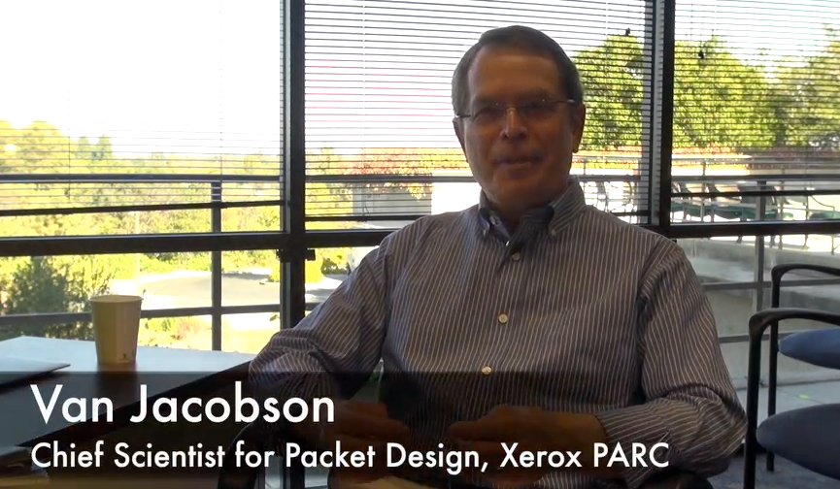
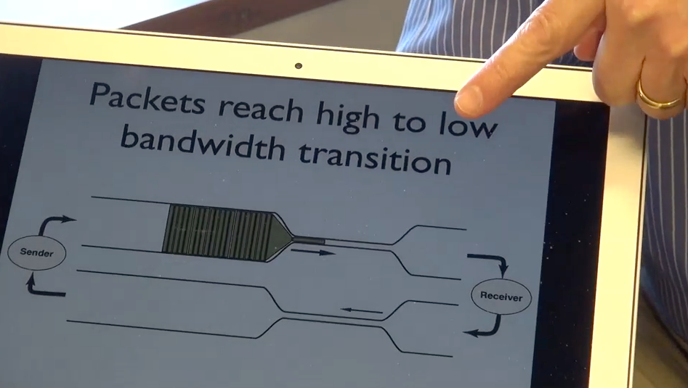
One (of many) Scary Problem(s)
In 1987 as local campuses with 10 MBit networks were connected together using 56Kbit leased lines, things kind of fell apart
At some point, when there was a little too much traffic, it all fell apart...
http://www.youtube.com/watch?v=1Vg1MeRYmWI
http://en.wikipedia.org/wiki/Van_Jacobson
http://en.wikipedia.org/wiki/TCP_congestion_avoidance_algorithm

Slide 61
Transmission Protocol (TCP)
The responsibility of the transport layer is to present a reliable end-to-end pipe to the application
Data either arrives in the proper order or the connection is closed
TCP keeps buffers in the sending and destination system to keep data which has arrived out of order or to retransmit if necessary
TCP provides individual connections between applications

Slide 63
Application Layer
Application Layer
Web, E-Mail, File Transfer
Transport Layer (TCP)
Reliable Connections
Internetwork Layer (IP)
Simple, Unreliable
Link Layer (Ethernet, WiFi)
Physical Connections

Slide 64
Quick Review
Link layer: gets the data onto the link, and manages collisions on a single hop
Internet layer: moves the data over one hop, trying to get it “closer” to its destination
Transport layer: Assumes that the internet layer may lose data, so request retransmission when needed—provides a nice reliable pipe from source to destination
Source: http://en.wikipedia.org/wiki/Internet_Protocol_Suite

Slide 65
Application Protocol
Since TCP gives us a reliable pipe, what to we want to do with the pipe? What problem do we want to solve?
Mail
World Wide Web
Stream kitty videos
Source: http://en.wikipedia.org/wiki/Internet_Protocol_Suite

Slide 66
Two Questions for the Application Layer
Which application gets the data?
Ports
What are the rules for talking with that application?
Protocols
http://en.wikipedia.org/wiki/TCP_and_UDP_port
http://en.wikipedia.org/wiki/List_of_TCP_and_UDP_port_numbers

Slide 67
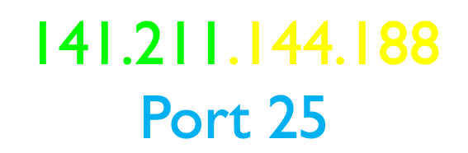

Ports
Like extensions in a phone number
The IP address network number (the area code) gets to the LAN
The IP address host number (the telephone number) gets you to the destination machine
The port (the extension) gets you to a specific application

Slide 68
TCP, Ports, and Connections
http://en.wikipedia.org/wiki/TCP_and_UDP_port
http://en.wikipedia.org/wiki/List_of_TCP_and_UDP_port_numbers

Slide 69
www.umich.edu
Incoming
E-Mail
25
Login
23
blah blah blah blah
80
74.208.28.177
Web Server
443
Personal
Mail Box
109
Please connect me to the secure web server (port 443) on http://www.dr-chuck.com
110
Clipart: http://www.clker.com/search/networksym/1

Slide 70
Common TCP Ports
Telnet (23) - Login
SSH (22) - Secure Login
HTTP (80)
HTTPS (443) - Secure
SMTP (25) (Mail)
IMAP (143/220/993) - Mail Retrieval
POP (109/110) - Mail Retrieval
DNS (53) - Domain Name
FTP (21) - File Transfer
http://en.wikipedia.org/wiki/List_of_TCP_and_UDP_port_numbers

Slide 71
Application Protocols
http://en.wikipedia.org/wiki/Http
http://en.wikipedia.org/wiki/Pop3

Slide 72
Application Protocol
Since TCP gives us a reliable pipe, what to we want to do with the pipe? What problem do we want to solve?
Mail
World Wide Web
Stream kitty videos
Source: http://en.wikipedia.org/wiki/Internet_Protocol_Suite

Slide 73
HTTP - Hypertext Transport Protocol
The dominant Application Layer Protocol on the Internet
Invented for the Web - to Retrieve HTML, Images, Documents etc
Extended to be data in addition to documents - RSS, Web Services, etc..
Basic Concept - Make a Connection - Request a document - Retrieve the Document - Close the Connection
http://en.wikipedia.org/wiki/Http

Slide 74
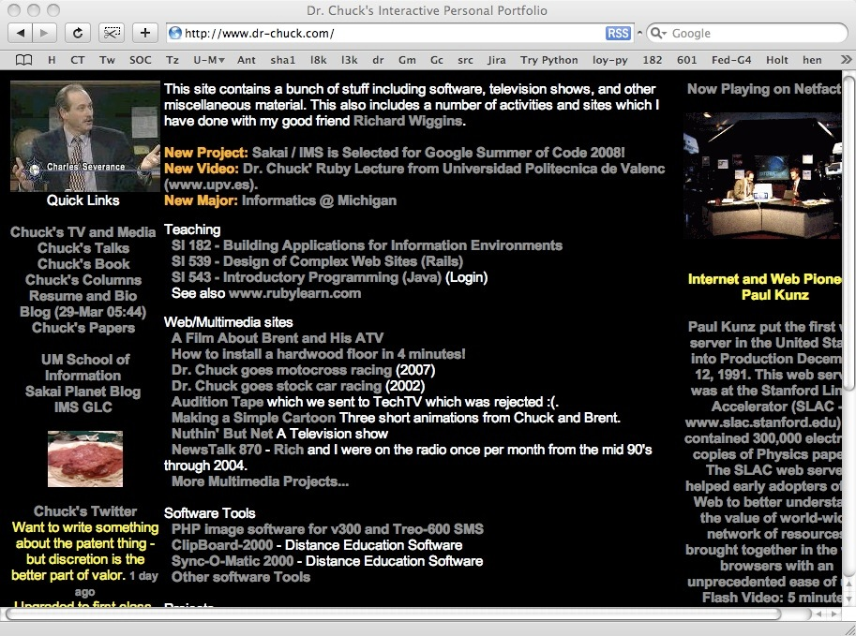

HTTP Request / Response Cycle
Web Server
HTTP
Request
HTTP
Response
Browser
Internet Explorer, FireFox, Safari, etc.
http://www.oreilly.com/openbook/cgi/ch04_02.html
Source: http://www.dr-chuck.com/

Slide 75
HTTP Request / Response Cycle
Web Server
<head> .. </head>
<body>
<h1>Welcome to my
application</h1>
....
</body>
HTTP
Request
HTTP
Response
GET /page2.html
Browser
Internet Explorer, FireFox, Safari, etc.
http://www.oreilly.com/openbook/cgi/ch04_02.html
Source: http://www.dr-chuck.com/

Slide 76
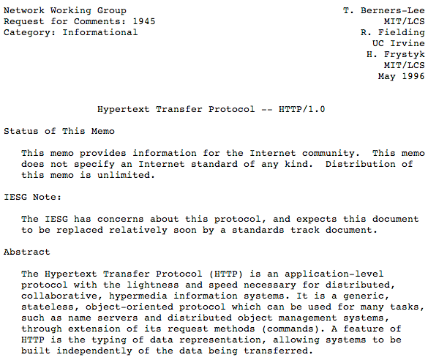
Internet Standards
The standards for all of the Internet protocols (inner workings) are developed by an organization
Internet Engineering Task Force (IETF)
www.ietf.org
Standards are called “RFCs” - “Request for Comments”
Source: http://www.ietf.org/rfc/rfc1945.txt

Slide 77
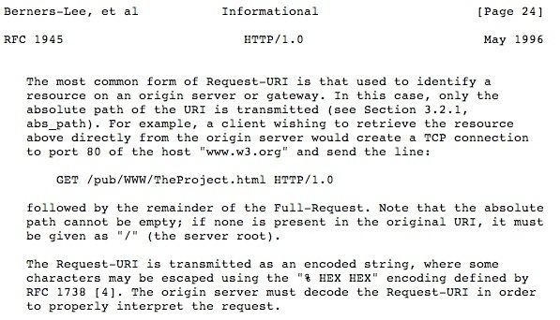
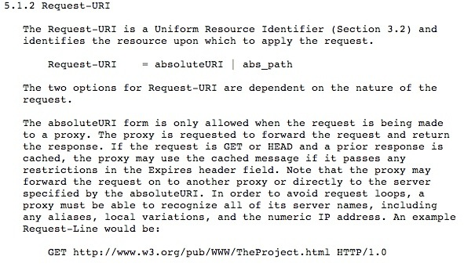

Slide 78
Source: http://www.ietf.org/rfc/rfc1945.txt

Slide 79
“Hacking” HTTP
Web Server
Last login: Wed Oct 10 04:20:19 on ttyp2
si-csev-mbp:~ csev$ telnet www.dr-chuck.com 80
Trying 74.208.28.177...
Connected to www.dr-chuck.com.
Escape character is '^]'.
GET http://www.dr-chuck.com/page1.htm
<h1>The First Page</h1>
<p>
If you like, you can switch to the
<a href="http://www.dr-chuck.com/page2.htm">
Second Page</a>.
</p>
HTTP
Request
HTTP
Response
Browser
Port 80 is the non-encrypted HTTP port

Slide 80

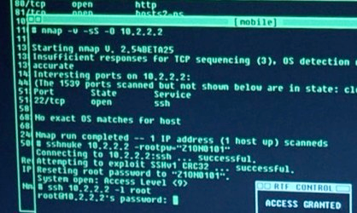
Accurate Hacking in the Movies
Matrix Reloaded
Bourne Ultimatum
Die Hard 4
...
http://nmap.org/movies.html (scroll down for video)
Or search YouTube for "Trinity hacking scene"

Slide 81
http://nmap.org/movies.html (scroll down for video)
Or search YouTube for "Trinity hacking scene"

Slide 82
Application Layer Summary
We start with a “pipe” abstraction - we can send and receive data on the same “socket”
We can optionally add a security layer to TCP using SSL - Secure Socket Layer (aka TLS - Transport Layer Security)
We use well known “port numbers” so that applications can find a particular application *within* a server such as a mail server, web service, etc

Slide 83
The Architecture of the Internet
Application Layer
Web, E-Mail, File Transfer
Transport Layer (TCP)
Reliable Connections
Internetwork Layer (IP)
Simple, Unreliable
August 1972
Link Layer (Ethernet, WiFi)
Physical Connections

Slide 84
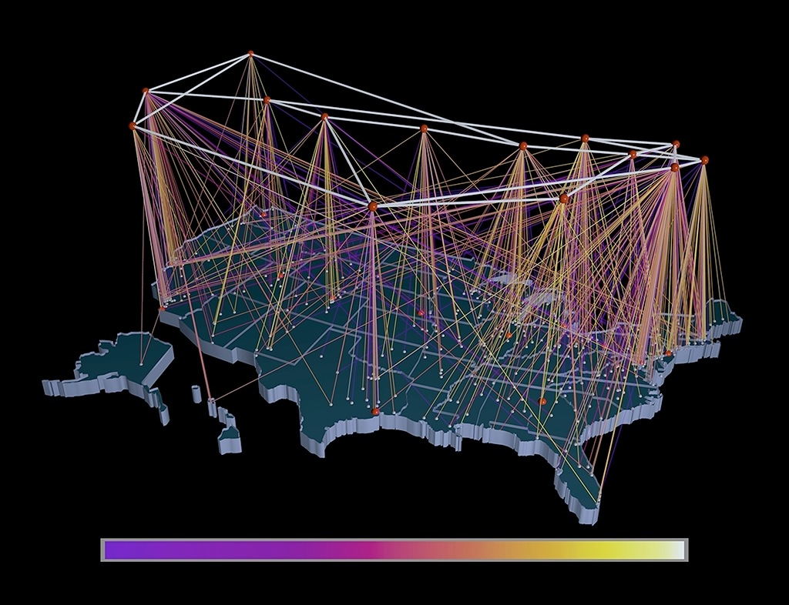
The Architecture of the Internet
Application Layer
Web, E-Mail, File Transfer
Transport Layer (TCP)
Reliable Connections
Internetwork Layer (IP)
Simple, Unreliable
Link Layer (Ethernet, WiFi)
Physical Connections

Slide 85
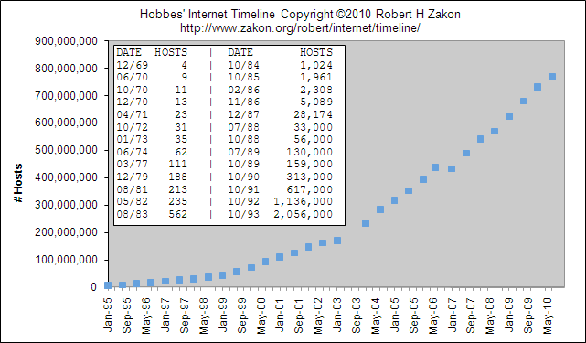
Application Layer
Web, E-Mail, File Transfer
Transport Layer (TCP)
Reliable Connections
Internetwork Layer (IP)
Simple, Unreliable
Link Layer (Ethernet, WiFi)
Physical Connections
http://www.zakon.org/robert/internet/timeline/

Slide 86
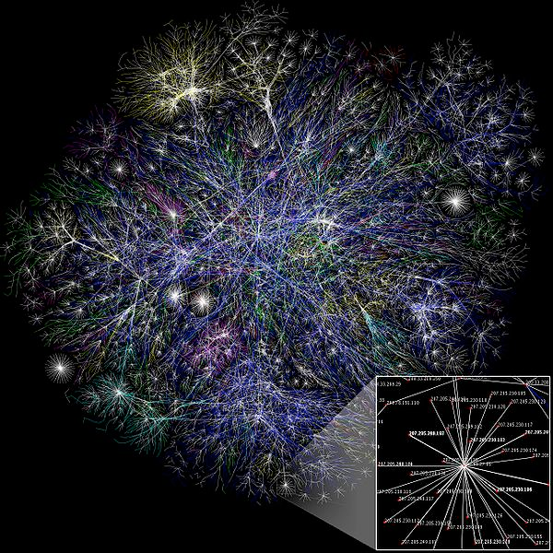
Application Layer
Web, E-Mail, File Transfer
Transport Layer (TCP)
Reliable Connections
Internetwork Layer (IP)
Simple, Unreliable
Link Layer (Ethernet, WiFi)
Physical Connections
http://en.wikipedia.org/wiki/File:Internet_map_1024.jpg

Slide 87
The Internet: An Amazing Design
Hundreds of millions of computers
Thousands of routers inside the Internet
Hundreds of millions of simultaneous connections
Trillions of bytes of data moved per second around the world
And it works

Slide 88
The Internet
It is said that “The Internet is the largest single engineering effort ever created by mankind”
It was created to work in an organic way - to repair itself and automatically adjust when parts fail
No one part of the Internet knows all of the Internet (like life)
It is never 100% up - but it seems up all the time

Slide 89
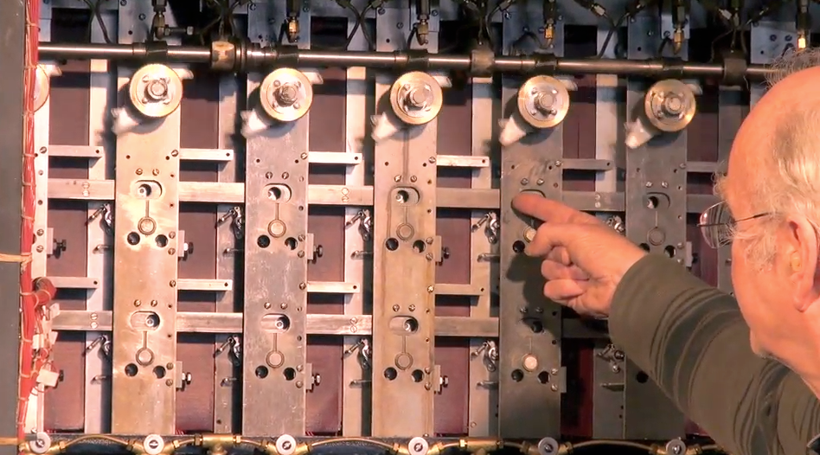
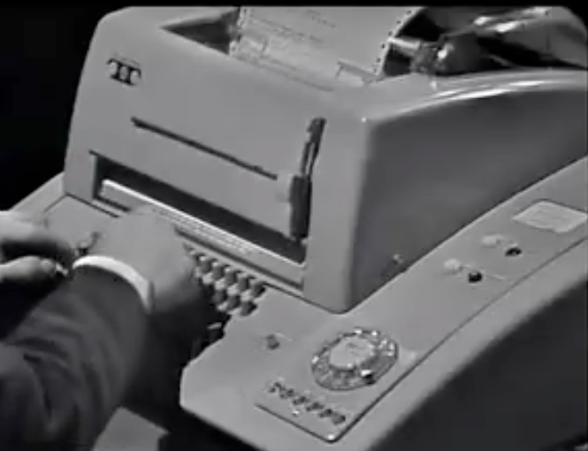

Slide 90
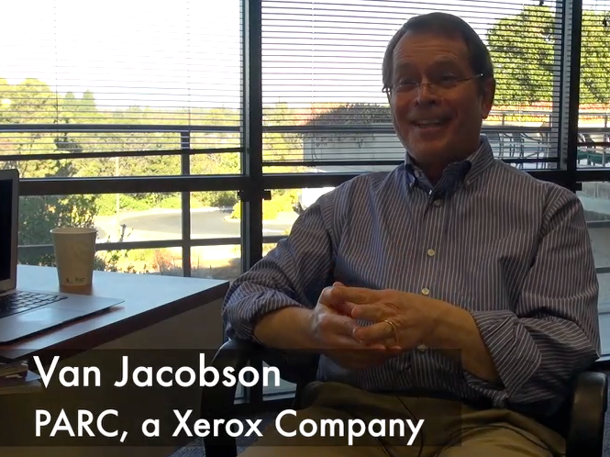
We are not done experimenting...
There is still very active exploration on how network technology can be improved
Content-Centric Networking is only one advanced idea
Routers in the future can have *lots* of memory - lets try not to send the same piece of data more than once

Slide 92
Additional Source Information
xkcd, http://xkcd.com/742/, CC: BY-NC, http://creativecommons.org/licenses/by-nc/2.5/
Internet Protocol Suite Diagrams: Kbrose, Wikimedia Commons, http://upload.wikimedia.org/wikipedia/commons/c/c4/IP_stack_connections.svg, CC:BY-SA, http://creativecommons.org/licenses/by-sa/3.0/deed.en
All your bases are belong to me: Karin Dalziel, Flickr, http://www.flickr.com/photos/nirak/270213335/, CC:BY, http://creativecommons.org/licenses/by/2.0/deed.en
Internet Map: The Opte Project, Wikimedia Commons, http://upload.wikimedia.org/wikipedia/commons/d/d2/Internet_map_1024.jpg, CC:BY, http://creativecommons.org/licenses/by/2.5/deed.en

Slide 93
Reuse of these materials
I intend for these materials to be reusable as open educational resources for those who would do so in a responsible manner
Please contact me if you are interested in reusing or remixing these materials in your own teaching or educational context

