Slide 1


Relational Databases and SQLite
Charles Severance
Python for Everybody
www.py4e.com/lectures3/
Notes:
Note from Chuck. If you are using these materials, you can remove the UM logo and replace it with your own, but please retain the CC-BY logo on the first page as well as retain the acknowledgement page(s) at the end.

Slide 2
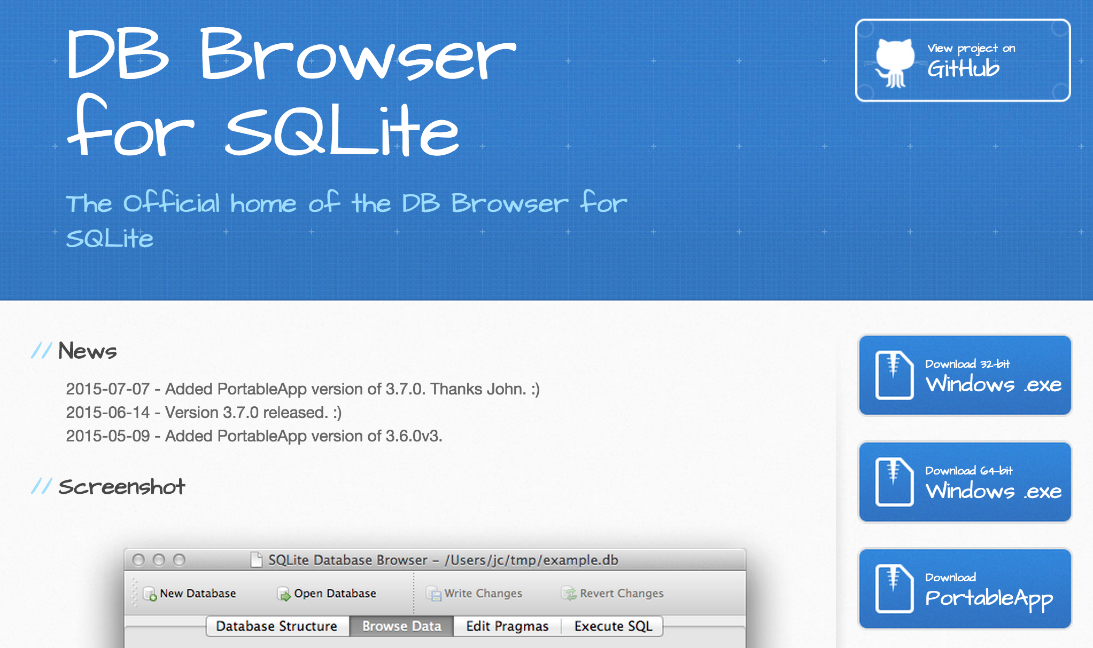
SQLite Browser
http://sqlitebrowser.org/

Slide 3



OLD
Sorted
Sequential
Master
Update
1970s
NEW
Sorted
Merge
Transactions
Sorted
https://en.wikipedia.org/wiki/IBM_729

Slide 4

Random Access
When you can randomly access data...
How can you layout data to be most efficient?
Sorting might not be the best idea
https://en.wikipedia.org/wiki/Hard_disk_drive_platter

Slide 5
Relational Databases
Relational databases model data by storing rows and columns in tables. The power of the relational database lies in its ability to efficiently retrieve data from those tables and in particular where there are multiple tables and the relationships between those tables involved in the query.
http://en.wikipedia.org/wiki/Relational_database

Slide 6
Terminology
Database - contains many tables
Relation (or table) - contains tuples and attributes
Tuple (or row) - a set of fields that generally represents an “object” like a person or a music track
Attribute (also column or field) - one of possibly many elements of data corresponding to the object represented by the row

Slide 7
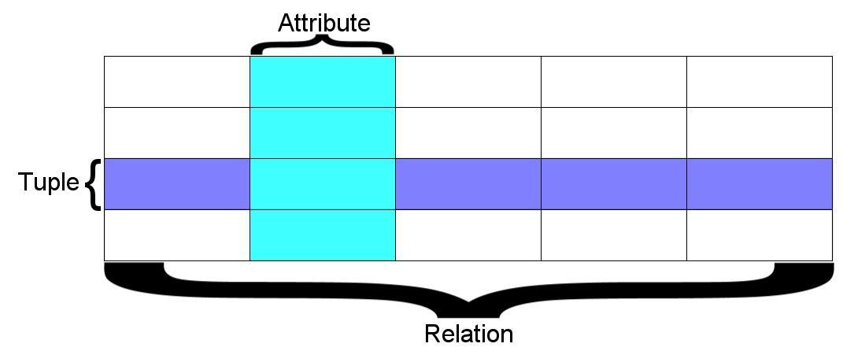
A relation is defined as a set of tuples that have the same attributes. A tuple usually represents an object and information about that object. Objects are typically physical objects or concepts. A relation is usually described as a table, which is organized into rows and columns. All the data referenced by an attribute are in the same domain and conform to the same constraints. (Wikipedia)

Slide 8
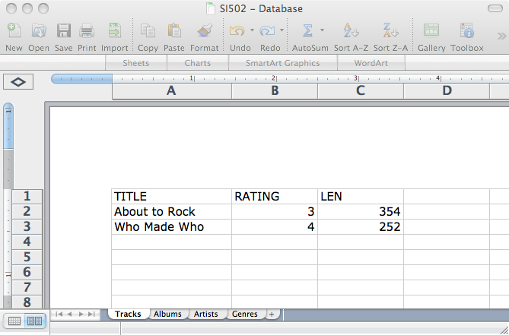
Columns / Attributes
Rows /
Tuples
Tables / Relations

Slide 9
SQL
Structured Query Language is the language we use to issue commands to the database
- Create data (a.k.a Insert)
- Retrieve data
- Update data
- Delete data
http://en.wikipedia.org/wiki/SQL

Slide 10

Input
Files
Python
Programs
Database
File
SQL
R
SQL
Output
Files
Excel
SQLite
Browser
You
D3.js

Slide 11
Web Applications w/ Databases
Application Developer - Builds the logic for the application, the look and feel of the application - monitors the application for problems
Database Administrator - Monitors and adjusts the database as the program runs in production
Often both people participate in the building of the “Data model”

Slide 12
Application
Software
Database
Data Server
End
User
SQL
SQL
Developer
Database
Tools
DBA

Slide 13
Database Administrator
A database administrator (DBA) is a person responsible for the design, implementation, maintenance, and repair of an organization’s database. The role includes the development and design of database strategies, monitoring and improving database performance and capacity, and planning for future expansion requirements. They may also plan, coordinate, and implement security measures to safeguard the database.
http://en.wikipedia.org/wiki/Database_administrator

Slide 14
Database Model
A database model or database schema is the structure or format of a database, described in a formal language supported by the database management system. In other words, a “database model” is the application of a data model when used in conjunction with a database management system.
http://en.wikipedia.org/wiki/Database_model

Slide 15
Common Database Systems
Three major Database Management Systems in wide use
- Oracle - Large, commercial, enterprise-scale, very very tweakable
- MySql - Simpler but very fast and scalable - commercial open source
- SqlServer - Very nice - from Microsoft (also Access)
Many other smaller projects, free and open source
- HSQL, SQLite, Postgres, ...

Slide 16













SQLite is in Lots of Software...
http://www.sqlite.org/famous.html

Slide 17
SQLite Browser
SQLite is a very popular database - it is free and fast and small
SQLite Browser allows us to directly manipulate SQLite files
http://sqlitebrowser.org/
SQLite is embedded in Python and a number of other languages

Slide 18
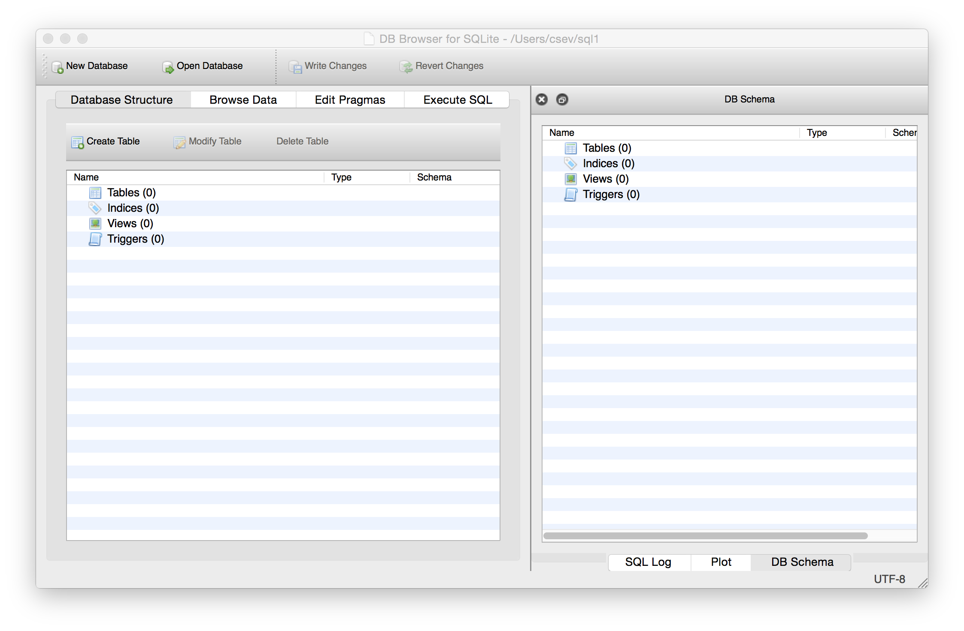
http://sqlitebrowser.org/

Slide 19
Lets Make a Database
https://www.py4e.com/lectures3/Pythonlearn-15-Database-Handout.txt

Slide 20
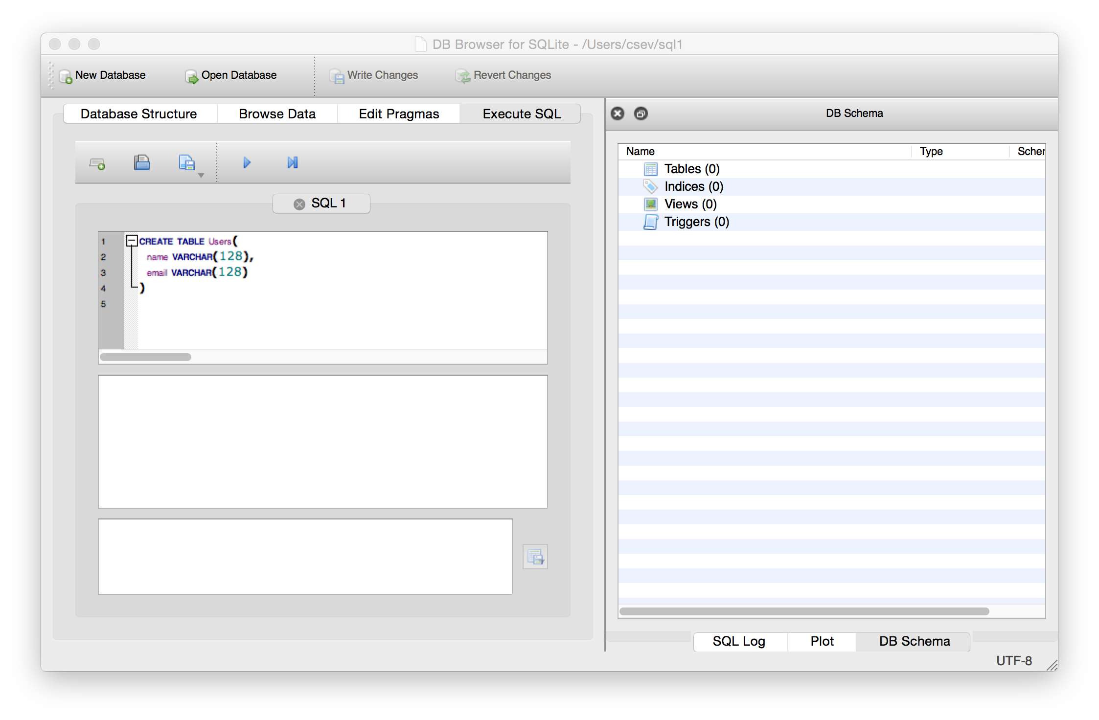
Start Simple - A Single Table
CREATE TABLE Users(
name VARCHAR(128),
email VARCHAR(128)
)

Slide 21
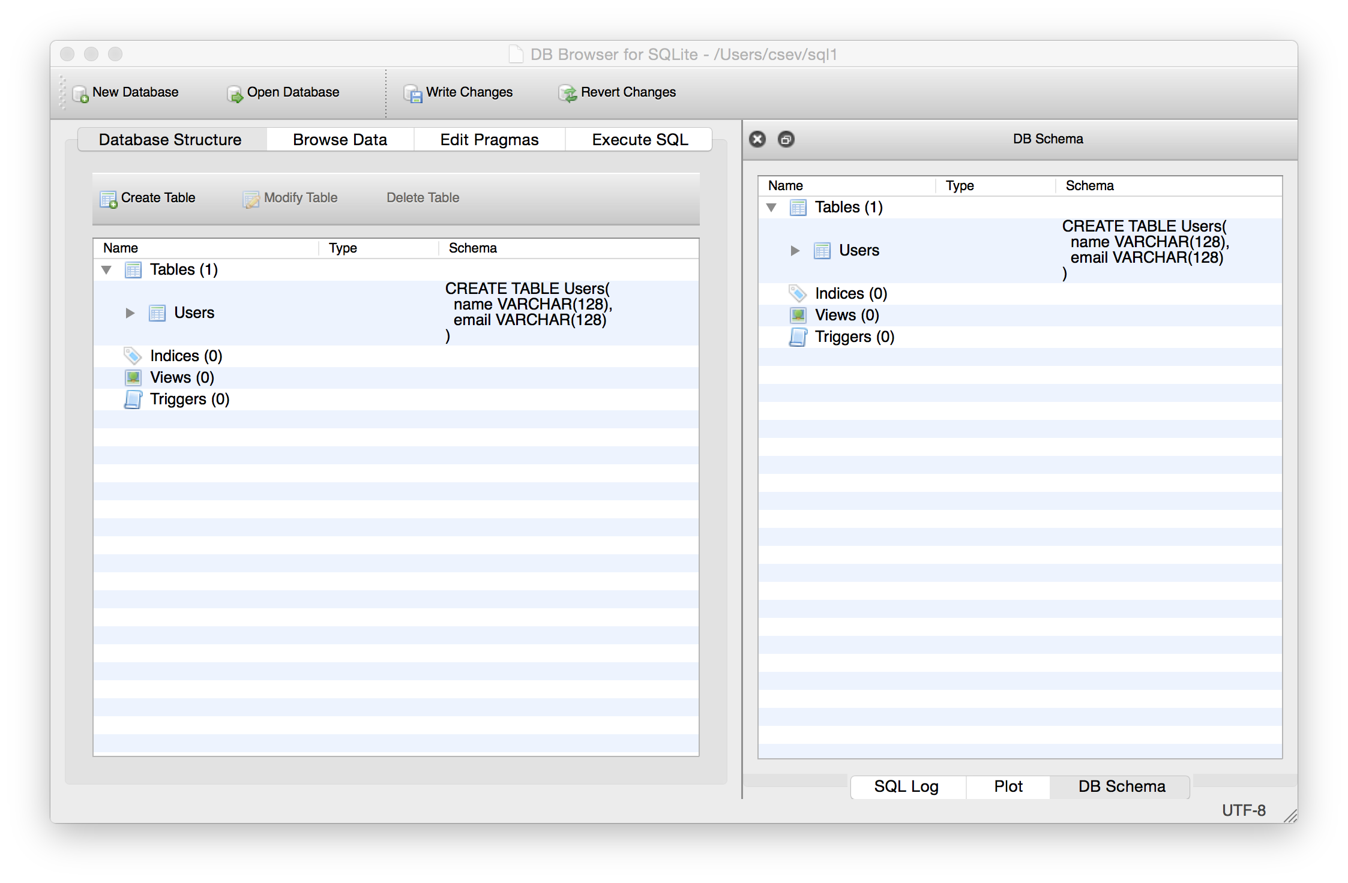

Slide 22
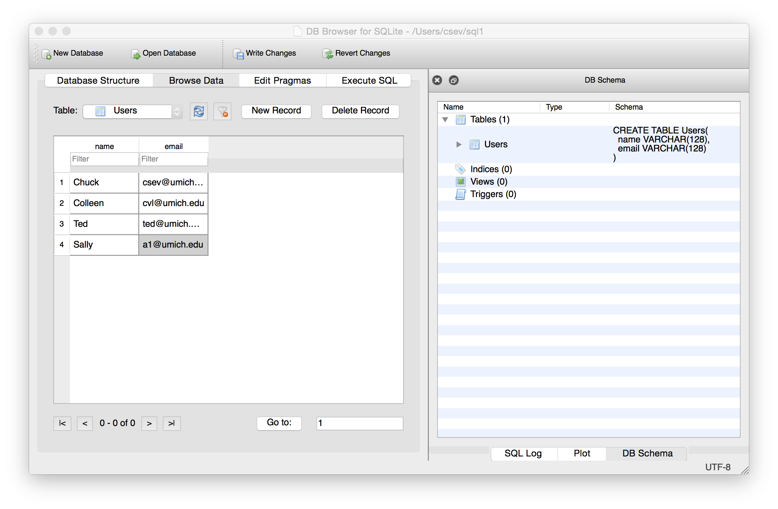
Our table with four rows

Slide 23
SQL
Structured Query Language is the language we use to issue commands to the database
- Create data (a.k.a Insert)
- Retrieve data
- Update data
- Delete data
http://en.wikipedia.org/wiki/SQL

Slide 24
SQL: Insert
The Insert statement inserts a row into a table
INSERT INTO Users (name, email) VALUES ('Kristin', 'kf@umich.edu')

Slide 25
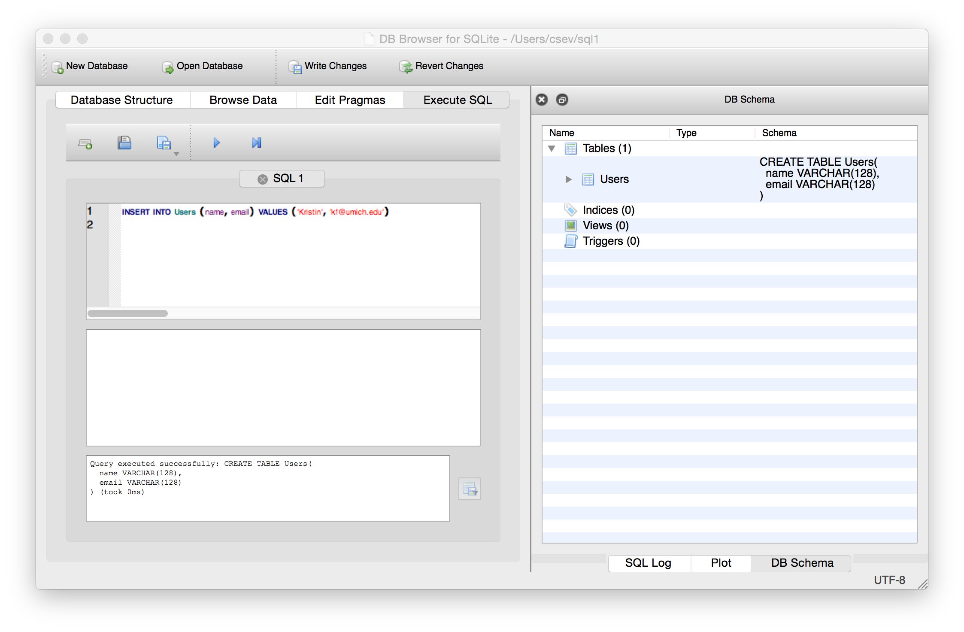

Slide 26
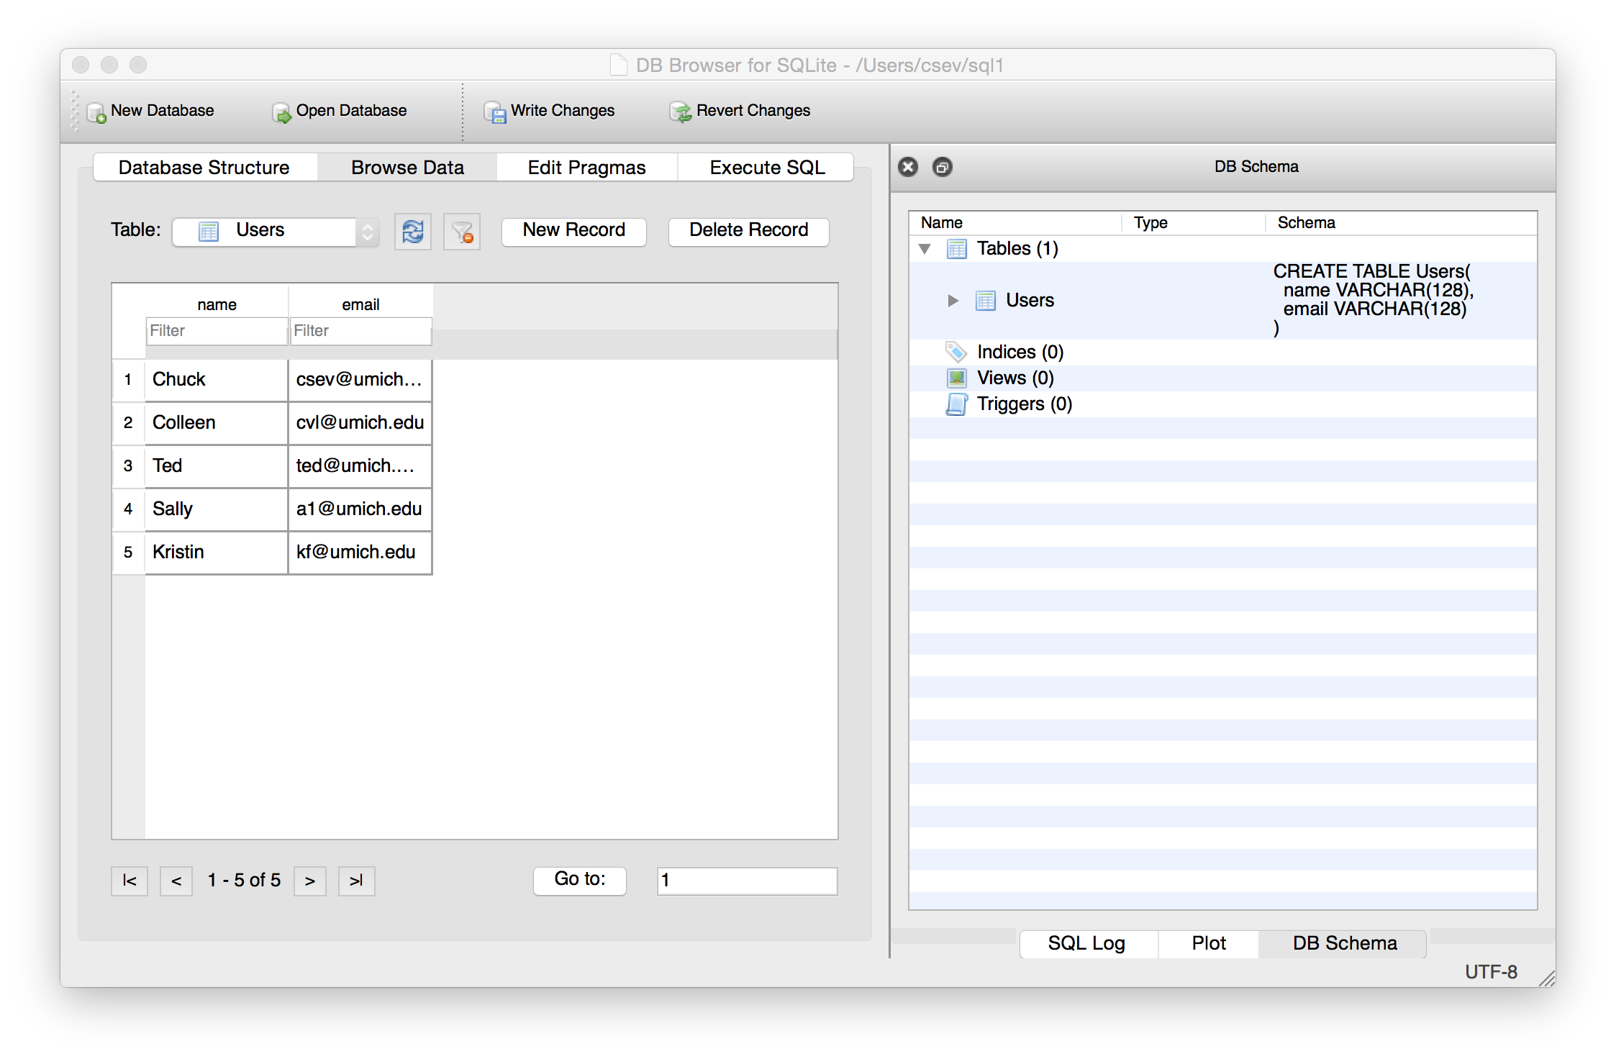

Slide 27
SQL: Delete
Deletes a row in a table based on selection criteria
DELETE FROM Users WHERE email='ted@umich.edu'

Slide 28
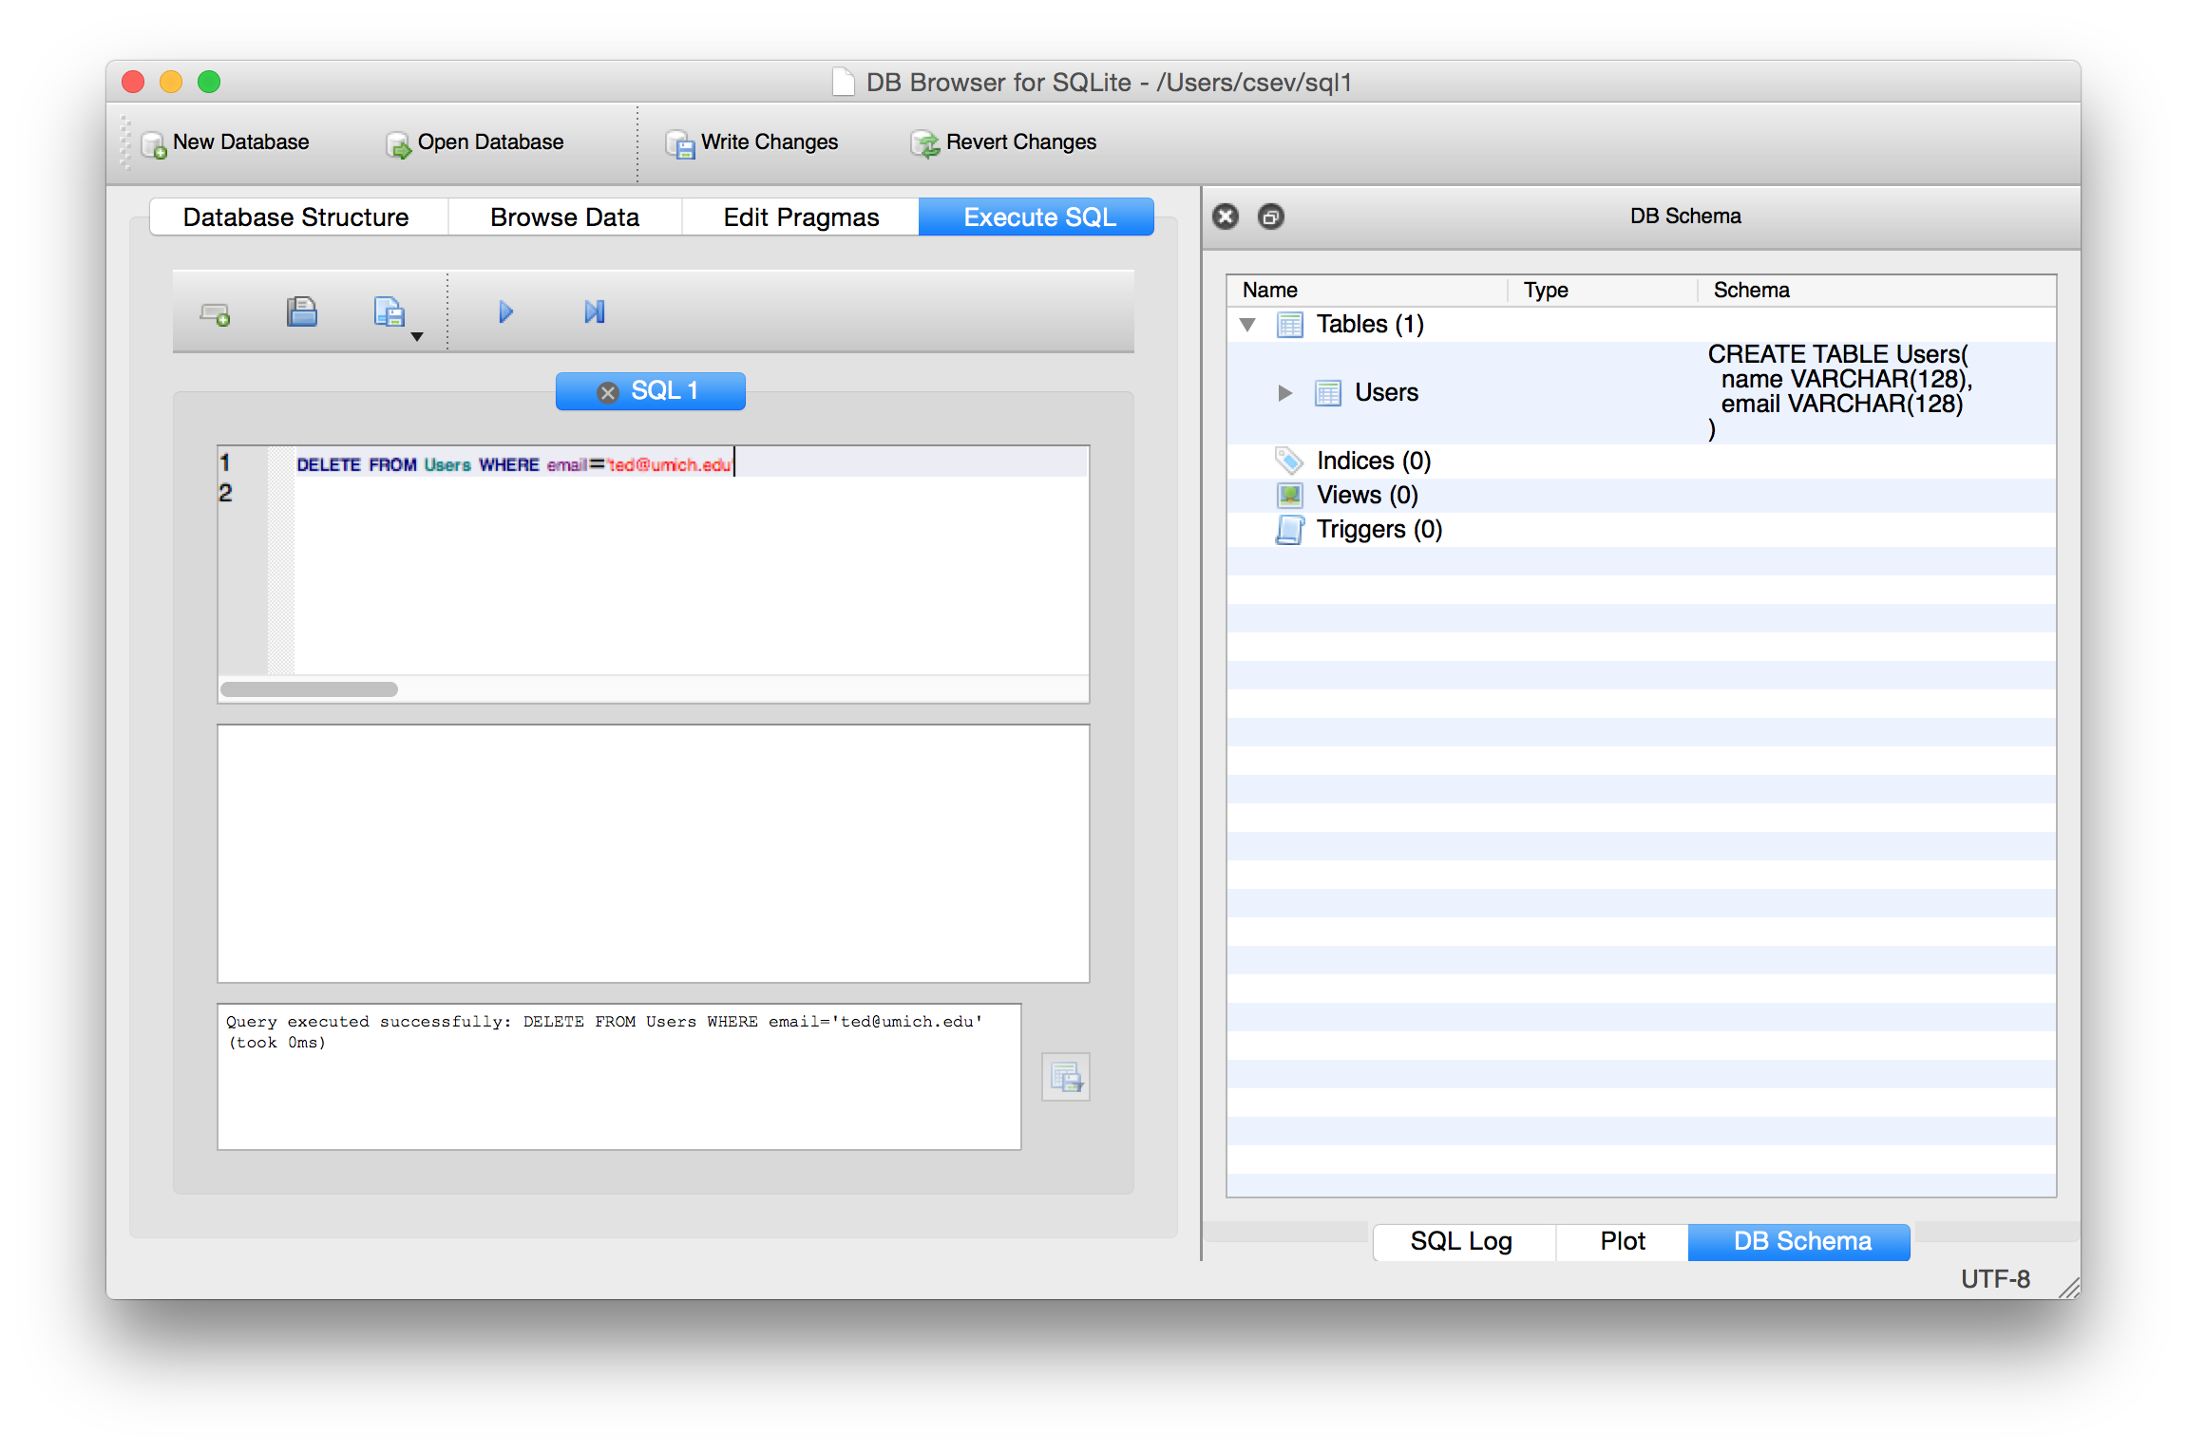

Slide 29
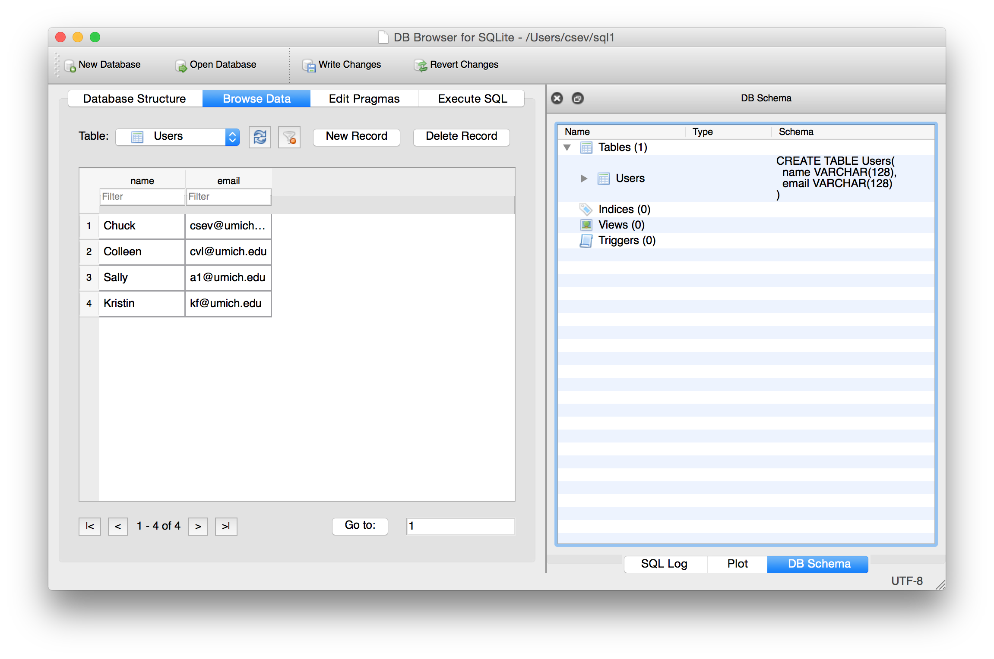

Slide 30
SQL: Update
Allows the updating of a field with a where clause
UPDATE Users SET name='Charles' WHERE email='csev@umich.edu'

Slide 31
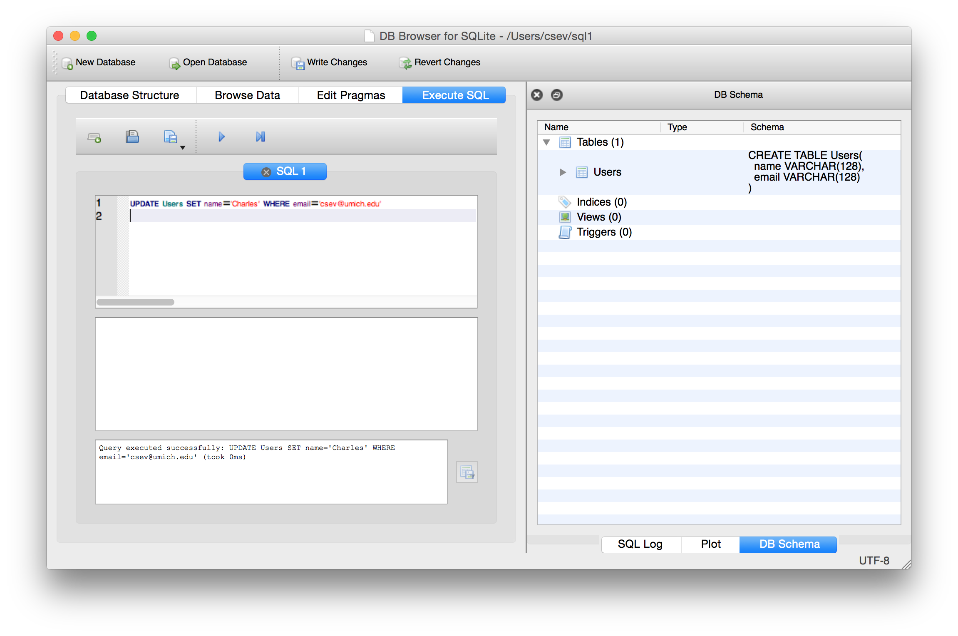

Slide 32


Slide 33
Retrieving Records: Select
The select statement retrieves a group of records - you can either retrieve all the records or a subset of the records with a WHERE clause
SELECT * FROM Users
SELECT * FROM Users WHERE email='csev@umich.edu'

Slide 34
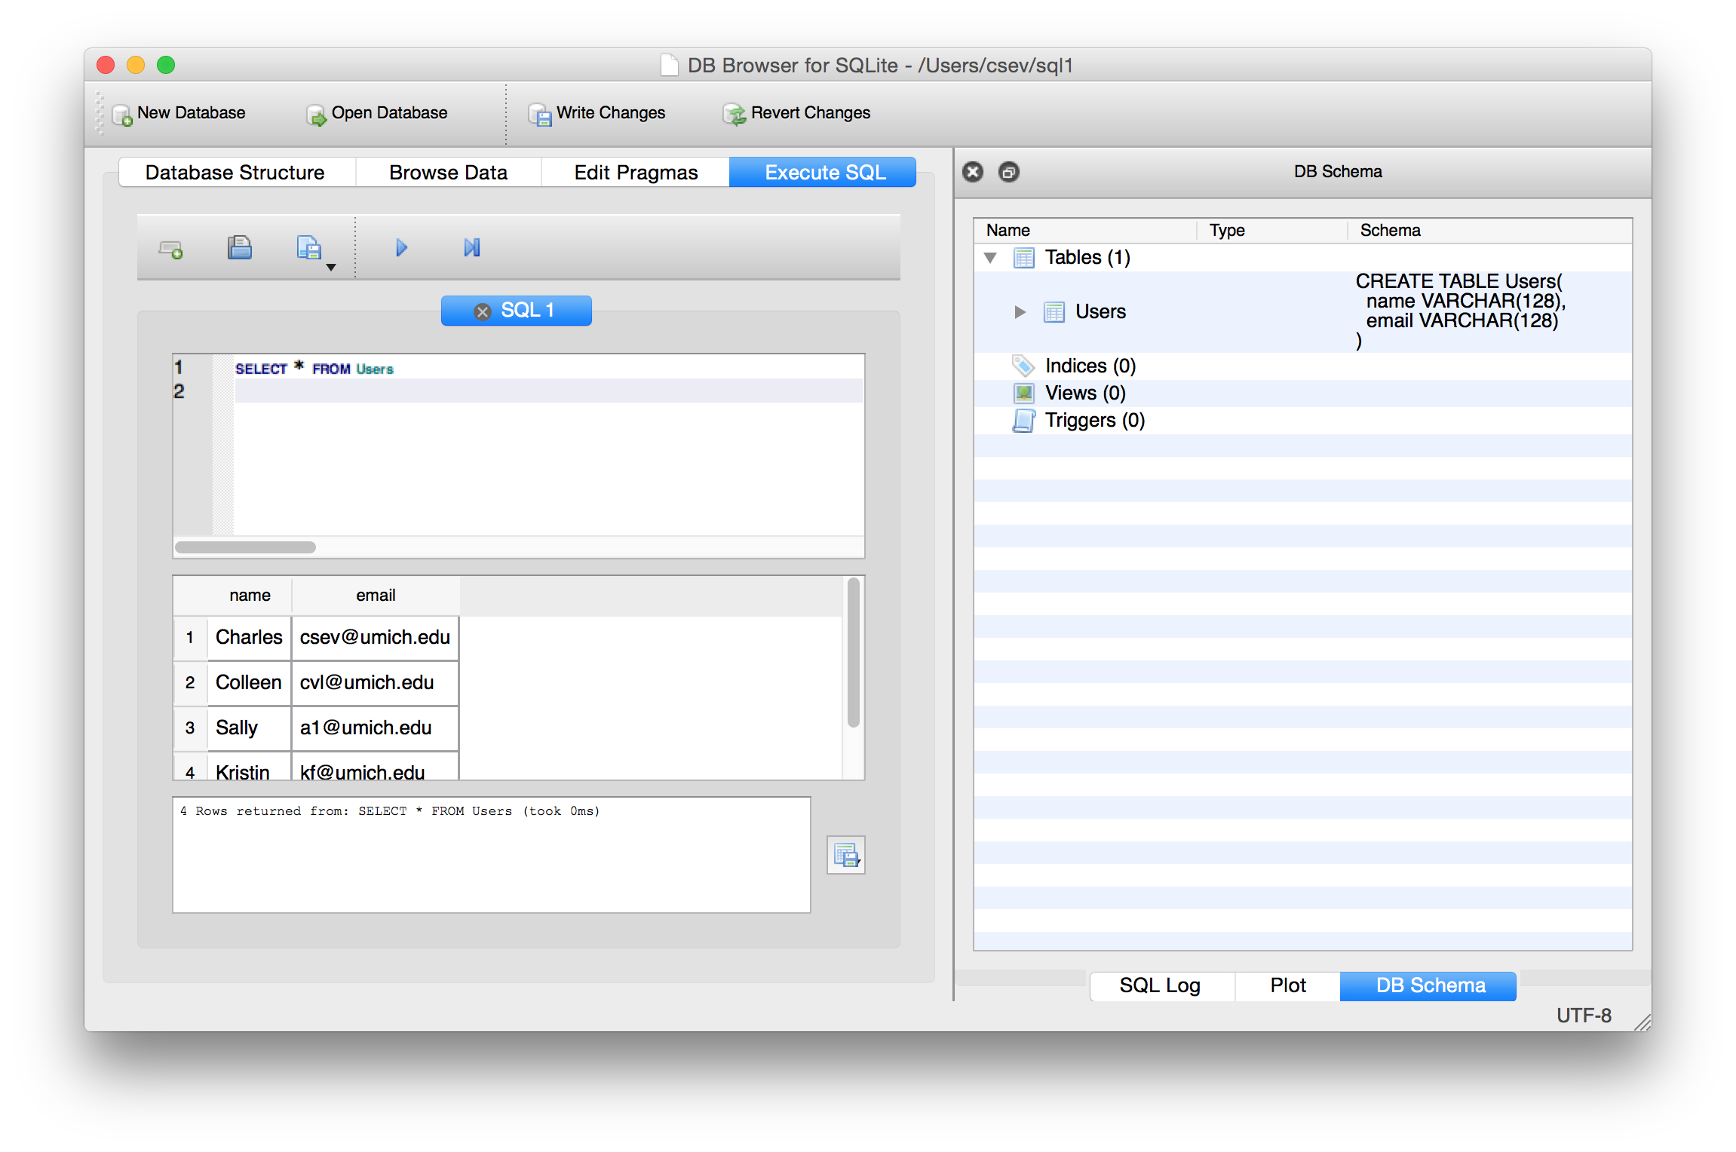

Slide 35
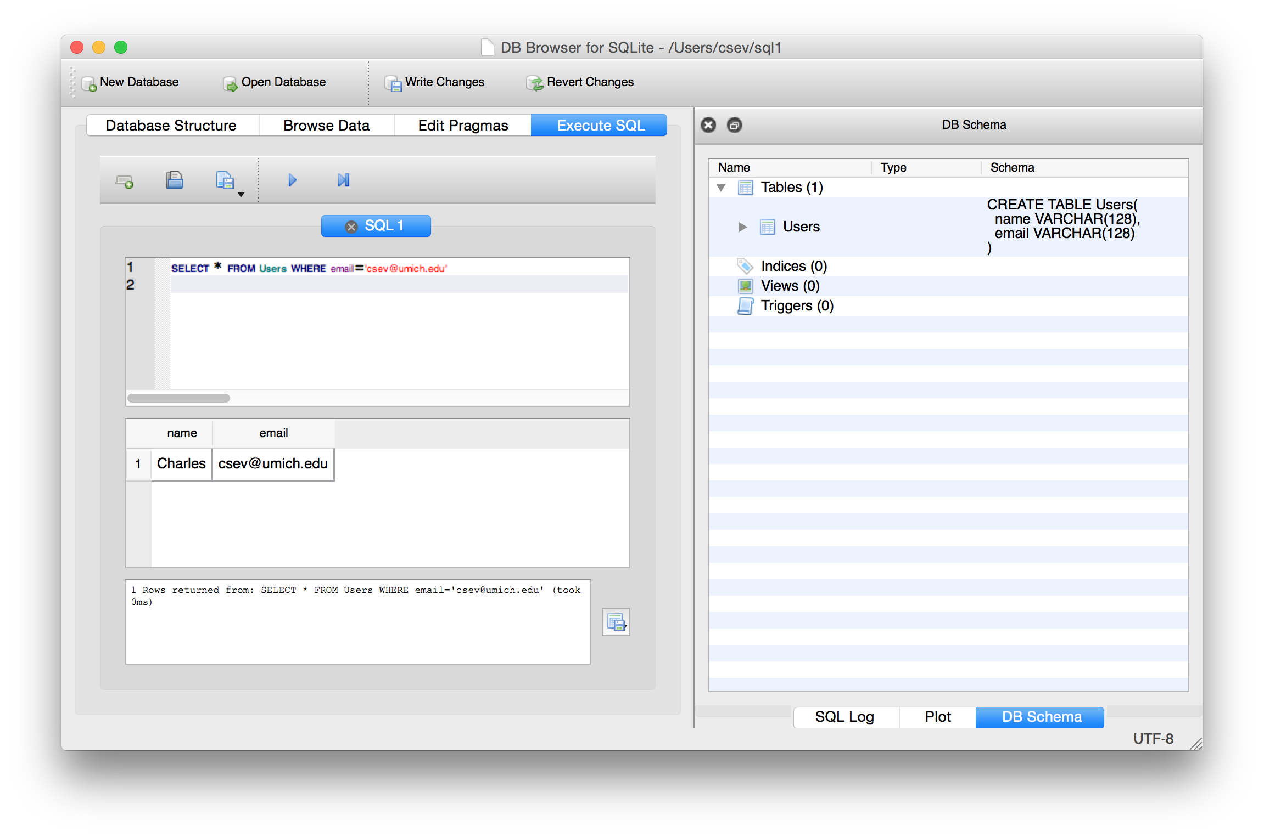

Slide 36
Sorting with ORDER BY
You can add an ORDER BY clause to SELECT statements to get the results sorted in ascending or descending order
SELECT * FROM Users ORDER BY email
SELECT * FROM Users ORDER BY name DESC

Slide 37
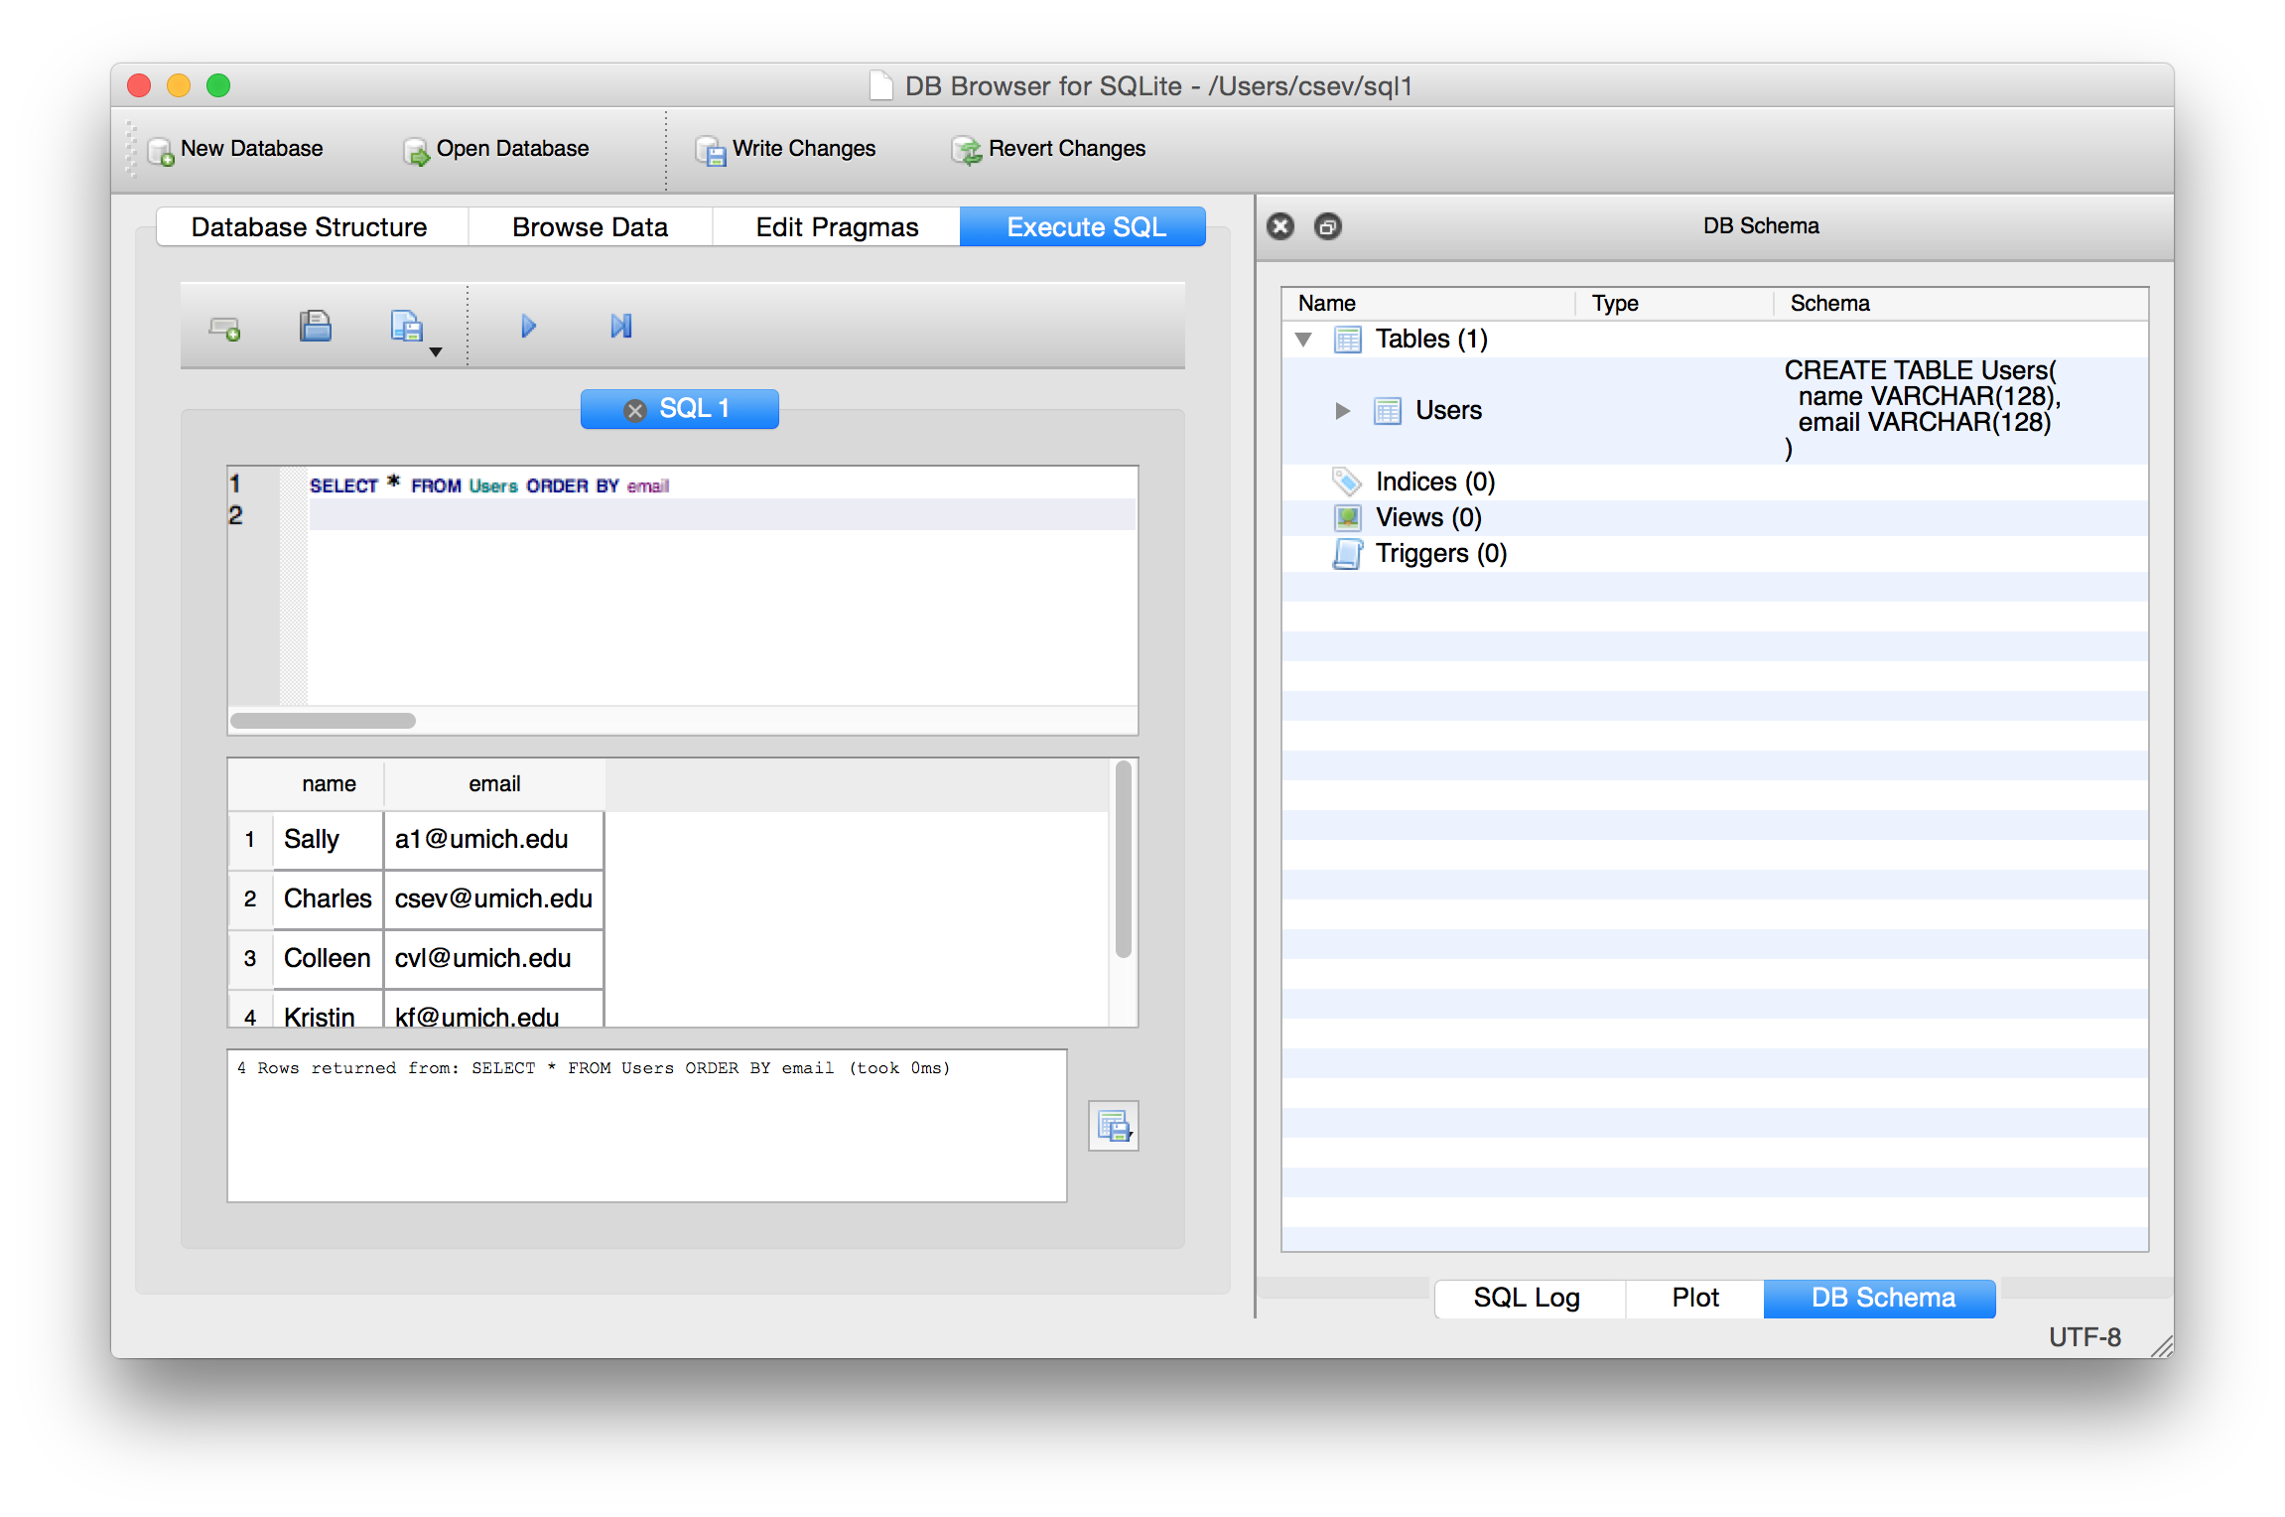

Slide 38
SQL Summary
INSERT INTO Users (name, email) VALUES ('Kristin', 'kf@umich.edu')
DELETE FROM Users WHERE email='ted@umich.edu'
UPDATE Users SET name="Charles" WHERE email='csev@umich.edu'
SELECT * FROM Users
SELECT * FROM Users WHERE email='csev@umich.edu'
SELECT * FROM Users ORDER BY email

Slide 39
This is not too exciting (so far)
Tables pretty much look like big fast programmable spreadsheets with rows, columns, and commands
The power comes when we have more than one table and we can exploit the relationships between the tables

Slide 40
Complex Data Models and Relationships
http://en.wikipedia.org/wiki/Relational_model

Slide 41
Database Design
Database design is an art form of its own with particular skills and experience
Our goal is to avoid the really bad mistakes and design clean and easily understood databases
Others may performance tune things later
Database design starts with a picture...

Slide 42
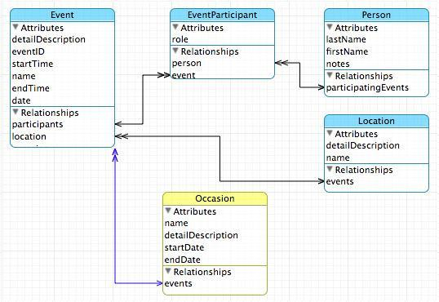

Slide 43
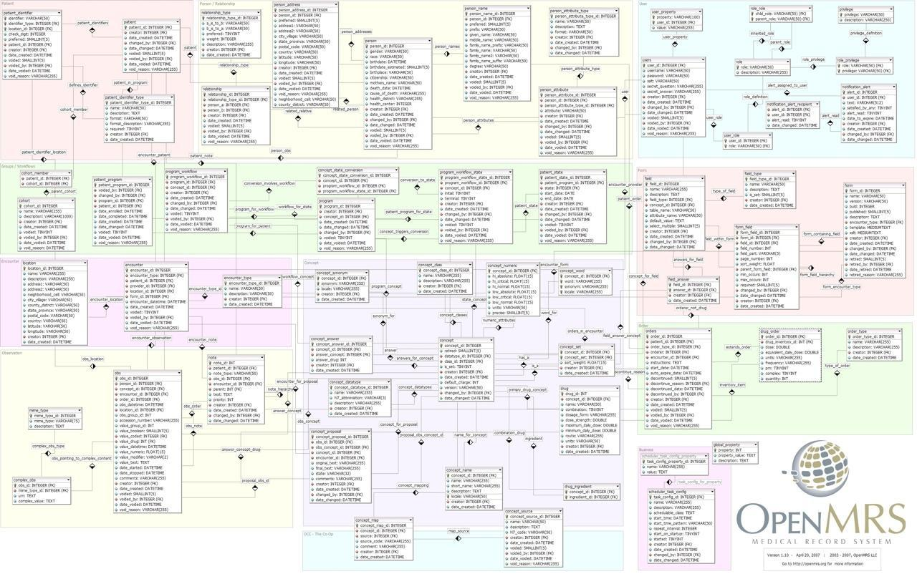

Slide 44
Building a Data Model
Drawing a picture of the data objects for our application and then figuring out how to represent the objects and their relationships
Basic Rule: Don’t put the same string data in twice - use a relationship instead
When there is one thing in the “real world” there should be one copy of that thing in the database

Slide 45
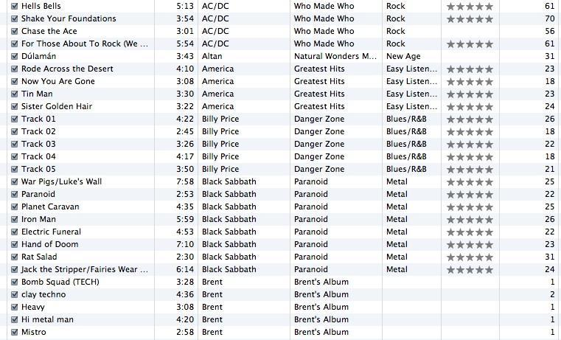
Track
Len
Artist
Album
Genre
Rating
Count

Slide 46
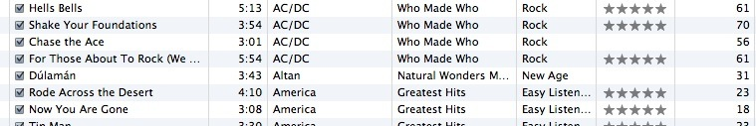
For each “piece of info”...
Is the column an object or an attribute of another object?
Once we define objects, we need to define the relationships between objects
Len
Album
Genre
Artist
Rating
Track
Count

Slide 47
Track
Album
Artist
Genre
Rating
Len
Count

Slide 48
Track
Rating
Len
Count
Track
Artist
Album
belongs-to
Artist
Album
Genre
belongs-to
Rating
Len
Genre
belongs-to
Count

Slide 49
Track
Rating
Len
Count
Artist
belongs-to
Album
belongs-to
Genre
belongs-to

Slide 50
Representing Relationships in a Database

Slide 51
Database Normalization (3NF)
There is *tons* of database theory - way too much to understand without excessive predicate calculus
Do not replicate data - reference data - point at data
Use integers for keys and for references
Add a special “key” column to each table which we will make references to. By convention, many programmers call this column “id”
http://en.wikipedia.org/wiki/Database_normalization

Slide 52
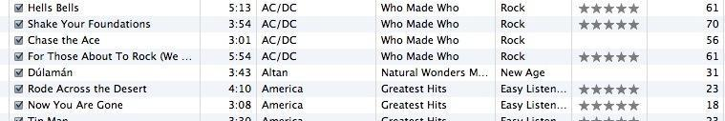
We want to keep track of which band is the “creator” of each music track...
What album does this song “belong to”??
Which album is this song related to?

Slide 53
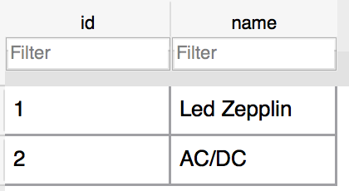
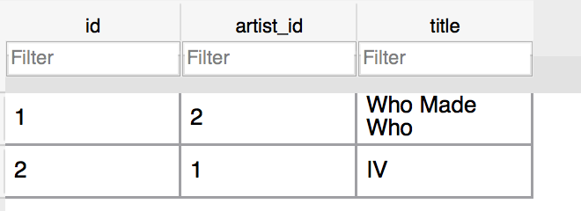
Integer Reference Pattern
Artist
We use integers to reference rows in another table
Album

Slide 54
Three Kinds of Keys
Primary key - generally an integer auto-increment field
Logical key - What the outside world uses for lookup
Foreign key - generally an integer key pointing to a row in another table
Album
id
title
artist_id
...

Slide 55
Key Rules
Best practices
Never use your logical key as the primary key
Logical keys can and do change, albeit slowly
Relationships that are based on matching string fields are less efficient than integers
User
id
login
password
name
email
created_at
modified_at
login_at

Slide 56
Foreign Keys
A foreign key is when a table has a column that contains a key which points to the primary key of another table.
When all primary keys are integers, then all foreign keys are integers - this is good - very good
Album
id
title
artist_id
...
Artist
id
name
...

Slide 57
Relationship Building (in tables)

Slide 58
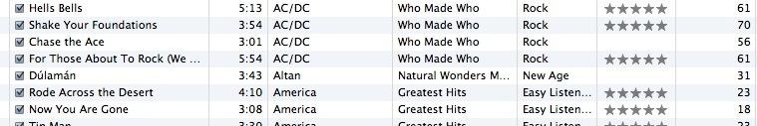
Artist
Track
Rating
Len
Count
belongs-to
Album
belongs-to
Genre
belongs-to

Slide 59
belongs-to
Track
Album
Title
Rating
Track
Len
Count
id
title
Album
rating
Table
Primary key
Logical key
Foreign key
id
len
title
count
album_id

Slide 60
Artist
Track
id
Album
id
name
id
title
title
rating
Table
Primary key
Logical key
Foreign key
artist_id
len
count
album_id
Genre
genre_id
id
Naming FK artist_id is a convention
name

Slide 61
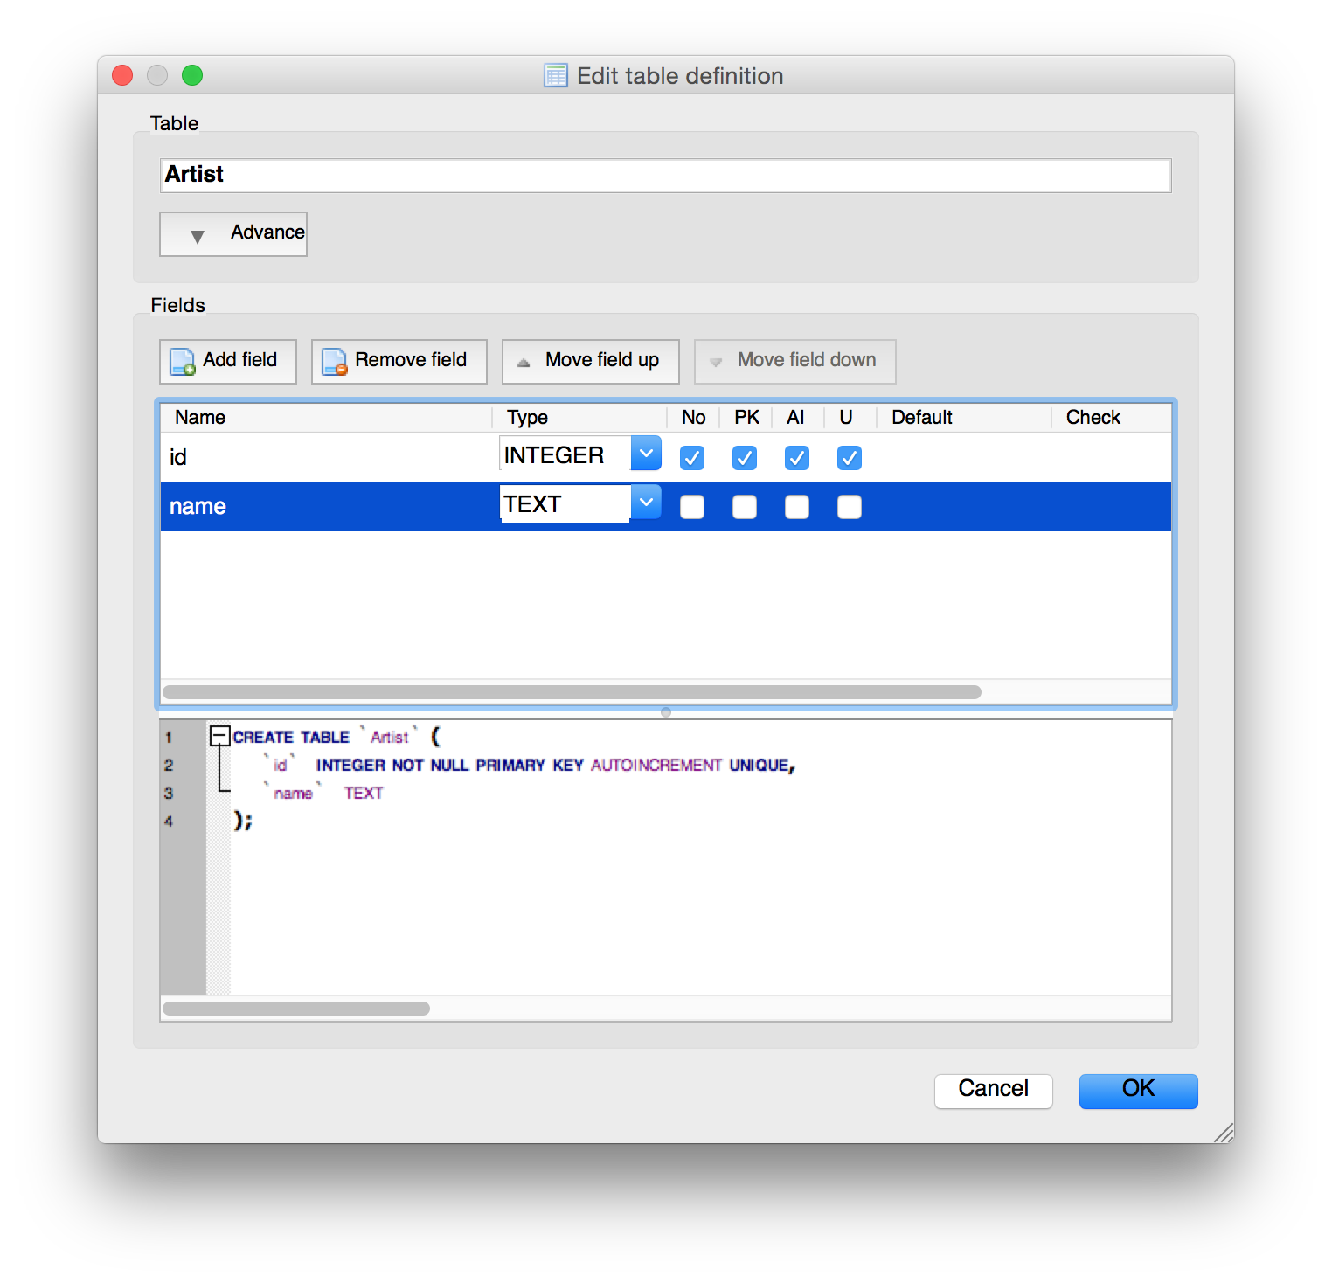

Slide 62
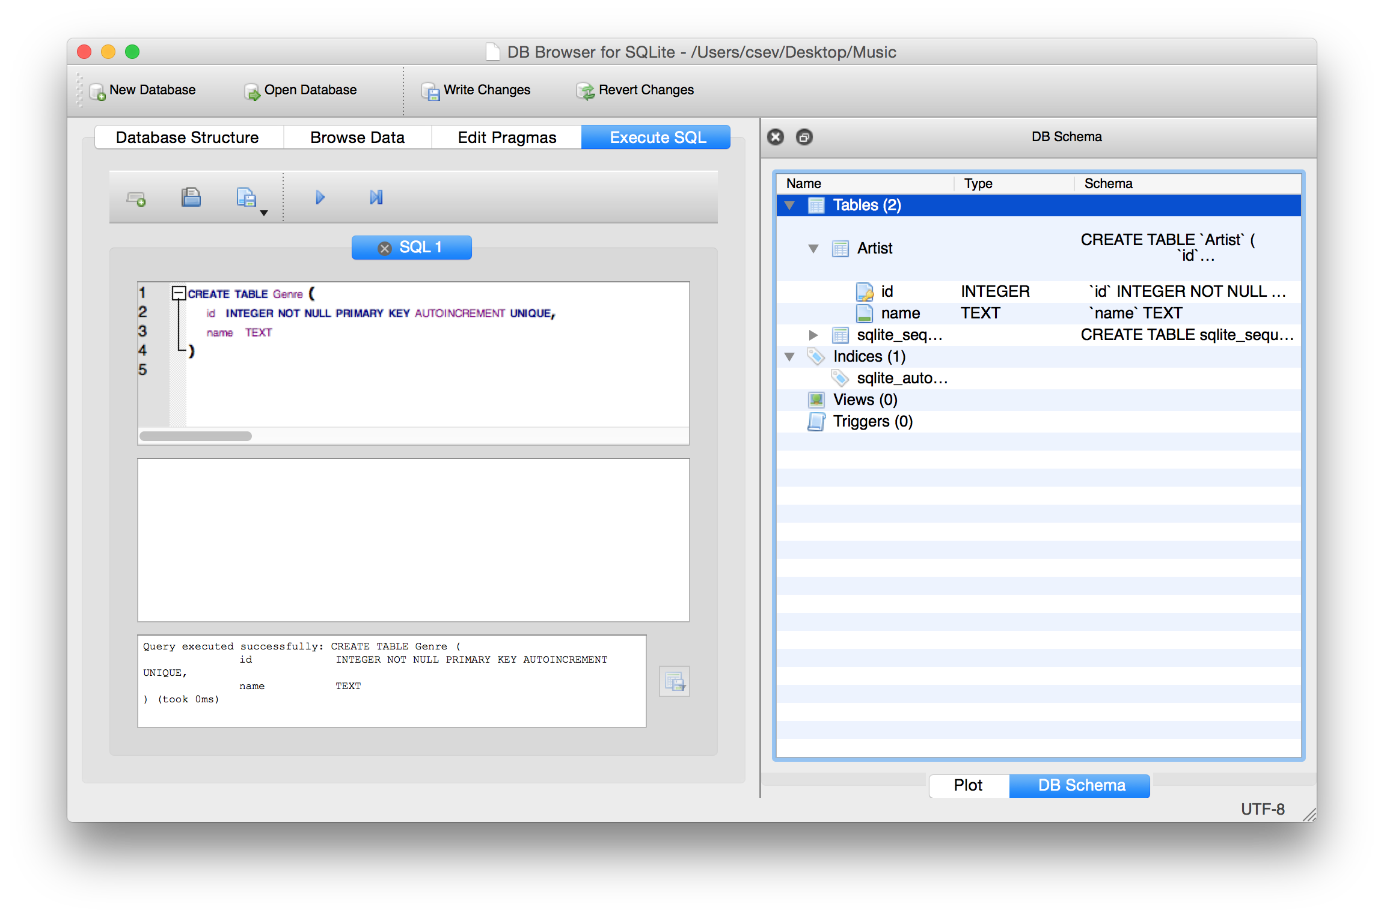
CREATE TABLE Genre (
id INTEGER NOT NULL PRIMARY KEY AUTOINCREMENT UNIQUE,
name TEXT
)

Slide 63
CREATE TABLE Album (
id INTEGER NOT NULL PRIMARY KEY AUTOINCREMENT UNIQUE,
artist_id INTEGER,
title TEXT
)
CREATE TABLE Track (
id INTEGER NOT NULL PRIMARY KEY AUTOINCREMENT UNIQUE,
title TEXT,
album_id INTEGER,
genre_id INTEGER,
len INTEGER, rating INTEGER, count INTEGER
)

Slide 64
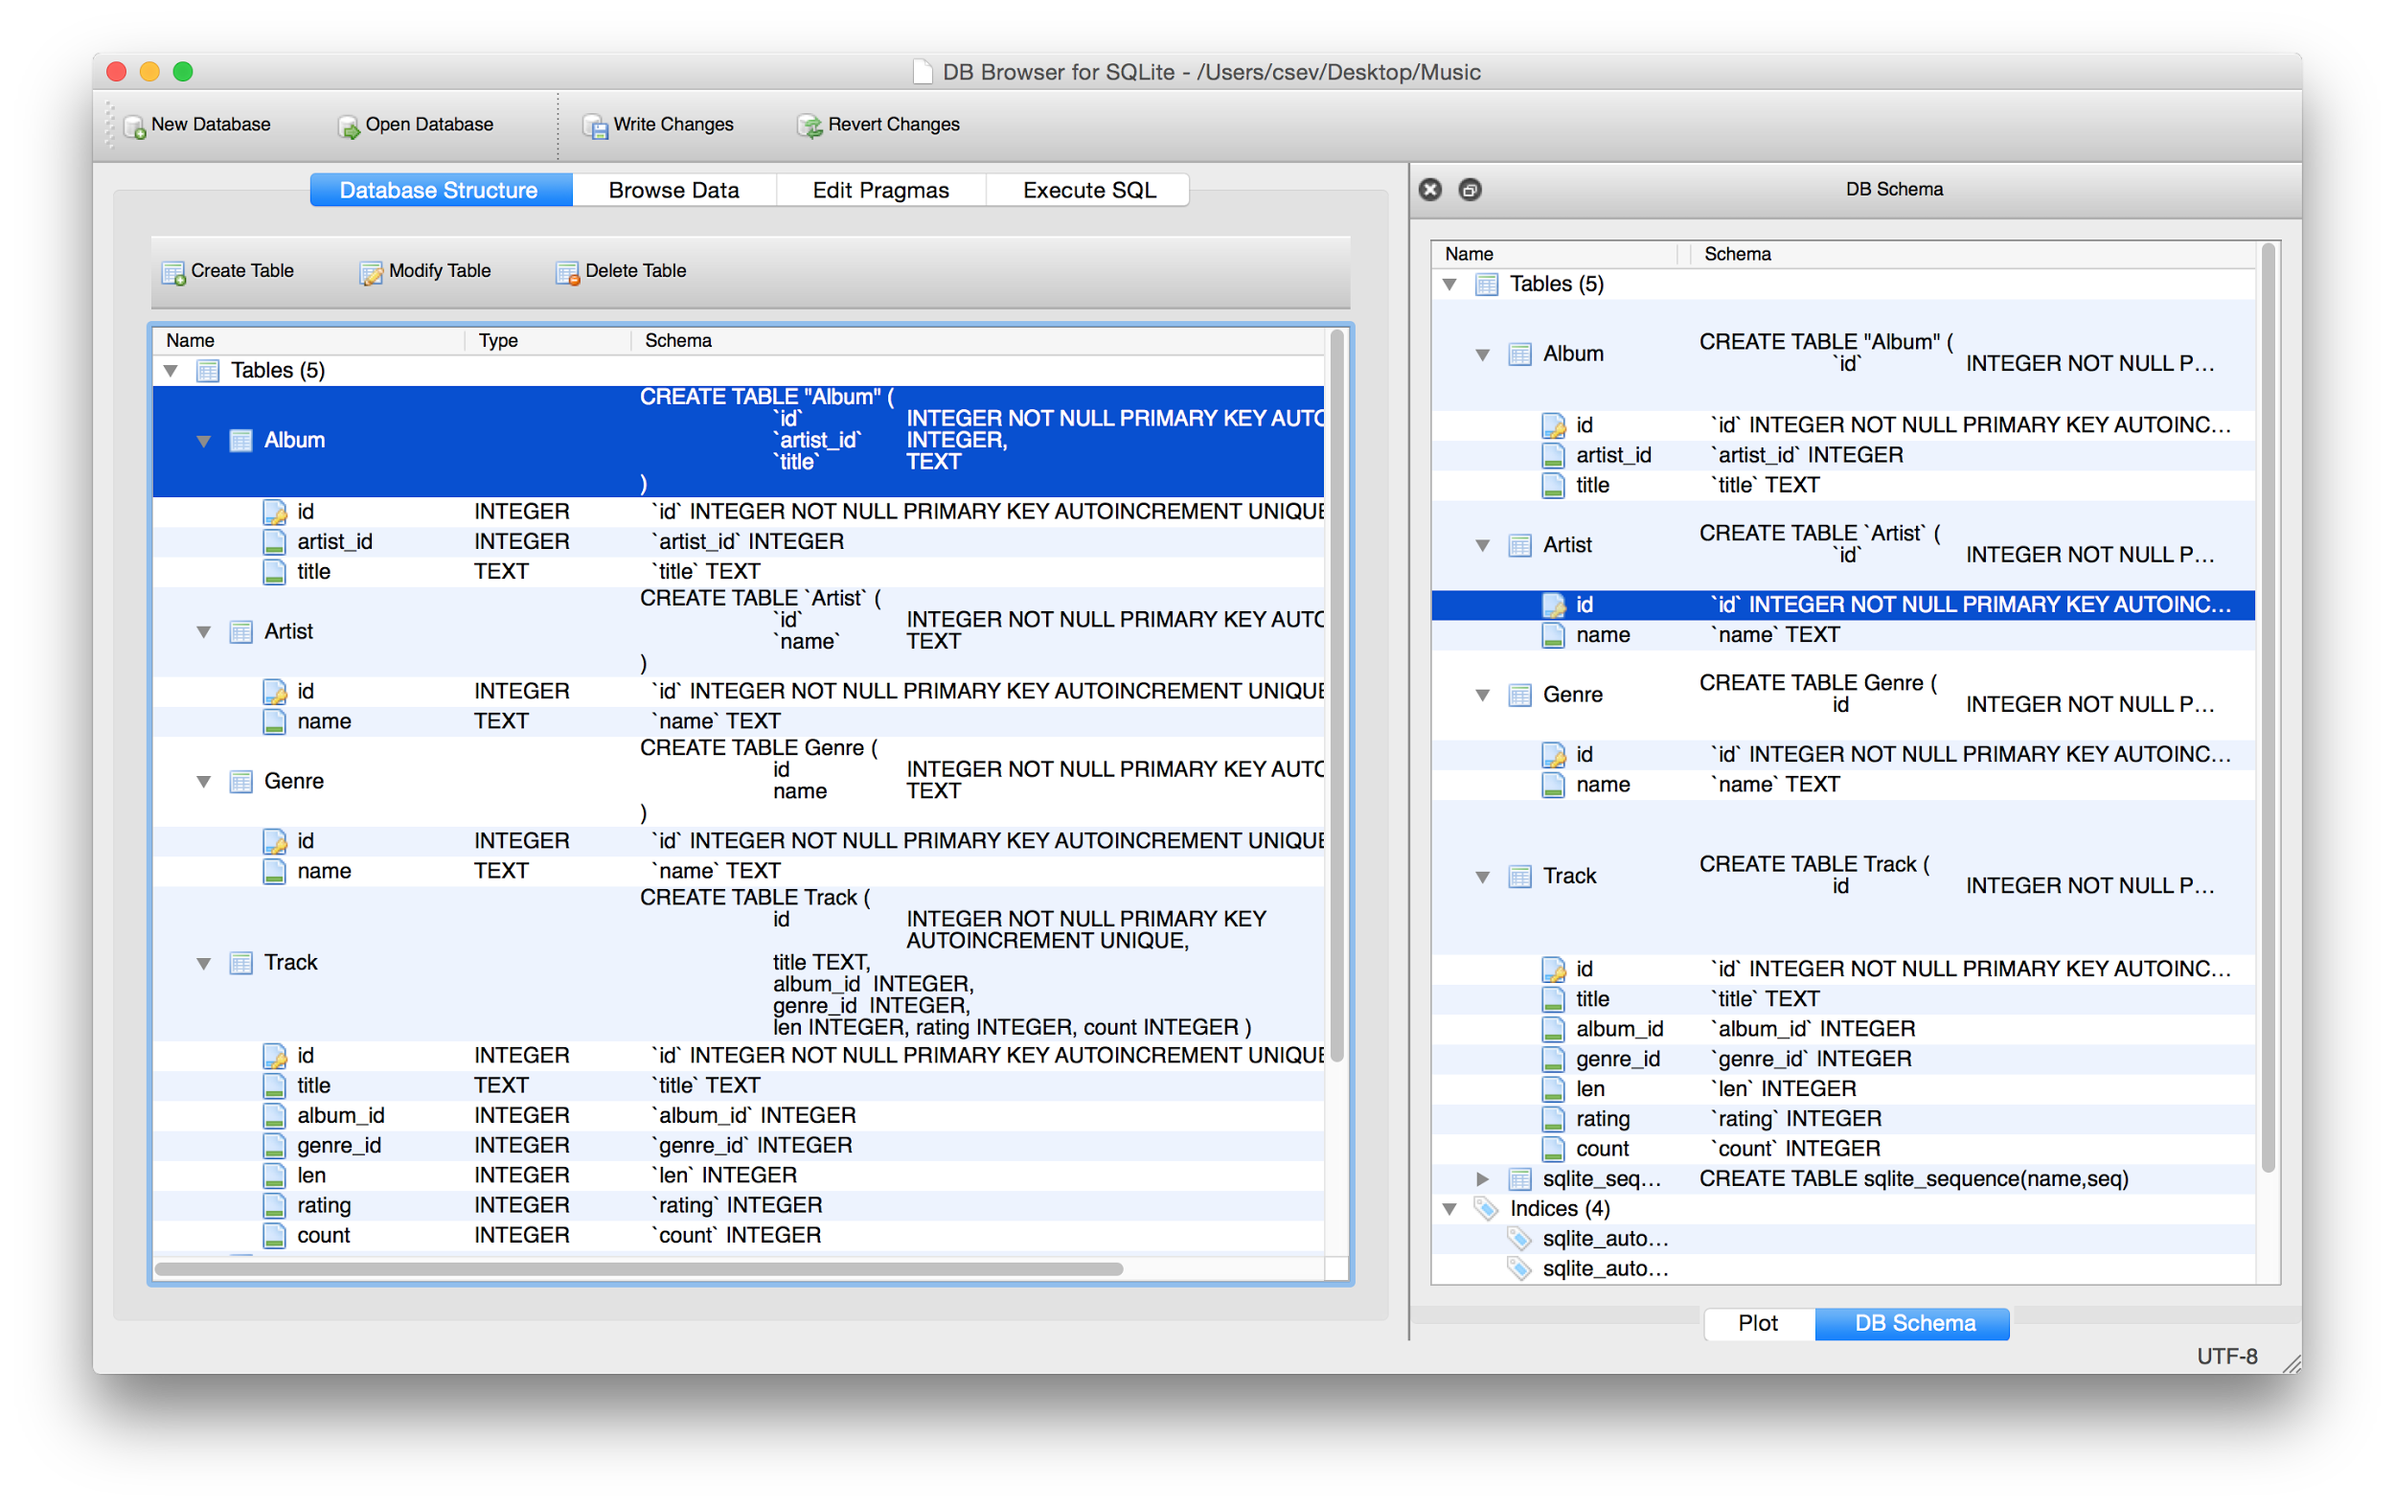

Slide 65
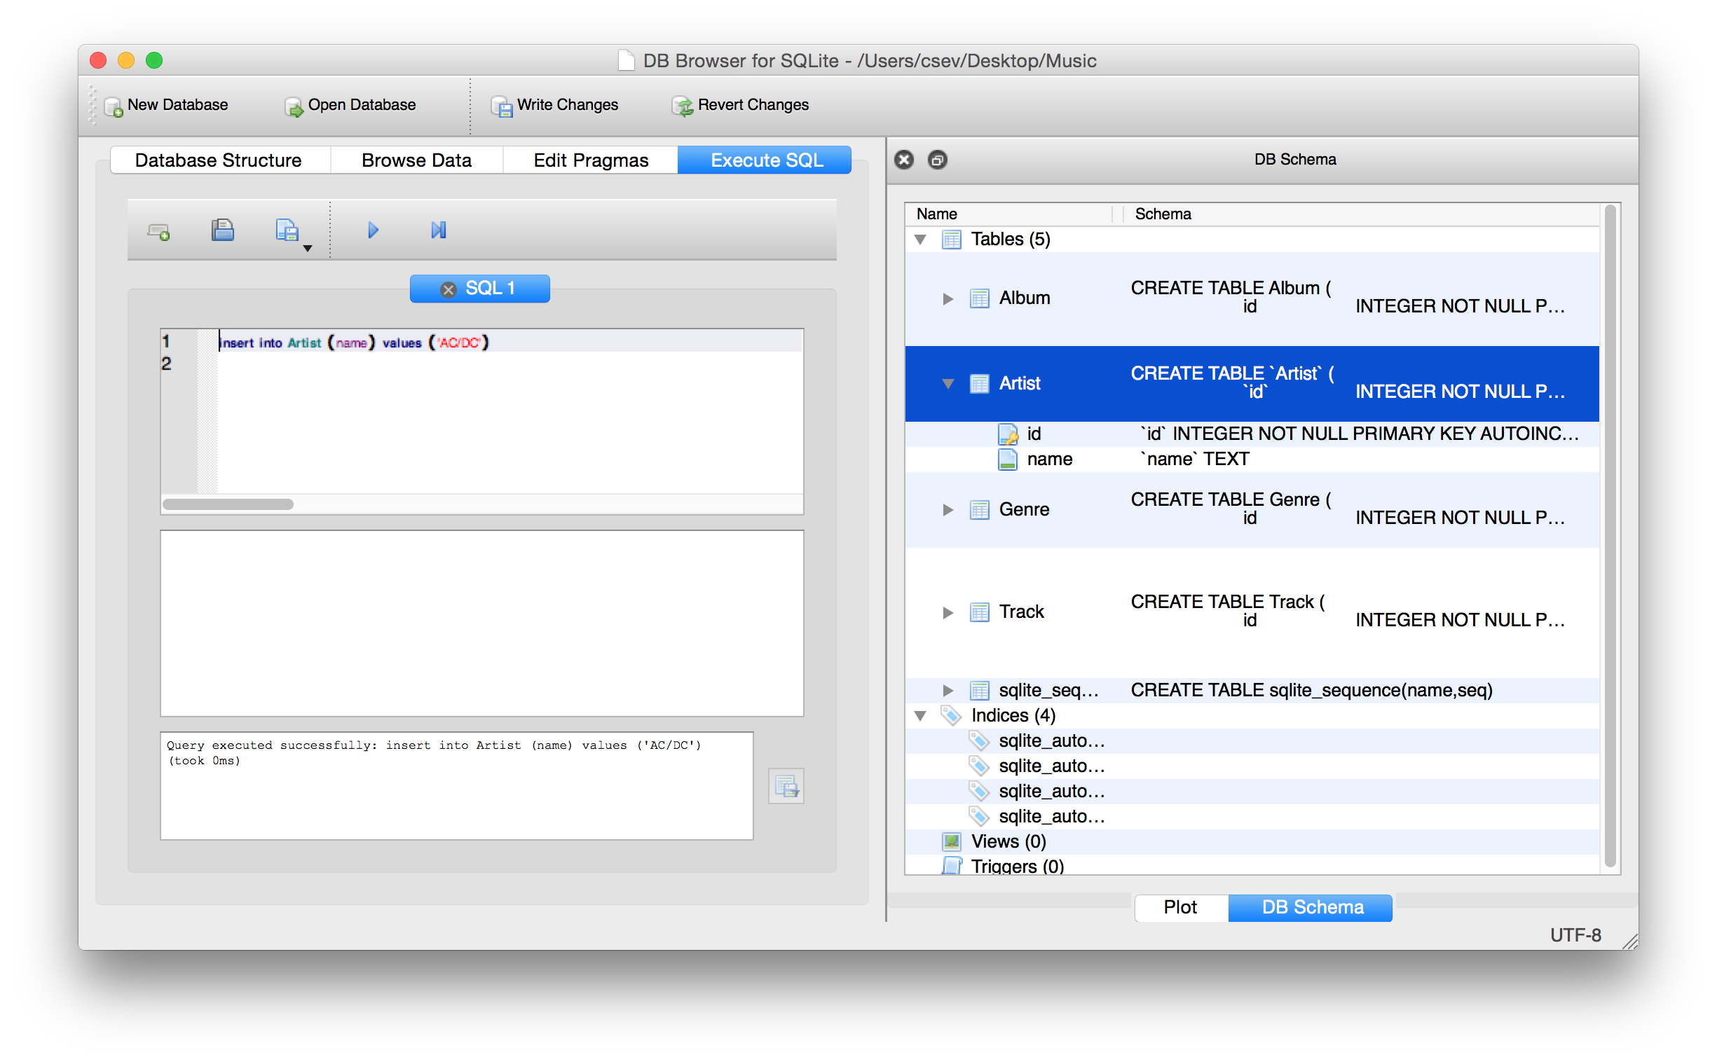
insert into Artist (name) values ('Led Zepplin')
insert into Artist (name) values ('AC/DC')

Slide 66
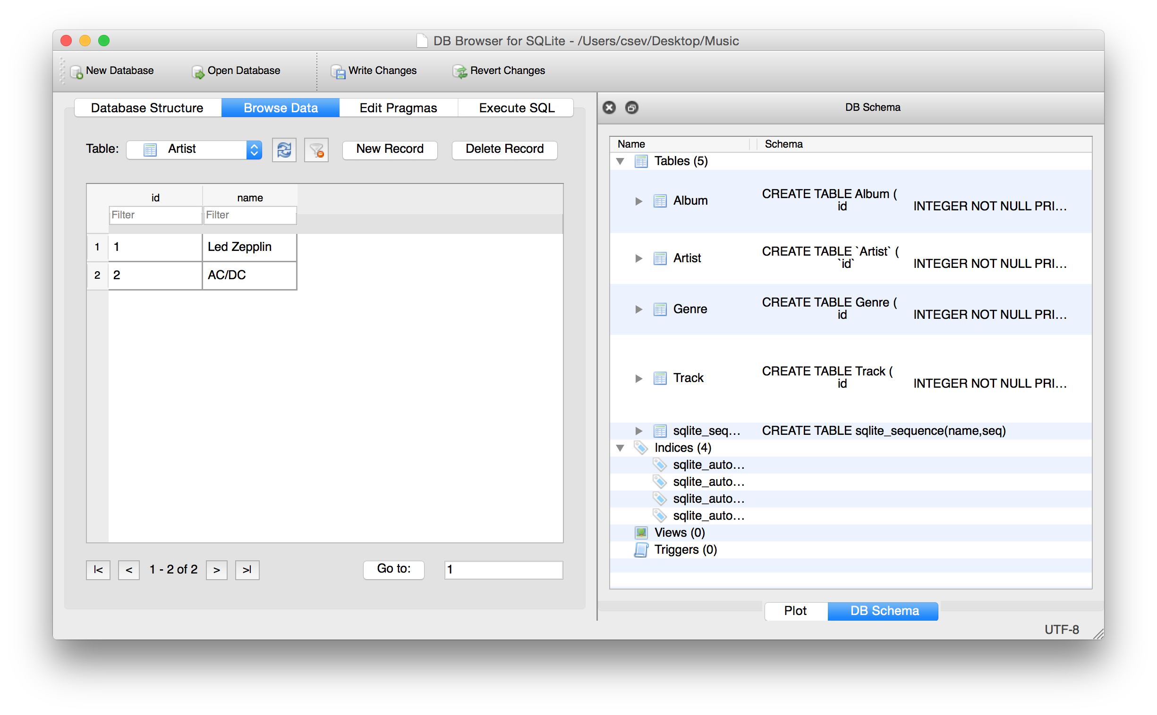
insert into Artist (name) values ('Led Zepplin')
insert into Artist (name) values ('AC/DC')

Slide 67
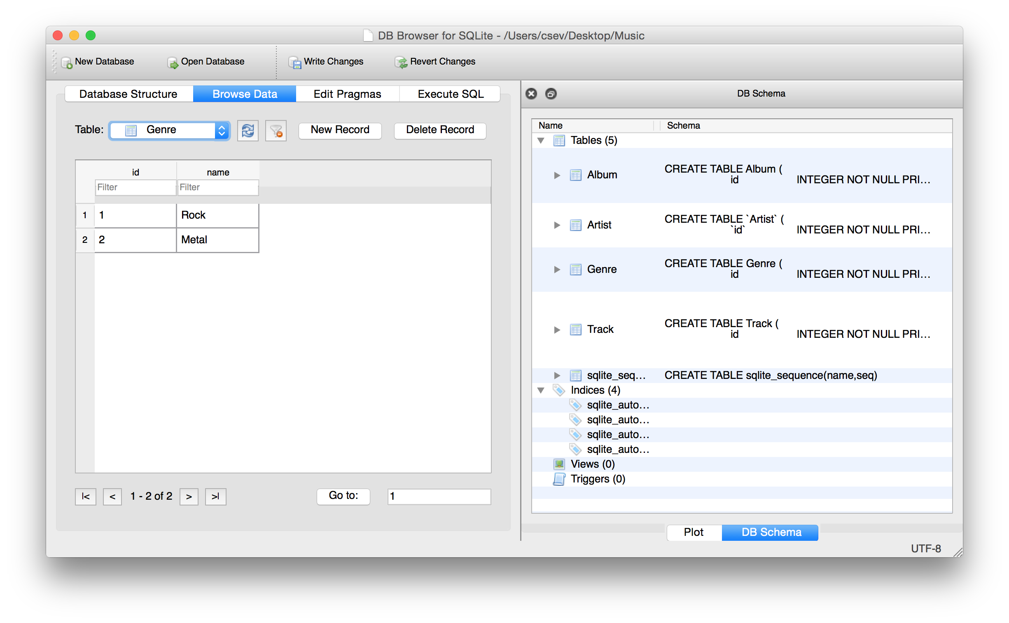
insert into Genre (name) values ('Rock')
insert into Genre (name) values ('Metal')

Slide 68
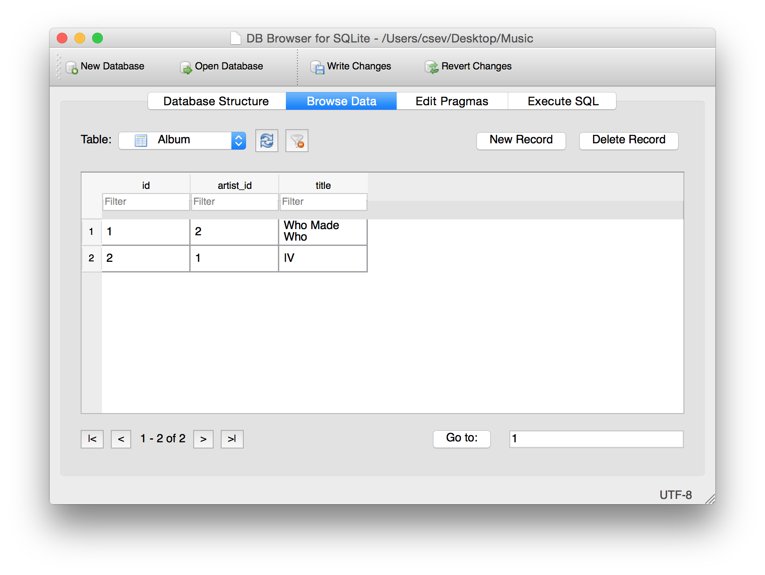
insert into Album (title, artist_id) values ('Who Made Who', 2)
insert into Album (title, artist_id) values ('IV', 1)

Slide 69
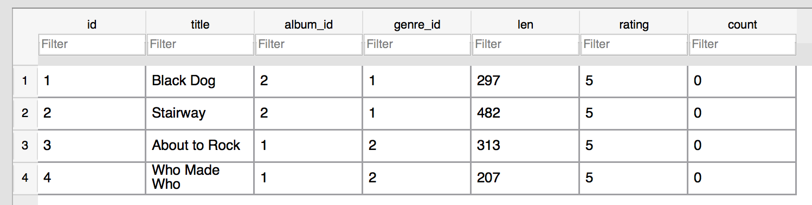
insert into Track (title, rating, len, count, album_id, genre_id)
values ('Black Dog', 5, 297, 0, 2, 1)
insert into Track (title, rating, len, count, album_id, genre_id)
values ('Stairway', 5, 482, 0, 2, 1)
insert into Track (title, rating, len, count, album_id, genre_id)
values ('About to Rock', 5, 313, 0, 1, 2)
insert into Track (title, rating, len, count, album_id, genre_id)
values ('Who Made Who', 5, 207, 0, 1, 2)

Slide 70
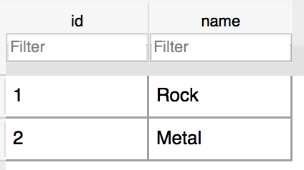
Track
Album
Genre
Artist

Slide 71
Using Join Across Tables
http://en.wikipedia.org/wiki/Join_(SQL)

Slide 72
Relational Power
By removing the replicated data and replacing it with references to a single copy of each bit of data we build a “web” of information that the relational database can read through very quickly - even for very large amounts of data
Often when you want some data it comes from a number of tables linked by these foreign keys

Slide 73
The JOIN Operation
The JOIN operation links across several tables as part of a select operation
You must tell the JOIN how to use the keys that make the connection between the tables using an ON clause

Slide 74
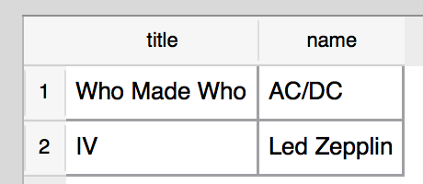
Album
Artist
select Album.title, Artist.name from Album join Artist on Album.artist_id = Artist.id
What we want to see
The tables that hold the data
How the tables are linked

Slide 75
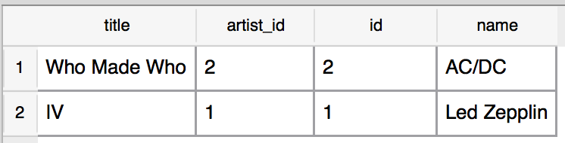
select Album.title, Album.artist_id, Artist.id,Artist.name
from Album join Artist on Album.artist_id = Artist.id

Slide 76
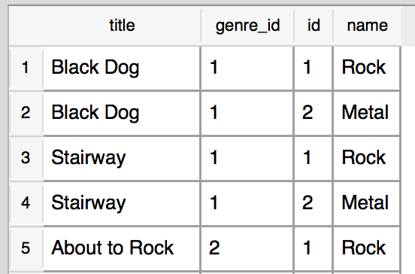
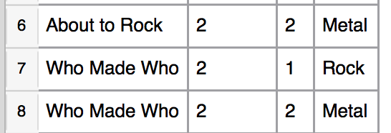
SELECT Track.title,
Track.genre_id,
Genre.id, Genre.name
FROM Track JOIN Genre
Joining two tables without an ON clause gives all possible combinations of rows.

Slide 77
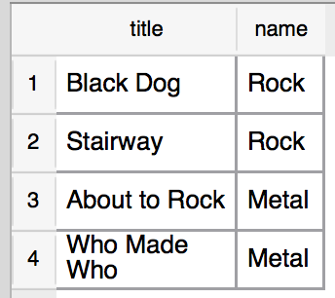
select Track.title, Genre.name from Track join Genre on Track.genre_id = Genre.id
What we want to see
The tables that hold the data
How the tables are linked

Slide 78
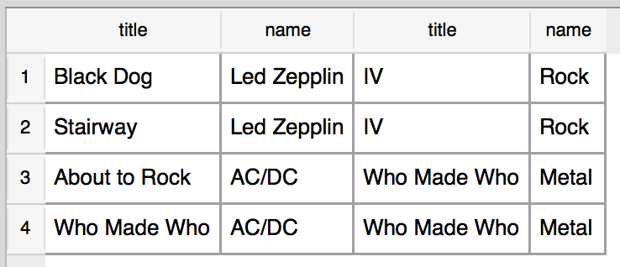
select Track.title, Artist.name, Album.title, Genre.name from Track join Genre join Album join Artist on Track.genre_id = Genre.id and Track.album_id = Album.id and Album.artist_id = Artist.id
What we want to see
The tables which hold the data
How the tables are linked

Slide 80
Many-To-Many Relationships
https://en.wikipedia.org/wiki/Many-to-many_(data_model)

Slide 81
belongs-to
Review:
One to Many
Track
Album
Title
One
Many
Rating
Len
Track
Count
id
Table
Primary key
Logical key
Foreign key
title
Album
One
rating
id
len
title
Many
count
album_id
https://en.wikipedia.org/wiki/One-to-many_(data_model)

Slide 82
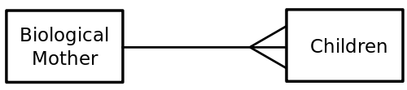
One
One
Many
Many
https://en.wikipedia.org/wiki/One-to-many_(data_model)

Slide 83

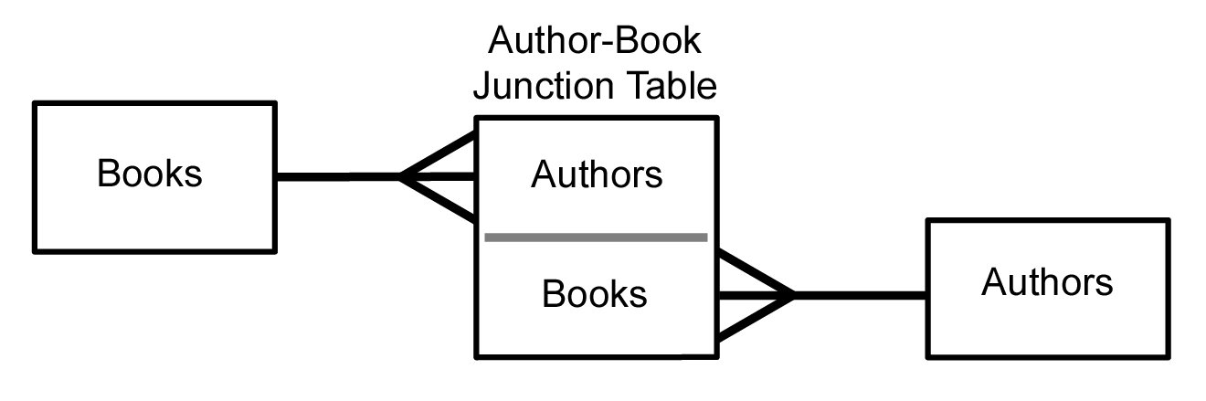
Many to Many
Sometimes we need to model a relationship that is many-to-many
We need to add a "connection" table with two foreign keys
There is usually no separate primary key
https://en.wikipedia.org/wiki/Many-to-many_(data_model)

Slide 84
member-of
User
Course
title
name
Many
Many
email
User
Course
Member
id
id
Many
user_id
One
name
title
One
course_id
Many
email
https://en.wikipedia.org/wiki/Many-to-many_(data_model)

Slide 85
Start with a Fresh Database
CREATE TABLE User (
id INTEGER PRIMARY KEY,
name TEXT UNIQUE,
email TEXT
)
CREATE TABLE Course (
id INTEGER PRIMARY KEY,
title TEXT UNIQUE
)
CREATE TABLE Member (
user_id INTEGER,
course_id INTEGER,
role INTEGER,
PRIMARY KEY (user_id, course_id)
)

Slide 86
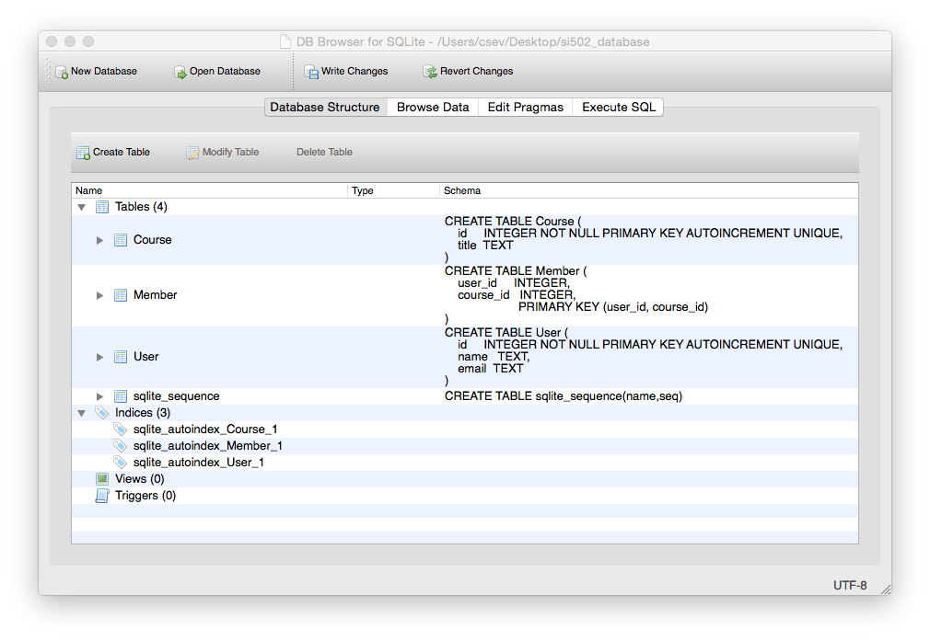

Slide 87
Insert Users and Courses
INSERT INTO User (name, email) VALUES ('Jane', 'jane@tsugi.org');
INSERT INTO User (name, email) VALUES ('Ed', 'ed@tsugi.org');
INSERT INTO User (name, email) VALUES ('Sue', 'sue@tsugi.org');
INSERT INTO Course (title) VALUES ('Python');
INSERT INTO Course (title) VALUES ('SQL');
INSERT INTO Course (title) VALUES ('PHP');

Slide 88
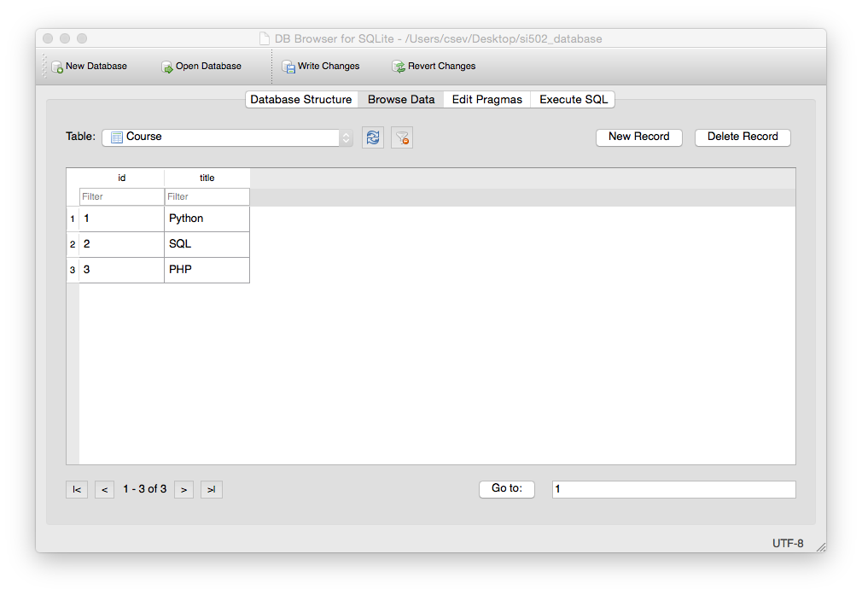
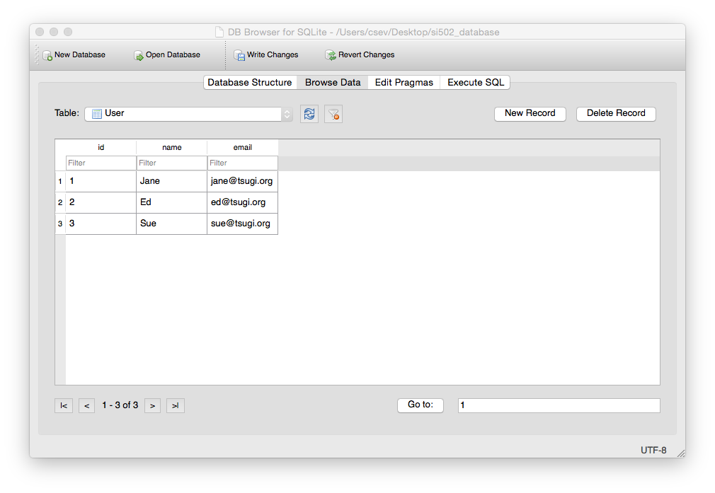

Slide 89
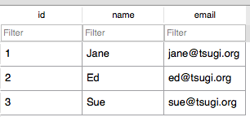
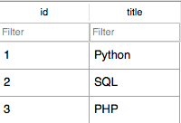
INSERT INTO Member (user_id, course_id, role) VALUES (1, 1, 1);
INSERT INTO Member (user_id, course_id, role) VALUES (2, 1, 0);
INSERT INTO Member (user_id, course_id, role) VALUES (3, 1, 0);
INSERT INTO Member (user_id, course_id, role) VALUES (1, 2, 0);
INSERT INTO Member (user_id, course_id, role) VALUES (2, 2, 1);
INSERT INTO Member (user_id, course_id, role) VALUES (2, 3, 1);
INSERT INTO Member (user_id, course_id, role) VALUES (3, 3, 0);

Slide 90
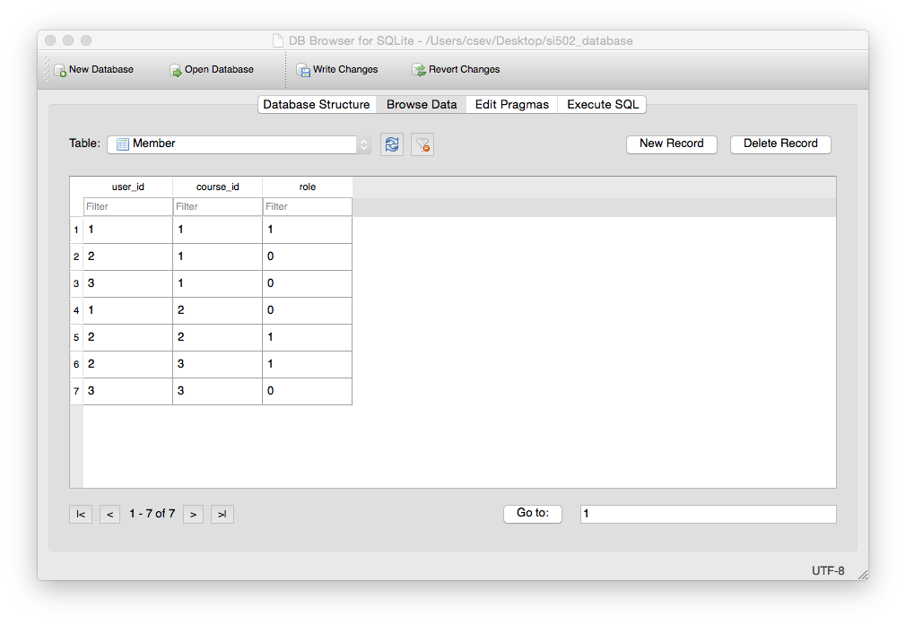

Slide 91
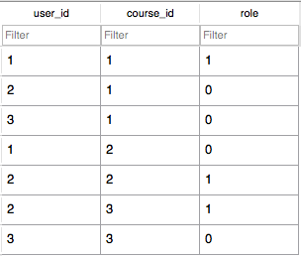
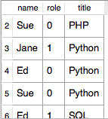
SELECT User.name, Member.role, Course.title
FROM User JOIN Member JOIN Course
ON Member.user_id = User.id AND
Member.course_id = Course.id
ORDER BY Course.title, Member.role DESC, User.name

Slide 92
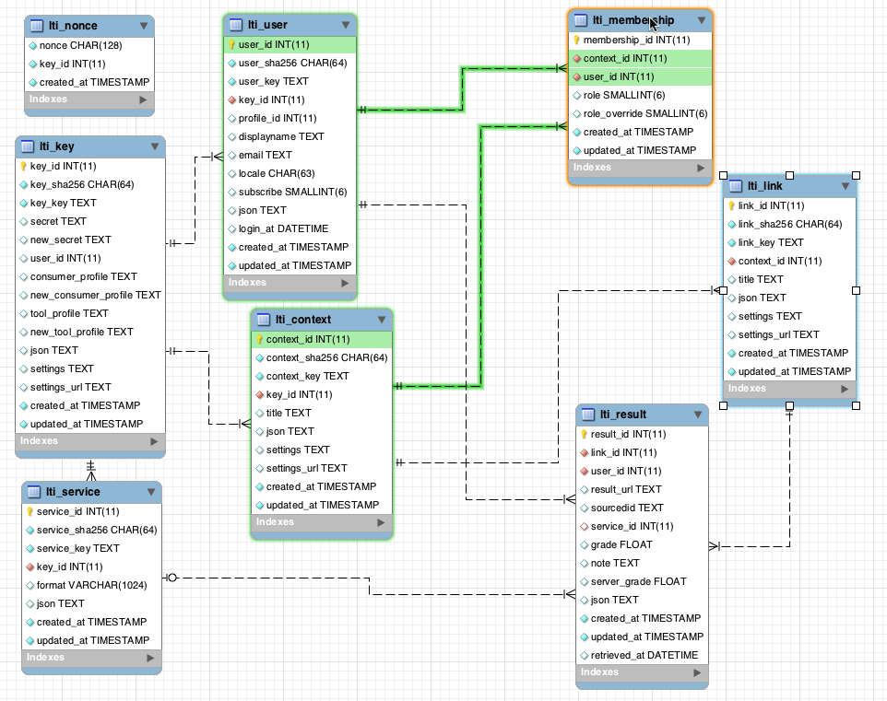
www.tsugi.org

Slide 93
Complexity Enables Speed
Complexity makes speed possible and allows you to get very fast results as the data size grows
By normalizing the data and linking it with integer keys, the overall amount of data which the relational database must scan is far lower than if the data were simply flattened out
It might seem like a tradeoff - spend some time designing your database so it continues to be fast when your application is a success

Slide 94
Additional SQL Topics
Indexes improve access performance for things like string fields
Constraints on data - (cannot be NULL, etc..)
Transactions - allow SQL operations to be grouped and done as a unit

Slide 95
Summary
Relational databases allow us to scale to very large amounts of data
The key is to have one copy of any data element and use relations and joins to link the data to multiple places
This greatly reduces the amount of data which much be scanned when doing complex operations across large amounts of data
Database and SQL design is a bit of an art form

Slide 96
Acknowledgements / Contributions
These slides are Copyright 2010- Charles R. Severance (www.dr-chuck.com) of the University of Michigan School of Information and open.umich.edu and made available under a Creative Commons Attribution 4.0 License. Please maintain this last slide in all copies of the document to comply with the attribution requirements of the license. If you make a change, feel free to add your name and organization to the list of contributors on this page as you republish the materials.
Initial Development: Charles Severance, University of Michigan School of Information
… Insert new Contributors here
...

