Slide 1
MODULE 3 SPECIAL TOPIC — LOGISIM EVOLUTION SYSTEM DESIGN
Design & Simulation of a 4-Bit Binary Arithmetic Calculator
A Complete Combinational Logic Architecture Supporting Binary Addition, Subtraction, Bitwise Logic, and Status Flag Generation
Digital Logic Architecture Project

Slide 2
System Functional Specifications
Top-level input, output, and operational requirements for the 4-bit calculator
4-Bit Inputs
2-Bit Control
Output & Flags
Operands A & B
Select Lines [S1, S0]
Result Bus & LEDs
Two 4-bit DIP switches providing binary inputs A [A3..A0] and B [B3..B0] spanning values 0 to 15.
Function select lines controlling a 4:1 multiplexer to choose between ADD, SUB, AND, and OR functions.
4-bit Result Output Y [Y3..Y0] along with Carry Out (Cout), Zero Flag (Z), and Overflow Flag (V).

Slide 3
System Block Architecture
Combinational datapath mapping input switches through compute blocks to output pins
1. Arithmetic Processing Unit
4-Bit Ripple Carry Adder paired with XOR mode-controlled input inverters.
Control Line Mapping
S1 S0 = 00 : Addition (A + B)
2. Bitwise Logic Engine
S1 S0 = 01 : Subtraction (A - B)
Parallel arrays of 4 AND gates and 4 OR gates computing logical operations.
S1 S0 = 10 : Bitwise AND (A & B)
S1 S0 = 11 : Bitwise OR (A | B)
3. 4-Bit Quad 4:1 MUX Array
Routes calculated arithmetic or logic results to final result bus based on S1, S0.

Slide 4
4-Bit Adder / Subtractor Sub-Circuit
Controlled two's complement subtraction using XOR conditional bit complementers
XOR Bit Inversion Mechanism
Input line B_i passes through an XOR gate with mode control M = S0. When M=0, output is B_i. When M=1, output is B_i' (1's complement).
Boolean Equations for FA_i Stage
Bi_eff = Bi ⊕ M
Si = Ai ⊕ Bi_eff ⊕ Ci
Carry In Addition (+1)
The mode control signal M is fed into Cin of the LSB Full Adder (FA0). Adding 1 to 1's complement completes 2's complement subtraction.
C_{i+1} = (Ai · Bi_eff) + Ci · (Ai ⊕ Bi_eff)

Slide 5


Bitwise Logic Engine Architecture
Parallel quad-gate arrays performing instantaneous bitwise operations
Bitwise AND Array
Bitwise OR Array
Constructed using four 2-input AND gates operating on matching bit pairs [A3..A0] and [B3..B0].
Constructed using four 2-input OR gates operating in parallel across input bus lines.
Y_AND[i] = Ai · Bi
Y_OR[i] = Ai + Bi

Slide 6
Quad 4:1 Multiplexer Selection Unit
Selecting compute results and steering calculated values to the output bus
4:1 Multiplexer Truth Table
S1 | S0 | Input Chosen | Calculator Operation
0 | 0 | I0 | ADD (A + B)
0 | 1 | I1 | SUB (A - B)
1 | 0 | I2 | AND (A · B)
1 | 1 | I3 | OR (A + B)
Quad Multiplexer Structure
Requires four identical 4:1 multiplexers (one per output bit Y3, Y2, Y1, Y0), all sharing the same control select signals S1 and S0.

Slide 7
Status Flag Generation Logic
Detecting boundary conditions: Carry Out (Cout), Zero (Z), and Overflow (V)
Zero Flag (Z)
Carry Flag (Cout)
Overflow Flag (V)
Z = NOR(Y3, Y2, Y1, Y0)
Cout = Carry from FA3
V = C3 ⊕ Cout
Asserts HIGH (1) whenever every bit of the 4-bit output result bus evaluates to zero.
Captures unsigned arithmetic overflow beyond 4 bits (e.g., sum exceeding 15).
Detects signed two's complement arithmetic overflow when adding inputs of same sign.

Slide 8
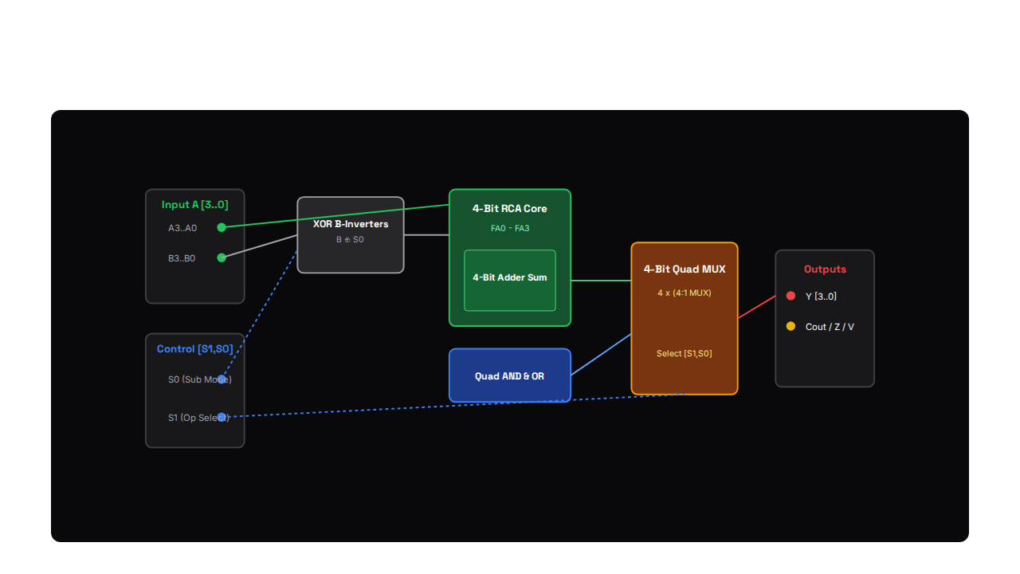
Logisim Evolution Circuit Schematic
Full gate-level wiring diagram of the 4-Bit Binary Calculator in Logisim

Slide 9
Logisim Simulation: Addition Test Case
Evaluating inputs A = 0101 (5_10) and B = 0011 (3_10) with S1,S0 = 00
Trace Execution Log
Operand A : 0101 (Decimal 5)
Operand B : 0011 (Decimal 3)
Logisim Probe Verification
Control : S1=0, S0=0 (ADD)
Individual full adder stages ripple carry bits successfully (C1=1, C2=1, C3=0) yielding exact expected output binary pattern 1000.
Output Y : 1000 (Decimal 8)
Flags : Cout=0, Z=0, V=0

Slide 10
Logisim Simulation: Subtraction Test Case
Evaluating inputs A = 1001 (9_10) and B = 0100 (4_10) with S1,S0 = 01
Trace Execution Log
Operand A : 1001 (Decimal 9)
Operand B : 0100 (Decimal 4)
2's Complement Hardware Action
B Inverted: 1011 + Cin(1) = 1100
Inverting B to 1011 and injecting Cin=1 converts subtraction directly into addition: 1001 + 1100 = (1) 0101.
Output Y : 0101 (Decimal 5)
Flags : Cout=1 (No Borrow), Z=0

Slide 11
Hardware Complexity & Propagation Delay
Quantitative gate count metrics and critical path timing analysis
42 Gates
9 t_gate
100%
Total Component Count
Critical Path Delay
Logisim Test Coverage
Includes XOR inverters, Full Adder gates, AND/OR logic gates, and MUX selectors.
Worst-case propagation path through 4-bit carry chain into multiplexer output.
Verified exhaustively across all 16 arithmetic and logical input combinations.

Slide 12
Scaling 4-Bit Design to 32-Bit CPUs
This 4-bit calculator establishes the exact same architectural principles utilized inside modern 32-bit and 64-bit RISC-V processor ALUs.
Combinational Logic
Logisim Verified
RISC-V Datapath

