Slide 1







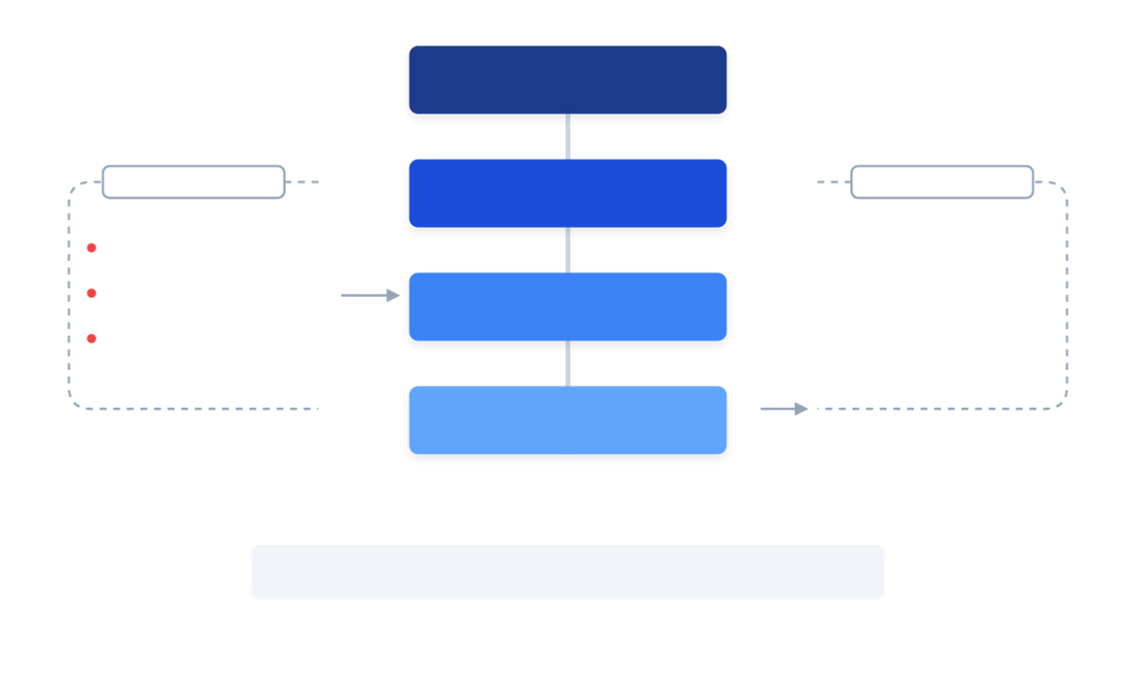



EXECUTIVE STRATEGY BRIEFING
SmartSDLC: Systemic Delivery Leverage
THE REALITY & COST
SYSTEM-ASSISTED COHERENCE
TARGETED VALUE
Manual Traction is Fragile
Product Owner
Complex delivery relies on heroic manual coordination, not systemic support.
Durable Decisions
Visible Dependencies
Preserved Context
Pre-aggregated signals & assisted replanning.
Artifacts, not chats
Status-driven objects
Systemic memory
Cognitive Overload
80% of leadership time spent reconstructing context.
THE OPERATING MODEL
SmartSDLC Core
Director / MD
Risk Concentration
Real-time bottlenecks & ad-hoc trends.
Critical logic trapped in heads. High "Bus factor".
Zero Reuse
Architect / Dev
Excellence is not currently durable; every project starts from scratch.
Designs locked, context embedded in IDE.
Fragile Coordination
One dependency break stops the entire release train.
EXPECTED IMPACT
↓
↓
WHY NOW?
COORDINATION
RISK
Complexity > Capacity: Interconnectedness growing faster than hiring capacity.
Reduced overhead
Lower risk
Distributed Teams: Manual coordination costs rise non-linearly with distance.
100%
2x
AUDITABILITY
DECISIONS
Full audit
Faster decisions

Slide 2


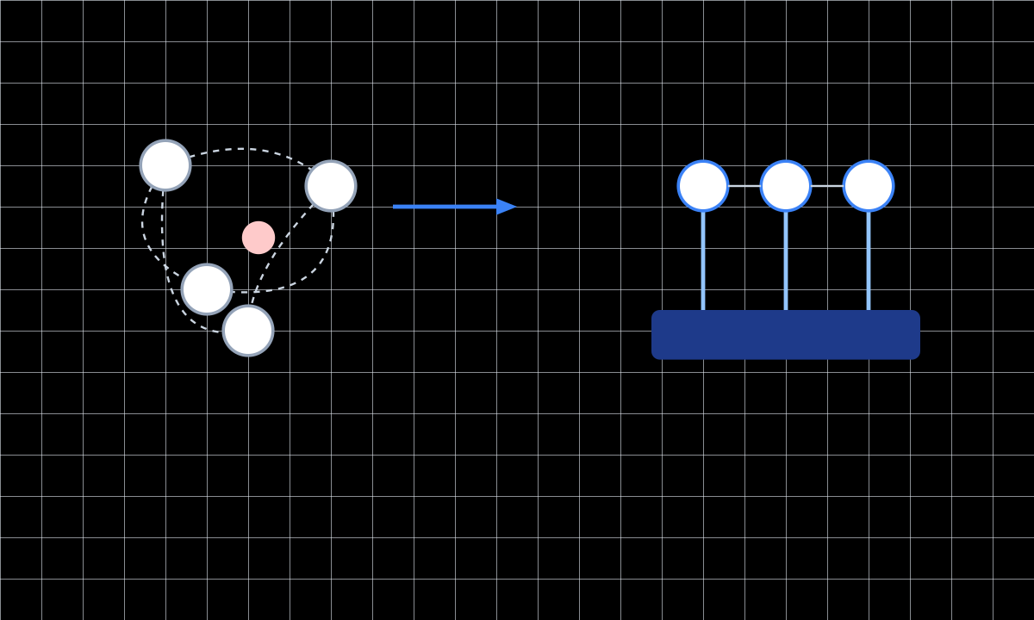



SmartSDLC — Executive Summary
The Leverage Thesis
PAGE 02
THE REALITY
HIDDEN COSTS
VISUALIZING THE SHIFT
Complex initiatives succeed due to manual traction, not systems:
Manual traction creates silent drag:
Cognitive overload on seniors
Continuous manual syncs
Risk concentration (bus factor)
Relationship-based escalation
Invisible replanning in heads
Heroic context reconstruction
Decisions based on summaries, not signals
We deliver despite the system.
WHAT IT IS
IMPROVEMENTS
A governance layer turning judgment into leverage:
Reduced overhead (fewer meetings)
Faster decisions (preserved context)
Decisions → Durable Artifacts
Lower risk (distributed knowledge)
Dependencies → First-class Objects
Progress → Derived from Evidence
Auditability by design
STRATEGIC POSITIONING
LEADERSHIP IMPACT
“SmartSDLC captures delivery intent, decisions, and evidence—so execution scales without relying on heroics.”
Outcome clarity over activity summaries.
Drill-down to evidence (not just RAG status)
Health driven by real dependency signals
Targeted intervention on specific bottlenecks
SmartSDLC Collaborative Session
Confidential & Proprietary

Slide 3
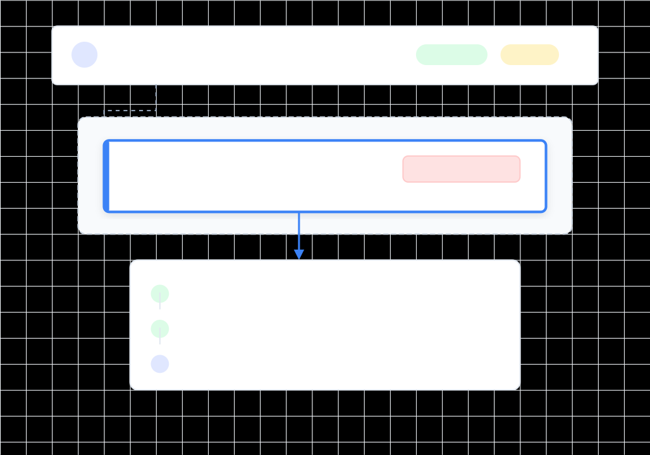
SmartSDLC — Executive Summary
How It Works & Enterprise Governance
PAGE 03
1. THE CORE OPERATING MODEL
THE LEADERSHIP VIEW
Live Drill-Down
SmartSDLC structures work in a connected hierarchy. Artifacts become proof objects, not just reports.
INITIATIVE
DELIVERABLE
EPIC
EVIDENCE
Requirement Intent: Linked to ADRs (Architectural Decisions).
Rules as Code: YAML configs with visible diffs.
Automated Evidence: Test results linked to release gates.
2. ENTERPRISE-GRADE COLLABORATION
Moving beyond "AI coding" to "Enterprise Governance". Collaboration is explicit around shared objects:
Maker/Checker Gates: Formal Approve / Reject workflows.
Versioning + Diff: Line-level context on every change.
Decision Logs: Capturing why a trade-off was made.
3. Pragmatic Adoption (No Big-Bang)
Start with one initiative / one system.
Capture artifacts and dependency signals first.
Expand to adjacent deliverables only after proving value.
Outcome: Truth derived from evidence, not summaries.
SmartSDLC Collaborative Session
Confidential & Proprietary

Slide 4
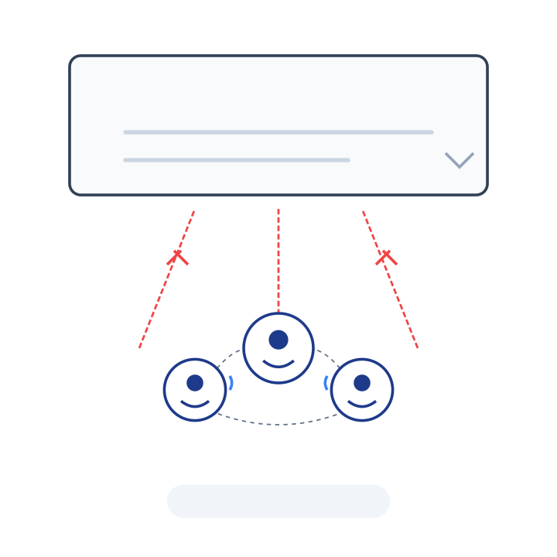


SMARTSDLC
Turning Manual Delivery Traction into Systemic Leverage
Executing complex change at scale —
without relying on heroics.
45-minute collaborative session
Not a tool pitch
Smart
SDLC

Slide 5
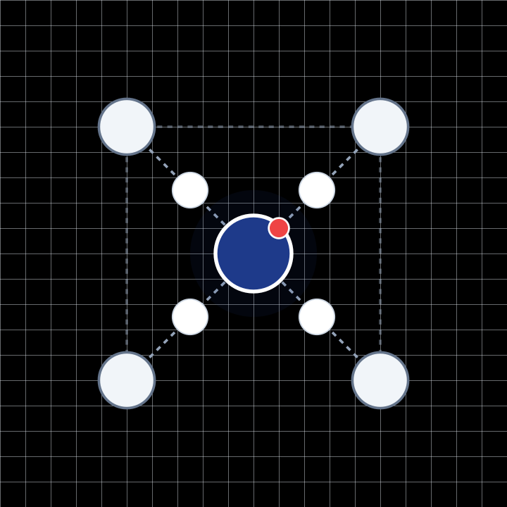





THE REAL QUESTION
What Does Delivery Currently Depend On?
People remembering dependencies manually
IMPLICIT DEPENDENCY NETWORK
Informal, relationship-based escalation paths
Senior individuals absorbing chaos silently
Context living in heads and inboxes
Plans explained repeatedly, not derived from data
THE REALITY
Delivery depends on people synchronizing manually — every single day.
SmartSDLC Collaborative Session
Page 05

Slide 6
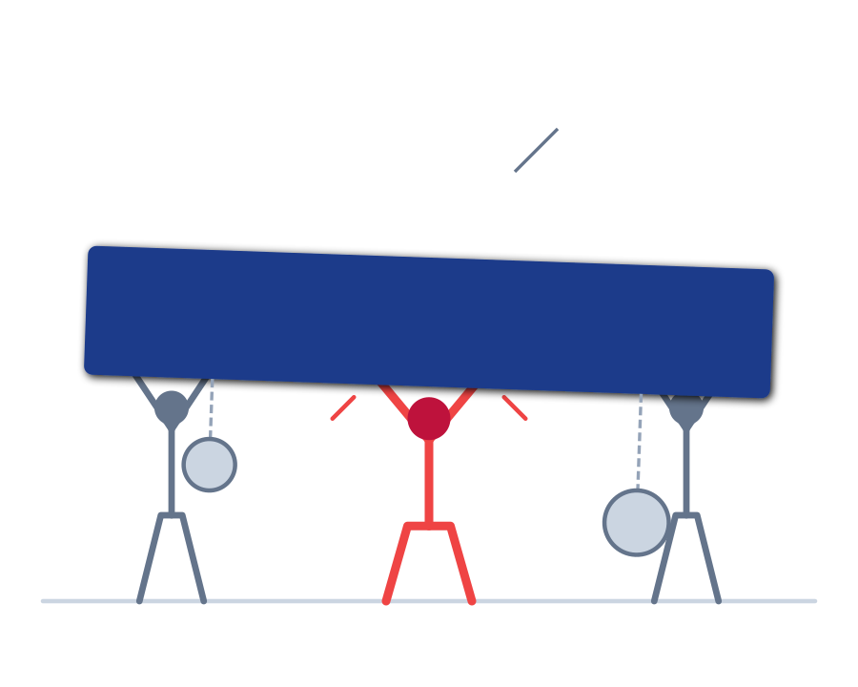





MANUAL TRACTION WORKS… BUT AT A COST
The Hidden Cost of Manual Traction
DELIVERY SUPPORTED BY STRAIN
Cognitive overload on senior roles leads to burnout and decision fatigue.
Risk is concentrated in a few key individuals ("Bus Factor" risk).
Replanning happens mentally, remaining invisible to systems and leadership.
Onboarding new teams is slow and expensive due to tribal knowledge.
Leadership decisions rely on manual summaries, not real-time signals.
KEY MESSAGE
Manual traction creates drag, not failure—making delivery expensive and fragile.
SmartSDLC Collaborative Session
Page 06

Slide 7

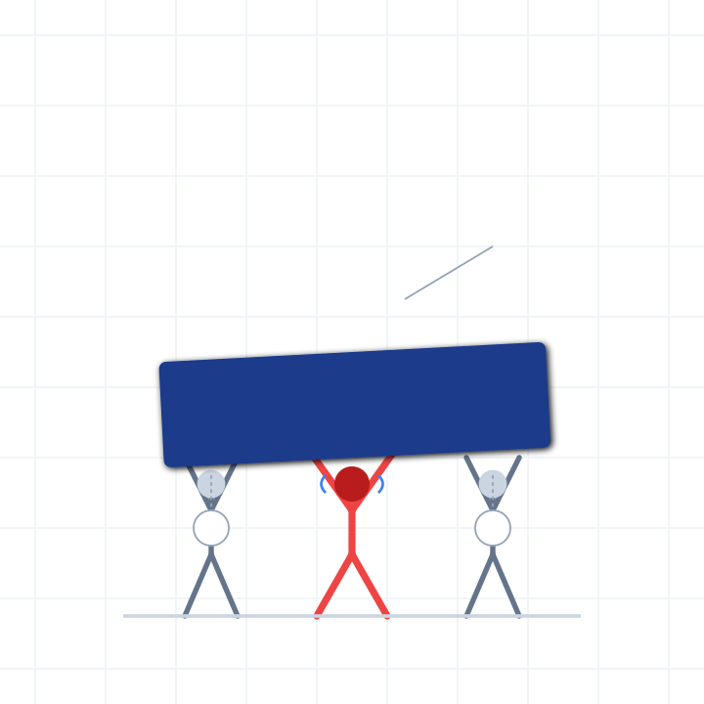




MANUAL TRACTION WORKS… BUT AT A COST
The Hidden Cost of Manual Traction
Cognitive overload on senior roles leads to burnout and decision fatigue.
Risk is concentrated in a few key individuals ("Bus Factor" risk).
Replanning happens mentally, remaining invisible to systems and leadership.
Onboarding new teams is slow and expensive due to tribal knowledge.
Leadership decisions rely on manual summaries, not real-time signals.
KEY MESSAGE
Manual traction creates drag, not failure—making delivery expensive and fragile.
SmartSDLC Collaborative Session
Page 07

Slide 8
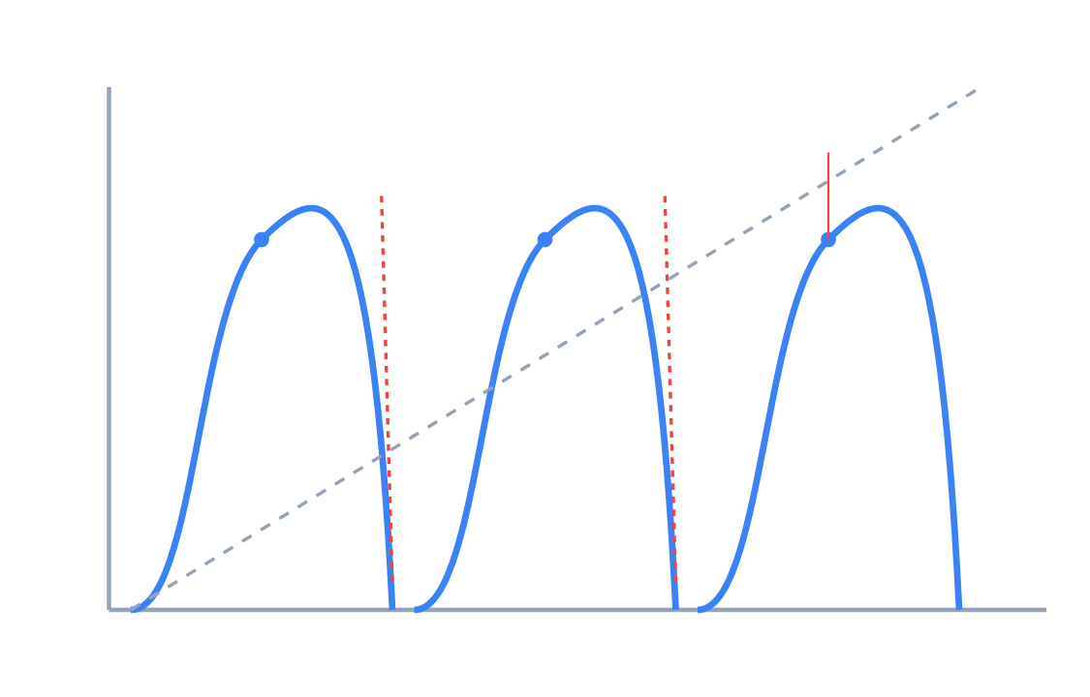



THE LEVERAGE GAP
Success Today Is Achieved
Despite the System
THE MEMORY RESET CYCLE
The SDLC does not capture why decisions were made or how trade-offs occurred.
When people change roles, context leaks immediately.
Each new project starts from zero, re-paying the same coordination tax.
THE REALITY
Excellence is not reusable today.
SmartSDLC Collaborative Session
Page 08

Slide 9

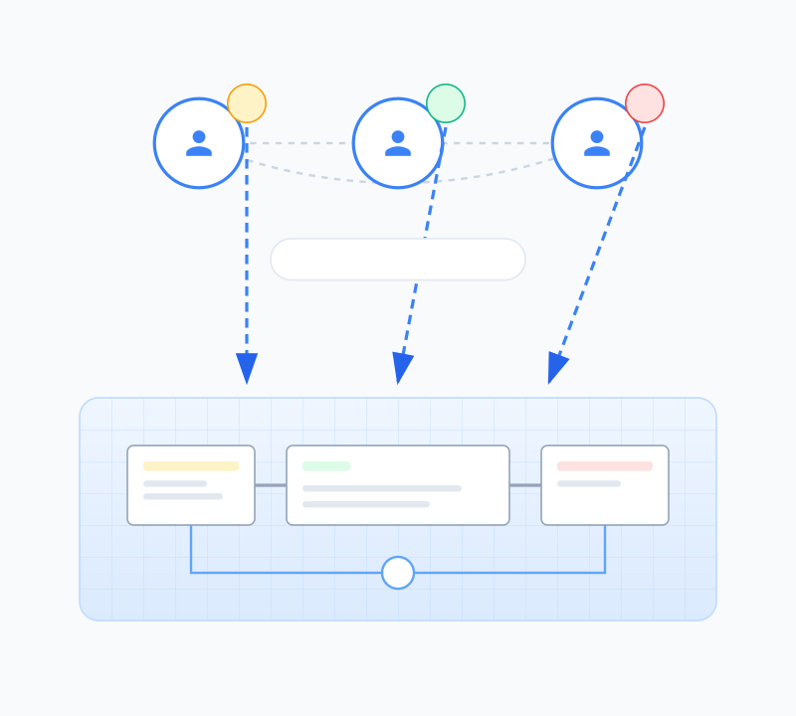




CORRECT POSITIONING
SmartSDLC Is Leverage,
Not Replacement
Observes how good teams already work (doesn't change the craft)
Makes implicit decisions explicit and visible
Reduces repeated human coordination overhead
Preserves context across time and changing roles
Enables scale without requiring individual heroics
KEY MESSAGE
SmartSDLC does not make people smarter — it makes their decisions durable.
SmartSDLC Collaborative Session
Page 09

Slide 10
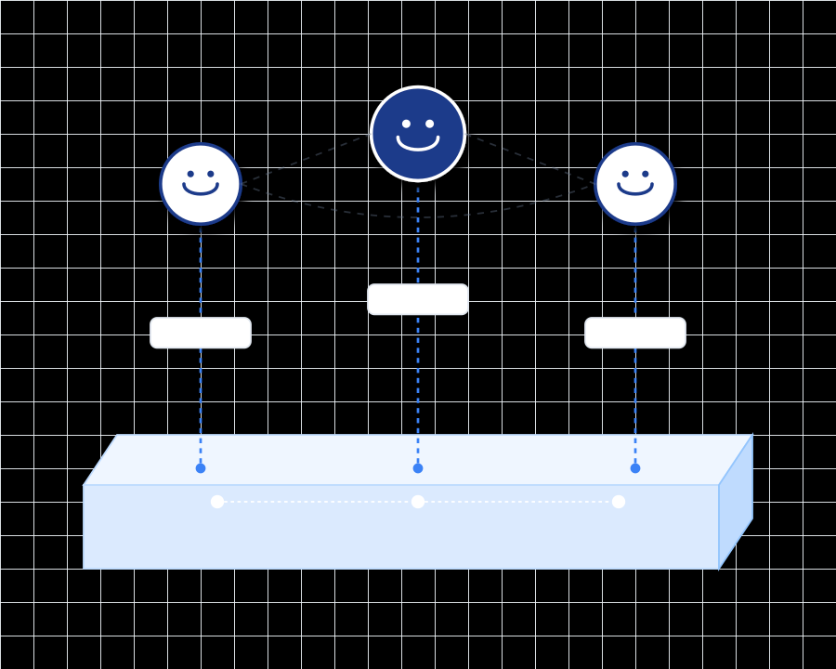





CORRECT POSITIONING
SmartSDLC Is Leverage, Not Replacement
Observes how good teams already work
SYSTEM-ASSISTED COHERENCE
Makes implicit decisions explicit
Reduces repeated human coordination
Preserves context across time and roles
Enables scale without heroics
KEY MESSAGE
SmartSDLC does not make people smarter — it makes their decisions durable.
SmartSDLC Collaborative Session | Not a tool pitch
Page 10

Slide 11
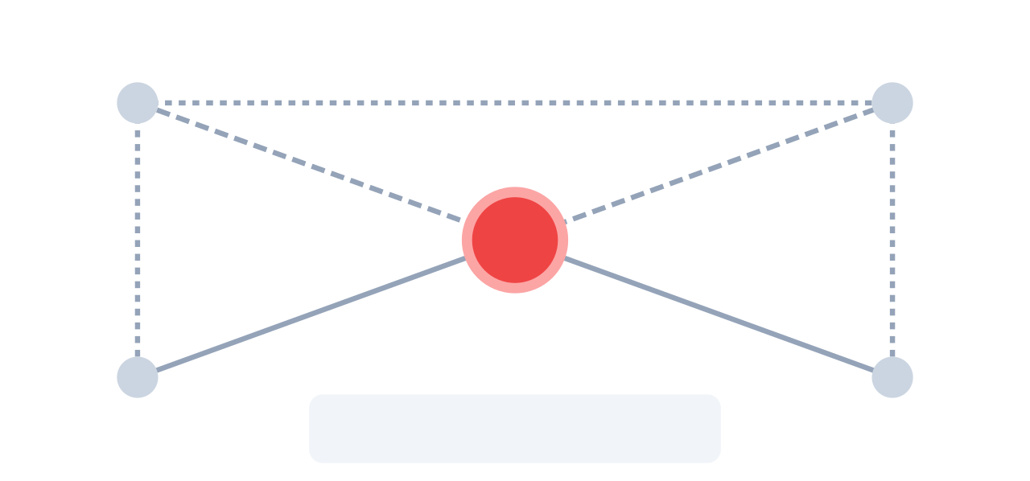
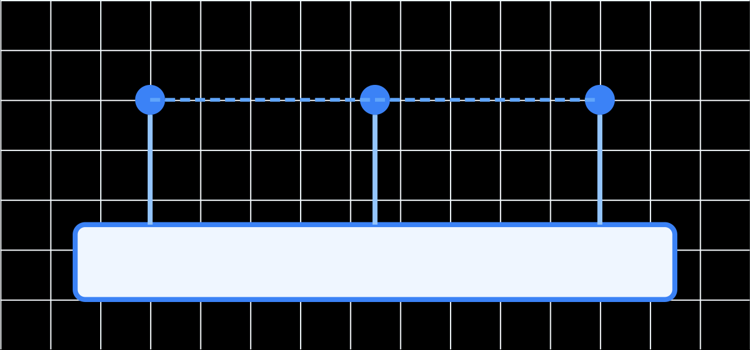









SLIDE 11
The Core Shift
From Manual Synchronization to System-Assisted Coherence
SmartSDLC Strategy
TODAY
WITH SMARTSDLC
Manual Synchronization
System-Assisted Coherence
Relies on heroics and constant checking
Explicit, durable, and derived from evidence
People remember dependencies
System remembers dependencies
Knowledge lives in heads
Explicit objects visible to all
Replanning happens mentally
Replanning is simulated
Invisible to the organization
Impact analysis before commitment
Progress is narrated
Progress is derived
Status updates vs reality
Evidence-based reality
Senior people absorb chaos
Chaos is redistributed safely
Unsustainable cognitive load
System absorbs complexity
SmartSDLC Collaborative Session
Turning Manual Delivery Traction into Systemic Leverage

Slide 12
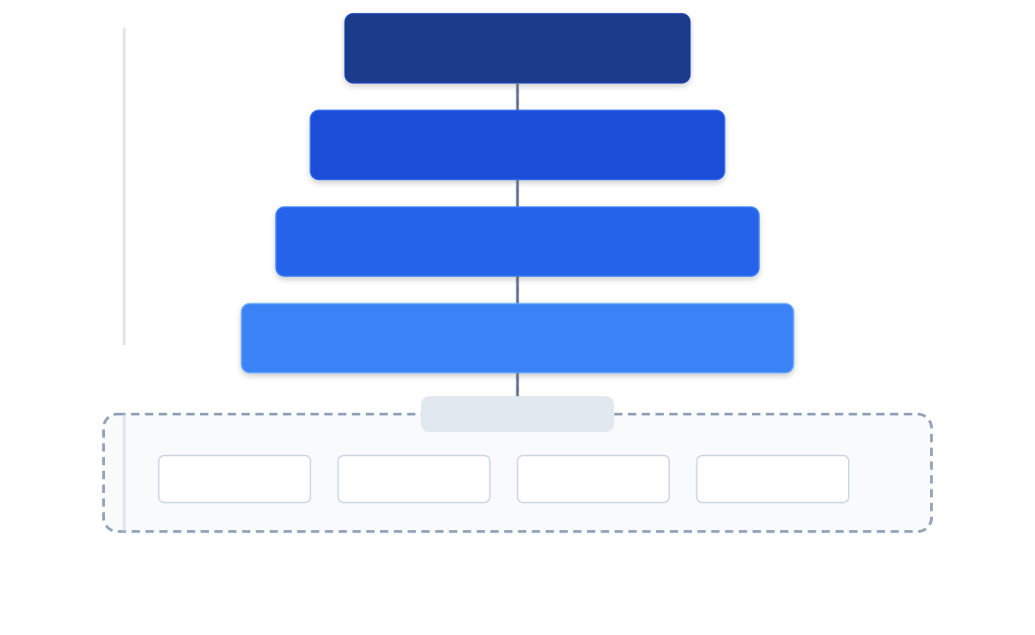


The Canonical Work Model
How SmartSDLC Structures Reality
PAGE 12
Implicit → Explicit
This hierarchy already exists in people's heads. SmartSDLC makes it explicit, connected, and queryable.
Connected Reality
Every item is strictly linked. No orphaned tickets or floating documents.
Artifacts as Proof
The bottom layer is evidence, not just status reports. Real code, logs, and approvals.
SmartSDLC Collaborative Session
Confidential & Proprietary

Slide 13

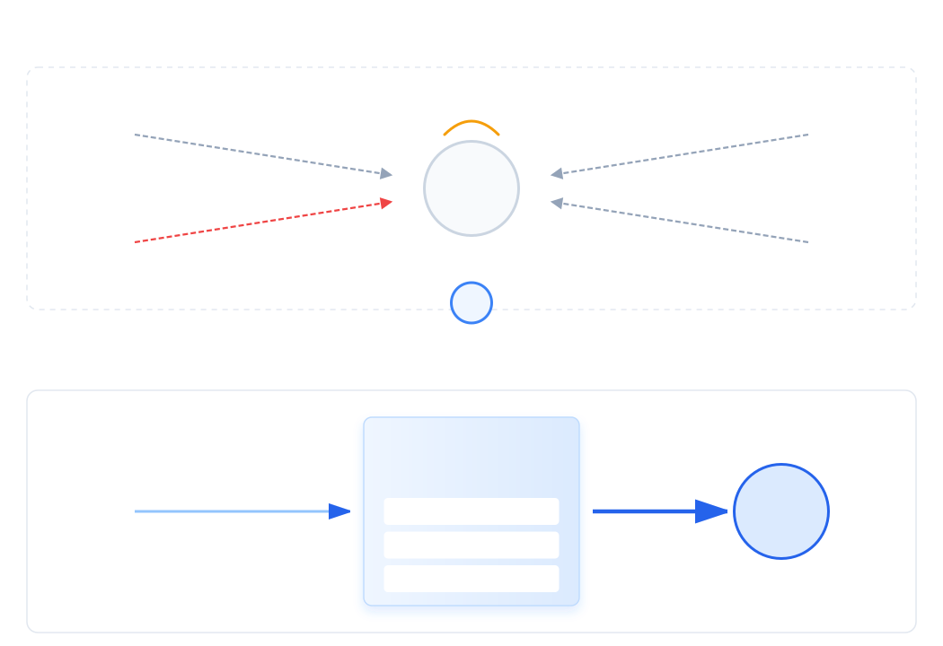


Product Owner Leverage
Product Owners Already Do This — Manually
PAGE 13
PO Today (Manual)
DATA FLOW TRANSFORMATION
Aggregates business asks & priorities mentally
Absorbs ad-hoc work & interruptions daily
Tracks hidden dependencies via meetings
Replans continuously in isolation
With SmartSDLC
Agent pre-aggregates signals & inputs
Capacity & dependency impact is plainly visible
Replanning is system-assisted, not guessed
SmartSDLC Collaborative Session
Confidential & Proprietary

Slide 14

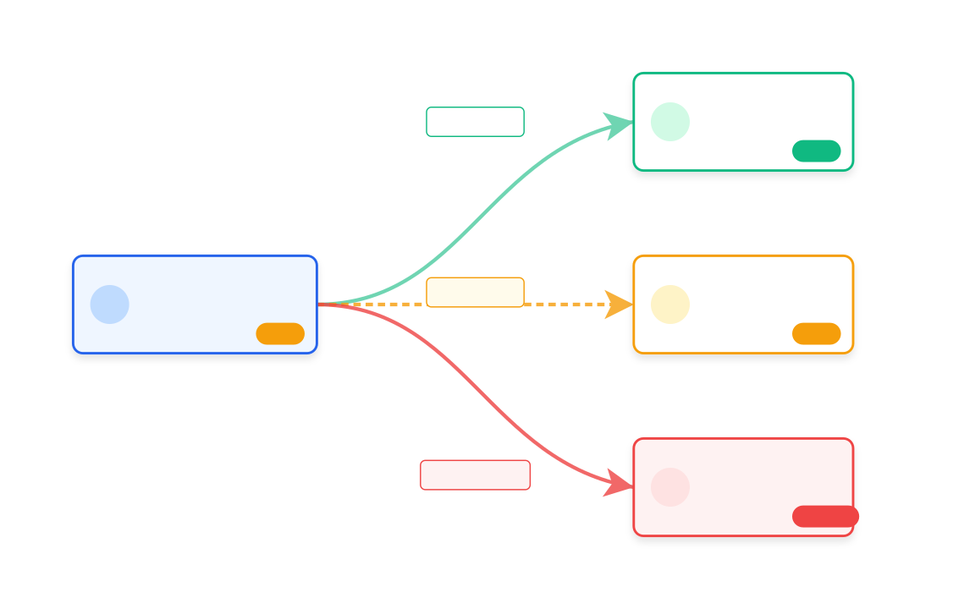








Cross-PO Dependency Leverage
Dependencies Become First-Class Objects
PAGE 14
Dependency Archaeology
LIVE DEPENDENCY GRAPH
LIVE STATUS SIGNALS
On Track
At Risk
Blocked
Informal: Dependencies exist between people, not systems.
Manual Tracking: Status lives in meetings & chat logs.
Invisible: Other POs cannot see your blockers.
Late Risk: Surprises surface only near deadlines.
First-Class Objects
Explicit: Dependencies link specific deliverables.
Universal Visibility: Visible to all owning POs instantly.
Signal Driven: Status derived from system evidence.
Early Warning: Risk is predictable and actionable.
SmartSDLC Collaborative Session
Confidential & Proprietary

Slide 15








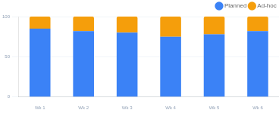







Director / MD Leverage
Leadership Sees Outcomes, Not Activity
PAGE 14
VISIBILITY SHIFT
ACTIVE INITIATIVES
ON TRACK
AT RISK / BLOCKED
AD-HOC LOAD
Initiative Health
12
2
8
67%
3
1
18%
<15% tgt
Real-time status derived from actual evidence, not manual RAG reporting.
System Contribution
STRATEGIC INITIATIVE PORTFOLIO
View Full Report
Visibility into which components are delivering vs. blocking progress.
INITIATIVE
OWNER
PROGRESS
DEPENDENCIES
HEALTH
Dependency Bottlenecks
Cross-team blockers surfaced automatically before they become delays.
Payment Gateway Migration
SC S. Chen
75%
Clear
ON TRACK
Ad-hoc Trends
Core Platform • Priority P0
Quantified impact of interruptions on committed roadmap delivery.
Customer 360 View
MJ M. Johnson
42%
2 Blockers
AT RISK
Digital Channels • Priority P1
Cloud Data Lake
AP A. Patel
15%
1 Pending
ON TRACK
Infrastructure • Priority P1
Mobile App Refresh
JS J. Smith
88%
1 Critical
BLOCKED
Consumer Mobile • Priority P0
STRATEGIC VALUE
AD-HOC VS PLANNED WORK LAST 6 WEEKS
SYSTEM CONTRIBUTION & BOTTLENECKS LIVE STATUS
"Leadership intervenes where it matters—targeted support on bottlenecks, not blanket status checking."
2
Order
Auth
Ledger
Data
Payment
SmartSDLC Collaborative Session
Internal Use Only • Confidential
Drill Down

Slide 16


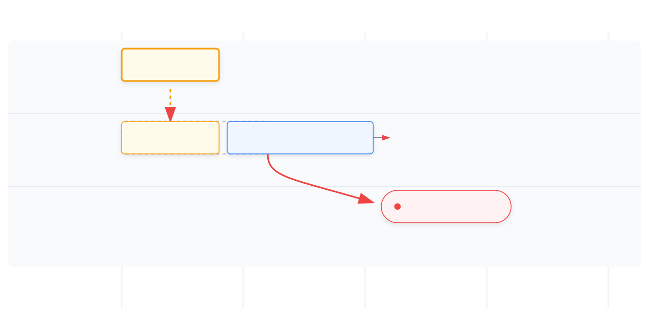


SMARTSDLC
Ad-hoc Reality (Handled Honestly)
Interruptions Are Normal. Silent Damage Is Not.
Slide 16
Ad-hoc work is inevitable
Impact Visualization Engine
Executive requests and urgent fixes happen. Denying them creates "shadow work" and invisible debt that undermines planned delivery.
Planned
Ad-hoc
Original
Impact must be explicit
SmartSDLC visualizes the trade-off immediately: "If we do X now, Y moves to next sprint." This removes emotion from the negotiation.
Local absorption first
Teams absorb small variations autonomously. Escalation only triggers when capacity trade-offs are exhausted and require leadership decision.
CORE PRINCIPLE
Interruptions become decisions, not surprises.
SmartSDLC Collaborative Session
Confidential & Proprietary

Slide 17
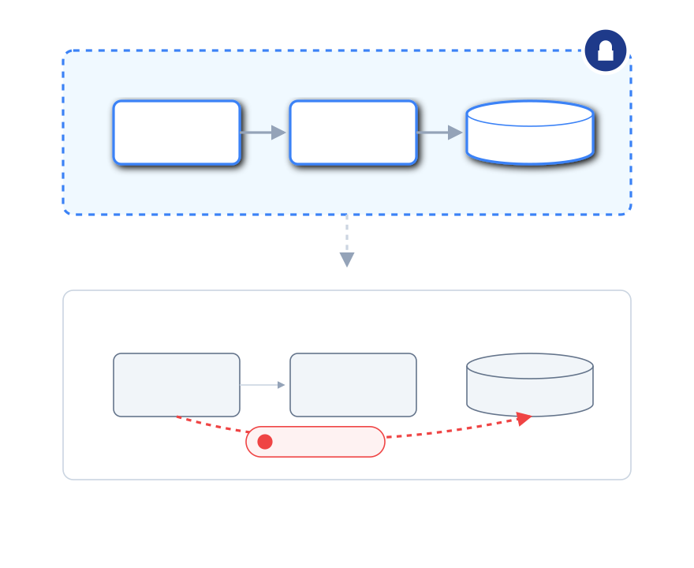





ARCHITECTURE STOPS BEING TRIBAL KNOWLEDGE
Architect Leverage
TODAY: MANUAL GOVERNANCE
Architects manually prevent drift through reviews and memory
AUTOMATED DRIFT DETECTION
Critical decisions live in conversations, chats, and ephemeral threads
WITH SMARTSDLC
Designs are locked as code and configuration
Drift is detected automatically when implementation diverges
Decisions persist beyond individuals
KEY MESSAGE
Architecture becomes a system guardrail, not just a human opinion.
SmartSDLC Collaborative Session
Page 17

Slide 18
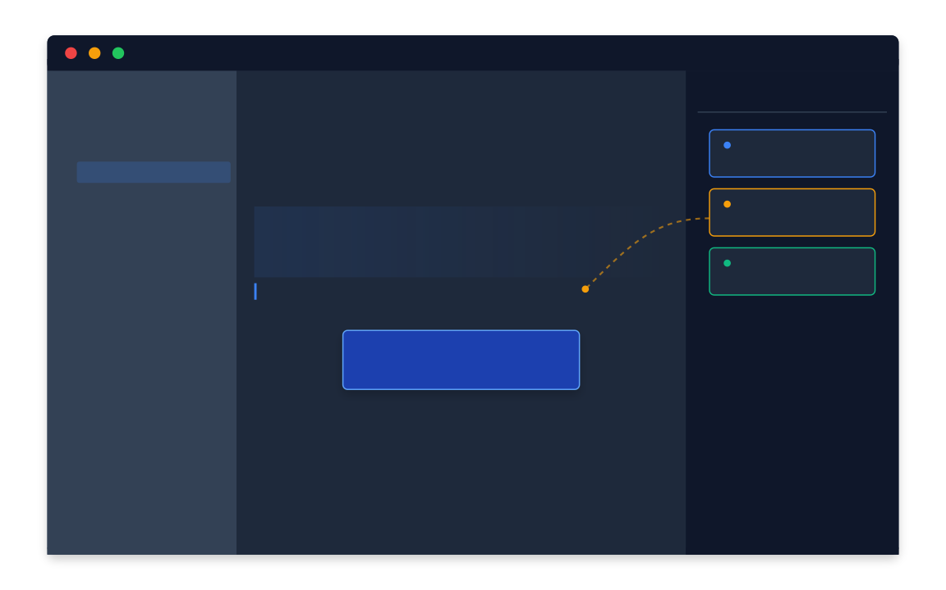



Developer Leverage
From "Archaeology" to Context-Aware Engineering
PAGE 18
Manual Context Hunt
Developer reconstructs requirements from chat history & JIRA tickets.
Hunts for latest Figma assets manually.
Code implementation drifts from original intent.
SmartSDLC Assistance
Context embedded in IDE:
Requirements & designs visible alongside code.
Kickstart Generation:
Boilerplate linked to architectural decisions.
Agent Assistance:
"Implement this story" uses actual approved specs.
Developers focus on solving problems, not rediscovering them.
SmartSDLC Collaborative Session
Confidential & Proprietary

Slide 19

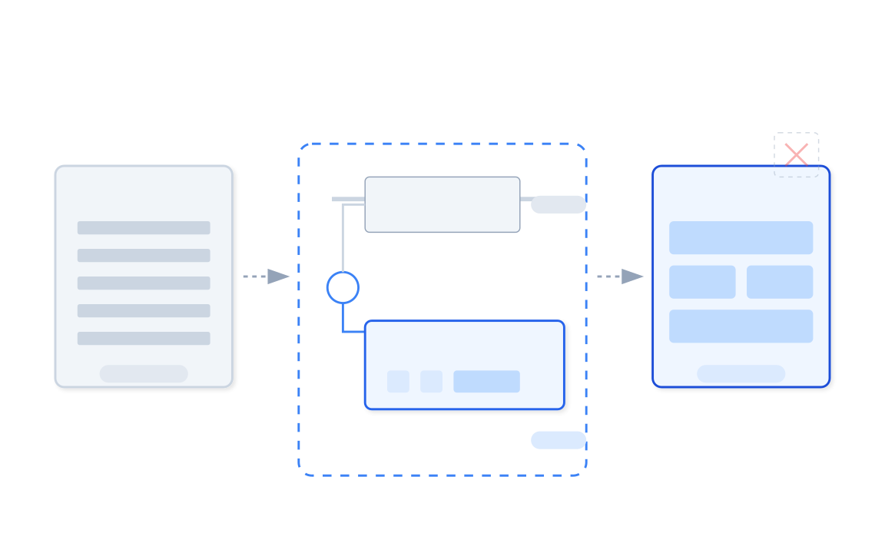







Migration Example
.NET → UI Migration with Leverage
PAGE 19
Manual Today
Heavy coordination
CONTROLLED HANDOVER PIPELINE
Constant sync meetings required to align frontend & backend teams.
Repeated replans
Scope creep and discovery causes continuous schedule drift.
Fragile progress
One dependency break stops the entire release train.
With SmartSDLC
Deliverable-based execution
Work is broken into small, verifiable, independently deployable units.
Dependency-aware sequencing
System automatically flags blockers before they become delays.
Feature-flagged rollout
Safe, controlled exposure of new UI alongside legacy code.
SmartSDLC Collaborative Session
Confidential & Proprietary

Slide 20

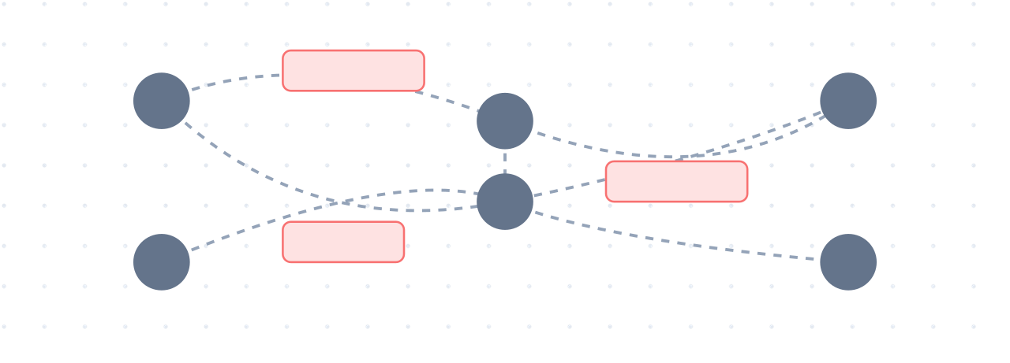

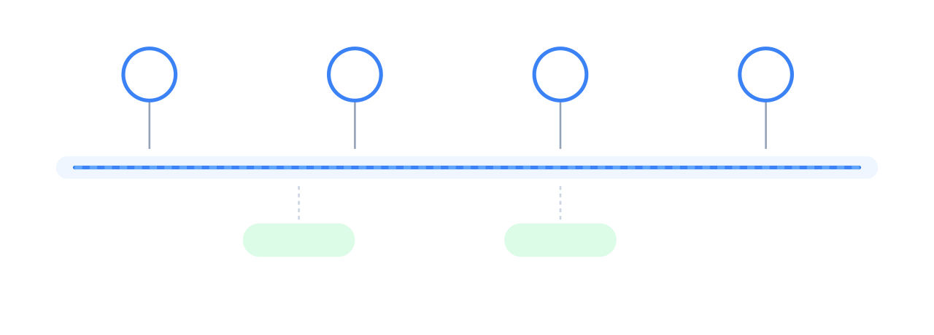


Where the Benefits Actually Show Up
Operational Benefits (No Hype)
PAGE 20
Reduced Coordination Overhead
Before: Manual Traction
HIGH FRICTION
Eliminates ritualistic "status sync" meetings. Truth is derived from system artifacts, not verbal reporting.
Faster Decision Cycles
Replaces "context archaeology" with live signals. Decisions happen in minutes based on evidence, not days based on meetings.
Lower Risk Concentration
Dependencies are explicit objects in the system, visible to all. Risk is no longer hidden in the heads of key individuals.
After: SmartSDLC Leverage
STREAMLINED FLOW
Faster Onboarding
New team members self-serve context from the system graph instead of requiring weeks of senior mentorship.
Institutional Memory
Why a trade-off was made is captured in decision logs. Governance is built-in and auditable by design.
SmartSDLC Collaborative Session
Confidential & Proprietary

Slide 21
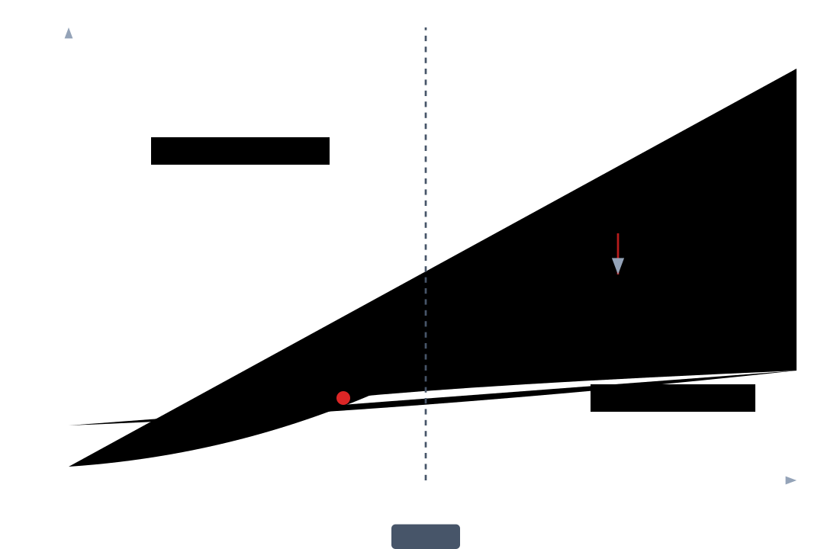




WHY THIS MATTERS NOW
Complexity Is Growing Faster Than Capacity
PAGE 21
The Scalability Trap
Systems are more interconnected
Dependencies multiply exponentially with every new service.
Ad-hoc work is increasing
Regulatory, security, and market pressures create constant interruptions.
We are currently operating beyond the safe capacity threshold
Teams are distributed
Manual coordination costs rise drastically with distance and size.
Senior capacity is finite
Heroic manual intervention has a hard ceiling.
THE BREAKING POINT
Manual traction does not scale linearly with complexity.
SmartSDLC Collaborative Session
Confidential & Proprietary

Slide 22
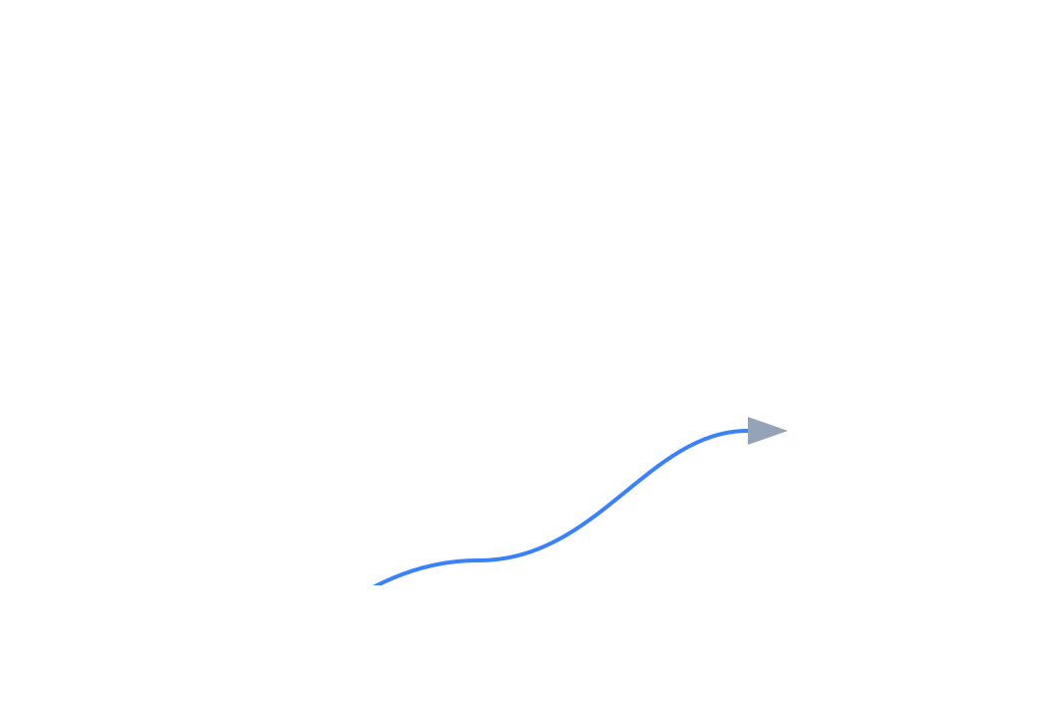




What We Are Proposing
A Pragmatic, Incremental Approach
PAGE 22
STRATEGY
3
Not a "Big Bang" Rollout
Scale
Avoid creating a massive change event. Do not disrupt current delivery to "fix" delivery.
FULL LEVERAGE
2
Portfolio visibility. Executive dashboard active. Cross-PO planning live.
Start Small, Prove Value
Focus on one high-value thread. Fix the context leak there first before scaling.
Expand
ADJACENT SYSTEMS
Capture Leverage Gradually
1
Add upstream & downstream dependencies. Learn and adapt governance gates.
As the system learns dependencies, the network value grows automatically.
Pilot
ONE INITIATIVE
Connect one system. Capture artifacts & approvals. Establish pattern.
Goal State
Weeks 1-4
Weeks 5-8
Month 3+
SmartSDLC Collaborative Session
Confidential & Proprietary

Slide 23
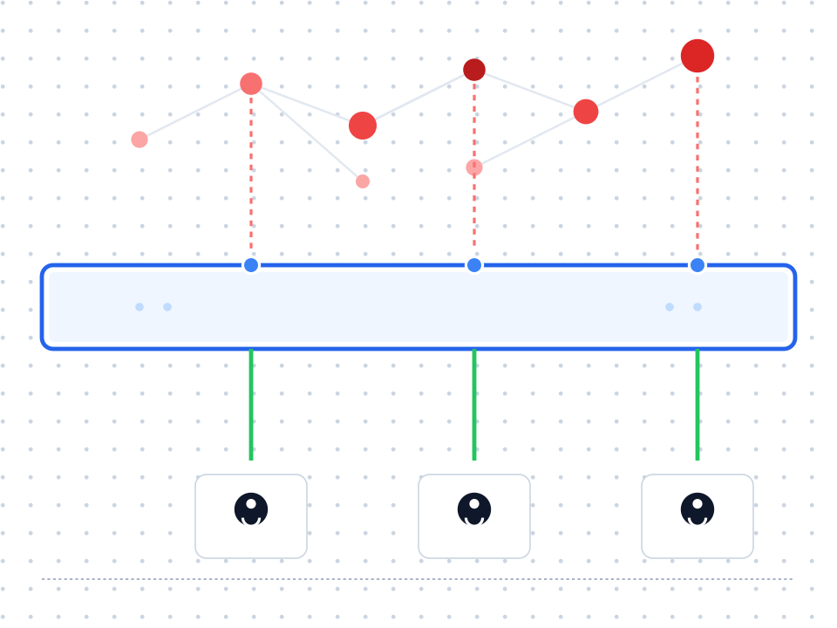

CONCLUSION
Protecting Delivery Excellence
“
PAGE 23
SmartSDLC is how we protect what already works — as complexity grows.
It’s not about replacing judgment. It’s about giving judgment a durable memory.
DISCUSSION
"Where do you feel manual traction the most today?"
SmartSDLC Collaborative Session
Confidential & Proprietary

