Slide 1
SAFETY HELMET DETECTION SYSTEM USING DEEP LEARNING TECHNIQUES
Guided by
Mrs Silambarasi p.,M.Tech.,
Project done by
DINESSH RAIJ.V (811719104024)
GOKUL.P (811719104029)
GOKUL RAJ .R (811719104030)
NISHAANTH.S (811719104061)

Slide 2
AIM
Predicting the safety wear helmet using deep learning method.
Using CNN a deep learning technique for predict the helmet Unwearable person on working site.

Slide 3
ABSTRACT
Automatically detect whether workers are wearing safety helmet at construction site is significant for safety production. Concerning the problem that the existing safety helmet wearing detection method is difficult to detect the partial occlusion, different size and small object, and the detection accuracy is low.
In this paper, we present an advanced deep learning based approach to determine whether workers are wearing safety helmets. In our framework, we first use the multi-scale training and the increasing anchors strategies to enhance the robustness of the original Faster RCNN algorithm to detect different scales and small object.
This paper presents a deep learning approach for accurate safety helmets wearing detection in employing a single shot multi-box detector. Moreover, because of safety helmet usually relatively small and unfortunately SSD struggles in detecting very small objects, a novel and practical safety helmet wearing detecting system is proposed, Finally, extensive compelling experimental results in construction working site illustrate the efficiency and effectiveness of our work.

Slide 4
OBJECTIVE
The main goal of the project is avoiding the accidents on coal mining site .
Workers should wear helmet during working on site.
We use deep learning method to predict the outcome of this project

Slide 5
PROBLEM IDENTIFICATION
Automation and AI are transforming a lot of industries. In construction, however, the expected changes are a little less important than in the automotive, logistics, or manufacturing of mainstream consumer products, where automation is a competitive advantage.
Especially when we see statistics that show one in five worker deaths annually is in construction:

Slide 6
DRAWBACK OF EXISTING SYSTEM
However, the detection model has a poor performance when the images are not very clear, the safety helmets are too small and obscure, and the background is too complex.
the presented model is limited by the problems that some images of the dataset are less in quantity.
the preprocessing operations of the images are confined to rotation, cutting, and zooming; the manual labeling is not comprehensive and may miss some objects.
In some extreme cases, for example, only part of the head is visible and the safety helmet is obstructed, the model cannot detect the helmets accurately

Slide 7
PROPOSED SYSTEM
In this paper we approach a new method in deep learning(CNN) for prediction of either helmet and gloves wearing or not.
Safety has always been a very important issue in all industrial activities, especially construction and coal mining site. It is after all, not a run-of-the-mill office job and requires some precautionary measures.
The more prepared the Labourers/workers are, the less chance for accidents and injuries at a coal mining site.
The head is the only organ of the human body that is totally encased in bone.
This by decree of nature states the importance of protecting a very vital functioning component of our body, the brain.
Hard hats or Safety helmets act as the first line of defense against head injury, but they only work when they are worn correctly. Thus, it’s safe to say safety Helmets save lives and reduce the risk of brain injury

Slide 8
ADVANTAGES
The proposed system automatic monitoring method can contribute to monitoring the construction workers and confirm the safety helmet wearing conditions at the construction site.
Get workers’ continuous body vitals, reducing cases of accidents, and increasing quick response time.
computer vision-based object detection, we develop a deep learning based method for the real-time detection of safety helmet at the construction site.

Slide 9
Block Diagram
MaxpoolD, Conv2D, Dense, Flatten
Train, Val- Dataset
Dataset Pre-processing
R-CNN FILE
Testing with a new input Image
CNN Model
OBJECT DETECTION
Classified Output

Slide 10
METHODOLOGY
The proposed system of our project is real time theft helmet. The own dataset(helmet) created using high quality camera . There are Training data, Test data and validation present in the proposed data model. With the help of training data, we just going to explain the system to identify the accurate results. In the proposed training process, the dataset is fed to the data preprocessing model.
The data preprocessing model helps to eliminate the unwanted images and then given to that neural network layers (Conv2D,Maxpool,dense and flatten layers ) used to enhance the pixel quality by convolve 2 dimensional array and max pooling operation is performed on the received input which is identification of highest value in each patch of feature map, dense layer is used to classify image based on output from convolutional layers and finally flatten layer is used to make the multidimensional input into one dimensional flatten layer or fully connected layer.
On successful completion of neural network layer process, automatically RCNN model file will be generated. The CNN model will analyze the image given input image and predict the correct result using the data pre-trained.. Finally the layers used to detect helmet and gloves ,thus the correct desired output is got from CNN model

Slide 11
MODULE DESCRIPTION - DEEP LEARNING
Deep learning is an that imitates the workings of the human brain in processing artificial intelligence function g data and creating patterns for use in decision making.
Deep learning is a subset of machine learning in artificial intelligence (AI) that has networks capable of learning unsupervised from data that is unstructured or unlabeled. Also known as deep neural learning or deep neural network.
Deep learning is an AI function that mimics the workings of the human brain in processing data for use in decision making.
Deep learning AI is able to learn from data that is both unstructured and unlabeled.
Deep learning, a machine learning subset, can be used to help detect fraud or money laundering.

Slide 12
NEURAL NETWORK
A neural network is a series of algorithms that endeavors to recognize underlying relationships in a set of data through a process that mimics the way the human brain operates.
In this sense, neural networks refer to systems of neurons, either organic or artificial in nature. Neural networks can adapt to changing input; so the network generates the best possible result without needing to redesign the output criteria.
The concept of neural networks, which has its roots in artificial intelligence, is swiftly gaining popularity in the development of trading systems.

Slide 13
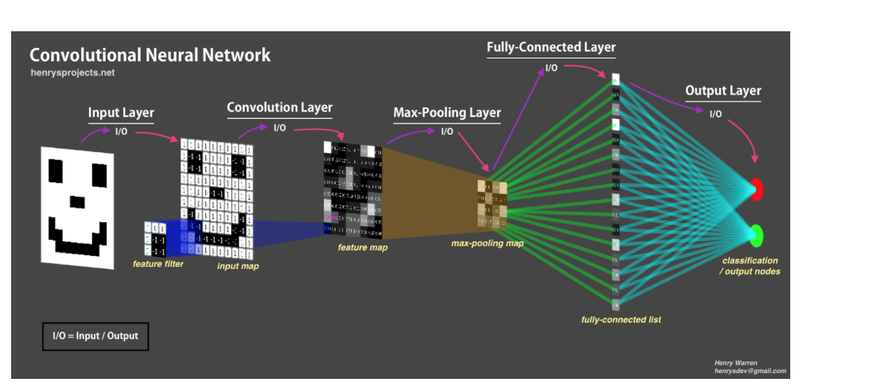
ALGORITHM- CONVOLUTIONAL NEURAL NETWORK
Convolutional Neural Network (ConvNet/CNN) is a Deep Learning algorithm which can take in an input image, assign importance (learnable weights and biases) to various aspects/objects in the image and be able to differentiate one from the other.
The pre-processing required in a ConvNet is much lower as compared to other classification algorithms. While in primitive methods filters are hand-engineered, with enough training, ConvNets have the ability to learn these filters/characteristics
CNN MODEL

Slide 14
SOFTWARE REQUIREMENTS
Front end : Python 3.6.5
Backend : image Dataset & CSV (comma delimited)
Operating system: windows OS
System type: 64 bits OS
Tensorflow
Keras
Pillow
Scipy
Opencv

Slide 15
HARDWARE REQUIREMENTS
USB Camera
PC

Slide 16
webcam used for on a computer
A webcam is a digital video device commonly built into a computer. Its main function is to transmit pictures over the Internet. It is popularly used with instant messaging services and for recording images.

Slide 17

PYTHON
Python is a wonderful and powerful programming language that's easy to use (easy to read and write) and lets you connect your project to the real world.
Python syntax is very clean, with an emphasis on readability and uses standard English keywords. Start by opening IDLE from the desktop.
Python is a general purpose programming language started by Guido van Rossum, which became very popular in short time mainly because of its simplicity and code readability. It enables the programmer to express his ideas in fewer lines of code without reducing any readability.

Slide 18
CONTD…
IDLE
The easiest introduction to Python is through IDLE, a Python development environment. Open IDLE from the Desktop or applications menu:

Slide 19
Confusion matrix
A confusion matrix is a tabular summary of the number of correct and incorrect predictions made by a classifier. It can be used to evaluate the performance of a classification model through the calculation of performance metrics like accuracy, precision, recall, and F1-score.

Slide 20

OPENCV
OpenCV-Python is the Python API of OpenCV. It combines the best qualities of OpenCV C++ API and Python language.
Currently OpenCV supports a wide variety of programming languages like C++, Python, Java etc and is available on different platforms including Windows, Linux, OS X, Android, iOS etc. Also, interfaces based on CUDA and OpenCL are also under active development for high-speed GPU operations.
OpenCV (Open source computer vision) is a library of programming functions mainly aimed at real-time computer vision
OpenCV is written in C++ and its primary interface is in C++, but it still retains a less comprehensive though extensive older C interface.] Wrappers in other languages such as C#, Perl,[13] Ch,[14] Haskell,[15] and Ruby have been developed to encourage adoption by a wider audience

Slide 21
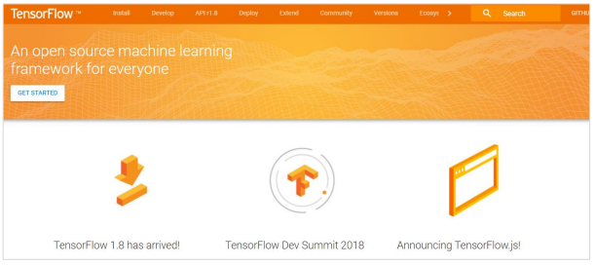
TENSORFLOW
TensorFlow is a software library or framework, designed by the Google team to implement machine learning and deep learning concepts in the easiest manner.
It combines the computational algebra of optimization techniques for easy calculation of many mathematical expressions.
The official website of TensorFlow is mentioned below: https://www.tensorflow.org/

Slide 22
Contd…
Let us now consider the following important features of TensorFlow:
It includes a feature of that defines, optimizes and calculates mathematical expressions easily with the help of multi-dimensional arrays called tensors.
It includes a programming support of deep neural networks and machine learning techniques.
It includes a high scalable feature of computation with various data sets.
TensorFlow uses GPU computing, automating management. It also includes a unique feature of optimization of same memory and the data used.
Pip install tensorflow

Slide 23
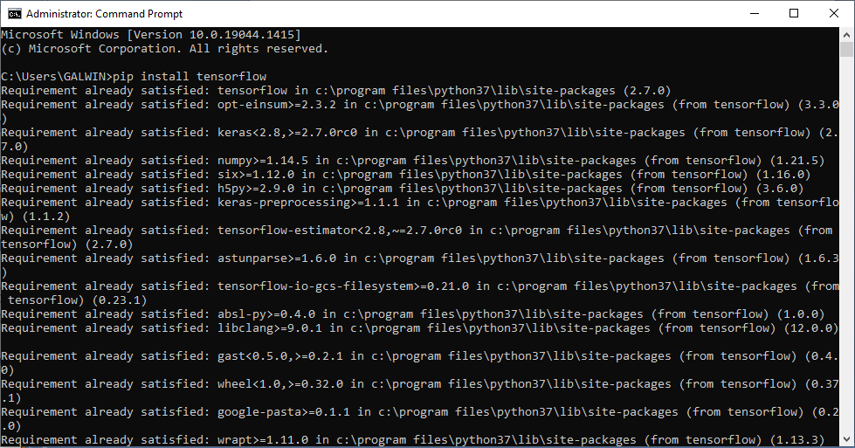
TENSORFLOW INSTALLATION

Slide 24
KERAS
Deep learning is one of the major subfield of machine learning framework.
Machine learning is the study of design of algorithms, inspired from the model of human brain.
Deep learning is becoming more popular in data science fields like robotics, artificial intelligence(AI), audio & video recognition and image recognition.
Artificial neural network is the core of deep learning methodologies.
Deep learning is supported by various libraries such as Theano, TensorFlow, Caffe, Mxnet etc., Keras is one of the most powerful and easy to use python library, which is built on top of popular deep learning libraries like TensorFlow, Theano, etc., for creating deep learning models

Slide 25
Contd…
Keras runs on top of open source machine libraries like TensorFlow, Theano or Cognitive Toolkit (CNTK).
Theano is a python library used for fast numerical computation tasks. TensorFlow is the most famous symbolic math library used for creating neural networks and deep learning models.
TensorFlow is very flexible and the primary benefit is distributed computing. CNTK is deep learning framework developed by Microsoft.
It uses libraries such as Python, C#, C++ or standalone machine learning toolkits. Theano and TensorFlow are very powerful libraries but difficult to understand for creating neural networks.
Keras is based on minimal structure that provides a clean and easy way to create deep learning models based on TensorFlow or Theano. Keras is designed to quickly define deep learning models. Well, Keras is an optimal choice for deep learning applications.

Slide 26
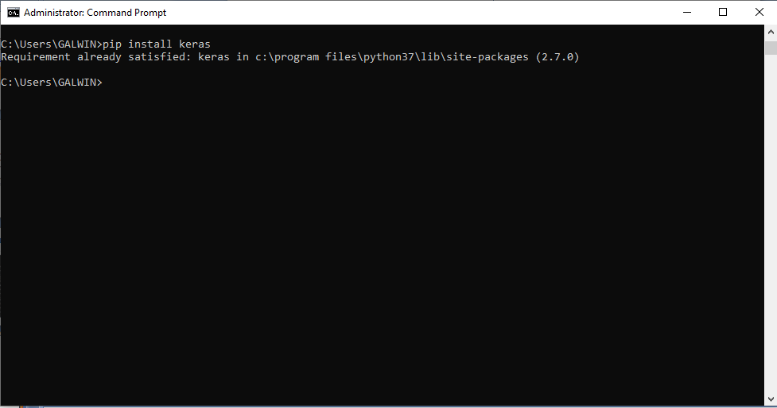
KERAS INSTALLATION

Slide 27
PILLOW
In today’s digital world, we come across lots of digital images. In case, we are working with Python programming language, it provides lot of image processing libraries to add image processing capabilities to digital images.
Some of the most common image processing libraries are: OpenCV, Python Imaging Library (PIL), Scikit-image, Pillow. However, in this tutorial, we are only focusing on Pillow module and will try to explore various capabilities of this module.
Pillow is built on top of PIL (Python Image Library). PIL is one of the important modules for image processing in Python. However, the PIL module is not supported since 2011 and doesn’t support python 3.
Pillow module gives more functionalities, runs on all major operating system and support for python 3. It supports wide variety of images such as “jpeg”, “png”, “bmp”, “gif”, “ppm”, “tiff”. You can do almost anything on digital images using pillow module. Apart from basic image processing functionality, including point operations, filtering images using built-in convolution kernels, and color space conversions.

Slide 28
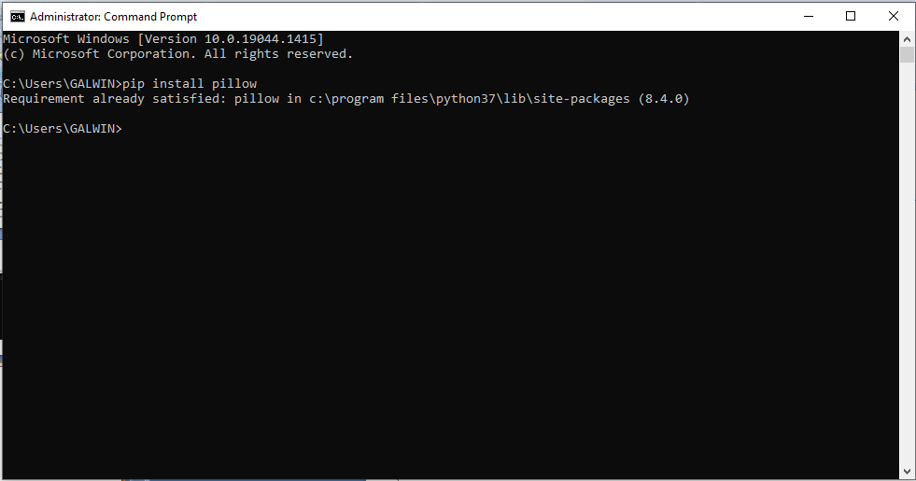
PILLOW INSTALLATION

Slide 29
SCIPY
SciPy is a collection of mathematical algorithms and convenience functions built on the Numpy extension of Python.
It adds significant power to the interactive Python session by providing the user with high-level commands and classes for manipulating and visualizing data.
The SciPy an interactive Python session becomes a data-processing and systemprototyping environment rivaling sytems such as MATLAB, IDL, Octave, R-Lab, and SciLab.
The additional benefit of basing SciPy on Python is that this also makes a powerful programming language available for use in developing sophisticated programs and specialized applications.

Slide 30
Contd..
Scientific applications using SciPy benefit from the development of additional modules in numerous niche’s of the software landscape by developers across the world.
Everything from parallel programming to web and data-base subroutines and classes have been made available to the Python programmer. All of this power is available in addition to the mathematical libraries in SciPy.
Pip install scipy

Slide 31
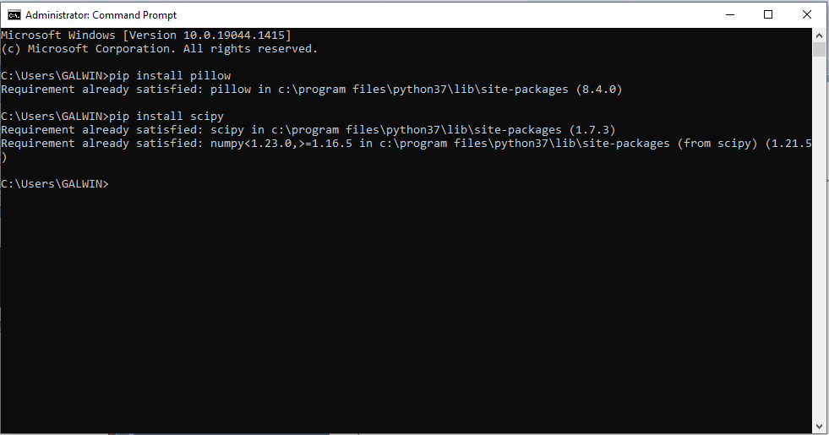
SCIPY INSTALLATION

Slide 32
Contd…
Watershed, and U-Net are used to identify the nodules of patients. The network can be trained end-to-end from raw image patches. Its main requirement is the availability of training database, but otherwise no assumptions are made about the objects of interest or underlying image modality.

Slide 33
APPLICATION
Safety helmets are intended solely to protect the head against knocks and falling objects.
Industrial safety helmets are particularly important when working at heights, as well as in the construction and forestry industries. They shield workers from falling objects, so their proper construction and durability are crucial to prevent head injuries.
Protective hats for head protection against impact blows must be able to withstand penetration and absorb the shock of a blow. In some cases, hats should also protect against electric shock.

Slide 34
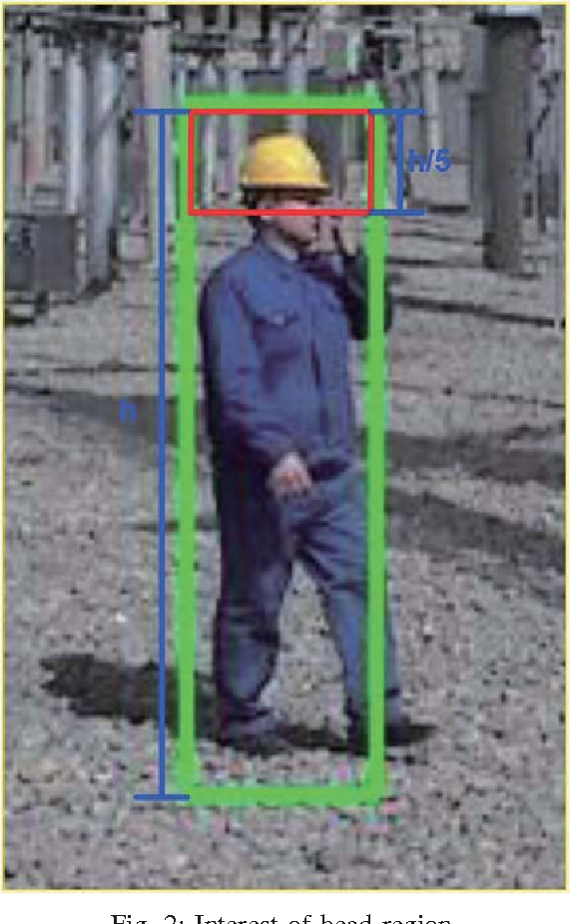

Slide 35
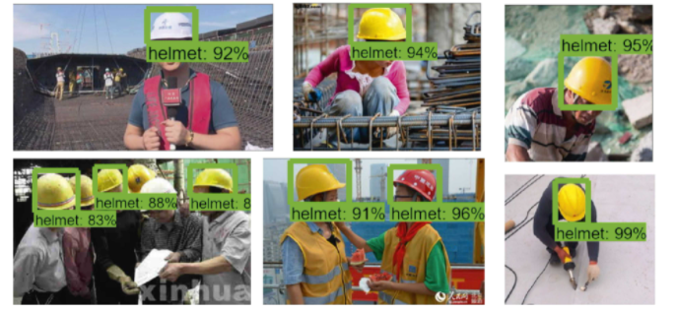
MODEL OUTPUT

Slide 36
CONCLUSION
The project proposed a method for detecting the wearing of safety helmets by the workers based on convolutional neural networks. The model uses the Faster RCNN-algorithm to detect safety helmets.
Then, a dataset of 500 images containing various helmets is built and divided into three parts to train and test the model. The Tensor Flow framework is chosen to train the model.
After the training and testing process, the mean average precision of the detection model is stable and the helmet detection model is built.
The experiment results demonstrate that the method can be used to detect the safety helmets worn by the construction workers at the construction site.
The presented method offers an alternative solution to detect the safety helmets and improve the safety management of the construction workers at the construction site.

Slide 37
Future Enhancements
The Future uses Wi-Fi technology to transfer data from the working environment to the remote monitoring unit. The merit in using Wi-Fi as a medium of transfer is that it covers wider area and it is the latest modern technology that has been emerging worldwide for transferring data. In this system the transferred data is collected.
We can implement various bioelectric sensors on the helmet to measure various activities.
We can use small camera for the recording the workers activity.
It can be used for passing message from the one vehicle to another vehicle by using wireless transmitter.
We can use solar panel for helmet power supply by using same power supply we can Charge our mobile.

Slide 38
CONT..
You can check on the location, health condition, and surrounding environment statistics of any worker wearing the helmet.
Get an SOS signal from any worker stuck in a dangerous situation.
Easily handle resource management and improve work division across several workstations.
Make sure no worker is sitting ideal at a single location or roaming around the regions they shouldn’t be.
Get workers’ continuous body vitals, reducing cases of accidents, and increasing quick response time.
Admin will receive a complete inventory list with tools and its current user at any given time.
Get an automatic logging attendance and worksheet for every worker.

Slide 39
REFERENCES
[1] Christopher J.C. Burges. A Tutorial on Support Vector Machines for Pattern Recognition[J]. Data Mining and Knowledge Discovery, 1998, 2(2):121-167.
[2] Wei Hao, Jiebo Luo. Generalized Multiclass AdaBoost and Its Applications to Multimedia Classification[C]// Computer Vision and Pattern Recognition Workshop, 2006 Conference on. IEEE, 2006.
[3] Canny J.A computational approach to edge detection.IEEE Transactions on Pattern Analysis and Machine Intelligence, 1986, PAMI-8 (6) :679- 698.
[4] Dalal N, Triggs B.Histograms of oriented gradients for human detection.In:Proceedings of the 2005 IEEE Computer Society Conference on Computer Vision and Pattern Recognition (CVPR) .San Diego, CA, USA:IEEE, 2005, 1:886-893.
[5] Viola P, Jones M. Rapid object detection using a boosted cascade of simple features[J]. CVPR (1), 2001, 1(511-518): 3.
[6] Lienhart R , Maydt J . An Extended Set of Haar-like Features for Rapid Object Detection[C]// Image Processing. 2002. Proceedings. 2002 International Conference on. IEEE, 2002.
[7] C. A. L. Almeida et al., Intelligent thermographic diagnostic applied to surge arresters: A new approach, IEEE Trans. Power Del., vol. 24, no. 2,pp. 751C757, Apr. 2009.
[8] H. Zou and F. Huang, A novel intelligent fault diagnosis method for electrical equipment using infrared thermography, Infr. Phys. Technol., vol. 73, pp. 29C35, Nov. 2015

