Slide 1
BEAT THE BUS
Chaya Perelson,
Mushka Stone,
Penina Gold,
Rina Steinberg,
Rivka Zitwer

Slide 2
Coding is like driving a bus; it's about navigating through the loops and making sure you reach your destination.

Slide 3
Agenda
The Problem
3
Our Solution
4
Our Key Factors
6
Our Future Goals
11
Conclusion
14

Slide 4
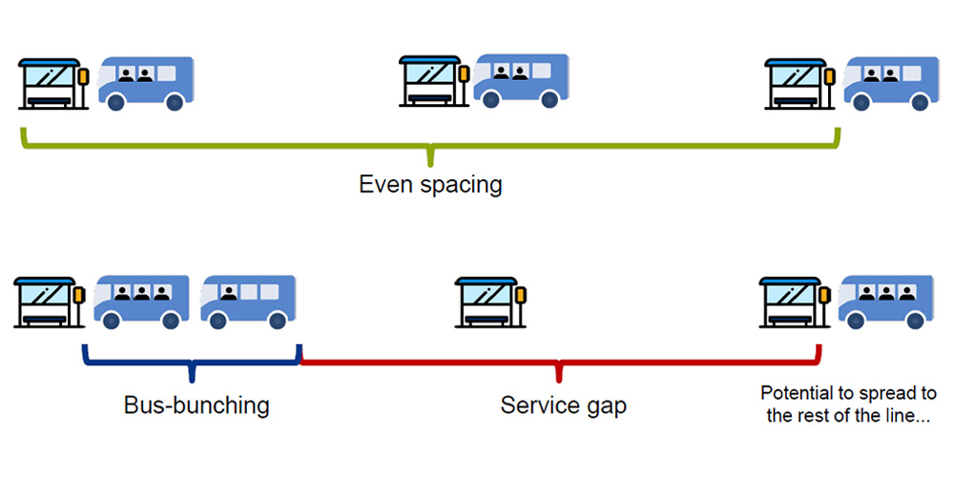
The Problem
3
Bus Bunching occurs when multiple buses on the same route bunch together, leaving long gaps in service followed by a cluster of buses at the same spot, which leads to uneven passenger distribution, increased wait times, decreased efficiency, and general commuter frustration.

Slide 5
Our Solution

Slide 6


The Solution
Bus route will be based off users’ needs:
Someone on the bus wants to alight
Someone is waiting at the bus stop
BUS
STOP

Slide 7
How it Works- STOP
On the bus stop – the user will send a request to be dropped off at a certain stop
Send bus from:
Stop 1:
Stop 1:

Slide 8
How it Works- COME
At the bus stop – user will send a request to be picked up
System will calculate whether there is room on the upcoming bus
If there is room – the bus will stop. If there is no room, the request is sent to the next bus…
Send bus from:
Stop 1:
Stop 1:

Slide 9
Bus Route- a visual representation
Stop requested
Stop 1
Stop 2
Stop 3
Stop 4
Station
Bus 2 is closer to stop 4 therefore it will stop there
Eventhough bus 1 started it’s route earlier

Slide 10
KEY FACTORS

Slide 11
Key Factors
Our approach complies with user requests, sending and stopping busses based off of user input.
Efficiency
Busses will not waste time or energy by stopping at unnecessary stops or if there is no room left on the bus which saves time and fuel/energy.
Human error
Many times, people mistakenly press the STOP or COME button, so we have incorporated an undo button. Also, people tend to press the buttons more than once, so we require each passenger to provide their ticket ID which will tell the system that one person is sending requests.
Dynamic Scheduling
Busses will follow their route but will stop ONLY as needed. The closest bus will receive requests to pick up passengers as updates happen instantly.
An API can be implemented into our code to coordinate real-time bus location and traffic.
Passenger Experience
Communication and coordination

Slide 12
API INCORPORATION
APIs used:
Open Street Map, CT Transit and Google Maps
Provides real-time updates for traffic and road conditions.
Shows a clear visual representation of buses moving along their routes.
Enter users’ ticket ID

Slide 13
OUR FUTURE GOALS
Scalability – users can request all different bus routes
Fully incorporate API into our code.
Send text message alerts to passenger
Accessibility- show handicap availability icon
Integrate AI to provide more efficient scheduling and communication algorithms

Slide 14
As a coder, don't wait for the bus to success; build your own route with determination and code

Slide 15
Thank you
Chaya Perelson
Mushka Stone
Penina Gold
Rina Steinberg
Rivka Zitwer

